Slide 1
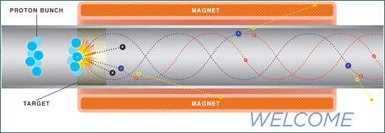

High-temperature superconducting (Bi-2212) magnet technology suitable for building final cooling solenoids for a muon collider and the conductors they depend on
Tengming Shen, Fermilab, presented at Muon Accelerator Program collaboration meeting, Stanford Linear Accelerator Center, December 5, 2014
With inputs from Pei Li (Fermilab), Liyang Ye (Fermilab & NCSU), Gene Flanagan (Muons Inc.), John Tompkins (Fermilab), Lance Cooley (Fermilab), and with collaboration with VHFSMC and BSCCo

Slide 2
Muon collider designs demand 30-50 T solenoids
NMR communities need 30 T all superconducting magnets.
Challenges to 30+ T HTS magnets:
  Understand the complex HTS material behavior
  High J_{c} at 20-50 T is the key.
  Stress management and quench protection.
(Courtesy of J. Jiang)
Notes:
A transformational opportunity for high-field science
But it is also a quantum leap in technology
Resistive magnets take 30 MW to reach 45 T;
LTS conductors mature, reaching their limits at ~20 T.

Slide 3
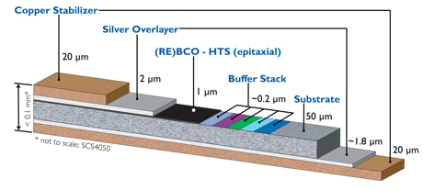
Magnet programs based on REBCO coated conductor
32 T NHMFL all superconducting
user magnet. Commissioning expected
in 2016
Cold Bore 32 mm
Uniformity 1 cm DSV 5·10⁻⁴
Total inductance 254 H
Stored energy 8.6 MJ
Superpower REBCO archietecture
NbTi
15 T / 250 mm
bore LTS magnet
17 T REBCO coils
Nb₃Sn
Courtesy of NHMFL

Slide 4
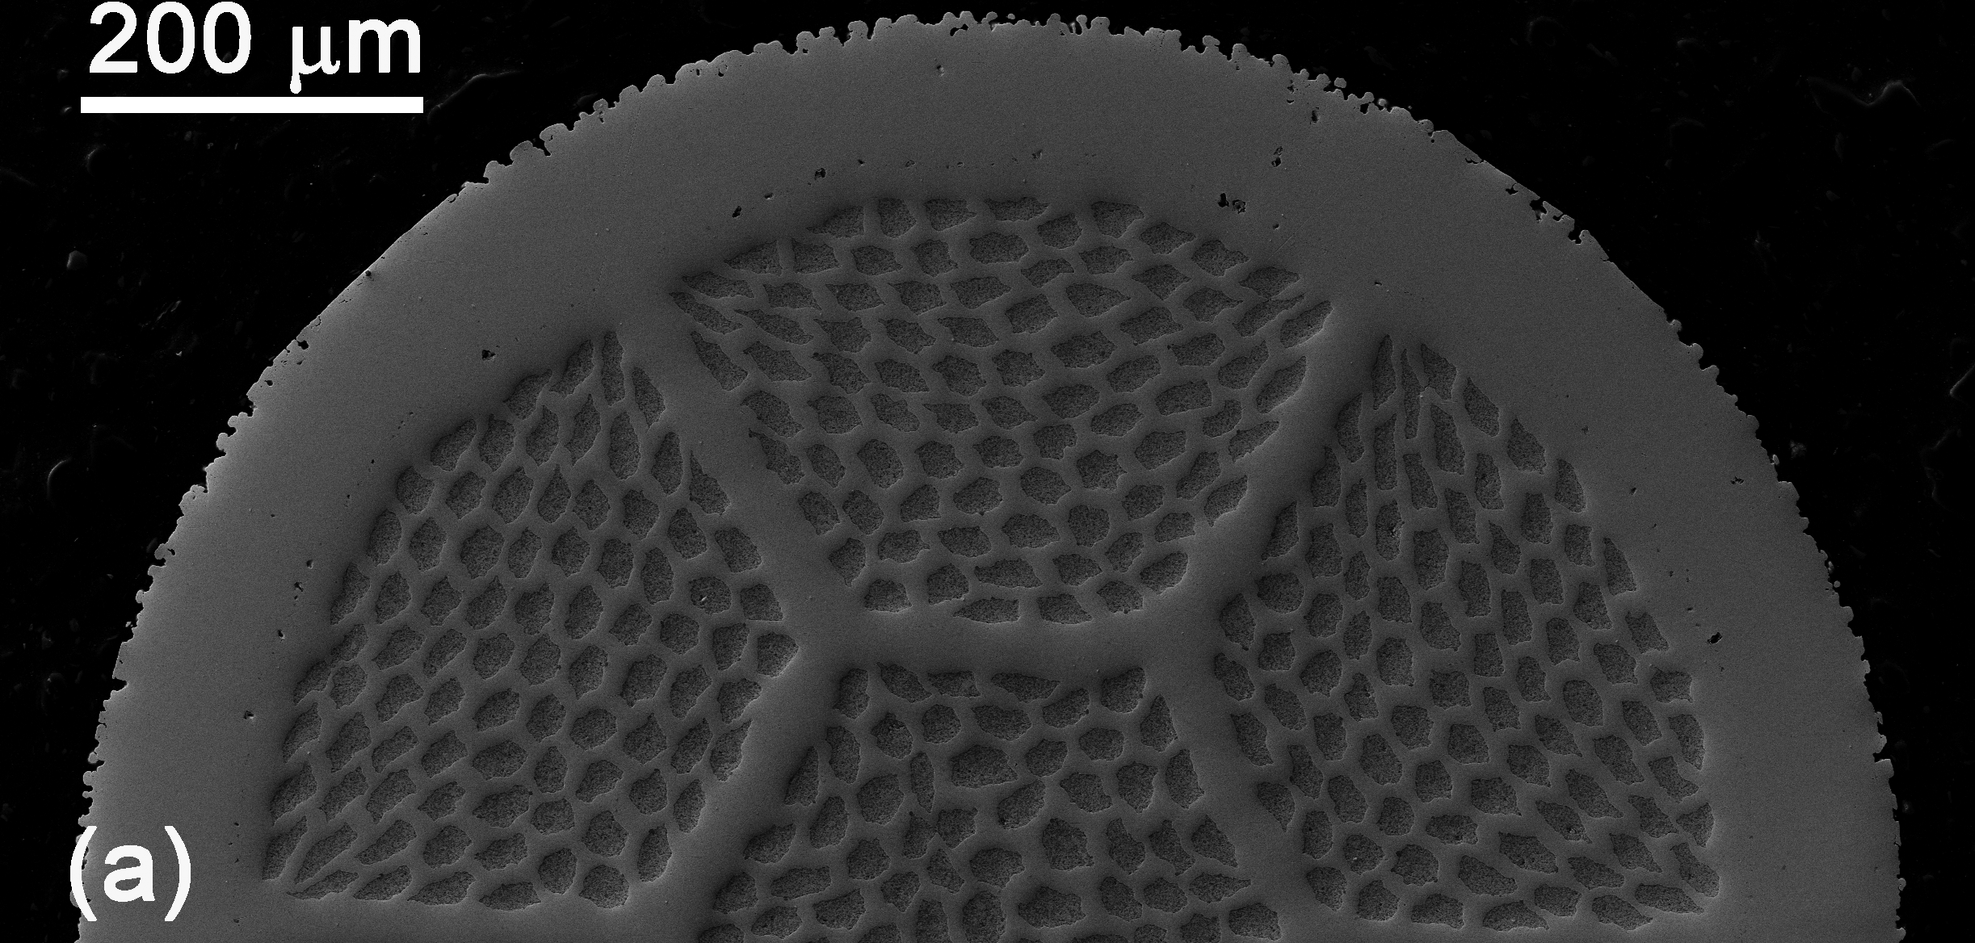
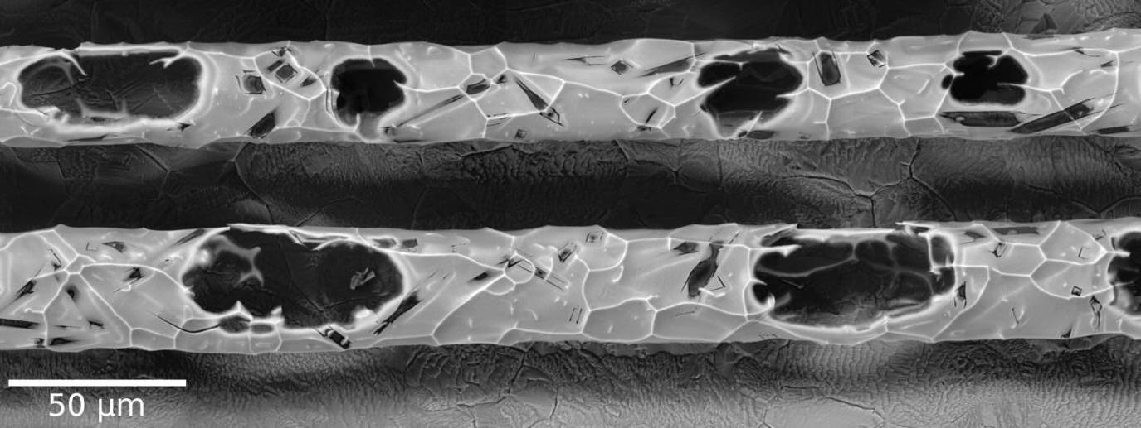
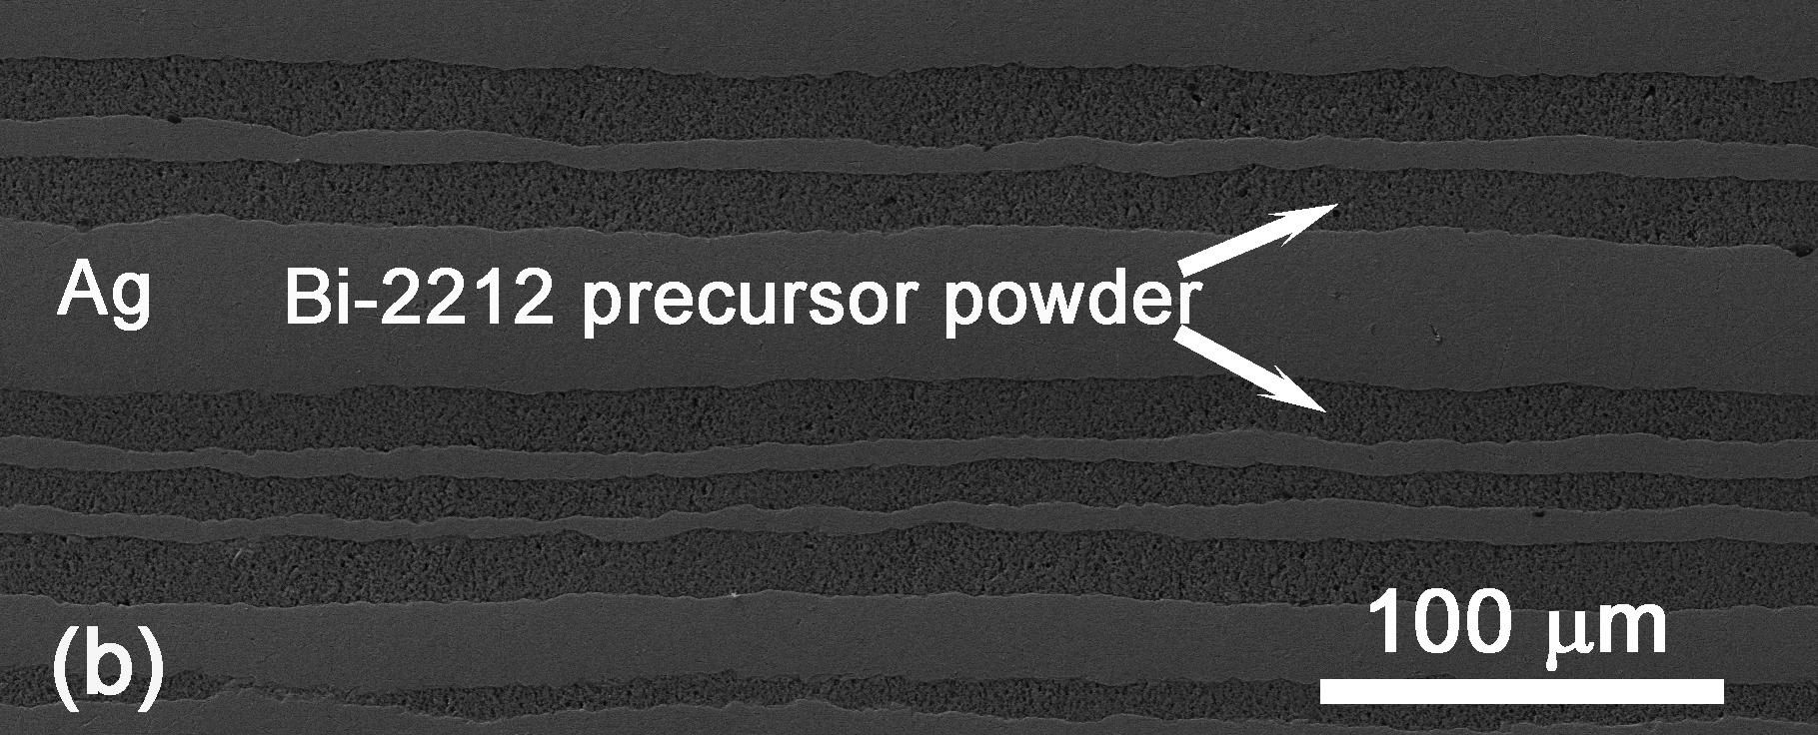
The secret to high J_{c} in industrial powder-in-tube wire: Removing porosity
Gas bubbles

Slide 5
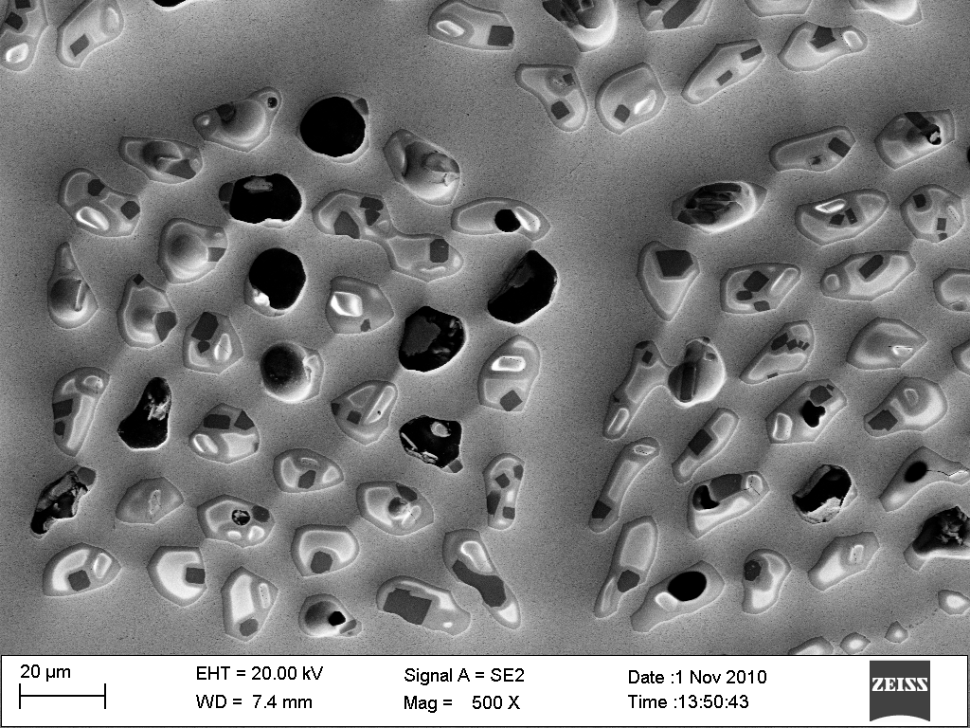
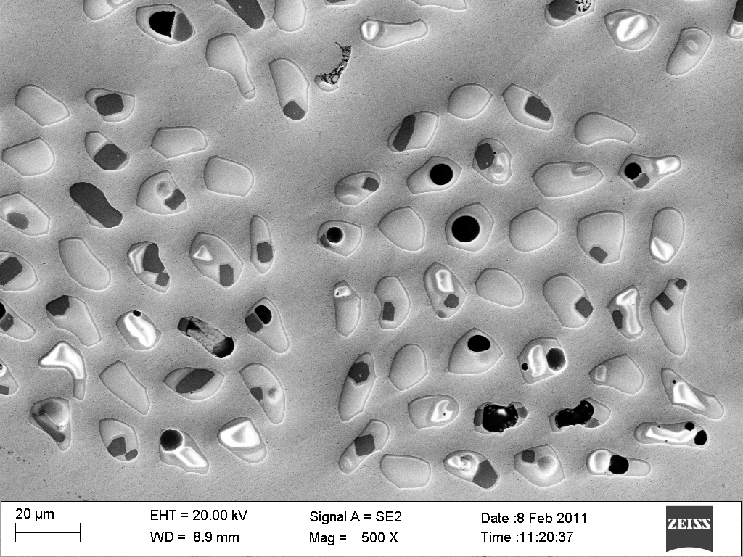
J_{c} in short-length samples was then quickly taken to 3500 A/mm² using cold densification methods
Cold isostatic processing of Bi-2212: Jiang et al. Supercon. Sci. Tech., 24, 082001 (2011)
Swaging of Bi-2212 (S. Hong HJC Enterprise, SBIR phase I): Jiang et al. IEEE Trans Appl. Supercond. 23, 6400206 (2013)
Sample | J_{c}(4.2K, 5T) | J_{e}(4.2K,20T)
PIT wires | 2000 A/mm² | ~340
PIT+CIP wires | 3500 A/mm² | ~530
Regular PIT wires, quenched@887C
PIT+CIP wires, quenched@887C

Slide 6
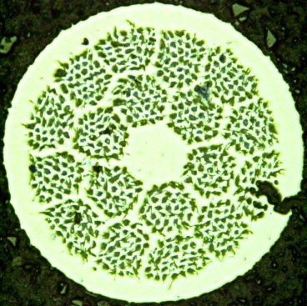
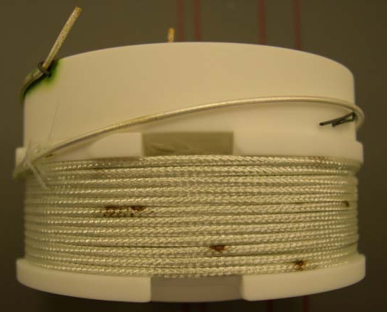
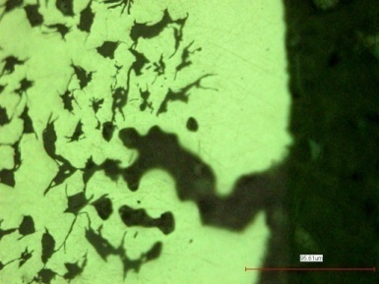
For 20 years, the performance of long length
Bi-2212 wires has been much worse than in short pieces.
Short pieces: J_{E}=500 A/mm² at 4.2 K and 20 T
Long pieces: J_{E}<200 A/mm² at 4.2 K and 20 T
Mysterious leakage appearing in long length wires during the forming reaction.
NHMFL, 1999,
3 T insert
from tape
OST, 2006
(U. Trociewitz, NHMFL)
Macor

Slide 7
Internal gases are the culprit of the low J_{c} and leakage in the long-length wires
Shen et al., J. Appl. Phys., 113,
213901 (2013)
Gas species detected by a residual gas analyzer while heating Bi-2212 wires at 180 °C/h in vacuum.
Key understanding:
Silver creeps outward, producing more porosity in 2212 and lowering J_{c} in long-length wire
Leakage is a natural consequence of the creep rupture of AgMg at the strain of ~3%.

Slide 8
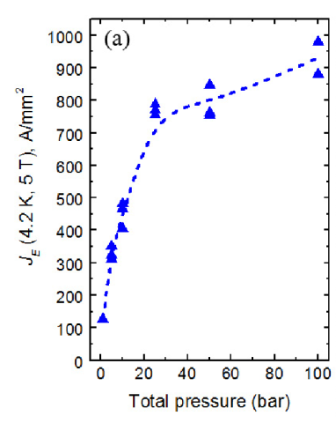
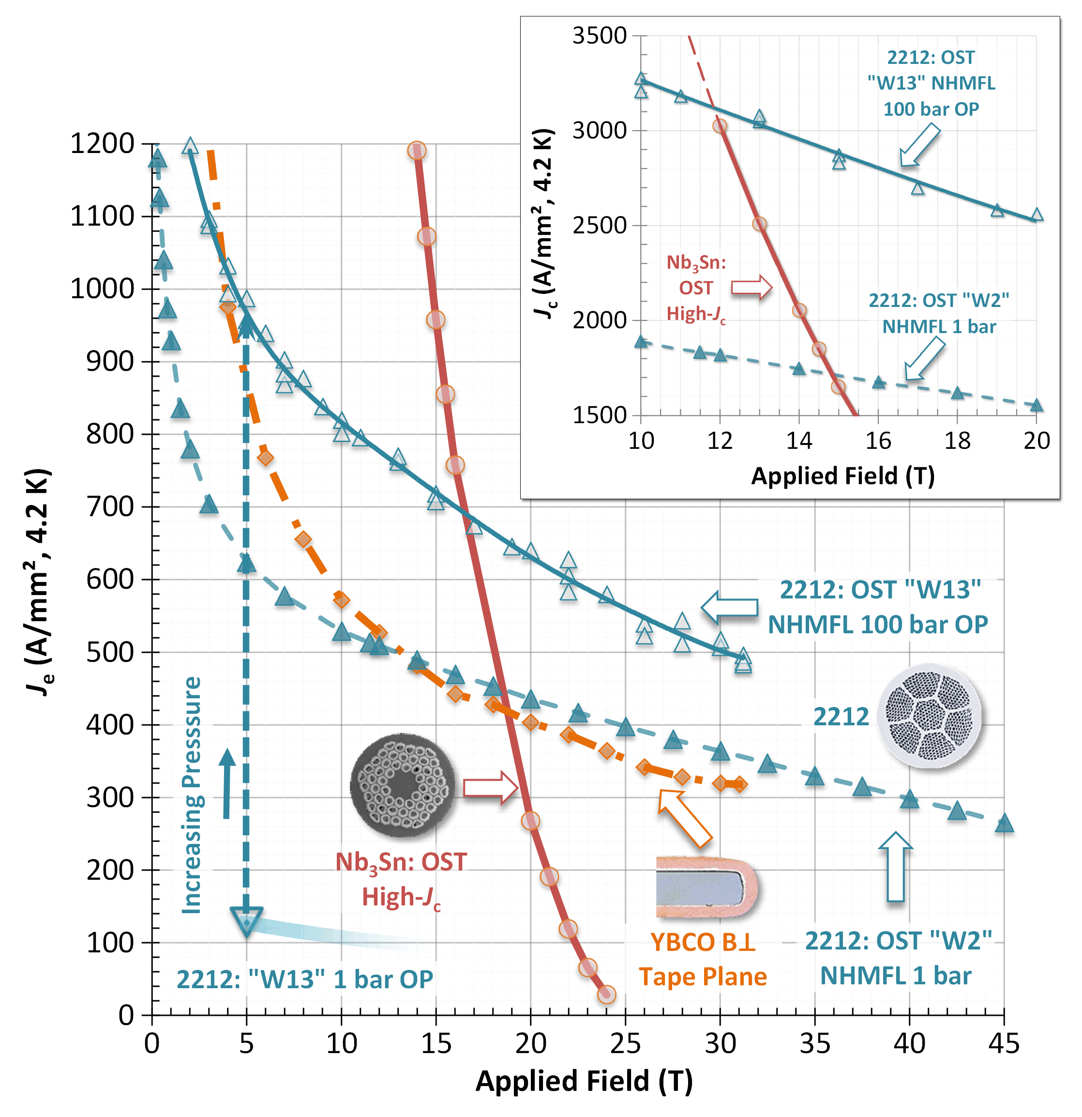
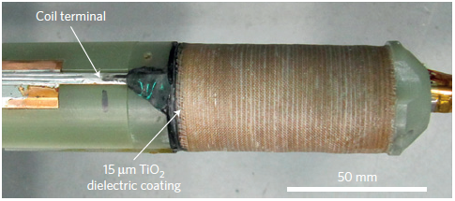
Breakthrough in J_{c}: J_{E} of 700 A/mm² at 4.2 K and 20 T
New paradigm: Overpressure processing
Larbalestier et al.,
(Nature Materials, 2014)
P_{o}
P_{o}
P_{o}
P_{i}
P_{o}
P_{o}
P_{o}
P_{o}
P_{o}
10 bar OP; J_{E}=252 A/mm² at 33.8 T (coil quenched). Add 2.6 T to 31.2 T background.
8
12/5/14

Slide 9
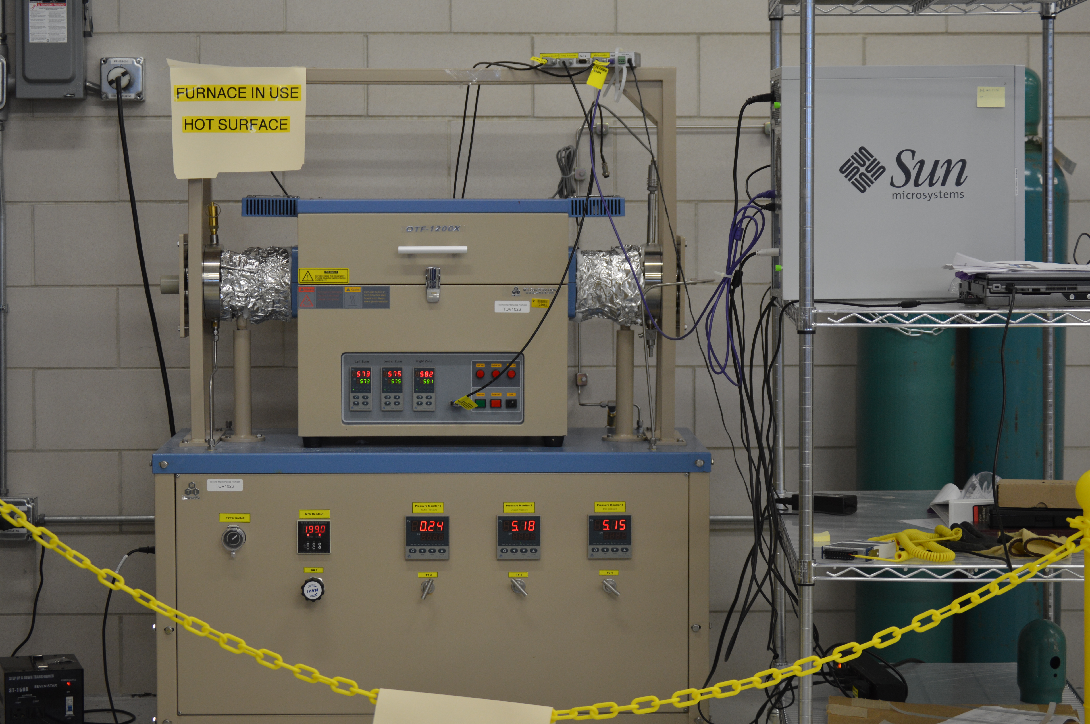
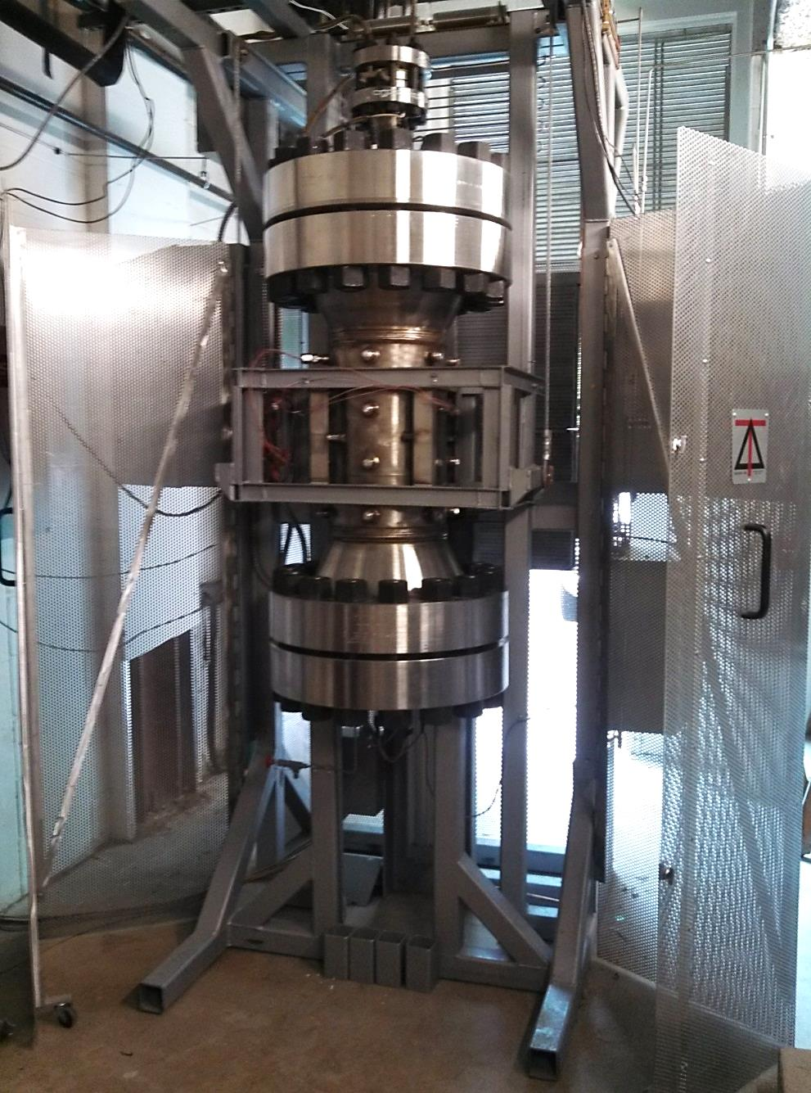
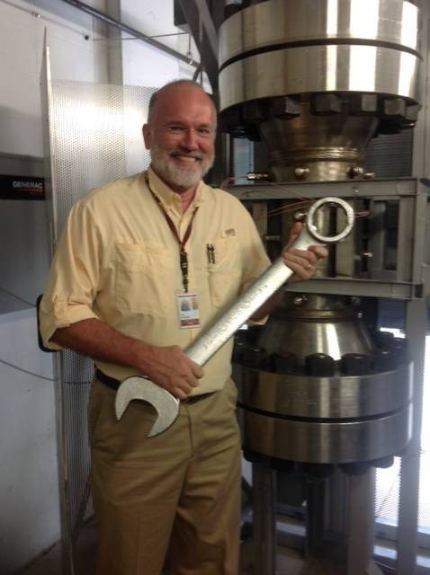
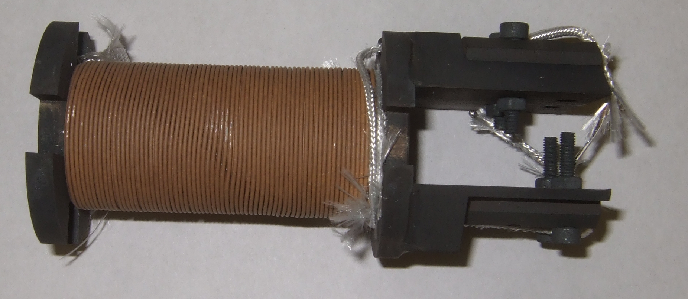
Zoo of Overpressure Processing Furnaces
Sumitomo Bi-2223 300 bar OP furnace: +/- 1C in a sample space of 1 m diameter x 1.2 m height
FSU – OP furnace: Hot Zone: 15 cm dia, 50 cm high at up to 100 bar (1 bar pO₂)
FNAL 100 bar OP system
Hot zone – 16 cm x 50 mm diameter
3.5 m
OP 2-layer coil; conductor
length=11 m; nGimat insulation
Fermilab
Courtesy of NHMFL

Slide 10
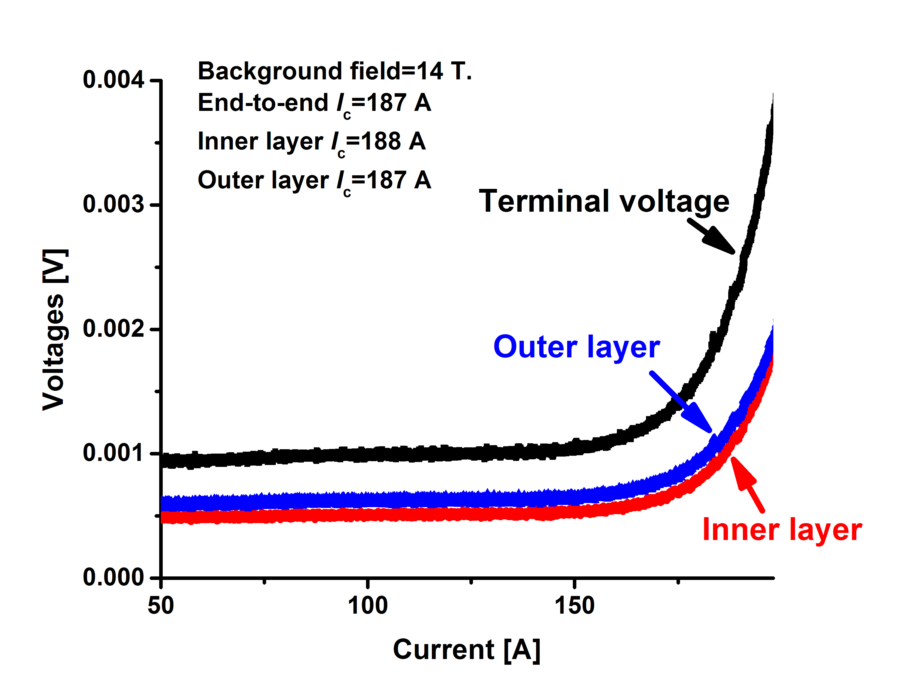
Prototype OP solenoids yielded I_{c} that is 2-2.6 times that of 1 bar solenoids
Muons Inc – Fermilab, U.S. DOE-OHEP STTR project
OP coil I_{c}(5 T)=250-320 A vs. typical 120±40 A in 1 bar coils (0.8 mm strand)
  400 A for the best witness sample (J_{E}=900 A/mm²)
No electrical shorts – nGimat TiO₂ insulation works well.
Survive more than 120 heater-induced quench using detect-and-dump technique.
OP 2-layer coil; conductor
length=11 m; nGimat insulation

Slide 11
J_{c} – axial stress/strain relations for Bi-2212
Ag/Bi-2212 is mechanically weak and its J_{c} is sensitive to strain.
  High-strength, kA-class Bi-2212 cables
Yielding stress – 120 MPa

Slide 12
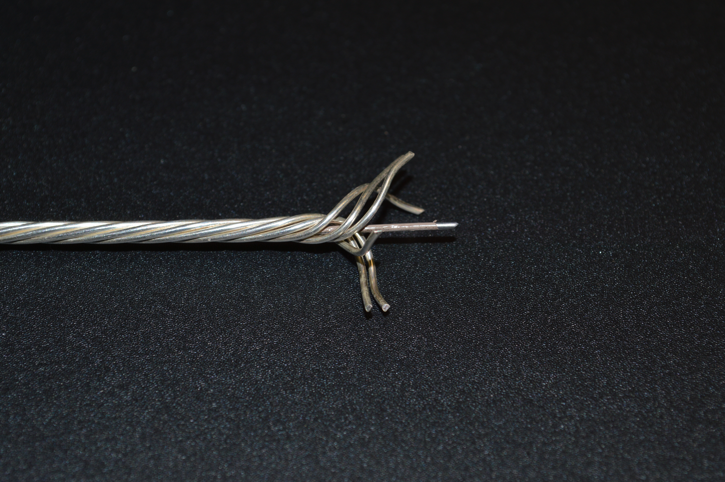
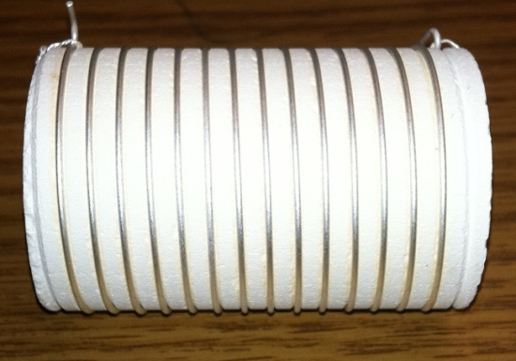
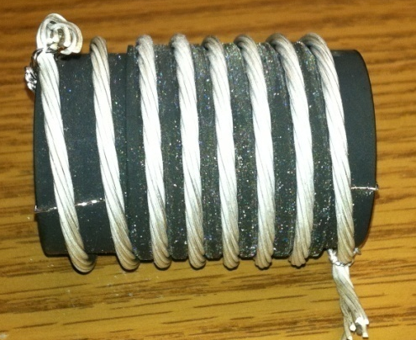
Development of high-strength, kA-class Bi-2212 cables for high field magnets
High strength
Bi-2212 6+1 cable
Bi-2212 wire
Fe-Cr-Al
TiO₂
coating
10 bar overpressure processing increased the J_{c} by 4 times.

Slide 13
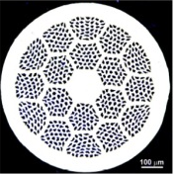




Quench degradation limit -
A large pool of wires, including OP wires, shows a consistent I_{c}/I_{co}-T_{max} behavior – conductor is safe below 350 K during a quench
OST 0.8 mm, 37x18
I_{c}(s.f)=450A
Bench marker
OST 1.0 mm, 27x7
I_{c}(s.f)=150A
No Bridging
OST 1.2 mm, 85x18
I_{c}(s.f)=950A
Liyang Ye, PhD thesis work
Justin Schwartz, Tengming Shen

Slide 14
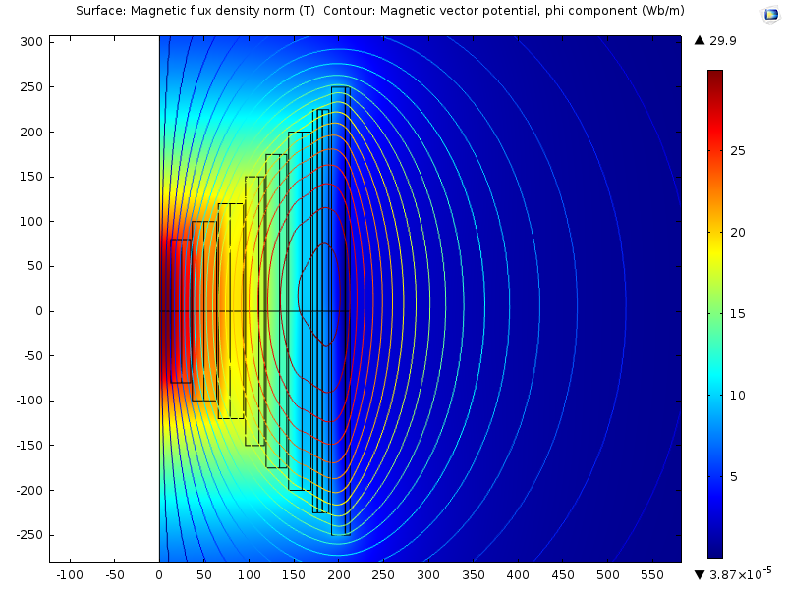
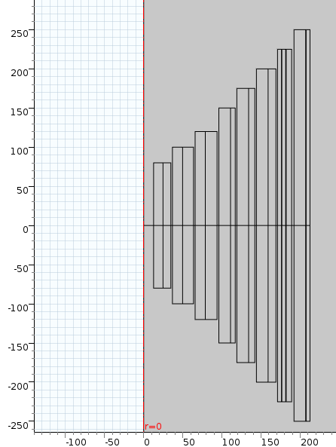
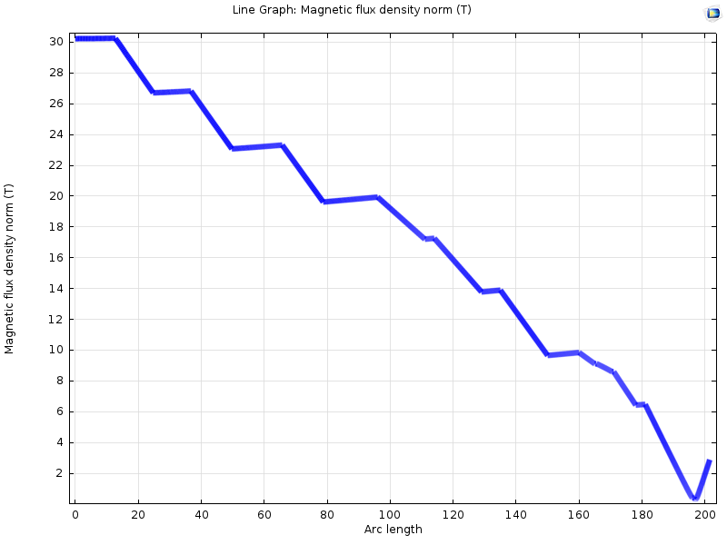
An all superconducting 30 T magnet design using overpressure processed Bi-2212
NbTi
Nb₃Sn
HTS
LTS (19 T, 200 mm cold bore) and HTS on independent PS.
J_{ave}(HTS coil)=240 A/mm²
J_{e}(HTS wire)=283 A/mm²

Slide 15
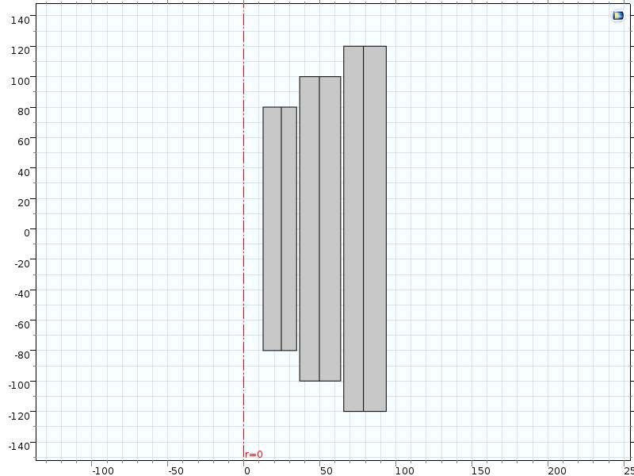
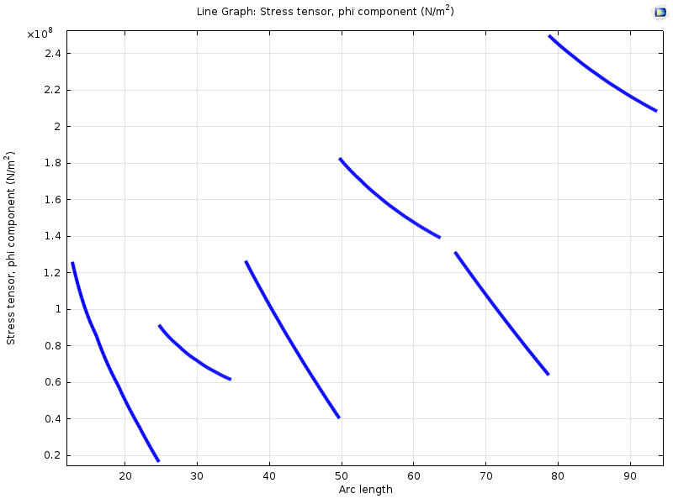
Stress management of the coil seems feasible
HTS inserts
S.S. reinforcement
S.S. reinforcement
2212
2212 – hoop stress less than 135 MPa

Slide 16
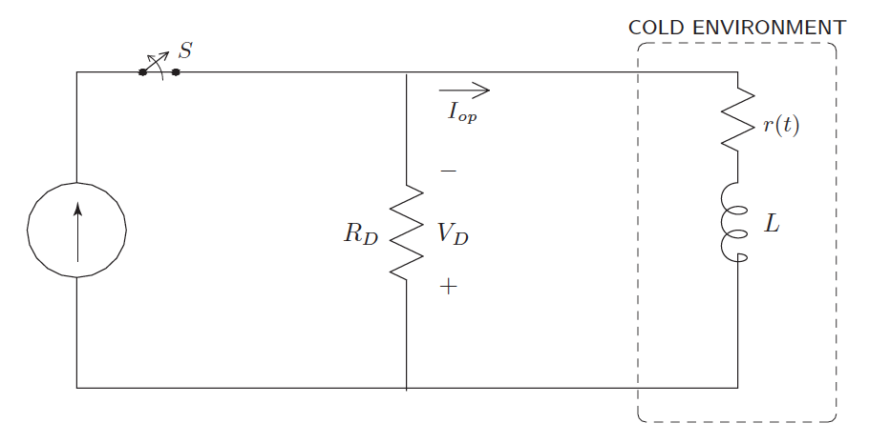
Quench protection of the insert coils constructed from kA-cable seems feasible
Detect-and-dump
Iwasa, Case studies in
superconducting magnets
Design 1: 1.2 mm wire, I_{o}=271.3 A, Coil inductance – 1 H, dump resistor needs to be 10 ohm, ground voltage=2713 V – Not OK
Design 2: cable, I_{o}= 1357 A, , Coil inductance – 0.04 H, dump resistor needs to be 0.4 ohm, ground voltage=543 V - Good
HTS on a PS
J_{ave}(HTS coil)=240 A/mm²
J_{e}(HTS wire)=283 A/mm²
J_{Ag}(HTS wire)=376 A/mm²
Quench protection time constant=0.10 sec

Slide 17
Summary
Bi-2212 is now a magnet-grade conductor.
  J_{E} reaches 700 A/mm² at 4.2 K and 20 T and 500 A/mm² in prototype coils
Magnet technology is getting ready for a big-time show
  Insulation is good.
  Quench detection is feasible.
  Quench degradation limit - >350 K
A conceptual design of an all superconducting magnet for the final cooling of muon collider
  A feasible design with the use of the high-strength, kiloamphere cable developed for stress management and fast quench protection

Slide 18
Supplement slides – quench detection and protection

Slide 19
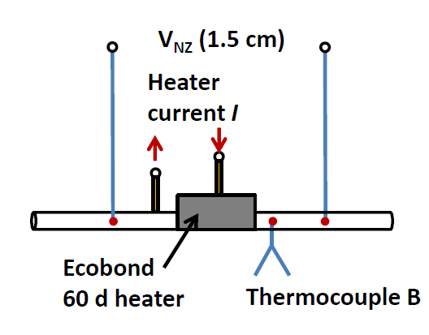
MQE determined from heater-induced quench experiments: a master plot
[1] Ye et al., SuST, 2013
[2] Yang et al., IEEE, 2012

Slide 20
NZPV determined from heater-induced quench experiments: a master plot
[1] Trociewitz, SuST, 2008
[2] Ye et al., SuST, 2013

Slide 21
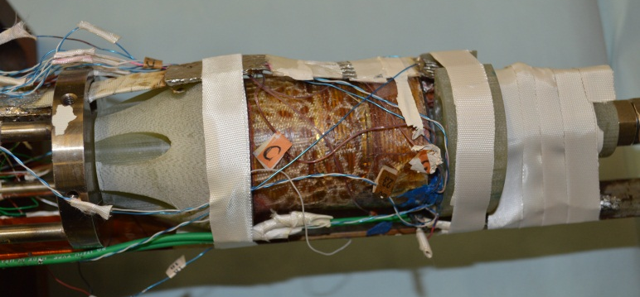
Though comprised by the slow normal zone propagation, quench detection using resistivity voltage across a normal zone is still feasible
Note: Temperature from voltage measurement, not from TCs.
TCs tend to underestimate T_{max} when dT/dt>10 K/s.
Temperatures derived from voltages across the 1.5 cm hot zone:
1 bar processing 6-layer coil
4.2 K, 7 T, coil experiment

