Slide 1
Cavity Inspection Results
Alexey Kochemirovskiy
The University of Chicago/Fermilab

Slide 2
Outline
Motivation
Instrumentation
Some pictures
Plans

Slide 3
Motivation
Breakdown limits the gradient of the cavity
Leaves traces – surface damage
We want to study that damage to understand more
We need tools to inspect the surface

Slide 4
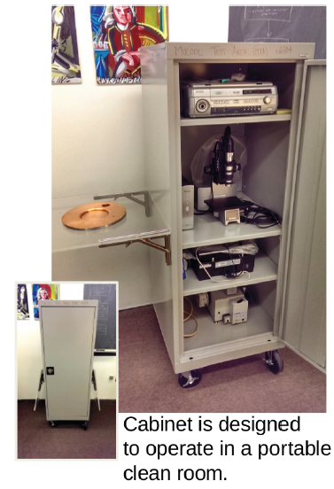
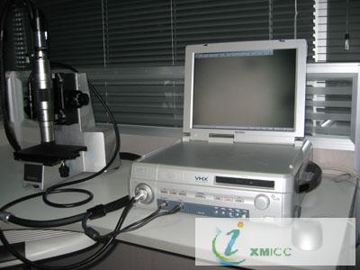
Portable Inspection Cabinet
VHX – 100K Microscope

Slide 5
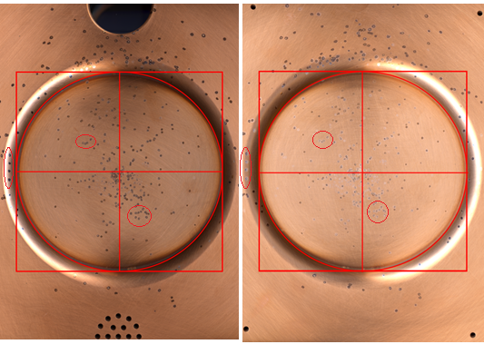
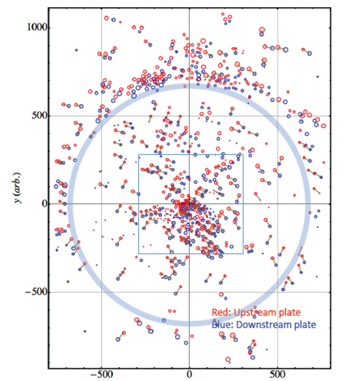
All Seasons Cavity End Walls
Scanned image of two end plates
Digital map

Slide 6
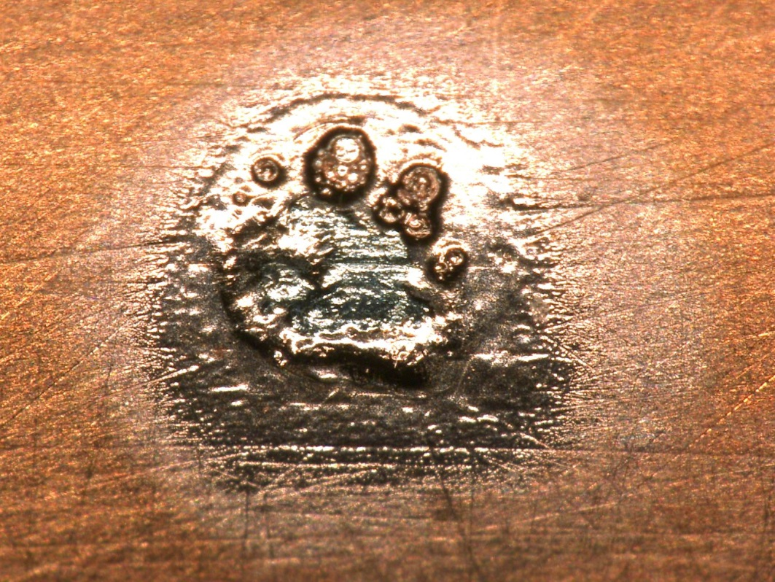
Pits close-up
What we can observe:
- Melted copper
- Surface roughness
- Traces of polishing
1.6 x 1.2 mm
Cavity surface - stainless steel plated with copper

Slide 7
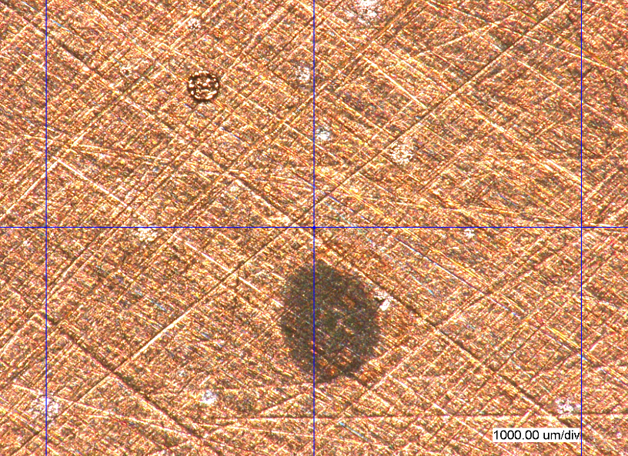
Surface inspection
Breakdown pit?
Dark current bombardment site?
Melted copper splashes?
Chemical traces?
Asteroid landing location?

Slide 8
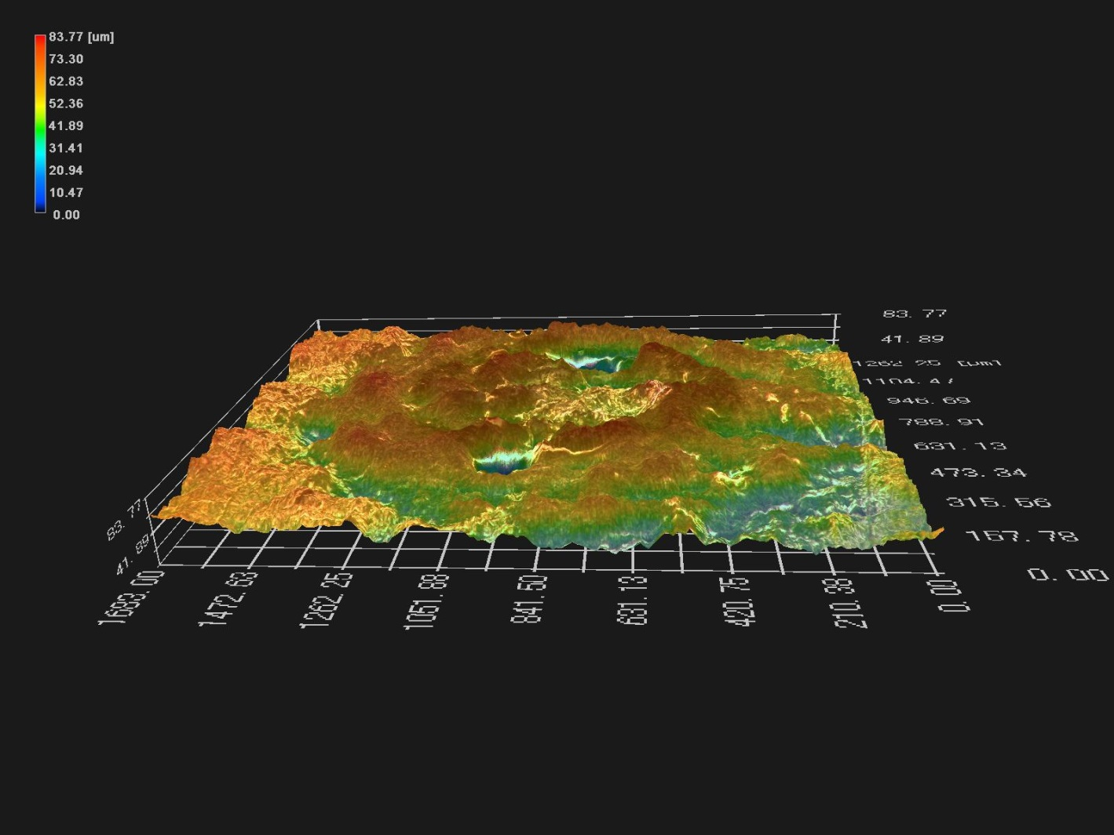
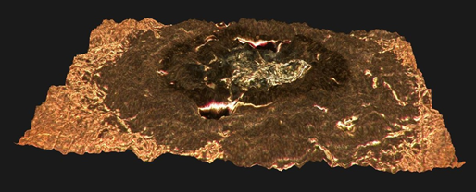
3D imaging
Crude tool to estimate deposited energy
Roughening the surface for future sparks
Depth From Defocus (D.F.D.) to construct 3d model

Slide 9
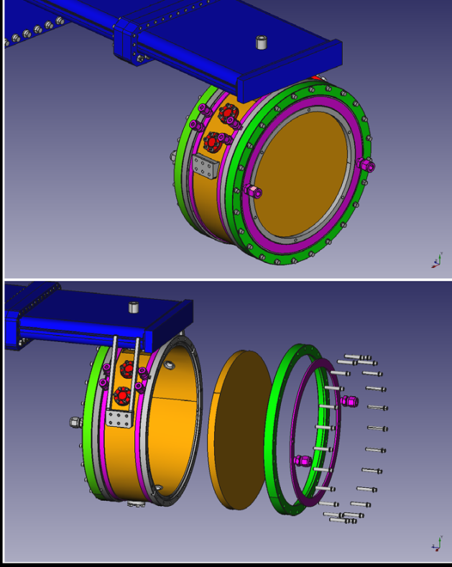
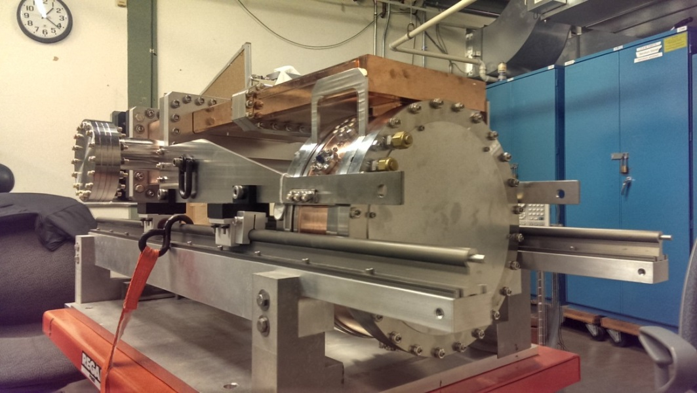
Plans
Modular cavity program
Designed to be frequently disassembled and inspected

Slide 10
Conclusion
We have portable inspection setup suitable for clean room operations
We hope to understand more about breakdown physics
Modular Cavity program

Slide 11
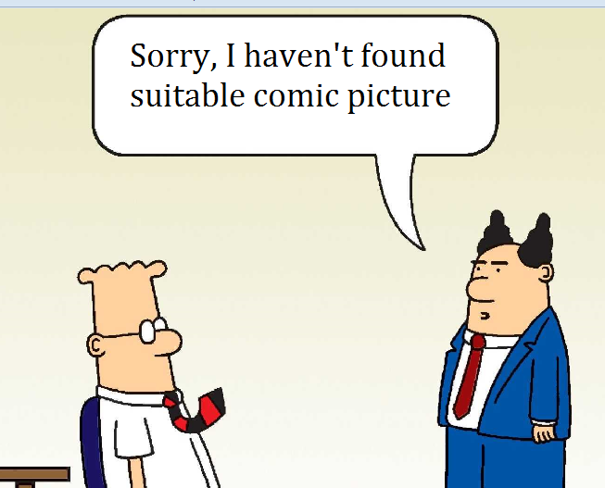
Obligatory comic slide

