Slide 1
Physics and Detectors for a Muon Collider
Ronald Lipton
SLAC MAP Meeting
December 3, 2014
Most analysis by Vito Di Benedetto, Anna Mazzacane, Nikolai Terentiev

Slide 2
Outline
Much of this talk will summarize the re-evaluations of backgrounds with the revised MARS simulation
Physics Overview
Backgrounds
  Tracking (N. Terentiev)
High Energy H/A with full background simulation (V. Di Benedetto, A. Mazzacane)
Parametric studies and Higgs Factory
Conclusions

Slide 3
An Initial Comment
Snowmass studies were based on a MARS simulation of a 1.5 TeV muon collider
A bug was found in the earlier simulation which results in a substantial increase in backgrounds at the detector. This was noticed in cross-checking with SLAC simulations. We have not fully explored the effects of this increased background, but it is clear that extracting physics measurements will be more difficult than we believed during Snowmass studies. I will present a summary of our current understanding of physics performance with the new backgrounds. The scope is limited by manpower.

Slide 4
Physics Overview
Although the muon collider shares Feynman diagrams with its e⁺e⁻ cousins there are a number of distinct differences which affect the physics reach of a muon-based machine. These considerations are distinct for a Higgs factory where a Muon Collider has x 40,000 higher coupling in the s-channel, and a multi-TeV machine, where most of the same physics processes dominate but the machine characteristics are different.

Slide 5
High Energy Collider
LHC results seem to indicate that any new physics spectrum is likely to be in the multi-TeV range.
This is problematic for
e⁺e⁻ machines due
to power lost to
radiation.
Muon collider seems
to be the only high
luminosity lepton
collider candidate
capable of delivering
CM energies >3 TeV

Slide 6
Higgs Factory
A Muon Collider is uniquely capable of producing Higgs bosons in the s channel with beam energy resolution comparable to its width
(m_{μ}/m_{e})² = ~40,000
Γ(H) ~ 4.2 MeV
ΔE(beam) ~ few MeV
The beam energy resolution
could be comparable to the
Higgs width which enables:
  Direct measurement of width
  Precise mass measurement
Enabled by precise beam energy measurement by g-2 precession (Raja & Tollestrup)

Slide 7
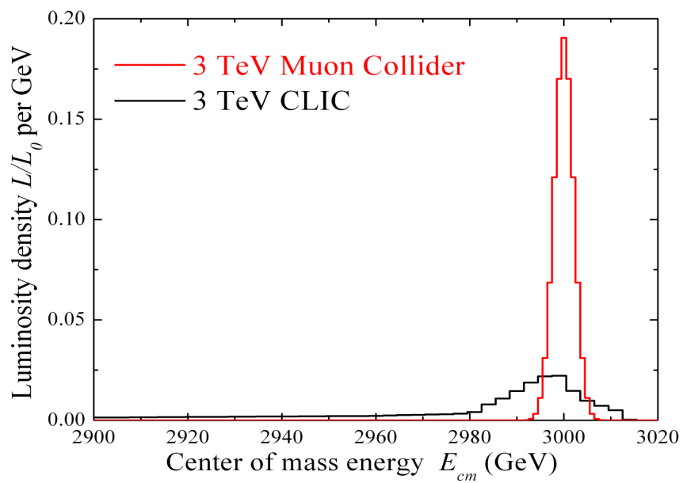
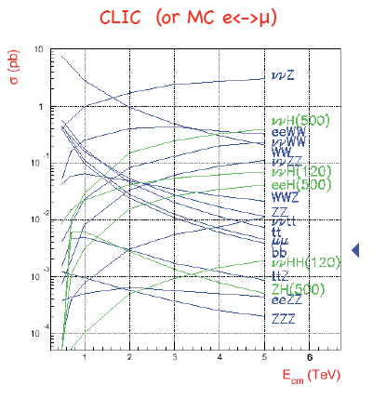
Physics Environment
Narrow beam energy spread
can enable precision physics
  Precision beam scans
  Kinematic constraints
2 Detectors
  ΔTbunch ~ 10 ms
Enhanced s-channel rates
for Higgs-like particles
Multi-TeV lepton collider cross sections dominated by boson fusion
(Han)

Slide 8
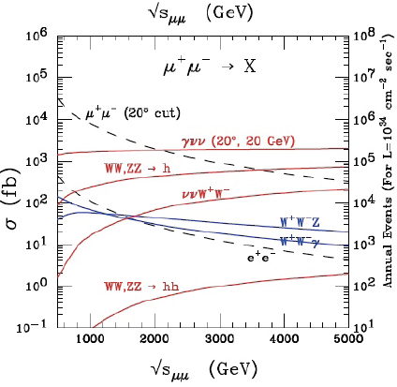
Luminosity Goals
L~10³⁴ at 3 TeV provides ~
965 events/unit R
  Events are precious
  Much of the yield is in boson
  fusion reactions
  Need to resolve W, Z jets
  Large missing energies
Physics environment similar
to CLIC with
  lower beamstrahlung,
  higher decay backgrounds
  less polarization
  Similar ~10 degrees around beam obscured by shielding

Slide 9
Backgrounds
From the detector side the central issue in a muon collider are backgrounds due to muon beam decays.
For a 0.75-TeV muon beam of 2x10¹²/bunch
  4.28x10⁵ dec/m per bunch crossing
  0.5 kW/m.
Understanding how to study and mitigate these backgrounds is crucial to the overall validation of the muon collider concept. That has been a primary focus of physics and detector work.
We have had to re-evaluate backgrounds and rejection techniques with the new simulation

Slide 10
MARS Simulations
MARS – is the framework for simulation of particle transport and interactions in accelerator, detector and shielding components.
Background calculation requires knowledge of machine components and design of integrated shielding throughout the system
  Machine must be designed before the background is calculated – may be an iterative process
  Recalculation of the background is completed for 1.5 TeV machine only
  Background is provided to detector simulation at the surface of MDI.

Slide 11
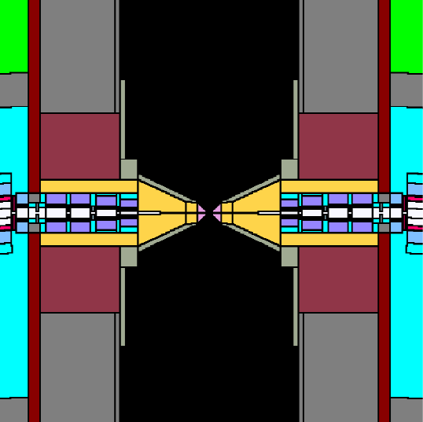
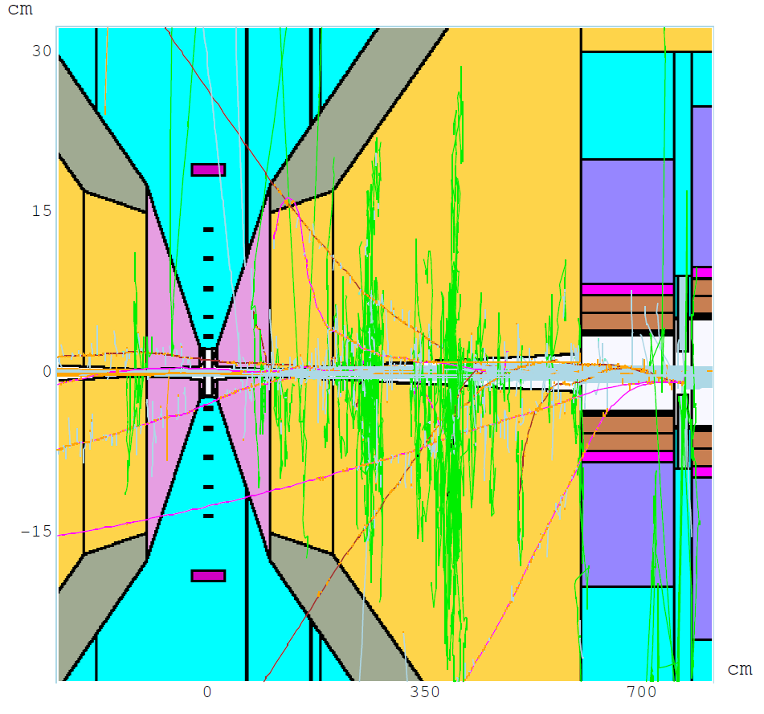
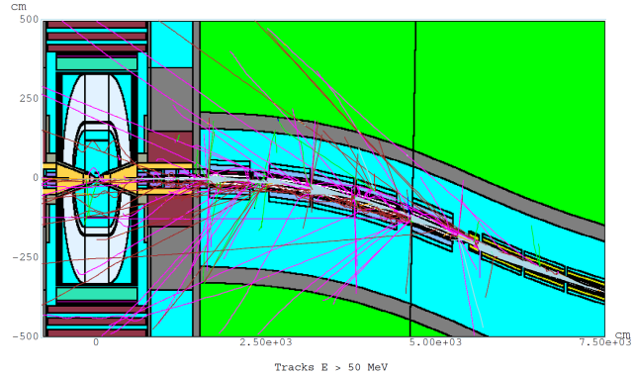
Machine Detector Interface Model
Θ = 10º 6 < z < 600 cm x:z = 1:17
MDI
surface
Q1
W
BCH₂
N. Mokhov design and MARS simulations

Slide 12
Detector Model
Detector is based on ILC concepts (SiD, 4th)
Fine pitch pixelated vertex and forward detectors (~20 μm)
More coarsely (50 μm) pixelated tracker
  Both with sub-ns timing resolution
Dual readout (scintillator/Cerenkov) calorimeter to optimize hadronic shower resolution
  Based on existing “Adriano” design with realistic parameters – not optimized for timing
  Between 1 and 12 ns timing gates

Slide 13
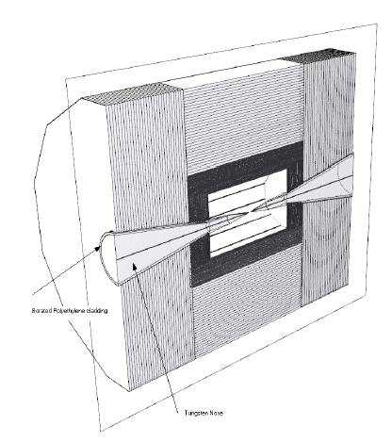
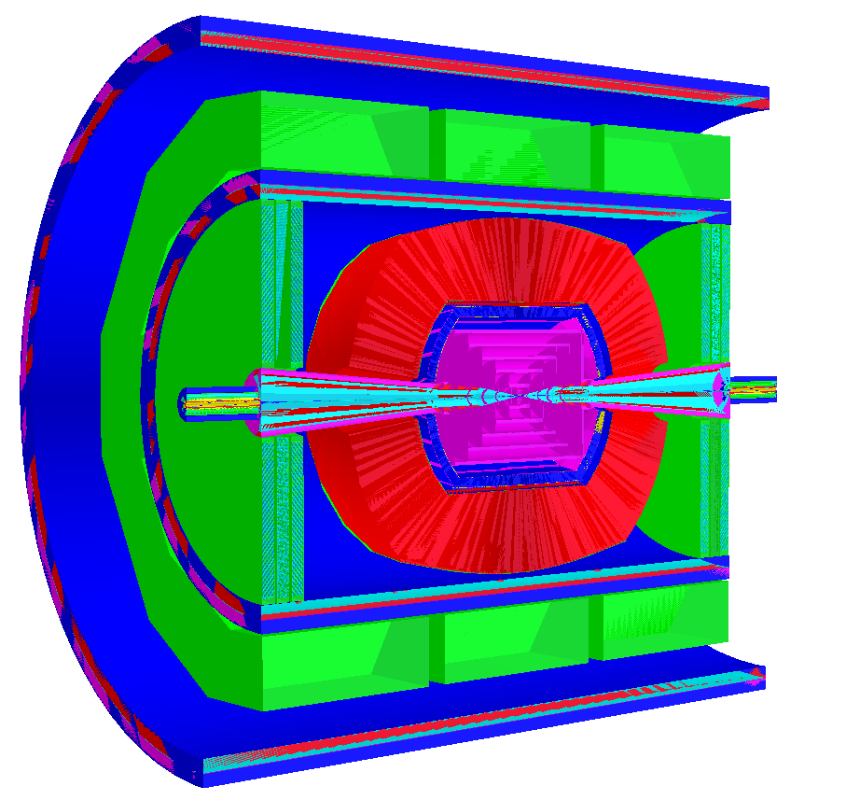
Detector Simulation Tools
LCSIM Detector Model
ILCROOT Detector Model
Models derived from the SiD ILC concept

Slide 14
Attacking the Background - Timing
It is clear that timing and energy discrimination will be important in limiting the background in a Muon Collider
We have concentrated on understanding the time resolution required and how it may affect the detector mass and resolution for physics objects
But new simulations show that timing will not be as powerful as we had hoped
The R&D on timing is synergistic with:
CLIC, which requires ns level resolutions,
LHC which is looking at fast timing for background reduction
Intensity frontier experiments, which may require 100’s of ps resolution or better

Slide 15
MARS Backgrounds
We had depended almost exclusively on timing to reject backgrounds. However in the new MARS simulation the prompt backgrounds are much larger, reducing rejection.
Timing is still important, but less powerful

Slide 16
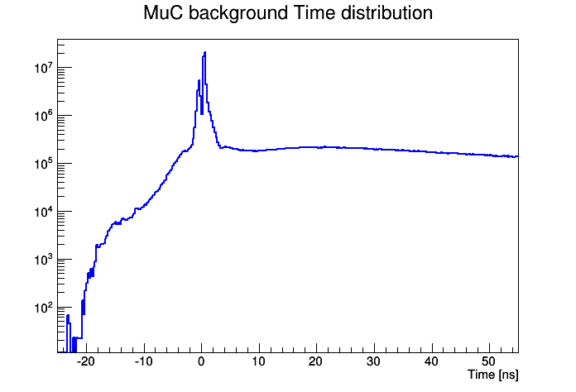
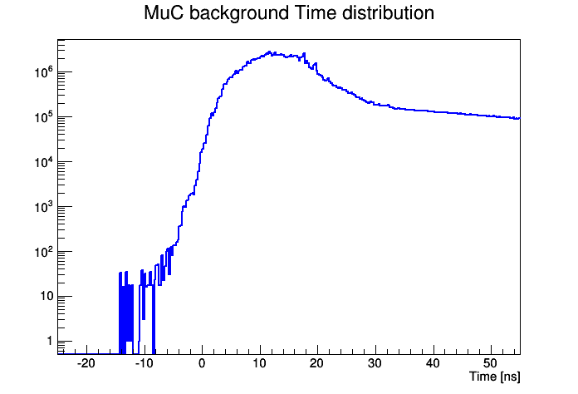
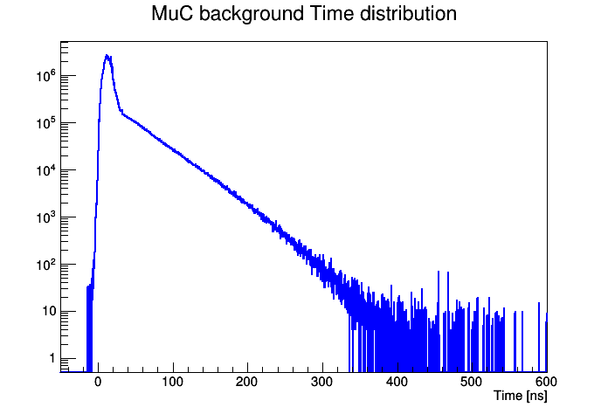
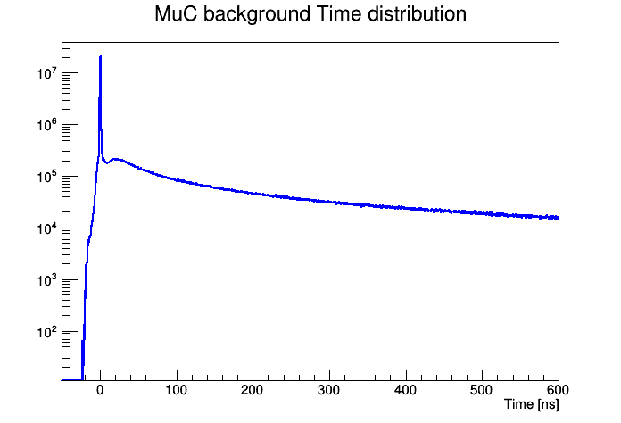
MuC background: Time distribution
2014
2013
Time distribution of the background is now very different.
The peak level at t=0 is about 4 orders of magnitude higher than before.
There is a long tail almost constant.
(Di Benedetto)

Slide 17
Tracker – N.Terentiev

Slide 18

MARS 1.5 TeV MC background data
N. Terentiev (CMU/Fermilab)
New MARS background simulation results (July 2014) for 750+750 GeV μ⁺ μ⁻ beams with 2*10¹² μ/BX each (N. Mokhov, S. Striganov, www-ap.fnal.gov/~strigano/mumu/2014)
  new geometry of MC magnets
  no weight fluctuation in interactions, intrinsic weight = 1
  low energy electron-photon modules in the MARS code were rewritten
  time of flight error fixed
Lower thresholds in new data
  100 keV threshold for γ, e± , μ± and charged hadrons, 0.001 eV for n
MARS particle yields for 1.5 TeV MC and 10⁰ shielding nozzle
  ~4.5% decays were simulated on the 26m length
  it gives statistical weight ~22.3 which is taken into account in ILCroot simulation
  correspondingly, total yield/BX ~ 3.24e+08 particles into detector

Slide 19
Background rejection techniques in Si VXD and Tracker
Timing
  time of flight (TOF) of MARS background particles (with respect to bunch crossing BX) is given on the detector side surface of the shielding cone
  in analysis use instead TOF-T0 where T0 – time of flight of IP photon from interaction point IP (X=0,Y=0,Z=0) to the point with IP muon or MARS background particle hit coordinates in sub-layer
  this compensates the different TOF for IP particles making hits in different layers of VXD and Tracker at different R and Z coordinates of the hit
(N. Terentiev)

Slide 20
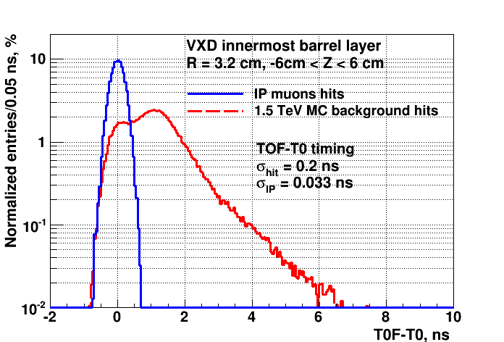
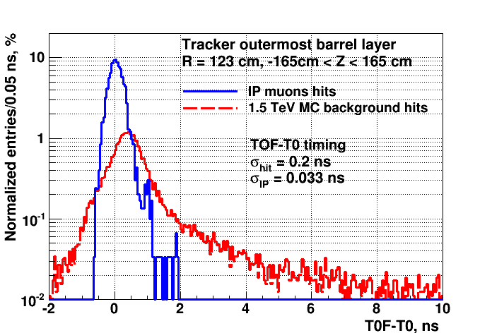
Background rejection techniques in Si VXD and Tracker
Timing (cont’d)
  the TOF of the IP muon hits and MARS background particles hits was smeared with Gaussian time resolution of 200 ps
  IP TOF-T0 distribution is fitted by Gaussian to determine start and width of the timing gate for given IP efficiency
  MARS background hits timing different from layer to layer, therefore different rejection if keep one and the same IP efficiency
(N. Terentiev)

Slide 21
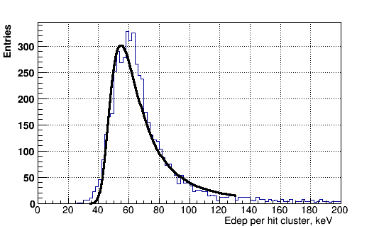
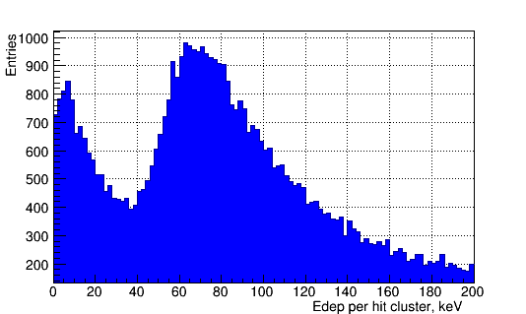
Background rejection techniques in Si VXD and Tracker
Energy deposition for IP muons and MARS background in the Tracker outermost barrel sub-layer (200 µm)
  IP muon
    Landau peak ~56 KeV at Z=0
    Edep threshold ~40 KeV, IP efficiency ~98.5% per sub-layer
  MARS background (all Z)
    mostly e- from n and γ interacted within the Si layer
    the second peak is for particles crossing sub-layer
(N. Terentiev)

Slide 22
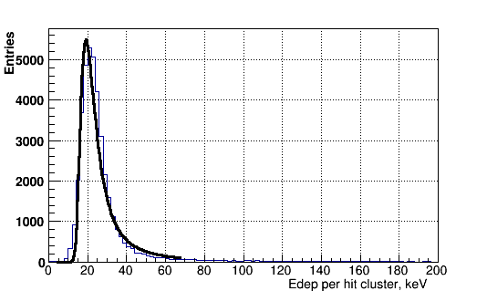
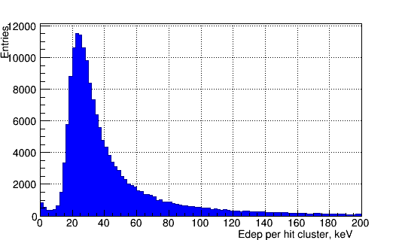
Background rejection techniques in Si VXD and Tracker
Energy deposition for IP muons and MARS background in the VXD innermost barrel sub-layer ( 75 µm)
  IP muon
    Landau peak ~20 KeV at Z=0
    Edep threshold ~13.5 KeV, IP efficiency ~98% per sub-layer
  MARS background (all Z)
    mostly MARS e+,e-
(N. Terentiev)

Slide 23
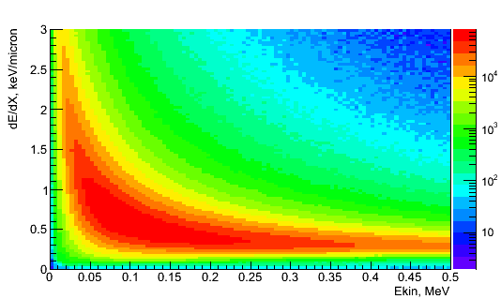
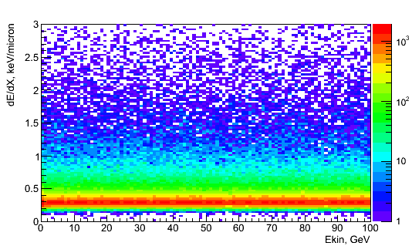
Background rejection techniques in Si VXD and Tracker
Edep_{thr} for the hit clusters does not provide good rejection of the muon collider background
  large dE/dX at the end of range for low energy e- coming from background photon and neutron interactions, exceeds dE/dX of IP muons crossing sub-layer (data for all barrel layers)
  e- from background γ and n IP muons
(N. Terentiev)

Slide 24
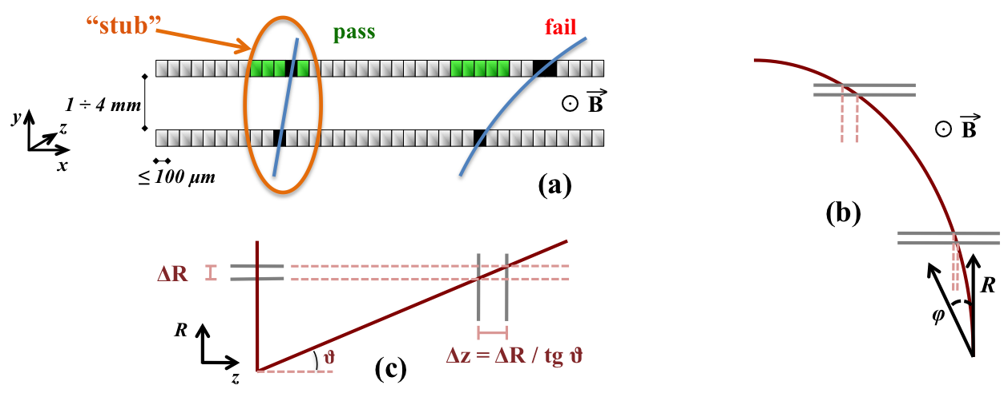
Doublet Layers
Use a doublet layer concept similar to that being used for the CMS upgrade track trigger. This allows local elimination of uncorrelated or low momentum hits.

Slide 25
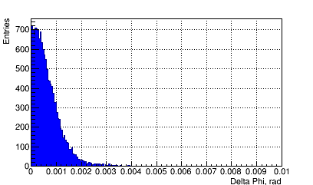
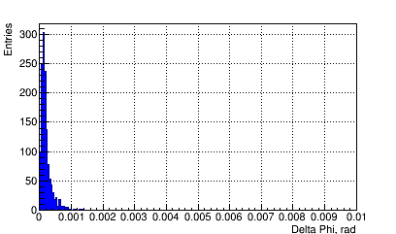
Background rejection techniques in Si VXD and Tracker
Double layer angle cuts
  smear hit cluster coordinates in each sub-layer in local Z and X with Gaussian σ_{res} = 15 µm for VXD and 40 µm for Tracker
  define Delta Phi and Delta Theta as differences between Phi and Theta angles (relatively to IP) of the hit cluster coordinates in two sub-layers of the given layer
Delta Phi for IP
VXD Δφ innermost barrel layer Tracker Δφ outmost barrel layer
(N. Terentiev)

Slide 26
Background rejection techniques in Si VXD and Tracker
Summary of used resolutions in VXD and Tracker barrel sub-layers
  0.2 ns for timing
  2 keV (VXD) and 5.6 keV (Tracker) for energy deposition as 1/10 of Landau peak position
  15 µm (VXD) and 40 µm (Tracker) X,Z for double layer method
Summary of used cuts in VXD and Tracker barrel sub-layers
  timing gate width 0.9 ns (VXD) and 0.9 ns – 1.05 ns (Tracker)
  energy deposition, depends on Z and layer
  Delta Phi, 1.95 mr - 1.15 mr (VXD), 1.65 mr - 0.7 mr (Tracker)
  Delta Theta, depends on Z and layer
(N. Terentiev)

Slide 27
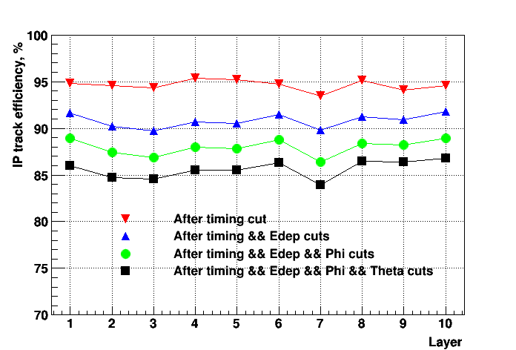
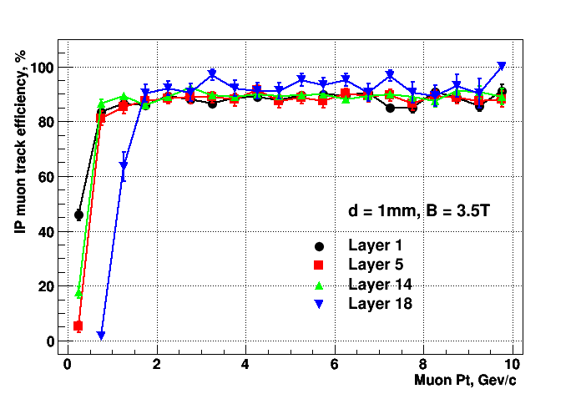
Results for IP efficiency and
MARS surviving fraction
IP muon tracks efficiency vs. cuts and layer (1-5 are VXD barrel, 6-10 are Tracker barrel)
  overall IP efficiency ~85%
IP muon tracks efficiency vs. Pt (1,5 are VXD barrel, 14(6),18(10) are Tracker barrel)
(N. Terentiev)

Slide 28
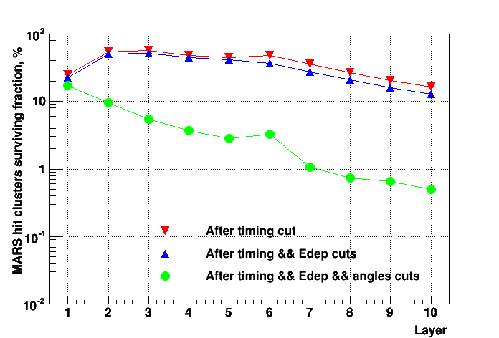
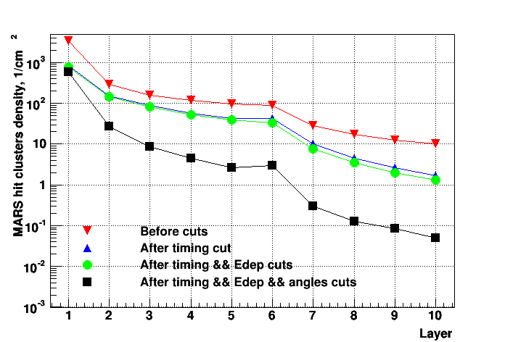
Results for IP efficiency and
MARS surviving fraction
MARS hit clusters surviving fraction per sub-layer vs. cuts and layer (1-5 are VXD barrel, 6-10 are Tracker barrel)
  overall MARS surviving fraction ~2.7%
MARS hit clusters density per sub-layer vs. cuts and layer (1-5 are VXD barrel, 6-10 are Tracker barrel)
Suggests
Outside->
In tracking
(N. Terentiev)

Slide 29
Calorimeter and Physics Analysis –
Vito Di Benedetto and Anna Mazzacane

Slide 30
Machine background suppression strategy in Calorimeter - V. Di Benedetto, A. Mazzacane
Define time gate with fixed width, but start and stop are theta dependent
according to the distance of the tower from the IP.
Time gate for each section
 | Front | Rear
Scint | Cer | Scint | Cer
front | 6.5 ns | 1.5 ns | 15. ns | 11.5 ns
back | 6.5 ns | 1.0 ns | 11.0 ns | 8.0 ns
Signal efficiency | 90% | 90%
BG suppression | 85.5% | 92.5%
BG energy | Front Section | Rear Section
Total | 532 TeV | 386 TeV
100% sign eff | 118 TeV | 63 TeV
95% sign eff | 85 TeV | 40 TeV
90% sign eff | 77 TeV | 29 TeV
ILCroot Simulation
Apply time gate cut.
Individuate Region of Interest (RoI), i.e. regions where the energy is 2.5 σ above the expected background level in that region (implemented on tower by tower basis).
In the RoI apply soft energy (pedestal) subtraction, i.e. use as energy subtraction the mean value of the background in that region.
In the other regions apply hard energy cut.
Final energy recovered to take in account the signal efficiency.
(V. Di Benedetto, A. Mazzacane)

Slide 31
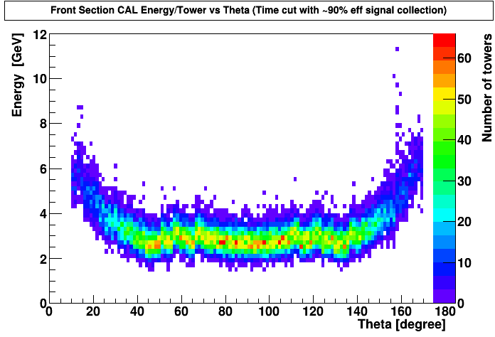
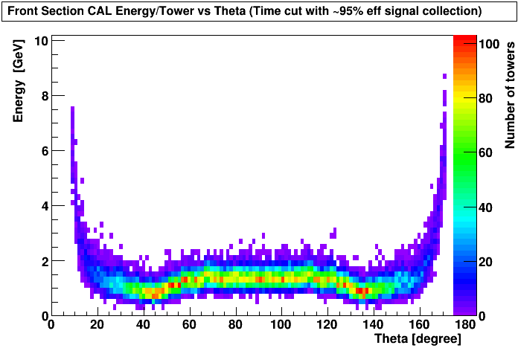
Improved machine background suppression strategy
An improved approach to remove machine background.
Use the “profile” of the energy distribution vs theta and use for each theta the “mean” value of the energy distribution as “Energy subtraction”.
This approach is
more effective for the
forward endcap region.
2014
Angular distribution of BG after Time cut
2013
ILCroot Simulation
(V. Di Benedetto, A. Mazzacane)

Slide 32
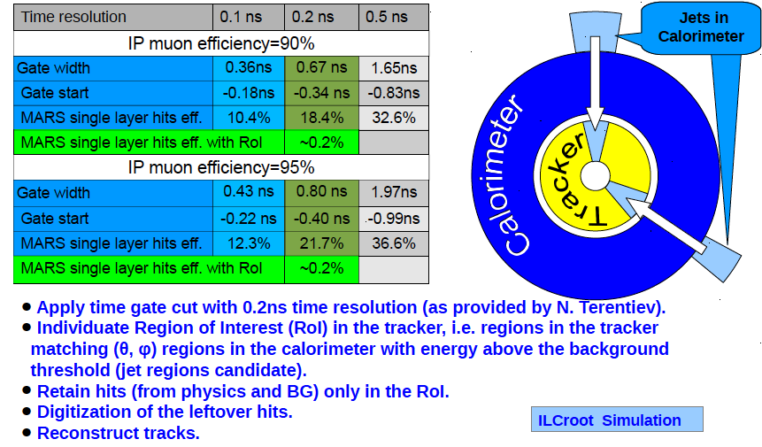
Improved machine background suppression strategy in the tracker
(V. Di Benedetto, A. Mazzacane)

Slide 33
Background Rejection Comments
To deal with the higher backgrounds we:
Tightened the tracker and calorimeter timing cuts
Used calorimeter roads to define tracking regions
Subtracted the background pedestal from calorimeter cells and imposed a threshold
Double tracking layers were not used in the H/A analysis, but would help
A strategy to utilize doublet layers to allow stand-alone, probably outside->inside tracking would be needed to validate “generic” physics capability.

Slide 34
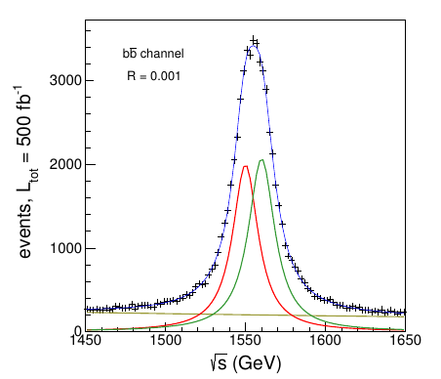
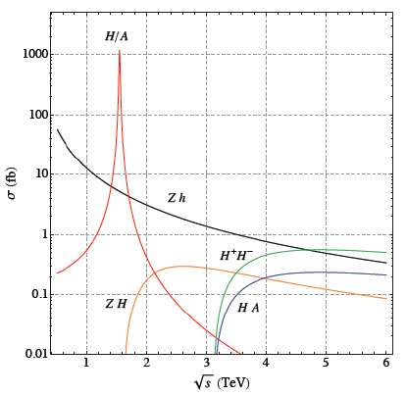
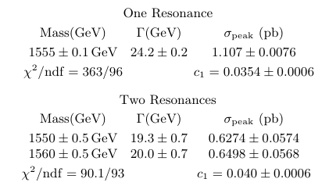

Physics analysis with MARS background
Heavy Neutral Higgses (H/A) and charged Higgses (H±) are a simple possibility of New Physics beyond the Standard Model.
H/A are likely to be difficult to find at the LHC due to the large backgrounds and small cross sections
At e⁺e⁻ colliders they must be produced in association with other particles, such as Z, since the electron Yukawa coupling is too small for s-channel production.
H and A can be produced as s-channel resonances at a Muon Collider. (Eichten and Martin arXiv:1306.2609).
Pseudo-data (in black) along with the fit result in the bb channel.
The peak signal is more than an order of magnitude larger than the physics background.
H/A production in the Natural Supersymmetry model compared with Z⁰h, Z⁰H and heavy Higgs pair production.
(V. Di Benedetto, A. Mazzacane)

Slide 35
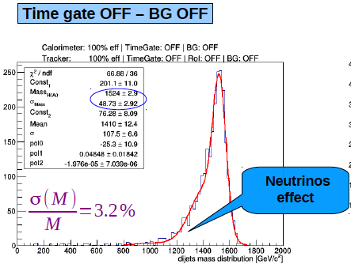
H/A Reconstruction
Reconstruct H/A decay into 2 B jets
With no cuts and no background the mass resolution is 3.2%, primarily due to missing neutrinos
(V. Di Benedetto, A. Mazzacane)

Slide 36
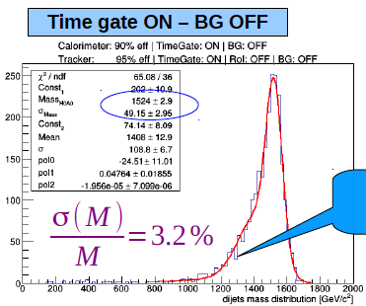
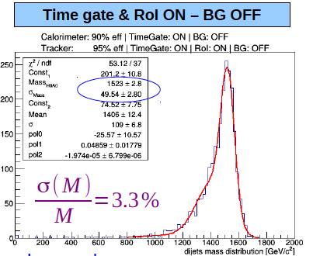
Cuts with Background off
Cuts applied in the absence of background have little effect on resolution
Time gate,NO background
Calorimeter efficiency: 90%.
Tracker single layer hit efficiency: 95%.
+ ROI
(V. Di Benedetto, A. Mazzacane)

Slide 37
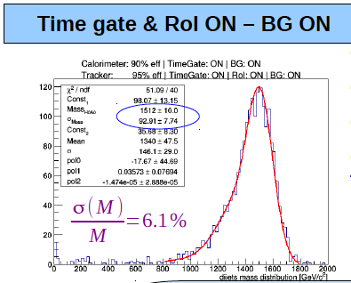
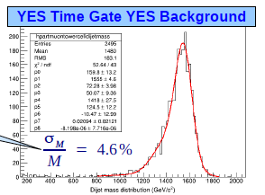
Final Result
Final Result
Time gate, RoI, and BG applied.
Calorimeter efficiency: 90%.
Tracker single layer hit efficiency: 95%.
At this step there is a degradation in the H/A mass resolution.
Result with old background was 4.6% ~ 30% increase in resolution, In this (rather clean) case the physics is still accessible
More details in Vito’s talk
(V. Di Benedetto, A. Mazzacane)

Slide 38
Parametric Studies
We have explored capabilities for both a Higgs factory muon collider and Higgs self-coupling measurements at a possible high energy (6 TeV) machine. These were based on parametric studies assuming backgrounds in these machines could be controlled, but the acceptance is limited by a 10-15 degree cone.

Slide 39
Higgs Factory
The s-channel Higgs production affords the most precise measurement of the muon Higgs-Yukawa coupling, g_{μ},
precision δg_{μ}/g_{μ} ~ (few)%.
The s-channel Higgs production affords the best mass measurement of the Higgs boson
precision of ~(few) x10⁻⁶ with a luminosity of 10³² cm⁻²s⁻¹.
It affords the best direct measurement of the Higgs boson width to a
precision of a few percent

Slide 40
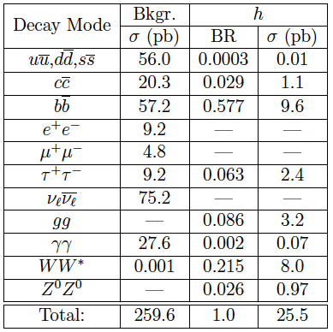
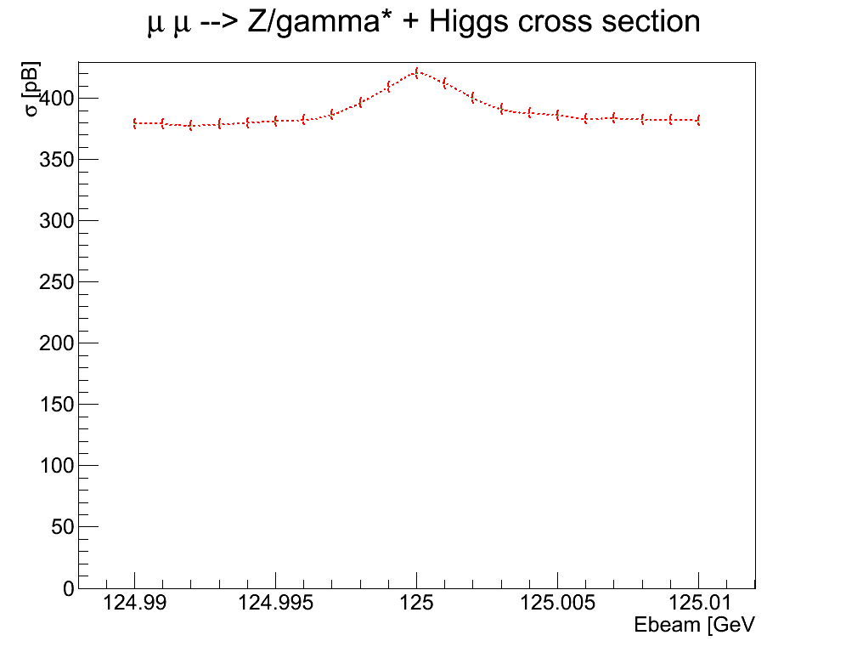
Higgs Factory S/B
Higgs production in an S-channel factory still has significant SM background.
cross sections are calculated as the peak value of the peak Breit-Wigner convoluted with a Gaussian of width 3.54 MeV to simulate the effect of beam smearing. The inclusion of initial state radiation effects and full one loop corrections further reduces the cross sections for Higgs production by a factor of 0.53; resulting in
a total Higgs cross section of 13.6 pb.

Slide 41
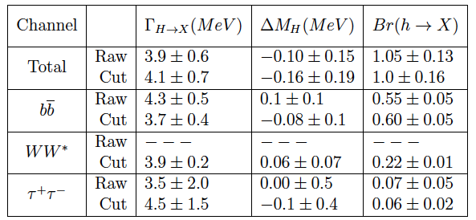
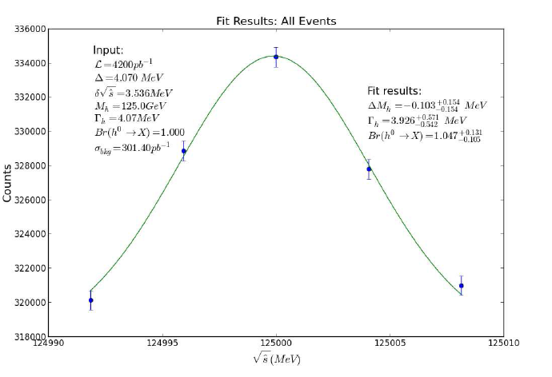
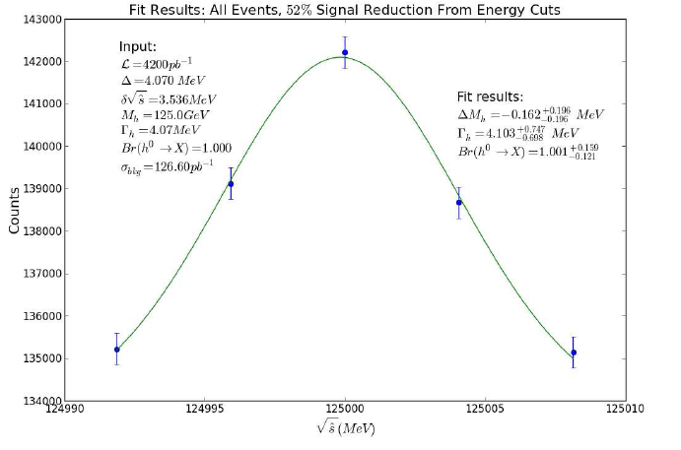
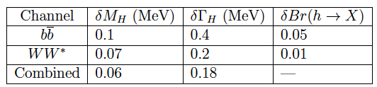
Higgs Mass and Width
Fitted values of Higgs decay width, mass and branching ratio from simulated data. Mass values are the difference between the measured mass and the true mass of 126 GeV. Total integrated luminosity was 4.2 fb⁻¹
336000
Scan-
All events
143000
Scan- energy
cuts
Accuracy of fitted parameters

Slide 42
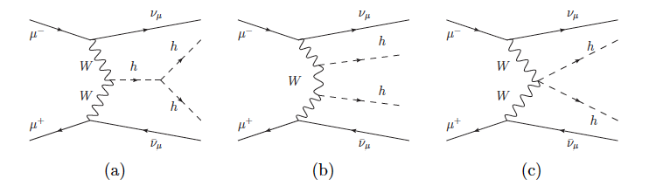
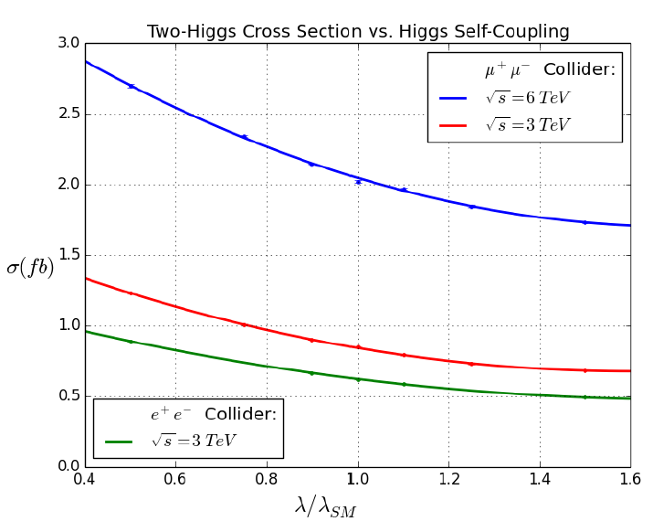
High Energy Collider Higgs Self-Coupling
Measurement of the Higgs trilinear self-coupling is a direct probe of the shape of the Higgs potential and a crucial test of the Standard Model.
All future high energy accelerators are likely to address this measurement.
A high energy (6 TeV) Muon collider would have the advantage of both higher luminosity and larger cross section
CLIC may have larger acceptance
Study the tradeoffs …
Variation of
σ with λ provides the sensitivity

Slide 43
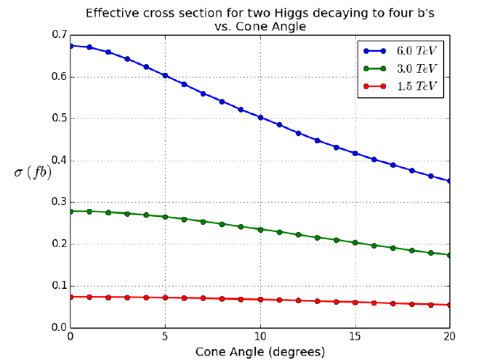
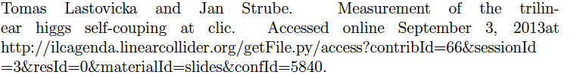
Self-coupling Analysis
For now we take the CLIC analysis and scale the results to the event yield correcting for events lost to the cone.
Losses due to the cone cut increase with E_{cm}, but the 6 TeV has about 2x the cross section for cone angles between 10 and 20 degrees
HH->4b, all 4 bs
accepted

Slide 44
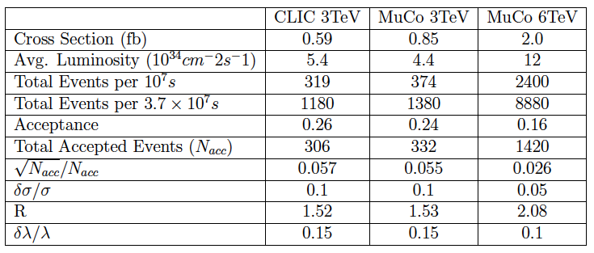
Self-coupling results
Results obtained by scaling CLIC results – note that the values can be improved by utilizing polarization
HL-LHC – evidence
ILC (20yr) – 13%
3 TeV CLIC (polarization) – 10%

Slide 45
Conclusions
Physics reach at a Muon Collider will be constrained by beam decay backgrounds
These backgrounds are significantly larger than in the previous simulation
They can be handled in the case of heavy Higgs by using calorimeter roads
More work needs to be done to understand and refine background rejection in more generic physics analysis
We hope to write up these results as conclusions of the Physics and Detector studies

Slide 46
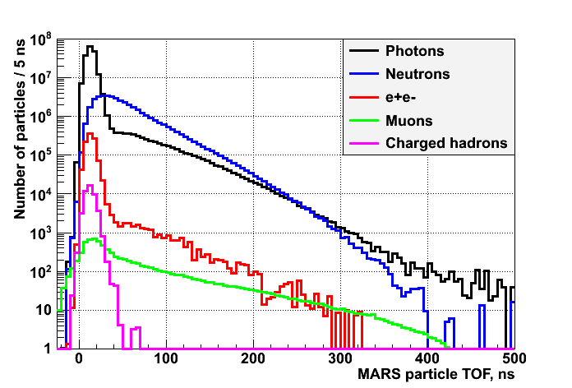
Old Tracking Rejection

