Slide 1
Fabrication and Quality Control of the Frequency Tuner for the XFEL
Lutz Lilje
DESY
Tuner meeting - ILC / Fermilab / LCLS-II Monday 13 October

Slide 2
Outline of the talk
Steps towards industrialisation
Mechanics
Motor drive
Piezo system
Current status
Disclaimer:
No details on Piezo amplifier or motor driver electronic given here
Developments well on-track by LLRF WP and DESY groups MSK and MCS

Slide 3
Tuner Scheme
Current design in use at FLASH
Original design by CEA
Fast piezo detuning introduced by DESY
Design by M. Maurier and P. Leconte based of the MACSE tuner design (CEA Saclay)
ΔL_{cavity}
ΔL_{arms}
ΔL_{screw}

Slide 4
Tuner Parts: Overview
Piezo System
Mechanics
Drive Unit

Slide 5
Challenges for industrialisation: Mechanics
Mechanics supplied by CEA
Adapted to local supplier in France
Cost reduction
Material quality
Steel with low permeability needed
Therefore
Prototypes with companies experienced in mass production of precision machined pieces (for Airbus etc.)
Conclusions
Several simplifications on the detailed drawings
Relaxed tolerances to reduce cost for precision machine time
Good basis for a successful call for tender

Slide 6
Industrial fabrication of mechanics
Contract awarded to Astro- und Feinwerktechnik, Berlin
Minor adaption of drawings
After initial problems with material smooth production
Quality control
Agreement on ‚essential‘ measures
Pre-series completely cross-checked at DESY
Piezo fixture incoming check at Piezo company
QC protocols delivered into DESY EDMS system by company
Delivery
Pre-assembled state
Allows for additional cross-check of completeness

Slide 7
Challenges for industrialisation: Motor and gear box
Basic idea from CEA: Step motor and harmonic drive
Initial tests failed due to insufficient coating
Lubrication under cold vacuum conditions tricky
DESY in-house development on coatings
Parts purchased via different sources
Integration/Assembly at DESY
Second motor supplier came into play later than expected
Cold testing possible at vendor
Therefore:
Training for at least two companies to deliver complete and tested drive units:
Motor, gear box, thread with nut
Test temperature liquid nitrogen, units under load
Use prototyping phase
Conclusion
Both vendors were capable to fulfill XFEL requirements
E.g. Life-Time

Slide 8
Industrial fabrication of drive unit
Contract awarded to Harmonic Drive, Limburg
Minor adaption of drawings
Quality control
Agreement on few ‚essential‘ mechanical measures
Room temperature and at liquid N2 temperature tests
Record current when
Beginning of movement
Loss of steps
Total number of steps
QC protocols delivered into DESY EDMS system by company
Delivery
Delivered in a sealed bag including disseccant and humidity indicator

Slide 9
Challenges for indutrialisation: Piezo system
DESY development with several iterations
Guaranteeing sufficient pre-load for piezos
Avoid loose piezos under all operation conditions
Change of pre-tuning of cavities
Assembly ‘hand-crafted’ at DESY
No burn-in tests
One special case of failure at initial operation suspected
Not fully conclusive data
Therefore:
Require companies to
Further improve radiation resistance (ETFE cabling)
Respect vacuum compatibility
assemble piezo systems
More than buying piezos only
Use experience of piezo companies for assembly
perform burn–in test
Room-temperature considered sufficient
Implementation in series production

Slide 10
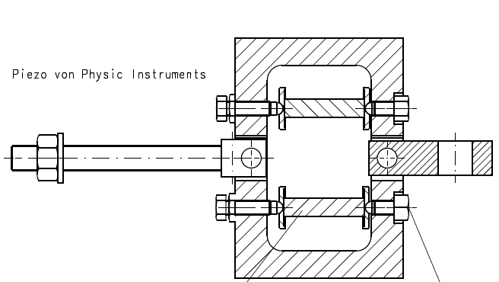
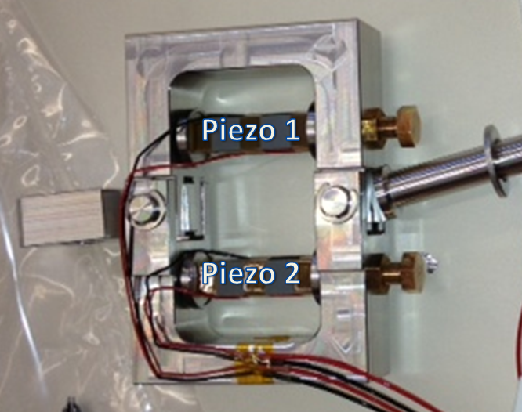
Industrial fabrication of Piezo System
Contract awarded to PI, Karlsruhe
PI Ceramics for Piezo elements
Design improved of drawings
Avoid local stresses on piezos by optimising the plates used for pressing the piezo elements
Increases thickness
Definition of surface quality
Better fixation of the wiring

Slide 11
Industrial fabrication of Piezo System
Quality control
Burn-in test after assembly
DC test
100 % of nominal voltage for 2 hours
AC test
Voltage:100% of nominal piezo voltage
Pulse length:Sinusoidal Half Wave of 1000 Hz
Rep rate: 100 Hz
Number of Cycles: 1 Million
After the tests the following parameters should be measured
Capacitance
Stroke
Leakage current at nominal voltage
QC protocols delivered into DESY EDMS system by company

Slide 12
Status of the System Components
Mechanics:
Series fabrication finished. Delivery completed
721 normal + 103 mirrored units
Minor problems with tolerances
Drive unit:
Documentation reports decided.
More than than half of all units have FAT and been delivered to CEA and DESY.
588 normal and 84 mirrored
Piezo system:
Continuing tests of permanent FLASH setup.
Series production of fixtures completed.
824 units
3 Piezos (of 1600) failed the FAT and were replaced by the company
QC testing during module installation at Saclay (INFN contribution).
Documentation in EDMS continues.

Slide 13
If I had had time, …
… what would be different?
Piezo
Design improved for mechanical robustness
Kept overhead in voltage
Position of the piezo?
T-sensor?
Mechanics
Nothing in the design
Assembly procedures and training of personnel
Drive unit
More lifetime testing
T-sensor?

Slide 14
Thanks!
Several people contributed with support and measurments to the work presented here:
R. Paparella, A. Bosotti, C. Albrecht, K. Jensch, O. Keller, K Przygoda, M. Grecki, C. Müller and many more also within the S1 Global Test at KEK

