Slide 1
LINAC2014 Satellite Meeting: SRF Cavity-Tuner Workshop held at CERN, 5 Sept. 2014 Summary
Akira Yamamoto (KEK/CERN)
To be reported at SRF Tuner Workshop, Fermilab, 13 October, 2014

Slide 2
Mini-workshop Plan & Objectives for SCRF Cacity Frequency-Tuners
Title: A mini-workshop on the SCRF-cavity tuner and He-Vessel design
Date: 5 Septermber, 2014 (Friday),
Time: 14:30 ~ 17:00 (CERN) 7:30 ~ 10:00 (Fnal), 21:30 ~ 24:00 (KEK)
Remote access: "Fuze meeting" to be provided.
Place: CERN Main Building 6, or B30-6-039
Participants: Y. Pischalnikov, K. Artoos, G. Devanz, O. Napoli, E. Montesinos, M. Champion, E. Jensen,
H. Hayano, N. Yanagisawa, S. Stepnes
Remote: T. Peterson, C. Ginsburg, M. Ross, J. Zhai (et al.) , C .Pagani (et al.)
Workshop Objectives to:
Seek for highly reliable and best cost-effective tuner and He-vessel designs for 1.3 GHz SRF Linear Accelerators,
Discuss the design and prototype development progress for the SLAC-LCLS cavities.
Discuss the maintain-ability and/or accessibility
Discuss the adaptability for the ILC SCRF cavity design update

Slide 3
SRF Tuner Workshop at CERN, 5 Sept. 2014
Face-to-face: Y. Pischalnikov, K. Artoos, G. Devanz, O. Napoli, E. Montesinos,
M. Champion, E. Jensen, H. Hayano, N. Yanagisawa, S. Stepnes
Remote: T. Peterson, C. Ginsburg, M. Ross, J. Zhai (et al.) , C .Pagani (et al.)

Slide 4
Agenda: 5 September
14:30 Objective of the meeting A. Yamamoto
14:40 Tuner design update and development Y. Pishalnikov (Fnal)
15:10 Comments on tuner design G. Devanz (CEA)
15:30 Comment on tuner design C. Pagani (INFN)
15:45 Report from SPL tuner test and comment K. Artoos (CERN)
16:00 Comment on He-vessel & HP. Code Issues TBD (DESY/KEK)
16:15 Discussions for further development All
17:00 End

Slide 5
Tuner Design Update and
Development at FNAL
Yuriy Pischalnikov
for FNAL’s LCLS II Tuner Team
Mini-workshop SCRF cavity frequency tuners CERN
Sept. 5, 2014

Slide 6
Goals
To design tuner which will fit to existing inventory of cavities at FNAL. ..”short-short” (cavity built for slim blade tuner for CM3/4/5…).
SACLAY-I (XFEL) tuner designed for “short -l ong” cavity;
Active tuner components (electromechanical actuator&
piezo-stack) can be replaceable through special port;
High reliability of tuner components (electromechanical actuator and piezo-actuator);
Cavity has narrow bandwidth (~30Hz) → tight requirements for slow/coarse & fast/fine tuning resolution;
Yu.Pischalnikov, CERN Sept. 5, 2014

Slide 7
LCLS II Tuner (designer Evgueniy Borissov)
Electromechanical actuator & piezo can to be replaced through special port
Yu.Pischalnikov, CERN Sept. 5, 2014

Slide 8
LCLS II Tuner (designer Evgueniy Borissov)
Electromechanical actuator & piezo can to be replaced through special port
Yu.Pischalnikov, CERN Sept. 5, 2014

Slide 9
SUMMARY (YP)
FNAL team designed LCLS-II Tuner, which adopted “double lever” features from SACLAY I Tuner. Major differences of LCLS II Tuner design related to Fast Tuner modifications and capability to replace active components through “special port”
Status of production of first (2) Tuner prototype :
Two tuner assemblies at FNAL. Assembled and went through preliminary tests
Phytron is working to deliver 3 units of Electromechanical actuators (mid-Sept.)
PI Ceramic is working to deliver 4 units of custom encapsulated piezo
Tuner will be test at HTS (cold) when He-vessel & cavity will be available. Preliminary HTS test will start at the end of October. Meanwhile warm tests of Tuner will take place.
Program for Tuner components reliability study is underway
•
•
•
Test stand for motor/actuators lifetime tests Cold stand for piezo lifetime tests Radiation hardness of piezo program
LCLS-II FAC Review, July 1-2, 2014

Slide 10
Possible synergy with ongoing/starting tuner work at CERN
- Testing of SPL cavity with CEA tuner, Mechanical measurement lab
- Tuner of HIE ISOLDE
- Tuner HL-LHC Crab cavities
Kurt Artoos,
5th September 2014

Slide 11
Touching points open for development :
Test set-ups
Compact design
Stiffness management
Motor design, outside or inside
cold motorisation and transmissions
Tuning and alignment, floating tuners
Cost optimisation
High resolution, low hysteresis design
reliability/ maintainability (give example of exchangeability + access motor flange Isolde

Slide 12
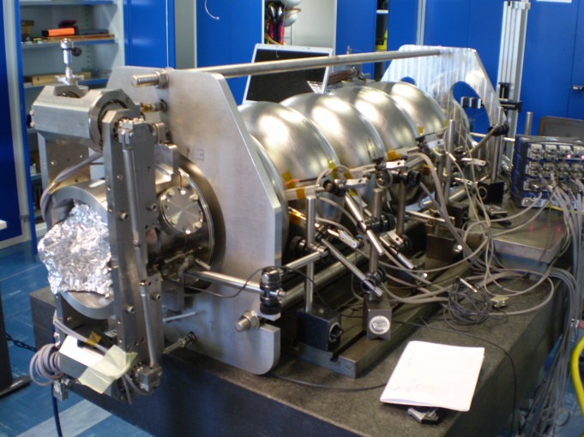
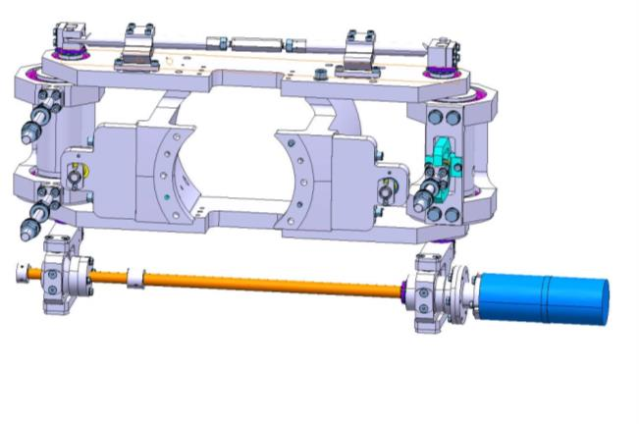
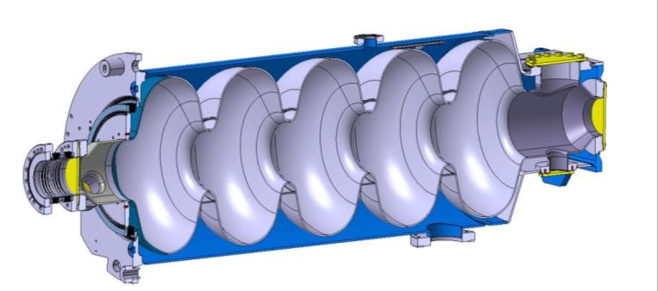
Testing of tuner SPL cavities
Cavity stiffness 4 kN/mm
Tank 130 kN/mm
CEA tuner provided

Slide 13
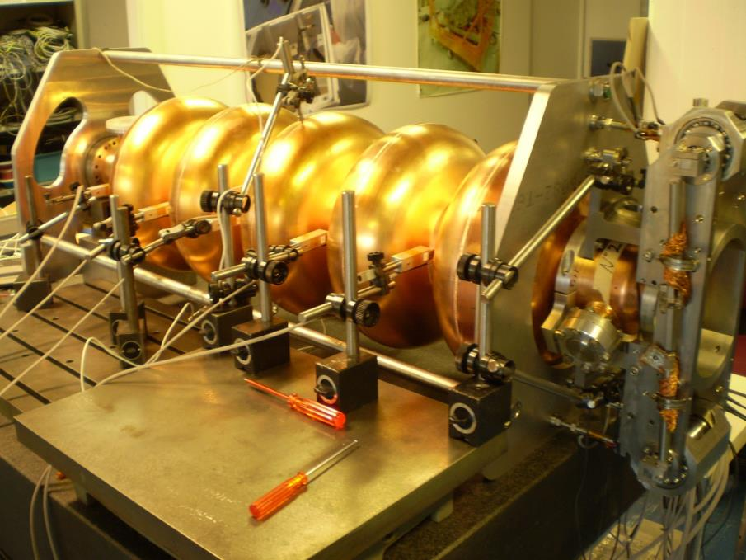
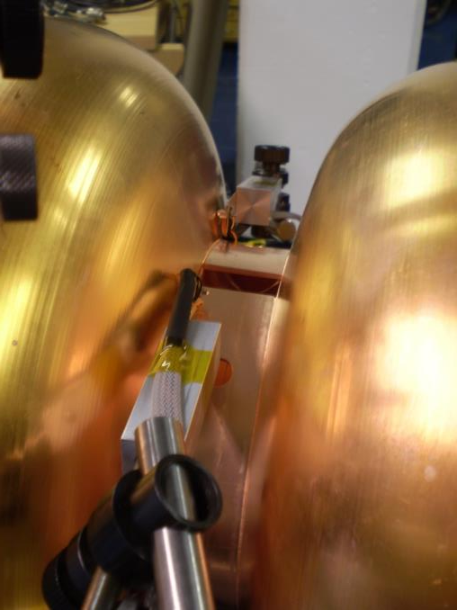
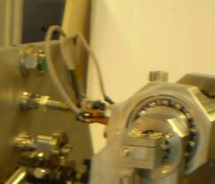
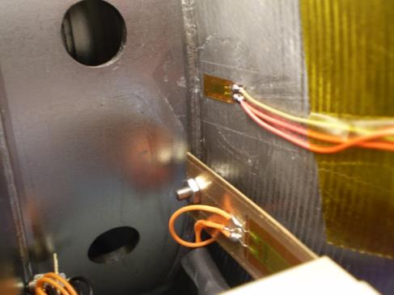
Courtesy M. Guinchard
5 LVDT’s HBM® – WI +/- 2.5mm
5 Displacement sensors based on bending stress measurements
Custom force sensors on rods
HBM® load cells
DAQ QuantumX from HBM ® – Fs 50 Hz

Slide 14
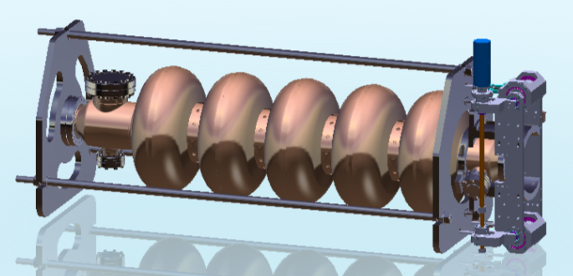
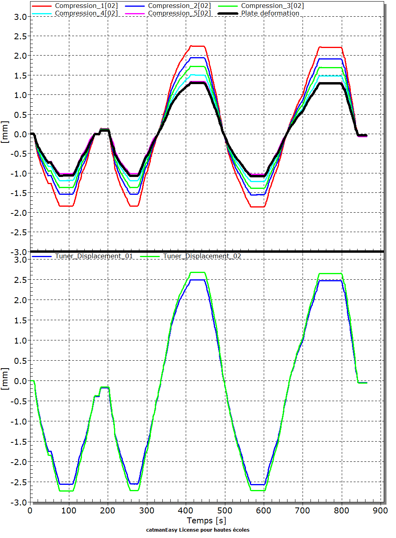
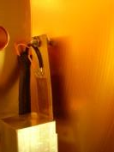
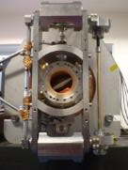
Test#01 : Cells deformation during cycles
+
 | Traction | Compression
Force@01 Force@02 Force@03 Tuner@01 Tuner@02 Cell@01 Cell@02 Cell@03 Cell@04 Cell@05 Extremity | 0.69 kN 1.27 kN 3.12 kN 2.46 mm 2.65 mm 2.21 mm 1.91 mm 1.69 mm 1.47 mm 1.31 mm 1.28 mm | No data No data No data -2.56 mm -2.72 mm -1.84 mm -1.54 mm -1.37 mm -1.19 mm -1.01 mm -1.07 mm
Next step : install motor + piezo
Test resolution + LD compensation
Courtesy M. Guinchard

Slide 15
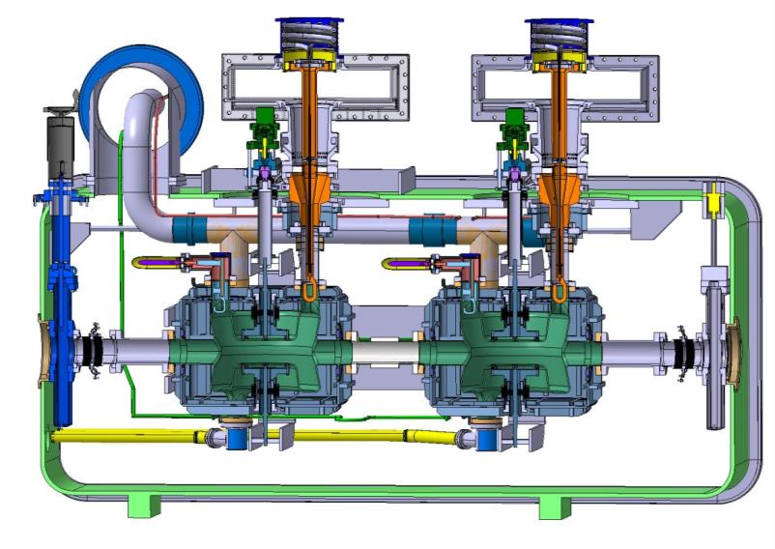
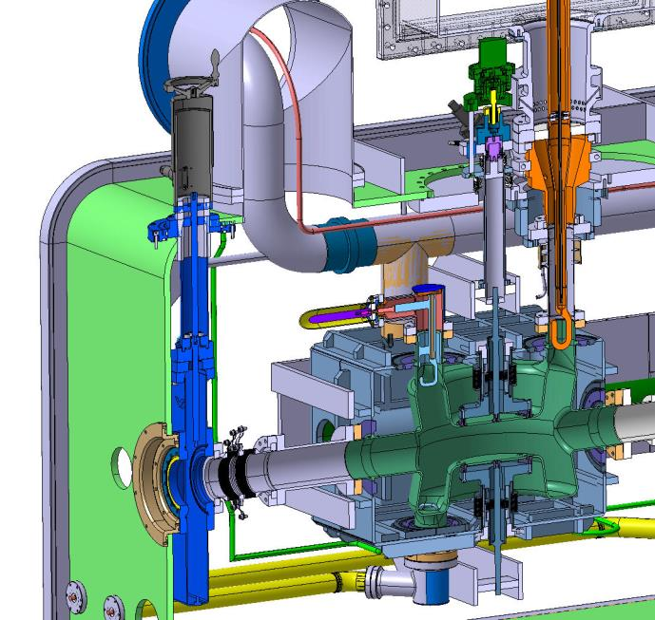
HL LHC Crab tuner

Slide 16
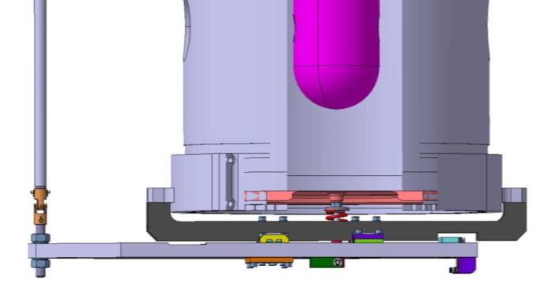
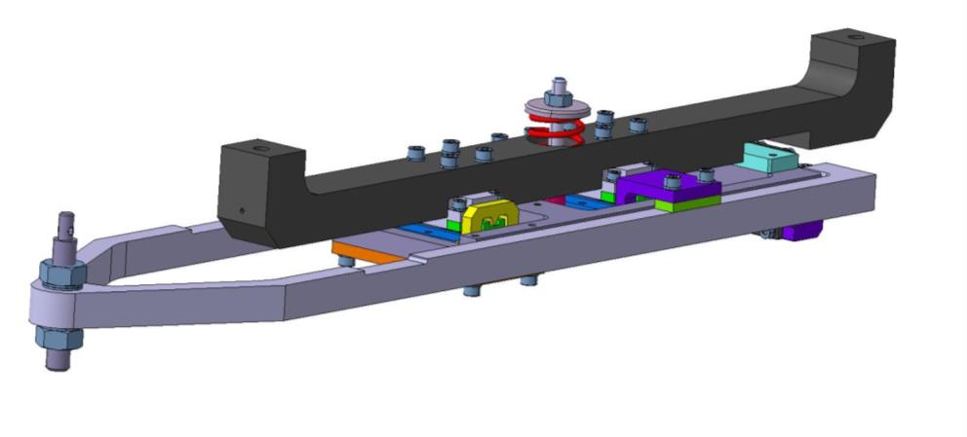
HIE Isolde QW cavity tuner
Requested range 32 kHz, resolution 0.5 Hz
Deformation 0.3 mm Cu OFE tuning plate 5 mm
Required high reliability + maintainability
Compact tuner
Low tuning forces to respect alignment

Slide 17
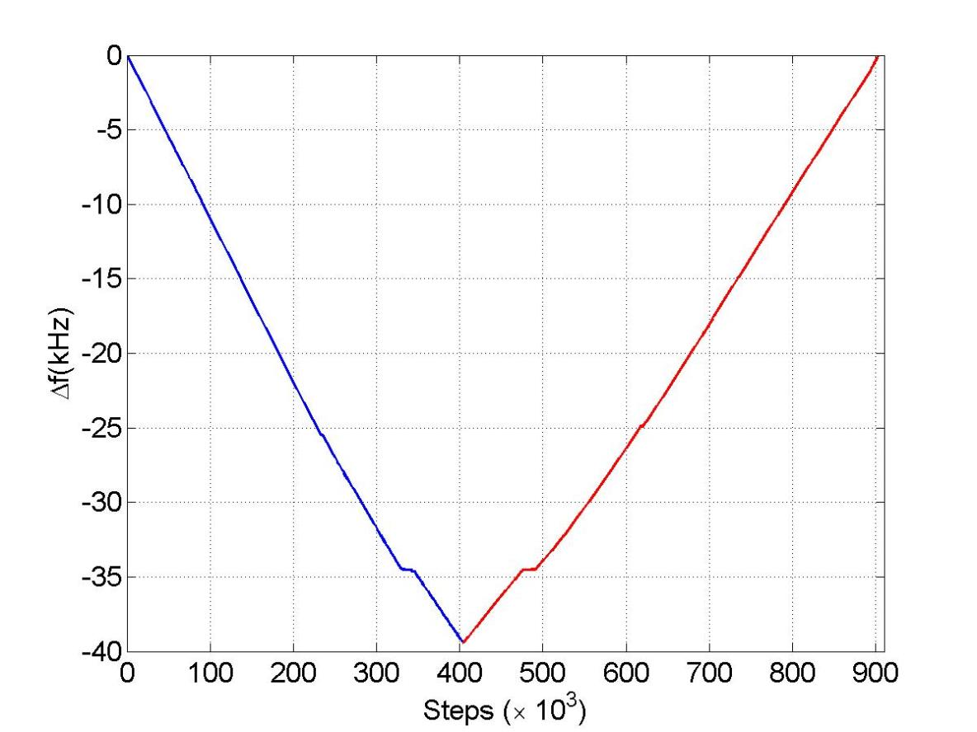
Full range
Coarse range
39 kHz
Pei Zhang

Slide 18
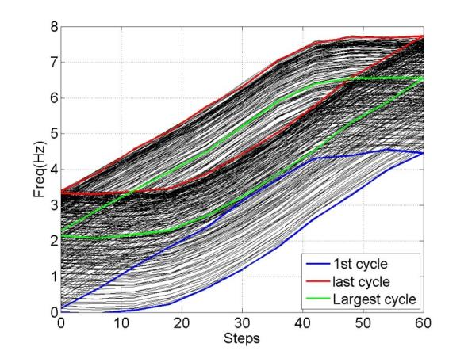
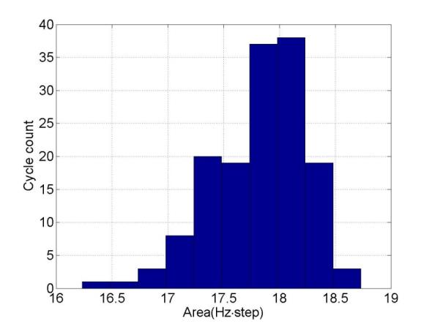
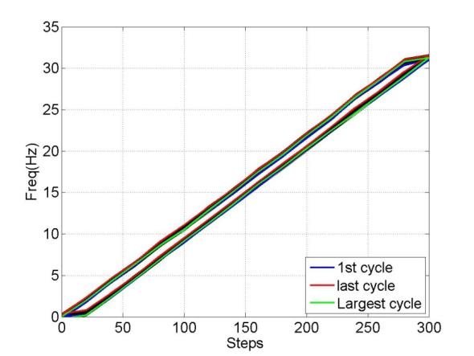
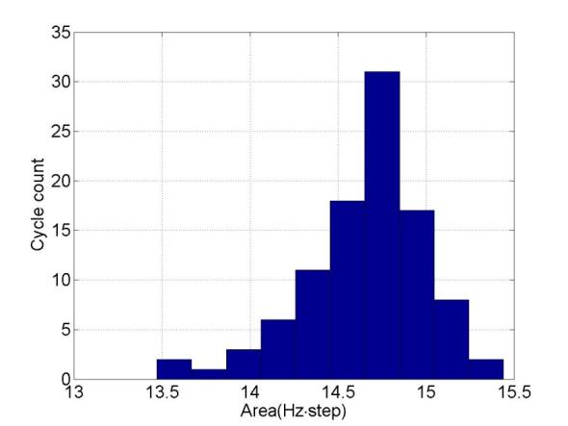
100 cycles
hysteresis
3Hz
0.08Hz/step
hysteresis
0.6Hz
0.11Hz/step
Pei Zhang

Slide 19
Summary
Tuner design and implementation ongoing at CERN for HIE ISOLDE, SPL , CRAB
For the moment little man power available to do much more but maybe with the similarities in the work some exchange can be made with the ILC
In EN/MME we have measurement and analysis capabilities, as well as for design, production and material science.
This meeting very useful to avoid double work
Test set-ups
Compact design
Stiffness management
Motor design, outside or inside
cold motorisation and transmissions
Tuning and alignment, floating tuners
Cost optimisation
High resolution, low hysteresis design
reliability/ maintainability

Slide 20
Cavity Fabrication in CFF/KEK
and
its pressure vessel certification
Reported by A. Yamamoto
This information provided by Eiji Kako,for this workshop at CERN, 5 Sept.,
referring a presentation given by T. Saeki et al., at the TTC meeting
at Jlab, 5- 8 November, 2012.
T. Saeki ^{#A)}, Y. Ajima ^{A)}, K. Enami ^{A)}, H. Hayano ^{A)}, H. Inoue ^{A)}, E. Kako ^{A)}, S. Kato ^{A)}, S. Koike ^{A)},
T. Kubo ^{A)}, S. Noguchi ^{A)}, M. Satoh ^{A)}, M. Sawabe ^{A)}, T. Shishido ^{A)}, A. Terashima ^{A)}, N. Toge ^{A)},
K. Umemori ^{A)}, K. Ueno ^{A)}, K. Watanabe ^{A)}, Y. Watanabe ^{A)}, S. Yamaguchi ^{A)}, A. Yamamoto ^{A)},
Y. Yamamoto ^{A)}, M. Yamanaka ^{A)}, F. Yasuda ^{B)}, K. Yokoya ^{A)}
A) KEK, 1-1 Oho, Tsukuba-shi, Ibaraki-ken, 305-0801, Japan
B) The University of Tokyo, 7-3-1 Hongo, Bunkyo-ku, Tokyo, 113-0033, Japan
1

Slide 21
Japanese High-Pressure Gas code regulation
We must fabricate cavities complying with Japanese High-Pressure Gas (PHG) code if we use the cavities in cryomodule.
Ti
Ti
Ti
Ti
NbTi
Nb
Design = TESLA-like KEK-type
NbTi
We must confirm the strength of liquid-He pressure-vessel by analysis with simulation and declare the welding details of Nb cavity and Ti jacket to the authority. In addition, we must perform series of pressure tests and report the results to the authority.
(Step-1)Bare 9-cell cavity （pressure-test with water)
(Step-2)Only He jacket (pressure-test with water)

Slide 22
Japanese High-Pressure Gas code regulation
(Step-3)9-cell cavity with welded He jacket （Pressure-test with gas and liquid penetrant test (PT) along welding seams between cavity and He jacket)
PT
PT
All the HPG-code process of past STF cavities had been done by the cavity vendor. But we (KEK/CFF) are trying to do the HPG process of KEK/CFF cavities by ourselves.
For realization of ILC, we need more cavity-vendors in Japan. In addition, in case of ILC in Japan, 2/3 of cavities might be imported from foreign vendors. If we (KEK/CFF) have the experience of HPG-code process, KEK/CFF can guide new and/or foreign vendors for the Japanese HPG-code process.
Also if KEK/CFF controls the HPG-code process, the cavity cost might be reduced.

Slide 23
Note 1
The meeting has focused on the LCLS tuner design and development
carried out at Fermilab in cooperation with SLAC.
Yuriy (Pischalnikov) gave the primary presentation, and it covered
the effort for a new end-lever tuner design extended from the Tesla/EXFEL
tuner design originally made at CEA-Saclary. and for a prototype development
status.
A prototype has just been completed, through a contract, at Fermilab, and
it is to be tested at a test bench and also at the HTS (horizontal test station)
at Fermilab in this autumn.
Guillaume (Devanz) and Carlo (Pagani) gave us their comments from their
professional experiences with positive attitudes for this developments.

Slide 24
Note 2
Kurts (Artoos) presented his experiences on the frequency tuners specially on
the CERN-SPL cavity frequency tuner tests recently carried out and on the
CERN-ISOLDE cavity tuner design and development.
Akira (Yamamoto) introduced a major effort for negotiation with
the High-Pressure-Code Authority in Japan to have reached an
optimized solution for the cavity inspection in a safe and cost-effective way.
Tom (Peterson) commented remotely the importance of this development
from LCLS cavity development view for maximizing a possibility to use
the ILC type (short) cavities developed by using existing ones.

Slide 25
Note 3
Olivier (Napoli), Mark (Champion), Erik (Jensen), Hitoshi (Hayano), and Steinar (Stepnes): stated that the design sounds OK, and did not find a show-stopper.
Akira suggested a possibility to organize the prototype tuner test also to be
carried out at CERN, after the test at Fermilab, to establish common understanding among world-wide experts and to prospect the future.
As a summary, the Fermilab’s design and development of a new wider lever-tuner should meet the requirements, and it is encouraged to go forward along this direction.
Following subjects should be further investigated:
Access-ability and/or maintenance-ability of the active components, for the best operational availability to be anticipated,
Tuner assembly procedure in harmonization with cavity string alignment work/check to be available after the tuner assembly work,
High-Pressure-Code (HPC) Issues: how we may manage it with technical and cost effective way.
Applicability of the new tuner design for both the shorter (ILC-type) and the ordinal (EXFEL-type) cavities as a common design (or not),
The possibility of the new tuner test to be carried out also at other laboratories to share the understanding and to prospect the future applications.
We agreed to organize the next meeting to be held at Fermilab, on 13 October, and the discussions to be progressed, based on further progress at Fermilab.

Slide 26
The 2nd Workshop at Fermilab, 13 Oct. Agenda
Monday, October 13, 2014
08:00 - 08:10 Welcome 10' Speakers: Camille Ginsburg (Fermilab), Akira Yamamoto (KEK)
08:10 - 08:30 Summary and open issues from the CERN meeting 20' Speaker: Akira Yamamoto (KEK)
08:30 - 09:00 LCLS-II tuner mechanics, especially accessibility, tuner accessibility mock-up 30' Speakers: Evgueni Borissov (Fermilab), Dr. Yuriy Pischalnikov (Fermilab)
09:00 - 09:30 Saclay 1 tuner for CW operations at HZB 30'
Speaker: Dr. Axel Neumann (Helmholtz Zentrum Berlin)
09:30 - 10:00 Experience with tuner integration/alignment with cavity string and cryomodules at CEA-Saclay 30'
Speaker: Dr. Olivier Napoly (CEA Saclay)
10:00 - 10:15 Coffee Break
10:15 - 10:45 Lessons learned from SNS tuner harmonic drive failures 30'
Speaker: Mr. Matthew Howell (Oak Ridge National Laboratory) Material: Slides
10:45 - 11:15 Piezo heating experience 30' Speaker: Mariusz Grecki
11:15 - 11:45 Piezo lifetime - testing 30' Speaker: Dr. Yuriy Pischalnikov (Fermilab)
11:45 - 12:15 Piezo lifetime - LLRF controls issues 30' Speaker: Larry Doolittle (LBNL)
12:15 - 12:45 Piezo lifetime - limiting LLRF slew rate 30' Speaker: Mr. Brian Chase (FNAL)
12:45 - 13:45 Lunch
13:45 - 15:15 Comments and further discussion 1h30'

