Slide 1
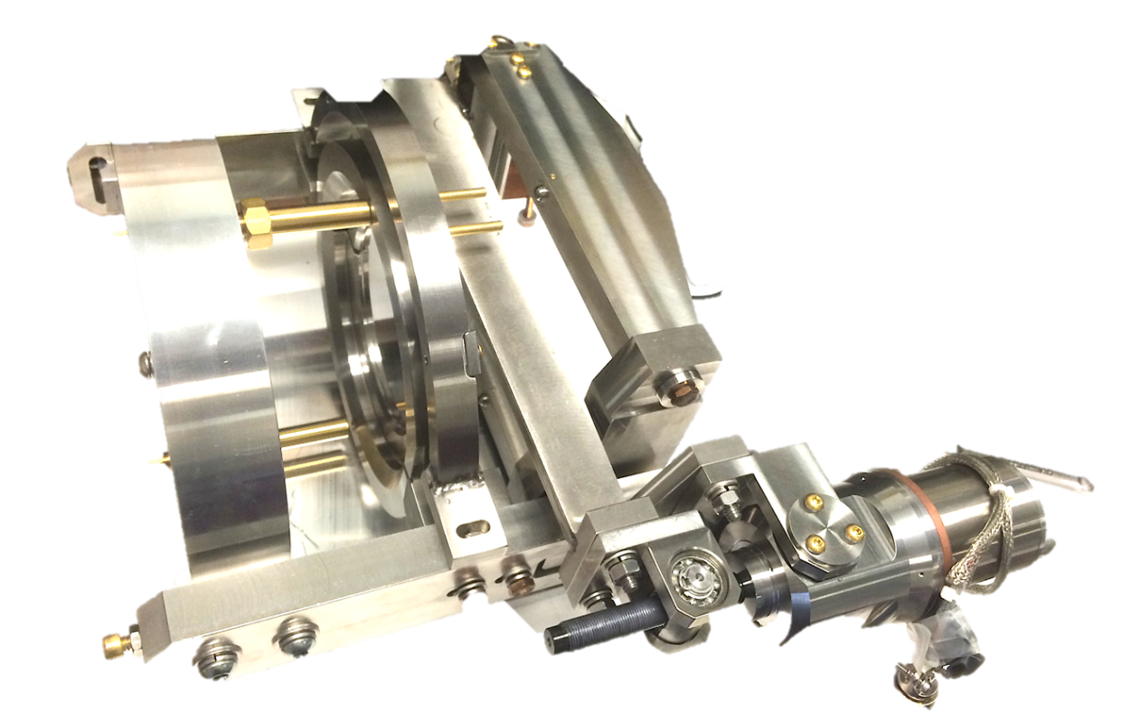
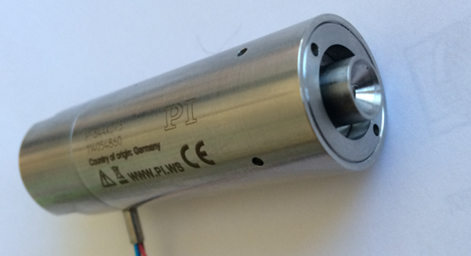
LCLS II Tuner Mechanics; Accessibility/Replacement
E. Borissov, Yu.Pischalnikov
SRF cavity Tuner Workshop, FNAL, Oct. 13

Slide 2
Tuners Specifications & Measurements
 |  | LCLS-II | XFEL | SACLAY 1/ Piezo modified tuner/ BESSY tests results
 | Parameters | Value | Value | Value
 | Cavity Frequency | 1.3GHz | 1.3GHz | 1.3GHz
 | Cavity bandwidth | 30Hz | 200Hz
 | Cavity elongation tuning | 340Hz/um | 340Hz/um | 340Hz/um
 | Cavity Spring Constant | 3N/um | 3N/um | 3N/um
 | Slow Tuner freq. range (expected) | 250kHz | 200kHz | 200kHz
 | Slow Tuner freq. range (max) | 420kHz | 600kHz | 750kHz
 | Slow Tuner cavity displament(exp./max) | 740/1300um | 1900um | 1900um
 | Slow/Coarse tuning sensitivity | 1-2 Hz/step | 1Hz/step | 1Hz/step
 | Fast Tuner cavity freq. range | 1KHz | 1KHz | 700Hz
 | Fast Tuner dimentional range | 3um | 3um | 2um
 | Fast Tuner tuning resolution | 1Hz | 10-20Hz | ~0.2Hz
 | Fast Tuner stroke resolution | 3nm | 30-60nm | 0.6nm
 | Fast Tuner response bandwidth | 5kHz | 1kHz | 900Hz
 | Min. tuner stiffness | 30N/um | 20N/um | 20N/um
 | Min. tuner mechanical resonance | 5kHz | 5kHz | 5kHz
 | Tuner operating condition | insulated vacuum T=20-60K | insulated vacuum T=20-60K | insulated vacuum T=20-60K
 | Slow Tuner / electromechanical lifetime (20years) | 1000 spindle rotation | 1000 spindle rotation | 1000 spindle rotation
 | Fast/piezo Tuner lifetime range | 5*10⁹ pulses | 5*10⁹ pulses | 5*10⁹ pulses

Slide 3
Goals
To design tuner which will fit to existing inventory of cavities at FNAL. ..”short-short” (cavity built for slim blade tuner for CM3/4/5…).
SACLAY-I (XFEL) tuner designed for “short-long” cavity;
Active tuner components (electromechanical actuator& piezo-stack) can be replaceable through special port;
High reliability of tuner components (electromechanical actuator and piezo-actuator);
Cavity has narrow bandwidth (~30Hz) → tight requirements for slow/coarse & fast/fine tuning resolution;

Slide 4
Proposed LCLS II Tuner Schematics
PI Ceramics experts expressed concerns:
it will be challenge to reach 3 nm resolution when stroke translated through flex joints/pins

Slide 5
LCLS II Tuner
Electromechanical actuator & piezo can to be replaced through special port

Slide 6
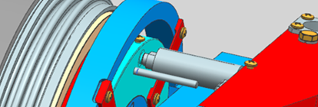
Details of Fast Tuner Design
Piezo capsule can be replaced through special port

Slide 7
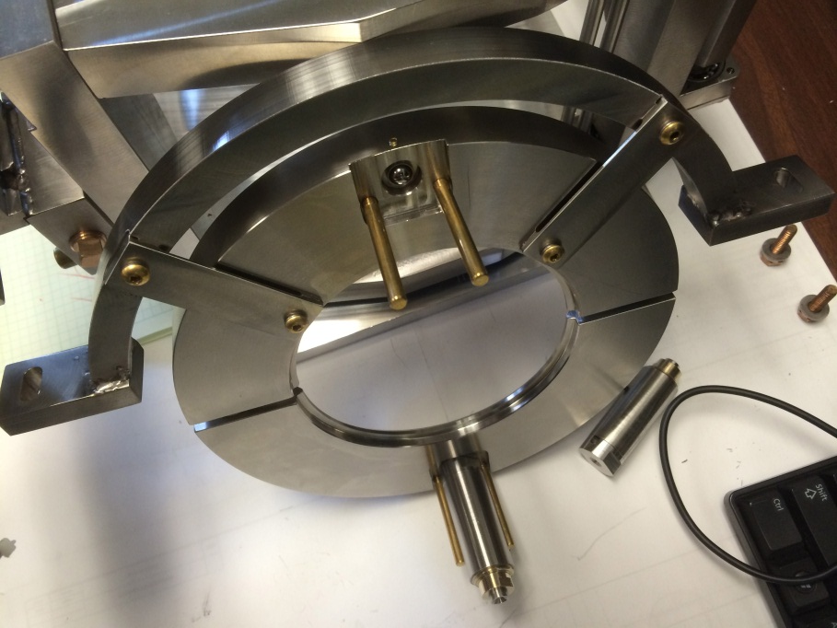
First Tuner assembly (design details)
Clamp-ring- to mount on the cavity flange ; ½ ring to support cavity flange from displacement in vertical direction
Tuner mounted to Al structure, which mimics He vessel
Bottom Piezo-capsule
Laying on the support rods

Slide 8
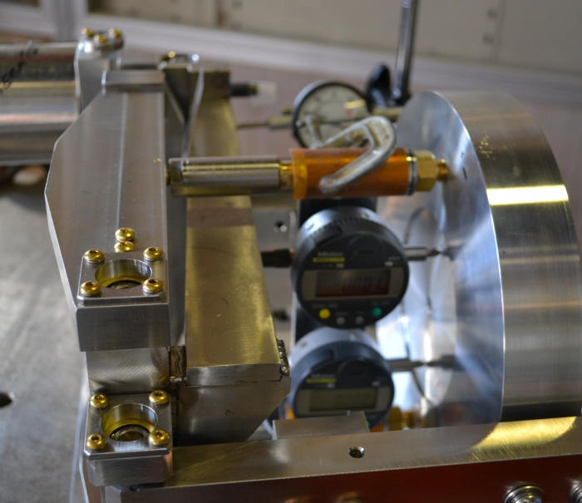
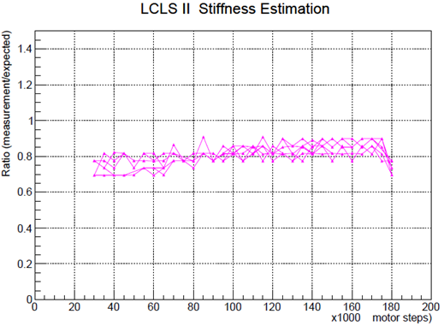
Test of Slow Tuner (warm)

Slide 9
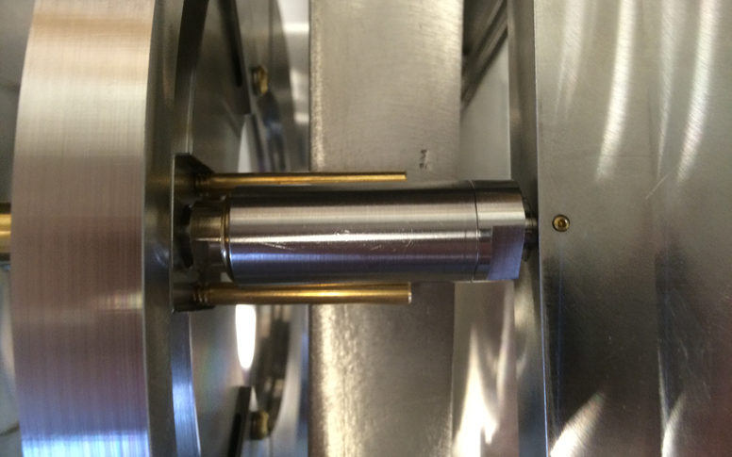
Tuner Accessibility/ Replacement through additional port
Piezo Tuner Replacement
EM actuator Replacement
EM actuator cartrige mounted on the tuner with 4 nuts. Special rods used to slide out&in cartridge during replacement
Horizontal support rods – to support piezo-capsule during process of installation/replacement
Unloading mechanism:
Adjustment screws used to unload &”load back” piezo-capsule & motor for replacement (in case of failure)
Tuning mechanism to uniformly preload piezo-capsule during assembly

Slide 10
Cavity alignment issues/limited space
Main lever (when tuner assembled) covered alignments targets installed on the cavity flange.
One of the solution is to swing main lever to allow access to targets during alignment procedure…(need to be confirm with alignment experts)

Slide 11
Summary
FNAL designed LCLS II Tuner for “short-short” cavity
Two prototypes manufactured and delivered to FNAL month ago
Tuner assembled on the mock-up of the cavity
Simple warm test of the tuner performance (hysteresis curve) performed
Model of the Cryomodule (wood) with accesses port is under construction (we will test how easy/difficult to replace tuner’s active parts)
Tuner is ready to be installed and tested at HTS (cold) as soon as cavity with He vessel will be available

