Slide 1
Lessons Learned from SNS tuner SNS Tuner Harmonic Drive Failures
October 13, 2014
Matt Howell
SNS/ORNL

Slide 2
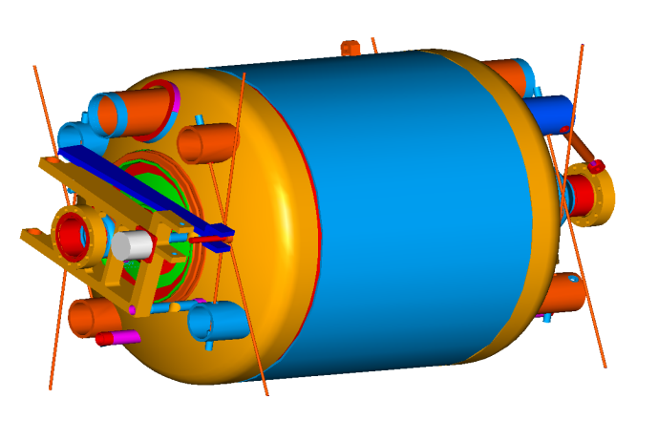
SNS Tuner Design
Adapted from Saclay-TTF design for TESLA cavities mounted to helium vessel operating through a bellows
Actuated by a cold stepping motor through a harmonic drive
Piezo tuners included to compensate for Lorentz force detuning of cavities
Never actuated in operation
No unexpected large mechanical resonance witnessed
Helium Vessel
Tuner

Slide 3
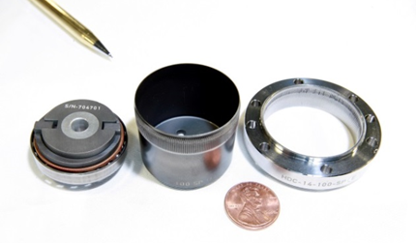
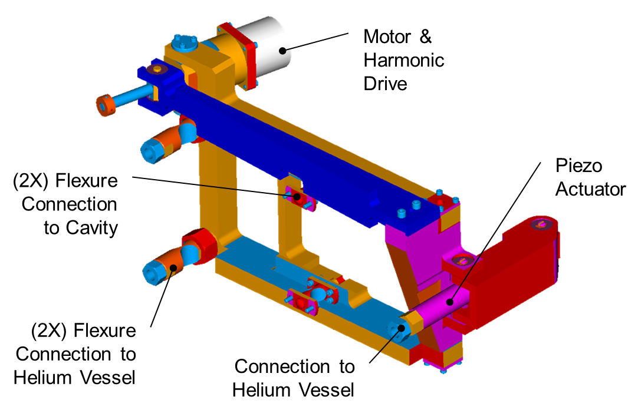
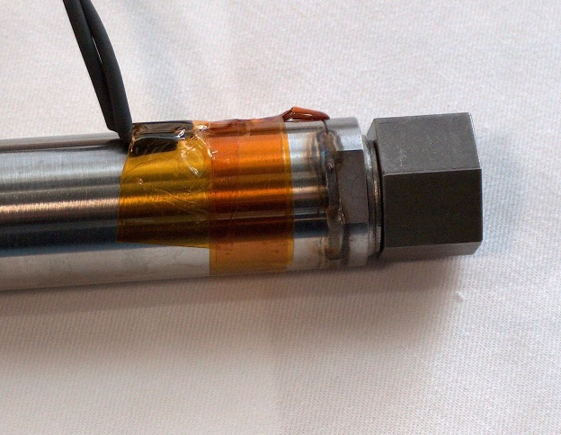
Where are the “weak” points?
Failure points exist at the harmonic drives, stepper motors, and Piezo stacks

Slide 4
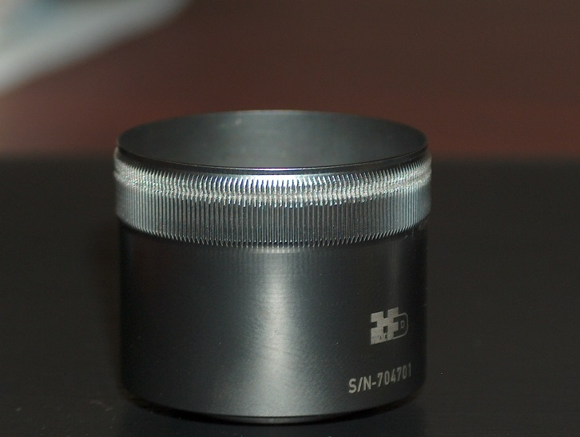
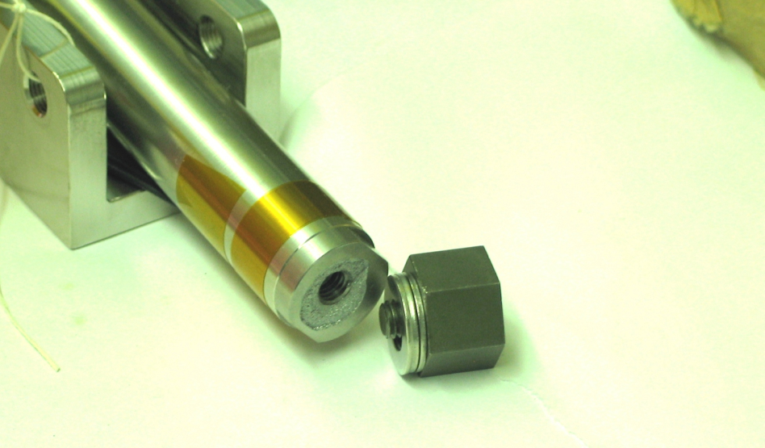
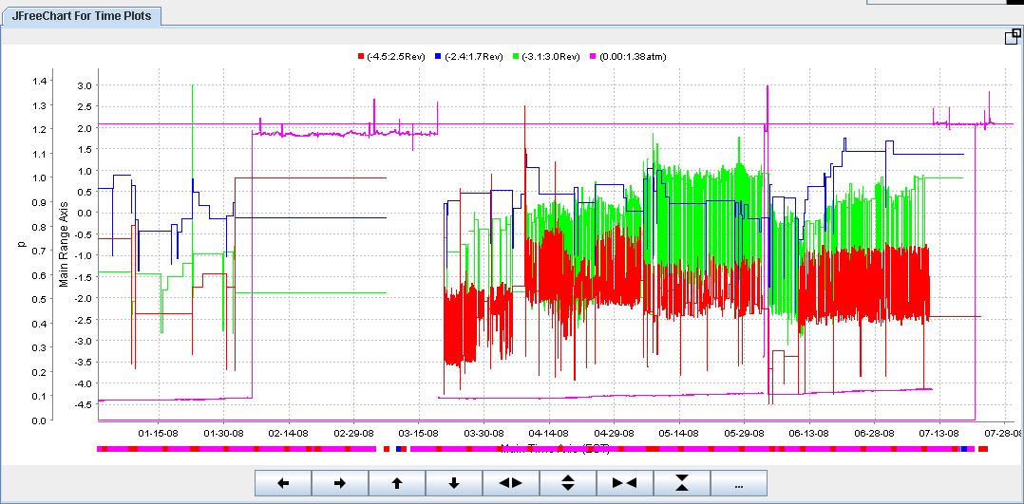
Types of Tuner Failures at SNS
Stepper motor and harmonic drive failures
Piezo stack failures
Irregular or excessive vibration

Slide 5
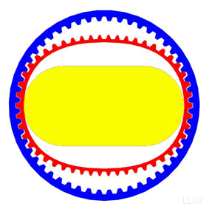
Harmonic Drive operating principle

Slide 6
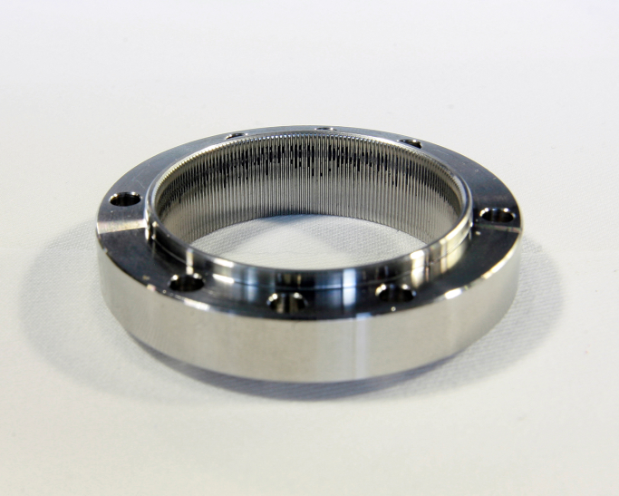
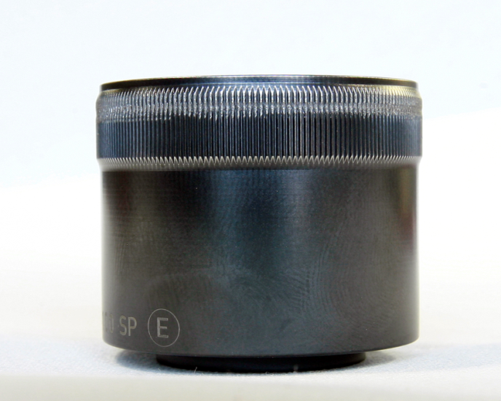
Harmonic drive failures
Wear on the harmonic drive is caused by
Normal wear and tear from operation
Component installation issues where the teeth of the harmonic drive are only partially engaged
Stepper motor failure
Indicated by
Inability to move tuner
Excessive or irregular vibration in RF measurement of cavity

Slide 7
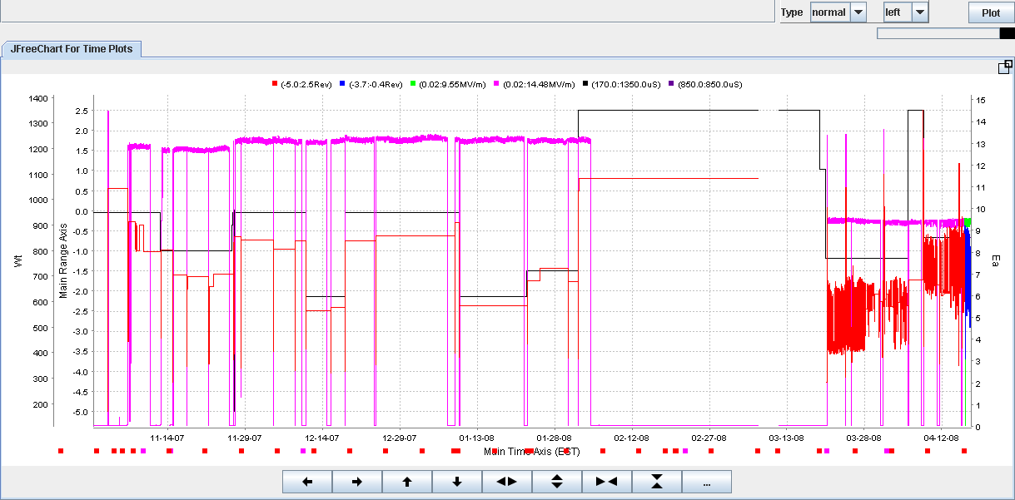
Tuner motion before and after cavity vibration
Cavity operating at 13 MV/m with stable tuner
After winter shutdown, vibration occurs and results in reduced gradient
Eacc
Tuner motion

Slide 8
Excessive or irregular vibration
Irregular vibration in this case
Sometimes excessive vibration is present and sometimes not
When excessive vibration, forward power required is higher without beam than with beam (3-5 kHz detuning)
In other cases, excessive vibration witnessed
Vibration is constantly present
Observed from three cavities so far
Normal LFD
Excessive LFD

Slide 9
Piezo tuner failures
Original installation of Piezo stack did not include a weld
Pressure fluctuations in Linac caused mechanical failures
2 to 4K transition
Upset conditions
Replaced with typical mechanical stand off
Stitch Weld

Slide 10
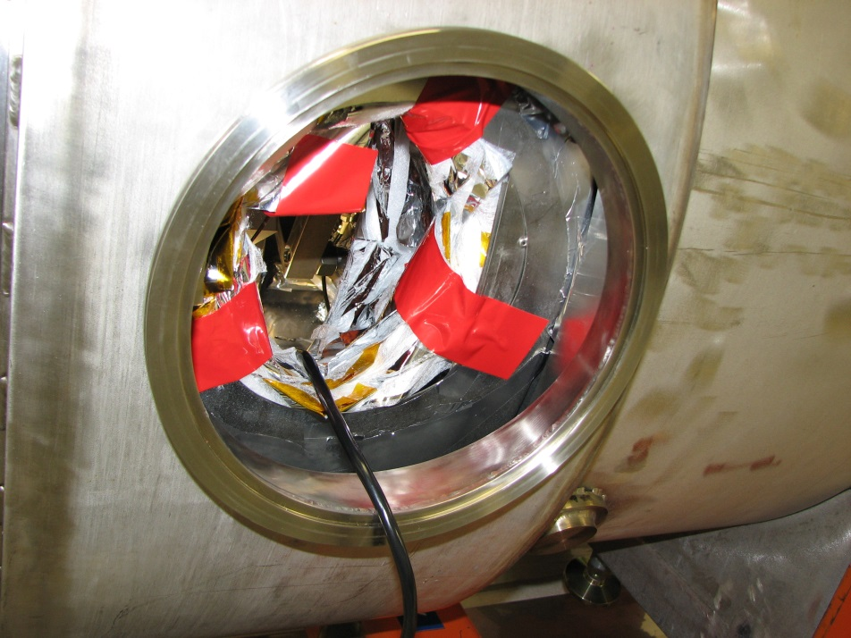
Operational strategy based on previous failures
Tuners are tested before and after every 2K to 4K or 4K to 2K transition
Approximately 20 tuner repairs have been performed at SNS
Access ports allow in-situ repair of tuners in tunnel
Vibration monitoring with RF
Alignment
Bigger vibration and/or more frequent tuner motion→ lower gradient→ detune/turn–off.

