Slide 1
Piezo reliability R&D program at FNAL
R&D program at FNAL to support LCLS II and PIP II projects.
Presented by Yuriy Pischalnikov
for FNAL Resonance Control Team
SRF Tuner Workshop at FNAL, October 13, 2014

Slide 2
Piezo lifetime R&D program
Factors that can affect lifetime include:
Environment, e.g. temperature, humidity, and voltage;
Shear forces;
Current Transients;
Radiation Damage.
There are several studies of the longevity of the piezo/ when piezo run for 10¹⁰ pulses. Studies done with normal air convection cooling at RT and factory designed encapsulation with optimal piezo preload. Studies by INFN/DESY done inside LN2– ideal cooling of the piezo-stack.
The proof for the piezo reliability is obtained by means of the test with particularly high control frequency…
As results some other effects (like piezo overheating) will provide wrong answers.
At the first stage of our R&D program we are planning to address piezo failure VS wide range of different factors instead of running piezo-stack for many months… at the same (conditions).

Slide 3
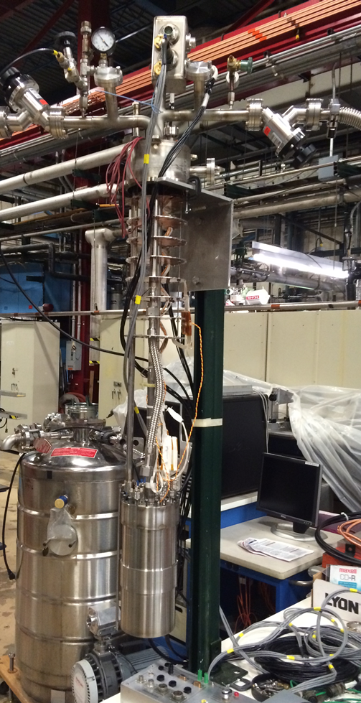
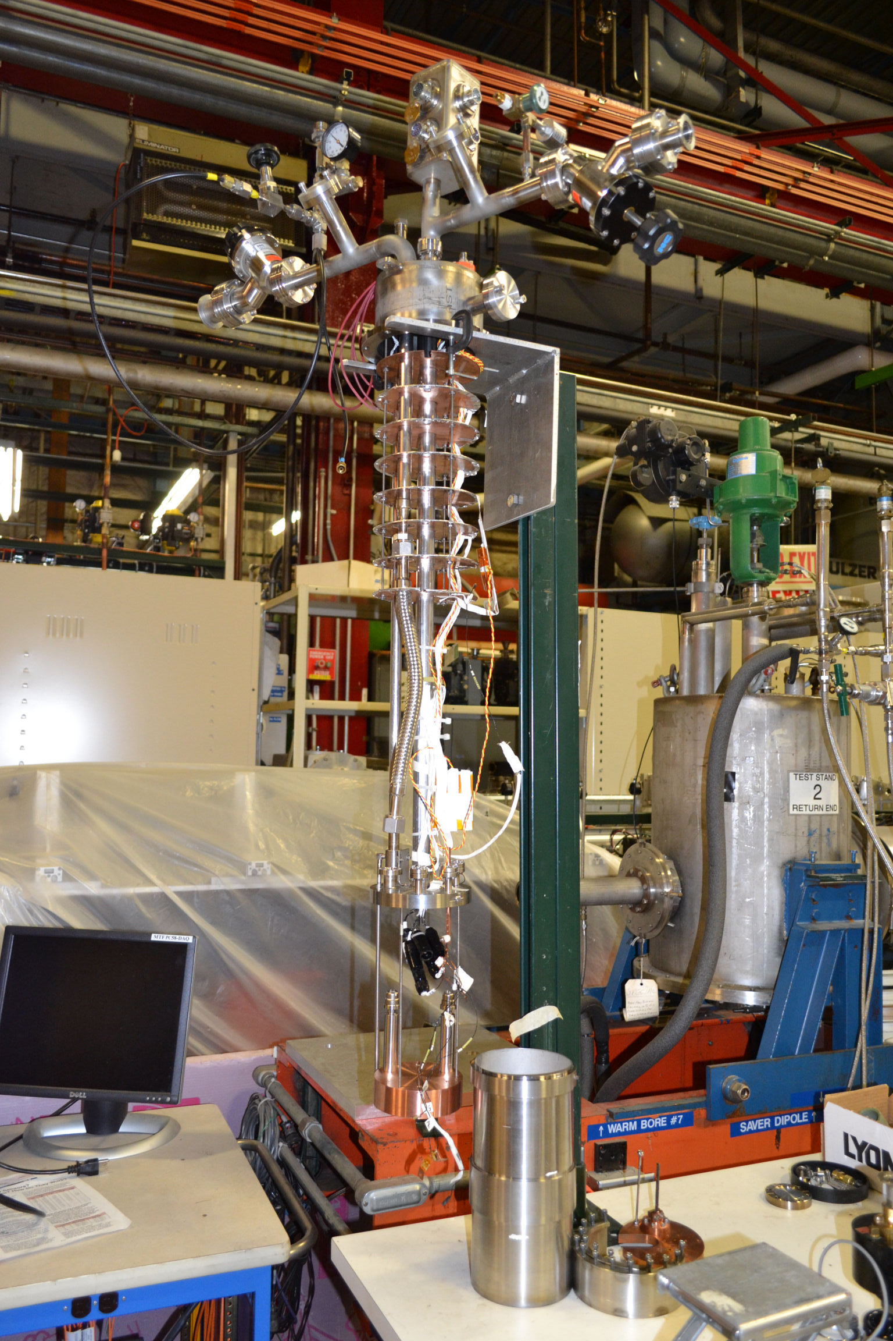
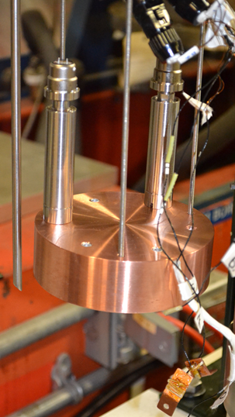
Cold (insulated vacuum)Piezo Test Stand (CivPTS) at IB1/TD
Insert into LHe dewar with cryo/vacuum and electrical connections
Capsules (up to 5)with Piezo-stacks
Mounted on the copper block
Helium Dewar
Vacuum Enclosure
- RTD (Cernox) –to mount on Piezos
- Geophones (to monitor piezo stroke)

Slide 4
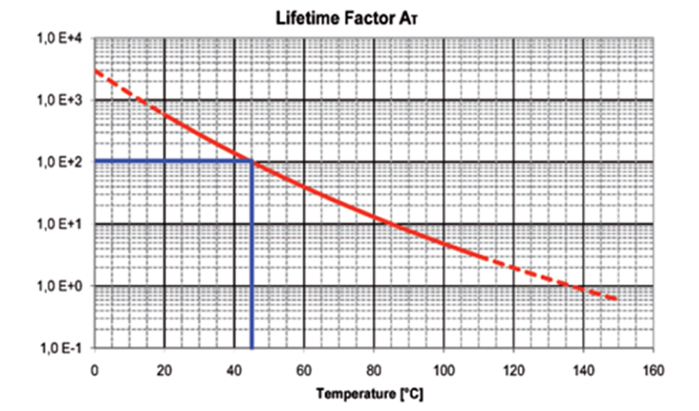
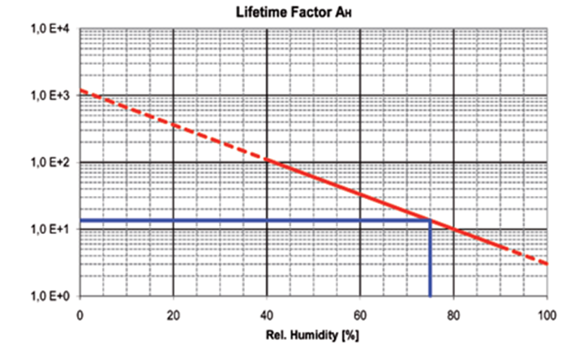
Piezo Tuner Lifetime (1)
In contrast with electromechanical devices , cold vacuum is an almost ideal environment for piezo actuators.
Environmental factors:
temperature, humidity, and voltage;

Slide 5
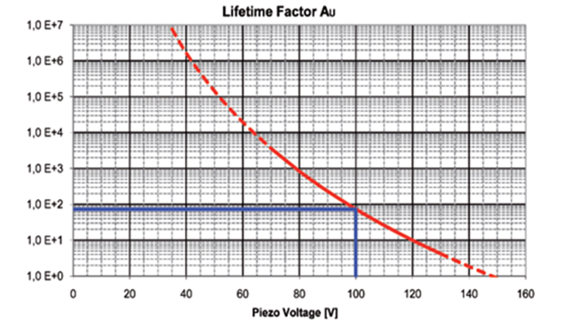

Piezo Tuner Lifetime (2)
- Piezo Operational Voltage.-
→ Increase length of piezo& operate at lowest Voltage
1,0E+4
LCLS II configuration allowed for max. length 36mm piezo
Piezo capsule build with piezo stack made from 2*18mm piezo

Slide 6
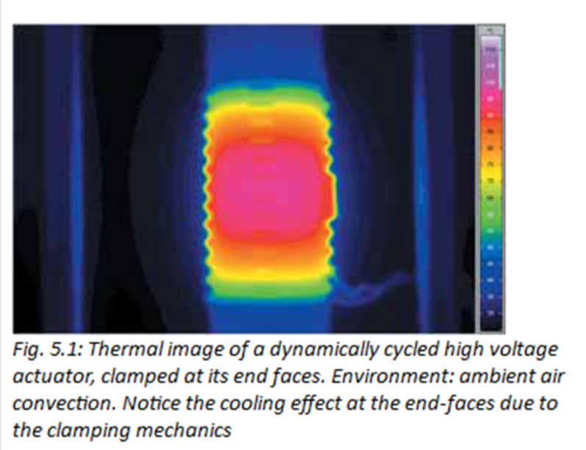
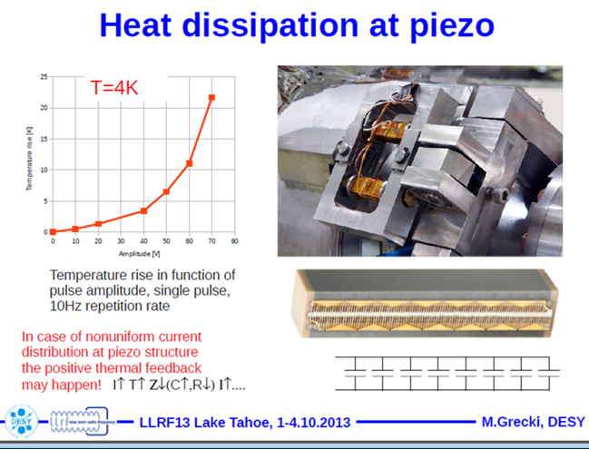
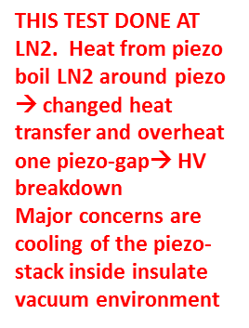
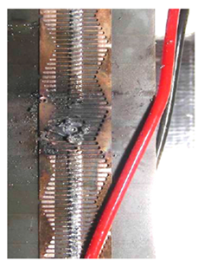
Piezo Tuner Lifetime (3)
…..cold vacuum is an almost ideal environment for piezo actuators… except the problems to heat transfer from piezo inside insulated vacuum…
Piezomechaniks ΔT~70Degree
DESY/XFEL Piezo Test

Slide 7
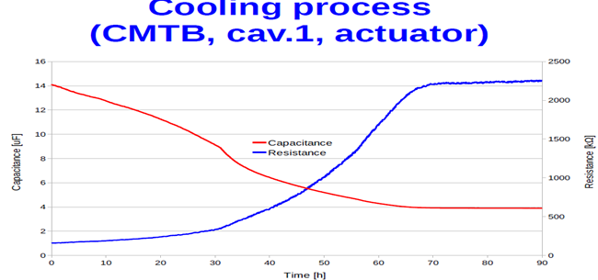
DESY/XFEL is planning to monitor Temperature of the piezo-stack by measuring Capacitance and Resistance of the piezo during operation
Question:
How well C&R monitoring (using data during slow 60hours cool down of whole CM) can detect fast over-heating small (central) part of Piezo-stack ??

Slide 8
Program to study issues related to piezo’s heat dissipation
To work with PI to review cost effective piezo-stack cool down design modifications
Review different design options to “heat-sink” of the piezo capsule to 5K shield
Conduct heat dissipation test at CivPTS with piezo-stack instrumented many (several RTD)

Slide 9
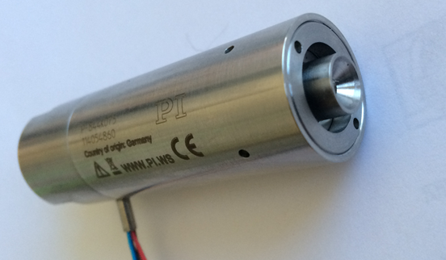
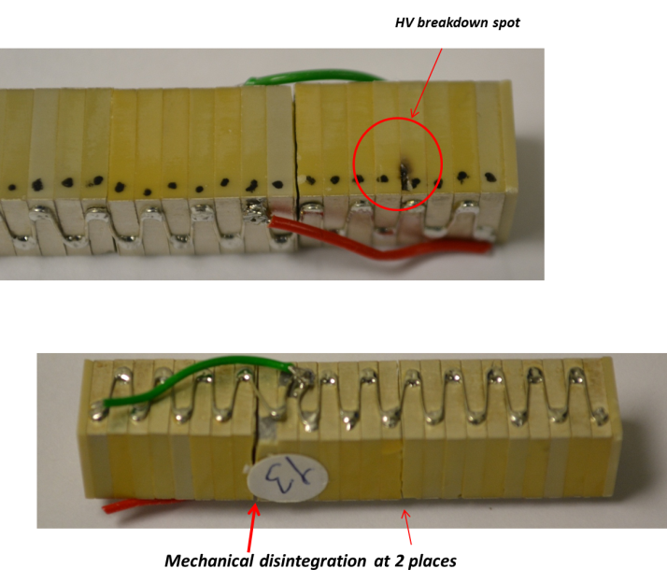
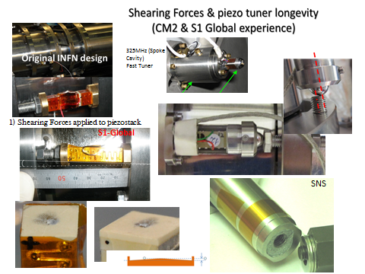
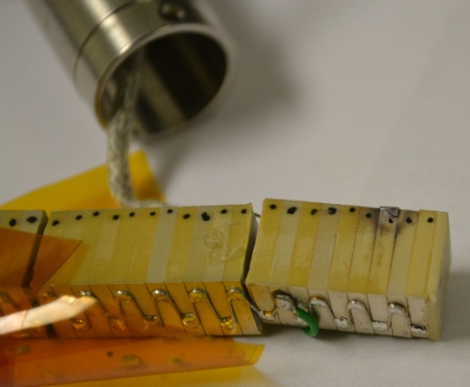
Shearing Forces on the piezo
Piezo-tack en-caplsulation
LCLS II Piezo Tuner

Slide 10
Piezo Dynamic Operation/ Current Transients / Slew Rate
The lifetime of the piezo element is in dynamic operation (AC Voltage) dominated by different factors to those affecting DC operation:
The impact of the dynamic forces and the changing state of the mechanical stress increases. Therefore, this can lead to the formation of cracks in the stack construction and hence to electrical discharges.
CivPTS will be used for study piezo longevity VS slew rate & at different piezo preload values & quality of piezo-fixture& amount of shearing forces on the piezo-stack.

Slide 11
Radiation Damage.
The IPN/Orsay group has measured the degradation due to neutron radiation of piezo actuators from several manufacturers (http://cds.cern.ch/record/1087645/files/note-2007-004-SRF.pdf) . Included in their study were the PICMIA actuators manufactured by PI Ceramic that have been selected for the LCLS-IIsc tuner.
The Orsay group concluded “no major damage was observed but slight performance degradation may be due to aging effect, is measured: these piezostacks are suited for use in cryogenic and neutrons radiation environment up to a total dose ~ 7.10¹⁴ n/cm2” (5 x 10⁴ Gy @ 1 MeV).
Further studies using gamma sources available at FNAL are planned to establish damage limits on the LCLS-IIsc piezo actuators. Even with such studies, it will be difficult to make definitive statements about the effects of radiation on tuner lifetime until estimates of the tuner radiation environment become available.
There are questions about radiation damage of epoxy (MasterBond EP21TCHT-1) , which used to glue ceramics end plate to piezoceramics (and we are planning to glue two 18mm piezo inside capsule).
Radiation damage to cable insulation may also be a concern. Radiation damage thresholds for insulation published by NASA range between 10³ Gy for Teflon and 5 x 10⁷ Gy for Kapton (http://nepp.nasa.gov/npsl/wire/insulation_guide.htm)

Slide 12
Summary
We built stand for Piezo reliability study at cold/insulated vacuum environment
We outlined R&D program to study piezo reliability VS several factors
We are working closely with PI engineers and application scientists. FNAL will provide SRF Tuner’s requirements and FNAL’s cryogenics test-stands capabilities & new ideas. PI will contribute with piezo experts advise and new products.
We are looking for close collaboration with DESY/XFEL and other national labs

