Slide 1
Scientific Computing for non-LHC
Burt Holzman
48th Annual Fermilab Users’ Meeting
10 June 2015

Slide 2
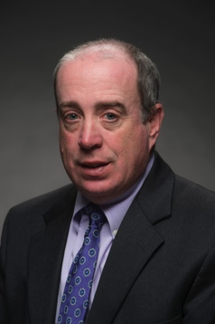
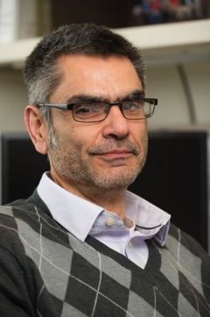
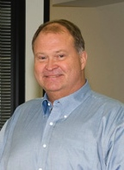
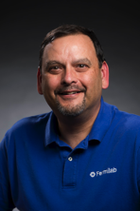
FNAL Computing Sector – Organization in 2014
Acting CIO
Rob Roser
Scientific Computing
Rob Roser
Core Computing
Jon Bakken
Deputy Mark Kaletka

Slide 3
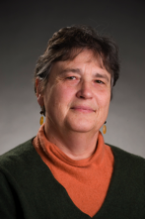
FNAL Computing Sector – Organization in 2015
Acting CIO
Rob Roser
Scientific Computing
Panagiotis Spentzouris
Core Computing
Jon Bakken
Deputy Ruth Pordes
Deputy Mark Kaletka

Slide 4

Scientific Computing – new Division Head
Scientific Computing
Panagiotis Spentzouris

Slide 5
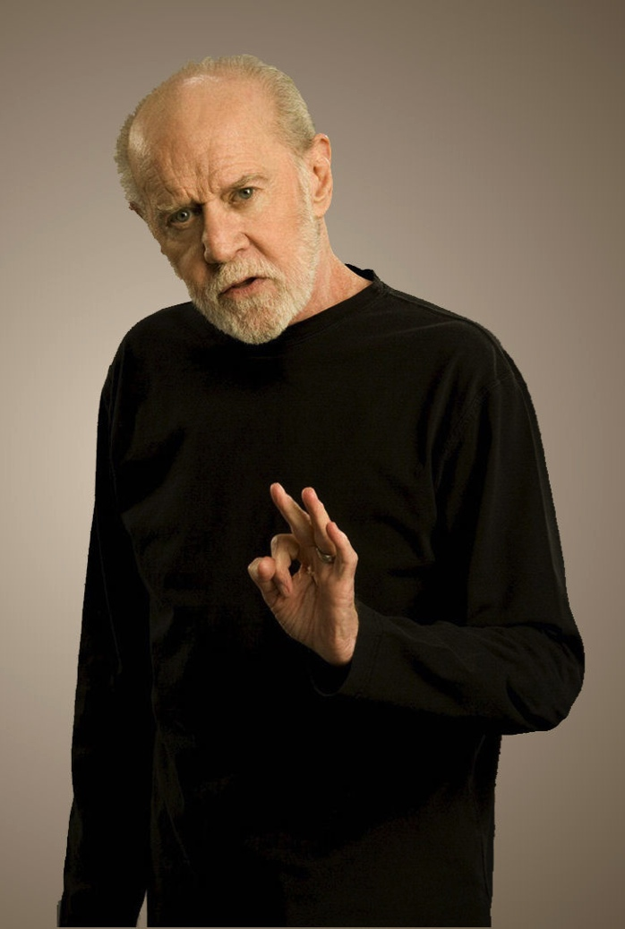
Scientific Computing – new Division Head
Scientific Computing
Panagiotis Spentzouris

Slide 6
Scientific Computing – new Division Head
Scientific Computing
Panagiotis Spentzouris

Slide 7
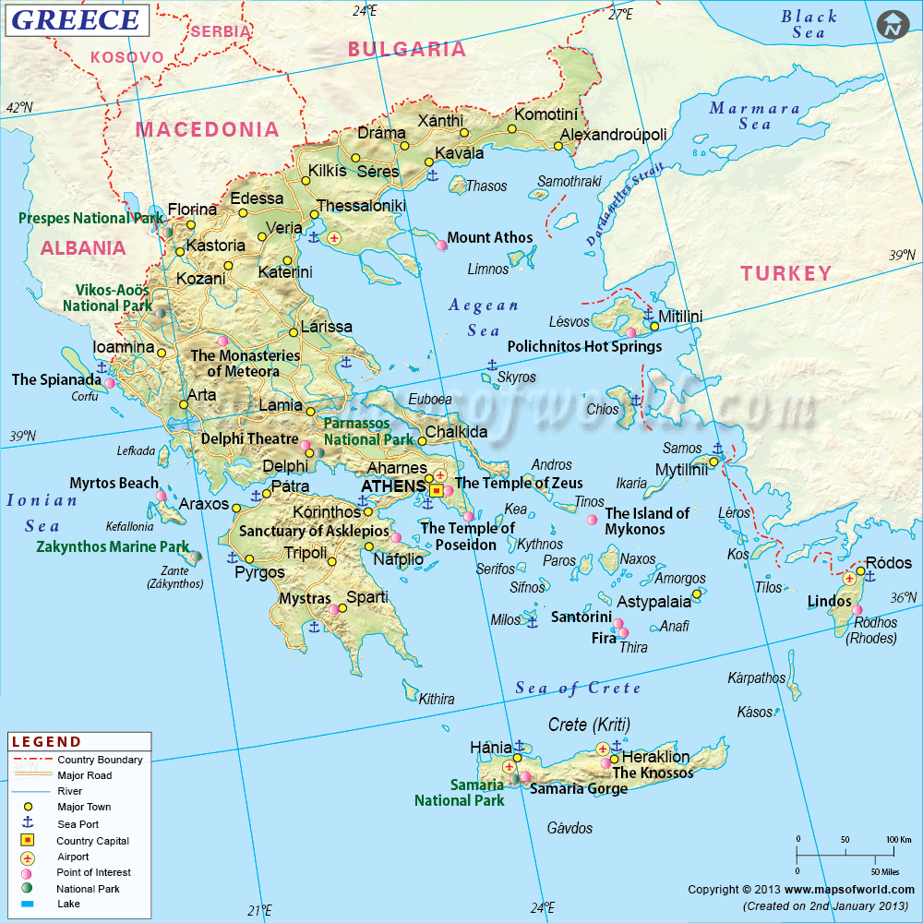
Scientific Computing – new Division Head
Scientific Computing
Panagiotis Spentzouris

Slide 8
Scientific Computing – new Division Head
Scientific Computing
Panagiotis Spentzouris

Slide 9


The menu is very large – we will order just a few
Experiments and Services: https://indico.fnal.gov/getFile.py/access?resId=3&materialId=4&confId=9353

Slide 10
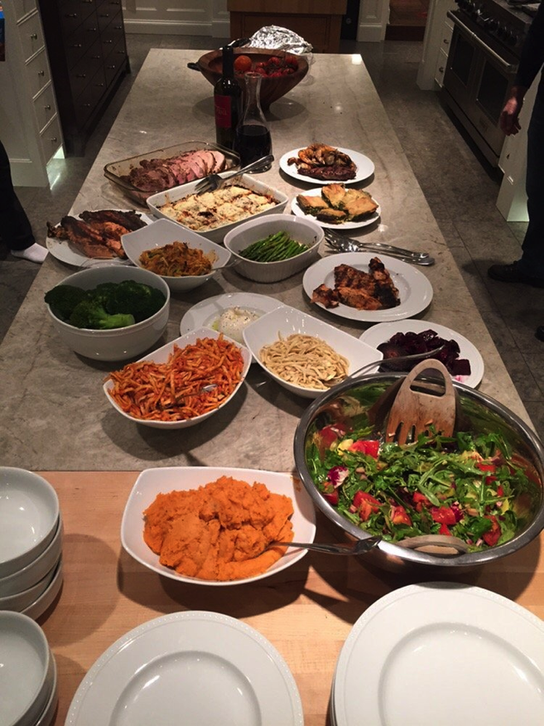
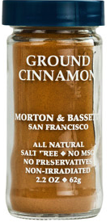
Shared Services Model – Family Style Dining
We are operating in an era of limited resources
SCD provides common shared services: improves efficiency for both the service providers and the users
Examples throughout the talk

Slide 11
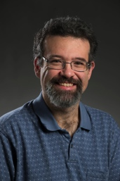
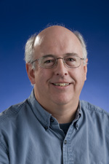
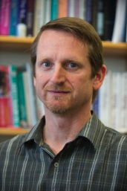
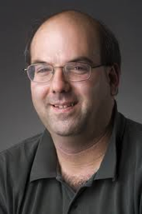
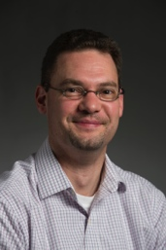
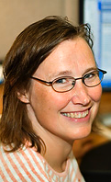
Scientific Computing: 3 functional areas
Scientific Facilities
  A Tier-1 center-like function for all users – providing and managing resources for data storage, processing, and analysis (and DAQ for FNAL-based experiments)
  A Tier-0 center-like function for users with such needs (recording/archiving data)
Development, Integration, Research
  Complete Stack for offline, simulation, real-time software and engineering
  Development and support software products and architecture for the facility, make them available to the community
Science Operations and Workflows
  Develop, configure, and operate the actual applications for projects and experiments, utilizing the services provided by the facility

Slide 12
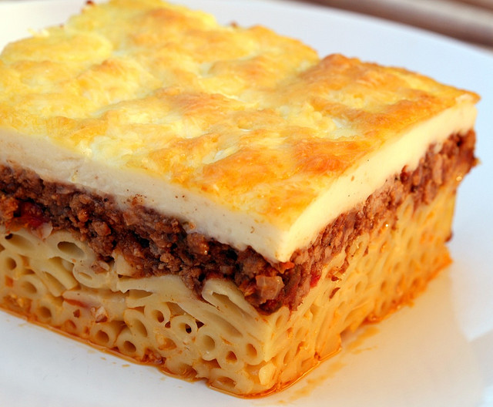
Scientific Computing: 3 layers of Pastitsio
Παστιτσιο
Science Operations & Workflows
Development,
Integration,
Research
Scientific Facilities

Slide 13
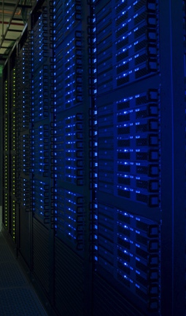
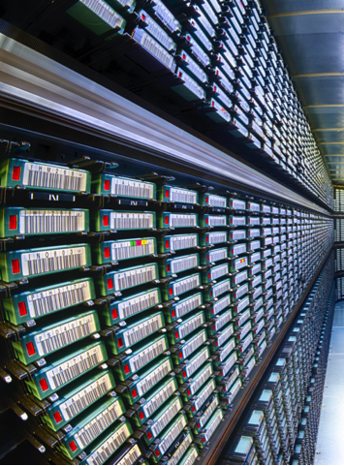
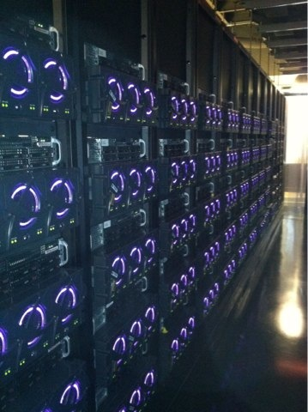
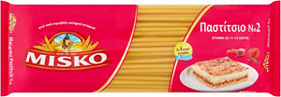
Scientific Facilities: the foundation
Provide and manage computing services and resources
  Data recording, storage, access
  Bulk processing, analysis
  Functionality analogous to LHC Tier-0 and Tier-1
CPU Cores, Online (Disk) and Offline (Tape) Storage, Networking
Cores:
48000 general
28000 HPC
(no w
65 PB Tape
(53 PB in-use)
7 tape robots
26 PB Disk
Managed by
Mass Storage
Systems
10/40/100 Gbit
Networking
~35k internal
network ports

Slide 14
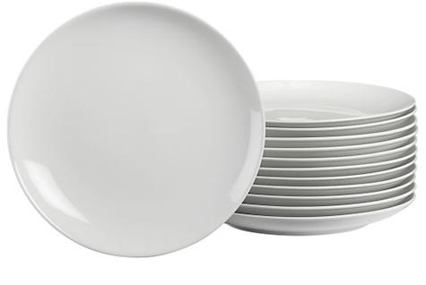
Physical Facilities: the foundation’s foundation

Slide 15
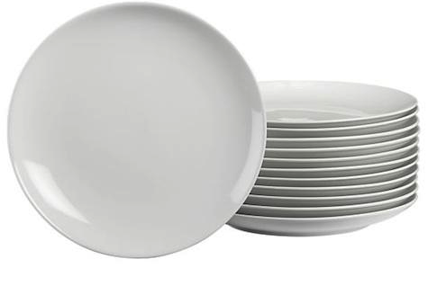
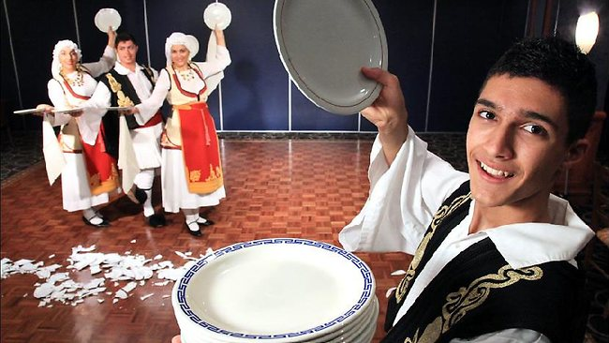
Physical Facilities: the foundation’s foundation

Slide 16
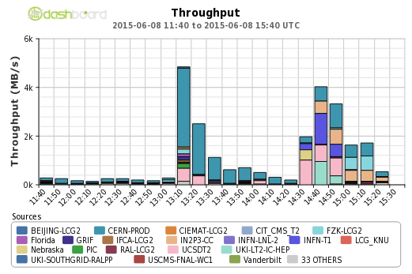
Physical Facilities: the foundation’s foundation
Ongoing investment in 100 Gbit networking
  5-10x increase!
4 GB/s

Slide 17
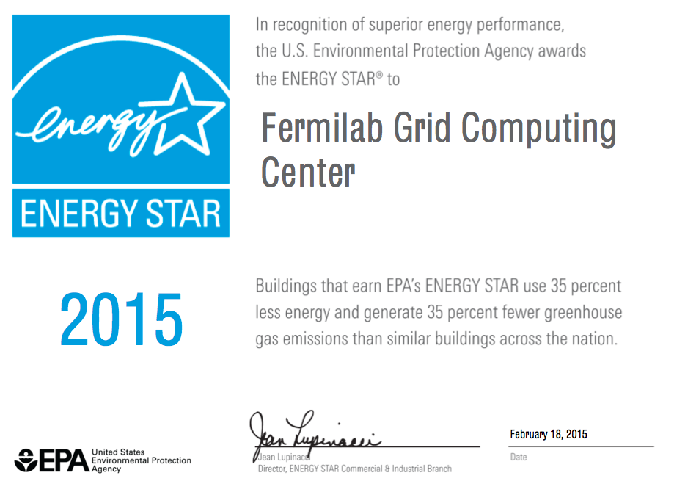
Physical Facilities: the foundation’s foundation
Invested about $100K to improve village network
  Previous technology dated from 2002
  Village now on-par with most ISP rates for home service
Cooling upgrade and cold aisle containment in all three on-site computing centers
Awarded Energy Star
for 5 years in a row
  And still working to improve
  data center efficiency

Slide 18

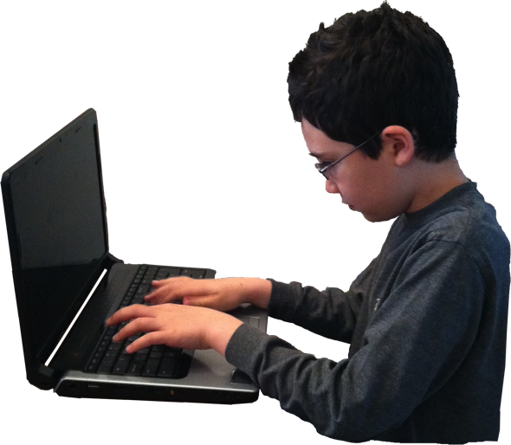
FNAL Scientific Facility - Now
FNAL
User
Submitter
Gateway
Local Resources
Scheduler
How to meet the ever-increasing
hunger for resources?

Slide 19
FNAL HEPCloud Facility – Coming Soon
FNAL
OSG
Sites
User
Submitter
Gateway
HPC
Leadership
Class
Facilities
Scheduler
Controller
Commercial Clouds
(e.g. Amazon)
Local
Scheduler
Local Resources
Provisioner

Slide 20
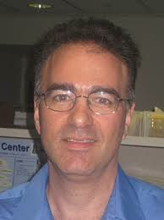
Science Workflows: Use Cases for HEPCloud
CMS: 40 M CPU hours over 1 month
  see Rob Harris’s talk tomorrow at 12:10
NOvA: Reprocessing the 2014/2015 datasets
  16 computational campaigns of data reconstruction
  2.1 M CPU hours spread across 12 months
Dark Energy Survey – Gravitational Wave LDRD
  Receive imprecise location of gravitational wave source from LIGO, VIRGO, …
  Use DES to search and locate source
  8k CPU hours, ~4 times a year

Slide 21
HPC Facility – tightly-coupled computing
Lattice QCD, Accelerator Simulations, and Cosmology are major users
For LQCD, as many as several thousand cores are routinely used in a single computation
LQCD computing expertise is leveraged to provide parallel computing to other HEP areas
Three separate facilities
  The Fermilab LQCD Facility is part of the DOE Office of Science’s national hardware infrastructure project for lattice field theory
  The Wilson facility serves accelerator simulations and HEP parallel computing
  Cosmology computing has a dedicated Infiniband cluster
The Wilson facility includes GPUs and Intel Many Integrated Core (MIC) accelerator cards.
The MIC architecture forms the basis of next-generation Leadership Class Machines across the DOE complex

Slide 22
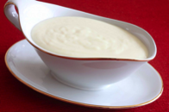
Science Operations & Workflows
Παστιτσιο
Science Operations & Workflows

Slide 23
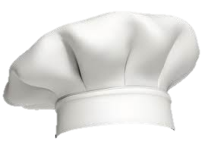
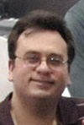
Science Operations & Workflows
Every experiment/project/collaboration has a SCD liaison
  SCD liaisons are embedded in Scientific Computing and vice-versa – ensuring smooth operation and communication
    Access to the kitchen
  Bi-weekly liaison meetings: experiments are included in management of scientific services
Portfolio Management: annual review by lab-wide committee of computing resource needs of experiments
  SCD works with experiments using an internal review process to prepare
SCD Computing Reviews: detailed review of experiments’ overall computing readiness and their needs from SCD
  MicroBooNE and mu2e – more to come!
  Many SCD action items generated

Slide 24
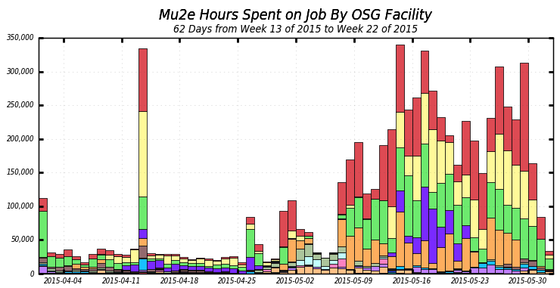
Science Operations & Workflows
Action item: help mu2e use opportunistic (OSG) resources
300k
Mu2e Fermigrid allocation

Slide 25
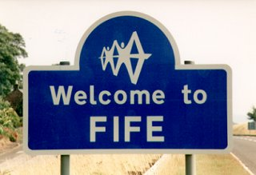
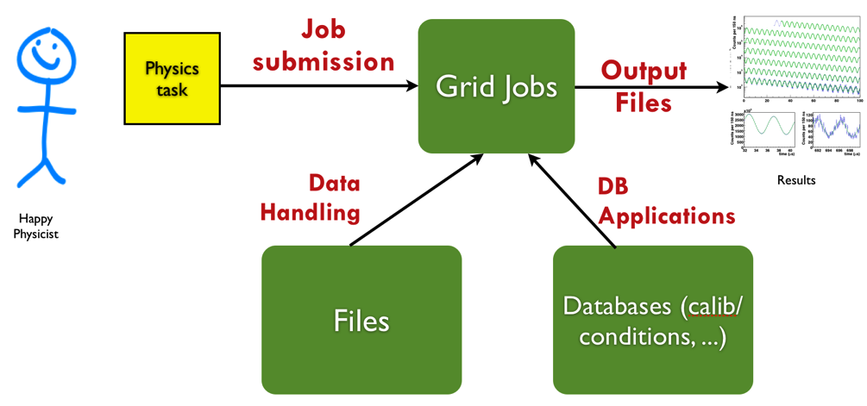
Science Operations & Workflows
FIFE (Fabric for Fermilab Experiments) project provides common computing services and interfaces that enable experiments to seamlessly use onsite and offsite resources
More than a dozen experiments participating
Offline Production Operations Group
  Leveraging CMS experience, operations group was established to run large scale production workflows for Fermilab experiments
  Successfully being used by NOvA, MINERvA, MINOS+; MicroBooNE and Mu2e to follow

Slide 26
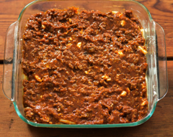
Development, Integration, Research
Παστιτσιο
Development,
Integration,
Research

Slide 27
Art and LArSoft
art: application software framework, developed at Fermilab for muon, neutrino (and other) experiments
  Framework allows shared development and support among experiments
LArSoft: common simulation, reconstruction and analysis toolkit for LAr TPC experiments, built on top of art
  LArSoft is managed by Fermilab with contributions from all LAr experiments
Artdaq: data acquisition toolkit for particle physics
  Uses art in offline and online contexts
Action item: help profile LArSoft performance for MicroBooNE
  SCD analysis yielded ideas that will optimize CPU by 25-30%
Art/LArSoft course: August 3-7 2015
  Still a few slots open!

Slide 28
Accelerator Modeling
Fermilab leads the Community Project for Accelerator Science and Simulation (ComPASS), funded by SciDac 3
  Develop and deploy state-of-the-art accelerator modeling tools that use
    the most advanced algorithms on the latest most powerful supercomputers
    cutting-edge non-linear parameter optimization and uncertainty quantification methods
  Synergia (Συνεργια) is a beam dynamics framework developed at Fermilab
    Scales from desktop computers to supercomputers
    Performed largest beam dynamics simulation ever:
    71 steps/turn, 7.1 Msteps, 4.1 Mparticles
    1.2 x 10¹⁵ calls to “drift”

Slide 29
Physics and Detector Simulation
Pythia: generator of collider events involving theoretical models and Monte Carlo techniques
GENIE: generator of neutrino events inlcuding 1st interaction of neutrino with matter in targets and detectors
Geant 4: detector simulation toolkit that models the passage of particles through matter and EM fields
We are part of the Pythia development team, an institutional member of the GENIE and Geant4 collaborations, and partner with CERN on next-generation R&D for Geant

Slide 30
R&D
Parallel Processing in HEP
  Using the Micron Automata processor (massively parallel architecture for searching unstructured data) to do tracking/pattern recognition – partnering with Micron and Uva
“Big Data” – Large-scale parallelized data-mining
  Library Event Matching for NOvA: classifying events against a large library of simulated events
    http://arxiv.org/abs/1501.00968
Off-the-Shelf DAQ – Internet of Things (IoT)
  Low cost DAQ architecture-as-a-service, based on commercial IoT technology
  Scales from few MB/s to hundreds of GB/s
  http://otsdaq.fnal.gov/docs/CCD-SCD_OtS_DAQ_talk.pptx

Slide 31
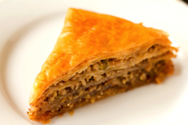
Dessert – Images from DES

Slide 32
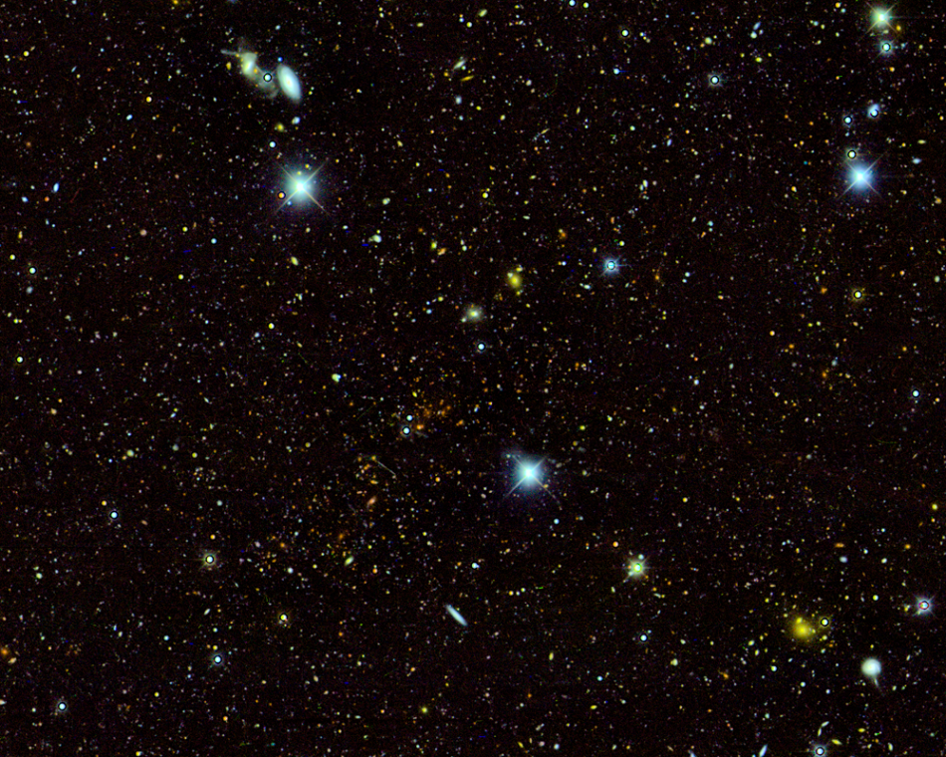
Dessert – Images from DES
El Gordo Galaxy Cluster
Prompt processing,
nightly pipeline
at FNAL
Rapid turnaround:
Detect Type 1A Supernova < 24h

Slide 33
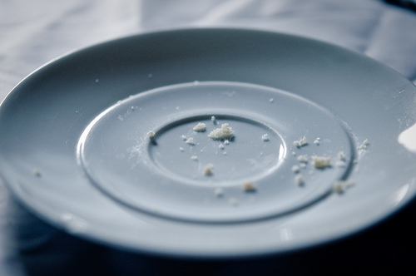
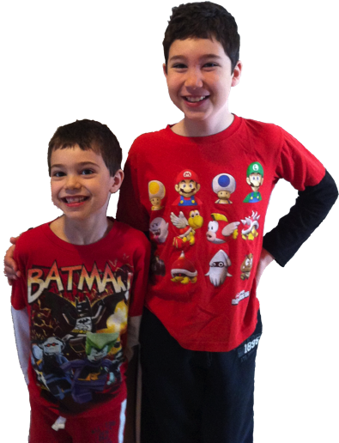
Check, please!

Slide 34
Backup

Slide 35
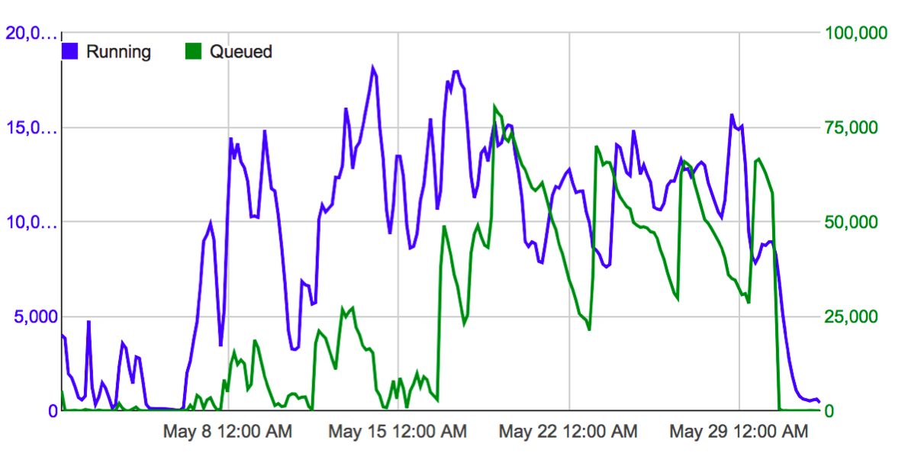
Mu2e Backup
Mu2e: View from the Submitter

Slide 36
DES - details
Within a few minutes of a 90-second exposure of the deep
sky arriving in the online system at the Blanco Telescope in Cerro Tololo, Chile, the image is sent via fiber to Fermilab's fermigrid cluster computing farm for immediate processing. Every two minutes later another exposure is fed into the queue, for a total of 200-300 nightly.
The Fermigrid cluster performed the nightly production pipeline operations during Year 1 (Aug 2013- Feb2014) and Year 2 (Aug 2014- Feb 2015) DES observing seasons, and is currently assisting in reprocessing and recalibration efforts.
Fermilab's scientific computing division assisted in making the parallel pipeline function smoothly, and also made available to DES a set of special high performance, high capability nodes (extra memory and scratch disk) to assist in the processing.
The rapid turn around of the parallel processing cluster allows transient phenomenon known as Type Ia supernovae to be detected within 24 hours of their explosions and this allows astrophysicist to coordinate crucial followup spectroscopic observations on the world's largest telescope before they fade from view in the night sky.

Slide 37
Sorry if I made you hungry
Basil’s (Aurora):
http://basilsgreekdining.com
Greek Islands (Lombard)
http://greekislands.net
Parthenon (Chicago)
http://theparthenon.com

Slide 38
Pastitsio Recipe
2 stick butter
½ cup flour
5 cups of milk
4 eggs
12 oz. macaroni
2 tbsp salt
3 cups grated Parmesan or Romano cheese
1 cup cream sauce
2 medium onions
2 lbs. ground beef
8 oz. tomato sauce
Cinnamon (to taste)
Cream Sauce: Melt 1 stick butter and add flour, stirring constantly over a low flame for 3 to 5 minutes. Remove from fire and gradually add scalded milk, stirring to blend smooth. Season to taste. Add beaten eggs; fold in well. Return to slow heat for one minute, stirring well. Set aside; cover with towel until used.
Macaroni: Boil macaroni in salt water, stirring occasionally from 7 to 9 minutes. Drain well. Melt ½ stick butter. When it begins to sizzle, pour over drained macaroni and mix well with ½ cup grated cheese and 1 cup cream sauce. Set aside.
Meat Layer: Sauté finely chopped onion in 1/2 stick butter until onion is transparent. Add meat and simmer until lightly browned and separated. Add tomato sauce. Season to taste with salt and pepper and a dash of cinnamon. Cook until all liquid is absorbed. If too fat, skim off.
Assembly: In 13x9 pan, spread ¾ of macaroni mixture and sprinkle with 1 cup grated cheese, patting down with hand to firm. Pour 1 cup of cream sauce over this. Spread meat mixture evenly over this. Then sprinkle with grated cheese. Spread remaining macaroni mixture and pat down to firm. Pour remaining cream sauce and bake at 350 degrees for 15 minutes, lower heat to 325 degrees for 30 minutes. Serve cut in squares.

