Slide 1
Illinois Accelerator Research Center (IARC)
48th Annual Fermilab Users Meeting
Status Review
Wednesday, June 10, 2015, 9:45

Slide 2
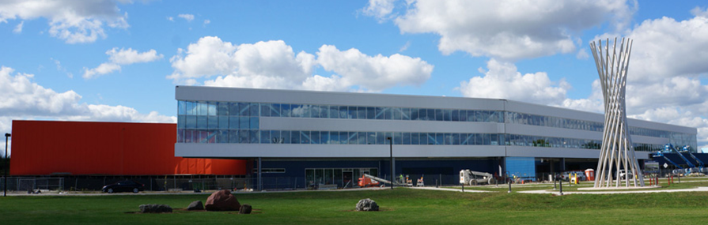
IARC – Illinois Accelerator Research Center
In pursuit of FNAL’s HEP mission:
  develops & operates high energy, high power (MW), high reliability accelerators;
  host largest U.S. accelerator complex; and
  Create unique technology and capabilities
IARC intended to be a portal for industry to leverage the larger core capabilities and infrastructure developed in pursuit of HEP mission.
IARC will provide access to state-of-the-art facilities and unique expertise for research, development and industrialization of particle accelerator technology.
IARC will develop partnerships with external entities for the application of accelerator technology in areas such as energy and the environment, medicine, manufacturing, national security and discovery science.

Slide 3
Role of IARC at Fermilab
Fermilab | IARC
Research hub | Technology development hub
Single program | Multi program
Funds out (procurement) | Funds in (Federal, State, Private)
Basic science/discovery mission | US competitiveness mission
Non-proprietary research | Patent/copyright
Large teams, complex goals | Small teams, targeted goals
Federal standards & best practices | Industry standards & best practices, agile
Long time frames | Short time frames

Slide 4
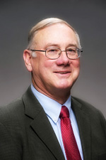
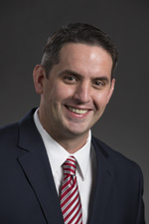
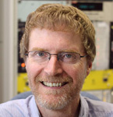

Who is IARC?
IARC is a new initiative; in Directorate reporting to COO
IARC staff is small, but leverages capabilities of the entire lab
  Accelerator Division: builds/operates accelerators (IARC landlord)
  Technical Division: develops components (design/expertise)
  OPTT, FESS, Finance, etc
Director
Bob Kephart
General Manager
Charlie Cooper
Acc. Div. Liaison
Thomas Kroc
IARC Administrator
Dawn Staszak

Slide 5
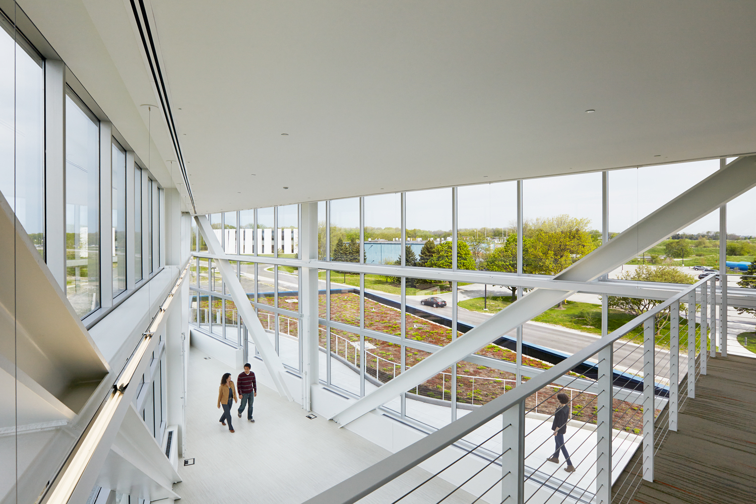
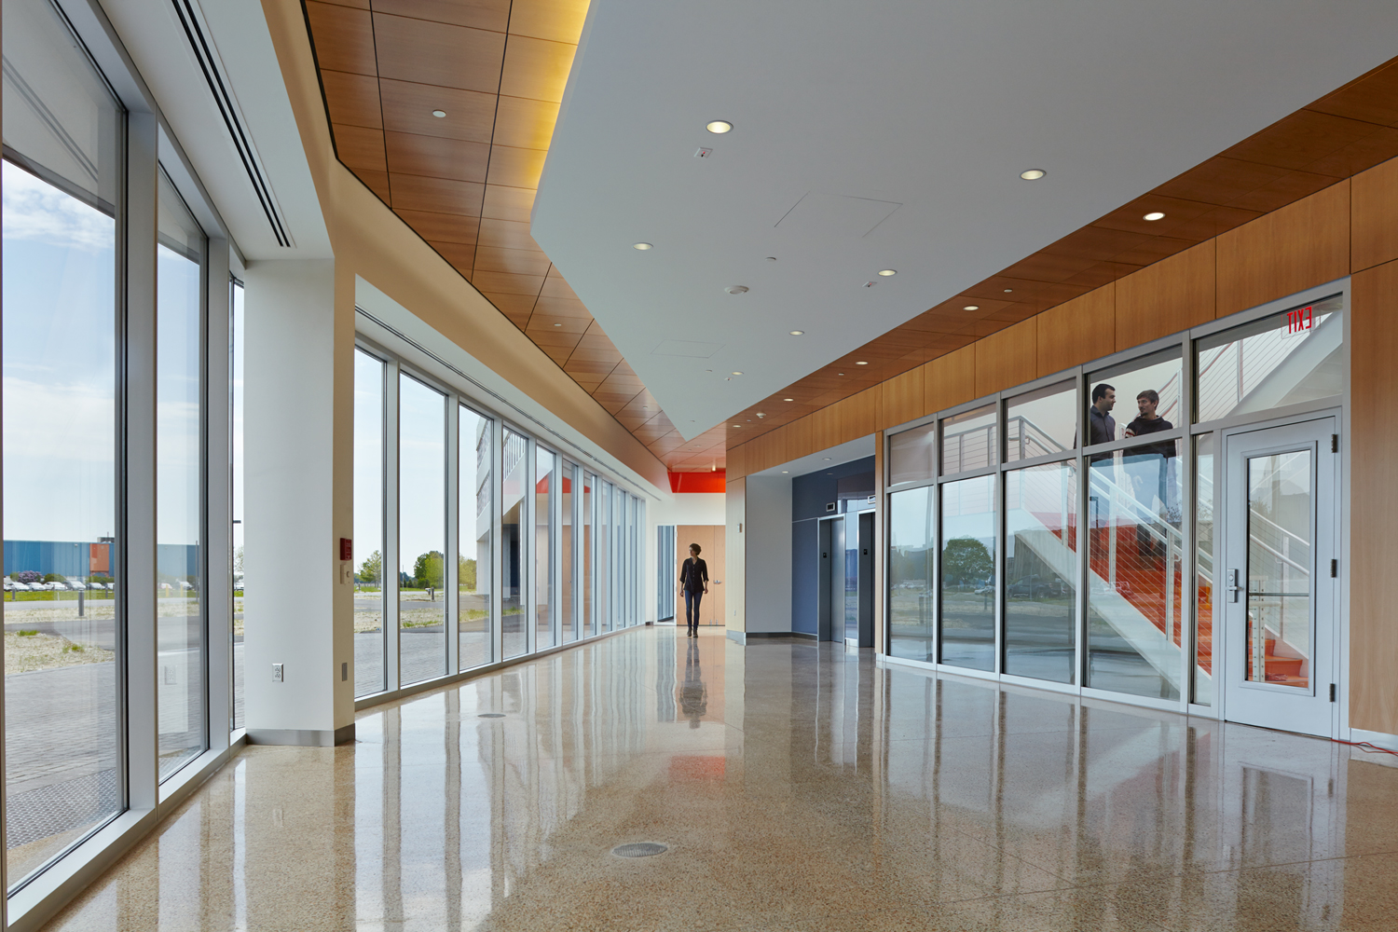
IARC Office, Technology & Education (OTE) Building
Building shell funded by Illinois Department of Commerce and Economic Opportunity ($20M)
47,000 square feet
1st Floor
  175 person meeting hall
  Executive meeting room
  ~3000 square feet light tech space
2nd and 3rd floor
  ~110 office spaces
  Inside and outside eating area
  Closed and open meeting areas

Slide 6
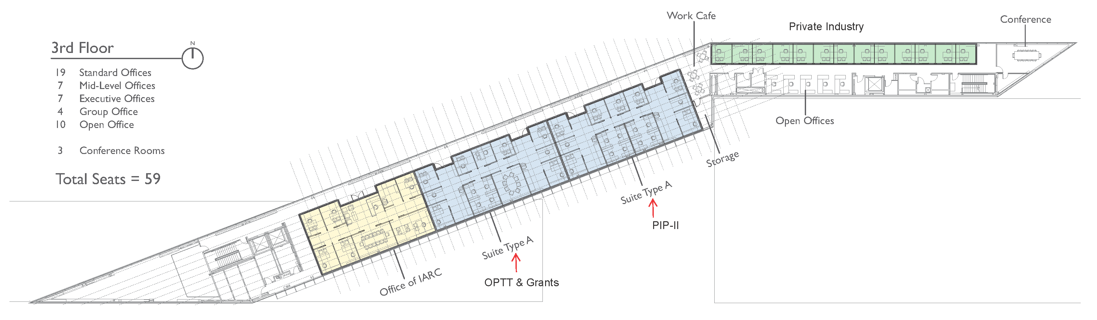
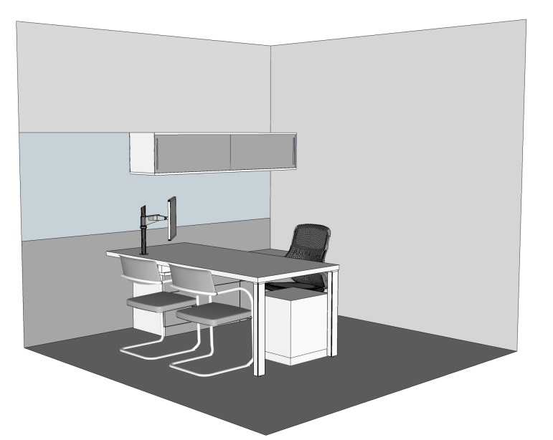
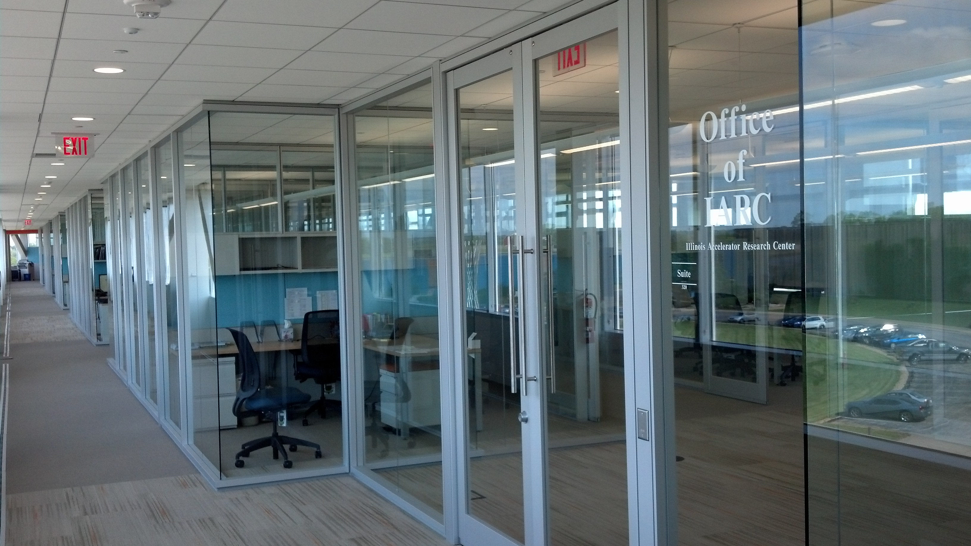
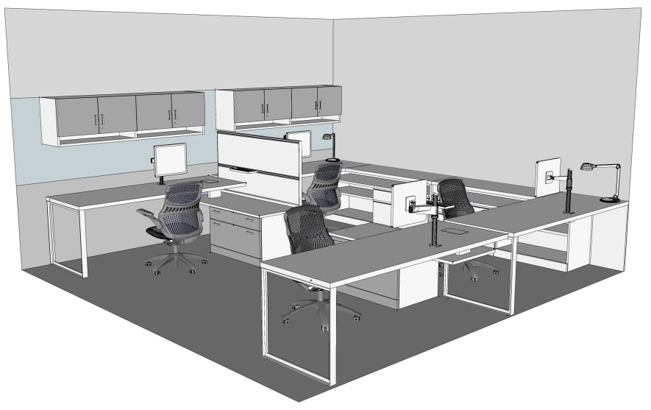
IARC OTE Building: 3rd Floor Offices (funded with DOE GPP)
(IARC and OPTT moved May 23, PIP-II moves in June, 1st Industry in the fall)

Slide 7
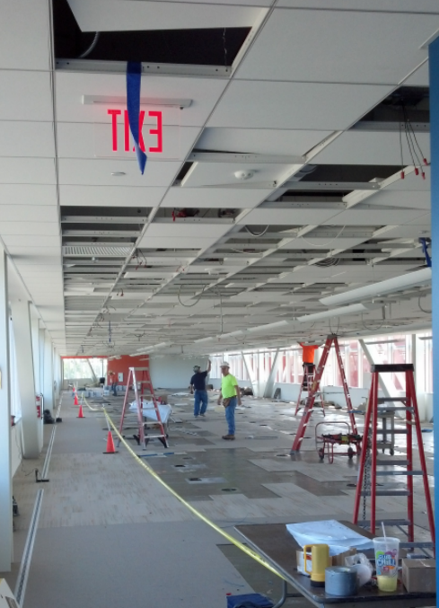
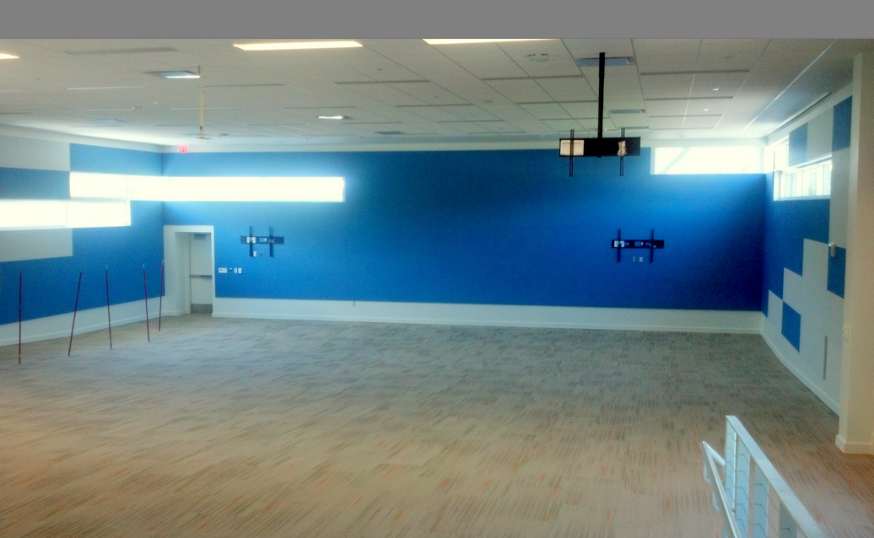
IARC OTE Building: 2nd Floor Offices and Lecture Hall
Even though we have moved into the 3rd floor of OTE, lots of construction is still in progress in OTE, paced by GPP funding
2nd floor layout is similar to the 3rd floor
  Currently… installing electrical and IT networks
Outfitting… 175 person lecture hall
  Furniture and AV system ordered… operational ~ Sept 1

Slide 8
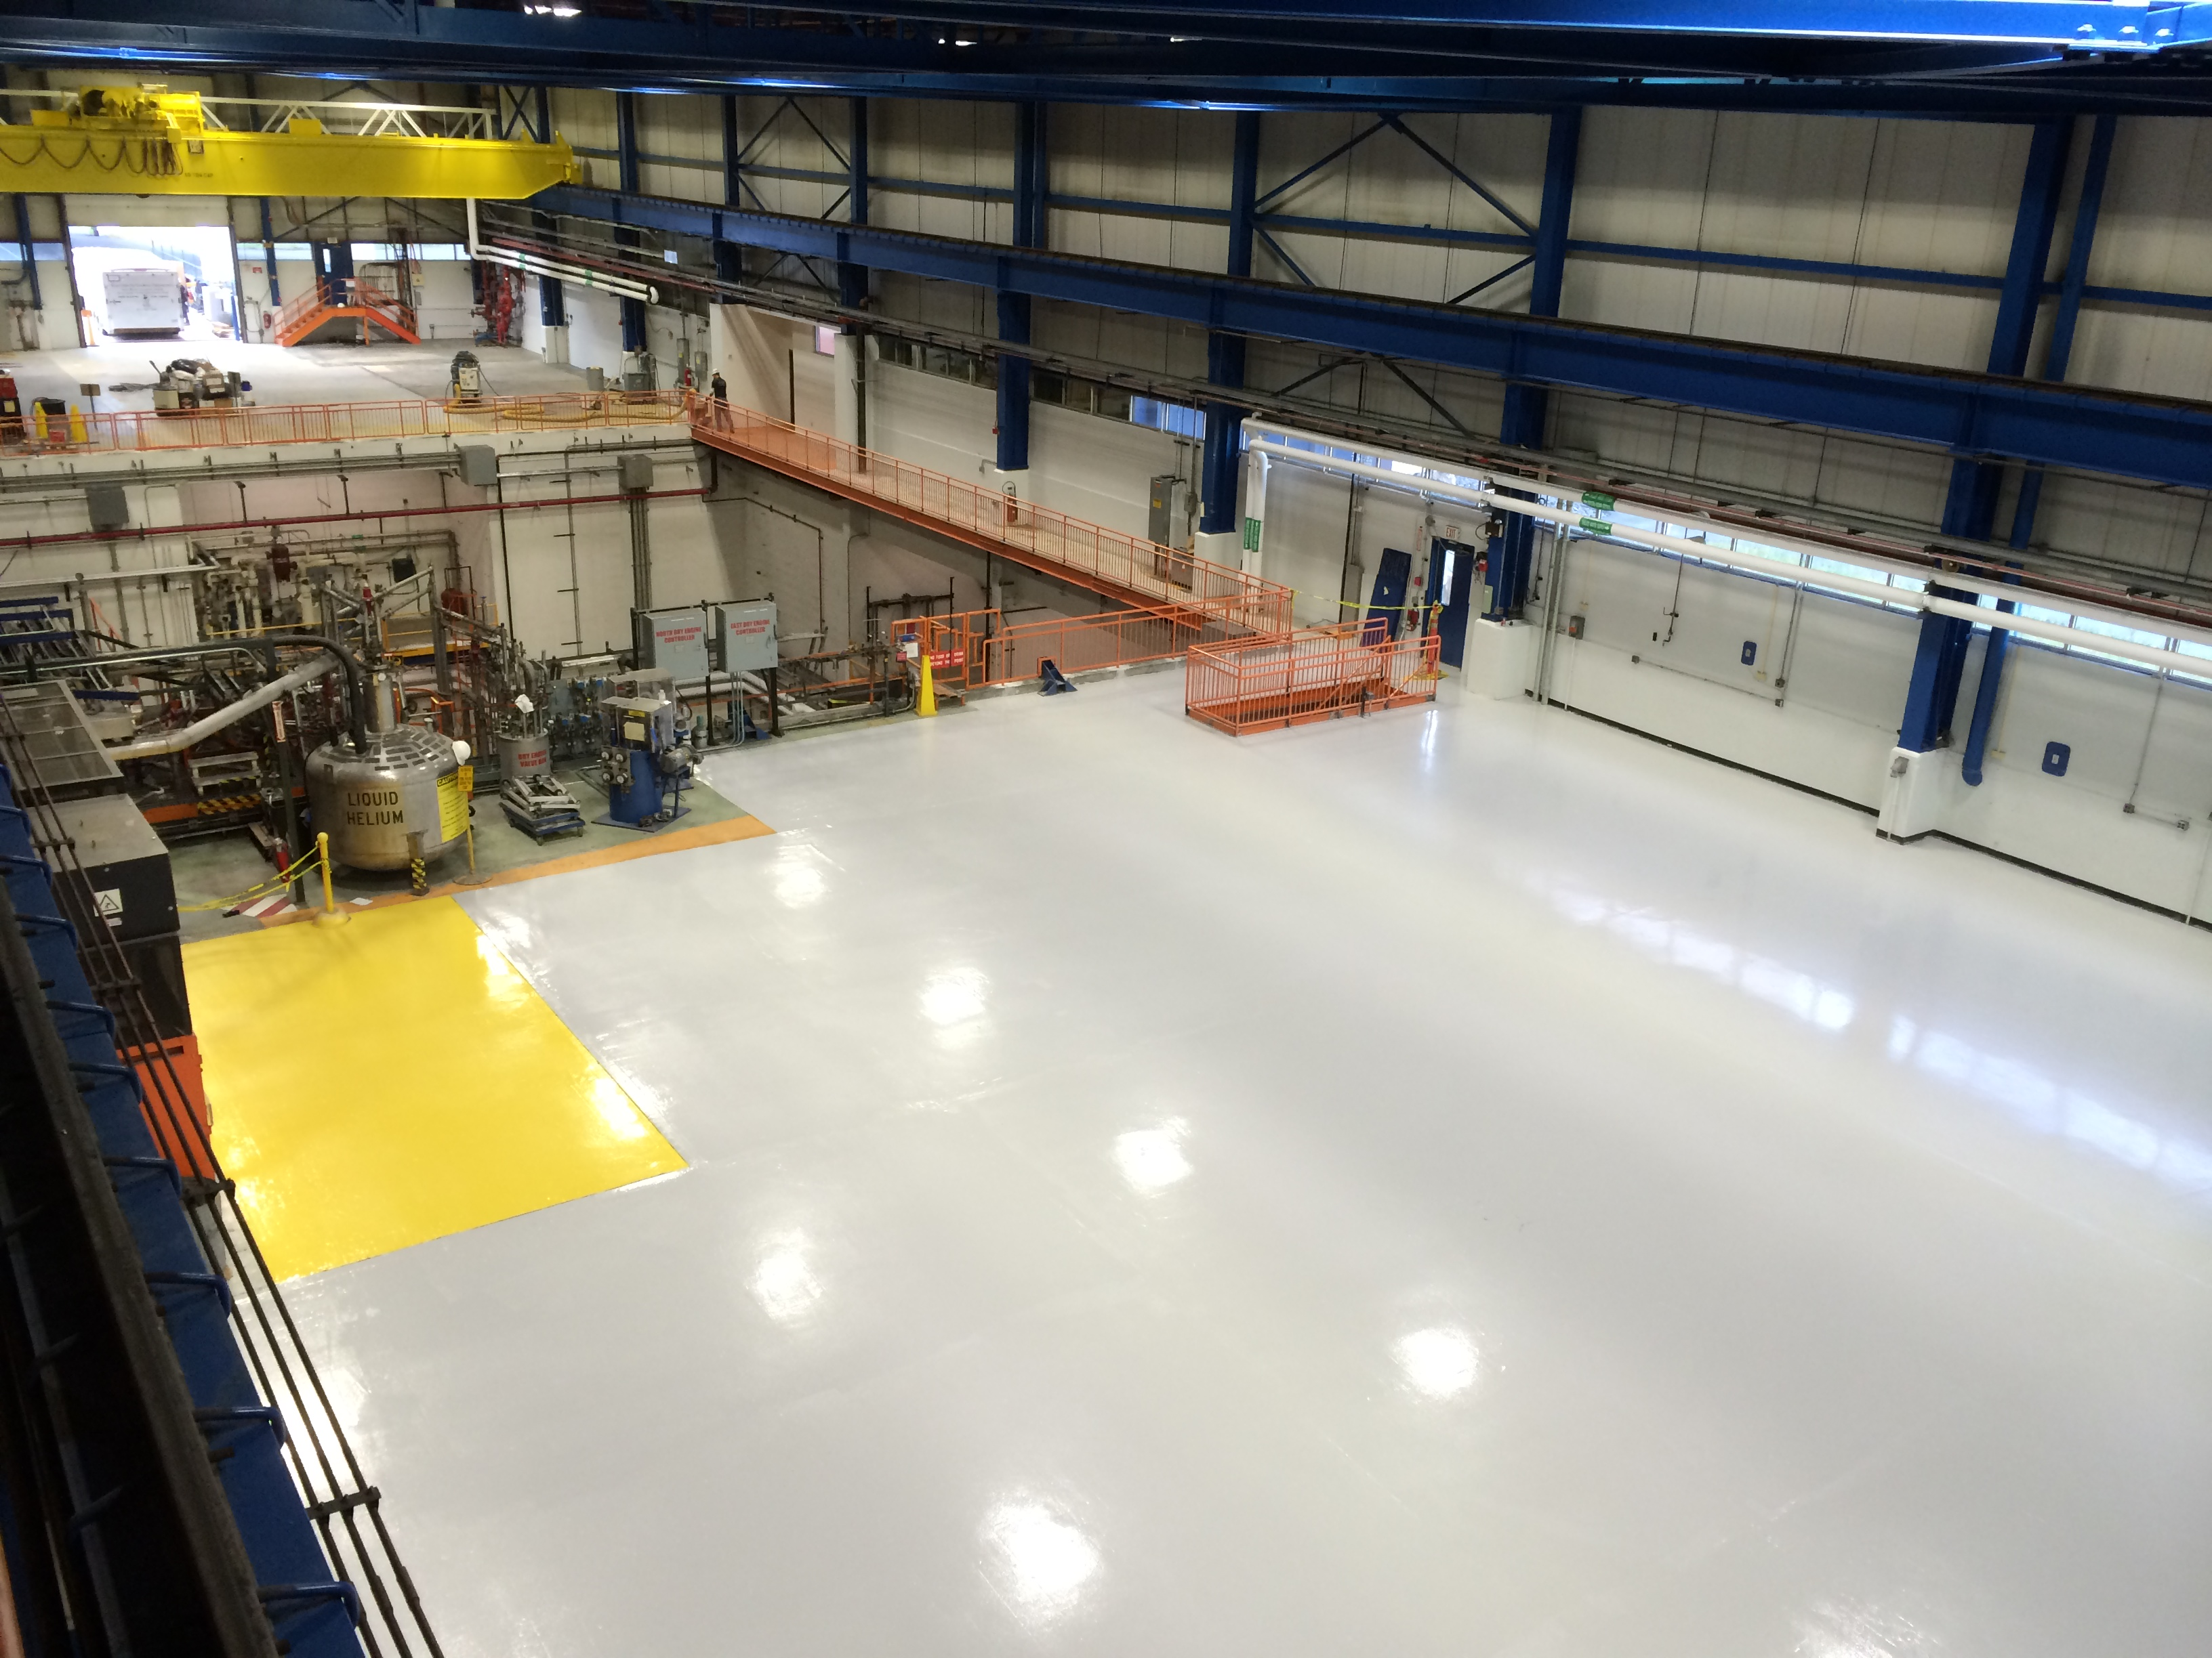
Heavy Assembly Building (HAB)
Repurposed from CDF
  Modernized to meet energy standards and to be ADA compliant
42,000 sq ft
50 T crane; 10 T crane
Deep pit ideal for radiation shielding of high power accelerators;
1.5 MW of installed electrical Power (upgradeable)
2.0 MW of industrial, Low conductivity, and chilled water systems
600 W @ 4 K cryogenic refrigerator (upgradeable)
Light tech space, 40 offices, high speed IT network
Status
Major work to remove CDF equipment is complete: 3200 T!
Electrical and cooling water systems refurbished
Contract (GPP funded) just released for major renovation of former CDF office and technical block - construction through 2016

Slide 9
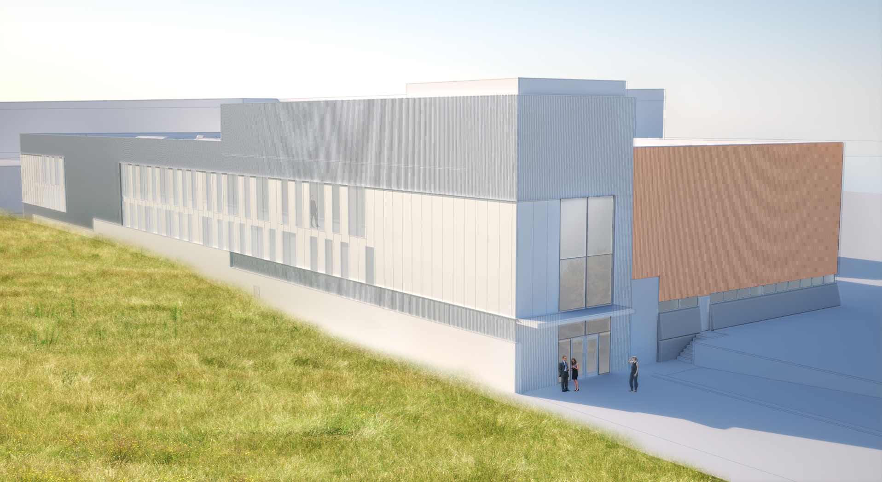
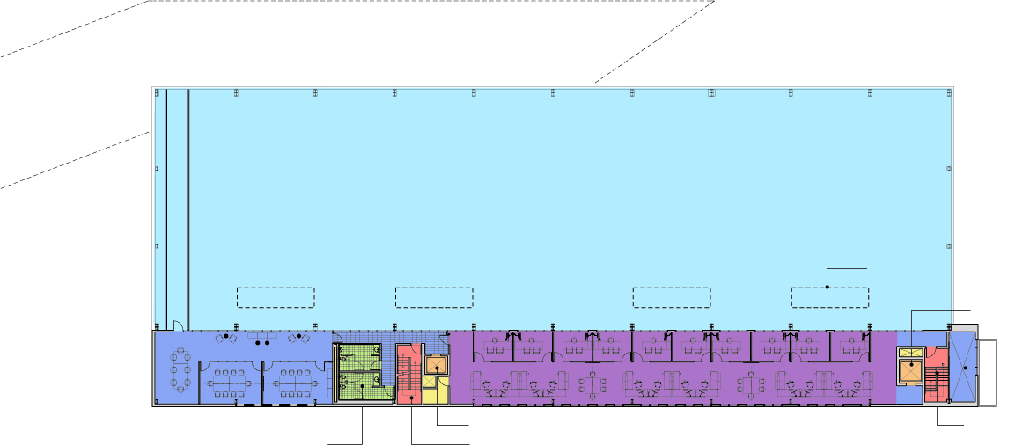
HAB Refurbishment
      New East Entry, HVAC
      ADA compliant Elevator;
      Additional offices and technical space
      New windows, siding, insulation to meet energy guiding principles
- Open to Below -
Elev. 2
MR
Gathering Space
O
O
O
O
O
O
O
O
O
O
Open to Below
MR
MR
Open Workstations
Elev. 1
Stair 2
Toilet
Stair. 1

Slide 10
The IARC Strategy and Benefits to FNAL
Facilitate partnership with small- and medium-sized industry players to commercialize new accelerators and related technologies-based products.
Engage in joint development with large strategic partners to develop new applications and industries.
Harvest and market mature Fermilab intellectual property (IP) to spin off new products with industrial partners.
Invest in IP maturation to attract private investment for commercialization.
Demonstrate the benefits and relevance of HEP developed technology to key stakeholders (Federal, State, Local, Industry)

Slide 11

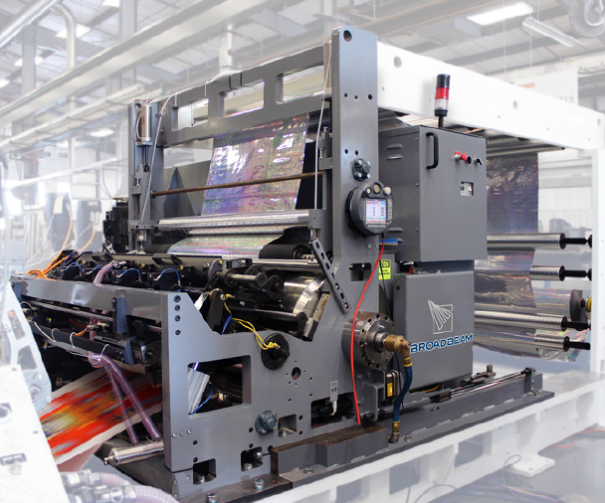

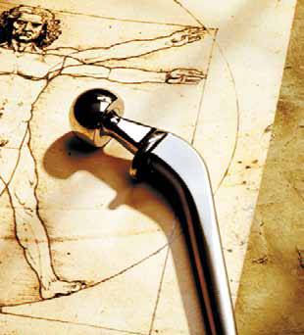
Impact of Accelerators
About 30,000 accelerators are in use world wide
  Sales of accelerators > $ 2 B /yr and growing
  Accelerators touch over $ 500B/yr in products
  Major Impact on our economy, health, and well being
Some Products:
Food Irradiation
  Becoming increasingly accepted
Metals
  Harden cutting tools
  Reducing friction
  Biomaterials for implants
Manufacturing of Radial Tires
High Speed solvent free printing
  12 colors at 600 fps!

Slide 12
Examples of efforts proposed via IARC
Heavy Oil Upgrading (Gas Technology Institute)
  Direct conversion of petroleum crude and residual oils into transportation fuels with minimum downstream processing via electron beam irradiation.
DNDO, DHS needs high power, compact accelerators to scan cargo and for “active interrogation” to find special nuclear materials.
Compact SRF Accelerator (multiple)
  Robust design with many industrial applications
Highway life extension (FNAL IP development, in discussion with FHWA)
Low heat leak coupler (Euclid)
Flu gas treatment and High purity Al on Nb (Pavac)
Rock Blaster (Gas Technology Institute)
  High power accelerator delivering 55 KJ pulses in 150 ns at 10 Hz with 5.4 MeV beam energy
Semiconductor industry very interested in a bright (10 KW) 13.5 nm light source for next generation photo-lithography. (euvL consortium)
  Consortium formed to explore an SRF linac driven FEL as an alternative light source, now creating LLC

Slide 13
Summary
IARC represents an extraordinary opportunity for the lab and for DOE
Well aligned with congressional initiatives to improve the relevance of the labs to U.S. industrial competitiveness and job creation, but perhaps ahead of the curve
We are in the process of launching a large program of cooperative work with industry (writing proposals, new funds!)
Many of these new accelerator applications can have transformative impacts on the way mankind generates and uses energy an positive effects on the environment
Our goal is all of this…
AND to create new industries and jobs within a sustainable IARC business model

Slide 14
END
Questions
http://iarc.fnal.gov/

