Slide 1
NO𝜈A
Operational Readiness Review
Data Acquisition and Timing Systems

Slide 2
DAQ Overview
Traditional DAQ readout path:
  Front End Readout (with zero suppression) via custom hardware
  First level data aggregation and event building on custom single board computer (Data Concentrator Module)
  Second level data aggregation and event building on large commodity computing farm (196 nodes)
  Top level of event building and data logging on high bandwidth disk arrays
All levels of readout chain extensively testing and used at full scale during 2013/2014 commissioning

Slide 3
DAQ Overview
Control of DAQ activities through Run Control + Subsystem front ends
  Resource Manager:
  Bookkeeping interface for hardware allocation to DAQ Activities
  Application Manager:
  Initiates starts and stops of software systems and communications channels
    168 DCMs, 196 buffernodes apps + trigger, timing, datalogging
  Run Control:
  Configures and Coordinates subsystems, Starts/Stops data taking activities
All systems extensively tested and used at full scale during 2013/2014 commissioning period

Slide 4
Data Recording Efficiencies
95% Uptime
(no water leaks during 7 day period)
Major Downtime Sources: ~66% Water Leaks, ~10% schedule maintenance

Slide 5
DAQ Monitoring
Three levels of real time monitoring
  DAQ Run Time Systems
  Message Logging and Analysis
  Metrics Reporting/Monitoring (Ganglia based)
  These system can halt the DAQ on fault detection
Two levels of higher latency monitoring
  Detector Data based Monitors (online monitor/event displays)
  Nearline Monitoring (data quality)
  These system require human intervention

Slide 6
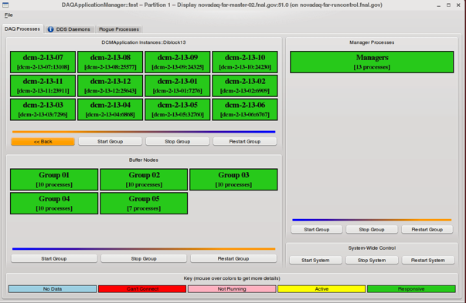
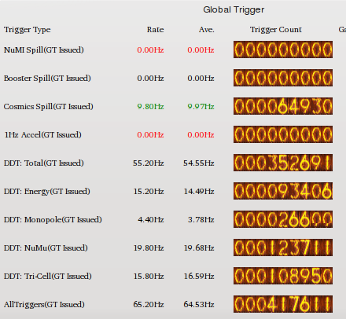
Monitoring in Run Time Systems
Run time systems are required to provide “status”
  Failure to report causes a fault to register in the Application Manager or in Run Control
  Faults are displayed on
  control room interfaces
  Latencies are ~ 1-10 s
Other interfaces are configured
with known critical operational
parameter out of range values
are set to trigger a fault or give a
visual cue
DAQ can be stopped directly from
these subsystems
These turn RED

Slide 7
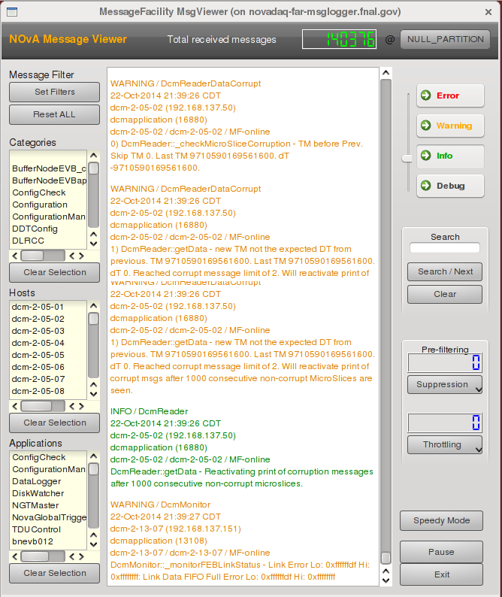
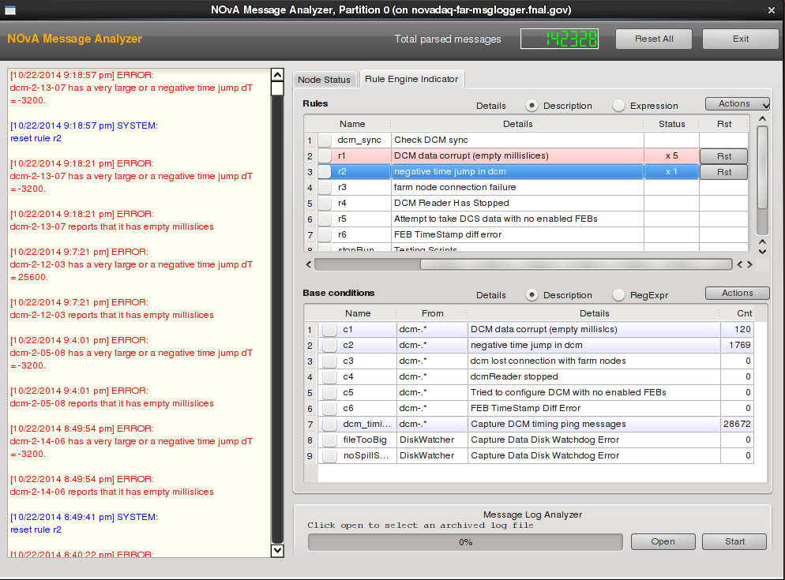
Monitoring in Messaging Systems
DAQ systems are required to provide messages
  Range from debug to info, warning, error
  Messages are displayed visually in
  message viewer
    Filterable stream
  Messages are logged to disk
Rules engine (Message Analyzer) scans
the message stream for correlations
and error states
Takes actions based on rule set (stop DAQ)

Slide 8
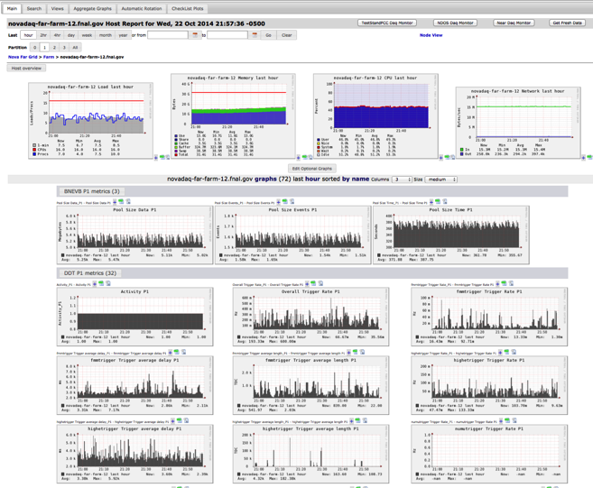
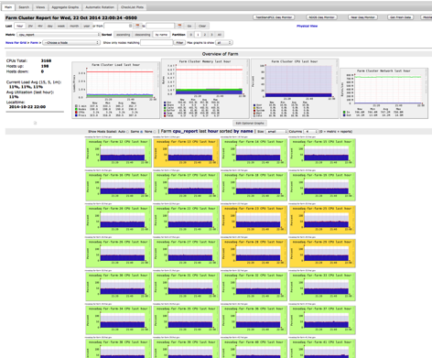
Metrics Reporting (Ganglia)
DAQ systems provide performance
metrics which are recorded via
Ganglia cluster monitoring suite
  Includes DCMs, Buffernodes,
  Trigger systems, Datalogging
  Metrics are custom (trigger rates, buffer depths)
  and standard system ones
  (CPU use, free memory)
Over 380 separate systems reports
  Organized and tagged by DAQ
  “partition” number to localize errors
  Full drill downs on each system
Integration with DAQ monitoring
in progress to allow for automated
alarming

Slide 9
Detector Data base Monitoring
Online Monitoring collects detector performance data and produces histograms (occupancies, hit rates, etc…)
  Input comes from live detector data stream via “dispatcher” systems
  Latencies for online monitor to see an event are are milliseconds after an event is acquired
  Histograms are refreshed continuously
Event display give visual verification that detector is reading out, is synchronized, etc…
  Latency is milliseconds after event is acquired and can be filtered by data stream
Software trigger system continuously analyzes full raw (unfiltered) detector data stream.
  Specific triggers are setup to flag error conditions in the detector

Slide 10
Timing and Synchronization System
Master clock systems are located at each detector site
  Each system is tied to the Global Positioning System (GPS) satellite reference system
  Derives a high precision (128 MHz) time base from GPS (1pps + 10 MHz).
    Tied directly to GPS second boundaries
    Established an absolute “wall” time at each detector
FNAL & Ash River time base
synchronization validated
through “time transfer” using
atomic clock between Soudan
and Ash River

Slide 11
Timing System Monitoring
Timing system is monitored using an independent reference clock system
  “Timing Calibration Reference” Unit (TCR)
    Deployed at each site with Nova Timing Units
    Provides fan out of reference signals (with programmable pattern) to each master TDU at the site
  TDU’s time stamp the reference signals
    Software compares time stamps to predicted intervals
    Issues warning/error messages on faults
  Latency for fault detection is ~1 s
Timing system monitoring has been used to identify 2 rare glitches:
  Incorrect initialization/sync to GPS at power up
    leads to 32 𝜇s offset in time base
  Hardware glitch/pause during sync process
    leads to exact 1.000000000 second offset in time base

Slide 12
Data Integrity
The NOvA raw data format is described in DocDB-4390
  47 page specifications document describing every Word/Byte/Bit in the readout format
  Tied to online code libraries which create/unpack/test the data
  All parts of the data have explicit tests to validate the format and detect corruption
System is “Paranoid” with respect to Data integrity checks
  Run on the data after the data is written to disk at the detector
  All transfers and copies (disk/disk, disk/tape) are verified using CRC32 style checksums and MD5 hashes
  No data is deleted if any integrity checks fail
File Transfer System reports failed files on status page
  Checks of system are mandated in shift checklists

Slide 13
Data Archiving & Retrieval
All data recorded by detectors (far/near/ndos) archived to tape with redundant copies
  dCache/Enstore System at FNAL
  0.652 PB of data (5.5M files) currently recorded to system
  Full integration with archiving system in operations since 2011
Archives include all data stream as well as logfiles from ops
All files are cataloged via SAM data handling system
Files are retrieved through SAM system (full integration with offline/analysis frameworks)
  Demonstrated using current data
    Peak single day transfer 103 TB (7-8-2014)
    Current analysis activity 30-52TB/day (Oct 2014)
Additional data replicas are retained at each detector site for a minimum of 7 days
  Permits recovery from catastrophic tape failures
  Sites are spec’d to hold 30+ days of data to handle prolonged network outages
  Actual far site storage estimated at ≈ 77 days (154 TB on primary storage arrays)

Slide 14
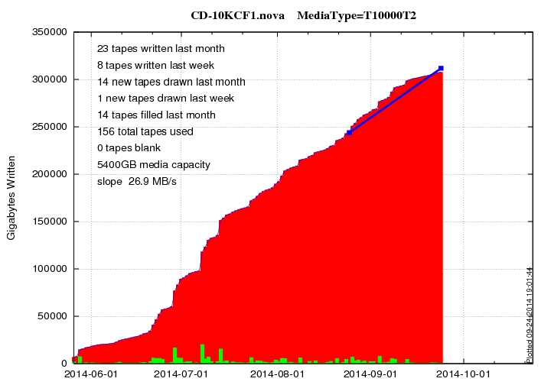
Data Archiving
NOvA Data to Archival Storage
Data written to archival storage during June-Sept 2014
DAQ averages ~125 TB/month at full detector mass

Slide 15
DAQ History
DAQ Software
  Written by a combination of NOvA collaborators, and Computing Professionals from Fermilab SCD and UM
    UM CP is also a collaborator
  Most collaborators who contributed to DAQ, including the UM computing professional, are still involved in Maintenance and Operations support
  Fermilab SCD CP’s are still available for consultation, and helping to improve documentation and procedures
DAQ Hardware
  Developed by Fermilab SCD
  Engineers still provide support, mainly for firmware improvements

Slide 16
DAQ Support Model
Collaborators in DAQ group answer calls 24x7
  10 DAQ experts total
    6 with no plans to stop in the coming year, at least,
    1 student cutting back to focus on analysis,
    1 student moving to Fermilab SCD, available for consulting,
    2 ramping up (post-doc & student)
  Experience with MINOS, MINERvA indicates this model will work for the first ~2 years of operations
  We have been operating under this model for the last 1.5 years during detector installation and commissioning
Collaborator DAQ experts receive shift credit for signing up for on-call shifts
  Experts are encouraged to take DAQ shifts over regular data taking shifts

Slide 17
Ongoing Activities
Near Term
  Improvements to stability and ease-of-use
    Collaboration DAQ experts with consultation from SCD
Medium term
  Need for firmware support and consultation for software beyond de minimis level is expected to roll off quickly as system reaches maturity.
  SCD is providing new instructions and procedures for compiling external products
    to allow collaborators to maintain compatibility as the software environment changes.

