Slide 1
Offline Infrastructure and Data Processing
NOvA Readiness Review 2014
Craig Group

Slide 2
Overview
The NOvA data set production paradigm has shifted over the last year to a more scalable file handling solution.
(SAM: Sequential data Access via Meta-data.)
Data processing is going well -- recent addition of automated “keep up” processing for raw to root, calibration, and some reconstruction datasets.
Support from the Computing Division has been excellent and data set production steps are performing well.
New offline operations service from CD helping with job management tasks.
The production group has continuity in the transition from the project to the collaboration era – this has always been a collaboration effort, and we have been producing production data sets for several years.

Slide 3
Demand is Large.
More than 1 PB of NOvA files already written to tape -- More than 5M files.
~5,000 raw data files per day
> 10M CPU hours used over the last year
Plan to reprocess all data and generate new simulation ~2 times per year.
(We call this a production run)

Slide 4
The Computing Team is Strong NOvA and CD Working closely together to improve data handling tools
NOvA
Computing Coordinator: Group
Production Group: Tamsett
Databases: Paley
Code: J. Davies
Other members:
G. Davies
Mayer
Backhouse
Rocco
Pandey
Sachdev
Computing Division
NOvA Liason: Norman
Data production: Bitrago, Sierra
Databases: Mandrichenko
SAM: Illingworth
Other members:
Gheith
Bitrago
Sierra
Mengel
Litvinse

Slide 5
Summary of Current Infrastructure
VM
10 virtual machines: novagpvm01 –novagpvm10 )
Blue Arc:
Interactive data storage for short term or small data sets
/nova/data (140 T),/nova/prod (100 T), /nova/ana (95 T)
Tape:
Long term data storage
Files registered with SAM
4 PB of cache disk available for IF experiments
File Transfer Service (FTS)
Batch:
Local batch cluster: ~40 nodes
Grid slots at Fermilab for NOvA: 1300 node quota
(opportunistic slots also available)
Remote batch slots: thousands of additional slots
Databases: Several, required for online and offline operations

Slide 6
Production Flow
Raw Data
(ND, FD, various triggers…)
Monte Carlo Generation
(ND, FD,GENIE, cosmic, ROCK,..)
Raw-to-ROOT
Reconstruction
Fast Reco
PID
LEM
Calibration Jobs
CAF

Slide 7
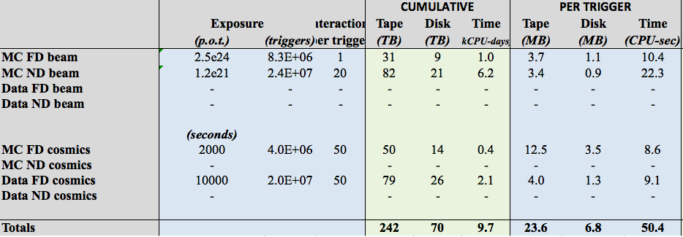
Fall 2013 Workshop
Production goals:
The footprint for final output of a production run should be less than 100TB.
The production run should be possible to complete in a two week period.
There was also a major effort to to understand resources and to streamline production tools . (Caveat – still validating these numbers…)
Summarized in DocDB 10129
Workshop: http://nova-docdb.fnal.gov:8080/cgi-bin/DisplayMeeting?conferenceid=1281

Slide 8
Fall 2013 Workshop
MC ND Beam drives CPU usage.
Production goals:
The footprint for final output of a production run should be less than 100TB.
The production run should be possible to complete in a two week period.
There was also a major effort to to understand resources and to streamline production tools . (Caveat – still validating these numbers…)
Summarized in DocDB 10129
Workshop: http://nova-docdb.fnal.gov:8080/cgi-bin/DisplayMeeting?conferenceid=1281

Slide 9
Fall 2013 Workshop
Almost 1 TB/hr ! (250 TB = IF+cosmics for full month)
Production goals:
The footprint for final output of a production run should be less than 100TB.
The production run should be possible to complete in a two week period.
There was also a major effort to to understand resources and to streamline production tools . (Caveat – still validating these numbers…)
Summarized in DocDB 10129
Workshop: http://nova-docdb.fnal.gov:8080/cgi-bin/DisplayMeeting?conferenceid=1281

Slide 10
Fall 2013 Workshop
About 1000 CPUs DC !
Production goals:
The footprint for final output of a production run should be less than 100TB.
The production run should be possible to complete in a two week period.
There was also a major effort to to understand resources and to streamline production tools . (Caveat – still validating these numbers…)
Summarized in DocDB 10129
Workshop: http://nova-docdb.fnal.gov:8080/cgi-bin/DisplayMeeting?conferenceid=1281

Slide 11
Fall 2013 Workshop
These were estimates.
Most validated in recent file production runs.
Production goals:
The footprint for final output of a production run should be less than 100TB.
The production run should be possible to complete in a two week period.
There was also a major effort to to understand resources and to streamline production tools . (Caveat – still validating these numbers…)
Summarized in DocDB 10129
Workshop: http://nova-docdb.fnal.gov:8080/cgi-bin/DisplayMeeting?conferenceid=1281

Slide 12
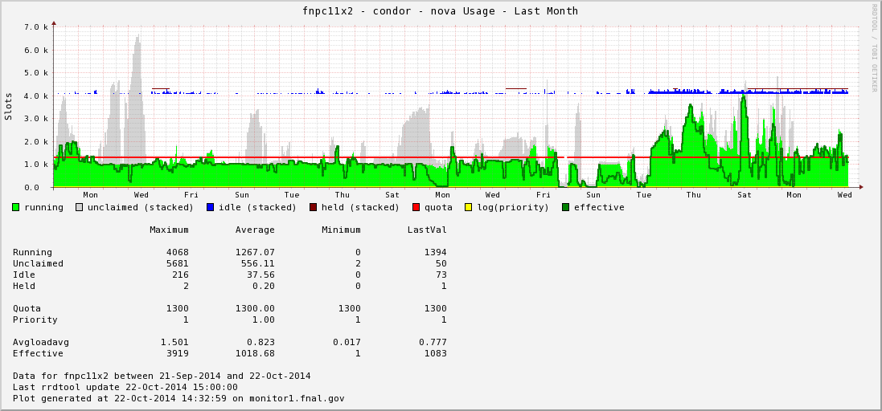
CPU (on site)
CPU is not currently a limiting factor.

Slide 13
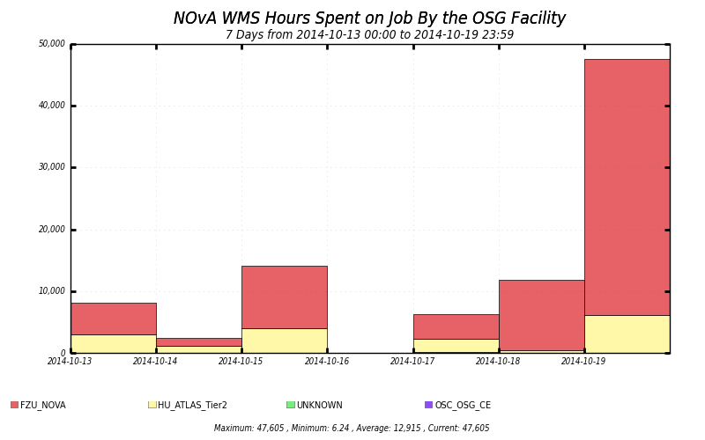
CPU (off site)
~5 thousand nodes running ~10 hour jobs
(50,000 hours)
CPU is not currently a limiting factor.
Thousands of offsite CPU slots are also available to us.

Slide 14
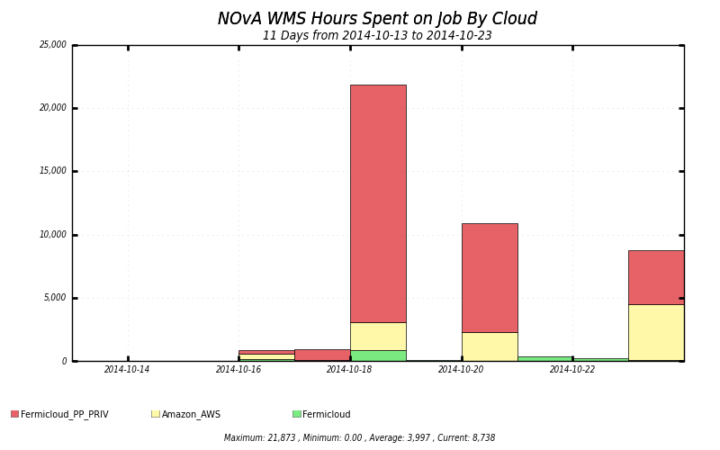
CPU (cloud)
Amazon Cloud!
(new last week)
CPU is not currently a limiting factor.
Thousands of offsite CPU slots are also available to us.

Slide 15
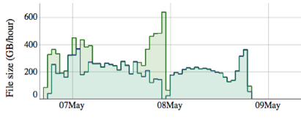
File Throughput
Example from novasamgpvm02: sustained at >200 GB/hr)
We have three FTS servers
Excess of 1TB/hour total has been demonstrated

Slide 16
File Production: Spring 2014
Spring 2014 production was a first in many respects:
First production run fully based on SAM datasets
First effort with a substantial FD data set
Frist effort since code was streamlined and footprint was reduced in the fall 2013 production workshop
The SAM transition was far from smooth and we had ups and downs.
In the end we ran all steps of production in time for Neutrino 2014 (some steps multiple times).

Slide 17
File Production: Fall 2014
This is the data set production effort for first physics results.
Many first-time requests: new keep-up data sets, calibration requests, systematic samples…
The SAM paradigm is functioning well.

Slide 18
Validation of File Production Tools
New tool available to check all data processing steps for every new software release.
Reports any failure of a file production step.
Metrics of each step compared between new and past releases:
Output file sizes
Memory Usage
CPU usage
All info published to the web
Easy to check for major changes in file production chain.

Slide 19
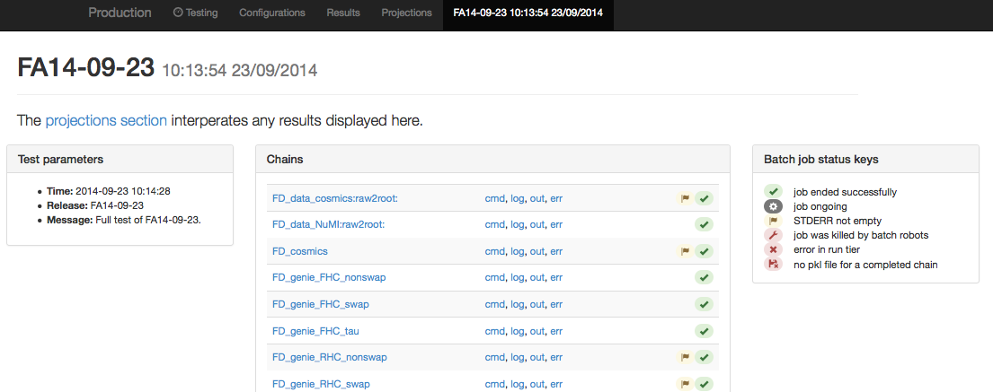
Validation of File Production Tools

Slide 20
Validation of File Production Tools

Slide 21
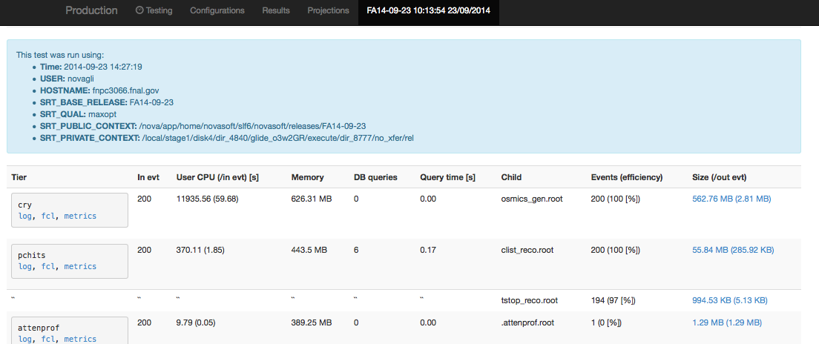
Validation of File Production Tools

Slide 22
Recent Progress
Now taking advantage of offsite CPU resources.
Move to SAM for data set management and delivery to reduce the dependence on local disk.
Database performance has been recently stable.
Demonstrated production framework, and measure/document resource requirements.
New production validation framework is very useful.
On going: producing a full set of production files for analysis groups and first physics.

Slide 23
Summary
Offline computing isn’t significantly affected by the transition from project to operations.
There has been a recent transition to a more scalable file handling system similar to what was employed by CDF and D0.
We have the resources we need and CD is working closely with is to solve issues as they arrive.
Computing resources are sufficient and we are ready to serve the data sets required by the collaboration for physics.

Slide 24
Extra slides follow…

Slide 25
Large scale computing activities:
Perform production data processing and MC generation (matched to detector config) about 2 times per year
Major productions scheduled in advance of NOvA collaboration meetings and/or Summer/Winter conferences
Full Reprocessing of raw data 1 time per year (current data volume 500+ TB)
Need to store raw and processed data, calibration data sets from far and near detector.
Need to store Monte Carlo sets corresponding to the near & far detectors matched to current production
Need to store data sets processed with multiple versions of reconstruction.
Need 2000+ slots dedicated to production efforts during prod/reprocessing peak to complete simulation/analysis chains within a few weeks.

Slide 26
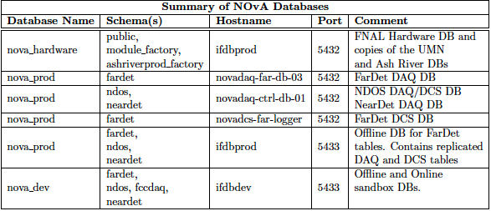
Database Overview
DAQ/DCS databases are critical for online opperations: 24/7 support
(Database executive summary available in DocDB 10602)

Slide 27
Offsite Resources
CVMFS makes NOvA code releases available offsite.
We can currently run NOvA art jobs at many offsite farms.
SMU, OSC, Harvard, Nebraska, San Diego, Indiana and U. chicago
Prague is about to come online.
Even a recent successful test run with some jobs on Amazon Cloud
Jobs can access files using SAM and write output to FNAL

Slide 28
SAM transition
Our detector and MC data is more than can be managed with local disk (Bluearc).
Solution: Use SAM for data set management interfaced with tape and large CACHE disc.
Each file declared to SAM must have metadata associated with it that can be used to define datasets.
SAM alleviates the need to store large datasets on local disk storage and helps ensure that all data sets are archived to tape.

Slide 29
Successes
Running MC offsite works.
File handling with SAM works well for production jobs.
Recent SAM tutorial was well received and users seem to be having positive experience with SAM.
Production tools are more robust and scalable.

Slide 30
What drives resource requirements?
CPU – ND Beam simulation
Disk:
FD Raw data – large calibration sample required
Many stages of processing each produce data copies (important for intermediate validation steps)

Slide 31
Production: CPU Requirements
CPU Requirements: ND Event MC dominates ~60% of production
Driven by generation speed: Order 10 seconds per event
Driven by quantity of events (MC to data ratio)
ND crucial for: tuning simulation, evaluating efficiencies, estimating background rates, and controlling systematics.
Minimal ND data set for first NOvA analyses in is 1e20 protons-on-target (2 Months of ND data)
MC samples need to be a few times larger than this to keep their statistical uncertainties from playing a significant role
Additionally, both nominal and systematically varied samples are needed.
So, our estimate is based on 1.2e21 p.o.t.
2014/2015 estimates based on 3 production runs:
1 M CPU hours ( .35 M per production run)
This manageable with our current grid quota and offsite resources.
(Note: This only includes production efforts (no analysis, calibration, …)

Slide 32
FD Data rate
As an upper limit consider the current date transfer limit from Ash River to Fermilab of 60 MB/s.
This is about 10% of FD data.
5 TB / day (seems possible data rate to transfer to tape)
1.8 PB/year (Full set of Tevatron datasets ~ 20 PB)
Only Raw data – gain about 4x from full production steps
Could be 10 PB/year, but we won’t process all of that.
Assuming 100 us for beam spill, <0.07 MB/s
Cosmic Pulsar, < 4 MB/s (currently ~2% of live time)
Calibration and other triggers (DDT) fill in ~ 50 MB/s.
GOAL: Tape storage should not limit the physics potential of the experiment!

