Slide 1
First Look at Issues to Rebuild HINS Proton Source & RFQ Vacuum
Henryk Piekarz
November 3, 2014

Slide 2
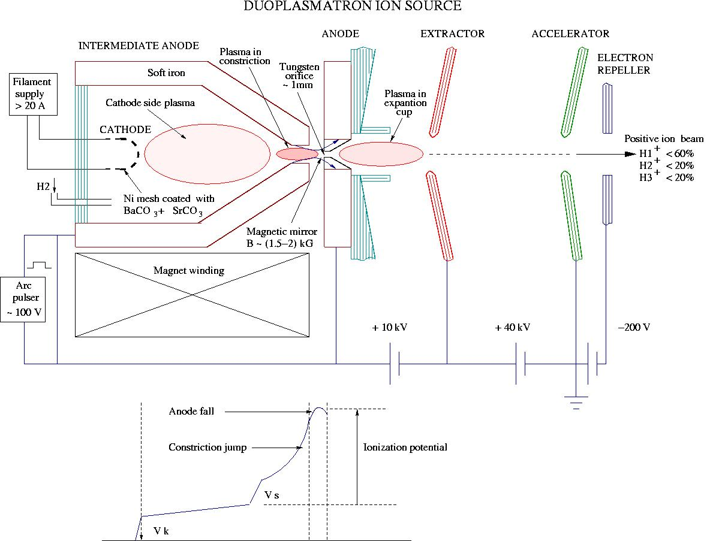
Conceptual view of proton source. Note: singly charged protons constitute 60% of ion species

Slide 3
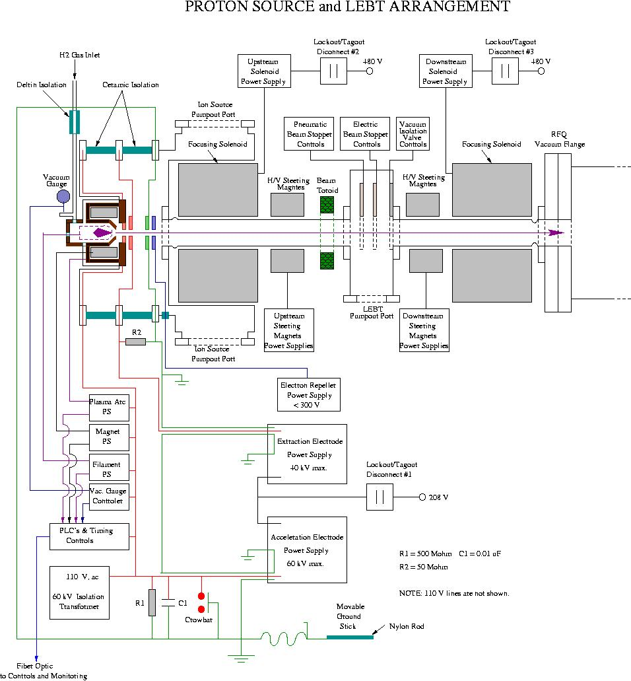

Slide 4
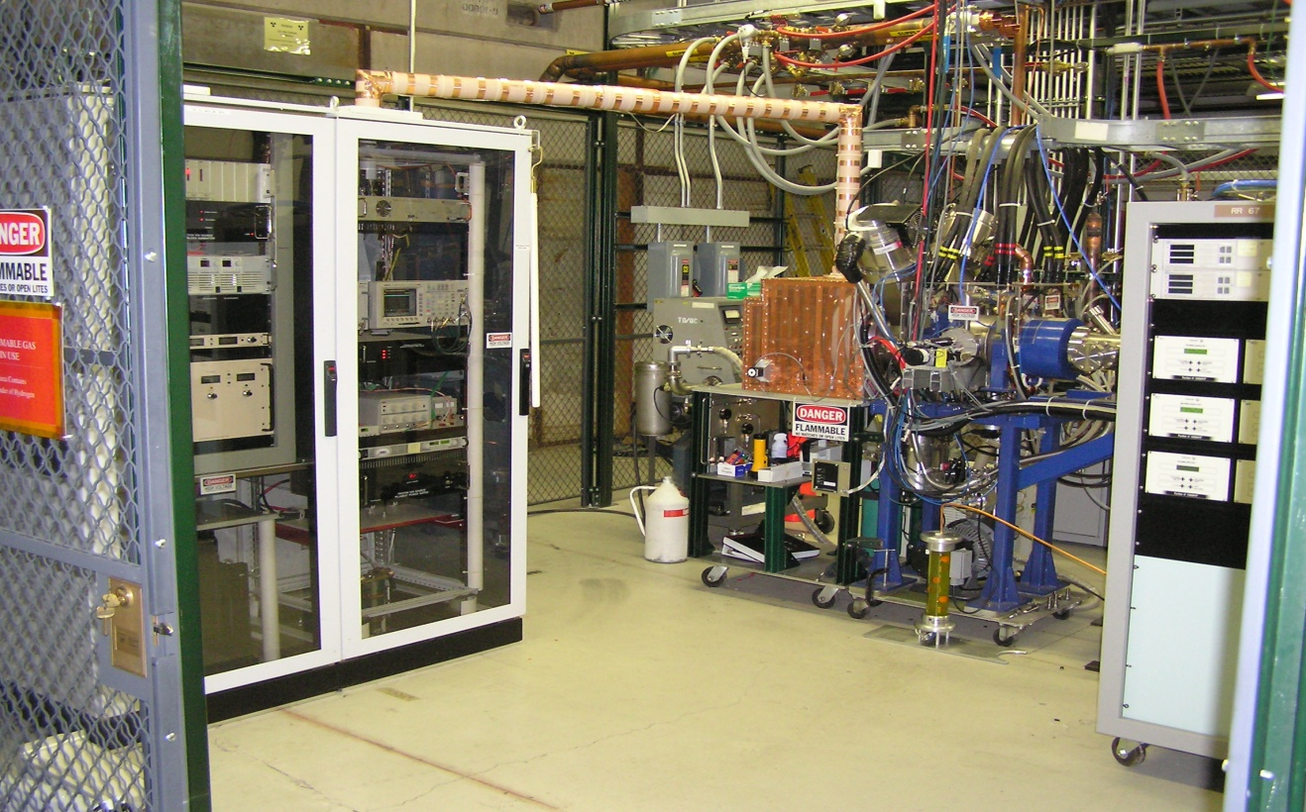
HINS Ion Source at MDB
Note: A considerable floor space is required.

Slide 5
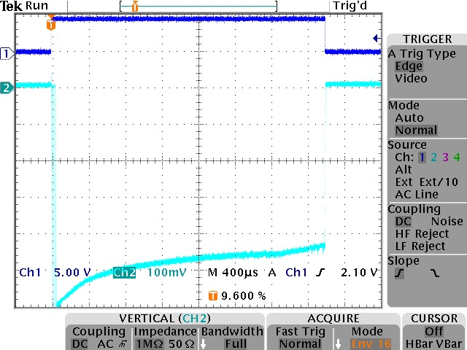
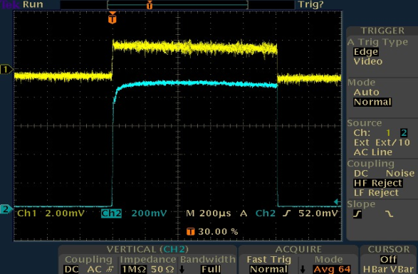
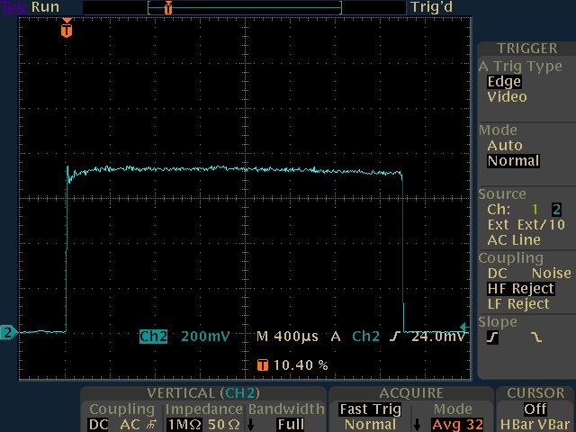
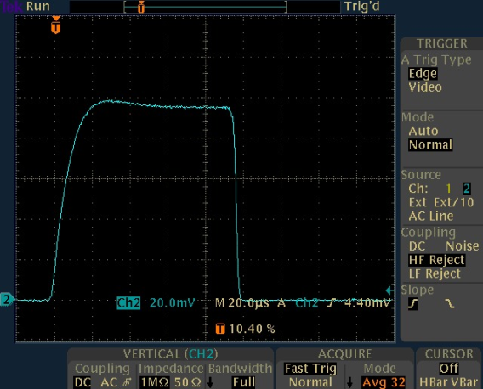
Examples of HINS proton pulses
Beam pulse: Blue - FC , Yellow – Toroid.
Note difference in rise time.
Plasma generator pulse & current.
Long beam pulse (3 ms)
Short beam pulse (100 µs)

Slide 6
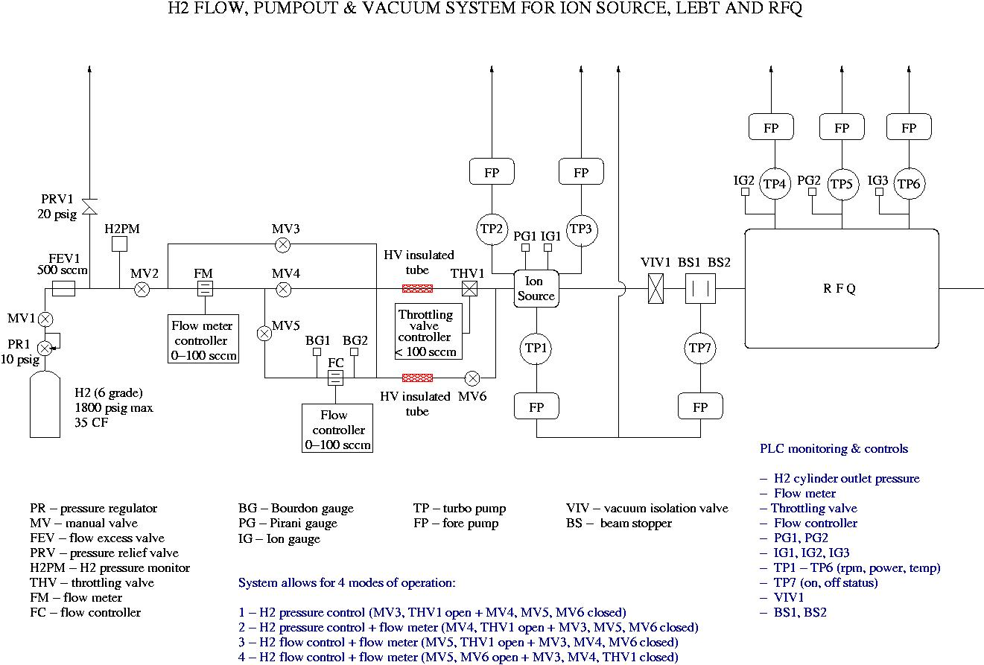

Slide 7
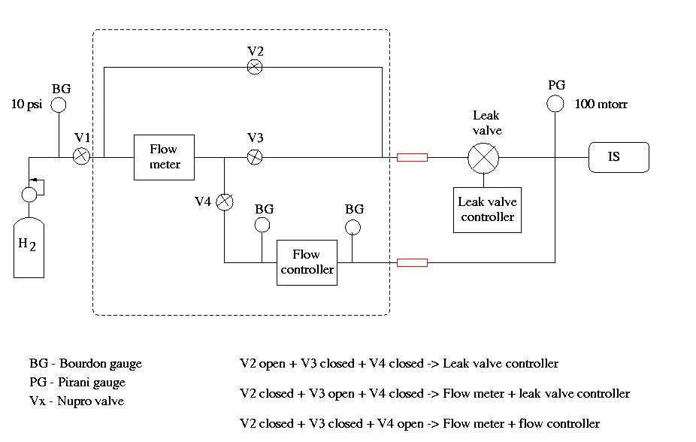
Details of H₂ gas injection to Ion Source
Components within the dashed line square sit on a 50 kV potential.

Slide 8
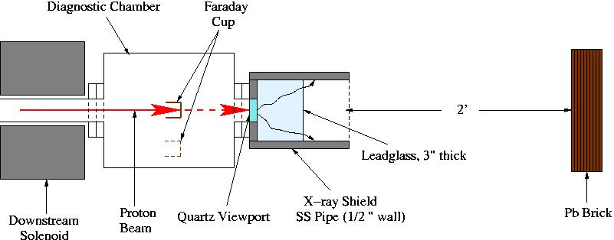
Stage 1 of proton source reconstruction:
Order IS vacuum components as shown on slide 5
Order power supplies for: Filament, Arc Pulser and IS Magnet
Order H2 gas cylinder, regulator, throttling valve, flow excess valve, etc.
Design/fabricate diagnostic chamber with quartz viewport & removable Faraday Cup
Repair filaments (2 pcs)
Test/repair (if needed) vacuum isolation and beam stopper valves
Install diagnostic chamber
Install vacuum pumping system on the IS and LEBT chambers
Install new filament
Pump & purge (N2 or H2) for extended period of time
Submit Hydrogen Gas Safety Note (should be able to use the old one)
Set H₂ gas flow to 10 mTorr pressure and monitor stability
Power filament, Arc Pulser & IS Magnet. Observe performance through the viewport.

Slide 9
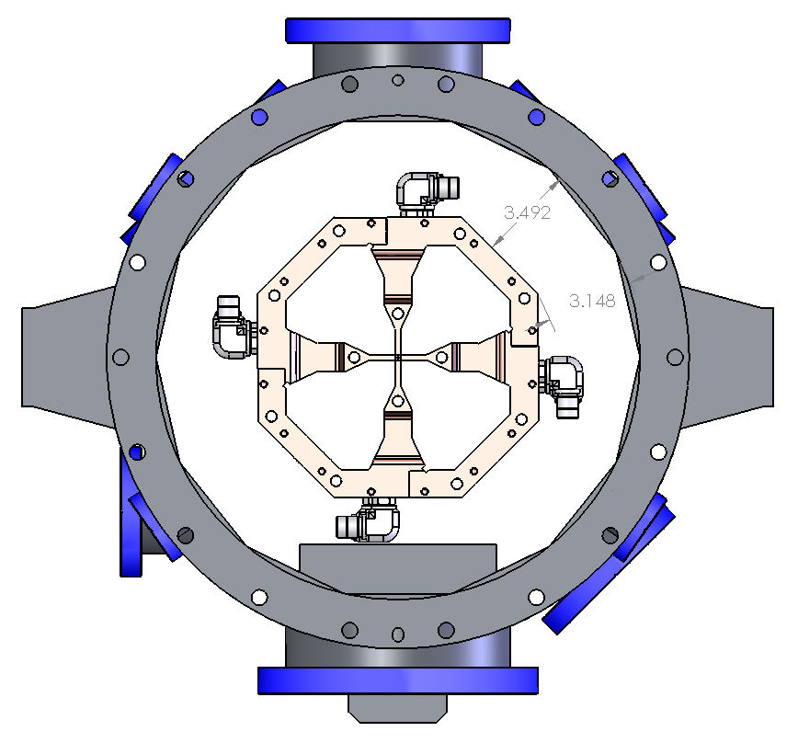
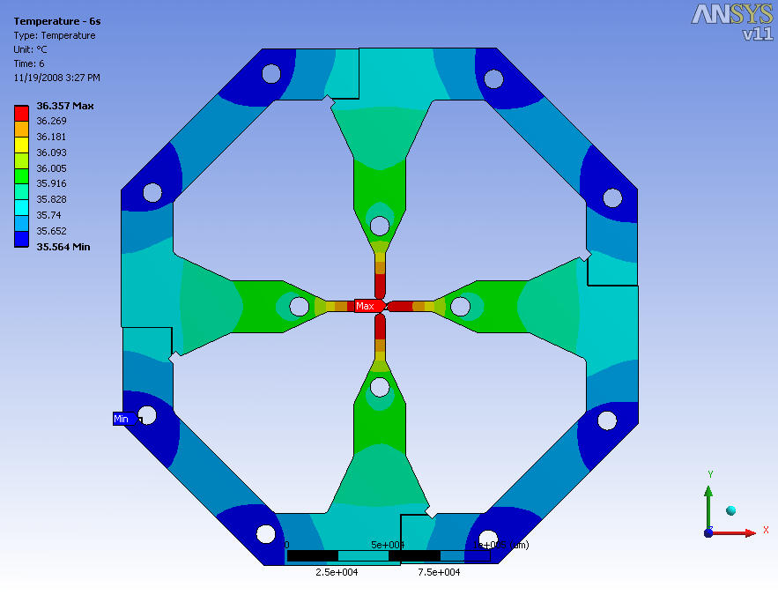
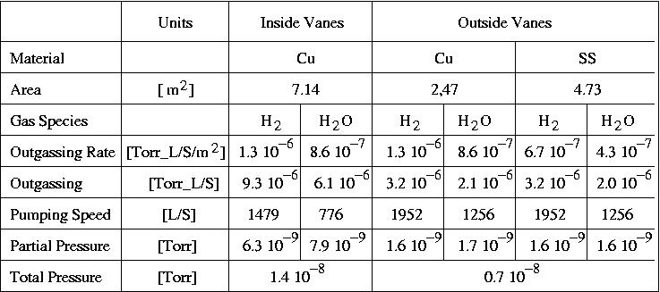
RFQ out-gassing sources
With vacuum pumping system shown in Slide 6 both projected and measured
pressure for the Inside & Outside Vanes spaces is in a range of 10⁻⁸ Torr.
But with RF ON the pressure is much higher, especially in the beam path space.
First step:
Close all RFQ ports and setup long-term N₂ gas purge with an occasional
pump-out using the dry-scroll pump (s).

Slide 10
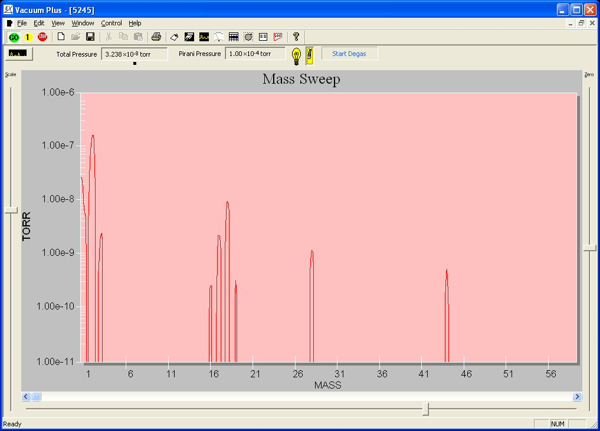
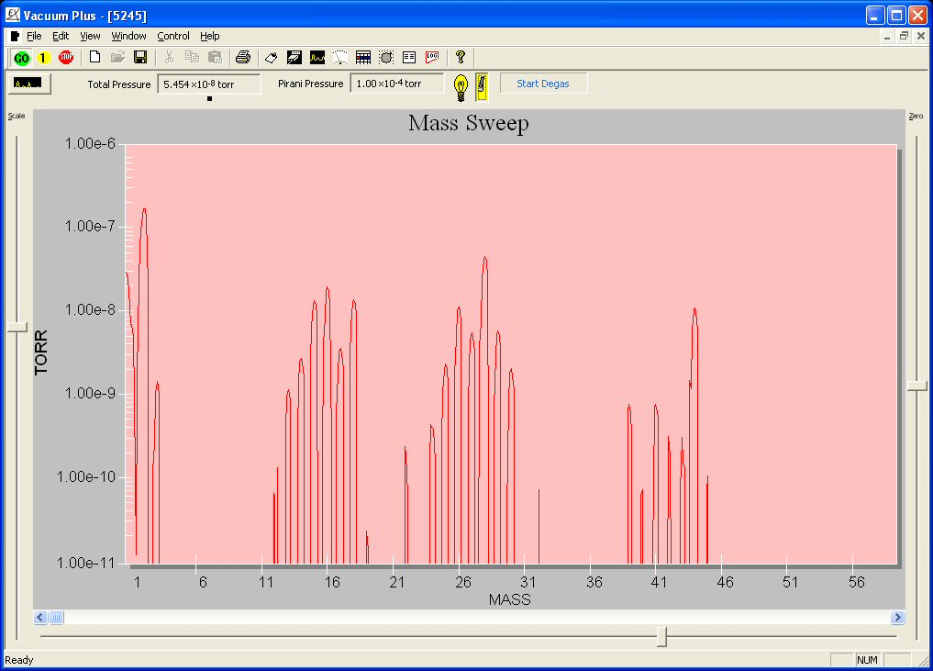
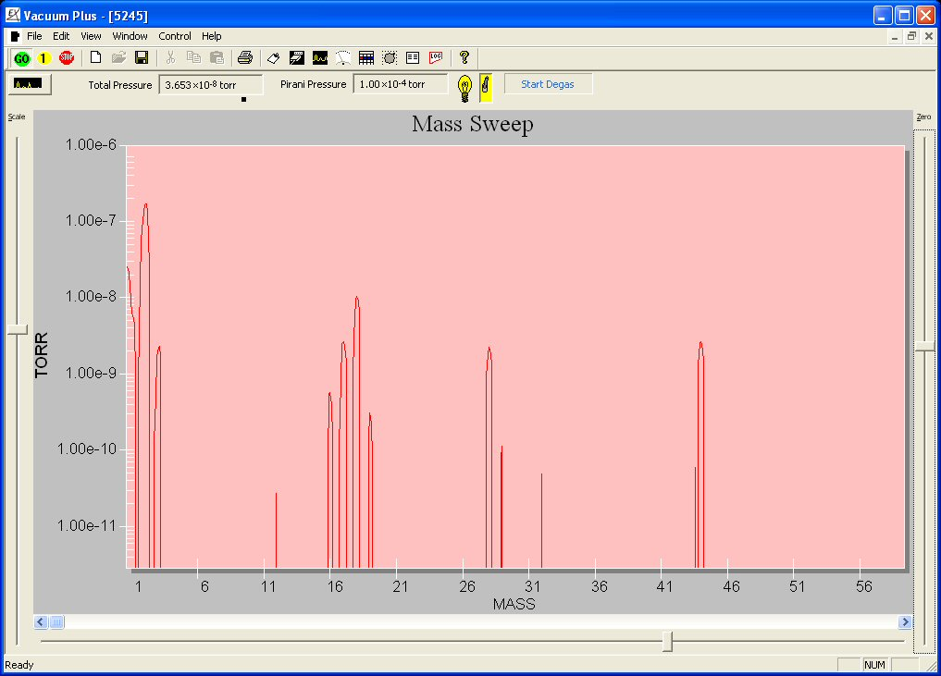
RGA data for the RFQ vacuum.
Note: A vey well performing
pumping system is required.
RF - no power
RF at 20 W (instantaneous)
RF at 20 W (4 hours of operation)

