Slide 1
Chromatic and Space Charge Effects
in Nonlinear Integrable Optics
Stephen D. Webb^{#1}, David Bruhwiler¹, Alexander Valishev²,
Rami Kishek^{1,3}, Slava Danilov⁴, Sergei Nagaitsev²
¹RadiaSoft, LLC., ²FermiLab, ³University of Maryland, ⁴Oak Ridge National Lab
#swebb@radiasoft.net
Boulder, Colorado USA – www.radiasoft.net

Slide 2
Outline
Crash Survey of Integrable Optics
Dispersion & Chromaticity
Space Charge & Invariants
Future work

Slide 3
Crash Survey of Integrable Optics

Slide 4
The properties of linear strong focusing
Strong focusing is robust because it is integrable
Two transverse Courant-Snyder invariants
orbits are integrable — regular, bounded, periodic motion
KAM theorem notably does not apply to linear systems
KAM Th^{m} does not apply to linear systems
single tune makes whole system unstable to resonant perturbations
higher-order effects such as chromaticity restore some stability
Linearity leaves system susceptible to parametric resonances
core-halo
resistive wall instability
beam break-up
…

Slide 5
Additional stability from nonlinear integrable optics
Key ideas:
A system with large tune spread…
fast Landau damping
suppresses parametric resonances
promises beam transport with lower losses
… but integrable dynamics
KAM Thm provides stability
on-momentum orbits are bounded and regular
perturbations lead to resonant lines…
…but orbits must diffuse out of dynamic aperture
so we expect stable beam dynamics in space charge

Slide 6
Conditions for Integrability
Bertrand-Darboux equation
Hamiltonians with 2nd invariants quadratic in momentum satisfy:
differential equation is linear
any superposition of potentials that satisfy this differential equation will have a 2nd invariant and be integrable
Other auxiliary conditions for accelerators:
matched beta functions in the drifts with these nonlinear elements
equal vertical and horizontal linear tunes

Slide 7
Nonlinearities suppress parametric resonances

Slide 8
Dispersion & Chromaticity

Slide 9
Dispersion & Chromaticity I
Off-momentum particles couple motion to energy
Linear lattice chromaticity:
energy-dependent tune could cross nonlinear resonance
no loss of integrability (assuming linear RF bucket/coasting beam)
Linear lattice dispersion:
large dispersion can cause large beam size
Potential problems for elliptic potential
unequal tunes violates the Bertrand-Darboux equation
dispersion violates the equal beta function requirement
Conclusions:
defocussing quadratic perturbation due to differing chromaticities
already have large tune spreads — no need to remove all the chromaticity

Slide 10
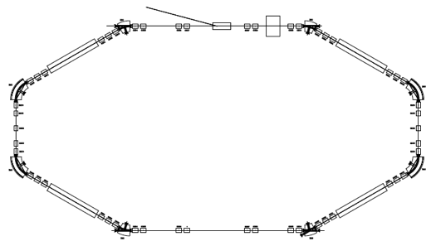
Single-turn Map
Single turn map
Figure from S. Nagaitsev, “IOTA Physics Goals” (2012)

Slide 11
Single-turn Map

Slide 12
Dispersion & Chromaticity II
Computed for the continuously varying magnet
Details in extra slides…
Compute single-turn map as
and the related Hamiltonian
For the Bertrand-Darboux potential, we require:
Very particular form for U
equal vertical and horizontal linear tunes

Slide 13
Dispersion & Chromaticity III
New Set of Design Rules:
Twiss parameters
require equal beta functions to get desired cancellation
effective double-focusing lens for on-momentum linear map
Chromaticity
transverse tunes must be equal
familiar chromaticity correction schemes sufficient
correct to make Cx = Cy
Dispersion
dispersion modifies the integrable potential
drift section for elliptic magnets must be dispersion-free

Slide 14
Space Charge & Invariants

Slide 15
Presence of Space Charge Changes Distribution

Slide 16
Presence of Space Charge Changes Distribution

Slide 17
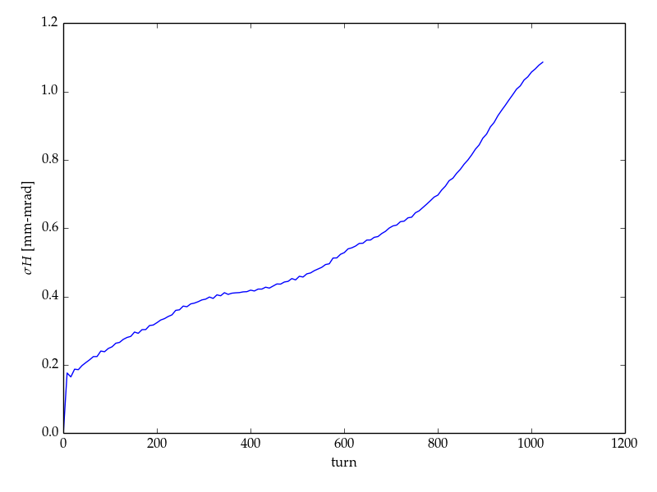
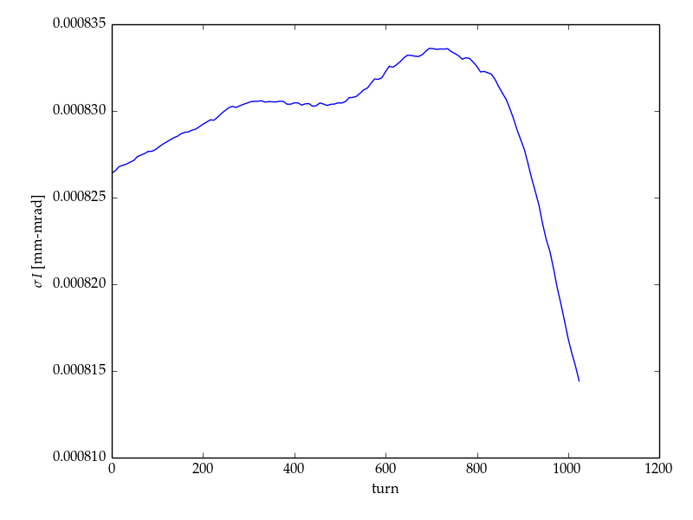
Presence of Space Charge Changes Distribution

Slide 18
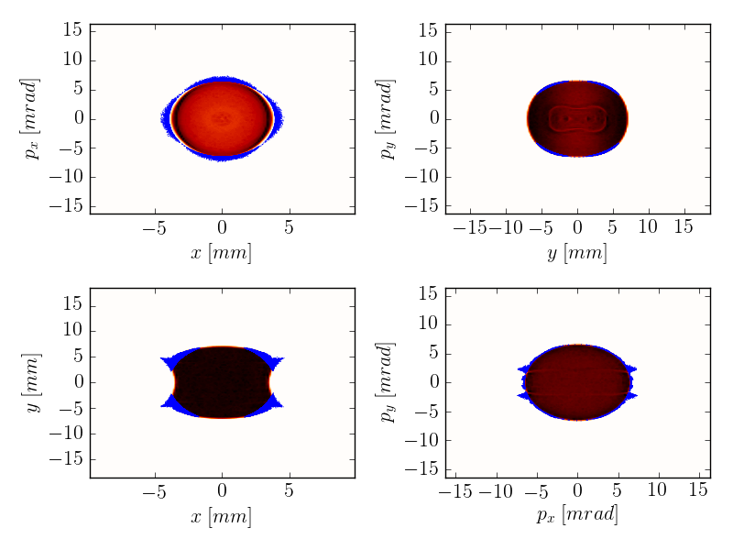
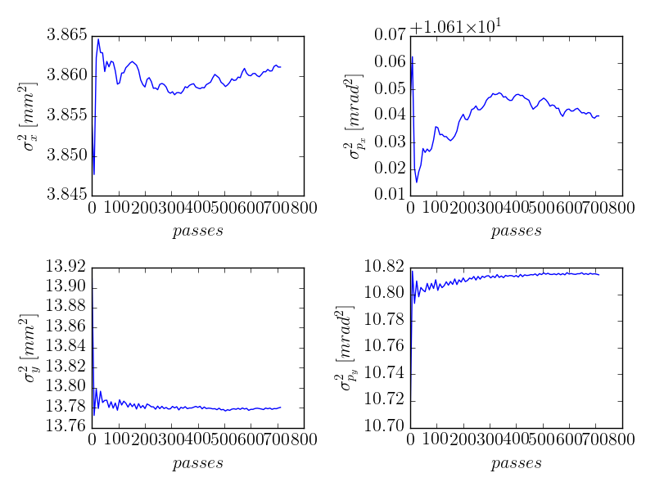
But the transverse beam distribution is static…
After 700+ turns, transverse phase space remains static
Transverse beam size has initial growth, followed by very small variations

Slide 19
What’s going on?
Hamiltonian now contains self-consistent space charge
Hamiltonian given by
[G] ∝ [current]
intensity-dependent effects induce diffusion
distribution diffuses to fill “potential”
achieves steady state through space charge induced stochasticity
Speculation, requires better evidence
diffusion rate ∝ current
actual calculation (unlikely)
¹see, e.g., Lichtenberg & Lieberman, §5.4

Slide 20
What’s going on?
Diffusion in Action Space
Fokker-Planck Equation for perturbed integrable systems¹
Modified Hamiltonian with space charge
Particles drift in effective potential and diffuse
some steady state reached
some particles diffuse out of the potential well
complicated by resonance islands, correlations, nonlinear Fokker-Planck…
¹see, e.g., Lichtenberg & Lieberman, §5.4

Slide 21
Future Work
What do the chromaticity corrections do to the invariants?
What do sextupoles, etc., do the the dynamic aperture?
How to minimize the impact on the beam?
What is the diffusion time for particles on resonance?
What does space charge do?
How does space charge affect the invariants?
What can be done to compensate space charge?
Is there a collective invariant that remains?

Slide 22
Thank you for your attention
This work is supported in part by US DOE Office of Science, Office of High Energy Physics under SBIR award DE-SC0011340.
11 November 2014
2014 High Brightness Beam Workshop

Slide 23
Digression on Lie Operators
Lie operators from Poisson brackets
Advantages
can multiply maps, cannot multiply Hamiltonians
maps make coördinate transformations into similarity transformations
Disadvantages
a lot of formalism to get to the physics
difficult to work with time-varying Hamiltonians
Key Identities
BCH Identity
Similarity transformation

Slide 24
When are sextupoles optically transparent?
Lie operator approach
Off-momentum particles do not cancel exactly because θ is energy-dependent. This is the basis of chromaticity correction.

Slide 25
When are sextupoles optically transparent?
Pictorial approach (design momentum)

Slide 26
When are sextupoles optically transparent?
Pictorial approach (off-momentum)

Slide 27
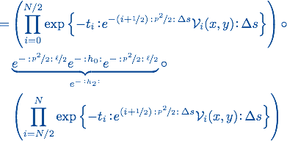
The horror…

Slide 28
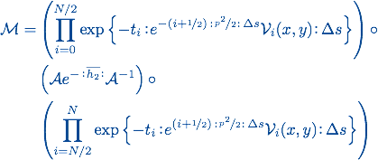
… the horror
Normalized coördinates
Courant-Snyder
Parameterization

Slide 29
The Danilov-Nagaitsev potential normalizing trick as follows:

Slide 30
Final transfer map in normalized coordinates

