Slide 1
The Long-Baseline Neutrino Facility
Jim Strait, LBNE Project Director
Open meeting for the scientific community to form LBNF
5 December 2014 (CERN)
12 December 2014 (Fermilab)

Slide 2
Outline
Overview of the Fermilab Neutrino Program
Increasing proton beam power: PIP and PIP-II
The Facilities for a long-baseline experiment
The facilities team for LBNF
Neutrino Beamline
Sanford Underground Research Facility
Conventional Facilities at Fermilab and SURF
Cryogenic infrastructure
Technically limited schedule
Summary and Conclusions

Slide 3
Accelerator-Based Neutrino Program at Fermilab
Fermilab hosts an active, diverse, international accelerator-based neutrino program
Two neutrino beams in operation and a third under design
Four experiments currently taking data
Three completed experiments analyzing data
One experiment under construction
Two experiments under design
One proposal reviewed by the PAC and under consideration by Fermilab management
Several experimental proposals submitted or in development
Various R&D programs proposed or under way
Supporting test beam program for detector development and calibration.
The Fermilab Neutrino Program Hosts Collaborators from across the globe:
Brazil, Canada, Chile, Czech Republic, Greece, India, Italy, Mexico, Peru, Poland, Russia, Switzerland, UK, US, ...

Slide 4
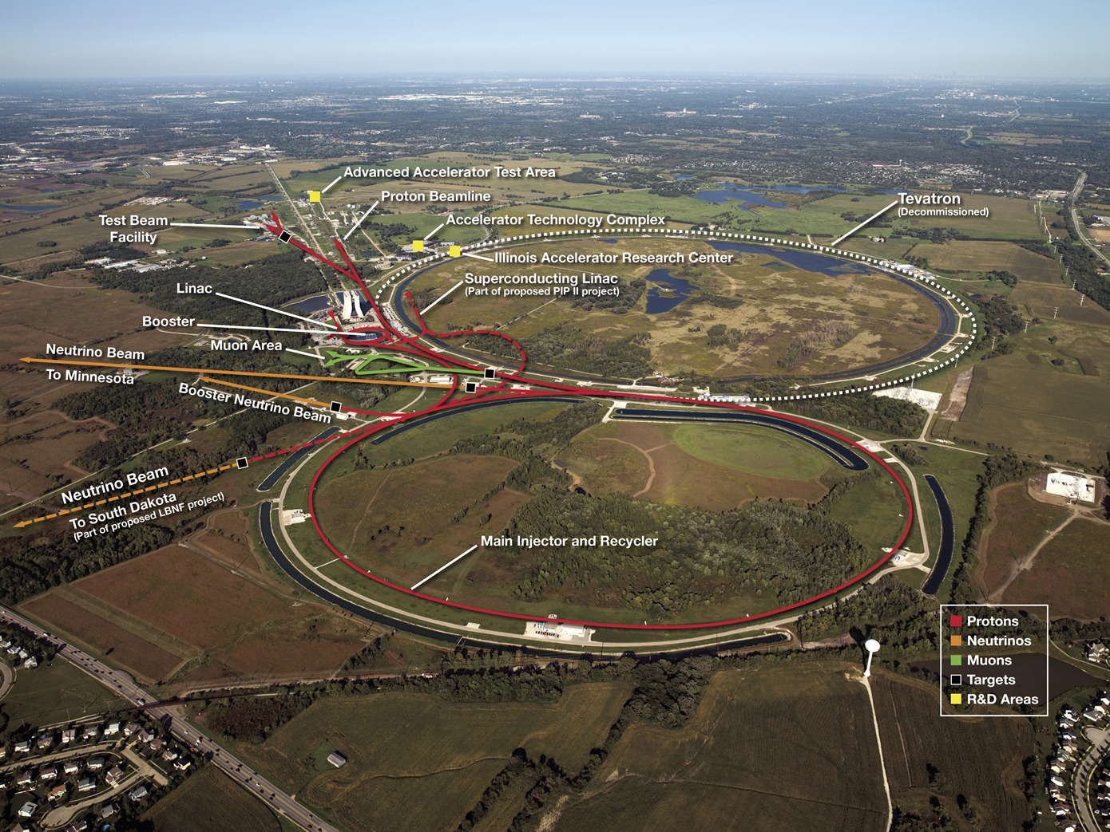
Fermilab Accelerator Complex

Slide 5
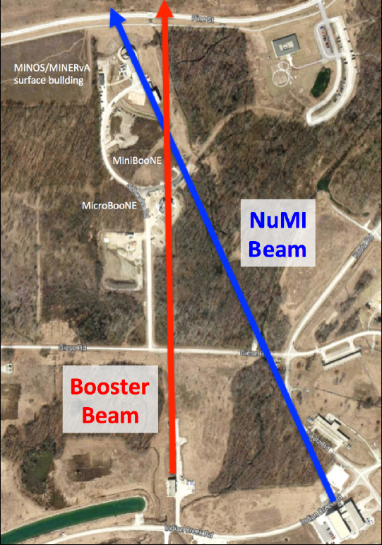
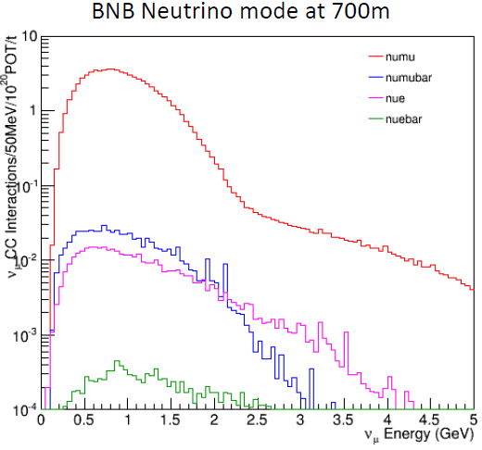
NuMI and Booster Beams
NuMI:
- tunable 1 GeV to >10 GeV
- Near hall at 1 km
- Far detectors 735 – 810 km
BNB:
- Low energy 0.1 – 1.5 GeV
- Focused on short-baseline oscillations and cross sections

Slide 6
Experiments in the NuMI Beam
Long-baseline oscillation experiments
Neutrino scattering experiments
Brazil, Greece, India, Poland, UK, US
Italy, Switzerland, US
Brazil, Czech Rep., Greece, India, Russia, UK, US
Brazil, Chile, Mexico, Peru, Russia, Switzerland, US

Slide 7
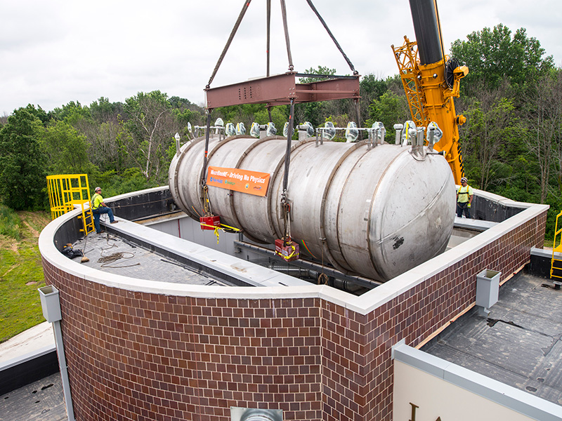
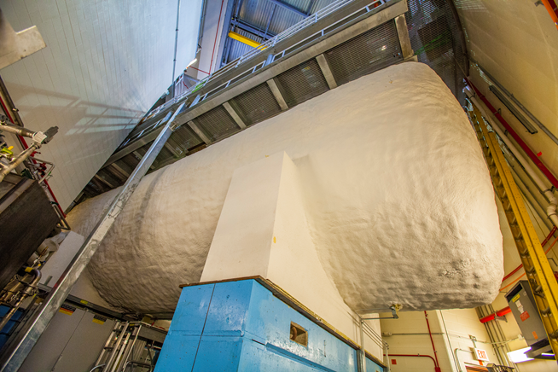
Experiments in the Booster Neutrino Beam
Testing short-baseline anamolies ... sterile neutrinos?
Canada, Mexico, UK, US
MicroBooNE
Switzerland, UK, US

Slide 8
Fermilab Short Baseline Neutrino (SBN) Program
Utilize successful Booster Neutrino Beamline (BNB) developed for MiniBooNE
In 2015 next phase: MicroBooNE (approved for 6.6E20 P.O.T.)
In 2018: Three LAr-TPC detectors:
Near: New detector using LBNE technology @ 110m from BNB target
Middle: MicroBooNE @ 470m
Far: refurbished ICARUS detector moved from Gran Sasso, Italy @ 600m
Motivations
Science: precise study of ν anomalies from the MiniBooNE and LSND experiments. Search for Sterile ν’s
R&D: continued development of LAr-TPC technology for LBNF program
Build international partnerships for LBNF program
Switzerland, UK, US
Switzerland, UK, US
Italy, Poland, Russia, Switzerland, US

Slide 9
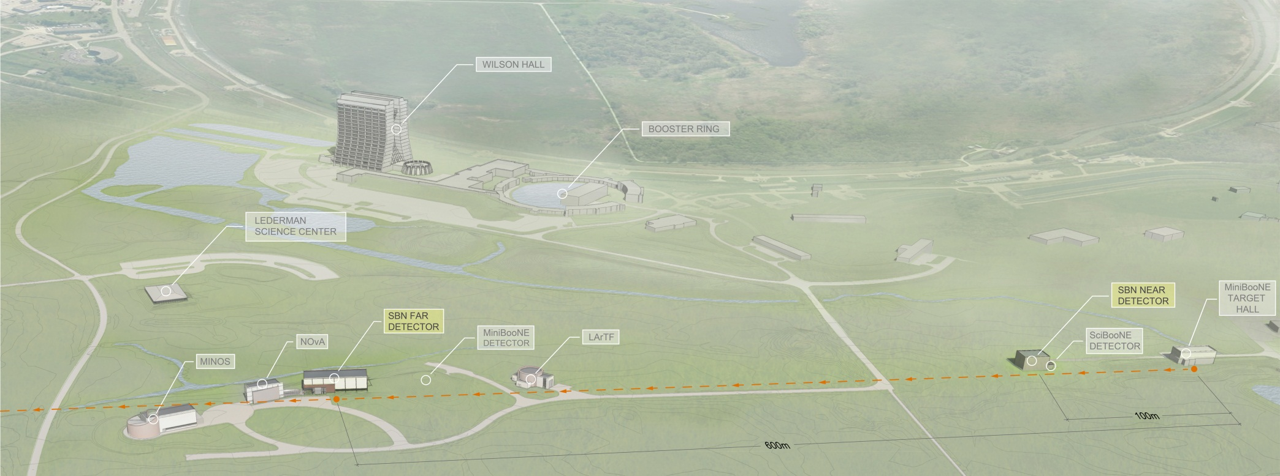
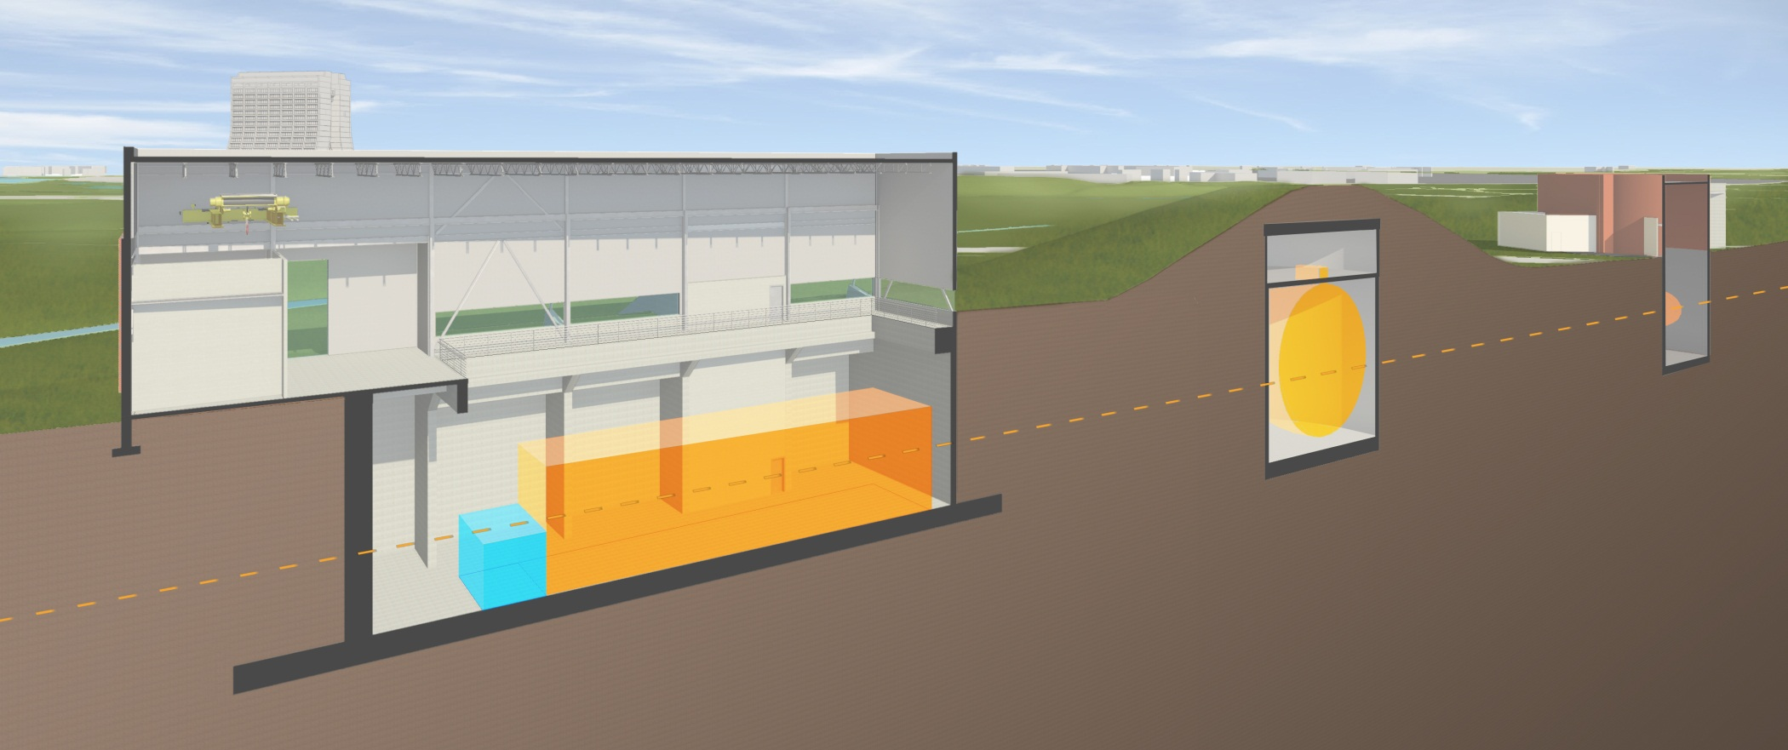
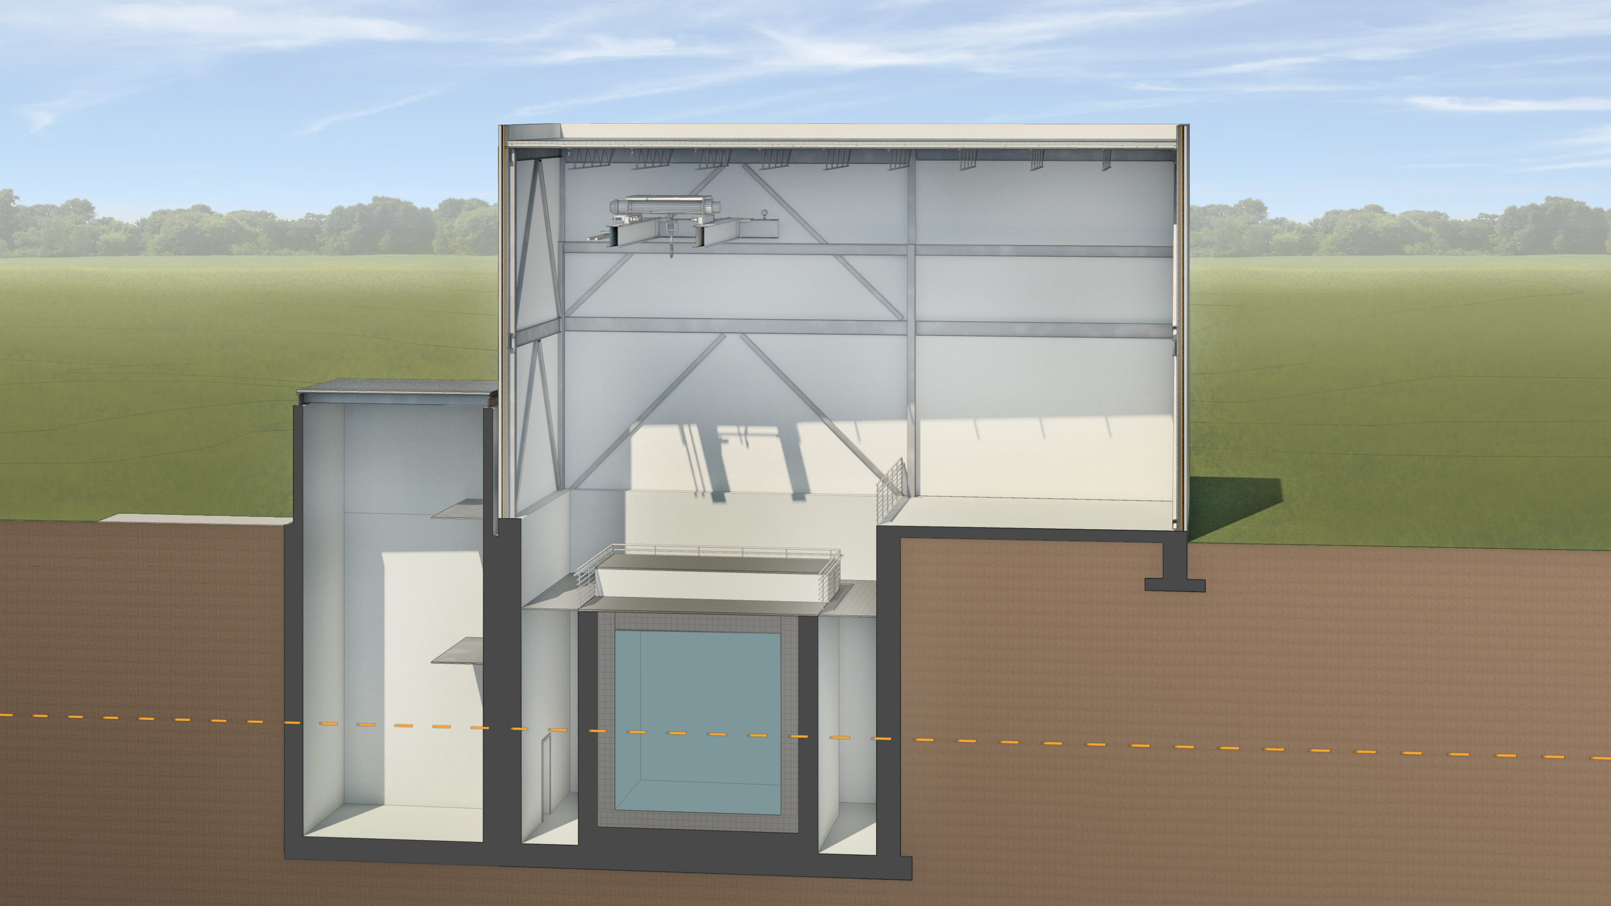
SBN Program Layout
MicroBooNE
DETECTOR

Slide 10
SBN Program Development
International partnership of the three collaborations developing joint proposal for submission to January 2015 PAC meeting
More than 40 institutions from 5 countries including 4 DOE labs and CER
Strong support from US DOE and NSF, INFN, and CERN. Additional support requests to CH NSF and UK STFC
Very Fast timeline
2014 – Proposal preparation initial design and logistics
2014 – Civil construction start, near detector design, T600 refurbishing
2016 – Civil construction complete, near detector construction, T600 refurbishing
2017 – Detector installation
2018 – Beam operations with all three detectors
Support expected from US DOE, US NSF, INFN and CERN.

Slide 11
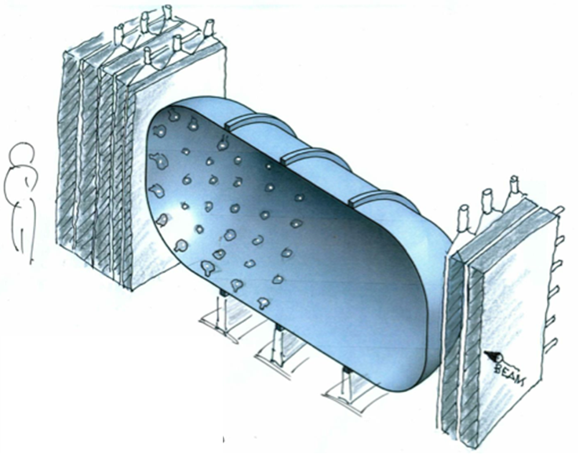
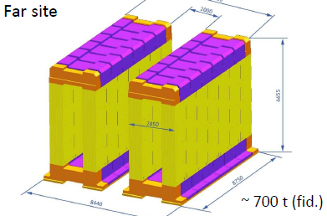
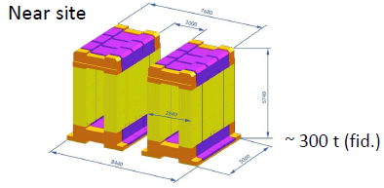
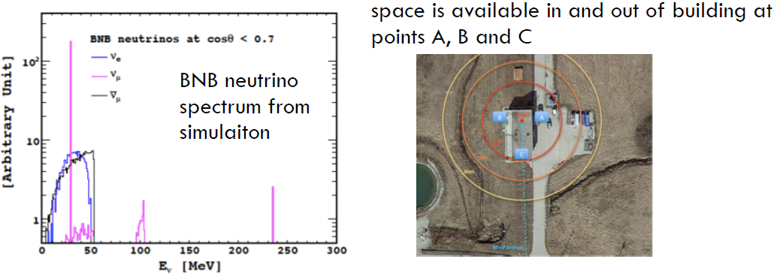
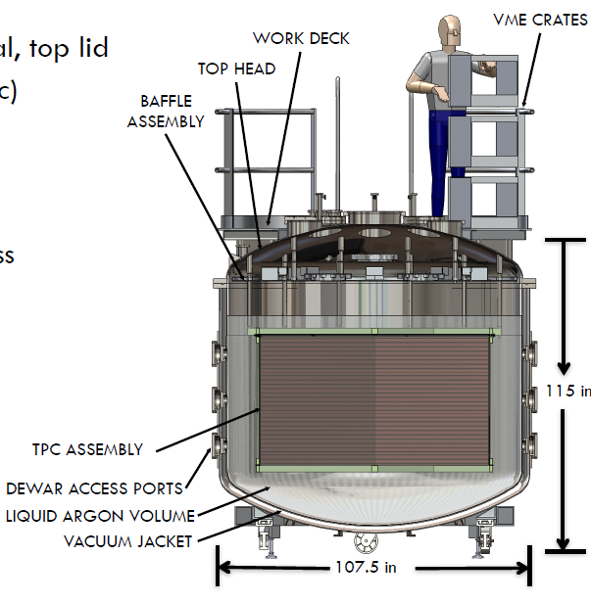
Additional Possible Experiments in the Booster Beam
Croatia, Italy, Russia, Switzerland
UK, US
Short-baseline ν_{μ}-disappearance measurement in BNB (NESSiE)
ANNIE: Measure ν-induced backgrounds relevant for large water detectors using an Optical Time Projection Chamber in BNB
CAPTAIN
US
Calibrate LAr TPC response to low-energy neutrinos with stopped pion beam

Slide 12
Increasing beam intensity
Upgrades to the Main Injector and Recycler done as part of the NOvA construction will enable doubling the NuMI beam power to 700 kW
Convert Recycler to proton-stacking ring
Increase Main Injector ramp rate
~10% increase in intensity per pulse
Proton Improvement Plan (PIP) to increase proton flux from Booster to the Main Injector
Refurbish Booster RF system: 7.5 → 15 Hz beam operation
Upgrades to Linac and Booster for higher reliability
Combined upgrades will deliver 700 kW to NOvA and increase the intensity of the Booster Neutrino Beam.

Slide 13
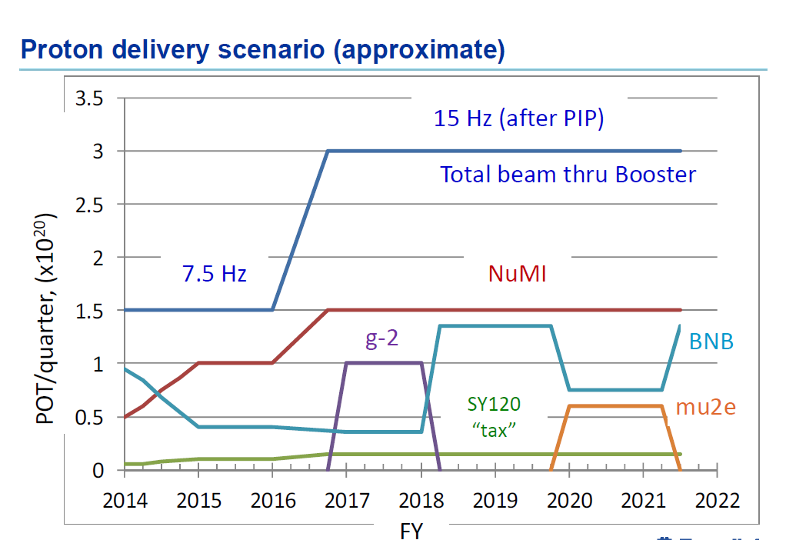

Slide 14
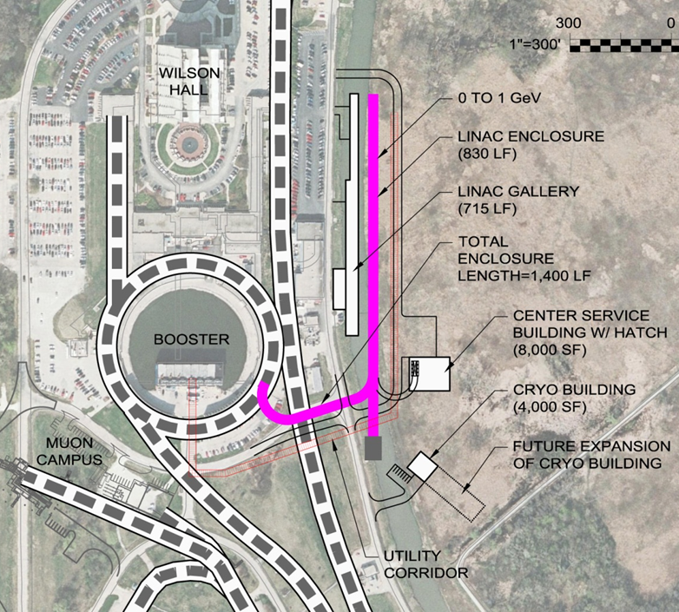
Proton Improvement Plan II (PIP-II)
Goal is to increase Main Injector beam power to 1.2 MW.
Replace the existing 400 MeV linac with a new 800 MeV superconducting linac => 50% increase in Booster intensity.
Shorten Main Injector cycle time 1.33 → 1.2 sec.
Build this concurrently with LBNF => 1.2 MW to LBNF from t = 0.
This plan is based on well- developed SRF technology.
Developing an international partnership for its construction
Strong support from DOE and P5

Slide 15
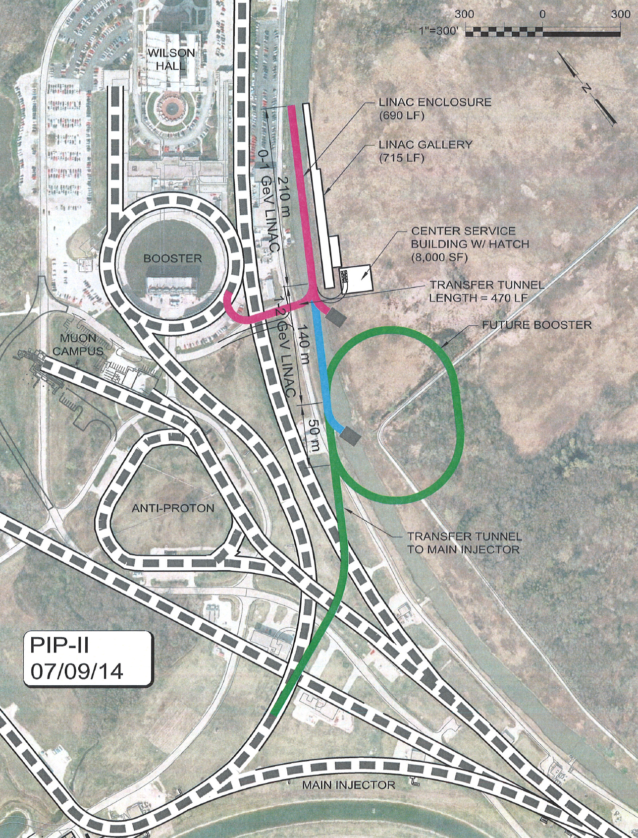
Flexible Platform for the Future
Future upgrade would provide > 2 MW to LBNF
Flexibility for future experiments
100’s kW at 800 MeV
100’s kW at few GeV, depending on design of next upgrade
Example shown is for 2 GeV SRF linac + new Rapid Cycling Synchrotron

Slide 16
Long-Baseline Neutrino Facility
Fermilab is prepared to host a Long-Baseline Neutrino Facility. Working with international partners it will provide the infrastructure required to carry out a world-leading long-baseline neutrino oscillation experimental program.
The facilities will include:
A neutrino beam capable of operating at 1.2 MW and upgradeable to at least 2.4 MW
Far site infrastructure to house a massive LAr TPC far detector 1300 km from Fermilab at the Sanford Underground Research Facility,
Near site infrastructure to house the near detector
Major technical infrastructure such as cryostats and cryogenic systems for LAr TPC detector(s).

Slide 17
The LBNF Facilities Team
The work so far has been done mainly by the LBNE Project Team, already with significant international collaboration:
Beamline: Fermilab with collaborations with UTA, RAL, RADIATE Collaboration, CERN, US-Japan Task Force, IHEP/Beijing, and others.
Conventional Facilities: Fermilab, SURF and contractors; collaboration initiated with LAGUNA-LBNO team
Cryostat and cryogenic systems: Fermilab; collaboration initiated with CERN and with LAGUNA-LBNO team.
The LBNF team will be built on this foundation, with expanded collaboration as this becomes a truly international program.
Expanded roles for existing partners
Augmented by additional partners
China, Finland, Japan, Switzerland, UK, US, ...

Slide 18
The LBNF Facilities
The facilities team has been working with the scientific community to develop facilities to support the experimental program.
Has worked for many years with the LBNE Collaboration
During the past year, have expanded to also work with the LAGUNA-LBNO Collaboration
The LBNF facilities team will work with the new Collaboration, which will provide scientific and technical requirements for the LBNF experiment, to design and build the facilities that will enable a world-leading long-baseline program.
The slides that follow summarize the current facility designs on which the new LBNF facility designs will build.
Armenia, Brazil, Czech Rep., India, Italy, Japan, Russia, UK, US
Bulgaria, Finland, France, Germany, Greece, Italy, Japan, Poland, Romania, Russia, Spain, Switzerland, Turkey, UK

Slide 19
Beamline for a new Long-Baseline Neutrino Facility
A design for a new neutrino beam at Fermilab is under development in the context of the LBNE Project, which will support the new Long-Baseline Neutrino Facility.
Directed towards the Sanford Underground Research Facility (SURF) in Lead, South Dakota, 1300 km from Fermilab.
Beam spectrum to cover 1st (2.4 GeV) and 2nd (0.8 GeV) oscillation maxima => Cover 0.5 ~ 5 GeV
All systems designed for 1.2 MW initial proton beam power.
Facility is upgradeable to ≥2.4 MW proton beam power.

Slide 20
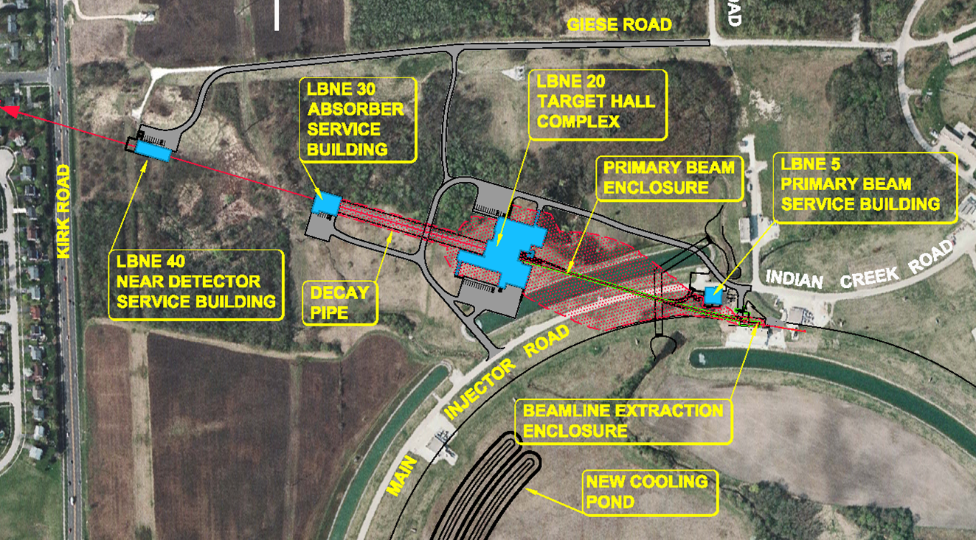
Beamline for a new Long-Baseline Neutrino Facility
Main
Injector

Slide 21
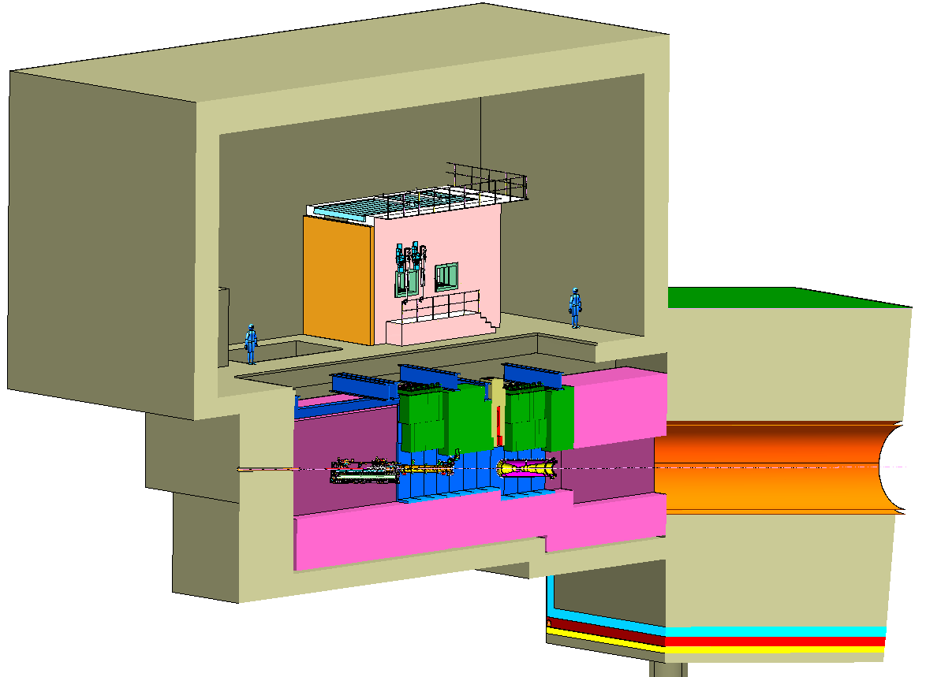
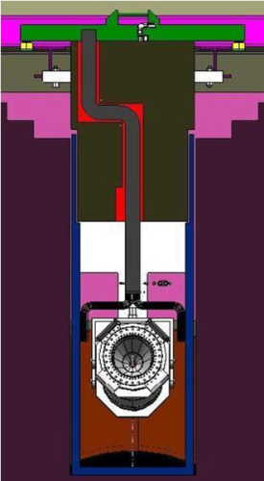
Target Hall and Decay Pipe Layout
Decay Pipe concrete
shielding (5.5 m)
Work Cell
Decay Pipe: Diameter = 4 m
Length = 200~250 m
helium-filled
Baffle/Target Carrier
Geomembrane barrier system to keep groundwater out of decay region, target chase and absorber hall
Target Chase: 1.6 m/1.4 m wide, 24.3 m long

Slide 22
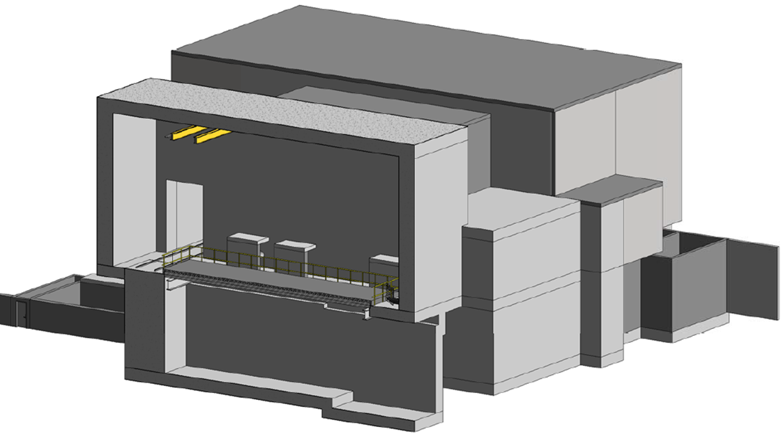
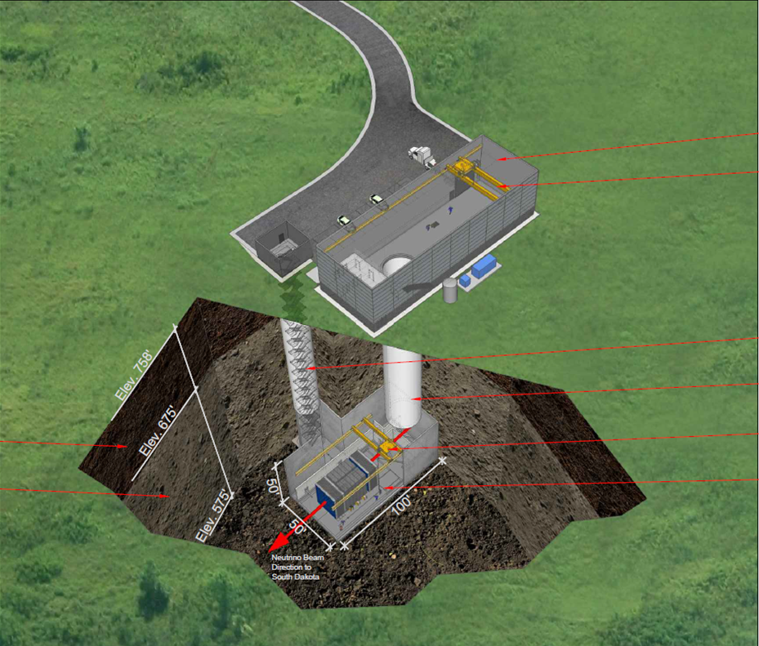
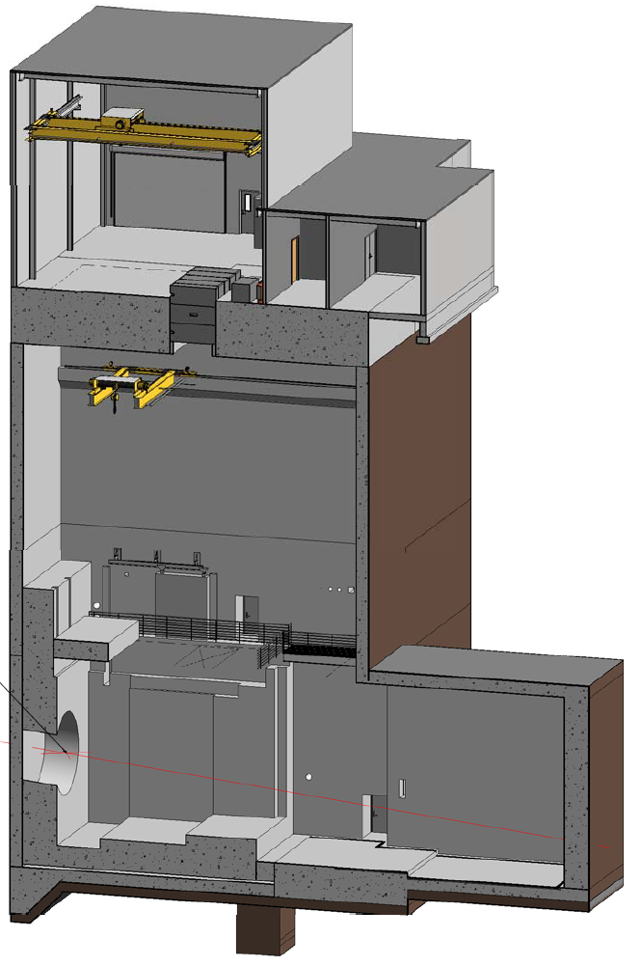
Conventional Facilities Designs
Target hall complex
Near Detector Hall and Surface Building
Absorber hall

Slide 23
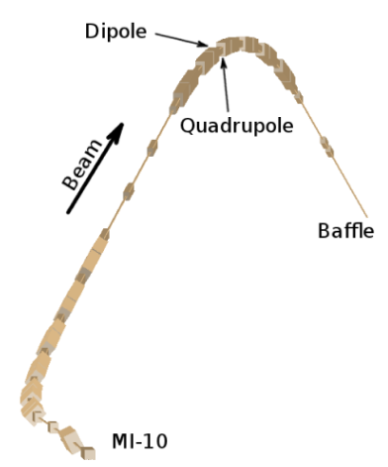
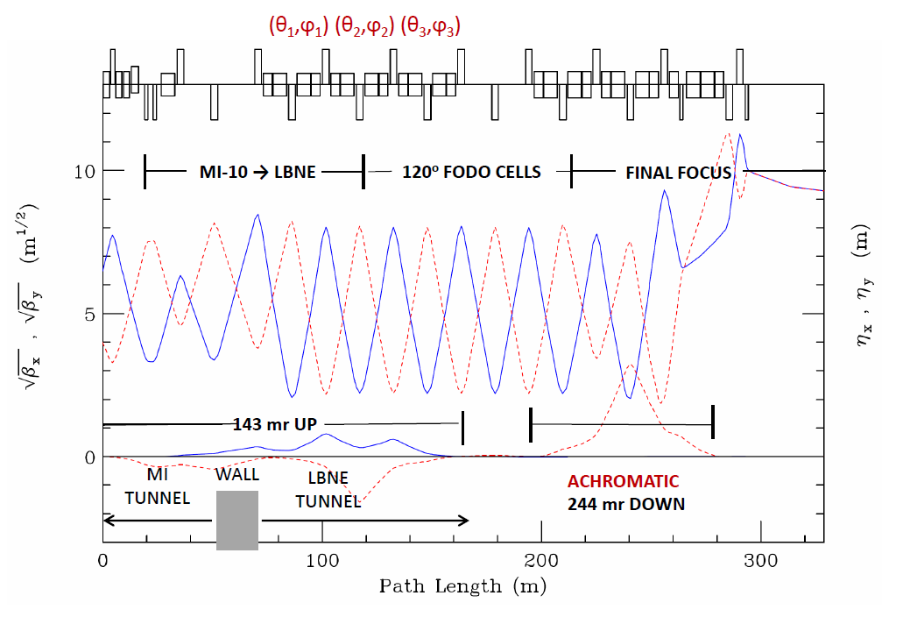
Primary Beam and Lattice Functions
The LBNF Primary Beam will transport 60 - 120 GeV protons from MI-10 to the LBNF target to create a neutrino beam. The beam lattice points to 79 conventional magnets (25 dipoles, 21 quadrupoles, 23 correctors, 6 kickers, 3 Lambertsons and 1 C magnet).
Beam size at target tunable between 1.0-4.0 mm
STRUCT/MARS simulations have shown that highest beam loss rate
takes place right at the apex of beamline
Horizontal (solid) and vertical (dashed) lattice functions of the LBNF transfer line
The final focus is tuned for σ_{x} = σ_{y} = 1.50 mm at 120 GeV/c with β* = 86.33 m and nominal MI beam parameters ε₉₉ = 30π μm & Δp₉₉/p = 11x10⁻⁴

Slide 24
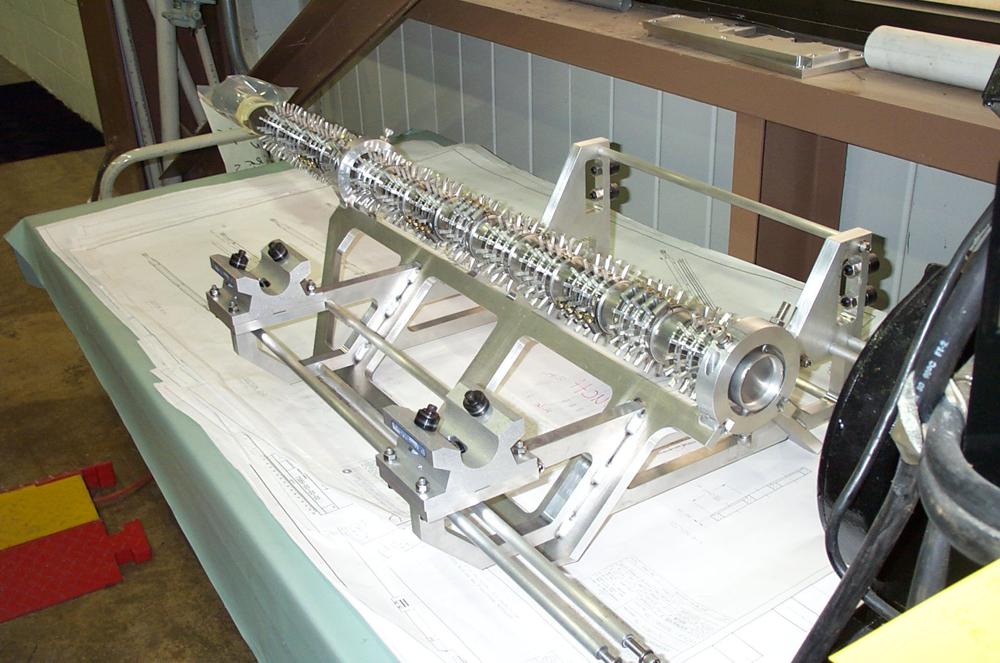
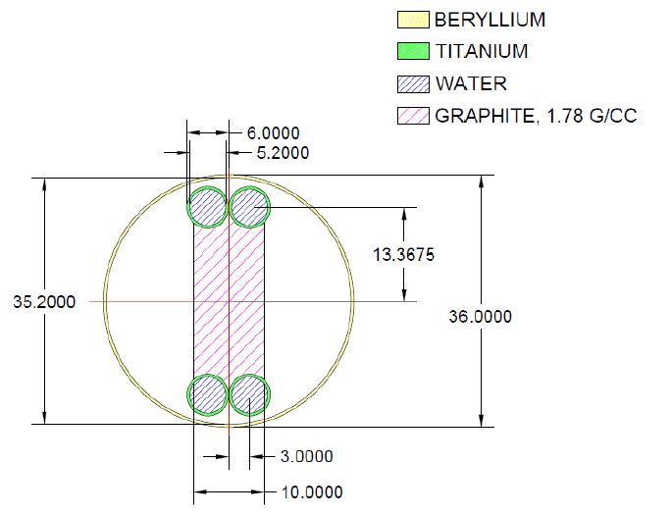
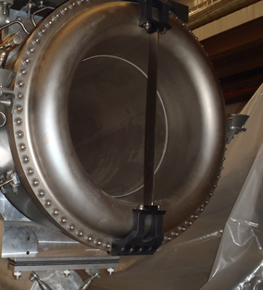
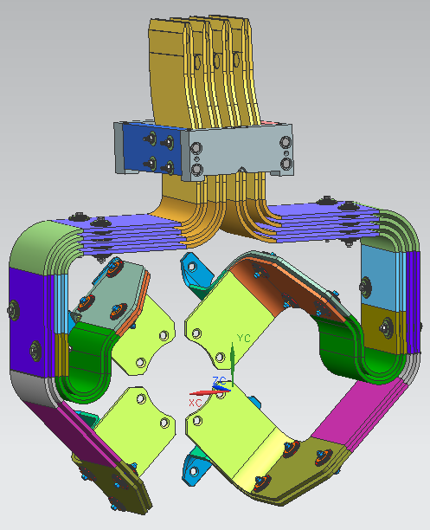
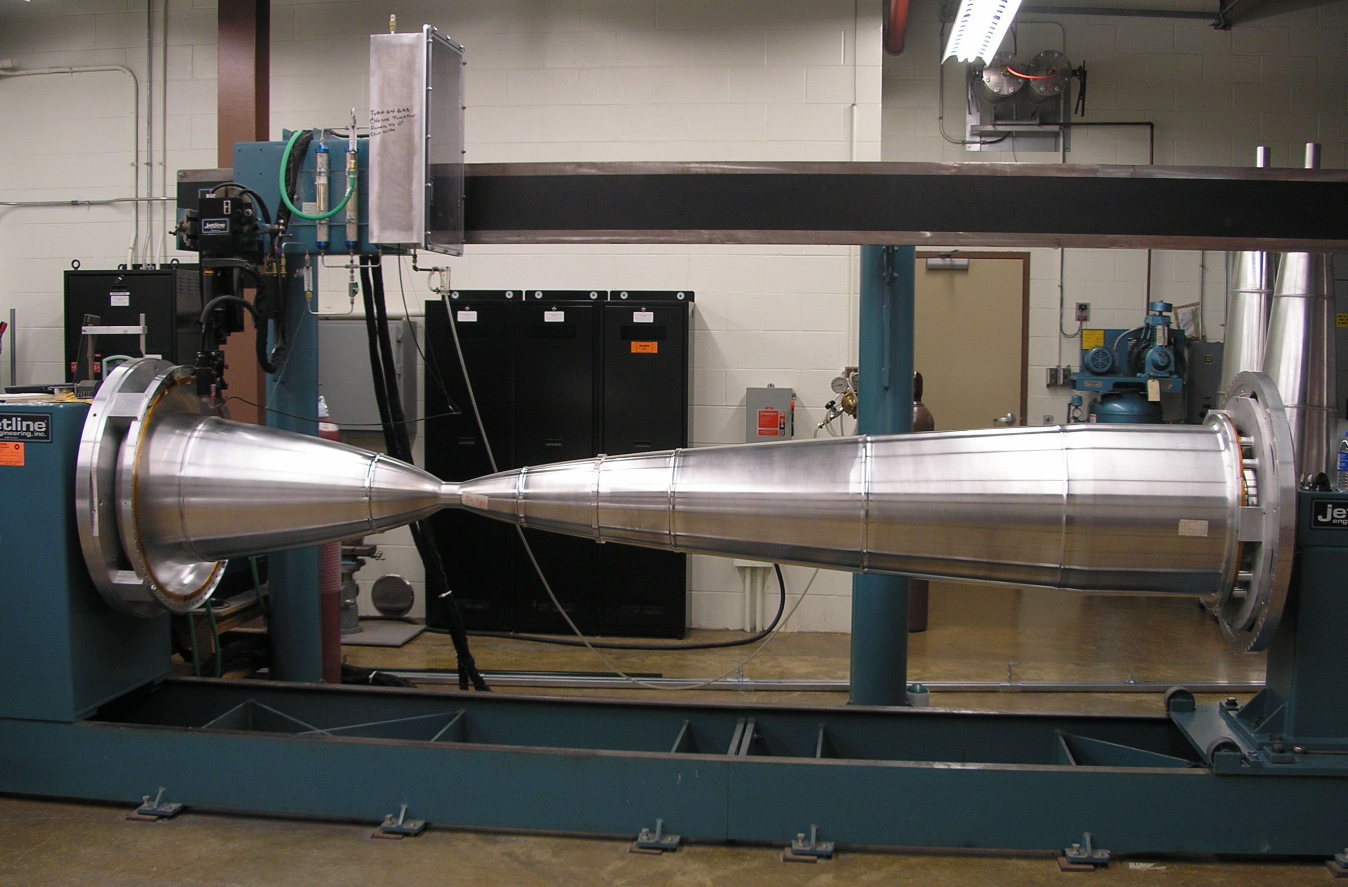
Components inside the target chase
Baffle
47 graphite target segments, each 2 cm long
Target cross section
Horn Stripline
Horn

Slide 25
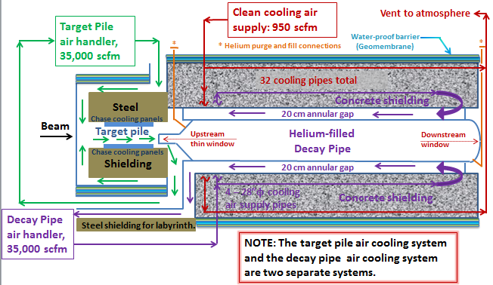
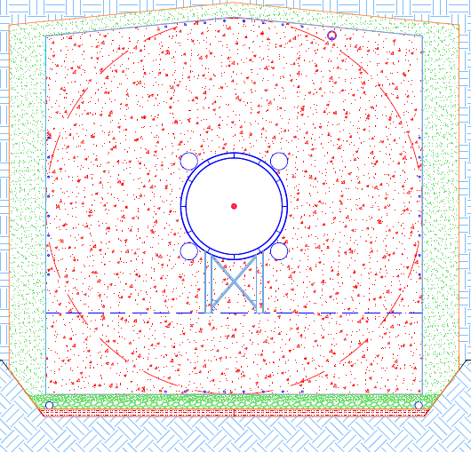
Helium-filled/Air-cooled Decay Pipe
4 - 28”φ cooling air supply pipes
Cooling air returns in the annular gap
32 clean cooling air pipes
Concentric Decay Pipe. Both pipes are ½” thick carbon steel
Decay pipe cooling air supply flows in four, 28” diam. pipes and the annular gap is the return path
The helium-filled decay pipe requires that a replaceable, thin, metallic window be added on the upstream end of the decay pipe
Al
(1m diam.)
Be: 23.8 cm diam.

Slide 26
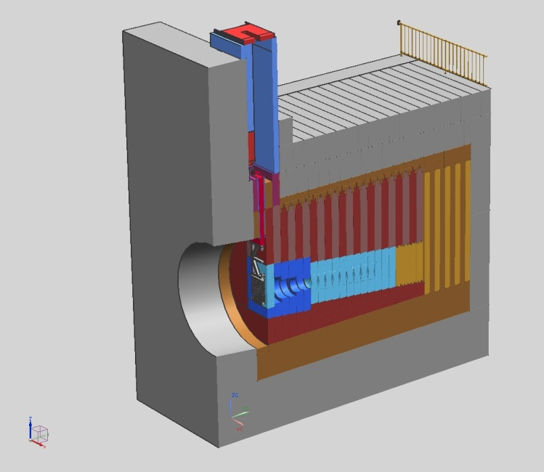
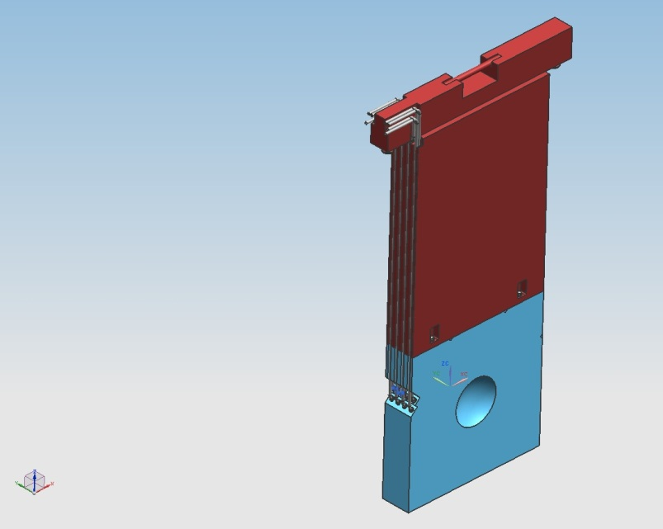
Absorber Complex – Longitudinal Section
The Absorber is designed for 2.4 MW
A specially designed pile of aluminum, steel and concrete blocks, some of them water cooled which must contain the energy of the particles that exit the Decay Pipe.
Thermal, structural, mechanical engineering development in progress
Decay Pipe
CCSS Steel
Steel
Al
Beam
concrete
Sculpted Al block
Remote Handling Facility for HM
Hadron Monitor (HM)

Slide 27
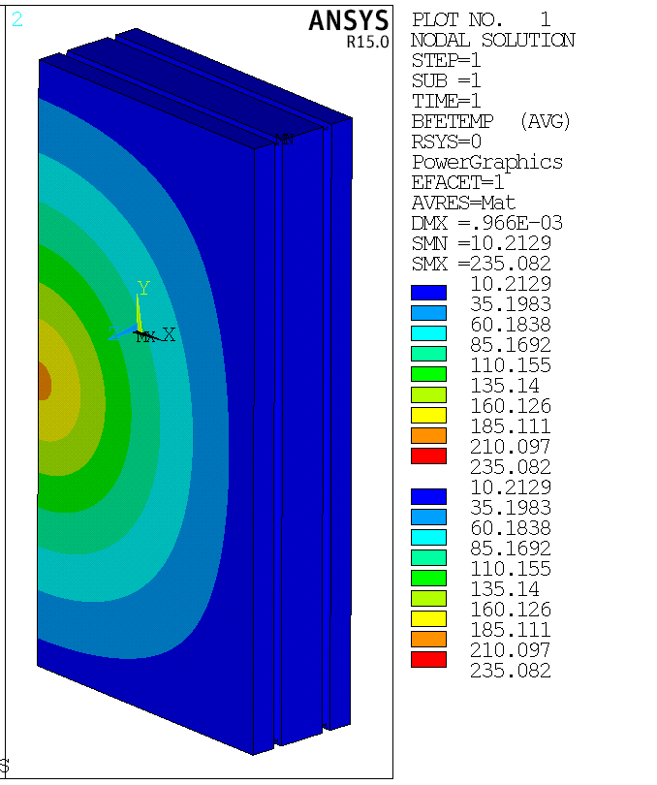
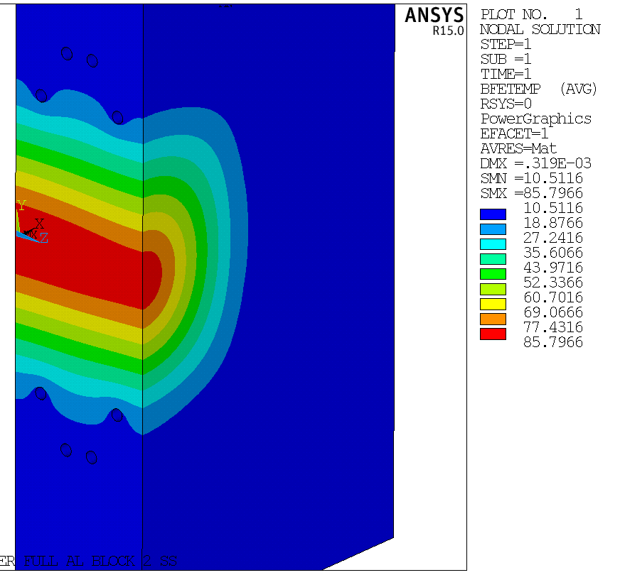
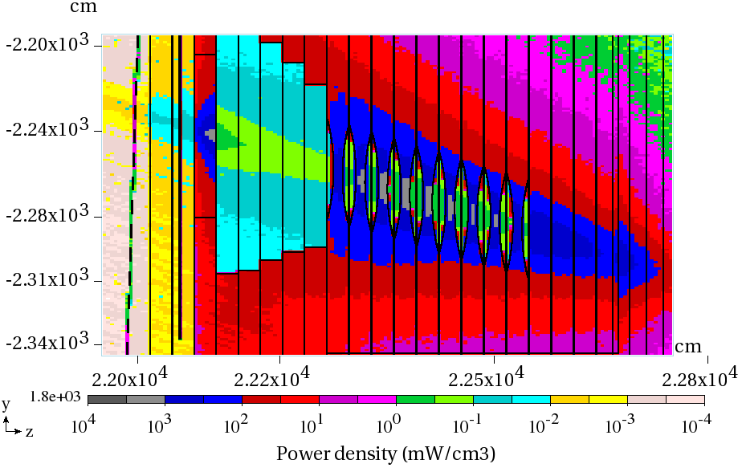
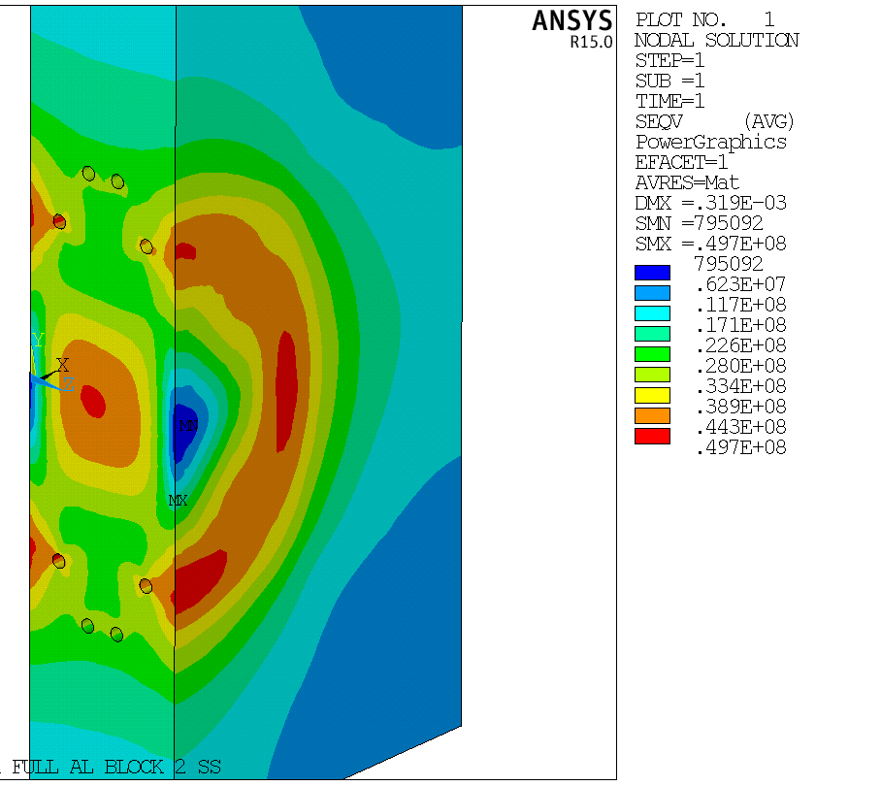
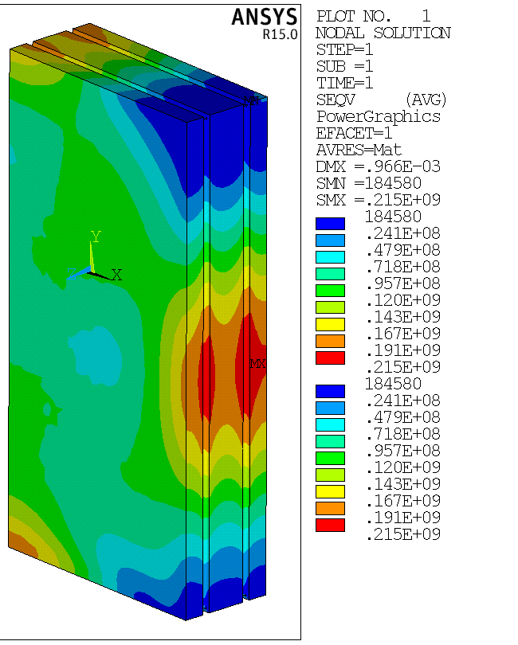
Absorber Design/MARS Simulations (2.4 MW)
9 sculpted Al blocks and 4 solid Al blocks in the core
Al spoiler
Al blocks
Steel blocks
Max Temp Al: 86⁰C
Max VM stress Al: 50 MPa at water line
Max Temp steel: 235⁰C
Max VM stress Al: 215 MPa

Slide 28
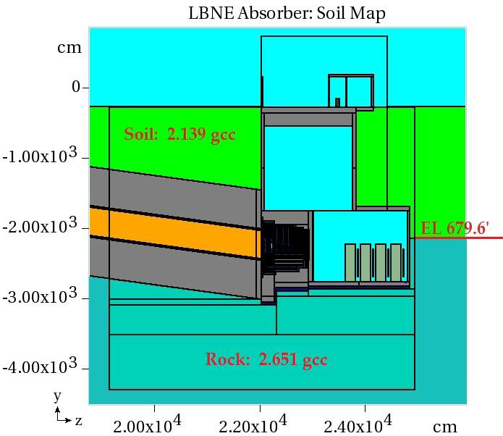
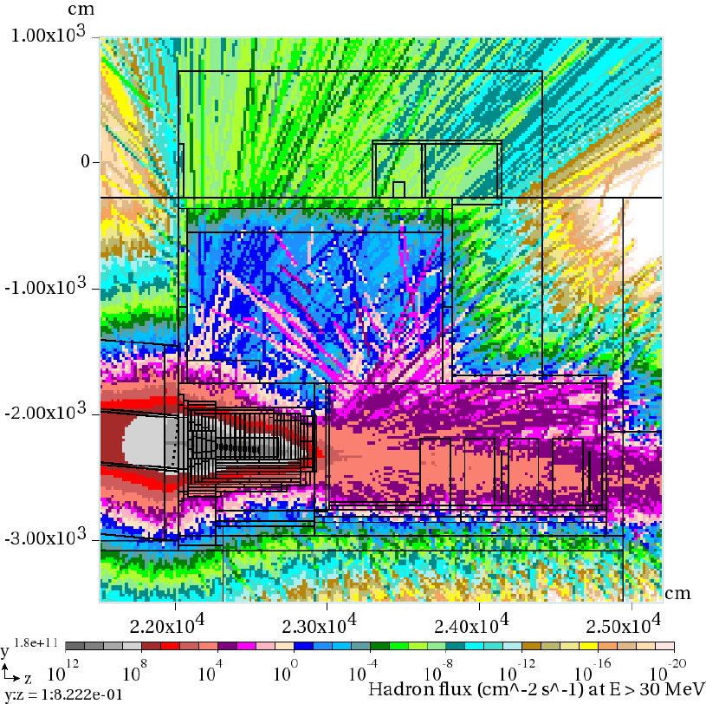
Hadron Flux (cm⁻² s⁻¹) at E > 30 MeV (2.4 MW)

Slide 29
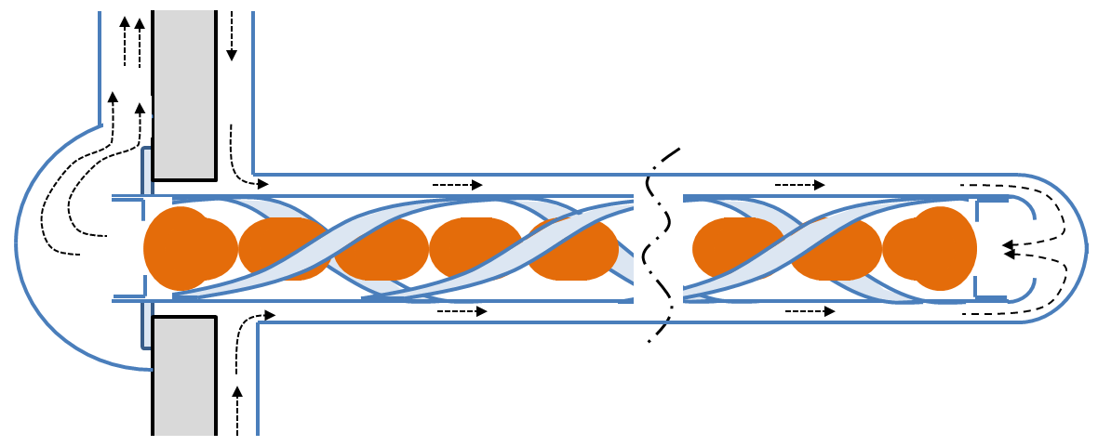
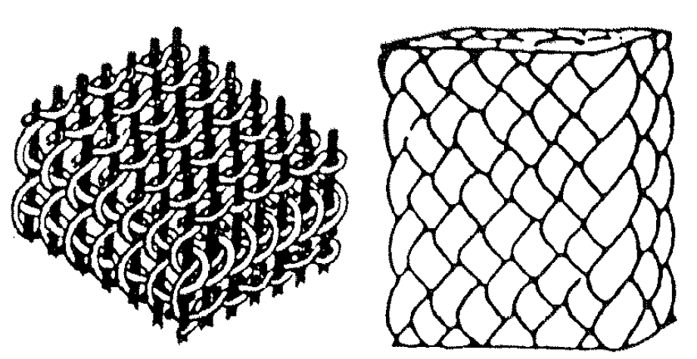
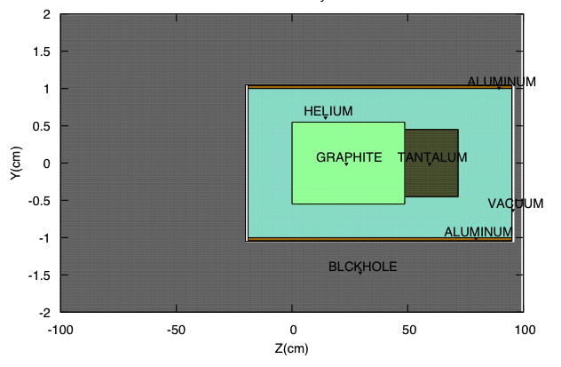
Novel Target Designs
High heat-flux coolants
Elimination of water
Composite targets
Segmentation
Robust materials and assemblies

Slide 30
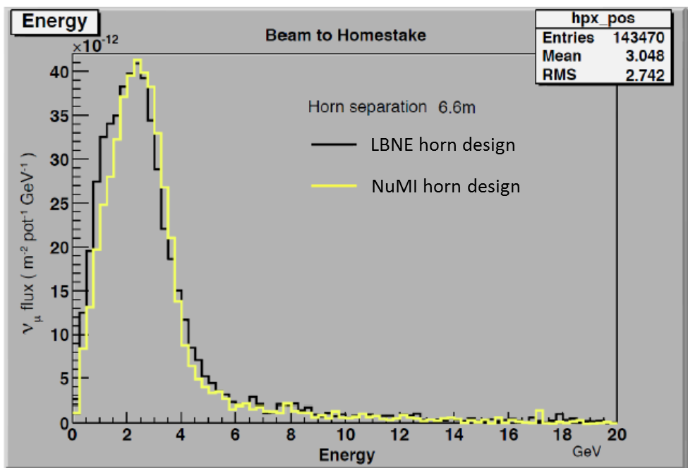
Improved Focusing for Second Oscillation Maximum
1st Horn: NuMI Design (current LBNE baseline)
1st Horn: Improved Design Concept
Significant improvements are possible and needed, which collaborators could bring into the design of the LBNF beam design.
+ 30% at 2nd osc. Max
… not fully optimized yet.

Slide 32
Apply LBNO-design low-energy beam (HPPS LE) to LBNE
LBNE with LBNO
HPPS LE Beam
LBNE with LBNO
HPPS LE Beam
LBNE with LBNE Beam
LBNE with LBNE Beam
Application of HPPS LE beam spectrum to LBNF baseline - modestly improves CP violation reach - improves minimum Δ^{χ2} by ~x2 for MH

Slide 33
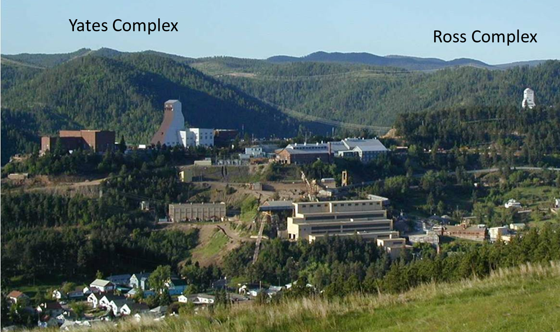
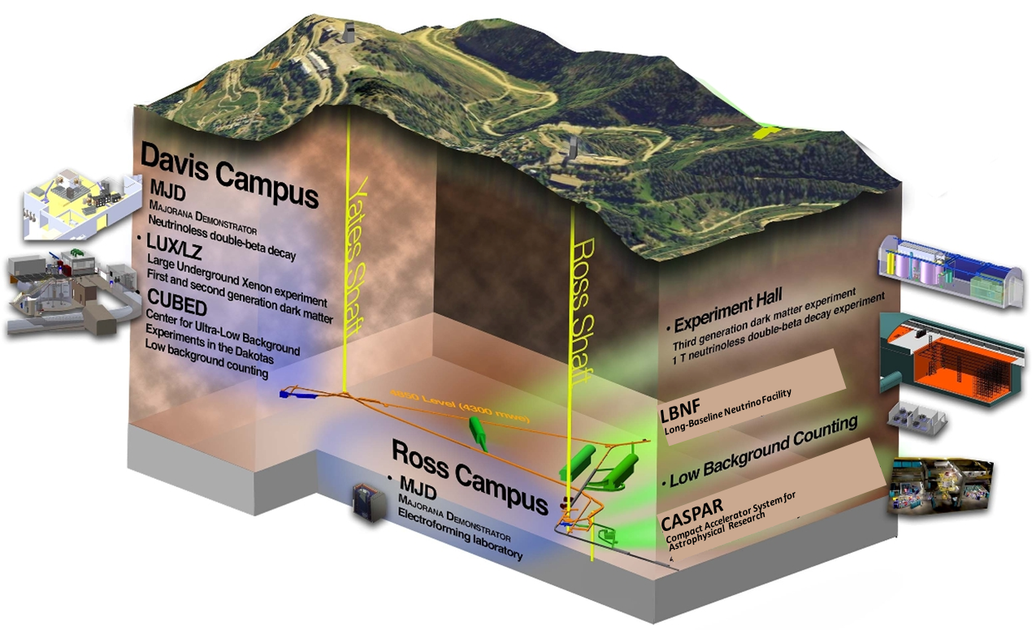
Sanford Underground Research Facility
Experimental facility operated by the State of South Dakota.
Current experiments:
LUX (dark matter)
Majorana (0νββ)
Several smaller experiments
Future home of:
LZ (G2 dark matter experiment)
CASPAR (Compact Accelerator System for Astrophysical Research)
LBNF

Slide 34
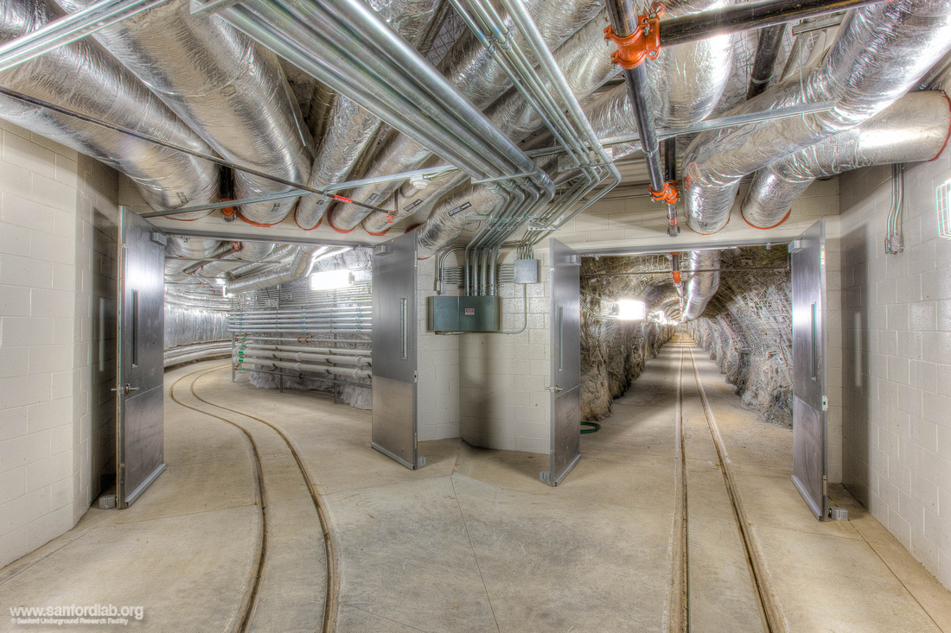
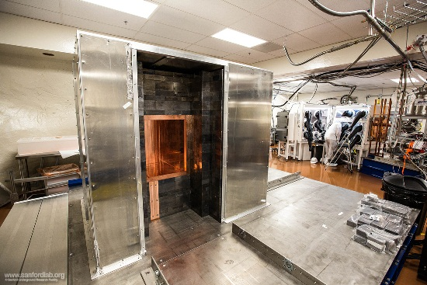
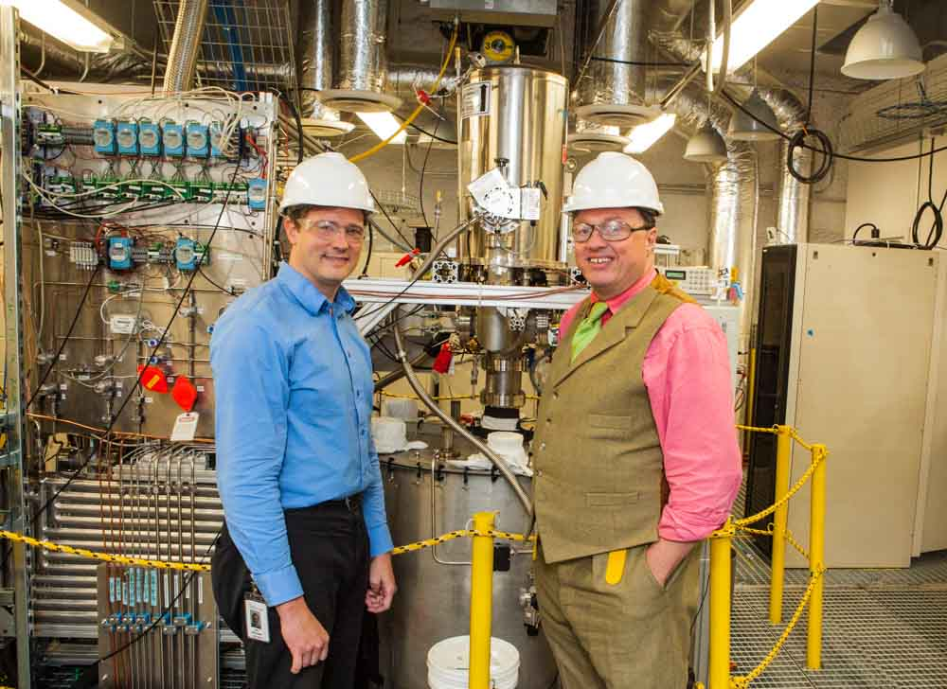
Sanford Underground Research Facility
Entrance to Davis Campus
Majorana Demonstrator (0νββ)
Experimental Facilities at 4300 mwe
Two vertical access shafts for safety
Shaft refurbishment in process and has reached the 2000 foot level
Total investment in underground infrastructure is >$100M
Facility donated to the State of South Dakota for science in perpetuity
LUX (dark matter)

Slide 35
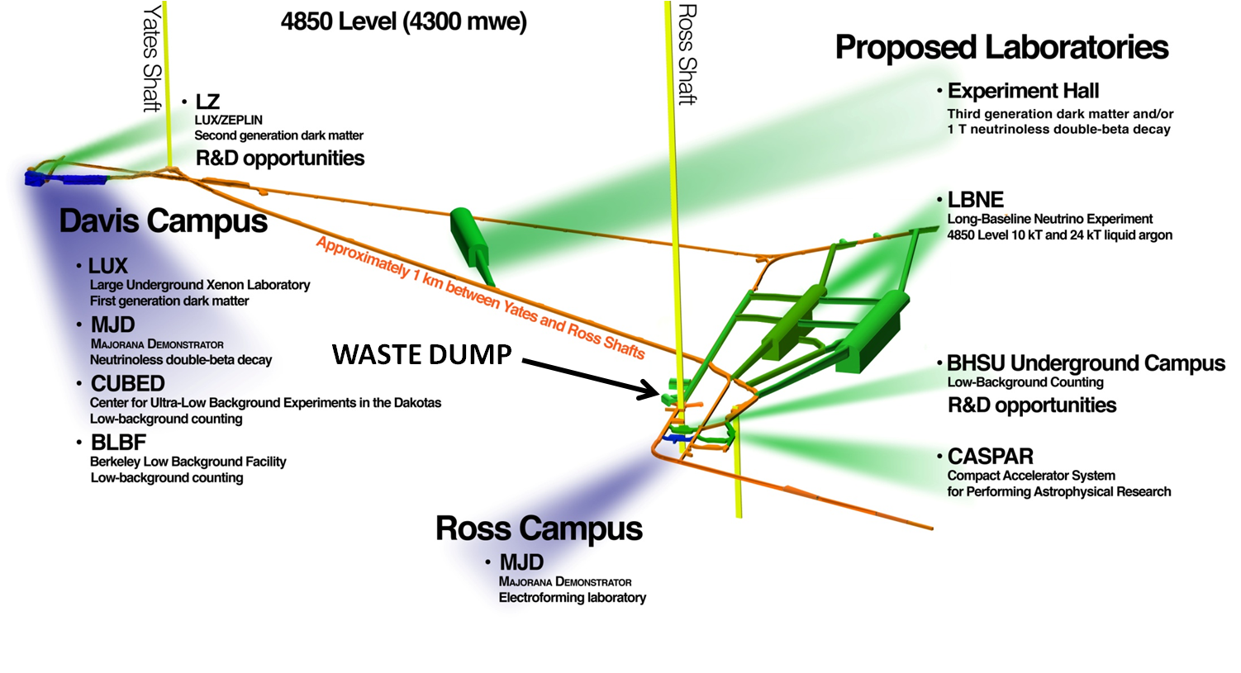
Planned Location of LBNF Cavern(s)
Current reference* design:
Rectangular caverns for rock-supported cryostats
2 caverns: 10 kt + 24 kt fiducial mass sizes
10 kt cavern fully outfitted and detector-ready
24 kt cavern excavated only
* Actual design will depend on strategy and requirements set in discussion with Science Collaboration

Slide 36
Geotechnical Investigation Program
A geotechnical exploration program at the 4850L has been completed to explore the rock mass south of the south access drift. Analysis of geotechnical data is on-going to determine maximum span and preferred cavern geometry.
Area near Yates shaft
extensively studied for WCD option.

Slide 37
Excavation and Ground Support Plans

Slide 38
Rectangular vs. Cylindrical Cryostat
LBNE Design: Rectangular, rock-supported cryostat
LBNO Design: Cylindrical, free-standing cryostat
Current reference design
Rectangular geometry makes maximum use of excavated volume
Rectangular geometry requires rock support
Follows industry standard design and construction methods
Requires larger span cavern, similar to LBNE WCD design
Joint LBNE – LBNO evaluation launched

Slide 39
Cryogenic System Design
Purification System
Refrigeration and LN Dewars
P&ID
Piping Layout

Slide 40
19 Sep 2014
Summary of a detailed, resource-loaded P6 schedule
Goal to move earlier by ≥ 2 yr

Slide 41
Summary and Conclusions
Fermilab hosts an active, diverse international accelerator-based neutrino program.
Fermilab has a record of delivering high-intensity proton beams with high reliability and long running time for neutrino physics.
On-going upgrades will increase the Main Injector beam power to 700 kW over the next ~2 years.
PIP-II will further increase the beam power to 1.2 MW and provide a platform for future beam power >2 MW.
Fermilab is prepared to host LBNF and work with international and U.S. partners to provide:
A high-intensity, broad-band neutrino beam
Conventional facilities for the LBNF detectors at SURF and Fermilab
Major technical infrastructure for the LBNF detectors

