Slide 1
MAP Update
M. Palmer
Fermilab
December 7, 2014

Slide 2
Outline
Update on Review Outcome and Budget Status
Key Elements of the Ramp-Down Plan
  Wrapping up key activities
    Supporting young investigators
  Documenting developments that have come out of the IBS process over the last 18 months
  Preliminary institutional guidance for next year
Moving Forward
  Preparation for GARD proposals
  JINST Volume
    Paper Committee Structure
  Need for an international collaboration
  Spring-Summer 2015 Collaboration Meeting

Slide 3
Outcome of August Review &
Budget Status

Slide 4
Major Thrusts of the Review
The review was a management and technical review to determine a path forward given the P5 recommendations
We presented 3 activities:
  Our plan to achieve MICE Step V
    Both its strengths and its weaknesses
  2 activities that we proposed for GARD consideration
    The MTA experimental effort
    A design and simulation effort towards advanced muon and neutrino sources

Slide 5
The Committee and Observers
Review Committee
  Erk Jensen (CERN)
  Dave McGinnis (ESS)
  Claus Rode (JLAB)
  Mike Syphers (MSU)
  Tom Taylor (CERN)
  Mark Thomson (STFC/RAL)
  Ian Robson (STFC)
  Howard Gordon (BNL)
  Leigh Harwood (JLAB)
Observers
  Charlotte Jamieson (STFC)
  Mike Procario (DOE-OHEP)
  LK Len (DOE-OHEP)
  Bruce Strauss (DOE-OHEP)
  Don Hartill (Cornell, Accel R&D Sub-Panel)

Slide 6
A Summary of the Response
Committee had mixed responses to moving muon-specific activities into GARD
  We will need to carefully lay the groundwork for what happens in FY16
Committee not supportive of Step V Conclusion because (my paraphrasing):
  US support would completely disappear during execution (option for follow-on support from GARD and/or NSF not guaranteed)
    NOTE: US experimental support ONLY guaranteed for duration of Step IV (through US FY16)
  Remaining risks felt to be too large to guarantee successful integration of Step V configuration
An alternative plan was proposed when it became clear that we could not make Step V converge within the budget constraints specified by DOE and the conditions specified by the committee
  An Aside: I would like to offer my compliments to the MICE team that enabled a coherent and flexible response to this issue on a <24 hour timescale
    MIPO: Roy Preece, Alan Grant, Peter Garbincius
    MICE Experiment: Dan Kaplan, Victoria Blackmore, Chris Rogers, Jaroslaw Pasternak
    MICE Spokesperson/Deputy: Ken Long, Alan Bross
MAP/MICE Report (of September 25) to DOE has been circulated to committee showing the outline of that simplified ionization cooling demonstration
  http://map-docdb.fnal.gov/cgi-bin/RetrieveFile?docid=4402&filename=DOE_Response_2014_0925_FINAL-docDB.pdf&version=1
Review web-site: http://www.bnl.gov/doemapreview/index.php
(access code: muons14)

Slide 7
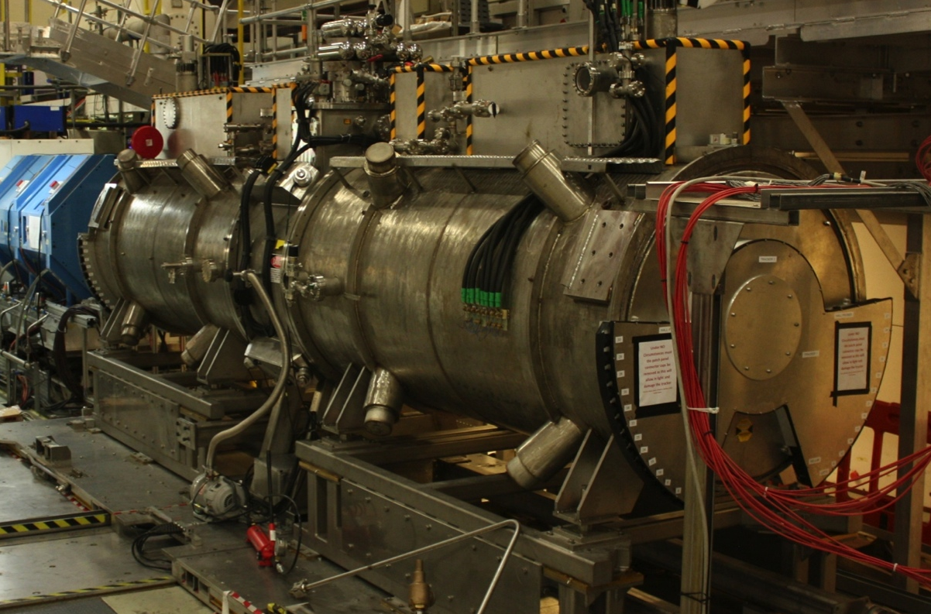
MICE Steps IV & V
Plan endorsed by MICE
Project Board in April 2014
Legend:
-SS = Spectrometer Solenoid-
-FC = Focus Coil-
-AFC = Absorber-Focus Coil Module-
CCM = Coupling Coil Magnet
-RFCC = RF-Coupling Coil Module-
Operational 2015
-Absorber-
-Tracker1-
-FC-
-Tracker2-
MICE Step IV
Configuration
-SS1-
-AFC-
-SS2-
Operational 2018
-Absorber1-
CCM
-Absorber2-
MICE Step V
Configuration
-Tracker1-
-FC1-
-FC2-
-Tracker2-
-SS1-
-AFC1-
-RFCC-
-AFC2-
-SS2-

Slide 8
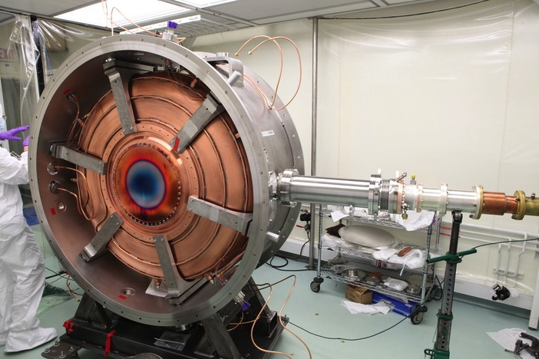
Expedited Muon Cooling Demonstration
Plan developed in response
to P5 recommendations
Legend:
-SS = Spectrometer Solenoid-
-FC = Focus Coil-
-AFC = Absorber-Focus Coil Module-
-RFA = RF-Absorber Module-
Operational 2015
-Absorber-
-Tracker1-
-FC-
-Tracker2-
Represents reduced cost and technical risk relative to MICE Step V
-SS1-
-AFC-
-SS2-
Operational
2017
Secondary
-Absorber1-
Secondary
-Absorber2-
Primary
-Absorber-
NEW
Expedited
MICE Final
Configuration
-Tracker1-
-FC1-
-FC2-
-Tracker2-
-SS1-
RFA1-
-AFC1-
-AFC2-
RFA2-
-SS2-

Slide 9
New US MICE Funding Scenario November 2014
Includes all MAP categories directed at MICE Completion
Includes ALL Contingency and Risk
Does NOT include:
MAP D&S ramp-down costs in FY15 (with carryover, have allocated just over
$2M to this activity)
~1.7M unallocated funds in present budget profile

Slide 10
Nominal US-DOE MICE Budget Profile
to Final Step
Modified Budget Definition in ALL YEARS to explicitly include:
Program Management,
MTA Test of MICE Cavity,
MICE Experimental Support
NOTE: ~$1.7M in funding not yet allocated (~10% planning reserve)
65%
85%
52%
100%
%: Effective Fraction of Annual
MAP Budget Directly
Supporting MICE
100%

Slide 11
Key elements of the
Ramp-down Plan

Slide 12
Young Investigators
DOE has given me a free hand to support young investigators to the maximum degree I can
  Consistent with completing MICE successfully
  We are making every effort to make the remaining effort match closely with wrapping up the key conclusions of the MAP IBS process
I do NOT have the same degree of flexibility with senior members of the collaboration
  This is leading to very challenging discussions where there is a desire to preserve people that MAP is simply unable to support.

Slide 13
Documenting the IBS
Must have the designs fully updated and documented in our code/lattice/report repository on the MAP site
A large number of new results have come out of the IBS process
  We are targeting their reviewed publication in a single coordinated volume on Muon Accelerator Technologies
  The JINST editorial staff has offered to support this

Slide 14
Preliminary Institutional Guidance for FY16
In FY16 MAP funds will ONLY be available for MICE-related activities
  This means all of the broader effort must complete its ramp-down within MAP and move into GARD
    MTA will be kept alive as part of the MICE effort through March 31, 2016
  We have received (somewhat vague) target levels to aim for within GARD
    2 coordinated proposals have been prepared by the MAP management team to
      (See materials from today’s MAP collaboration meeting discussions)
      Fundamental Aspects of Muon Beams
      RF in magnetic field R&D at the MTA
    These activities will no longer be directly managed by MAP
    MAP institutions should attempt to be strongly coupled to these proposals
All institutions must be working actively to re-orient their staff to be supported outside of MAP

Slide 15
Moving Forward

Slide 16
Preparation for GARD Proposals
Fundamental Aspects of Muon Beams
  MAP Senior Management contacts:
    R. D. Ryne, J.-P. Delahaye
  Proposal Team includes the MAP L2 D&S managers
Normal-Conducting RF Cavity R&D at the MuCool Test Area
  MAP Senior Management contact:
    A. Bross
  Proposal Team led by
    Y. Torun, K. Yonehara, D. Bowring
These proposals need strong support from the Institutional Board if we are to have hope for them to succeed

Slide 17
Dedicated Volume on Muon Accelerator Capabilities
Journal of Instrumentation
Joint Endeavor
  Institute of Physics (IOP) Publishing
  International School for Advanced Studies
Offers an easy-to-access online journal format
Offers a unique breadth that is extremely well-matched to the work that we are doing towards future accelerator capabilities

Slide 18
Volume Contents
Aiming for a volume of peer-reviewed articles that will span all key muon accelerator activities
  Overview articles
    Including MAP, MICE and (hopefully IDS-NF)
  MAP
    Design concepts from MASS and the IBS
      Including nuSTORM, NuMAX, collider and collider detector
    Recent Technology Developments
    MTA Research Program
  MICE
    Can serve as a central destination for articles describing the demonstration
  IDS-NF
    We are discussing with the IDS-NF team the possibility of including the RDR related articles here

Slide 19
Practical Issues
This would be a “living” volume
  No fixed submission date for the whole body of work
  Abstract and overview articles expected first
  General articles can be submitted as they are ready
    Editors request that we provide them an organization table of expected contributions and then they will work with us to maintain the organization of the overall volume
JINST Author Information available at:
  http://jinst.sissa.it/jinst/help/helpLoader.jsp?pgType=author

Slide 20
What’s Needed from the IB
For such a volume, I strongly desire to have a paper committee process in place before articles are submitted
I would request the IB to formally organize this part of the process
We will put in the necessary connections with the management team to monitor the submissions and coordinate with the editors

Slide 21
International Collaboration
It is clear that, within the next year, MAP will no longer be able to effectively serve as the organizing entity for muon accelerator research activities
It is time to re-organize and strengthen and international collaboration
  With our MICE, IDS-NF and nuSTORM colleagues
  The IB needs to consider this option and provide input on how they would like to proceed

Slide 22
Another Collaboration Meeting
There have been multiple requests for holding another collaboration meeting sometime next summer
Given limited travel funds, MAP management feels that this would be best held in the Chicago area
Need IB input on the options, plans and dates

Slide 23
AnY Other Business

Slide 24
Thank you for your time today…
And for the productive efforts of the group over the last 34 months that I’ve been involved.

