Slide 1
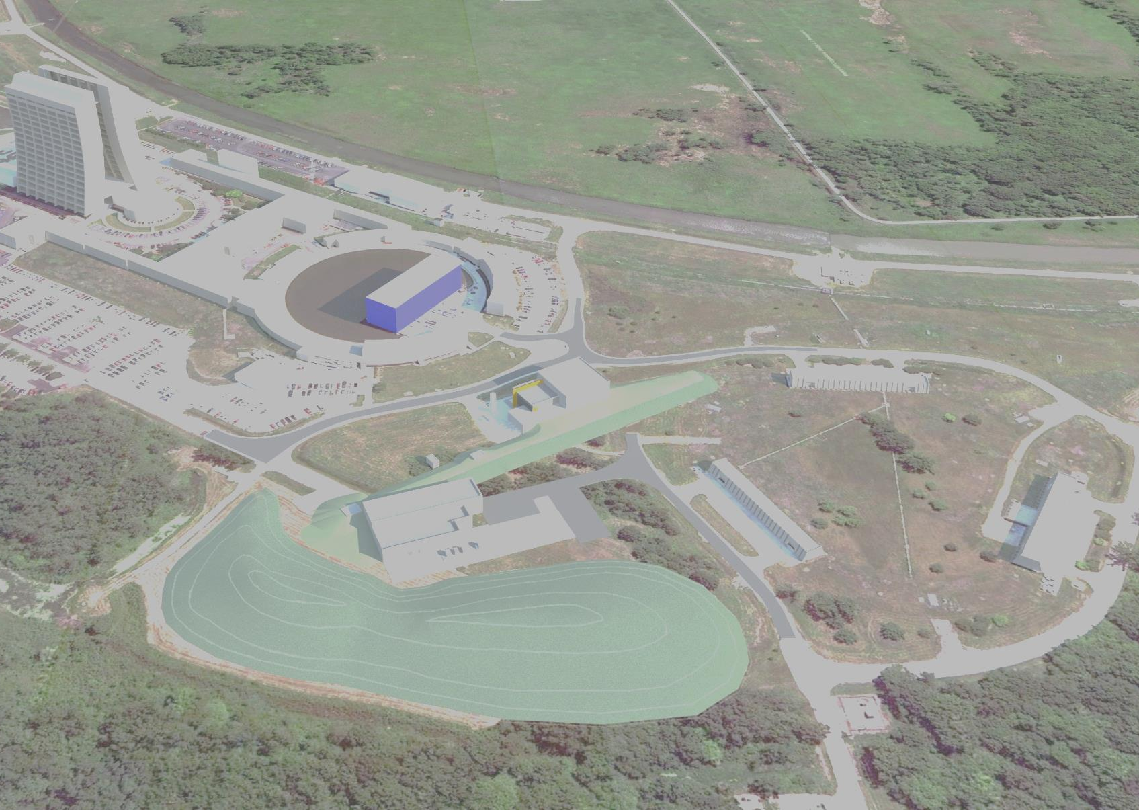
Muon Campus Beam Transport
December 15, 2014
J. Morgan

Slide 2
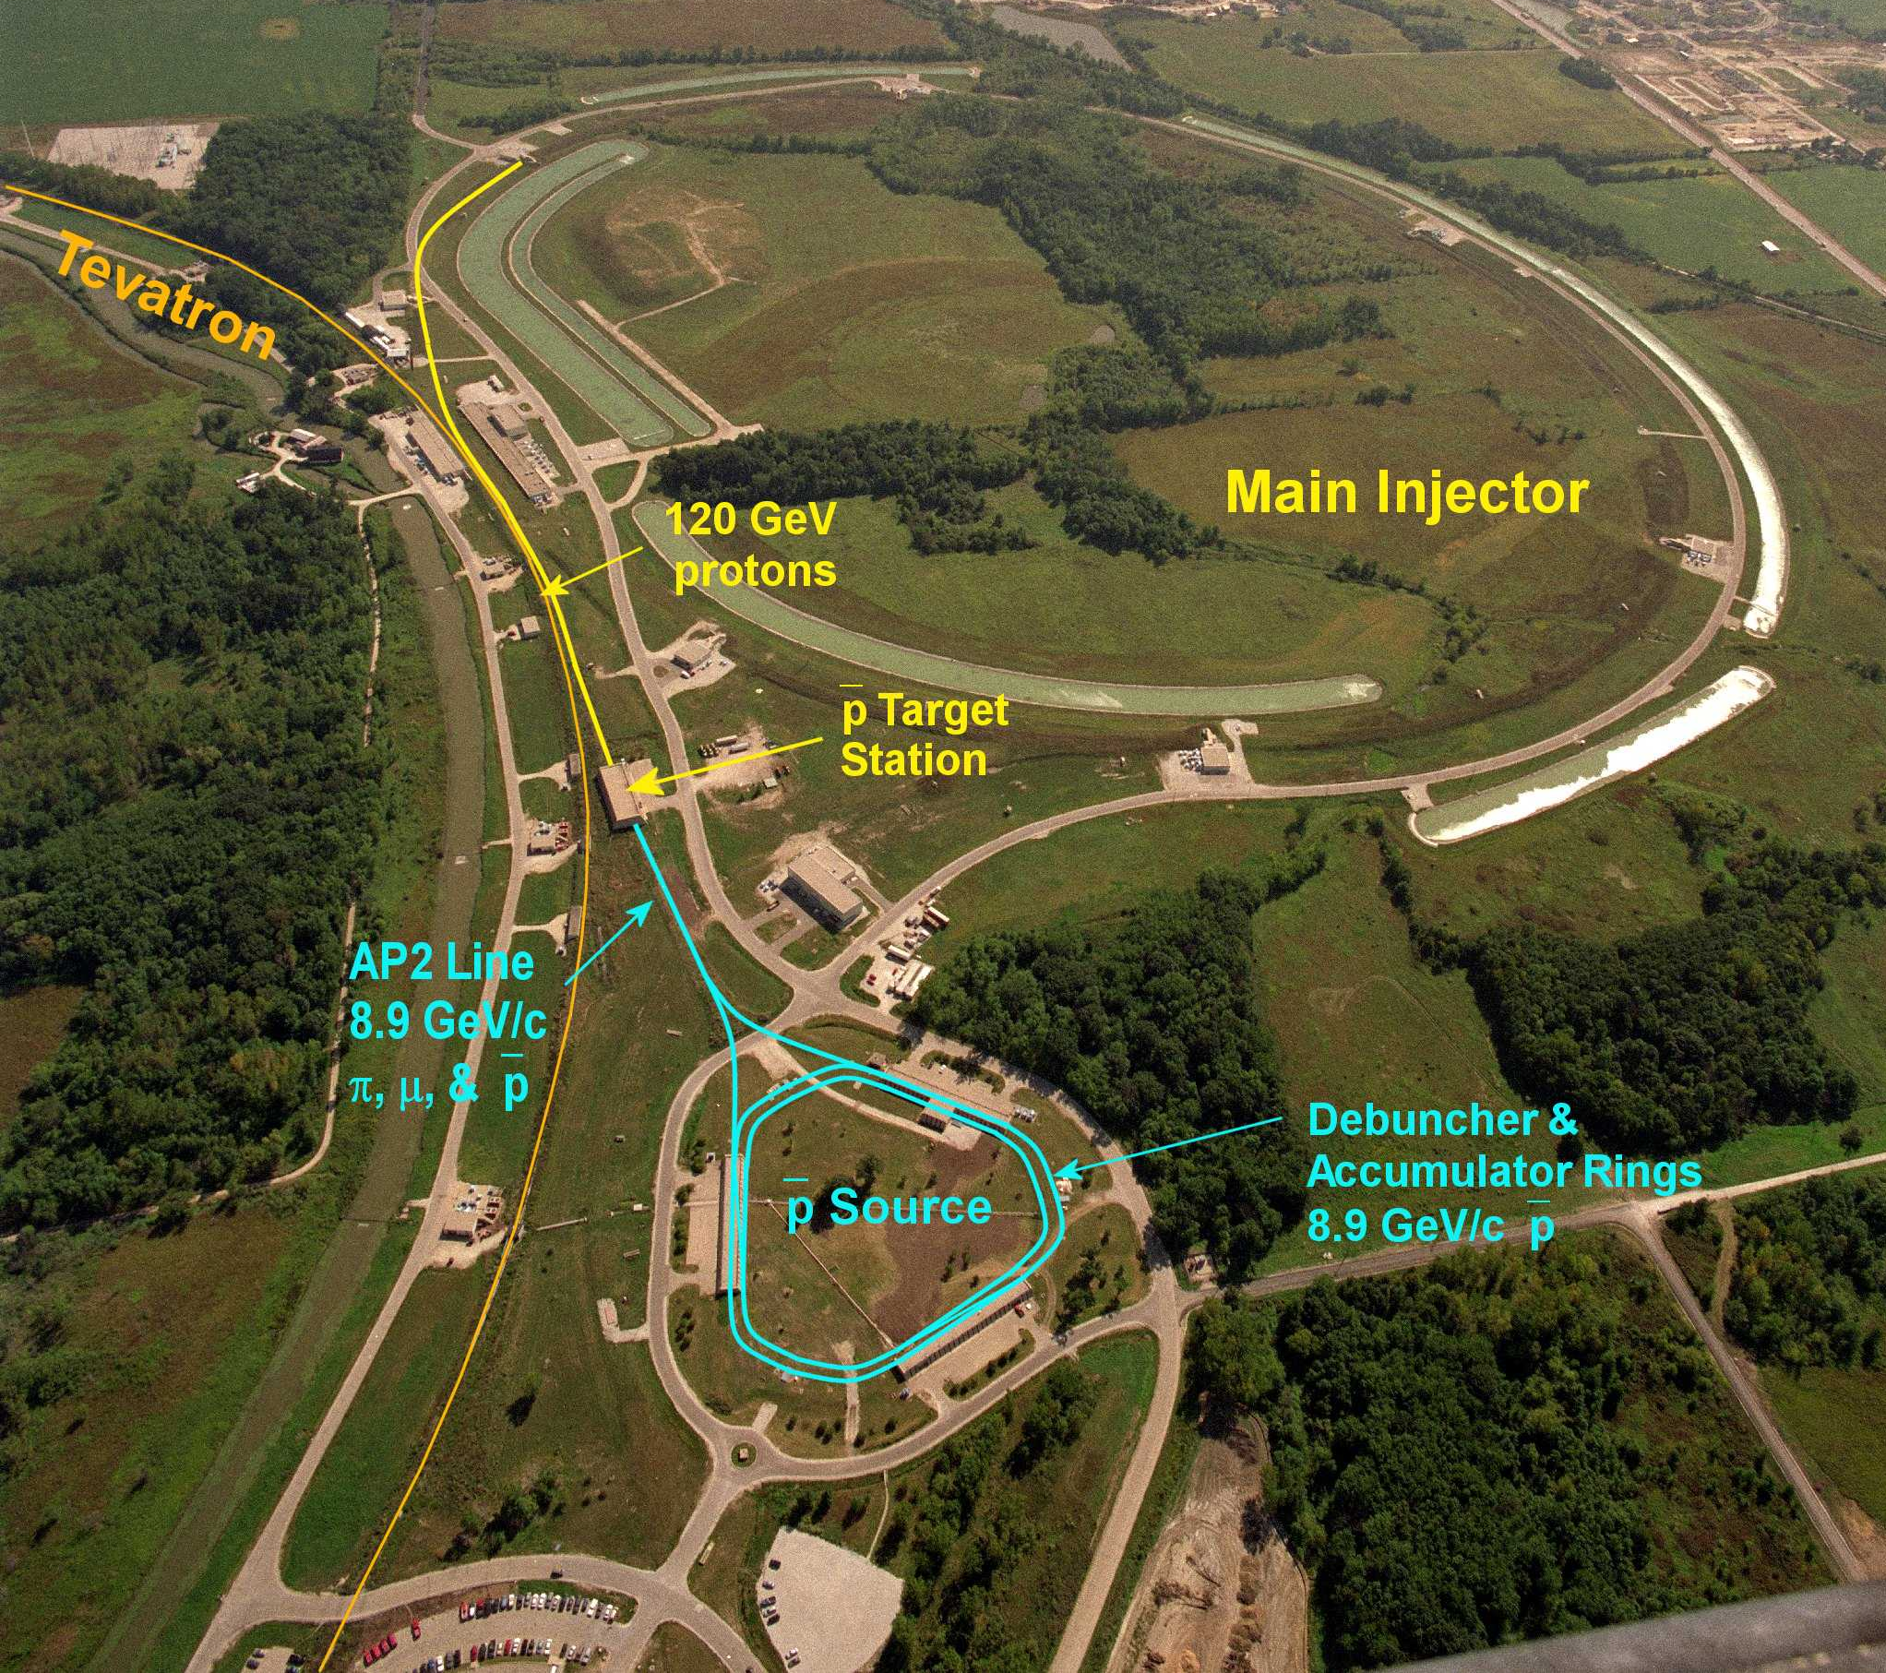
What we started with – the Pbar source
December 15, 2014

Slide 3
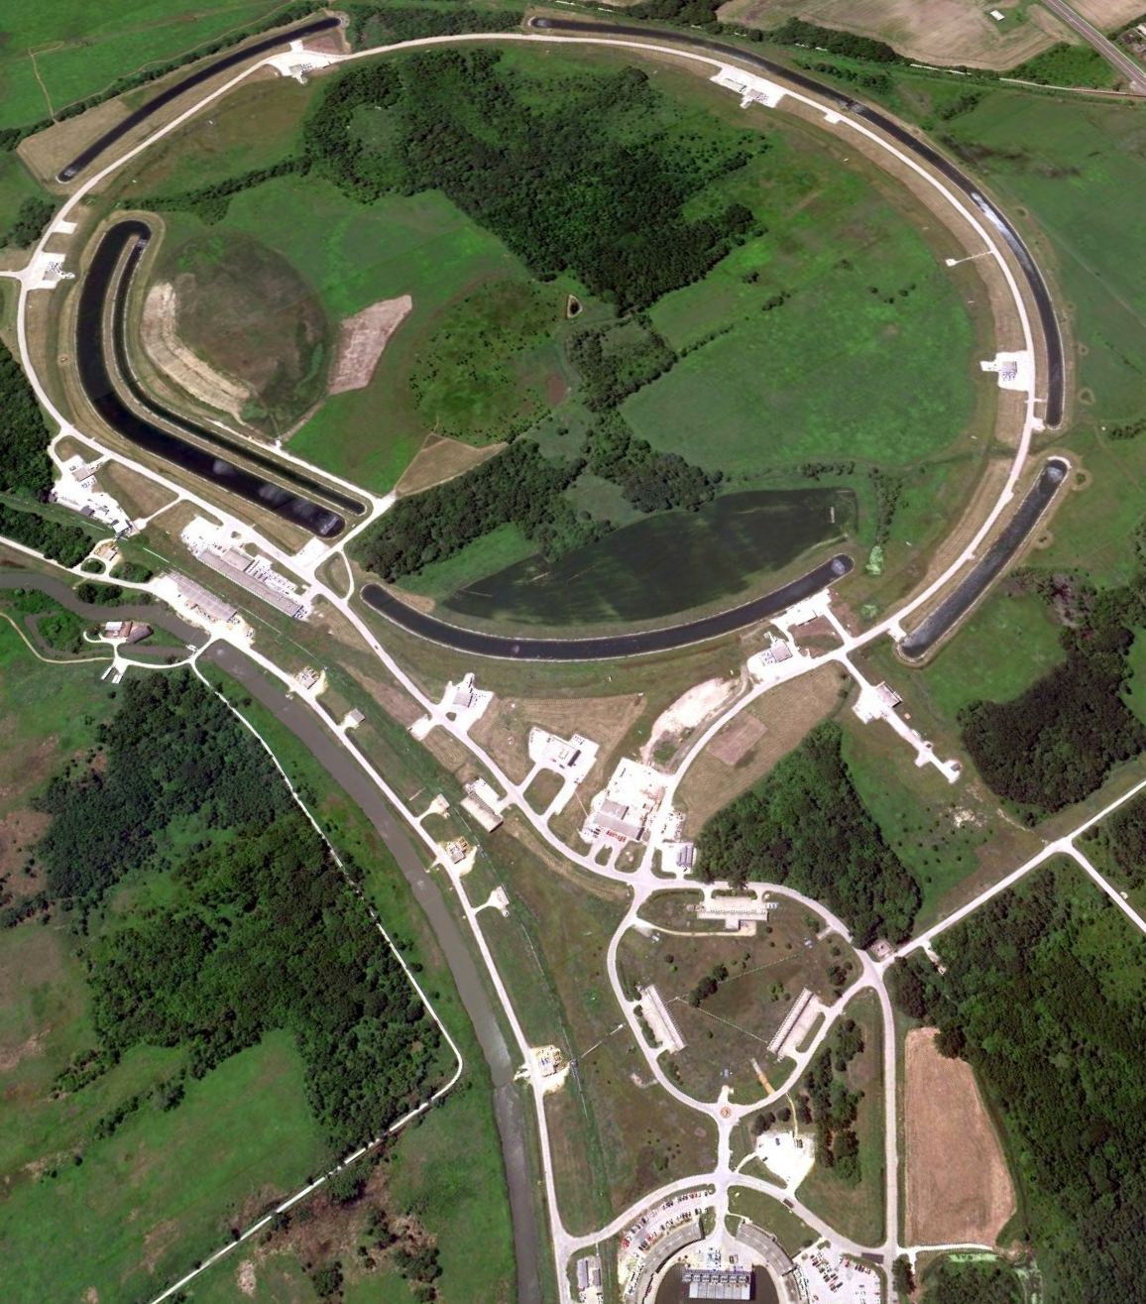
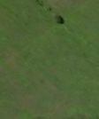

The
Muon
Campus
Recycler Ring
RR extraction
And RR to P1
beamline
P1 - P2 - M1
AP-0
M2
Delivery Ring
M3
AP-50
MI-8 Line
AP-30
AP-10
M5
M4
Mu2e
Muon Campus
MC-1
R. Ray - Director's CD-1 Review
R. Ray - Mu2e Collaboration Meeting
December 15, 2014

Slide 4
Beam to Muon Campus
Protons to Mu2e
Main Injector
Energy
{
Booster
Cycles
Protons to g-2
Protons to NOvA
Need 2 Booster cycles
to manipulate g-2 beam
in Recycler
Protons to MicroBooNE
(Mu2e and g-2 cannot run simultaneously)
December 15, 2014

Slide 5
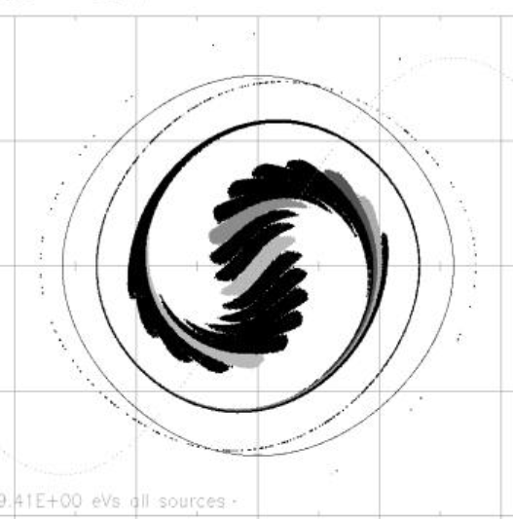
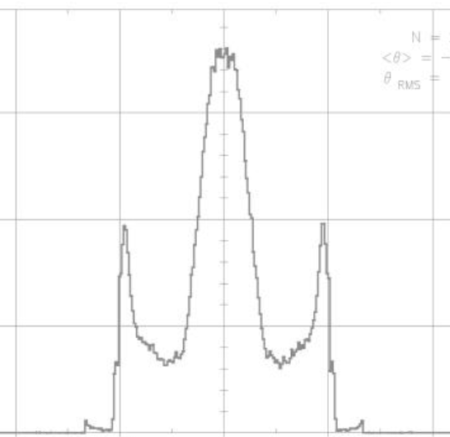
Bunching beam in RR (RF AIP)
40
96
20
E-E0 (MeV)
RF voltage (kV)
Counts per bin
0
0
-20
95% contour
-96
120 ns
-40
-4 -2 0 2 4
-4 -2 0 2 4
phase (1 deg = 31 ns)
phase (1 deg = 31 ns)
95% of captured beam contained within 120ns
December 15, 2014

Slide 6
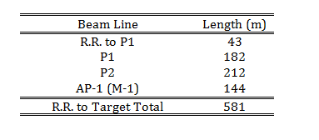
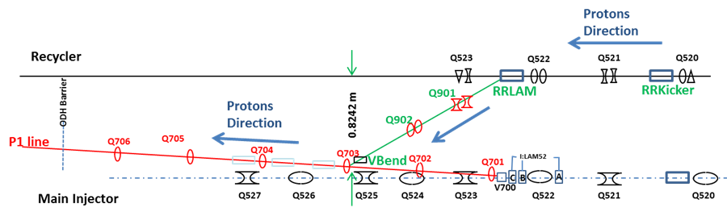
RR to P1 connection (BT AIP)
  Required to transport 8.89 GeV/c RR protons to the P1 line and on to the M1 Line
Extraction from the Recycler is accomplished with a horizontal kicker at the 520 location and a Lambertson magnet at 522
New line intercepts the existing P1 line just upstream of the 703 quadrupole
P1 line will still be used for SY120, so new beamline connection must not interfere with upstream end of P1
December 15, 2014
6
J. Morgan - Muon Campus Beam Transport

Slide 7
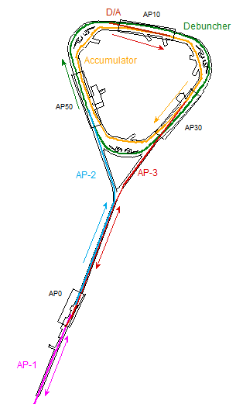
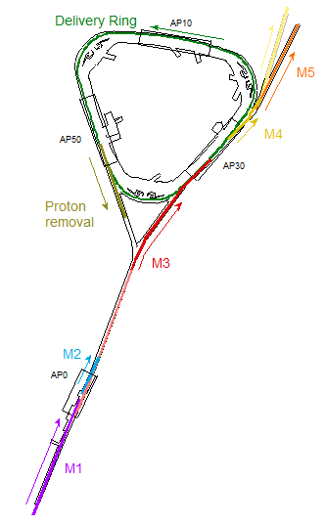
Beamline Overview
Repurposing Pbar
Target Station
Target Station
Antiproton
production
Muon Campus
(g-2 operation)
December 15, 2014

Slide 8
Muon Campus configuration
  The Accumulator and D/A line are no longer needed and will be used for beamline components
  M1 is the new name for AP-1, apertures will be improved to accommodate the larger 8.89 GeV/c primary beam
AP-2 will be renamed M2 and will be a dedicated beam line for g-2
The M3 line will connect to the Delivery Ring (Debuncher) in the D30 straight section
Both the g-2 secondary beam and Mu2e proton beam will be transported to the Ring via M3
M2 and M3 will have a higher quadrupole density than AP-2 did (~4.4 m vs. ~13.0 m) for g-2
Extraction, both single turn for g-2 and resonant for Mu2e, are in the D30 straight section
The old injection region for AP-2 will become an abort for Mu2e and used for proton removal for g-2
The new extraction line will be called M4
The M5 Line connects M4 to the g-2 Storage Ring
M4 continues to the Mu2e experiment
December 15, 2014
8
J. Morgan - Muon Campus Beam Transport

Slide 9
Muon g-2 beamlines
  The P1, P2 and M1 lines will transport an 8.89 GeV/c proton bunch, 120 ns long, to the Target Station at an average rate of 12 Hz, with 100 Hz bursts (16 bunches, 10 ms interval)
Downstream of the Target Station, the M2 line will carry the 3.1 GeV/c secondary beam 150 m until it connects with M3
Some of the pions decay into 3.09 GeV/c muons as they travel down M2/M3
The M2 and M3 lines have an increased quadrupole density to improve muon yield
The M3 line connects to the Delivery Ring after an additional 130 m and is injected in the 30 straight section
Muons can circle the 505 meter Delivery Ring as many times as desired (3-4 planned)
The abort located in the 50 straight section can be used to remove protons (requires multiple turns)
3.09 GeV/c muons are extracted into the M4 line, then bent into the g-2 line for transport to the Storage Ring in the MC-1 building
Target Station
December 15, 2014
9
J. Morgan - Muon Campus Beam Transport

Slide 10
Mu2e beamlines
  An 8.89 GeV/c proton bunch, 120 ns long, is transported to the Delivery Ring via M1 and M3 (bypassing the Target Station) at an average rate of 6 Hz with 18 Hz bursts
The 8.89 GeV/c bunch is injected into the Delivery Ring in the 30 straight section with a pulsed septum and kicker
A 2.5 MHz RF system maintains the short bunch as it circulates in the Delivery Ring
The proton bunch is resonantly extracted with electrostatic septa and a Lambertson into the M4 line
The M4 line transports the short proton “micro-bunches” to an external Target Station to produce an intense muon beam
The remaining proton beam that is not resonantly extracted is aborted in the 50 straight section and transported to the abort dump
December 15, 2014
10
J. Morgan - Muon Campus Beam Transport

Slide 11
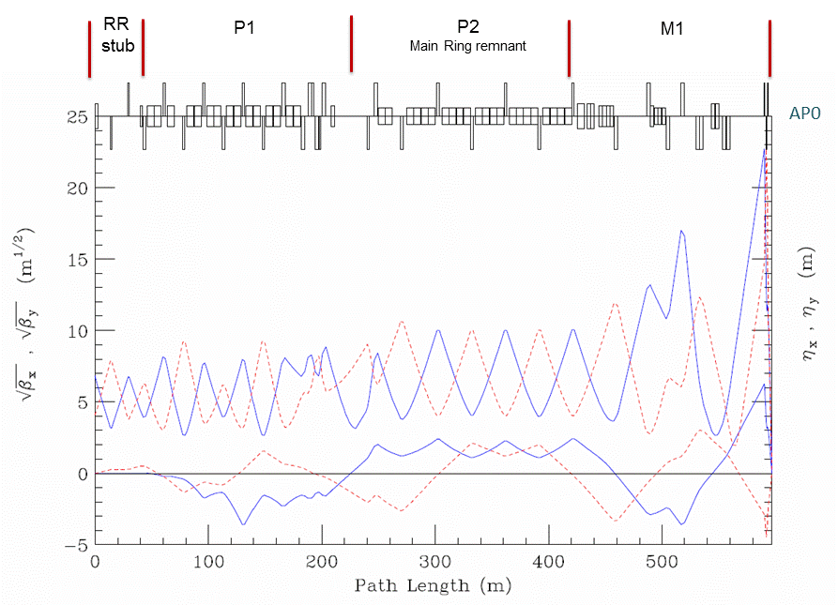
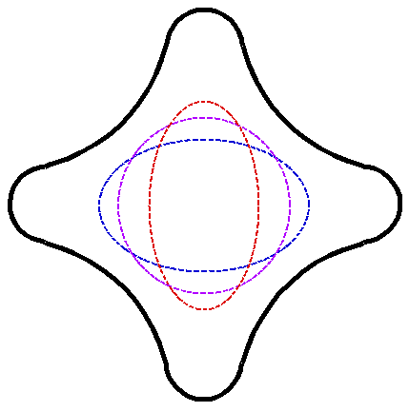
RR to Target optics
Quadrupole triplet
December 15, 2014

Slide 12
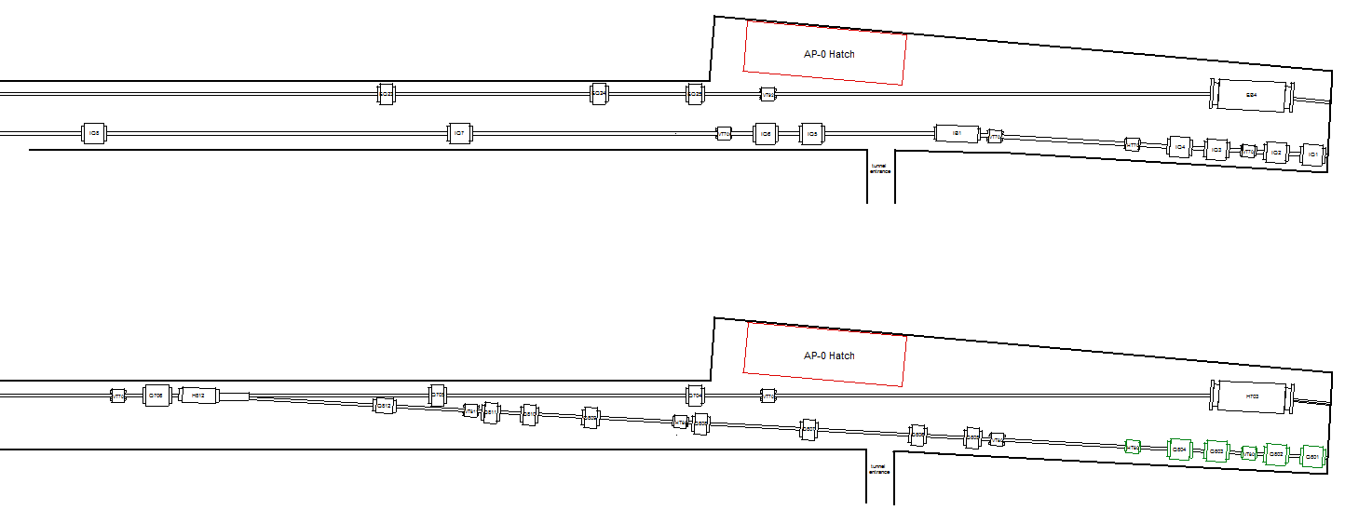
M2 Line layout
  3.1 GeV/c Pion decay channel, beta functions need to be as small as possible to maximize muon capture
  M3 Line follows the path of the Pbar AP-3 Line
M2 Line will cross tunnel and converge with M3 with a 3°angle
First four quadrupoles and two trims in AP-2 are left unchanged for M2
M2 requirement: 40 pi-mm-mr transverse acceptance, +/- 2% dp/p momentum acceptance (actually much better, at least +/- 5% dp/p)
M2 magnets must avoid doorway from AP-0
Best to minimize number of M3 magnets near drop hatch
Existing AP-3 (above) and AP-2 (below)
M3 Line (above) and M2 Line (below)
December 15, 2014

Slide 13
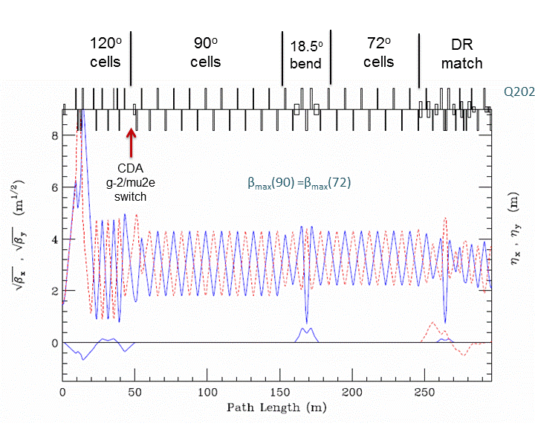
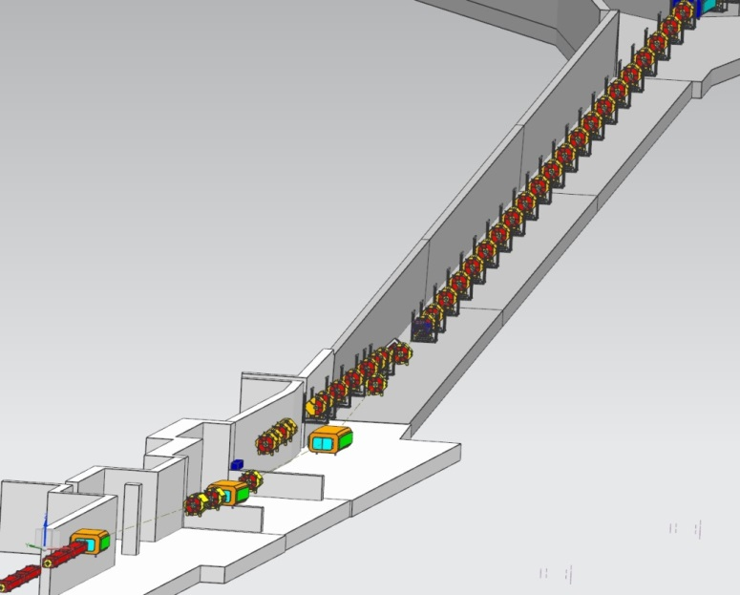
M3 Line design
  Match from M2, transition to FODO lattice with 90°cells
After M2/M3 merge, beta functions vary between 4 and 20 m
Magnets and power supplies can produce fields required for 8 GeV/c Mu2e operation
Two dipole 18.5°achromatic bend made of two Accumulator SDB dipoles
  Another FODO section with 72°cells spans section between “Right Bend” and Delivery Ring match
M3 Line changes elevation in two steps to Delivery Ring level, on either side of a horizontal bend
Two dipole 5°achromatic bend made of two MDC dipoles to align M3 with Delivery Ring
Injection is at the 303 location, with a modified Booster style magnet septum (DR AIP)
5D32
December 15, 2014

Slide 14
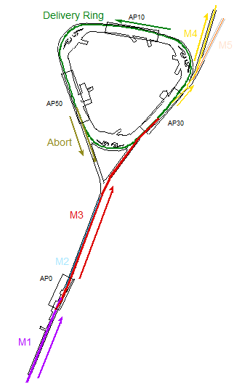
M3 Line modes of operation
M3 line – Dual purpose g-2 and Mu2e
  3.1 GeV/c Pion decay channel, beta functions need to be as small as possible to maximize muon capture
40 pi-mm-mr transverse acceptance, +/- 2% dp/p momentum acceptance
8.89 GeV/c proton transmission must be extremely efficient
Magnet currents must be reasonable for 8.89 GeV/c operation
Upstream M3 must have an optics match to the downstream (shared between g-2 and Mu2e) end
Merge with M3 line must be accomplished without compromising 8.89 GeV/c proton transport
Switching between modes should be easy to accomplish
Existing 3 SDE dipole configuration in 18.5°Right Bend changed to 2 SDBs
g-2 operation
Mu2e operation
December 15, 2014

Slide 15
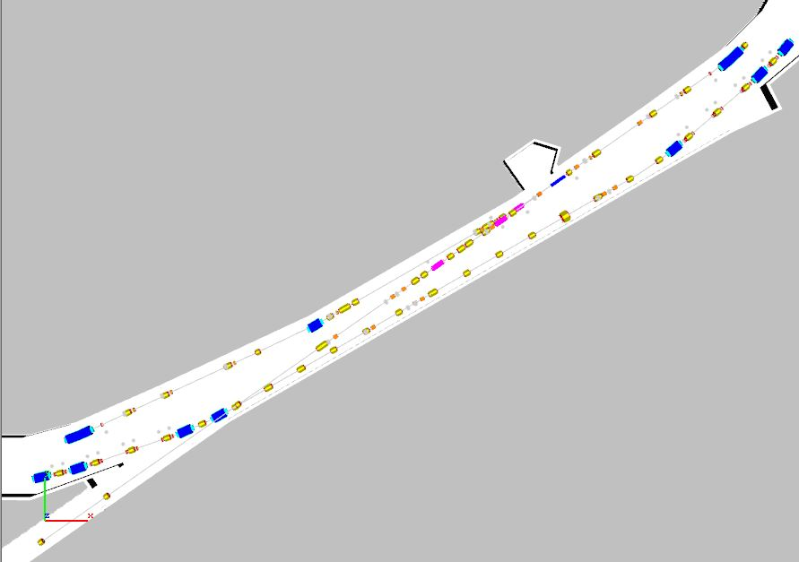
Delivery Ring D30 reconfiguration
Overview of what needs to be reconfigured
Obsoleted AP3 Line
Obsoleted Accumulator
Remove the AP3 Line,
store magnets in the tunnel for reuse.
Current Debuncher - Future Delivery Ring
December 15, 2014

Slide 16
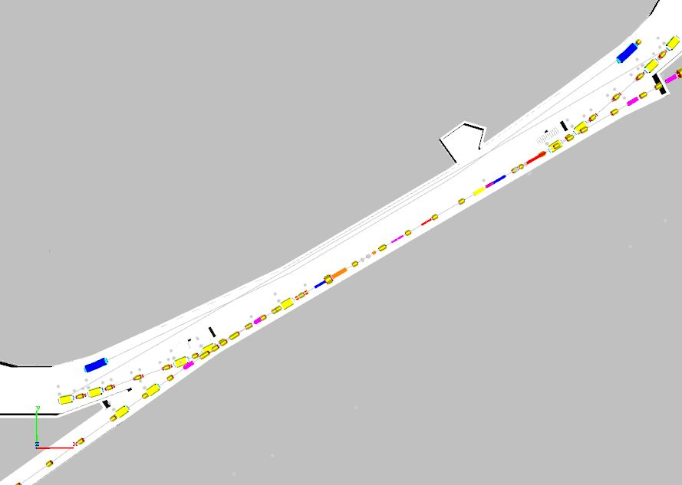
Delivery Ring D30 reconfiguration
After reconfiguration
New M4 Beamline
New Extraction Devices
Delivery Ring
New Injection Devices
New M3 Beamline
December 15, 2014

Slide 17
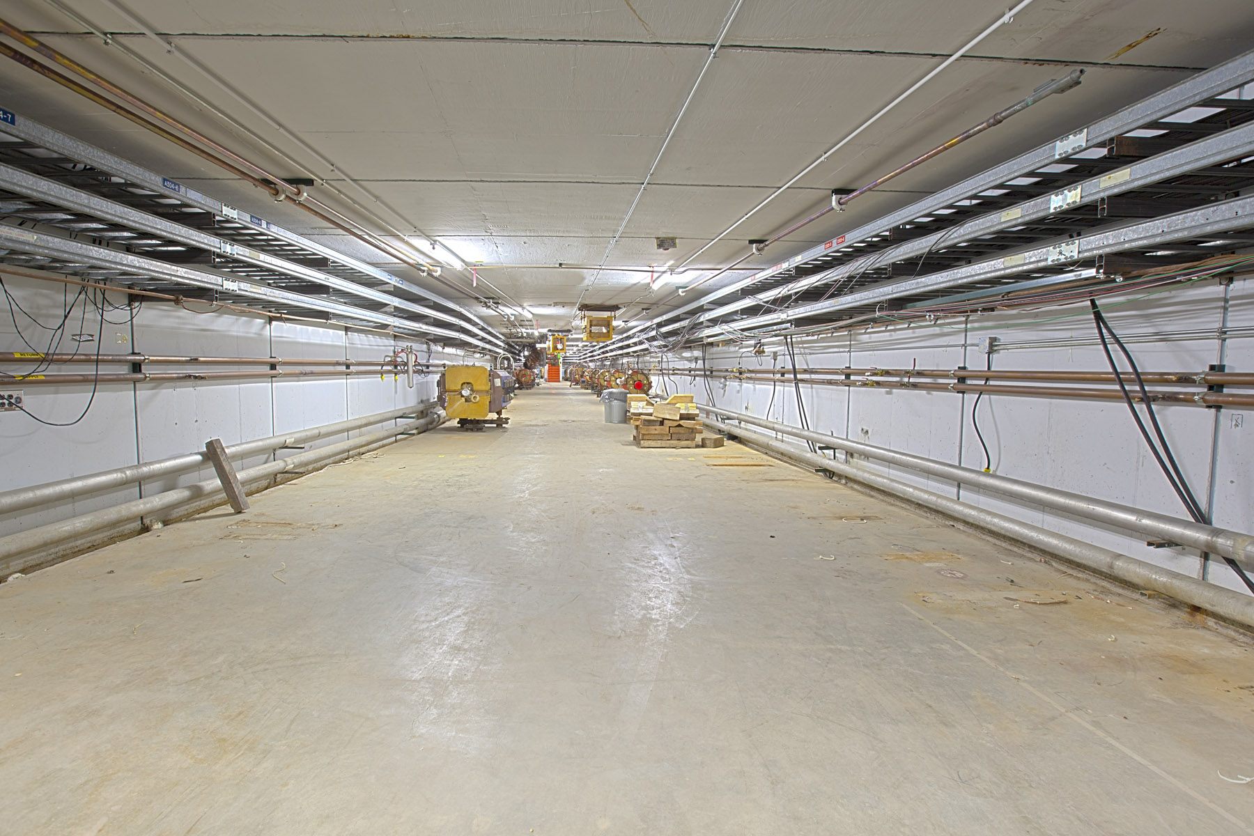
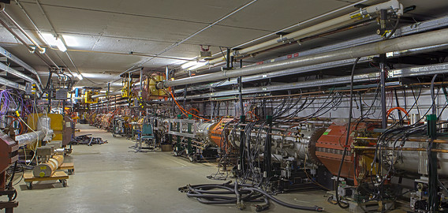
Delivery Ring D30 reconfiguration
Decommissioning work for the D30 straight section started in May
5/8/14
December 15, 2014

Slide 18
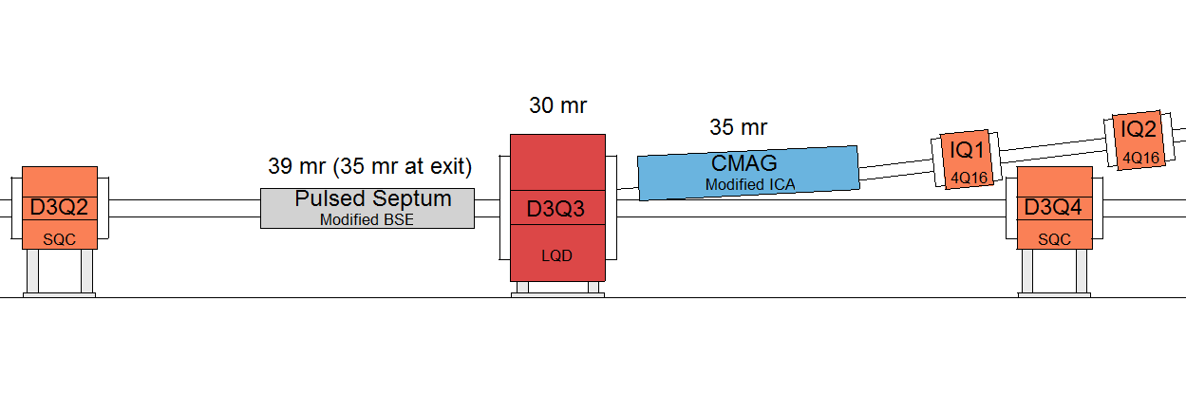
Injection Region
Bend angles of Septum, LQ and C-Magnet
Injection region
December 15, 2014
18
J. Morgan - Muon Campus Beam Transport

Slide 19
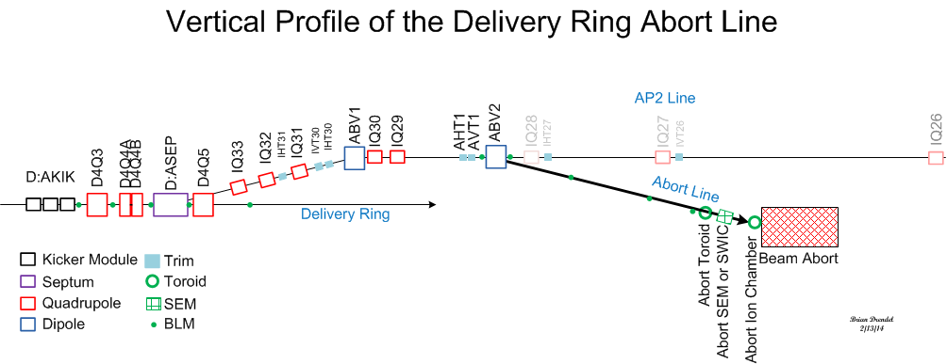
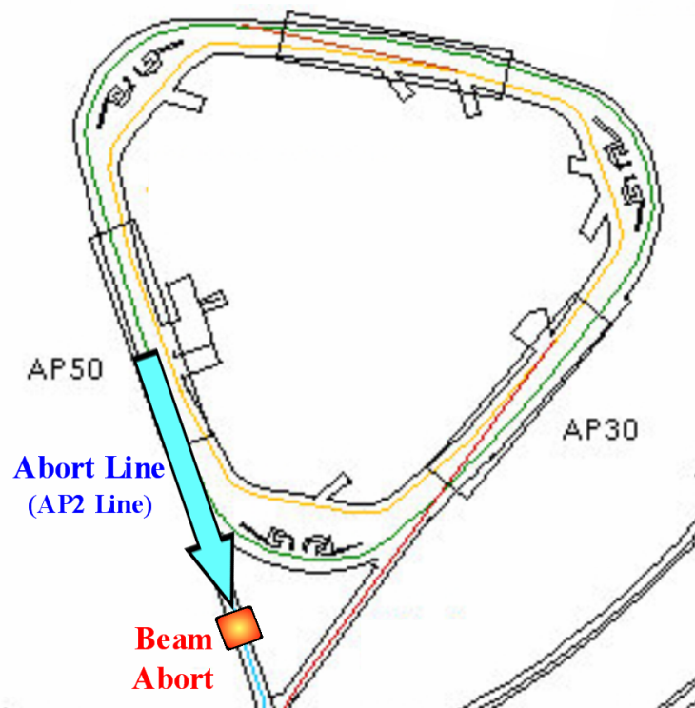
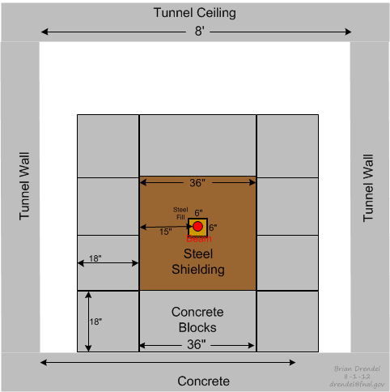
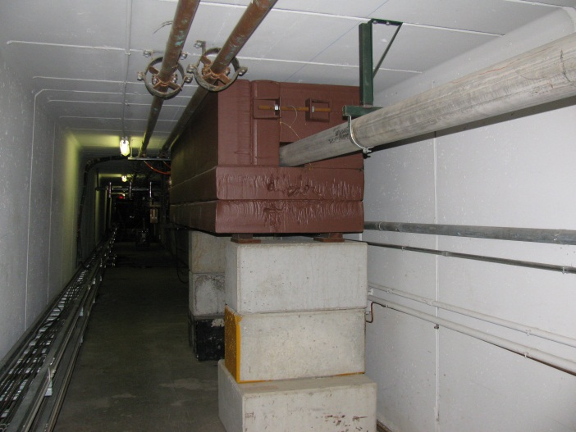
Delivery Ring Mu2e Abort (DR AIP)
Former downstream section of AP-2 used for abort line
Abort absorber located in Transport tunnel (using existing E760 collimator)
Relatively low beam power (0.40 kW – designed for 5% of 8 kW beam power) so cooling water system is not needed
Requires one new Vertical bending magnet and trims
December 15, 2014
19
J. Morgan - Muon Campus Beam Transport

Slide 20
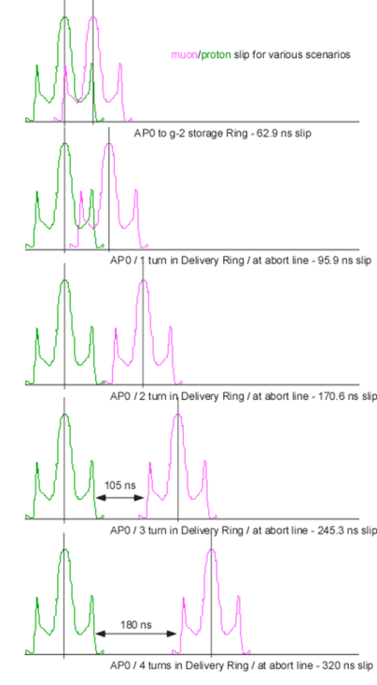
Delivery Ring proton removal
Using the Delivery Ring and Mu2e Abort for g-2 proton removal
Multiple revolutions required to provide enough kicker gap between muons and protons
  Target Station to Delivery Ring distance will be about 290 meters (centroids separate by 41 ns)
    Distance between injection and abort at D4Q5 is 352 meters (50 ns)
“Straight through” distance to g-2 is about 425 meters
    91% of the pions will decay “straight through”, >99% after one turn in DR
Delivery Ring circumference is 505 meters
  Muon and proton centroids separate by about 70 ns per turn
    Bunch length is about 120 ns (with satellites)
    Centroid separation to abort on first turn is 91 ns, second turn 161 ns, etc.
Mu2e abort can be used for g-2 proton removal (DR AIP)
Mu2e abort has a 450 ns rise time with 3 kicker magnets
g-2 will use a single kicker magnet to reduce rise time to 180 ns
  Single magnet option possible because of lower beam momentum
  Using first magnet increases the separation at the abort septum for the same kick angle
Nominally, 4 turns are required to completely eliminate protons
  3 turns possible if some muons are sacrificed
  Too many turns (conservatively >10) leads to significant undesirable systematics for experiment
December 15, 2014

Slide 21
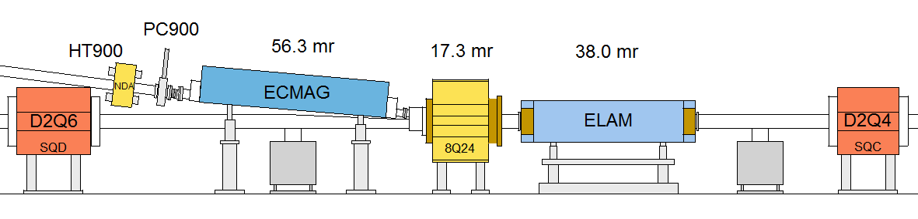
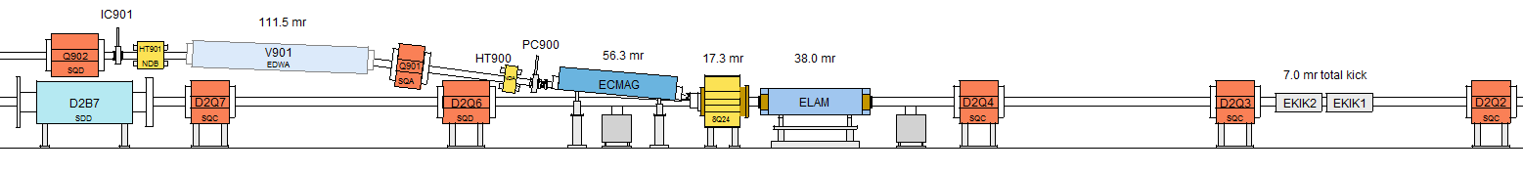
Delivery Ring Extraction
Extraction Devices
8Q24 40 pi-mm-mr
beam envelopes
Extraction region
December 15, 2014
21
J. Morgan - Muon Campus Beam Transport

Slide 22
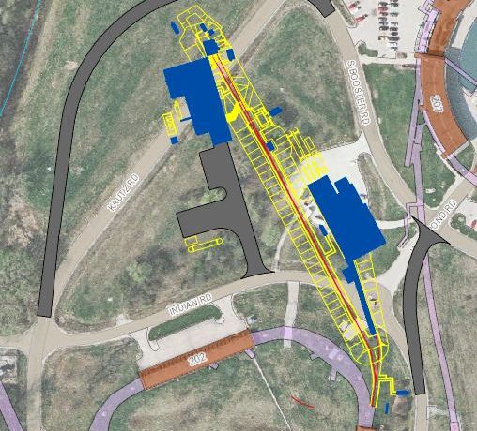
M4 and M5 Lines
Mu2e
Bldg
Booster
MC-1
Bldg
Delivery Ring
December 15, 2014

Slide 23
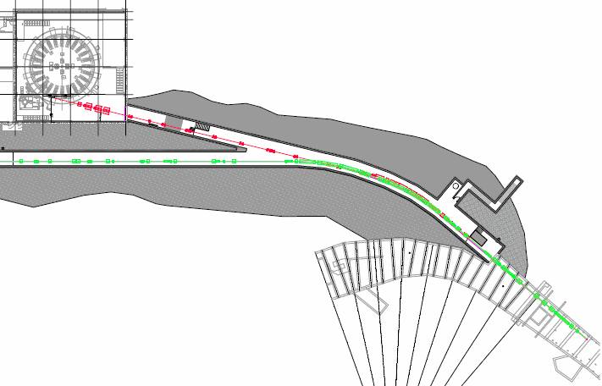
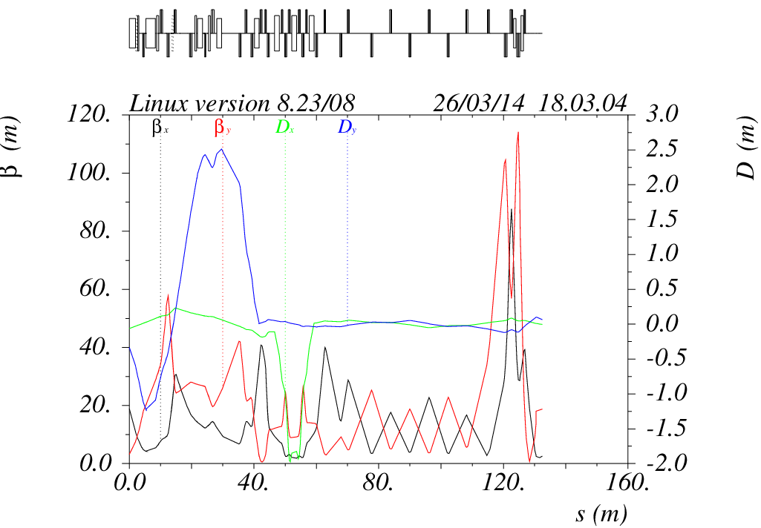
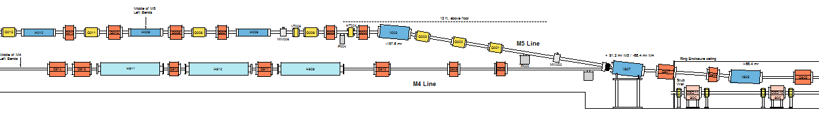
M4 and M5 Lines
M5 Line
M4 Line
M4/M5 split
December 15, 2014

Slide 24
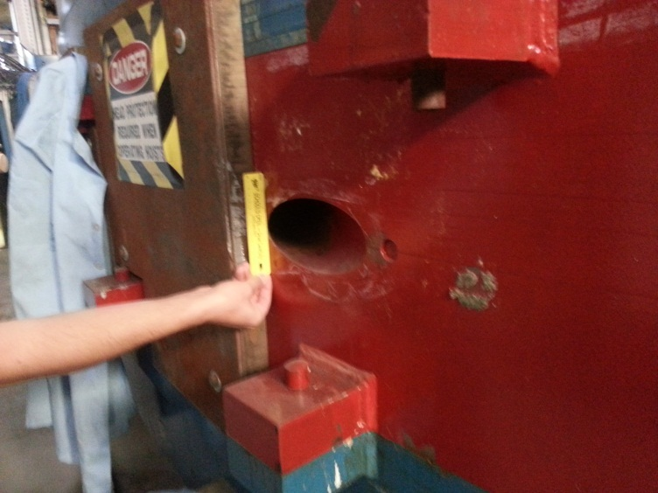
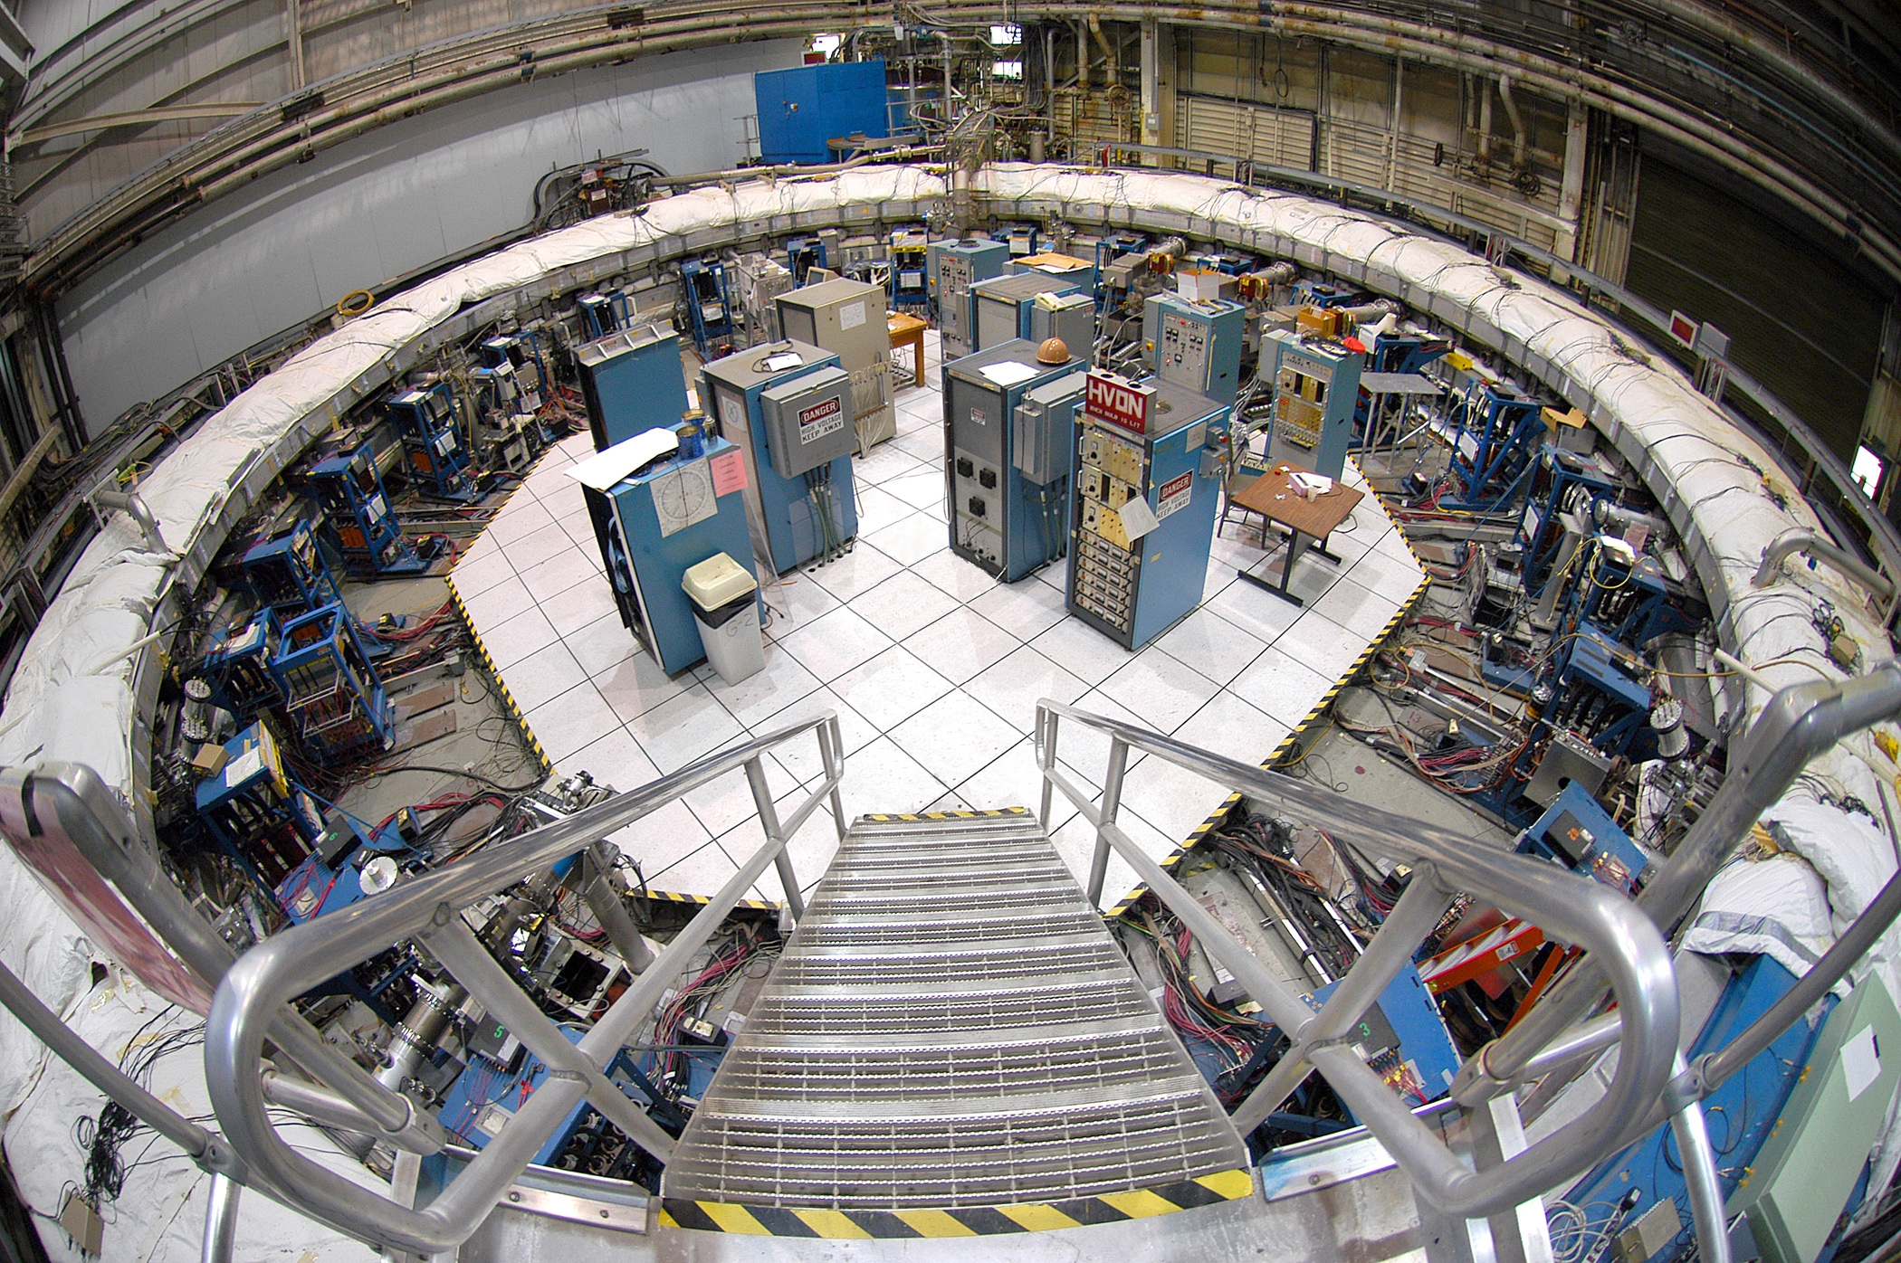
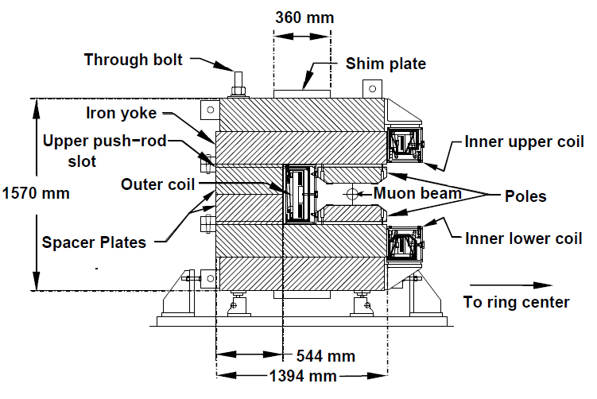
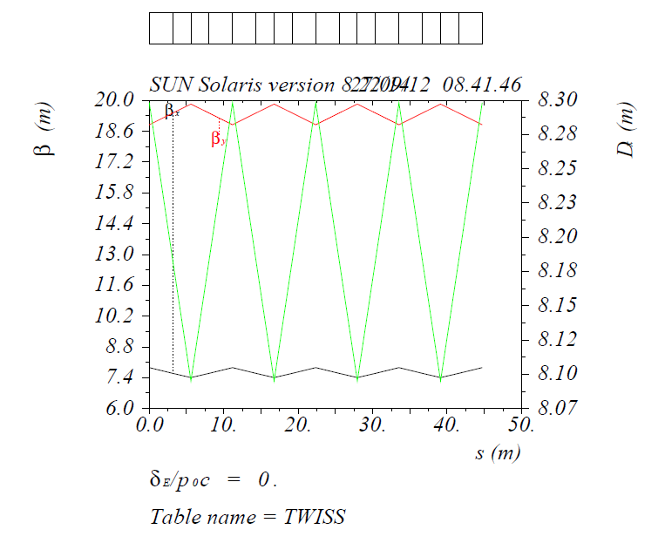
g-2 Storage Ring
10 cm beam access port
December 15, 2014

Slide 25
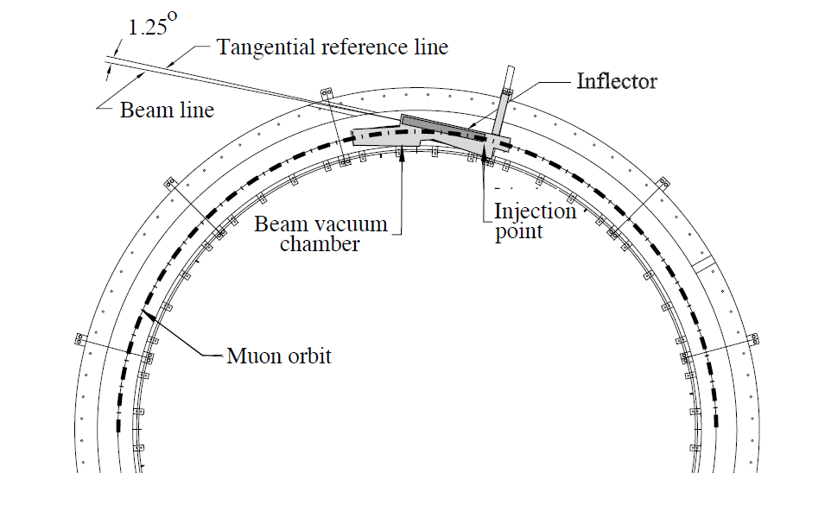
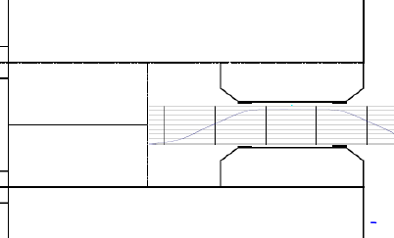
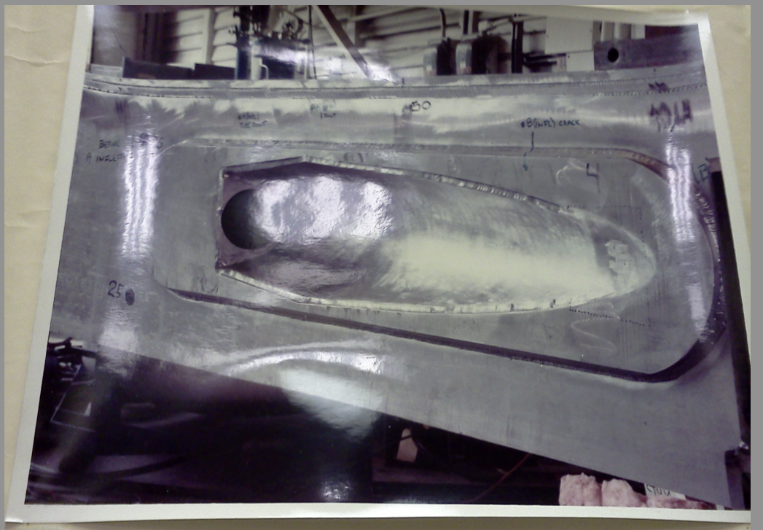
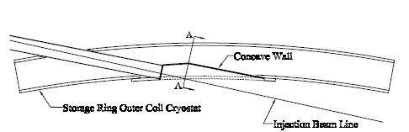
Beam trajectory into Storage Ring
Beam passes through fringe fields in both the yoke steel (weak) and drift to Inflector (strong)
Beam passes through a bore in the cryostat between the yoke and Inflector
The Inflector produces a uniform 1.45 T magnetic field to cancel main dipole field
Main dipole field
December 15, 2014

