Slide 1
Scintillating Fiber Profile Monitor
The M-Test Experience
Gianni Tassotto

Slide 2
The Project
The original project called for building and testing a profile monitor using scintillating fibers (SFPM) in the M-Test secondary beamline that had the following specifications:
- Beam energy in the range 1 – 120 GeV and at an intensity range from a few 1000 - 700,000 particles.
- Install the detector in a moveable vacuum can thereby reducing beam scattering when the detector was moved out of the beam.
Physicist– Hogan Nguyen
Project leader – Gianni Tassotto
Engineer – Greg Sellberg
Information about Fermi Beam Test Facility (FTBF) can be found at http://www-ppd.fnal.gov/ftbf/

Slide 3
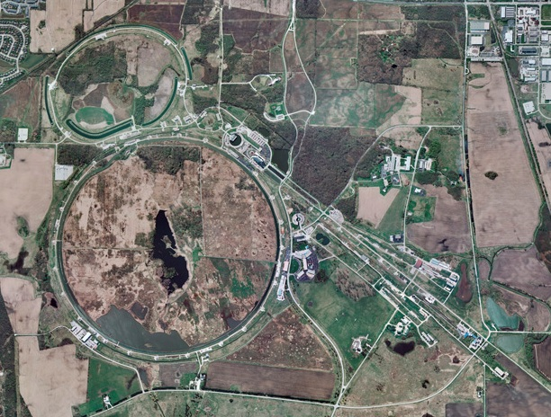
M-Test Location
Fermilab Test Beam Facility

Slide 4
M-Test Beam
Beam destined for M-Test via Switchyard is accelerated to 120 GeV in the Main Injector. It can be extracted in two ways: slow spill and single-turn extraction. Slow spill, currently the most common operational method, uses the QXR quadrupole circuit to resonantly extract beam over 1 second ( TEV event 20) or 4 seconds (TEV event 21). In single-turn extraction, beam is extracted with the MI-52 kicker/Lambertson combination.
Mode of Operation:
Proton mode 120 GeV protons reach MT6 experiment
Low energy pion mode where pion fluxes from 60 GeV down to 1 GeV can be selected
For a list of M-Test beamline component see:
http://www-ppd.fnal.gov/FTBF/Drawings/SY120.pdf

Slide 5
M-Test Profile Monitors
The energy range - 120 GeV down to 1 Gev at the experiment
The beam intensity – from a few 10¹¹ ppp on target to a few thousand particles at the experiment
All of the devices described below are interceptive and therefore cause beam losses. The use of an SFPM would reduce the losses considerably
Pre-target beamline:
Multiwire/SEMs - Based on secondary emission phenomenon
- Used in medium and high intensity beamlines
SWICs - Segmented Wire Ion Chamber – Based on ionization
- Middle and low intensity range
Secondary beamline:
PWCs - Proportional Wire Chamber - Ionization
- Low and very low intensity range
SFPMs - Scintillation Fiber Profile Monitor
- Low and very low intensity range

Slide 6
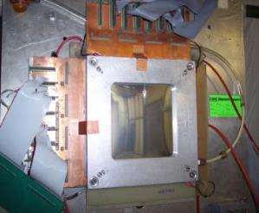
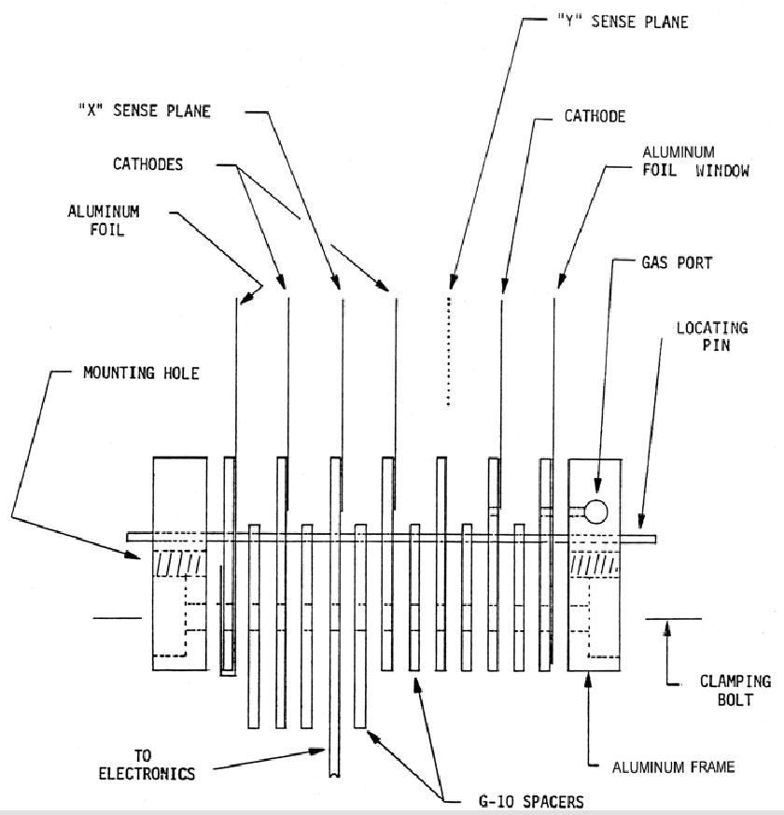
PWC Specifications
Proportional Wire Chamber originally designed by Howard Fenker [1]
Chamber Specifications
Requires vacuum break with typically 2 75 μm Ti windows
Modular
X,Y sense plane between 10 μm HV foils
Signal wires 10 μm AuW. These wires are fragile and can spark can break them. That’s why these chambers are modular
Material in the beam:
- 2 75 μm beamline window
- 60 μm total Al foils,
- 10 μm diameter AuW wire, - - 2 cm Ar/Co₂ at 80/20 %
Equals to 0.0071 rad lentghs and 0.0016 Int. lentghs
Chamber Layout
Completed chamber

Slide 7
New PWC
A new PWC called Schoo PWC (SPWC) designed by Dan Schoo has been built to be installed in a bayonet style vacuum thereby reducing beam scattering when not in the beam.
- X,Y wire pitch 2 mm
- Active area 98 mm
- gas ArC02 80/20%
- Uses scanner II electronics
- Cost: $550 parts, 1 week for assembly and testing and installing in vacuum can

Slide 8
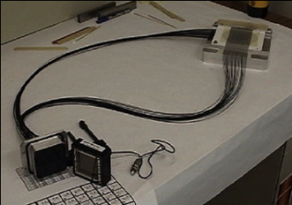
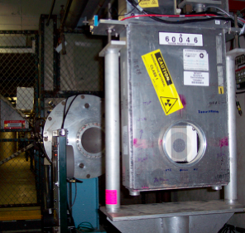
SFPM - Specifications
• Reduce beam losses of PWCs
M-Test beam energy range – 1-120 GeV
Low beam intensity - down to a few ppp
Detector Specifications:
Fiber type – St. Gobain type BCF-12MC covered with
black EMA for crss-talk reduction [2]
Fibers are mated to 64 channel microchannel plate
PMT for electron multiplication
Burle Planacom # 85011-501 from Photonisusa.com [3]
HV = -2300 Volts (Gain = 800,000)
Light output – 5 photo-electrons/MIP/fiber/
Detector Assembly:
Set of 32 fibers/plane having Diameter 0.75 mm
are epoxied to both sides of a ceramic board at a pitch
of 2 mm
Fibers are bundled and epoxied into a vacuum feed-through called “cookie” that match the optical inputs of the Planacon PMT
Vacuum to 10⁻⁷ Torr – limited by the epoxy and O-rings
Tests showed noise overcame signal around 10,000 particles
Cost: $8830 just for MCP-PMT
SFPM assembly
SFPM in vacuum can

Slide 9
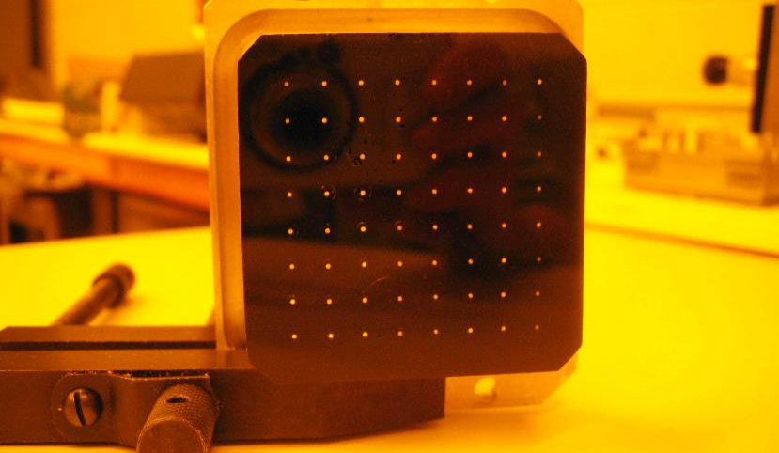
Epoxy Block test
The picture below show the testing of the epoxy block that mates with the MCP-PMT using a light source

Slide 10
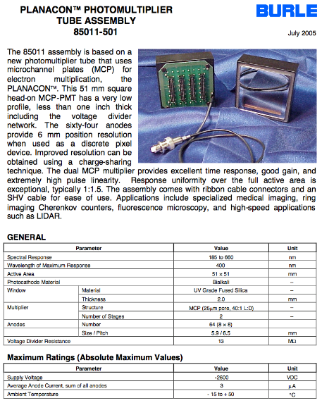
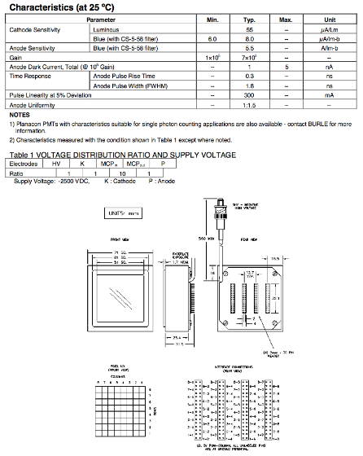
MCP-PMT specifications

Slide 11
Electronics
M-Test uses the same electronics for all profile monitors – designed by Al Franck [4] – scanner type II.
Scanner has 48 integrating inputs in both X,Y planes
Integration time is programmable from 5 μsec - 6.5 sec
Trigger timing can use clock events or a remote trigger
The A/D for each plane processes +/- 10 volt signals. The amplifier is programmable for 1, 10 or 100 gain settings placed between the integrator outputs and the A/D inputs
• Noise ≅ 0.2% of full scale
• A calibration option
Dynamic range – Scanner can display a
minimum of about 5 pCoul. Depending on mode of operation, M-Test secondary beamline could have very low intensity - a few 1000’s particles
Testing now a “Scanner III” version which will allow for background subtraction

Slide 12
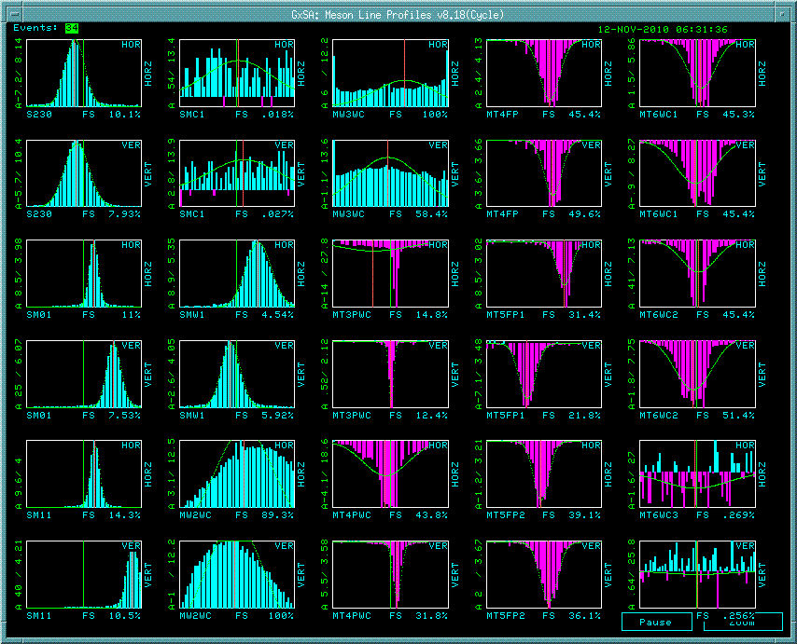
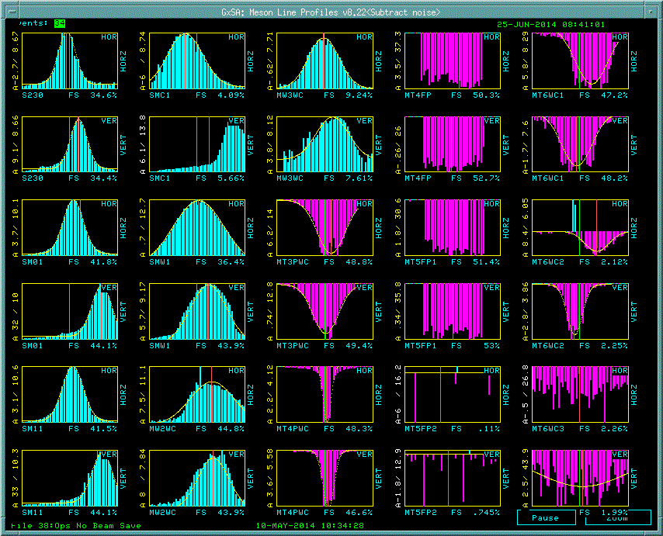
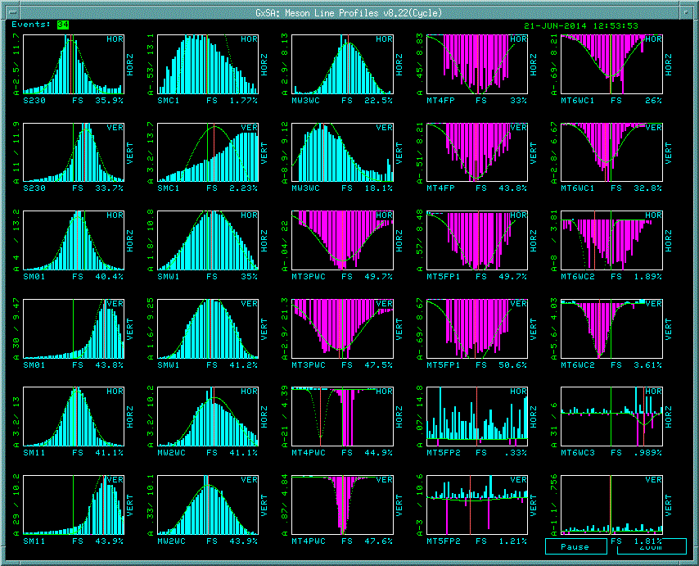
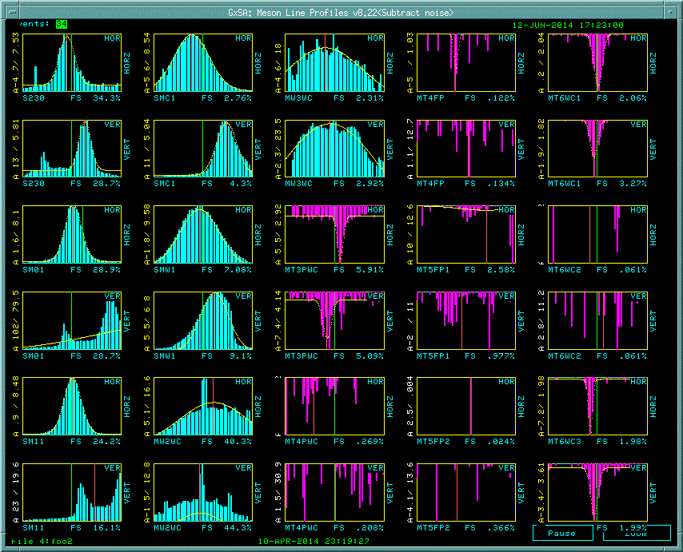
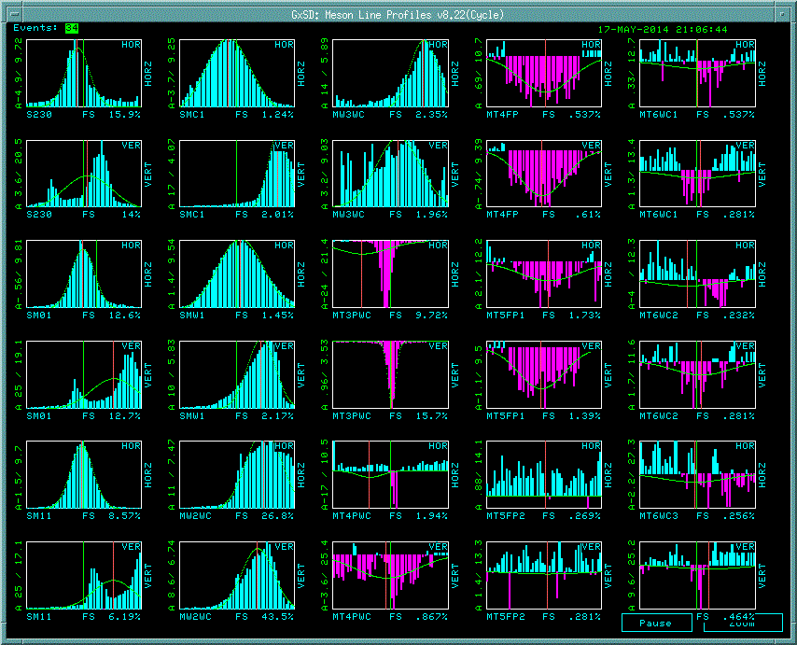
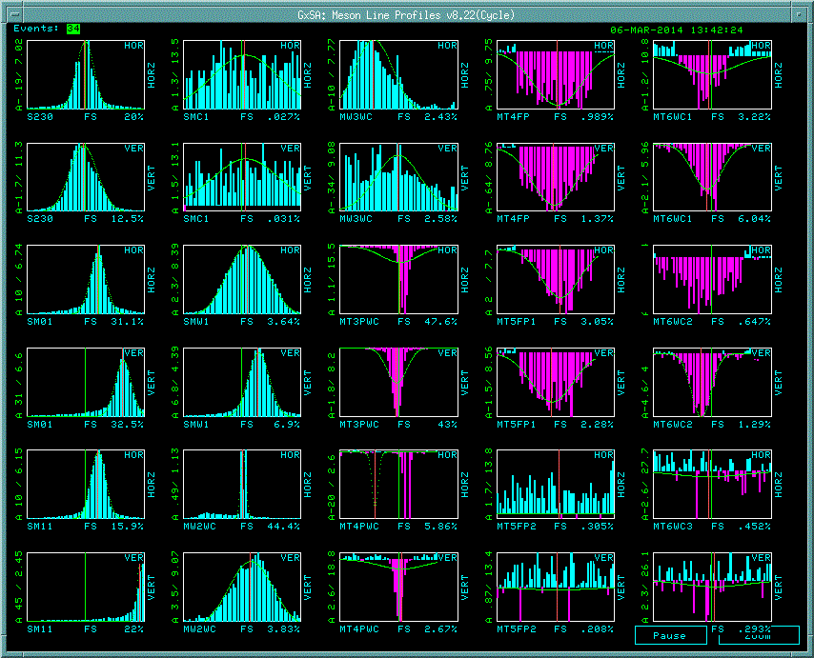
SWIC/PWC/Fiber Profiles
Display of SWIC (azure) starting in Switchyard, PWCs and Fibers downstream of target (magenta)
120 GeV - 150 cts 11/2010
32 GeV-500,000 cts 6/2014
16 GeV-400,000 cts 6/2014
120 GeV – 20,000 cts 6/2014
32 GeV - 8,000 cts 5/2014
32 GeV-50,000 cts 6/2014

Slide 13
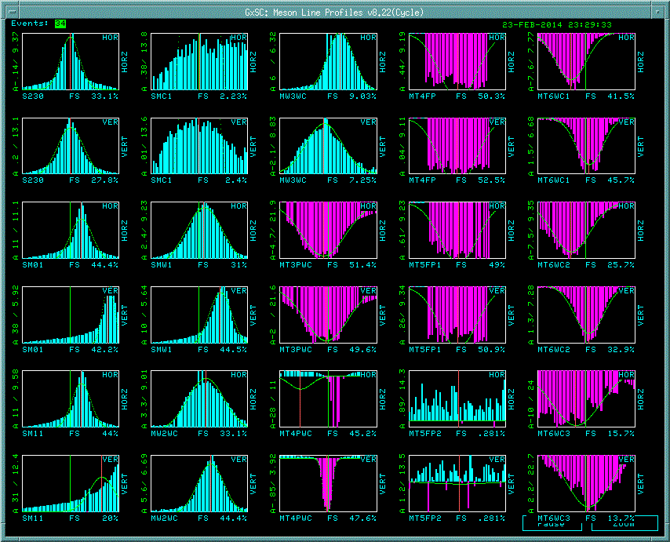
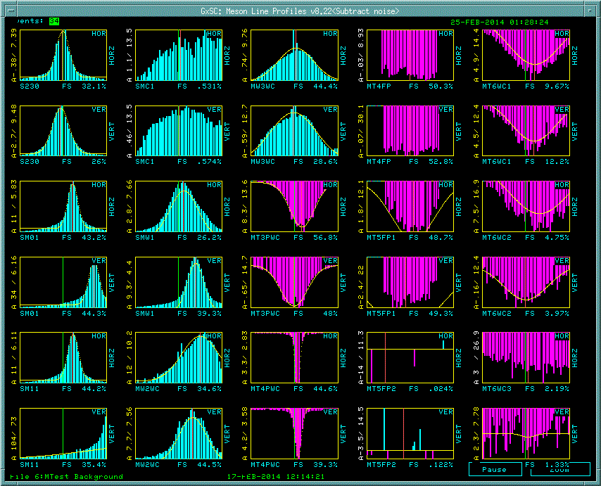
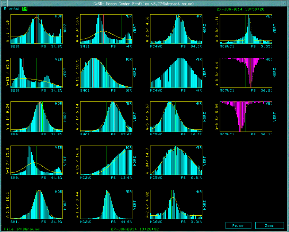
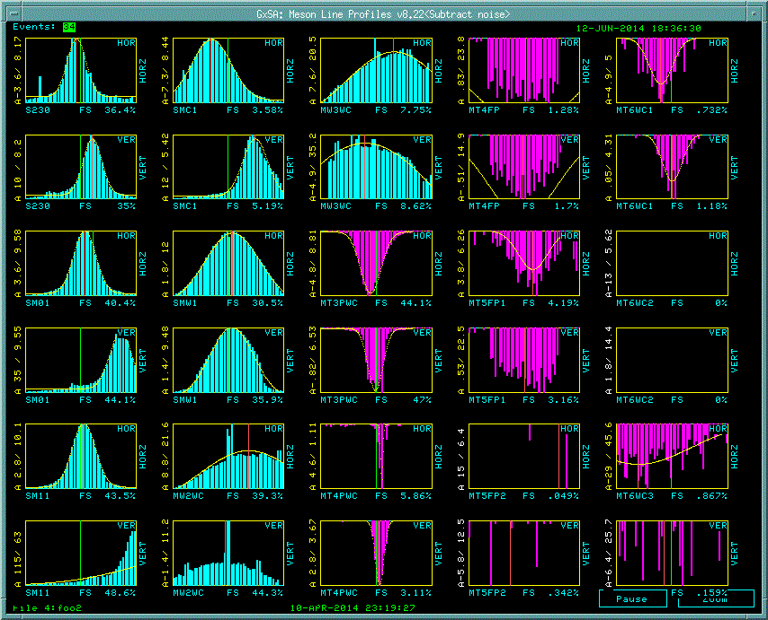
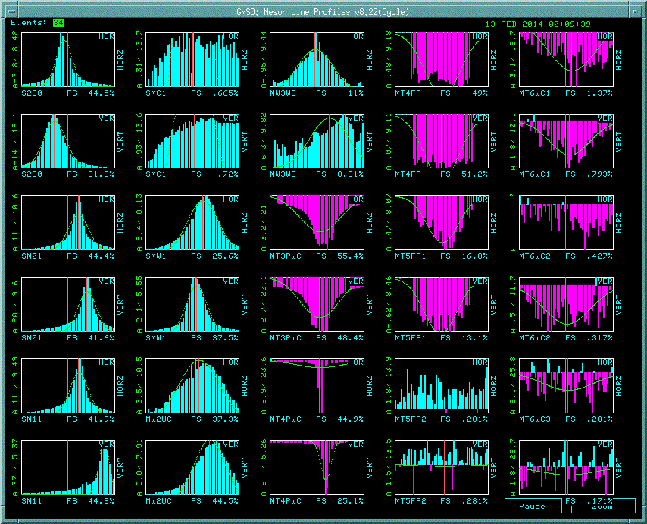
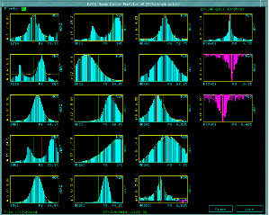
SWIC/PWC/Fiber Profiles - 2
M-Test beam profiles
M-Center beam profiles using SPWC
8 GeV – 400,000 cts 2/2014
2 GeV-400,000 cts 2/2014
32 GeV-13,000 cts 6/2014
120 GeV – 20,000 cts 2/2014
2 GeV - 50,000 cts 2/2014
32 GeV-5,000 cts 6/2014

Slide 14
Recommandations and Conclusion
Tests have been done so far using either Fenker PWC or SFPM show that below about 10,000 particles the monitors do not produce acceptable profiles.
Decisions:
- Evaluate proposal from INFN
- For the Fermi SFPM, consider improving the signal/noise ratio by
reducing the length of the scintillating fibers to the size of the ceramic
board, about 10 cm, thereby reducing the effect of halo.
- We are planning to test the new SPWCs in M-Test. Preliminary
tests performed in M-Center show a good profile at 2000 particles
Cost consideration:
Assuming that we use the same scanner II and bayonet style vacuum cans, which both are available, there is a large cost differential between the PWCs and the FNAL style fiber monitors and the INFN proposal:
  $550/unit for SPWS detector parts + 3K$ to modify Bayont boards
  Need some R&D to optimize the performance of the Fermi SFPM: 5K$
  Cost of INFN scintillation detector 20K$
Finally if the beamline requires less beam scattering the decision maybe to select an FPM

Slide 15
References
[1] H. Fenker, “A Standard Beam PWC for Fermilab” TM-1179, Feb.1983
[2] http://www.crystals.saint-gobain.com/Scintillating_Fiber.aspx
[3] http://www.photonisusa.com/
[4] W. Kissel, B. Luublynsky, A. Franck, “New SWIC Scanner/Control System”,
ICALEPCS “95, Chicago, IL, Oct. 1995

