Slide 1
Muon g-2 Low Intensity Instrumentation Plans
Fiber Profile Monitor Workshop
December 15, 2014
B. Drendel
Muon g-2 L3 Manager

Slide 2
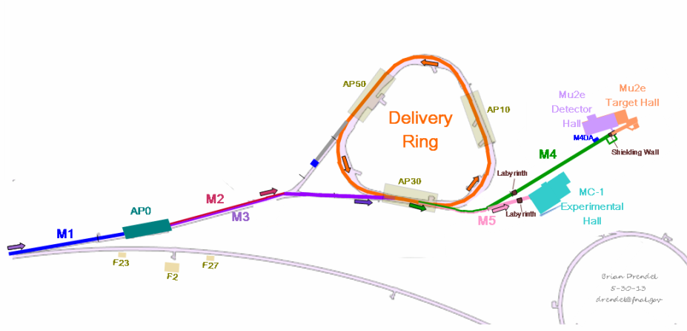
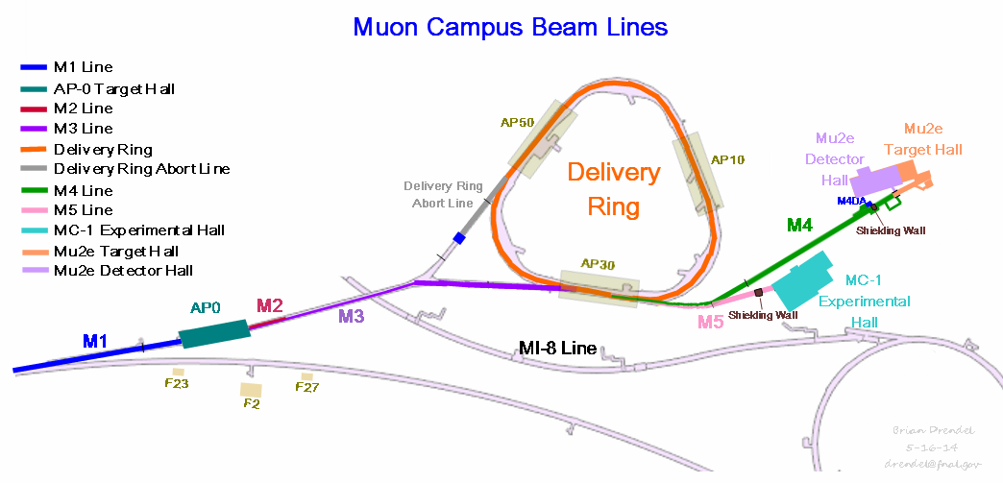
Instrumentation Requirements
  Much of the existing Instrumentation from the Antiproton Source will be reused for g-2 operations. Beam requirements can be broken down into the following categories.
    Mixed Secondary Beam (1E7 to 2E8)
      Intensity: Ion Chambers
      Position: SEMs
      Losses: BLMs
    Proton-only (2E7)
      Intensity: Ion Chambers
      Position: SEMs
      Losses: BLMs
    Muon-only (2E5)
      Intensity: Ion Chambers
      Position/Profile: PWCs
      Particle Composition: Cerenkov Detector

Slide 3
Instrumentation Requirements
 | Mixed Secondary Beam |  | Proton-Only | Muon-only
 | Beam Lines | Delivery Ring
Beam Lines | M2 (AP2) ->M3 (AP3) | Delivery Ring | Abort Line | M4 -> M5
Particles | μ+,π+,tau, p, e+ | μ+,π+, p | Protons | Muons
Momentum (GeV/c) | 3.094 | 3.094 | 3.094 | 3.094
# of Particles | 1E7 to 2E8 | 1E7 | 1E7 | 1E5
Transverse Acceptance (π-mm-mrad) (unnormalized) Beam sizes vary | 40 | 40 | 40 | 40
Bunch Length (nsec) (95%) | 120 | 120 | 120 | 120
Beam Line (m) | 285 | 505 | 50 | 130
Beam | 12Hz, 100Hz bursts | Circulates a few turns (1.69 μsec/turn) | 12Hz, 100Hz bursts | 12Hz, 100Hz bursts

Slide 4
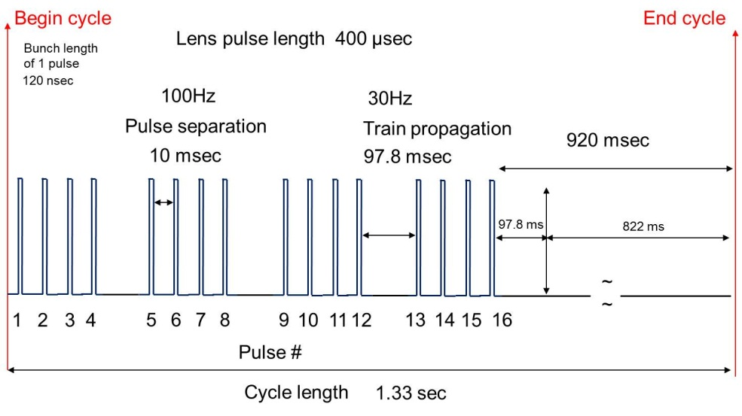
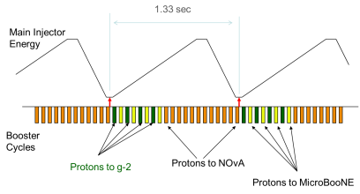
Instrumentation Requirements
g-2 average 12Hz pulse scenario
Average Rate = 12Hz, Burst rate = 100Hz
Four groups of four in a 1.33 second neutrino cycle.
g-2 booster cycles during Nova acceleration cycle

Slide 5
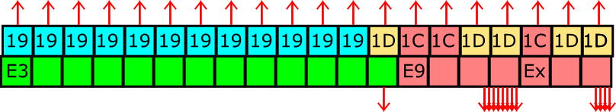
g-2 Proposed Pulse Train (12 Hz mode)
Begin cycle
End cycle
Bunch length
of 1 pulse
11 / 20 Nova Cycles
120 nsec
100Hz
Pulse separation
10 msec
Lens pulse length 400 µsec
193 msec
990 msec
~
~
1
2
3
4
5
6
7
8
9
10
11
12
13
14
15
16
Pulse #
MI Nova Cycle Length
1.33 sec

Slide 6
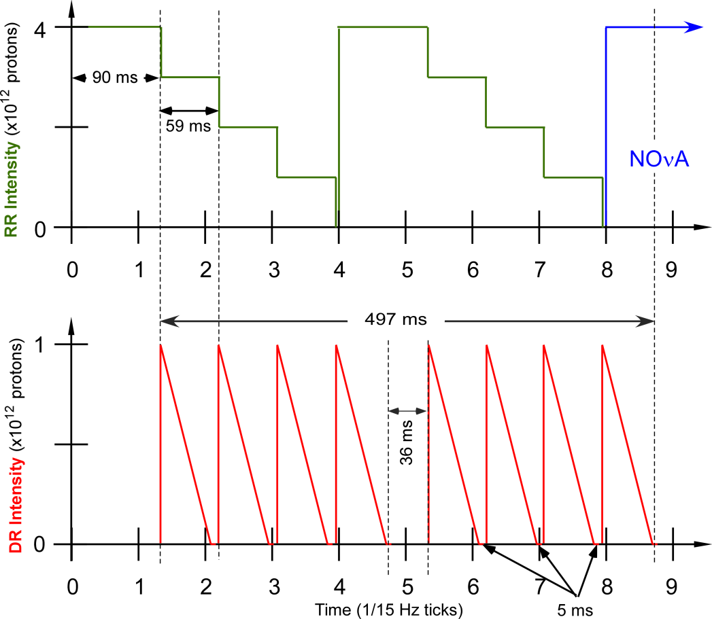
Mu2e Pulse Train

Slide 7
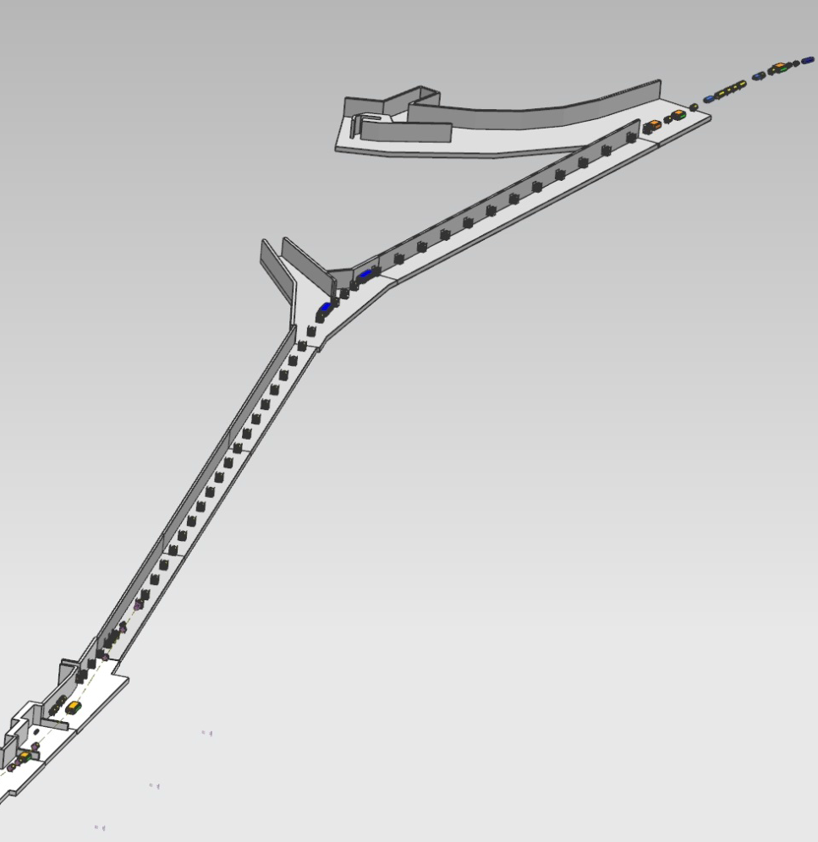
Low Intensity Secondary Beam Instrumentation
Name | Device | Beam Line | Specific Location
SEM804 | SEM | M2 | Use existing SEM704 location
Tor804 | Toroid | M2 | Use existing Tor704 location
IC804 | Fixed Ion Chamber | M2 | Use existing IC704 location. In place.
SEM810 | SEM | M2 | Immediately downstream of Q811
SEM702 | SEM | M3 | Use existing SEM926 location
SEM703 | SEM | M3 | Immediately downstream of H703
SEM706 | SEM | M3 | Immediately downstream of Q706
SEM711 | SEM | M3 | Immediately downstream of Q711
SEM719 | SEM | M3 | Immediately downstream of Q719
SEM726 | SEM | M3 | Immediately downstream of Q726
SEM729 | SEM | M3 | Immediately downstream of Q729
SEM740 | SEM | M3 | Immediately downstream of Q740
IC740 | Ion Chamber | M3 | Immediately downstream of SEM740
SEM744 | SEM or PWC | M3 | Immediately downstream of Q744
SEM749 | SEM or PWC | M3 | Immediately downstream of Q749
SEMs
or
PWCs
SEM740
IC740
SEM729
SEM726
SEMS
Repurpose 21 Pbar SEMS
Should have hardware for two spares
Build 21 super high gain preamps
Build 21 generation 3 scanners
Ion Chambers
Two Fixed (in air) ion chambers. Need to be mindful of scattering.
Four retractable ion chambers using bayonet cans.
SEM719
SEM711
SEM810
SEM706
SEM804
IC804
Notes:
Instrumentation locations for low intensity secondary beam going through the M2 line, M3 line and Delivery Ring have been chosen for
Toroids: Beam Intensity
SEMs: Beam Profile
WCM: Beam Intensity (temporary)

Slide 8
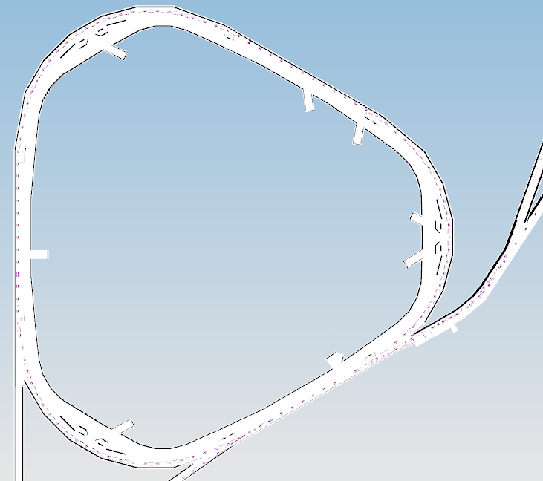
Low Intensity Secondary Beam Instrumentation
Name | Device | Beam Line | Specific Location
SEM204 | SEM or PWC | DR | Immediately upstream of ELAM
SEM302 | SEM or PWC | DR | Immediately downstream of ISEP
IC300 | Ion Chamber | DR | D30 straight (Retractable)
SEM607 | SEM or PWC | DR | Use existing SEM607 location
SEM105 | SEM or PWC | DR | Near D1Q5
IC100 | Ion Chamber | DR | D10 straight (Retractable)
SEM403 | SEM or PWC | DR | Use existing SEM403 location
SEM506 | SEM or PWC | DR | Near D5Q6
WCM503 | WCM | DR | Between D5Q3 and D5Q4. Mu2e Device
IC500 | Ion Chamber | DR | D10 straight (Retractable) – Not costed
ICABT | Fixed Ion Chamber | Abort Line | Immediately upstream of abort block
Tor000 | Toroid | Abort Line | Existing Tor733 as is
TorABT | Toroid | Abort Line | Existing Tor724 near abort block.
MWA00 | SEM | Abort Line | Existing SEM733 at current location
MWA05 | SEM | Abort Line | Existing SEM728 at current location
MWABT | SEM | Abort Line | Immediately upstream of ICABT
SEM
or
PWC
ion
chamber
SEM
or
PWC
SEM
or
PWC
WCM
SEM
or
PWC
SEM
SEM
or
PWC
SEMS
Repurpose 21 Pbar SEMS
Should have hardware for two spares
Build 21 super high gain preamps
Build 21 generation 3 scanners
May use PWCs in DR and some of M3.
Ion Chambers
Two Fixed (in air) ion chambers
Four retractable ion chambers using bayonet cans.
ion
chamber
SEM
SEM
or
PWC
WCM
Mu2e device, but can be used to measure g-2 beam intensity.
Notes:
Instrumentation locations for low intensity secondary beam going through the M2 line, M3 line and Delivery Ring have been chosen for
Toroids: Beam Intensity
SEMs: Beam Profile
WCM: Beam Intensity (temporary)

Slide 9
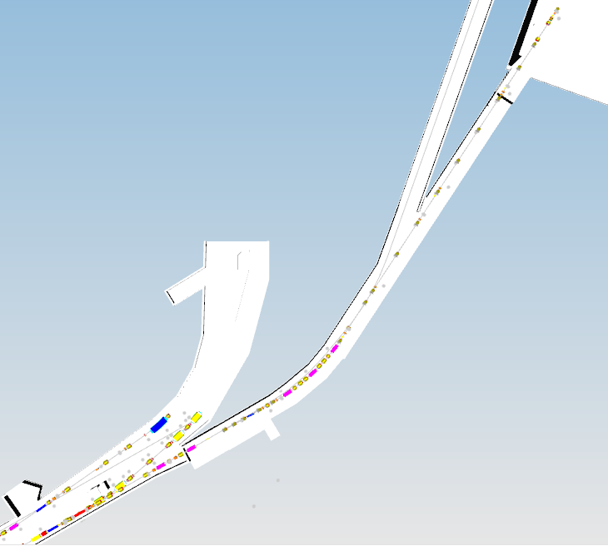
Muon-only Instrumentation
Name | Device | Beam Line | Specific Location
PC900 | PWC | M4 | Immediately downstream of c-magnet
IC901 | Ion Chamber | M4 | Immediately upstream of Q902
PC903 | PWC | M4 | Immediately downstream of Q903
PC000 | PWC | M5 | Half-way between V907 and Q001
PC006 | PWC | M5 | Immediately upstream of H006
PC012 | PWC | M5 | Immediately downstream of H012
PC021 | PWC | M5 | Immediately downstream of Q021
PC026 | PWC | M5 | Immediately downstream of Q026
PC027 | PWC | M5 | Immediately downstream of Q027
IC027 | Ion Chamber | M5 | Immediately downstream of WC027
PWC
PWC
ion
chamber
PWC021
PWCs
Eight PWCs in repurposed Bayonet vacuum cans
Plus one spare.
No preamps
Build eight generation 3 scanners.
PWC12
Ion Chambers
One fixed ion chamber. Need to be mindful of scattering.
One retractable ion chamber in repurposed Bayonet vacuum can
PWC06
PWC00
PWC903
PWC900 IC901
Notes:
Instrumentation for muon-only beam in the upstream M4 line and M5 line have been chosen.
Ion Chamber (Intensity)
PWC (Profiles)
Cerenkov Counter (Particle composition)

Slide 10
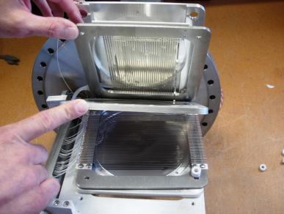
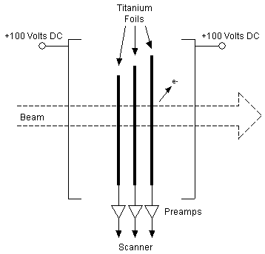
Secondary Emission Monitors (SEMs)
Measure the beam profile using 30 horizontal and 30 vertical titanium strips.
Beam particles have elastic collisions with the strips, dislodging them, creating current. 2.5% to 5% efficient.
Destructive measurement, but operate at beam pipe vacuum and have no gas.
SEM Foils
SEM and Preamp
Foil spacing 3mm (coverage 90mm) or 1.5mm (coverage 45mm)
Beam sigmas range from ~12-30mm
  Have enough wires to see profile
  Use 3mm foils for largest beam (unfortunately big in one plane and small in other)
Notes:
Secondary Emission Monitors (SEMs) will be used to measure beam profiles in the M2 and M3 lines, as well as the Delivery Ring. There are eight SEMs in the AP2 line, seven SEMs in the AP3 line, three SEMs in the D/A line, two in the Debuncher, one in the Accumulator and three spares from the former AP4 line to draw from. SEM tunnel hardware will require some maintenance, and locations where SEMs are moved will require new cable pulls.
We have a pool of 24 SEMs to choose from.
Need a total of 21 SEMs.
Not a large excess, but we should have enough
Beam studies showed that special high-gain preamps will be required to measure the low-intensity secondary beam during (g−2) operations [25]. Accelerator Controls has designed a new high gain preamp [23]. The design will be covered below.
SEMs will provide profile information via Fermilab generation 3 profile monitor scanner and Fermilab standard profile monitor software. An example beam profile is shown in Figure 1.53. Each scanner connects to one SEM and communicates to the control system via an Ethernet connection.
SWIC Scanner
The SWIC scanner is at the center of all profile monitor installations. The SWIC scanner collects the charge from each of the detector wires and converts the values of the charges to a set of digital numbers. The data are transferred to the Accelerator Control System and used to plot a graph of the beam profile or for other purposes that a user may need.
The SWIC scanner consists of five printed circuit boards, one controller board and four analog integrator boards. It has a set of 96 integrator circuits, 48 for horizontal and 48 for vertical. The integrators collect the charge from each of the detector titanium strips and converts it to a voltage value proportional to the total charge collected. The basic integration capacitor value for most SWIC scanners is 100 picofarads. This value provides the most sensitivity. Other values commonly in use are 1000 picofarads and 10,000 picofarads for integration time constants of ten or one hundred times the basic 100 picofarad value respectively for use in higher intensity beams. Longer time constants require more charge coming in from the detector to reach the same resulting voltage output from the integrators. Larger capacitors are used in higher intensity beams to minimize the possibility of overloading the integrators.
The integrators collect charge until they reach the end of the integration duration time that is set up in the plot application program by the user or until at least one wire reaches the preset threshold voltage. At the end of the integration period the integrators are switched from the sample mode to the hold mode. The integrated voltages on each channel are measured one by one. The voltages are converted to digital values. After conversion from analog to digital the integrators are all reset to zero and the scanner is ready to take another sample.
The 3rd generation SWIC scanner is an evolution of the previous design. The SWIC interfaces to the scanner through integrator boards (96 channels total), which are a direct carry-over. The control board centers around an Altera Cyclone III FPGA, which handles sequence control, ADC conversion, TCLK decoding, and timing. Communications and data handling are performed by a Rabbit Semiconductor RCM3209 module. The Rabbit module includes the microprocessor and Ethernet interface. New features include Ethernet communications, advance triggering options, and background subtraction [23].
High Gain Preamps
A new high gain preamp has been designed to allow the existing SEMs to be able to measure the low intensity secondary beam. The new preamp consists of two amplification stages. The first stage is a transimpedence amplifier with a gain of approximately 20,000,000 and an integration capacitor to slow down and widen the incoming pulse. The second stage reduces the DC offset of the first stage by a factor of about 100, then amplifies the remaining signal by about 100, with a low-pass roll-off of about 16 kHz.
There is a DC blocking capacitor at the output of the amplifier. This is to prevent any offset voltage of the amplifier from washing out our signal.
The SWIC scanner uses a TI/Burr-Brown ACF2101 integrator. The solid-state switch on its input has a resistance of 1.5 kohms (“typical”, per the datasheet). This extra 1.5k must be accounted for in the gain equation (R_INT).
After integration in the SWIC scanner, the integrator output can be amplified by another 10x or 100x if necessary.
SEM beam study results
AP-2 line beam studies were completed to commission the SEM prototype high gain preamps [24]. Beam lines were configured for +8 GeV primary beam and +3.1 GeV secondary beam. Beam intensities were varied through the range expected for (g – 2) operations. Figure 1.56 shows SEM profiles at two locations in the AP2 line using the new high gain preamps with the (g – 2) operational design intensity of 1E12 protons on target. The SEM at the 706 location has some bad wires which will be repaired during maintenance periods.
Beam target intensities were lowered to a little over one order of magnitude less than expected (g - 2) operations to test the range of the SEM high gain preamps. Figure 1.57 shows profiles with 1E11 protons on target. This simulates the lowest expected intensities expected at the end of the M3 line during (g - 2) operations.
Pulse to pulse beam noise variation has been an issue with AP-2 line SEMs, so a third generation scanner was tested during beam studies. This scanner implements a hardware pulse-by-pulse background noise subtraction. For each beam cycle, the background noise is subtracted before the beam pulse arrives and that signal is subtracted from a second sample taken at beam time. The results were very promising, giving us clean looking profiles.
The overall results of the beam studies show that the high gain preamps are sensitive enough to measure the low intensity secondary beam expected for (g – 2) operations, while the generation 3 scanner effectively eliminates noise from the raw signal via a pulse-to-pulse background subtraction.
SEMs
Name Device Specific Location
M2
MW804 SEM Existing SEM 704 near current location
MW810 SEM Immediately downstream of Q804
M3
MW702 SEM Existing SEM 926, in current location
MW703 SEM Immediately downstream of H703 (old EB4)
MW706 SEM Immediately downstream of Q706
MW711 SEM Immediately downstream of Q711
MW719 SEM Immediately downstream of Q719
MW725 SEM Immediately downstream of Q725
MW730 SEM Immediately downstream of Q730
MW740 SEM Immediately downstream of Q740
MW744 SEM Immediately downstream of Q744
MW753 SEM Immediately downstream of Q749
Abort
MWA00 SEM Existing SEM 733 at current location
MWA05 SEM Existing SEM 728 at current location
MWABT SEM Immediately upstream of ICABT, near abort block

Slide 11
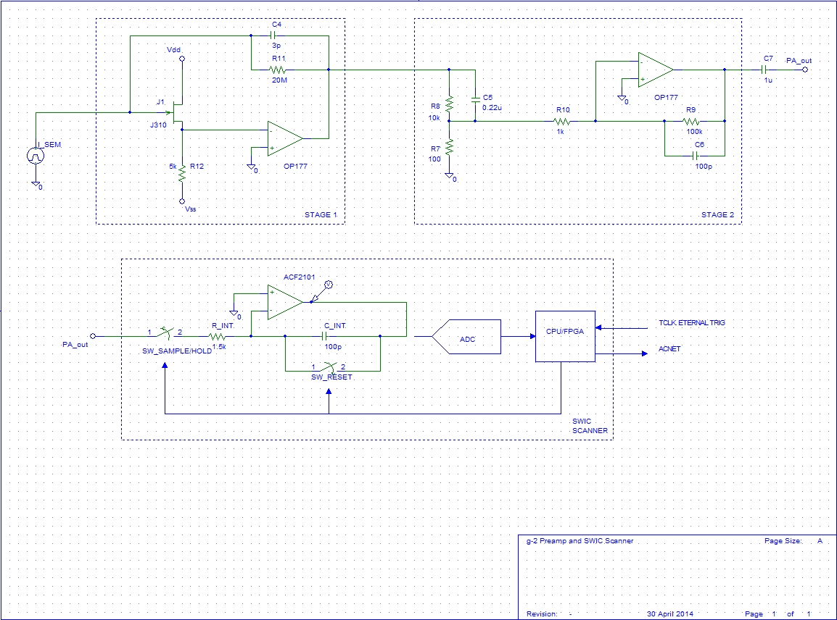
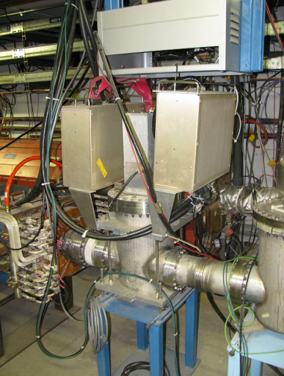
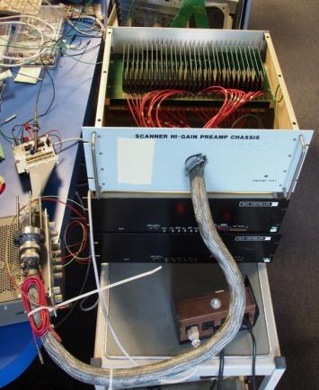
SEM Preamps
A new high gain preamp has been designed to allow the existing SEMs to be able to measure the low intensity secondary beam.
The new preamp consists of two amplification stages.
  The first stage is a transimpedence amplifier with a gain of approximately 20,000,000 and an integration capacitor to slow down and widen the incoming pulse.
  The second stage reduces the DC offset of the first stage by a factor of about 100, then amplifies the remaining signal by about 100, with a low-pass roll-off of about 16 kHz.
There is a DC blocking capacitor at the output of the amplifier. This is to prevent any offset voltage of the amplifier from washing out our signal.
Preamp
Preamp Test
SEM
Notes:
Secondary Emission Monitors (SEMs) will be used to measure beam profiles in the M2 and M3 lines, as well as the Delivery Ring. There are eight SEMs in the AP2 line, seven SEMs in the AP3 line, three SEMs in the D/A line, two in the Debuncher, one in the Accumulator and three spares from the former AP4 line to draw from. SEM tunnel hardware will require some maintenance, and locations where SEMs are moved will require new cable pulls.
We have a pool of 24 SEMs to choose from.
Need a total of 21 SEMs.
Not a large excess, but we should have enough
Beam studies showed that special high-gain preamps will be required to measure the low-intensity secondary beam during (g−2) operations [25]. Accelerator Controls has designed a new high gain preamp [23]. The design will be covered below.
SEMs will provide profile information via Fermilab generation 3 profile monitor scanner and Fermilab standard profile monitor software. An example beam profile is shown in Figure 1.53. Each scanner connects to one SEM and communicates to the control system via an Ethernet connection.
SWIC Scanner
The SWIC scanner is at the center of all profile monitor installations. The SWIC scanner collects the charge from each of the detector wires and converts the values of the charges to a set of digital numbers. The data are transferred to the Accelerator Control System and used to plot a graph of the beam profile or for other purposes that a user may need.
The SWIC scanner consists of five printed circuit boards, one controller board and four analog integrator boards. It has a set of 96 integrator circuits, 48 for horizontal and 48 for vertical. The integrators collect the charge from each of the detector titanium strips and converts it to a voltage value proportional to the total charge collected. The basic integration capacitor value for most SWIC scanners is 100 picofarads. This value provides the most sensitivity. Other values commonly in use are 1000 picofarads and 10,000 picofarads for integration time constants of ten or one hundred times the basic 100 picofarad value respectively for use in higher intensity beams. Longer time constants require more charge coming in from the detector to reach the same resulting voltage output from the integrators. Larger capacitors are used in higher intensity beams to minimize the possibility of overloading the integrators.
The integrators collect charge until they reach the end of the integration duration time that is set up in the plot application program by the user or until at least one wire reaches the preset threshold voltage. At the end of the integration period the integrators are switched from the sample mode to the hold mode. The integrated voltages on each channel are measured one by one. The voltages are converted to digital values. After conversion from analog to digital the integrators are all reset to zero and the scanner is ready to take another sample.
The 3rd generation SWIC scanner is an evolution of the previous design. The SWIC interfaces to the scanner through integrator boards (96 channels total), which are a direct carry-over. The control board centers around an Altera Cyclone III FPGA, which handles sequence control, ADC conversion, TCLK decoding, and timing. Communications and data handling are performed by a Rabbit Semiconductor RCM3209 module. The Rabbit module includes the microprocessor and Ethernet interface. New features include Ethernet communications, advance triggering options, and background subtraction [23].
High Gain Preamps
A new high gain preamp has been designed to allow the existing SEMs to be able to measure the low intensity secondary beam. The new preamp consists of two amplification stages. The first stage is a transimpedence amplifier with a gain of approximately 20,000,000 and an integration capacitor to slow down and widen the incoming pulse. The second stage reduces the DC offset of the first stage by a factor of about 100, then amplifies the remaining signal by about 100, with a low-pass roll-off of about 16 kHz.
There is a DC blocking capacitor at the output of the amplifier. This is to prevent any offset voltage of the amplifier from washing out our signal.
The SWIC scanner uses a TI/Burr-Brown ACF2101 integrator. The solid-state switch on its input has a resistance of 1.5 kohms (“typical”, per the datasheet). This extra 1.5k must be accounted for in the gain equation (R_INT).
After integration in the SWIC scanner, the integrator output can be amplified by another 10x or 100x if necessary.
SEM beam study results
AP-2 line beam studies were completed to commission the SEM prototype high gain preamps [24]. Beam lines were configured for +8 GeV primary beam and +3.1 GeV secondary beam. Beam intensities were varied through the range expected for (g – 2) operations. Figure 1.56 shows SEM profiles at two locations in the AP2 line using the new high gain preamps with the (g – 2) operational design intensity of 1E12 protons on target. The SEM at the 706 location has some bad wires which will be repaired during maintenance periods.
Beam target intensities were lowered to a little over one order of magnitude less than expected (g - 2) operations to test the range of the SEM high gain preamps. Figure 1.57 shows profiles with 1E11 protons on target. This simulates the lowest expected intensities expected at the end of the M3 line during (g - 2) operations.
Pulse to pulse beam noise variation has been an issue with AP-2 line SEMs, so a third generation scanner was tested during beam studies. This scanner implements a hardware pulse-by-pulse background noise subtraction. For each beam cycle, the background noise is subtracted before the beam pulse arrives and that signal is subtracted from a second sample taken at beam time. The results were very promising, giving us clean looking profiles.
The overall results of the beam studies show that the high gain preamps are sensitive enough to measure the low intensity secondary beam expected for (g – 2) operations, while the generation 3 scanner effectively eliminates noise from the raw signal via a pulse-to-pulse background subtraction.
SEMs
Name Device Specific Location
M2
MW804 SEM Existing SEM 704 near current location
MW810 SEM Immediately downstream of Q804
M3
MW702 SEM Existing SEM 926, in current location
MW703 SEM Immediately downstream of H703 (old EB4)
MW706 SEM Immediately downstream of Q706
MW711 SEM Immediately downstream of Q711
MW719 SEM Immediately downstream of Q719
MW725 SEM Immediately downstream of Q725
MW730 SEM Immediately downstream of Q730
MW740 SEM Immediately downstream of Q740
MW744 SEM Immediately downstream of Q744
MW753 SEM Immediately downstream of Q749
Abort
MWA00 SEM Existing SEM 733 at current location
MWA05 SEM Existing SEM 728 at current location
MWABT SEM Immediately upstream of ICABT, near abort block

Slide 12
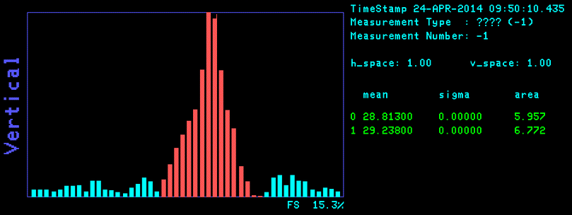
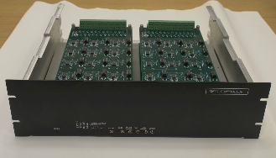
Scanner for SEM Readout
The SWIC scanner uses a TI/Burr-Brown ACF2101 integrator. The solid-state switch on its input has a resistance of 1.5 kohms (“typical”, per the datasheet).
After integration in the SWIC scanner, the integrator output can be amplified by another 10x or 100x if necessary.
The SWIC scanners (Gen 2 and Gen 3) have 16-bit ADCs reading the integrators.
The voltage range within that 16 bits is -10V to +10V.
  That ends up being about 300 uV per count.
  On a 100 pf cap, 1 volt equates to about 6.24 E8 particles. That’s about 1.9 E5 particles per count.
  That’s the particles that accumulate on the 100 pf cap through the integrator.
  Then you have to figure in the capture rates of the detectors, plus any gain you expect from a preamp.
Gen 3 scanners add pulse to pulse background subtraction.
  The profiles are read with no beam at a changeable time prior to each beam pulse. This time can be as close as 800 microseconds prior to the beam pulse.
  The profiles are read with beam.
  The raw and background signals are subtracted giving the final profiles.
Background
Subtraction
Gen 3 Scanner
Notes:
Secondary Emission Monitors (SEMs) will be used to measure beam profiles in the M2 and M3 lines, as well as the Delivery Ring. There are eight SEMs in the AP2 line, seven SEMs in the AP3 line, three SEMs in the D/A line, two in the Debuncher, one in the Accumulator and three spares from the former AP4 line to draw from. SEM tunnel hardware will require some maintenance, and locations where SEMs are moved will require new cable pulls.
We have a pool of 24 SEMs to choose from.
Need a total of 21 SEMs.
Not a large excess, but we should have enough
Beam studies showed that special high-gain preamps will be required to measure the low-intensity secondary beam during (g−2) operations [25]. Accelerator Controls has designed a new high gain preamp [23]. The design will be covered below.
SEMs will provide profile information via Fermilab generation 3 profile monitor scanner and Fermilab standard profile monitor software. An example beam profile is shown in Figure 1.53. Each scanner connects to one SEM and communicates to the control system via an Ethernet connection.
SWIC Scanner
The SWIC scanner is at the center of all profile monitor installations. The SWIC scanner collects the charge from each of the detector wires and converts the values of the charges to a set of digital numbers. The data are transferred to the Accelerator Control System and used to plot a graph of the beam profile or for other purposes that a user may need.
The SWIC scanner consists of five printed circuit boards, one controller board and four analog integrator boards. It has a set of 96 integrator circuits, 48 for horizontal and 48 for vertical. The integrators collect the charge from each of the detector titanium strips and converts it to a voltage value proportional to the total charge collected. The basic integration capacitor value for most SWIC scanners is 100 picofarads. This value provides the most sensitivity. Other values commonly in use are 1000 picofarads and 10,000 picofarads for integration time constants of ten or one hundred times the basic 100 picofarad value respectively for use in higher intensity beams. Longer time constants require more charge coming in from the detector to reach the same resulting voltage output from the integrators. Larger capacitors are used in higher intensity beams to minimize the possibility of overloading the integrators.
The integrators collect charge until they reach the end of the integration duration time that is set up in the plot application program by the user or until at least one wire reaches the preset threshold voltage. At the end of the integration period the integrators are switched from the sample mode to the hold mode. The integrated voltages on each channel are measured one by one. The voltages are converted to digital values. After conversion from analog to digital the integrators are all reset to zero and the scanner is ready to take another sample.
The 3rd generation SWIC scanner is an evolution of the previous design. The SWIC interfaces to the scanner through integrator boards (96 channels total), which are a direct carry-over. The control board centers around an Altera Cyclone III FPGA, which handles sequence control, ADC conversion, TCLK decoding, and timing. Communications and data handling are performed by a Rabbit Semiconductor RCM3209 module. The Rabbit module includes the microprocessor and Ethernet interface. New features include Ethernet communications, advance triggering options, and background subtraction [23].
High Gain Preamps
A new high gain preamp has been designed to allow the existing SEMs to be able to measure the low intensity secondary beam. The new preamp consists of two amplification stages. The first stage is a transimpedence amplifier with a gain of approximately 20,000,000 and an integration capacitor to slow down and widen the incoming pulse. The second stage reduces the DC offset of the first stage by a factor of about 100, then amplifies the remaining signal by about 100, with a low-pass roll-off of about 16 kHz.
There is a DC blocking capacitor at the output of the amplifier. This is to prevent any offset voltage of the amplifier from washing out our signal.
The SWIC scanner uses a TI/Burr-Brown ACF2101 integrator. The solid-state switch on its input has a resistance of 1.5 kohms (“typical”, per the datasheet). This extra 1.5k must be accounted for in the gain equation (R_INT).
After integration in the SWIC scanner, the integrator output can be amplified by another 10x or 100x if necessary.
SEM beam study results
AP-2 line beam studies were completed to commission the SEM prototype high gain preamps [24]. Beam lines were configured for +8 GeV primary beam and +3.1 GeV secondary beam. Beam intensities were varied through the range expected for (g – 2) operations. Figure 1.56 shows SEM profiles at two locations in the AP2 line using the new high gain preamps with the (g – 2) operational design intensity of 1E12 protons on target. The SEM at the 706 location has some bad wires which will be repaired during maintenance periods.
Beam target intensities were lowered to a little over one order of magnitude less than expected (g - 2) operations to test the range of the SEM high gain preamps. Figure 1.57 shows profiles with 1E11 protons on target. This simulates the lowest expected intensities expected at the end of the M3 line during (g - 2) operations.
Pulse to pulse beam noise variation has been an issue with AP-2 line SEMs, so a third generation scanner was tested during beam studies. This scanner implements a hardware pulse-by-pulse background noise subtraction. For each beam cycle, the background noise is subtracted before the beam pulse arrives and that signal is subtracted from a second sample taken at beam time. The results were very promising, giving us clean looking profiles.
The overall results of the beam studies show that the high gain preamps are sensitive enough to measure the low intensity secondary beam expected for (g – 2) operations, while the generation 3 scanner effectively eliminates noise from the raw signal via a pulse-to-pulse background subtraction.
SEMs
Name Device Specific Location
M2
MW804 SEM Existing SEM 704 near current location
MW810 SEM Immediately downstream of Q804
M3
MW702 SEM Existing SEM 926, in current location
MW703 SEM Immediately downstream of H703 (old EB4)
MW706 SEM Immediately downstream of Q706
MW711 SEM Immediately downstream of Q711
MW719 SEM Immediately downstream of Q719
MW725 SEM Immediately downstream of Q725
MW730 SEM Immediately downstream of Q730
MW740 SEM Immediately downstream of Q740
MW744 SEM Immediately downstream of Q744
MW753 SEM Immediately downstream of Q749
Abort
MWA00 SEM Existing SEM 733 at current location
MWA05 SEM Existing SEM 728 at current location
MWABT SEM Immediately upstream of ICABT, near abort block

Slide 13
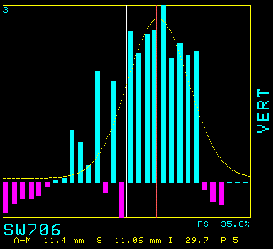
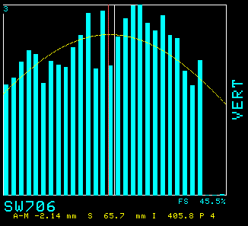
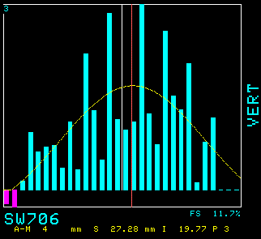
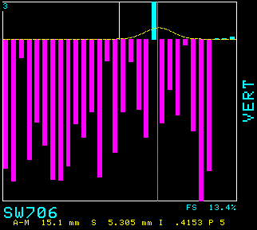
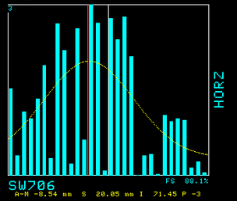
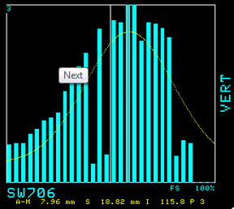
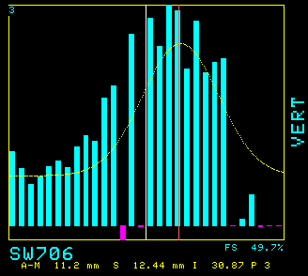
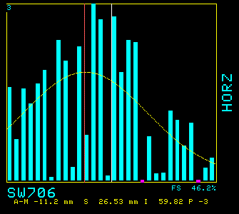
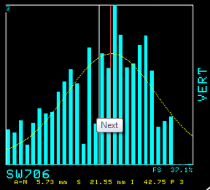
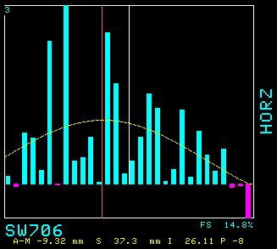
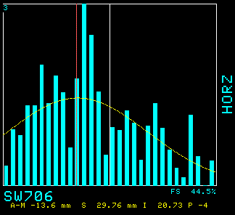
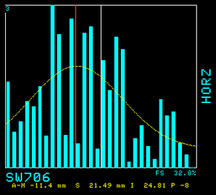
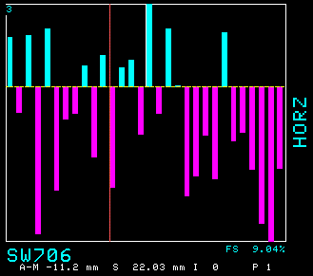
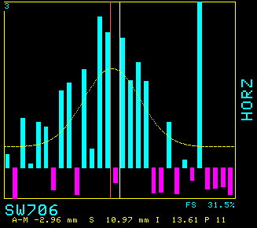
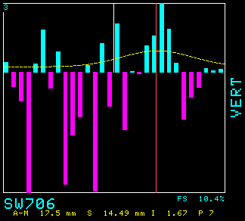
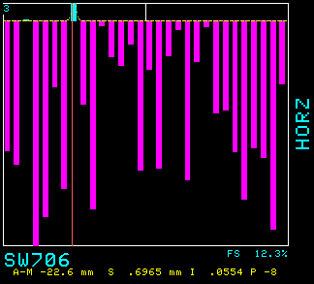
2014 SEM Beam Tests
Beam studies performed in March and April of 2014 (http://gm2-docdb.fnal.gov:8080/cgi-bin/ShowDocument?docid=1707).
Different high gain preamp options tested.
Background subtraction required .
  Large pulse to pulse variation in noise (generation 3 scanner)
100pf Generation 2 scanner
8 GeV protons on target -> +3GeV secondaries
Beam intensities comparable to what we will see in the M2 and M3 during g-2 operations.
6 Turns
84 bunches
TOR105 = 1.6E12
IC704 = 1.2E9
IC728 = 5.0E7
Gain = 10
Duration = 0.004ms
Threshold = 10
4 Turns
84 bunches
TOR105 = 0.99E12
IC704 = 7.2E8
IC728 = 3.0E7
Gain = 10
Duration = 0.004ms
Threshold = 10
2 Turns
84 bunches
TOR105 = 4.4E11
IC704 = 6.6E8
IC728 = 2.4E7
Gain = 10
Duration = 0.004ms
Threshold = 10
2 Turns
20 bunches
TOR105 = 1.1E11
IC704 = 2.5E8
IC728 = 4.5E6
Gain = 100
Duration = 0.004ms
Threshold = 10
2 Turns
5 bunches
TOR105 = 1E10
IC704 = 5E7
IC728 = 4.0E6
Gain = 1
Duration = 0.09ms
Threshold = 10
2 Turns
10 bunches
TOR105 = 4.7E10
IC704 = 2.5E7
IC728 = 4.3E6
Gain = 100
Duration = 0.009ms
Threshold = 10

Slide 14
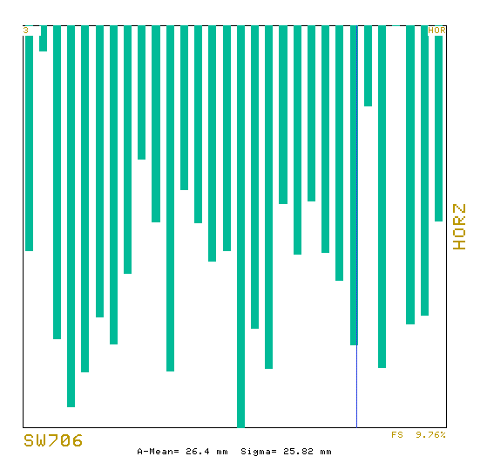
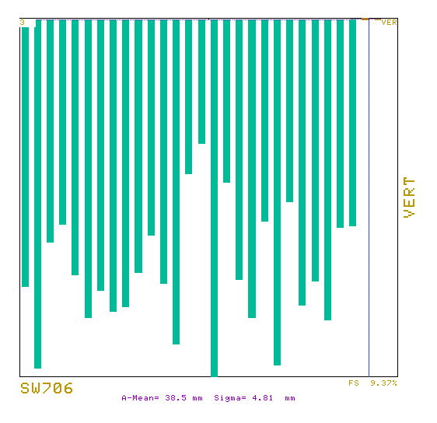
SEM Noise
Noise signals for the SEMs can be significant and vary pulse to pulse.
Some noise can be as much as 10% full scale.
Scale: 10V integrator output = 100%.
Signal depends on scanner configuration (100pf, 1000pf or 10000pf) and gain (1, 10 or 100).
  100 pf -> 100 pC/volt/gain -> 10% = 6.24E8 particles/gain
  1000 pf -> 1000 pC/volt/gain -> 10% = 6.24E9 particles/gain
  10000 pf -> 10000 pC/volt/gain -> 10% = 6.24E10 particles/gain

Slide 15
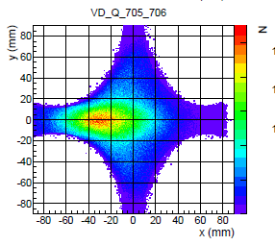
SEM resolution
SEM 706 had prototype preamp like g-2 will use and was located near intensity monitor (ion chamber)
Average noise ~10% (100% = saturation)
Intensity reduced to 5x10⁷ particles measured in nearby ion chamber
  Expect ~4x10⁷ protons to Delivery Ring based on G4beamline
  Peak signal reported as ~30% (3x noise), sigma fit to ~11mm
  Roughly 5x10⁶ particles per wire near peak, magnitude of tails comparable to noise level
Noise appears to be random in time and increase with gain: increasing integration times gives much cleaner profiles than increasing gain
2 Turns
5 bunches
TOR105 = 1E10
IC704 = 5E7
IC728 = 4.0E6
Gain = 1
Duration = 0.09ms
Threshold = 10
  (Lose beam btwn 105 and target)
  G4bl: 9E6 Why do we measure
  4E5 10x more???

Slide 16
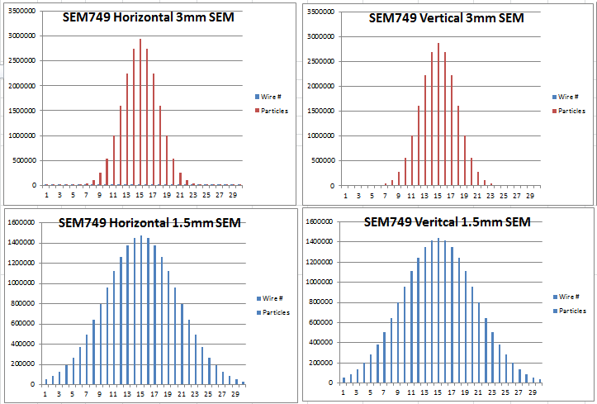
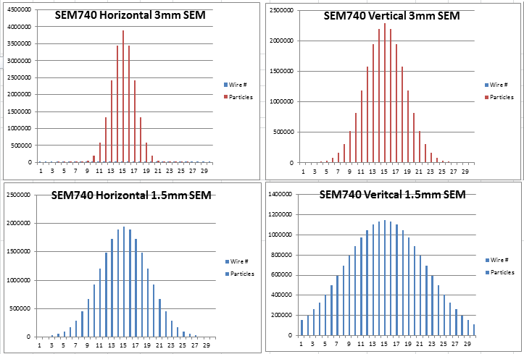
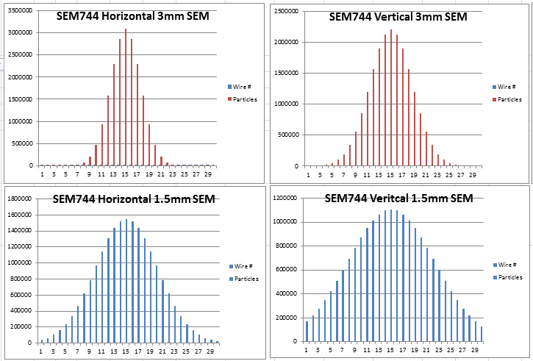
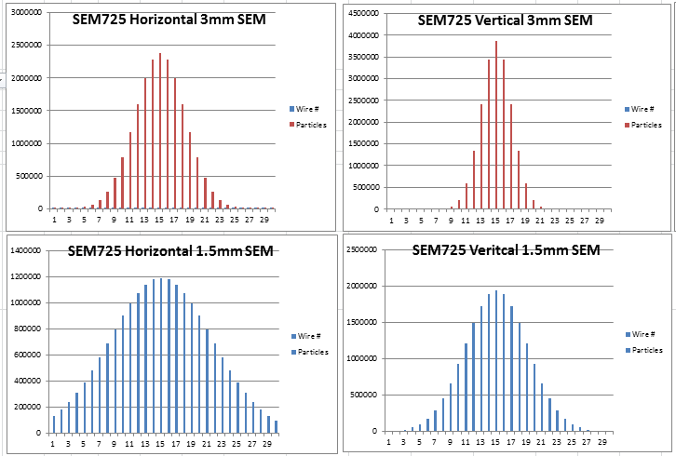
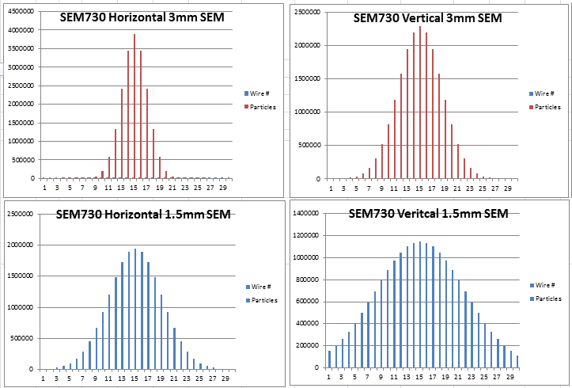
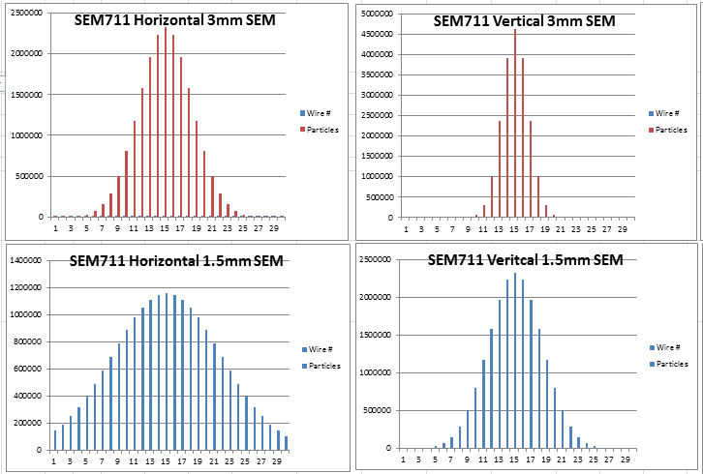
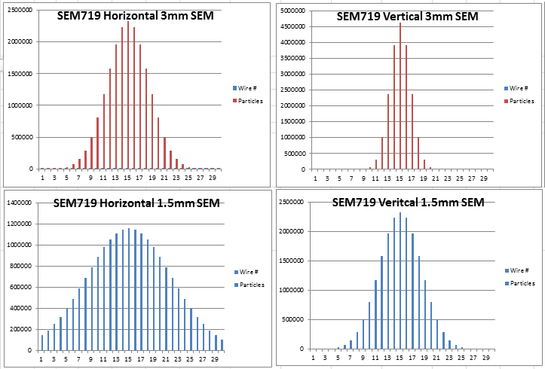
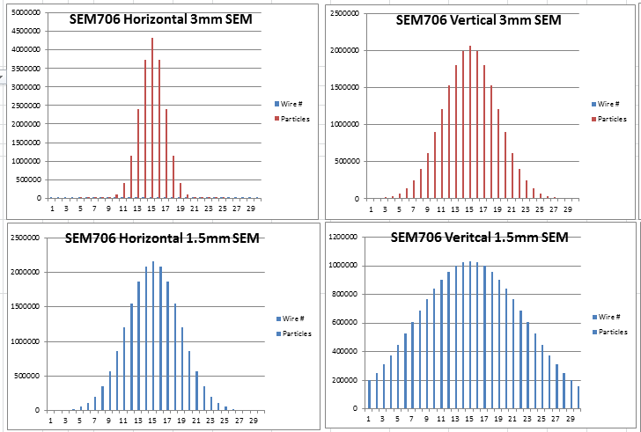
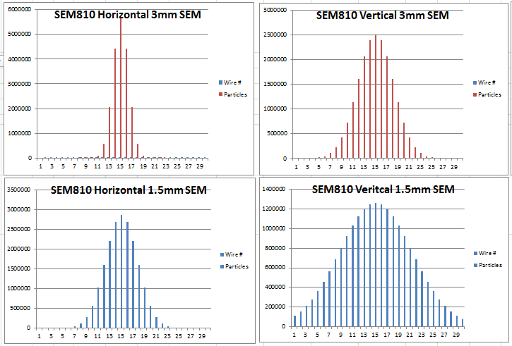
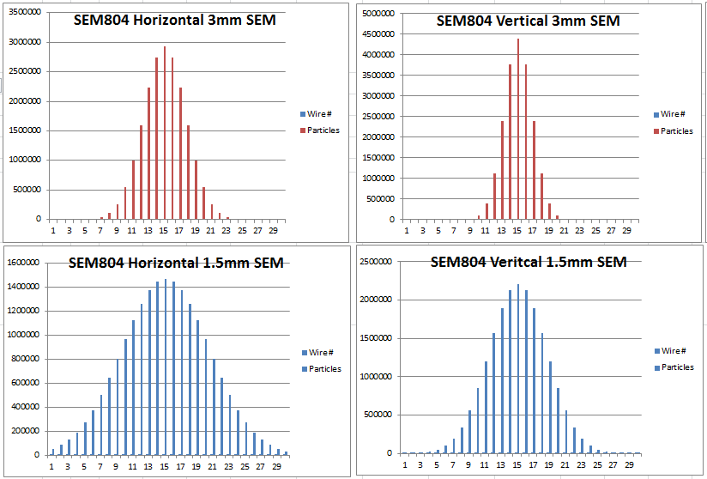
M2/M3 SEMs
Simulated beam size including dispersion
  http://gm2-docdb.fnal.gov:8080/cgi-bin/ShowDocument?docid=2235

Slide 17
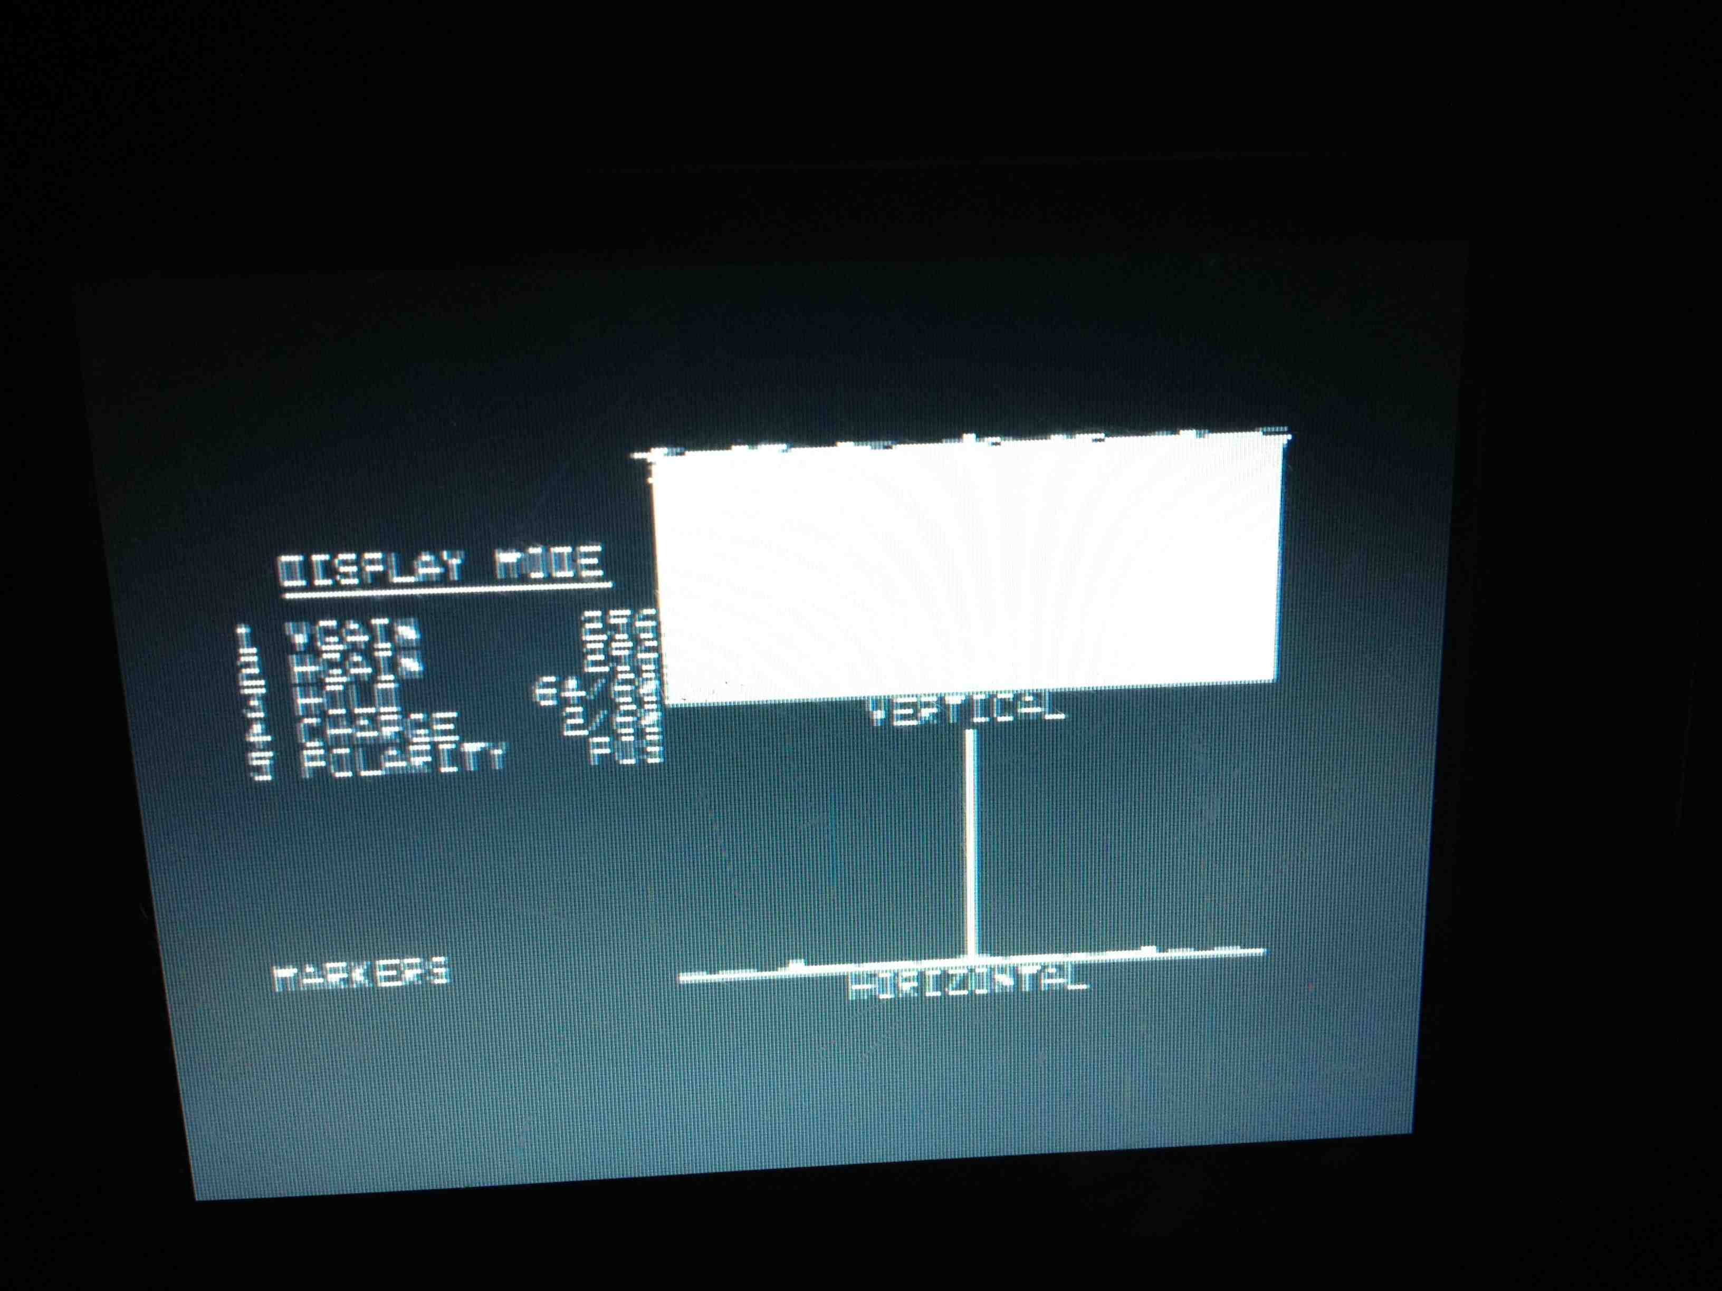
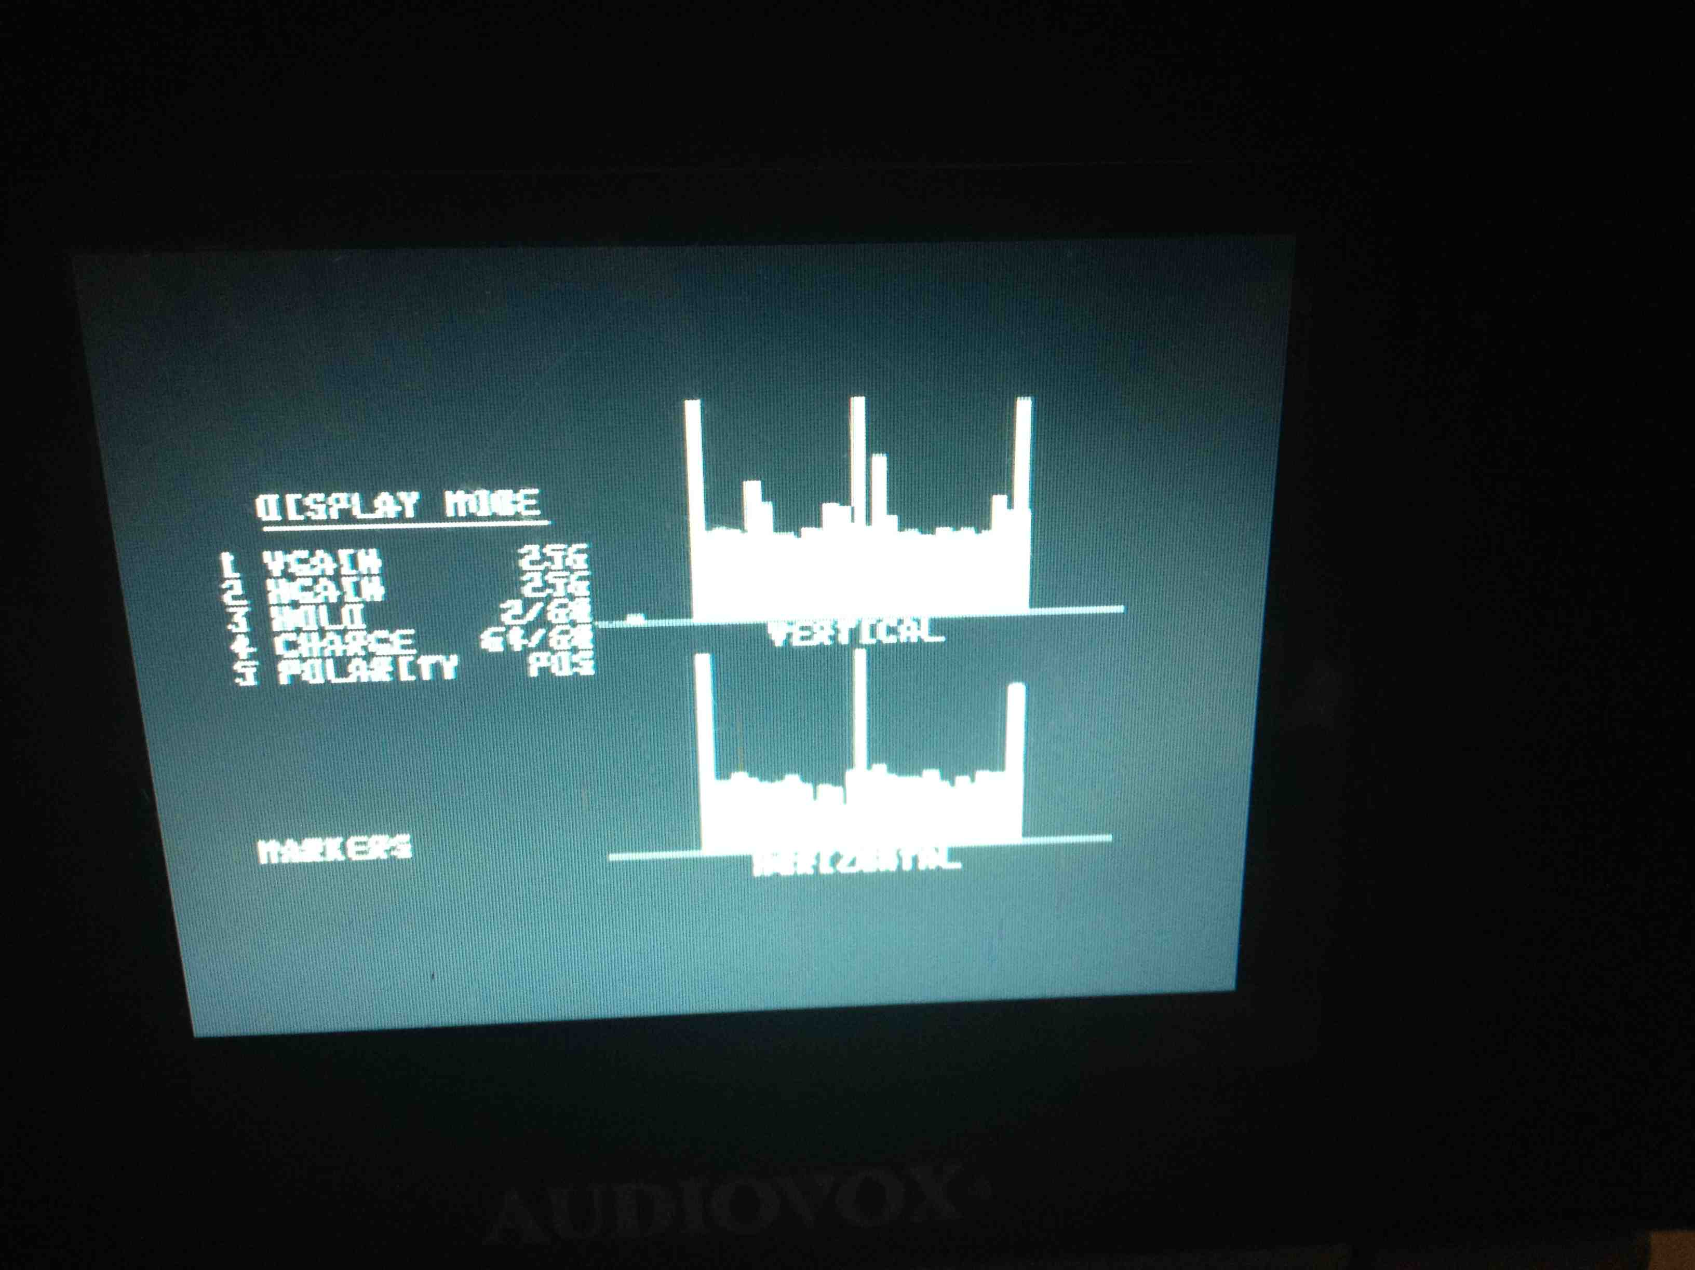
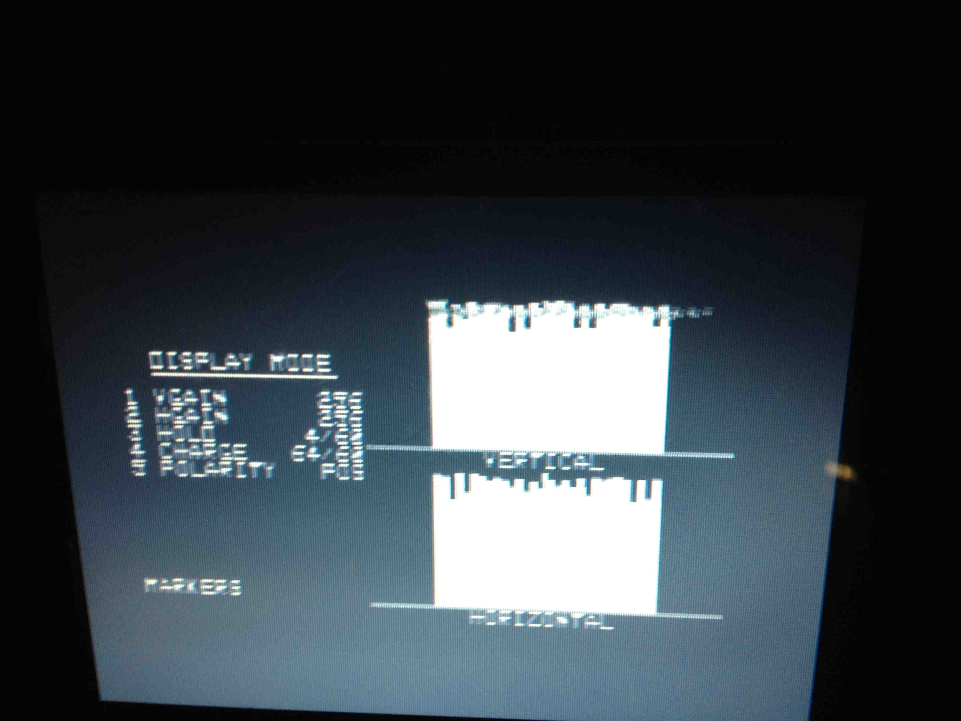
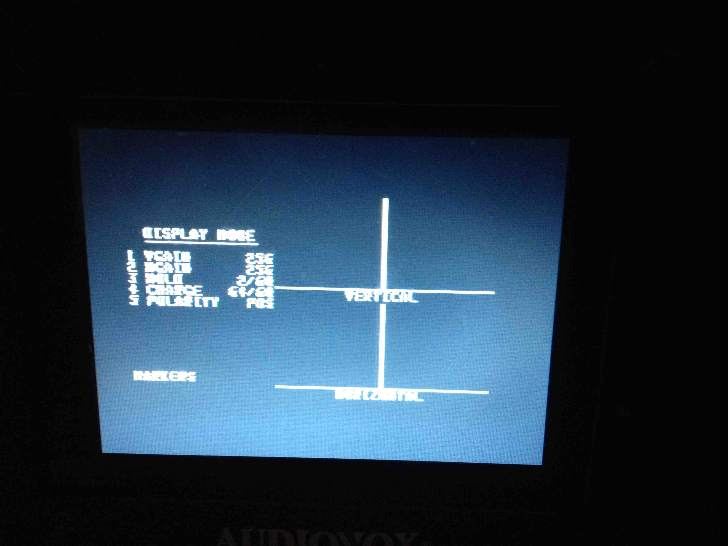
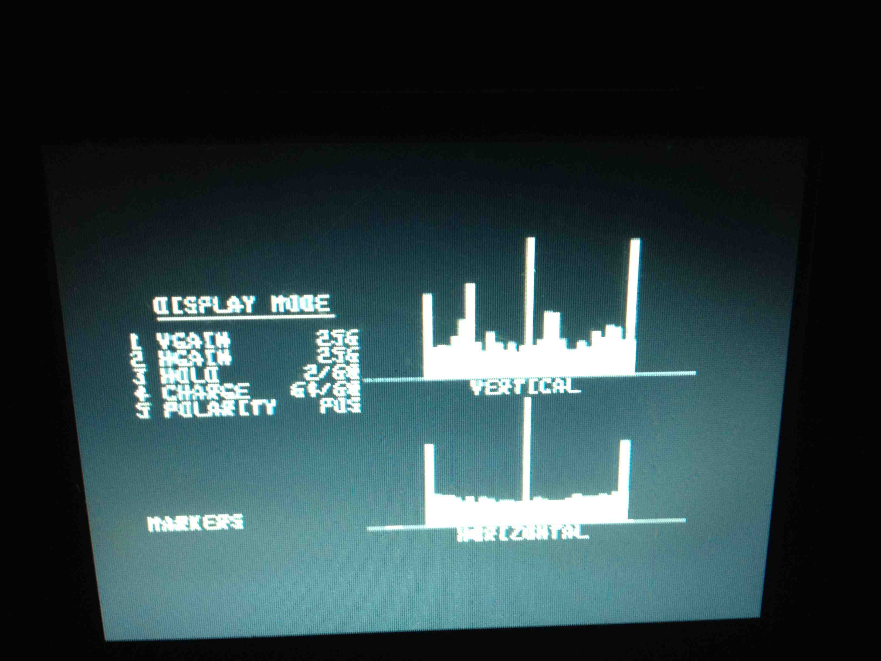

















SEM Hardware Testing
A portable test unit was built to “flash test” each SEM locally.
14 SEMs tested good out of the pool of 22 tested (2 more older units have yet to be tested).
We need 21 SEMs
We will either repair the broken SEMs or build new PWCs in their place.
SEM-909
SEM-913
SEM-900
SEM-715
SEM-704
SEM-900
SEM-723
SEM-607
SEM-403
SEM-107
SEM-706
SEM-706
SEM-104
SEM-906
SEM-728
SEM-733
SEM-710
SEM-710
SEM-917
SEM-719
SEM-802
SEM-921
SEM-806
SEM-807
Bad
Scanner parameters:
VGain 256
HGain 256
Hold 2/60
Charge 64/60
Voltage applied 250 V
Good
Good
Good
Bad
Good
Good
Bad
Good
Good
Good
Bad
Bad
Bad
Good
Good
Bad
Bad
Bad
Good
Good
Good
Good
Good
Signal to HV shorts
No signal 9/12/14
5 shorted wires
Draws current @ 107V
Many shorted strips
Many wires shorted to HV

Slide 18
SEM Hardware Summary
Overall Results
  3mm SEMs (90mm span)
    5 good
    6 bad
  1.5mm SEMs (45mm span)
    9 good
    1 bad
We will need some combination of refurbishing broken SEMs and building new PWCs.
  SEMs are ~$20K per unit without refurbishing costs.
  PWCs are ~$40K per unit.
  Above total costs that include all cable pulls, preamps, scanners, labor, etc…

Slide 19
SEM Refurbish Plan
Refurbish Plan
  Remove the HV bias foils and replace the original x,y frames with ceramic frames.
  Redesign the ceramic board to hold both x and y strips (1.5 or 3 mm pitch or more),
  Order new Ti material
  Etch the foils and using conductive epoxy to adhere the strips to the pads.
  If the signal wires are in good condition they could be reused but our Engineers would prefer designing a kapton to Deutch connector interface.

Slide 20


Proportional Wire Chamber (PWC)
Use new Switchyard design to save on Engineering costs.
There are 48 wires in each plane.
Wire spacing comes in either 1mm or 2mm.
  2mm spacing used in g-2 only areas has a 96mm span.
  1mm spacing has a 48mm span.
Intensity range
  Adjust high voltage to get a range of intensities from E4 to E10.
PWC
Notes:
The base plan for measuring beam profiles in the upstream M4 and M5 beam lines is to use Proportional Wire Chambers (PWCs). Other proposed solutions, such as the BNL SWICs, would have required design of vacuum bypass systems as well as permanent vacuum windows in the path of the beam that would create significant losses due to coulomb scattering effects [27]. PWCs are more sensitive than SWICs with the capability of measuring beam intensities down to the 10³ particle range. When mounted inside refurbished Switchyard bayonet vacuum cans, the PWCs can be pulled out of the beam path when not in use. This eliminates the need for permanent vacuum windows and vacuum bypasses. The PWC solution became even more cost effective, when a new design that will be used for the Switchyard beam lines, was recently developed and provides the measuring capabilities needed to measure low intensity muon only beam for the (g – 2) experiment [21]. Using an existing design will save engineering and design costs.
The PWC has two planes of signal wires, one plane for horizontal and one for vertical. There are 48 signal wires in each plane which are 10 micron diameter gold plated tungsten and can be configured with either 1mm or 2mm spacing. The wire planes are sandwiched between Aluminum high voltage bias foils, where negative voltage is applied. In addition to the bias foils, there are two more grounded foils on the outermost surfaces over the outer bias foils. These grounded foils balance the electrostatic field on the bias foil and prevent the bias foil from deflecting towards the sense wires. They also provide a degree of safety by covering the bias foils with a grounded conductive shield. Two end plates hold the entire assembly together. See figure 1.61 for a detailed view of the assembly.
The PWC assembly is filled with an 80% Argon and 20% Carbon Dioxide gas mixture. Ions are created when beam passes through the gas in the chamber. The positive ions are drawn toward the negatively charged high voltage foils, where they are neutralized. The electrons are drawn toward the signal wires. As the electrons get within close proximity of the sense wires the electrostatic field around the wires causes the electrons to accelerate creating an electron cascade in the gas. The collected negative charge on the wires is then processed by the SWIC scanner.
As with the previously mentioned ion chambers, the gas filled PWCs must be isolated from beam tube vacuum. The PWCs will be packaged in an anti-vacuum box. An anti-vacuum box is a sturdy machined aluminum shell with a .003 inch thick titanium foil window mounted on each side for the beam to pass through. The anti-vacuum box allows the detector to be mounted in a beam line vacuum chamber while the PWC inside the box remains at atmospheric pressure. There is a vacuum tight duct attached to the box in which the gas tubing, signal and high voltage cables are routed in order to get them to atmosphere outside the vacuum chamber.
To save engineering and assembly costs, the anti-vacuum boxes will be installed inside of bayonet vacuum vessels that are being repurposed from Switchyard. The bayonet type drive slides the PWC linearly into and out of the beam with a screw drive system. Bayonet drives use a 72 RPM Superior Electric Slo-Syn AC synchronous stepping motor coupled through a set of gears to a pair of screw drive shafts. The detector linear drive shaft is housed in a collapsible bellows that seals it from atmosphere. Figure 1.62 shows PWC assembly, the anti-vacuum box and the bayonet vacuum can. The same configuration is being used for the earlier mentioned retractable ion chambers. In that case, the PWC assembly is modified by exchanging the two wireplanes with a single foil signal plane and adding spacers such that the ion chamber version is exactly the same dimensions as the PWC.

Slide 21


Proportional Wire Chamber (PWC)
Modified PWC stack to fit in existing anti-vacuum box.
  Antivacuum box contains ArCO2 gas and wire planes.
Use recycled Bayonet vacuum cans from Switchyard.
Wires are pulled out of the beam when not in use.
Anti-vacuum Box
PWC
Bayonet
Vacuum
Can
Notes:
The base plan for measuring beam profiles in the upstream M4 and M5 beam lines is to use Proportional Wire Chambers (PWCs). Other proposed solutions, such as the BNL SWICs, would have required design of vacuum bypass systems as well as permanent vacuum windows in the path of the beam that would create significant losses due to coulomb scattering effects [27]. PWCs are more sensitive than SWICs with the capability of measuring beam intensities down to the 10³ particle range. When mounted inside refurbished Switchyard bayonet vacuum cans, the PWCs can be pulled out of the beam path when not in use. This eliminates the need for permanent vacuum windows and vacuum bypasses. The PWC solution became even more cost effective, when a new design that will be used for the Switchyard beam lines, was recently developed and provides the measuring capabilities needed to measure low intensity muon only beam for the (g – 2) experiment [21]. Using an existing design will save engineering and design costs.
The PWC has two planes of signal wires, one plane for horizontal and one for vertical. There are 48 signal wires in each plane which are 10 micron diameter gold plated tungsten and can be configured with either 1mm or 2mm spacing. The wire planes are sandwiched between Aluminum high voltage bias foils, where negative voltage is applied. In addition to the bias foils, there are two more grounded foils on the outermost surfaces over the outer bias foils. These grounded foils balance the electrostatic field on the bias foil and prevent the bias foil from deflecting towards the sense wires. They also provide a degree of safety by covering the bias foils with a grounded conductive shield. Two end plates hold the entire assembly together. See figure 1.61 for a detailed view of the assembly.
The PWC assembly is filled with an 80% Argon and 20% Carbon Dioxide gas mixture. Ions are created when beam passes through the gas in the chamber. The positive ions are drawn toward the negatively charged high voltage foils, where they are neutralized. The electrons are drawn toward the signal wires. As the electrons get within close proximity of the sense wires the electrostatic field around the wires causes the electrons to accelerate creating an electron cascade in the gas. The collected negative charge on the wires is then processed by the SWIC scanner.
As with the previously mentioned ion chambers, the gas filled PWCs must be isolated from beam tube vacuum. The PWCs will be packaged in an anti-vacuum box. An anti-vacuum box is a sturdy machined aluminum shell with a .003 inch thick titanium foil window mounted on each side for the beam to pass through. The anti-vacuum box allows the detector to be mounted in a beam line vacuum chamber while the PWC inside the box remains at atmospheric pressure. There is a vacuum tight duct attached to the box in which the gas tubing, signal and high voltage cables are routed in order to get them to atmosphere outside the vacuum chamber.
To save engineering and assembly costs, the anti-vacuum boxes will be installed inside of bayonet vacuum vessels that are being repurposed from Switchyard. The bayonet type drive slides the PWC linearly into and out of the beam with a screw drive system. Bayonet drives use a 72 RPM Superior Electric Slo-Syn AC synchronous stepping motor coupled through a set of gears to a pair of screw drive shafts. The detector linear drive shaft is housed in a collapsible bellows that seals it from atmosphere. Figure 1.62 shows PWC assembly, the anti-vacuum box and the bayonet vacuum can. The same configuration is being used for the earlier mentioned retractable ion chambers. In that case, the PWC assembly is modified by exchanging the two wireplanes with a single foil signal plane and adding spacers such that the ion chamber version is exactly the same dimensions as the PWC.

Slide 22

PWC Readout
No preamp is required when measuring particle intensities from 10^4 to 10^10….
  10^10 /cm-2 s-1.
PWCs use the same gen 2 or gen 3 SWIC scanner for readback as is used for the SEMs.
Notes:
The base plan for measuring beam profiles in the upstream M4 and M5 beam lines is to use Proportional Wire Chambers (PWCs). Other proposed solutions, such as the BNL SWICs, would have required design of vacuum bypass systems as well as permanent vacuum windows in the path of the beam that would create significant losses due to coulomb scattering effects [27]. PWCs are more sensitive than SWICs with the capability of measuring beam intensities down to the 10³ particle range. When mounted inside refurbished Switchyard bayonet vacuum cans, the PWCs can be pulled out of the beam path when not in use. This eliminates the need for permanent vacuum windows and vacuum bypasses. The PWC solution became even more cost effective, when a new design that will be used for the Switchyard beam lines, was recently developed and provides the measuring capabilities needed to measure low intensity muon only beam for the (g – 2) experiment [21]. Using an existing design will save engineering and design costs.
The PWC has two planes of signal wires, one plane for horizontal and one for vertical. There are 48 signal wires in each plane which are 10 micron diameter gold plated tungsten and can be configured with either 1mm or 2mm spacing. The wire planes are sandwiched between Aluminum high voltage bias foils, where negative voltage is applied. In addition to the bias foils, there are two more grounded foils on the outermost surfaces over the outer bias foils. These grounded foils balance the electrostatic field on the bias foil and prevent the bias foil from deflecting towards the sense wires. They also provide a degree of safety by covering the bias foils with a grounded conductive shield. Two end plates hold the entire assembly together. See figure 1.61 for a detailed view of the assembly.
The PWC assembly is filled with an 80% Argon and 20% Carbon Dioxide gas mixture. Ions are created when beam passes through the gas in the chamber. The positive ions are drawn toward the negatively charged high voltage foils, where they are neutralized. The electrons are drawn toward the signal wires. As the electrons get within close proximity of the sense wires the electrostatic field around the wires causes the electrons to accelerate creating an electron cascade in the gas. The collected negative charge on the wires is then processed by the SWIC scanner.
As with the previously mentioned ion chambers, the gas filled PWCs must be isolated from beam tube vacuum. The PWCs will be packaged in an anti-vacuum box. An anti-vacuum box is a sturdy machined aluminum shell with a .003 inch thick titanium foil window mounted on each side for the beam to pass through. The anti-vacuum box allows the detector to be mounted in a beam line vacuum chamber while the PWC inside the box remains at atmospheric pressure. There is a vacuum tight duct attached to the box in which the gas tubing, signal and high voltage cables are routed in order to get them to atmosphere outside the vacuum chamber.
To save engineering and assembly costs, the anti-vacuum boxes will be installed inside of bayonet vacuum vessels that are being repurposed from Switchyard. The bayonet type drive slides the PWC linearly into and out of the beam with a screw drive system. Bayonet drives use a 72 RPM Superior Electric Slo-Syn AC synchronous stepping motor coupled through a set of gears to a pair of screw drive shafts. The detector linear drive shaft is housed in a collapsible bellows that seals it from atmosphere. Figure 1.62 shows PWC assembly, the anti-vacuum box and the bayonet vacuum can. The same configuration is being used for the earlier mentioned retractable ion chambers. In that case, the PWC assembly is modified by exchanging the two wireplanes with a single foil signal plane and adding spacers such that the ion chamber version is exactly the same dimensions as the PWC.

Slide 23








PWC Beam Tests
Beam studies performed on 6/27/14 (https://www-bd.fnal.gov/Elog/?entryIDs=28574).
PWC prototype was installed at MC7WC1.
Counts collected from scintillator just downstream of the PWC.
Data includes manual background subtraction.
4 second 53MHz slow spill with +32GeV pions.
We expect 7E5 beam in the M5 line during g-2 operations
4 sec Slow spill
+32GeV pions
HV = -1640V
Duration = 400ms
Gain = 1
13,000 counts
8,000 counts
5,000 counts
2,000 counts

Slide 24






Delivery Ring PWCs
Simulated beam size including dispersion
  http://gm2-docdb.fnal.gov:8080/cgi-bin/ShowDocument?docid=2235

Slide 25









M4/M5 PWC
Calibration of PWC will occur in the Swithcyard beam line.
Simulated beam size including dispersion
  http://gm2-docdb.fnal.gov:8080/cgi-bin/ShowDocument?docid=2235

Slide 26




In-place Ion Chambers
Ion Chambers will be the primary beam intensity measuring device for low intensity secondary beam.
Use existing FNAL design.
Beam studies during spring 2014 shows they will work with g-2 operational intensities.
Ion Chamber
IC704
7E8
IC728
7E8
IC704
2E7
ICBNL
3E7
IC728
2.5E7
1.5E8
7E6
5E11
1E12
Tor105
Notes:
Ion Chambers
Ion chambers will become the primary beam-intensity measurement device for mixed-secondary beam. They are relatively inexpensive devices that can measure beam intensities with an accuracy of ±5% with as little as 10⁵ particles. Ion chambers were used in the AP2 line in the past, and work was done during beam studies to re-commission the ion chamber that used to be operational near the end of the AP2 line [2]. For (g − 2) operations, one ion chamber will be implemented in the M2 line. Ion chambers will also be implemented in the M3 line and the Delivery Ring; however, these ion chambers will need to be installed in a vacuum can with motor controls to allow them to be pulled out of the beam during the higher-intensity Mu2e operations. Figure 1.47 shows an ion chamber installation in the AP2 line.
Each ion chamber consists of 3 signal foils interleaved between 4 bias foils, each spaced 1/8” apart. The foils are sealed in an aluminum chamber 10 inches in diameter by 4.5 inches long continuously purged with an 80% argon - 20% carbon dioxide gas mix. The standard ion chamber is shown in Figure 1.51. Protons passing through ArCO₂ gas generate 96 e/ion pairs or about 1.6 x 10⁻¹⁷ charges/cm which equals about 1.6 picocoulomb for 10E5 p [18].
The ion chambers in the M3 line and Delivery Ring will not be installed in the above described manner because the beam going through those ion chambers and vacuum windows would result in excessive coulomb scattering during high intensity operations [27]. The solution is to make the ion chamber retractable much like what will be discussed in more detail in the Proportional Wire Chamber (PWC) section below. The ion chamber will be installed inside of an anti-vacuum chamber with two titanium vacuum windows to provide a barrier between the gas needed for the ion chamber and vacuum. The entire anti-vacuum chamber would be mounted inside of a vacuum can that is common to beam tube vacuum. The ion chamber will be on a motorized drive that would allow it to be taken in or out of the path of beam [18]. Figure
Beam studies were completed to check the effectiveness of using ion chambers in the range of intensities expected during (g – 2) operation [24]. One ion chamber was installed in the upstream portion of the AP-2 beam line at the 704 location, while the other ion chamber was located at the downstream portion of the AP-2 line at the 728 location. Both ion chambers were shown to integrate beam charge as expected over the normal range of (g – 2) operational intensities for the M2 and M3 lines as can be seen in Figure 1.52.
Figure 1.51: Fixed-position ion chamber in the AP2 line. The ion chamber is separated from the beam pipe by a vacuum window on each side. Fixed-position ion chambers will only be used in the M2 line. In locations like the M3 line and Delivery Ring that will also see Mu2e beam, the ion chambers will be put inside of vacuum cans and made retractable.
Figure 1.52: AP2 ion chamber performance was measured during beam studies. Ion chamber integration (left) over time. The signal is reset at 1.0 seconds and samples at beam time just after 1.5 seconds. The yellow trace is the ion chamber at the 704 location and the red trace is the ion chamber at the 728 location. This plot was taken with 1E12 protons on target and shows 7.5E8 at the 704 location and 2.5E7 at the 728 location. The plot on the right plots the output of the same two ion chambers over varied target intensities. The response is linear through a wide range of beam intensities.

Slide 27



Retractable Ion Chambers
Ion
Chamber
Anti-vacuum Box
Use new PWC stack design to save on Engineering costs.
Modified IC to fit in existing anti-vacuum box.
Use recycled Bayonet vacuum cans from Switchyard.
Ion chambers will be calibrated during beam studies in calendar 2015.
Prototype readout digitizer is 10x more sensitive than previous digitizers.
Bayonet Can
Notes:
Ion Chambers
Ion chambers will become the primary beam-intensity measurement device for mixed-secondary beam. They are relatively inexpensive devices that can measure beam intensities with an accuracy of ±5% with as little as 10⁵ particles. Ion chambers were used in the AP2 line in the past, and work was done during beam studies to re-commission the ion chamber that used to be operational near the end of the AP2 line [2]. For (g − 2) operations, one ion chamber will be implemented in the M2 line. Ion chambers will also be implemented in the M3 line and the Delivery Ring; however, these ion chambers will need to be installed in a vacuum can with motor controls to allow them to be pulled out of the beam during the higher-intensity Mu2e operations. Figure 1.47 shows an ion chamber installation in the AP2 line.
Each ion chamber consists of 3 signal foils interleaved between 4 bias foils, each spaced 1/8” apart. The foils are sealed in an aluminum chamber 10 inches in diameter by 4.5 inches long continuously purged with an 80% argon - 20% carbon dioxide gas mix. The standard ion chamber is shown in Figure 1.51. Protons passing through ArCO₂ gas generate 96 e/ion pairs or about 1.6 x 10⁻¹⁷ charges/cm which equals about 1.6 picocoulomb for 10E5 p [18].
The ion chambers in the M3 line and Delivery Ring will not be installed in the above described manner because the beam going through those ion chambers and vacuum windows would result in excessive coulomb scattering during high intensity operations [27]. The solution is to make the ion chamber retractable much like what will be discussed in more detail in the Proportional Wire Chamber (PWC) section below. The ion chamber will be installed inside of an anti-vacuum chamber with two titanium vacuum windows to provide a barrier between the gas needed for the ion chamber and vacuum. The entire anti-vacuum chamber would be mounted inside of a vacuum can that is common to beam tube vacuum. The ion chamber will be on a motorized drive that would allow it to be taken in or out of the path of beam [18]. Figure
Beam studies were completed to check the effectiveness of using ion chambers in the range of intensities expected during (g – 2) operation [24]. One ion chamber was installed in the upstream portion of the AP-2 beam line at the 704 location, while the other ion chamber was located at the downstream portion of the AP-2 line at the 728 location. Both ion chambers were shown to integrate beam charge as expected over the normal range of (g – 2) operational intensities for the M2 and M3 lines as can be seen in Figure 1.52.
Figure 1.51: Fixed-position ion chamber in the AP2 line. The ion chamber is separated from the beam pipe by a vacuum window on each side. Fixed-position ion chambers will only be used in the M2 line. In locations like the M3 line and Delivery Ring that will also see Mu2e beam, the ion chambers will be put inside of vacuum cans and made retractable.
Figure 1.52: AP2 ion chamber performance was measured during beam studies. Ion chamber integration (left) over time. The signal is reset at 1.0 seconds and samples at beam time just after 1.5 seconds. The yellow trace is the ion chamber at the 704 location and the red trace is the ion chamber at the 728 location. This plot was taken with 1E12 protons on target and shows 7.5E8 at the 704 location and 2.5E7 at the 728 location. The plot on the right plots the output of the same two ion chambers over varied target intensities. The response is linear through a wide range of beam intensities.

Slide 28




Beam Loss Monitor (BLM)
PMT style BLM
Use in Delivery Ring…
Existing PMT BLMs refurbished.
Spare parts from unused Accumulator system.
Detectors swapped during periods of Mu2e operations due to intensity differences.
Would like to use current VME-based electronics, but R&D work must be completed.
Notes:
BLMs
BLMs (Fig. 1.59) will be used to help maintain good transmission efficiency through the beam lines. Both Delivery-Ring and AP3 loss monitors will use the existing hardware and electronics for (g −2) operations, but will be replaced for the higher-intensity Mu2e operations. A careful BLM design plan allows for switching back and forth between the two separate BLM systems with minimal overhead.
Figure 1.59: Two styles of BLMs will be used. Tevatron-style ion chamber loss monitors (left) will be used in areas of primary beam, and also in the Delivery Ring for Mu2e operations. The Pbar-style ion chamber, which consists of a plastic scintillator and a long light guide connected to a photomultiplier tube shielded from light in PVC, will be used in the Delivery Ring during (g − 2) operations.
The plastic scintillator design BLM is sensitive to a small number of particles, making them ideal for Delivery Ring (g – 2) operations. The loss monitors are made up of a 4"x2"x1/2" piece of plastic scintillator glued to a 36" long Lucite light guide (see Figure 1.60). At the end of the light guide, a small Lucite coupling attaches it to an RCA 4552 PMT. The intent of the light guide is to keep the scintillator near the magnets but to extend the phototubes up and away from the region of beam loss. This assembly is mounted in a housing made up of PVC pipe and has feed-throughs for the high voltage and signal cables.

Slide 29
Upcoming 2015 Beam Studies
Beam
Ion Chamber
PWC
SEM
In Spring 2015, we will have the opportunity to test our instrumentation in the Mtest beam line.
PWC and Ion Chamber
  Test Bayonet can under vacuum
  Test new ion chamber integrator (find working intensity range).
  Test PWC working intensity range.
SEM
  Further test high gain preamp and generation 3 scanner
  Find working intensity range.

Slide 30
Characterization of SY beam
MTest beam details
  http://www-ppd.fnal.gov/ftbf/beam/energies.html
There are several targets, absorbers, and collimators in the MTest beamline which can be arranged in different configurations and tuned to produce secondary particles at single energies in various configurations including
  32 - 1 GeV: Pions, electrons, kaons, or broadband muons
Scintillator paddles provide accurate calibration of beam intensities.

Slide 31
Summary
We plan to implement instrumentation to measure the low intensity secondary beam during g-2 operations.
  M2 line, M3 line, Delivery Ring and Abort:
    Intensity: Ion Chambers
    Profiles: SEMs
      Repurposed from Pbar
      New high gain preamps to measure the lower intensity beam
    Losses: Pbar-style PMT BLMs
  M4 and M5 lines
    Intensity: Ion Chambers
    Profiles: Proportional Wire Chambers (PWC)
      New Design PWC
      Repurposed anti-vacuum cans and Bayonet vacuum cans to save money.
    Particle Composition (commissioning only): Cerenkov Counter

Slide 32

Scintillating Fiber Profile Monitors

Slide 33
Scintillating Fiber Profile Monitors
SFPMs worked well in well defined and clean beams i.e., 120 GeV and 10E5 particles
At low secondary beams, depending of ration of particles, the signal to noise got worse as energy and intensity decreased.
Cons
  At 1GeV to 3GeV the old PWCs worked better.
  Cost of SiPM PMT was $8K/plane.
  Less working experience than with PWCs
Notes:
Dear all,
I'd like to suggest to seriously consider beam profile monitors based on scintillating fibers for the muon-only g-2 beamlines M4/M5.
The purpose is to address two critical aspects of the experiment, as I understand them:
- to detect very low muon intensities and profiles during the commissioning phase;
- to optimize injection into the ring, whose efficiency affects the statistical significance of the experiment.
Both of these aspects can have an impact on the duration of the commissioning and data-taking periods.
It is of course up to the collaboration to decide whether this kind of instrumentation makes sense for its purposes and whether it should be part of the project, of proposed upgrades, or of external contributions. I would be glad to put you in contact with groups at INFN and CERN, and there may already be expertise at Fermilab and within the g-2 collaboration.
Here is some more detailed information.
One could envision a detector with approximately 50 horizontal and 50 vertical (staggered) scintillating fibers, with a typical diameter between 0.25 mm and 1.0 mm and a pitch that is appropriate for the beam size to be detected. The fibers are held on a grooved plexiglass support. In M4/M5, it looks like the transverse rms will be of the order of 4 mm to 40 mm, so that spatial resolution is not an issue.
The detector may be housed in one of the retractable vacuum chambers already foreseen for the proportional wire chambers.
Each fiber can be read by a segmented silicon photomultiplier (SiPM), also called multi-pixel photon counters (MPPCs) by Hamamatsu.
The cost is about $50/channel for the photodetectors plus another $50/channel for the electronics. Fibers, plexiglass, and connectors are much cheaper. Therefore, of the order of 10 k$ to 20 k$ per detector in materials.
The advantage of segmented silicon photomultipliers is that the photons generated in each fiber are detected by thousands of sensors, so that the response is linear over a wide dynamic range.
The disadvantages are sensitivity to radiation (but the radiation field in M4/M5 is relatively low, if I understand correctly) and noise, which is almost completely mitigated by gating over the 120 ns of the beam pulse every 10 ms -- a typical dark count of 100 kHz is reduced to 1 count per beam pulse.
This kind of detector is sensitive to single particles, so there is no lower limit on the dynamic range.
The maximum flux will be on average 10^{^5} muons / 120 ns = 833 muons/ns, with peaks of 2200 mu/ns (which I roughly deduced from the simulated time distribution of the pulse after the Delivery Ring).
Conservatively, one can assume a minimum Gaussian transverse beam rms of 3 mm and a maximum fiber diameter of 1 mm, so that about 13% of the flux hits the central fiber. The maximum flux per fiber is therefore 290 minimum-ionizing particles (mips)/fiber/ns. Each mip generates a few photons, depending on the thickness and type of fiber.
Some tests may be required to experimentally demonstrate that fibers, photodetectors, and readout electronics can handle these maximum instantaneous fluxes, but these numbers appear low compared to the saturation flux and radiation damage in scintillators.
In any case, this kind of detector would fill the large gap between zero flux and the sensitivity of proportional wire chambers (which is one of the topics of tomorrow's review).
I hope all this is useful to help g-2 achieve its goals.
Cheers,
Giulio
--
Scientist I
Accelerator Physics Center
Fermi National Accelerator Laboratory
Mail Station 221
PO Box 500
Batavia IL 60510 U.S.A.

Slide 34


Instrumentation Design: SEM Preamp
The preamp amplifies the beam signal from each wire foil in the SEM.
  Use existing Preamp chassis.
  Replace amplifier boards with new op-amp design.
  Prototype is in progress.
SEM Foils
SEM
Preamp Design
Preamp Test
SEM
Notes:
The 60 amplifier boards are replaced with a new, op-amp based design.
The signal from the SEM, a very small current, is turned into a voltage by running it through a resistor, R1. The capacitance of the coaxial cable connecting the preamp to the SEM will slow down and stretch the incoming pulse. The op-amp amplifies the voltage pulse, and its output trickles out a resistor R4 to a current integrator in the scanner.
The DC blocking capacitor eliminates the need for a trim pot to remove DC bias.
The circuit is easily reconfigurable for higher or lower gains. Higher gains will be more sensitive to the signal, but are also more susceptible to noise. Experimentation will tell us where the happy medium lies.
A challenge will be integration timing. In experiments, best results were obtained with very short integration windows (< 100 msec). Placing the integration window around the incoming pulse may be tricky, but should be feasible.

Slide 35






Alternatives
Use BNL SWICs in M5 line.
  BNL SWICs could be refurbished and used instead of designing new.
  Technical issues:
    Vacuum windows and SWICs result in significant Coulomb scattering (GM2-doc-1443).
    To make retractable, a new design required, adding design and implementation costs.
    Vacuum bypasses or many small vacuum sectors would increase mechanical design and implementation costs.
  PWC solution was discovered.
    Use new Switchyard design
    Re-use Bayonet vacuum cans.
$θ_{s}$ [mrad] =$\frac{13.6MeV}{p\left[\frac{GeV}{c}\right]c}\sqrt{\frac{t [cm]}{X_{0} [cm]}}$ $\left(1+0.038ln⁡(\frac{t [cm]}{X_{0} [cm]})\right)$
8 SWICs = 25% Beam Loss
    $∆ε_{x}=3 \sum_{s}{\left({θ_{s}^{}}^{2}β_{x}\right)}$
    $$ε_{xtot}=ε_{xini} + ∆ε_{x}$$
    $P_{Lost}$ = ${e }^{(\frac{−A}{2ε_{xtot}})}$- ${e }^{(\frac{−A}{2ε_{xini}})}$
Notes:
Material:
The detectors require a vacuum break which for a 4” beampipe has 2 – 75 μ thick Ti windows.
The gas is ArCO2 80/20% for a total of 12 cm.
2 – 75 μ kapton windows
SWIC Profile Section:
2 – 10 μ AuW dia. wire signal planes at a pitch of 4 mm.
3 – 10 μ thick Al bias foils.
6.35 mm space between foils.
Ion Chamber Section
9 – 10 μ thick Al foils (4 signal, 5 bias) for a total of 90 μ
6.35 mm space between foils.
$θ_{s}$ [mrad] =$\frac{13.6MeV}{p\left[\frac{GeV}{c}\right]c}\sqrt{\frac{t [cm]}{X_{0} [cm]}}$ $\left(1+0.038ln⁡(\frac{t [cm]}{X_{0} [cm]})\right)$
$∆ε_{x}=3 \sum_{s}{\left({θ_{s}^{}}^{2}β_{x}\right)}$
$$ε_{xtot}=ε_{xini} + ∆ε_{x}$$
$P_{Lost}$ = ${e }^{(\frac{−A}{2ε_{xtot}})}$- ${e }^{(\frac{−A}{2ε_{xini}})}$
Assume a 40 pi-mm-mrad acceptance
Assume a 40 pi-mm-mrad Gaussian beam distribution
Did not calculate scattering through gas in the SWICs
Estimated Beta’s from June lattice file (G2M-doc-1134)
For 8 BNL SWIC + IC Packages
16 – 0.003” Titanium Vacuum Windows
25% beam loss
Material in the beam:
At the 704 location:
75 mircon Titanium vacuum window
FNAL Ion Chamber
Titanium: 150 microns
Kapton: 150 microns
Aluminum: 56 microns
ArCo2 gas: 4.25 cm
75 micron Titanium vacuum window
At the 728 location 75 micron Titanium vacuum window
FNAL Ion Chamber
Titanium: 150 microns
Kapton: 150 microns
Aluminum: 56 microns
ArCo2 gas: 4.25 cm
BNL Ion Chamber/SWIC
Kapton: 150 microns
Aluminum: 120 microns
Gold Plated Tungsten Wires: 2 planes of 10 micron diameter wires with 4mm pitch
ArCO2 gas: 12cm
Cerenkov Counter
Titanium Window: 203 microns (0.008")
C4F8O gas: ~50"
I am not counting the window on the downstream side of the Cerenkov counter since beam to the PMT does not pass through it.

Slide 36

Scattering
Made an Excel Spreadsheet to calculate scattering in the M5 Line
    $θ_{s}$ [mrad] =$\frac{13.6MeV}{p\left[\frac{GeV}{c}\right]c}\sqrt{\frac{t [cm]}{X_{0} [cm]}}$ $\left(1+0.038ln⁡(\frac{t [cm]}{X_{0} [cm]})\right)$
  Equn 27.14 Journal of Physics G, Nulcear and Particle Physics, July 2010
  Emittance Growth in Each Transverse Plane and Resulting Beam Loss
    $∆ε_{x}=3 \sum_{s}{\left({θ_{s}^{}}^{2}β_{x}\right)}$
    $$ε_{xtot}=ε_{xini} + ∆ε_{x}$$
    $P_{Lost}$ = ${e }^{(\frac{−A}{2ε_{xtot}})}$- ${e }^{(\frac{−A}{2ε_{xini}})}$

Slide 37


Quick Excel Calculation
Excel Spreadsheet can be found in G2M-doc-1443

Slide 38




Scattering due to Ion Chambers
http://gm2-docdb.fnal.gov:8080/cgi-bin/ShowDocument?docid=1443
IC027 plus two 0.003 Ti vacuum windows
IC804 plus two 0.003 Ti vacuum windows
IC027 only
IC804 only

Slide 39




Tor704 Test Signal Response
2E9
Test Pulse
2E8
Test Pulse
Notes:
-Put high gain preamps
-Advantage of toroid is you can plug in a test signal in the upstairs electronics to calibrate the output signal.

Slide 40


Tor704 Beam Response
No Beam
Beam
Similar conditions to g-2 we see a small beam signal.
  1E12 protons on target (8.9 GeV/c) with 3.1 GeV/c secondaries
  Tried to setup software to get the scope peak and calculate intensity.
    Had trouble with intensities this low.
  Picking out the peak by eye, we get about 5e8, or about two times what the model says.

Slide 41



Tor724 Test Signal Response
No Signal
2.4E9
Test Pulse
2E8
Test Pulse
Notes:
-Model shows beam at Tor724 should be a factor of 8 reduction. We see no signal at 724.
-Toroid will get less signal with the short 2.515MHz bunch.
-We will not be able to use Toroids for low intensity operations.

Slide 42

IC728 Beam Response
8.9GeV/c primaries, 3.1 GeV/c positive secondaries.
Beam intensity plot stepping down from 2E12 on target to ~1E11.
Ion chamber tracks beam on target.
Ion chamber intensities (not calibrated) measured from 8E7 down to ~5E6.

Slide 43


Wall Current Monitor
Mu2e WCM designed to measure slow spill in quanta of 2E7.
Similar to M2 and M3 line intensities, so maybe we can use a WCM as a less evasive option that IC for measuring beam intensities.
Peter Prieto
Notes:
Mu2e WCM may be able to be used for g-2 operations too.
-Designed method of measuring beam intensity without causing losses
-Capable of resolving ~3e7 protons per bunch during slow spill
-To be used as a signal source for feedback regulation of the RF knockout system in mu2e
-Optimize passband of WCM between 400 KHz and 3 MHz
Test Setup
-Gaussian bunches τ=1.69 usec
-Current on WCM wire = 1 uAmp
-Amplifier Gain = 80 dB
-Scope termination = 50 Ohm
Problems:
-Signal modulation due to power supply ripple amplified by the 80 dB amplifier gain
-Measured ripple 400 mV caused by 60Hz from PS and then amplified 80 dB
-Solve problem by averaging signal
Beam with a bunch structure causes current to flow on the inside of a metallic beam pipe, such as the stainless steel beam pipes used in the Antiproton Source. By breaking the metal beam pipe with an insulating ceramic gap and placing a resistor across the gap, one can measure the voltage drop across the resistor that is proportional to the beam current.
The frequency response of the pickup rolls off on the low end because of beam pipe conditions external to the pickup, so the pickup is housed in a shielding box loaded with ferrite material to provide a known value of inductance. The geometry of the ceramic gap and the resistors are chosen to form a properly terminated transmission line. The low frequency response of the wall monitor is determined by the time constant set by the ferrite (16 mH) and the gap resistance (0.5Ω), it is about 5 kHz. The characteristics of the ferrite inductors also set the high frequency response of the pickup. Two types of ferrites and a coating of microwave absorbing paint inside the shielding box are used to provide an even frequency response to 6 GHz.
As beam passes irregularities like bellows in the beam pipe, it induces microwave fields at frequencies determined by the dimensions of the beam pipe structures. That energy travels down the inside of the pipe and can be detected by the wall monitor. To avoid those noise problems, ferrite chokes are installed on both ends of the wall detector.
Signals are taken off the gap at four points around the circumference and summed to minimize sensitivity of the output signal to variations in beam position within the pipe. The overall sensitivity of the monitor, accounting for gap resistance, summing of the four signals, 50Ω terminating resistor, etc. is approximately 0.15Ω.

Slide 44
Beam Position Monitors
BPMs were used in Pbar Operations to measure beam position with sub-millimeter resolution for autotune steering program.
  Three different styles of BPMs.
  Preamps used for downstream AP2 (10¹⁰ particles)
  Two cascaded preamps for a total gain of 50dB used for ~ 2 x 10⁸ D/A line beam.
P1, P2, M1 and M3 BPMs are designed to see four 2.5MHz bunches.
  Minor electronics changes required.
M2 and Debuncher BPMs can only see 53MHz and will be upgraded to Echotech standard with 2.5MHz electronics.
  Repurpose Tevatron BPM crates
  Repurpose Recycler BPM electronics
Where can we use BPMs?
BPMs can be used for primary beam autotune.
BPMs will likely not be used for low intensity secondary beam.
Notes:
Delivery Ring BPM Plan:
-Removing old BPM electronics hardware from the Delivery Ring (Debuncher).
-Modify Recycler analog transition boards to handle expected signal intensity produced by a 1e12 ppb (2.5 MHz) in the Delivery Ring.
-Design a plate which transitions N-type connectors to DB-9 connectors allowing BPM signals to connect to 2.5 MHz transition board DB -9 input connectors.
-Design and test 2.5 MHz filters in the digital down-converter boards installed in the Debuncher.
-Install VME64X crates in Delivery Ring service building.
-Purchase MVME5500 processor boards to be used as crate controllers or if any available from TeV BPM system use those.
-Make # of Top Plates for the relay racks where the VME64X crates will be installed.
-Modify transition boards to handle signal intensity in the 2.5 MHz channel which is already implemented in the existing transition boards.
-Develop front-end software in the BPM system that can be used with Debuncher control system.
-Develop code to process signals from the digital down converter boards and produce a beam position signal.
Beam Line BPM Plan
-P1, P2, M1 (AP1) and M3 (AP3) lines have an Echotek-based BPM system , no software is required for these lines. It is based on detecting 2.5MHz single bunch on a single pass by digitizing at 80 MHz.
-Hardware changes to the 2.5 MHz channel to handle the input signal level consist on adding an external attenuator at the top plate for each BPM pickup.
-The Debuncher Abort line has 8 BPM’s. It will require two 2.5 MHz recycler transition boards and two 8 channel echotek boards. It will need 1 VME64X -9 channel slot crate, one MVME5500 processor and one timing board.
Pbar has three different styles of BPMs.
Provide sub-millimeter resolution of the horizontal and vertical positions.
Debuncher BPM’s are cylindrical with an 18 cm diameter. BPM's can also be found in the AP1, 2 and 3 beamlines. The AP-1 line has 7.6 cm diameter combined horizontal and vertical BPM’s at every quadrupole location while the AP-2 and AP-3 lines are single-plane and 13 cm in diameter, generally alternating planes at quadrupole locations.
The 120 Debuncher BPMs are divided into six “houses” of 20 BPMs each (10 horizontal and 10 vertical) – can only see 53MHz beam.
The P1, P2, AP1 and AP3 lines all share the Echotek style BPM electronics that were built as part of the “Rapid Transfers” Run II Upgrade. Electronics racks reside in MI60-S (P1 Line), F1 (P2 Line), F23 (AP1 and AP3 Lines), F27 (AP3 Line) and AP30 (AP3 Line). These BPMs are designed to detect seven to 84 consecutive 53MHz proton bunches in reverse proton or stacking mode, and four 2.5MHz pbar bunches in Accumulator to Recycler antiproton transfer mode. There are two crates used to process the BPM data: the analog crate and the VME crate. Figure 7.7 gives an overview of the Echotek BPM layout.
-Signals from the BPM A and B plates in the tunnel are sent up to the service buildings via RG8/RG213 cables and are connected to the back of the analog filter cards in the analog crate. The analog cards filter, attenuate and amplify the analog BPM signals as needed. Each analog card can handle two BPMs (four BPM plate signals) which are processed and output through the front panel cables to Echotek cards in the BPM VME crate. The analog crate also contains a test/control module that handles setup of the filter modules including test pulses. The entire crate is powered with an external +5V power supply that is found near the bottom of the rack.
- Secondary particles in the AP-2 line have the same 53MHz bunch structure as the targeted proton beam, so BPM’s can be used to detect beam position. There are 34 BPMs in the AP-2 beam line and seven BPMs in the D to A line that share common design features. When stacking, the number of antiprotons and other negative secondaries (mostly pions and electrons) in the AP-2 line is relatively small, on the order of 1 x 10¹¹ at the beginning of the line and 1 x 10¹⁰ at the end of the line. The beam intensity in the D to A line is even smaller, with ~10⁸ or less reaching the Debuncher. In addition, the AP-2 BPMs on the Debuncher end of the line see significant electrical noise from the Debuncher Injection kicker. For these reasons, the AP-2 and D to A Line BPMs could not be used for measuring pbars in past years. In 2005, new BPM electronics were designed for use in the AP-2 line. After the electronics were installed and deemed a success, they were then propagated to the D to A line BPMs. AP-2 BPMs can be used to look at both bunched stacking secondaries and bunched reverse proton beam while D to A line BPMs are only used under special conditions. During stacking, the D to A BPMs are only used with the Pledge Pin application (currently P155) for tuning on closure into the Accumulator. The D to A line BPMs can also be used to look at bunched reverse protons.
As beam decreases in intensity while traversing the AP2 and the D to A lines, increasing amounts of amplification is needed before the signals can be processed. The upstream AP2 BPM (701-715) plate signals are sent straight up to the F27 service building where they are amplified by 20dB RF amps. The downstream AP2 BPM (716-734) plates have low noise Hittite amps with 25dB gain located in the tunnel. The D/A line BPMs must read even lower intensities, so two cascaded Hittite amps with a total gain of about 50dB are attached to the pickup plates in the tunnel.
P1, P2, AP1 and AP3 lines hardware and Echotek electronics are already in place and are already are capable of seeing 2.5MHz beam.
Debuncher BPM tunnel hardware can be reused. Electronics would need to be removed and replaced with the Echotek system to see the 2.5MHz beam.
Echotek electronics would be repurposed from the Tevatron and Recycler.
Beam only circulates in the Debuncher three times, we need to determine if we can see this beam with the proposed BPM system. Debuncher abort line would use the AP2 line BPM tunnel hardware and update the electronics to the Echotek system.
We will not likely be able to use them in AP3, Debuncher, Abort or Extraction Line

Slide 45


AP2 BPMs
8.9GeV/c primaries, 3.1 GeV/c positive secondaries.
Beam intensity plot stepping down from 2E12 on target to ~1E11.
Only first couple of BPMs in the AP2 line have intensity data with 1E12 POT.

Slide 46


Secondary Emission Monitor
Measure the beam profile using 30 horizontal and 30 vertical titanium strips.
Beam particles have elastic collisions with the strips, dislodging them, creating current. 2.5% to 5% efficient.
Destructive measurement like the SWIC, but operate at beam pipe vacuum and have no gas.
We have an ample supply of SEMs already installed in the AP2 and AP3 lines that could provide coverage for the M2 and M3 lines with minimal expense.
New preamps and clearing foils may need to be implemented to work with the lower g-2 intensities.
  D/A line SEMs have special high gain preamps that make them 260 times more sensitive. There are only five of these preamps.
SEMs “may” be able to be used for low intensity secondaries in the M2, M3 and Delivery ring.
SEMs will not work for M4 and g-2 lines for g-2 operations.
SEMs can be used for occasional diagnostics in the beam lines for Mu2e operations.
Notes:
SEM grids are used to measure the beam profile in the horizontal and vertical planes. SEMs consist of rows of 30 vertical and 30 horizontal titanium strips that can be placed in the path of the beam. Beam particles have elastic collisions with electrons in the strips and dislodge them (see figure 7.8). This causes a current to flow in the strips, which is amplified by preamplifiers.
Wire spacing is either 1.5mm or 3mm and most are 3mm.
- SEMs: P1 (6), P2 (4), AP1 (5), AP3 (7), AP2 (8), D/A (4), DR (2), Acc (1)
For every forty protons or antiprotons passing through the SEM, one electron is dislodged yielding a detector efficiency of 2.5%. A
- clearing voltage of +100 VDC can be applied to foils placed before and after the strips to improve the work function of the titanium and double the efficiency to 5%. Since a small amount of the beam collides with the titanium strips, SEM grids are not completely passive devices. Most SEM grids are located in the transport lines, although a few are located near injection and extraction points in the rings to be used during initial tune-up. If one of the ring SEM grids is left in, beam will be rapidly lost.
The SEM grids operate at beam pipe vacuum pressure and thus have no gas gain like the Segmented Wire Ionization Chambers (SWICs) found in Switchyard. Preamp boxes are used to amplify the signals generated by the SEM. Preamp boxes contain a pair of motherboards with 30 preamp boards plugged into each (one horizontal and one vertical set). Some versions of the preamp box have charge splitters that, when selected, attenuate the signal to the preamps 15 times when the charge split input is +5V. D to A line SEMs use preamps with two available gain configurations. Switching the gains requires a tunnel access. D to A line SEM gains are up to 260 times more sensitive than those of the other SEMs due to the low beam intensities found during stacking.
P1, P2, AP1 and AP3 :
Existing SEM/Multiwire tunnel hardware will be used.
Some refurbishing will be required on some of the cans.
Electronics will be upgraded to an instrumentation standard.
Debuncher There is currently one SEM in the Debuncher Ring.
Debuncher Abort One or two existing AP2 SEMs can be used for the Debuncher abort line
Extraction Line Need to develop a plan for SEMs in the extraction line.
BNL SWICS and/or ion chambers
Instrumentation experts will determine if we can use the SWICs and Ion Chambers used by the BLN g-2 decay line.

Slide 47






2012 Beam Studies – AP2 SEMs
AP2 Line SEMs for 3.1GeV/c secondaries from 1E12 protons on target.
Noise
  Raw data is noisy
  Manual background subtraction
  Hardware background subtraction?
Preamps
  Six “high gain” preamps
  Only two worked in 8/3.1
  Designing a new high gain preamp
Clearing Foils
  Clearing foils can increase signal to noise for low intensity signals.
  Was not used for Pbar Operations.
Manual Noise Subtraction
Clearing Foil
Noisy Signals
Low gain preamp
Gain of 250
~ 25 units + spare
High gain preamp
Gain of 1000
Only 6 units
Notes:
AP2 Line SEMs RAW data for 3.1GeV/c secondaries from 1E12 protons on target.
Only 2 of 6 hi gain preamps worked for 8/3.1
715 and 733 provide profiles.
Not enough spare cards to build
additional units for AP2 & g-2 line
Need preamp redesign with possible increased dynamic range for g-2 and M4 (mu2e) line
Need to develop a set of specs for design.
AP2 Line SEMs with manual (file) noise subtraction for 3.1GeV/c secondaries from 1E12 protons on target.
Need triggered background subtraction (BGS). The new scanner will provide this feature.
New scanner time difference from background and beam frame -> ~ 3msec.
Would like to get profiles for all 16 g-2 pulses with BGS. Looks achievable.
We understand that there can be an increase in signal to noise by using clearing fields (CF) (for low intensity signals).
Currently, CF not used or supported. 100V power supplies are removed. AP1,AP2,Ap3 had sufficient intensities without them.
Hooked up the CF to 1 SEM during beam studies and applied 100v but did not see any differences.
Need expert technical help to assess.

Slide 48
Mu2e Pulse Train

Slide 49
Original g-2 Pulse Train
g-2 average 12Hz pulse scenario
Average Rate = 12Hz, Burst rate = 100Hz
Four groups of four in a 1.33 second neutrino cycle.
g-2 booster cycles during Nova acceleration cycle

Slide 50
Original g-2 Pulse Train
g-2 average 12Hz pulse scenario

Slide 51
g-2 Proposed Pulse Train (9 Hz mode)
Begin cycle
End cycle
Bunch length
of 1 pulse
12 / 20 Nova Cycles
120 nsec
100Hz
Pulse separation
Lens pulse length 400 µsec
10 msec
167 msec
1066 msec
~
~
1
2
3
4
5
6
7
8
9
10
11
12
Pulse #
MI Nova Cycle Length
1.33 sec

Slide 52
g-2 Proposed Pulse Train (12 Hz mode)
Loss of 1 Nova Pulse
Begin cycle
End cycle
Bunch length
of 1 pulse
11 / 20 Nova Cycles
120 nsec
100Hz
Pulse separation
10 msec
Lens pulse length 400 µsec
193 msec
990 msec
~
~
1
2
3
4
5
6
7
8
9
10
11
12
13
14
15
16
Pulse #
MI Nova Cycle Length
1.33 sec

Slide 53
g-2 Proposed Pulse Train (11.4 Hz mode)
Extended Cycle Length
Begin cycle
End cycle
Bunch length
of 1 pulse
12 / 21 Nova Cycles
120 nsec
4.2% Loss for Nova per Cycle
g-2 runs at 11.4 Hz
100Hz
Pulse separation
10 msec
Lens pulse length 400 µsec
193 msec
1057 msec
~
~
1
2
3
4
5
6
7
8
9
10
11
12
13
14
15
16
Pulse #
MI Nova Cycle Length
1.3997 sec

Slide 54
g-2 Proposed Pulse Train (6 Hz mode)
Begin cycle
End cycle
Bunch length
of 1 pulse
120 nsec
12 / 20 Nova Cycles
100Hz
Pulse separation
Lens pulse length 400 µsec
10 msec
167 msec
1100 msec
~
~
1
2
3
4
5
6
7
8
Pulse #
MI Nova Cycle Length
1.33 sec

Slide 55
g-2 Pulse Train at the Target (12Hz mode)
Begin cycle
End cycle
Lens pulse length 490 µsec
Bunch length
of 1 pulse
120 nsec
100Hz
30Hz
Pulse separation
Train propagation
800 msec
10 msec
90 msec
~
~
1
2
3
4
5
6
7
8
9
10
11
12
13
14
15
16
Pulse #
Cycle length
1.33 sec

