Slide 1


Ideas for a Muon Beam Monitor
W.Baldini, M. Fiorini
Ferrara University and INFN

Slide 2
Overview
Past Experiences with fiber detectors:
  E835 @ FNAL
  Channeling
  SuperB
    The IFR Prototype and its test @ the FTBF
    SiPMs Irradiation Tests
Possible ideas for the Beam Monitor
  The Layout
  Challenges..
Discussion

Slide 3
E835 at FNAL: Charmonium Spectroscopy

Slide 4
E835 at FNAL
E835 was a fixet target experiment which studied the Charmonium spectroscopy at the antiproton accumulator
Antiproton on a gas jet-target and a non magnetic spectrometer to mainly detect the electromagnetic decays.
A SCI-FI detector was built by the Ferrara Univ. and FNAL to measure the polar angle θ with a resolution of ~ 1mrad
The readout was through VLPCs

Slide 5
Beam profile monitor for Channeling experiments

Slide 6
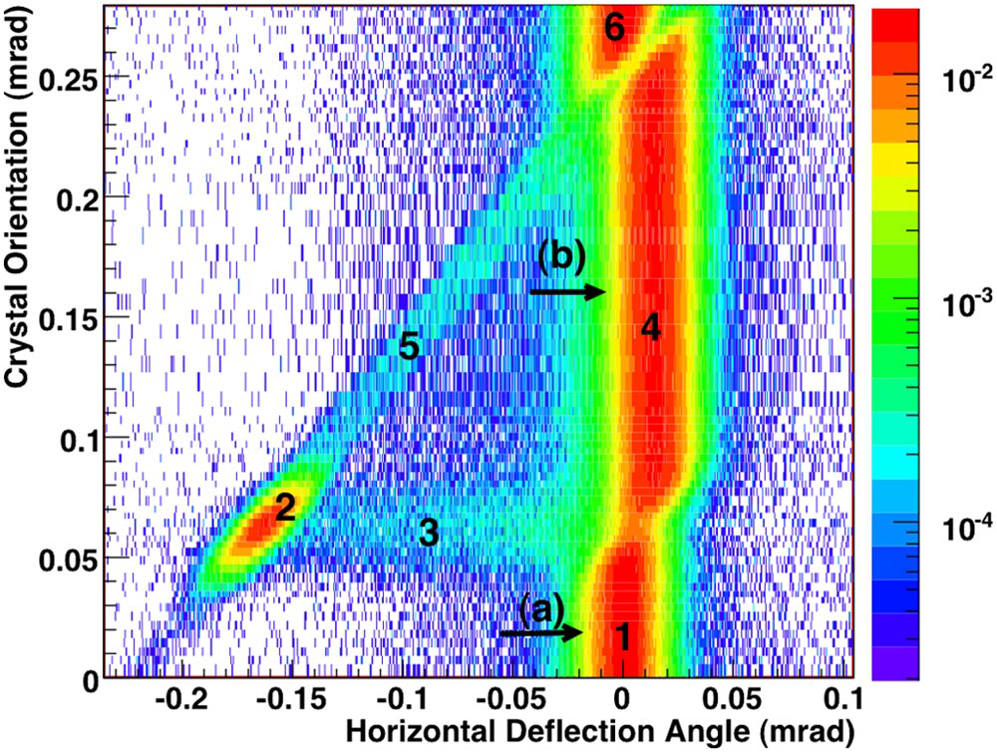
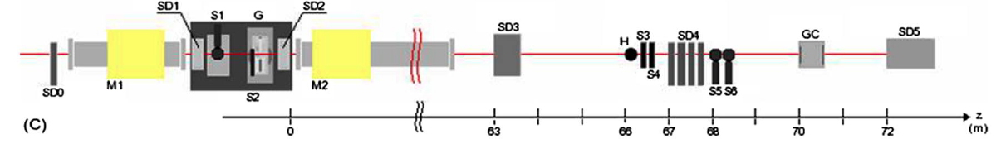
H8-RD22 (then UA9) Experiment at CERN
Experiment to study channeling and volume reflection phenomena on bent silicon crystals
Initially in extracted line at the CERN SPS
Then application to collimation in the SPS and LHC
Used different beam types:
  protons
  pions
  electrons
  ions (planned)

Slide 7
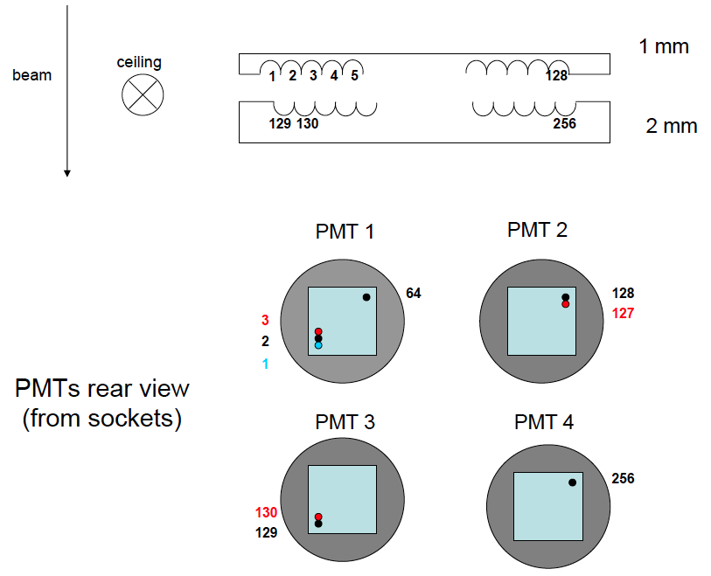
Beam profile monitor (1)

Slide 8
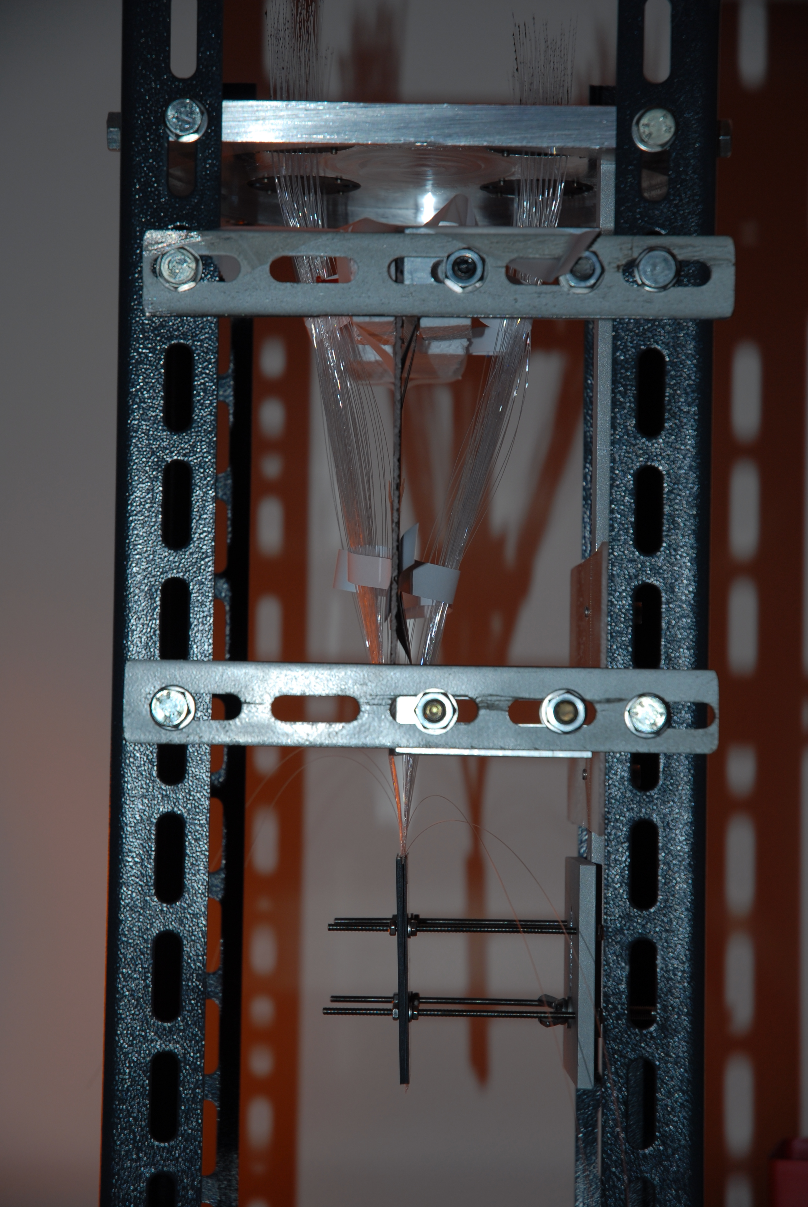
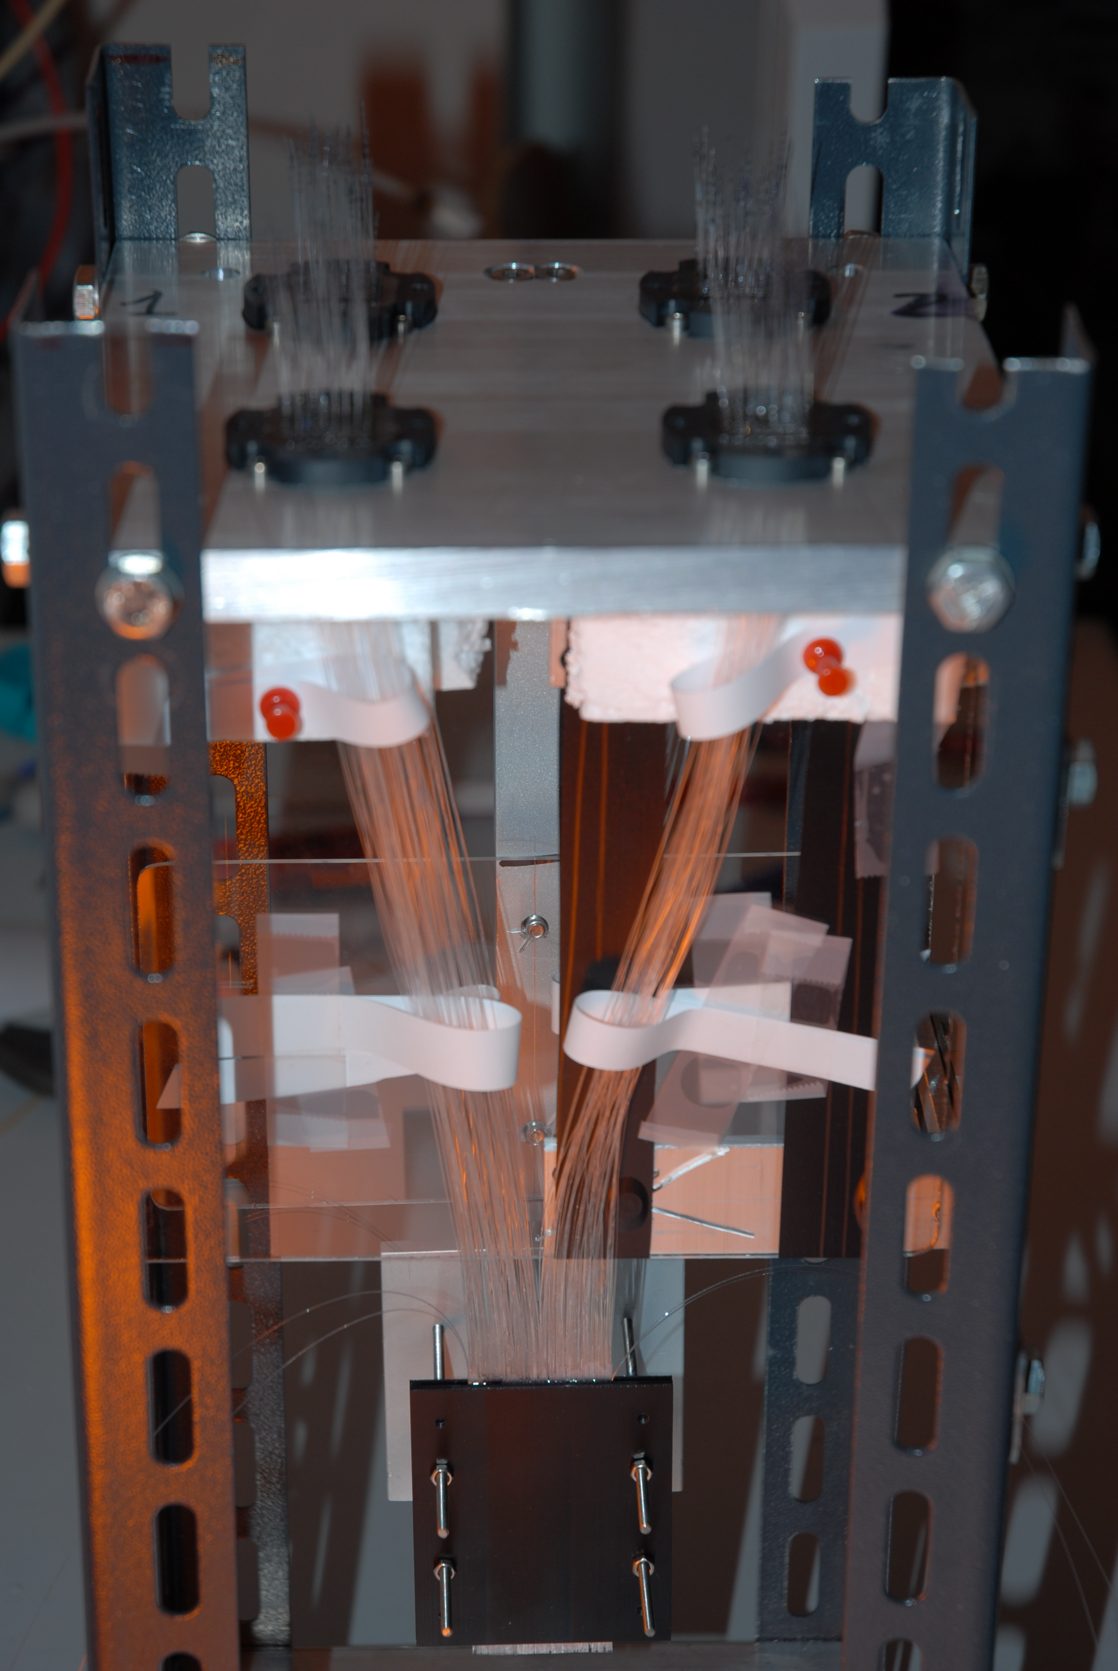
Beam profile monitor (2)

Slide 9
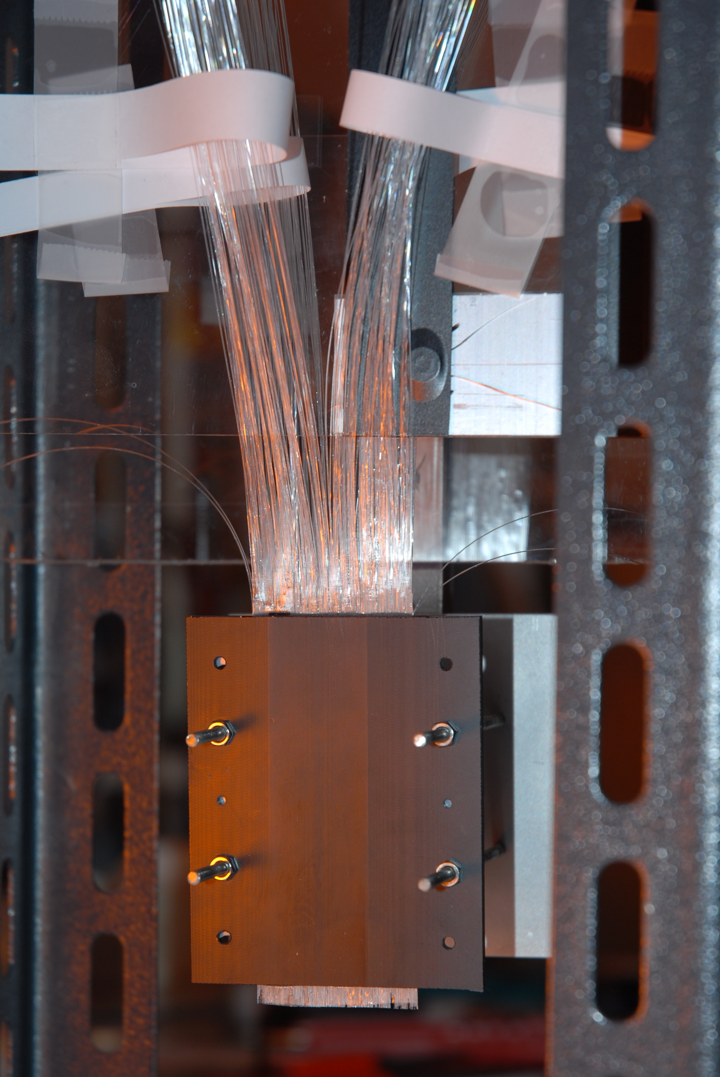
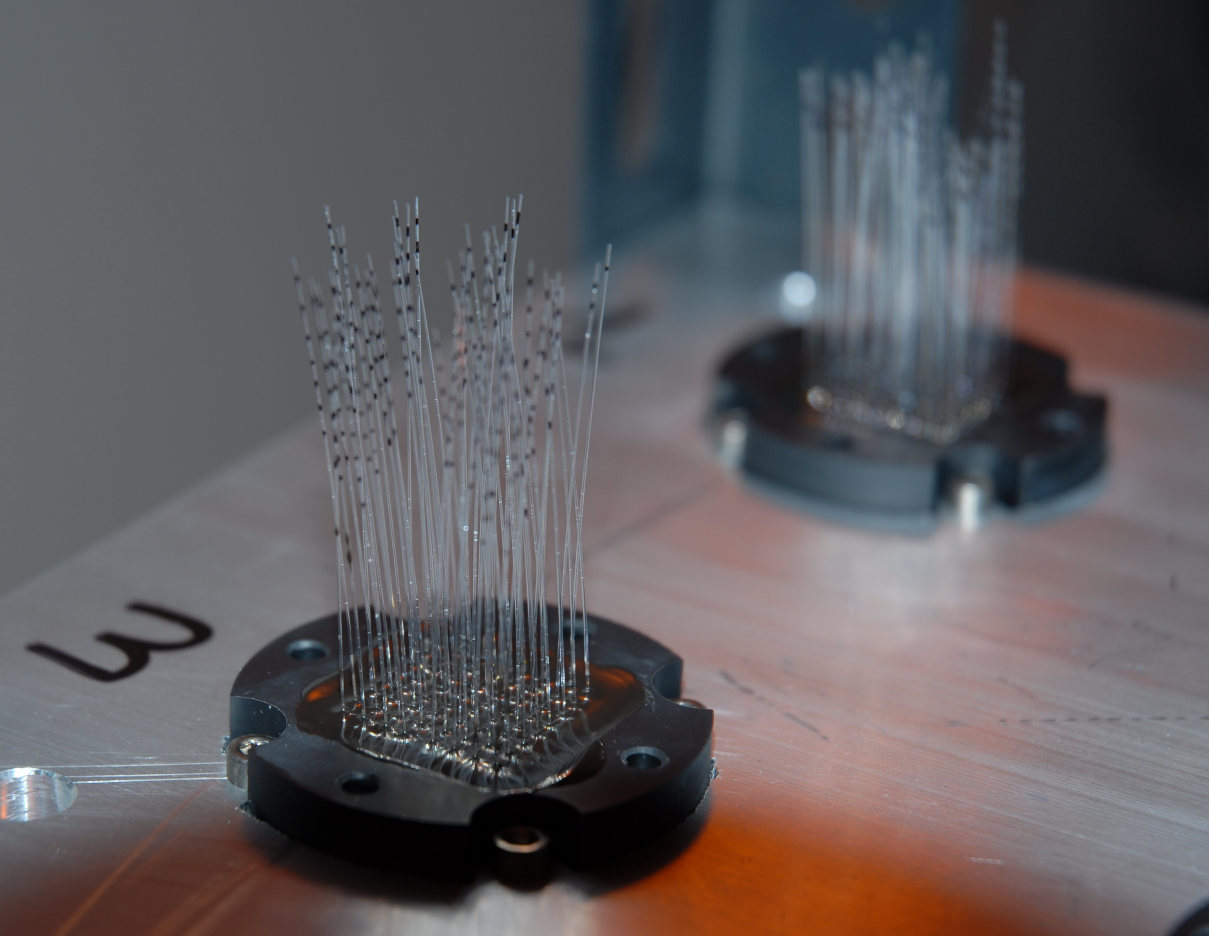
Beam profile monitor (3)

Slide 10
The SuperB Muon Detector

Slide 11
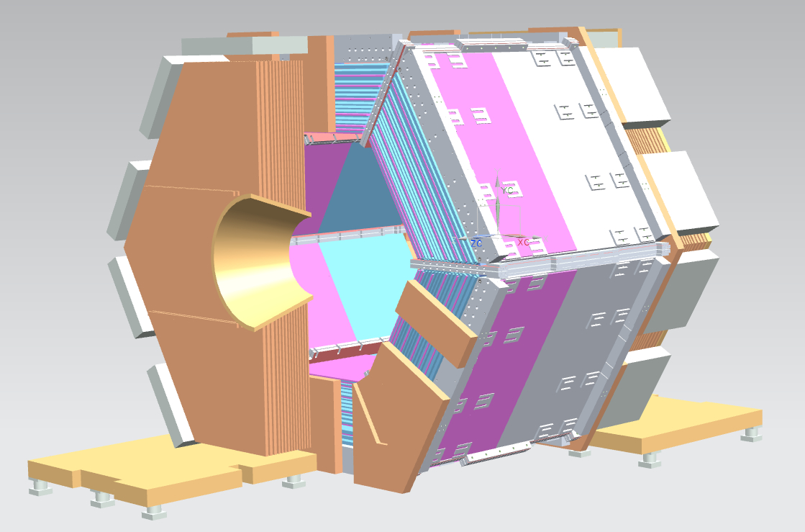
The SuperB Muon Detector
Part of the SuperB apparatus is the Instrumented Flux Return (IFR): the outer most detector for the identification of muons and neutral hadrons
Superconducting solenoid iron yoke instrumented with fast scintillators to cope with high flux of particles (~ few 100 Hz/cm²)
It is composed by a Central Barrel and two movable Endcaps
Each part consists of 92cm of Iron interleaved by 9 active layers of segmented scintillator
5/10cm scintillator bars readout through 3 Wave Length Shifter fibers (WLS) and Silicon Photo-Multipliers (SiPM)
Barrel
Forward Endcap
Backward Endcap
The Instrumented Flux Return
Particle
Scintillator – Iron segmentation

Slide 12
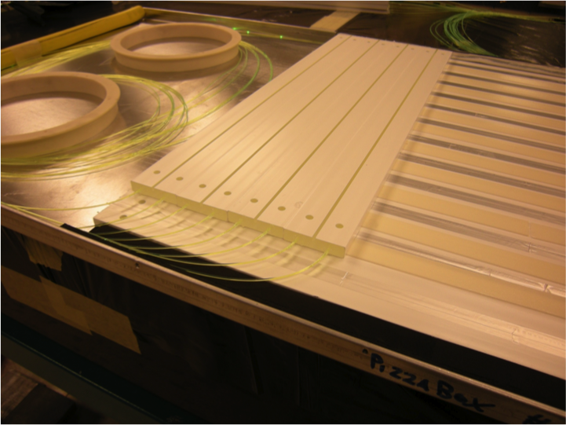
The IFR Readout Technique
The active modules are the assembly of two layers of orthogonal scintillator bars:
  5 cm bars in each direction for the Endcaps
  10cm bars in the transverse direction for the Barrel
Each scintillator bar is readout through 3 Wave Length Shifting Fibers housed into surface grooves
The three fibers bring the light signal to a custom shaped Silicon Photo Multiplier
Each bar is Digitally readout through custom made Front End electronics
WLS fibers
Scintillator
SiPM

Slide 13
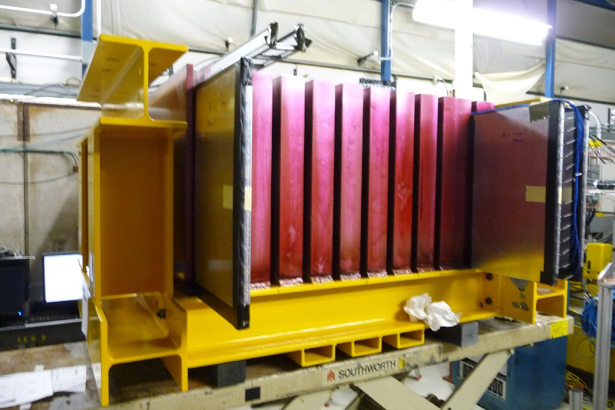
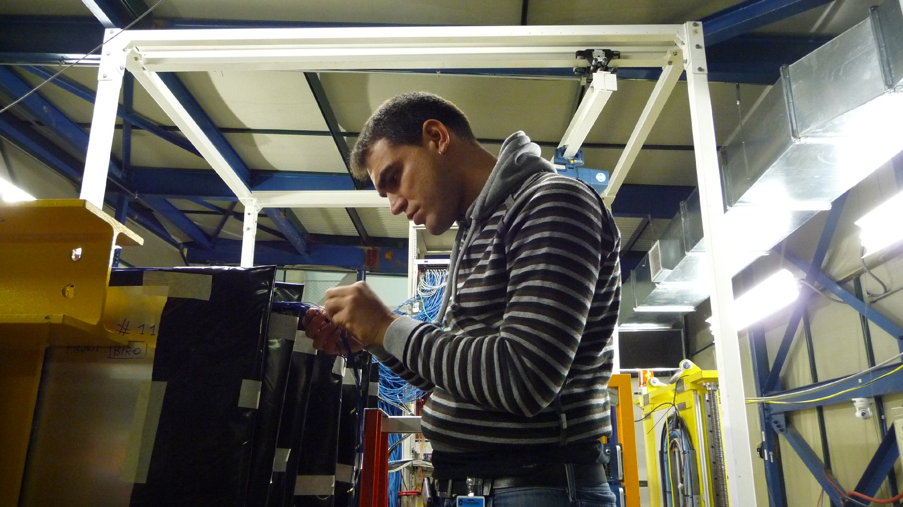
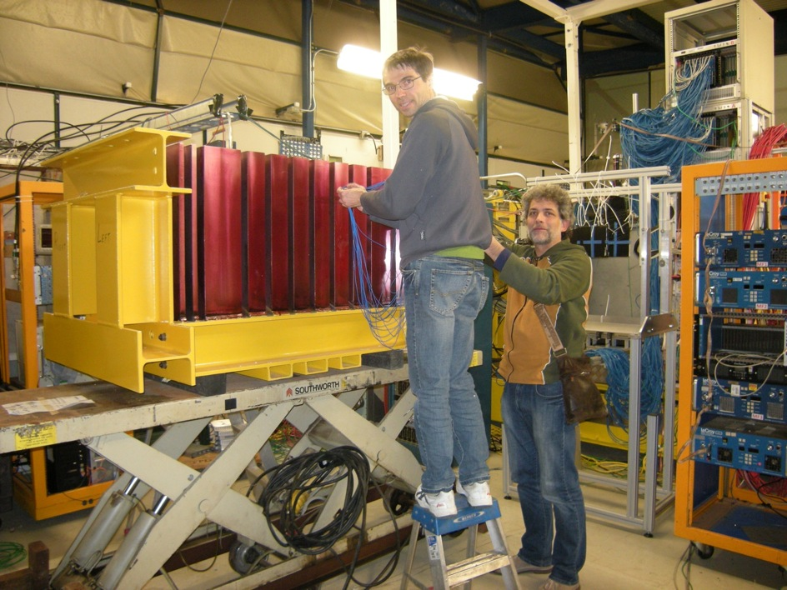

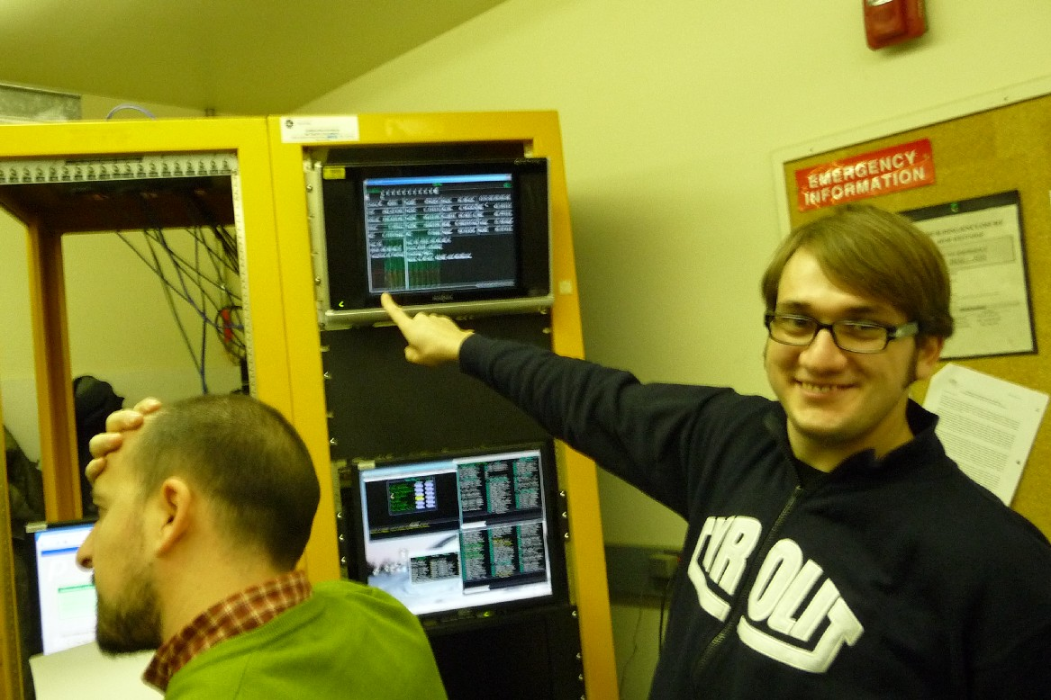
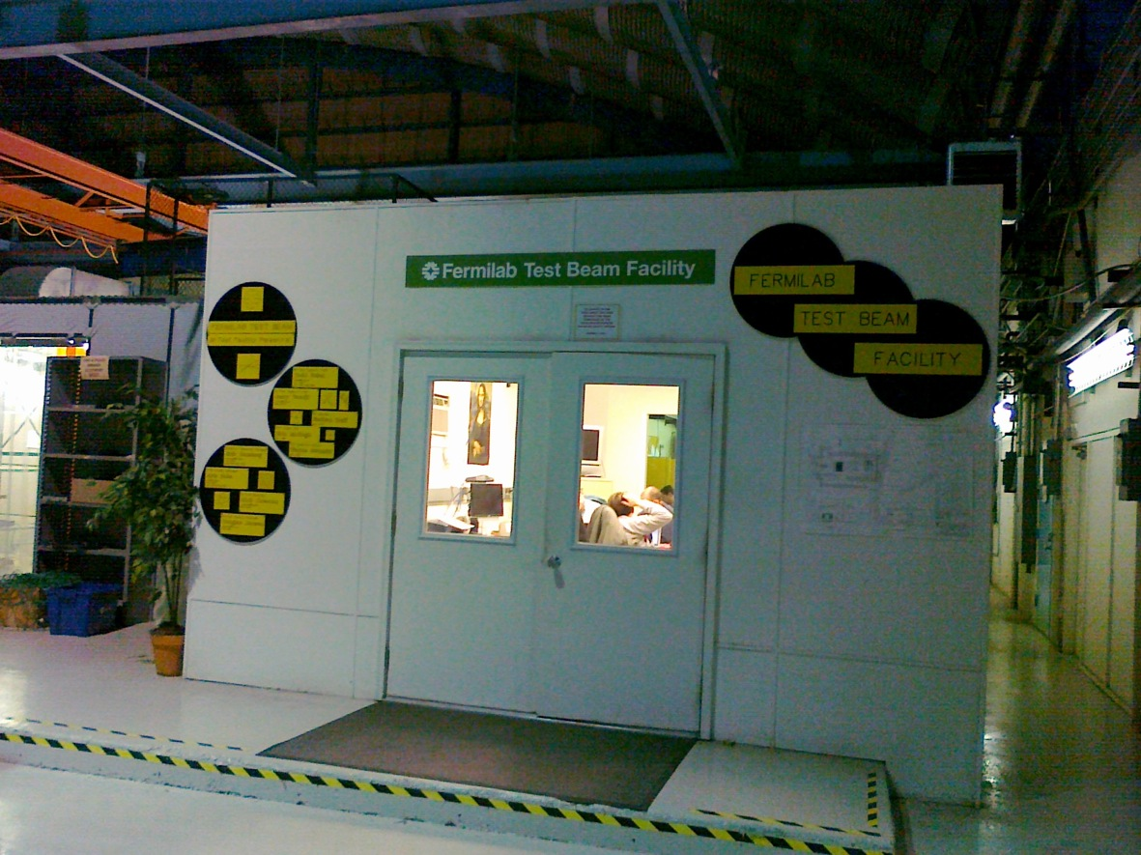
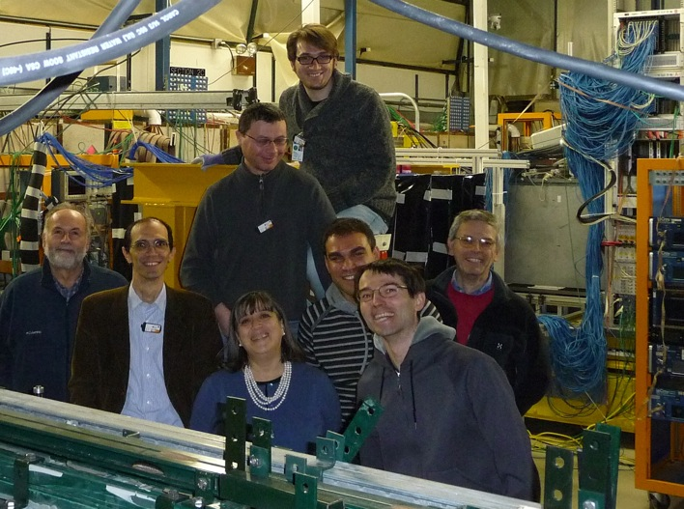
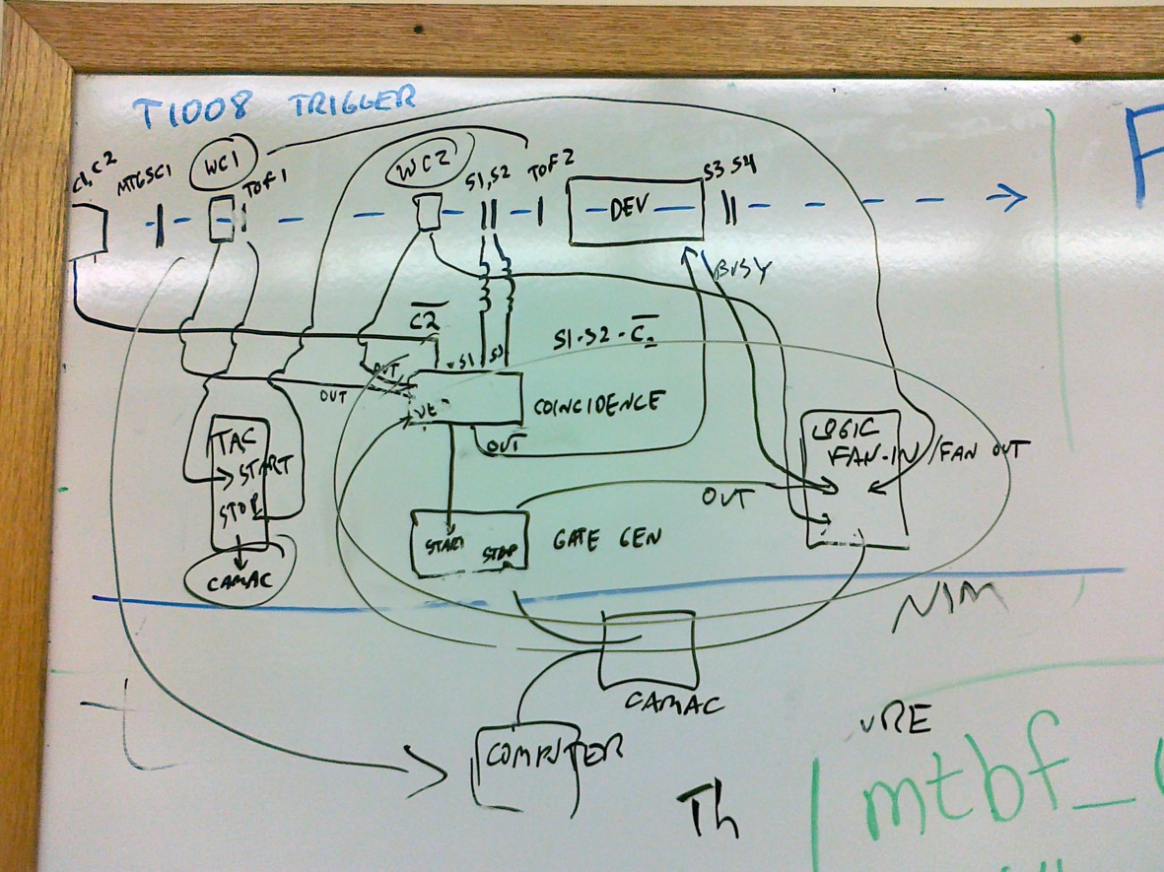
The beam test at Fermilab
The prototype
The FBTF
The “SuperB
group”
The DAQ & Trigger “scheme”
Photos by R.Malaguti

Slide 14
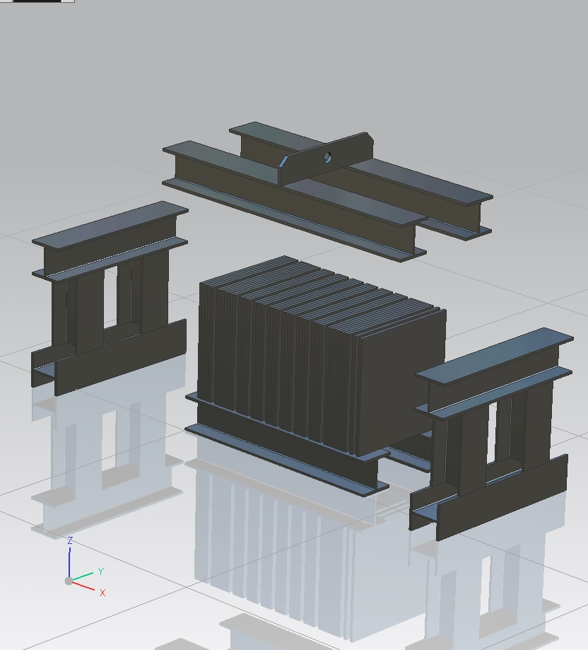
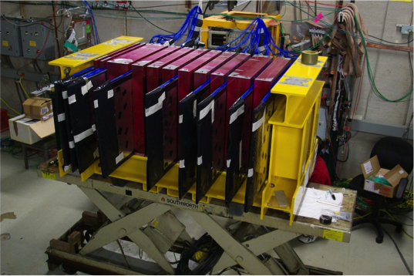
The IFR Prototype: Design and Construction
Full depth prototype: 60x60x92cm³ of Iron interleaved by 12 slots to house the active layers
12 slots: Possibility to house the 9 active layers in different positions to test different iron-scintillator configurations
Possibility to test another readout solution (TDC) and to compare different SiPMs and WLS fibers:
  4 Time Readout (TDC-RO) “standard “
  4 Binary Readout (BiRo) “standard”
  4 special modules to study different fibers and SiPM geometry
Iron
9 Active Layers

Slide 15
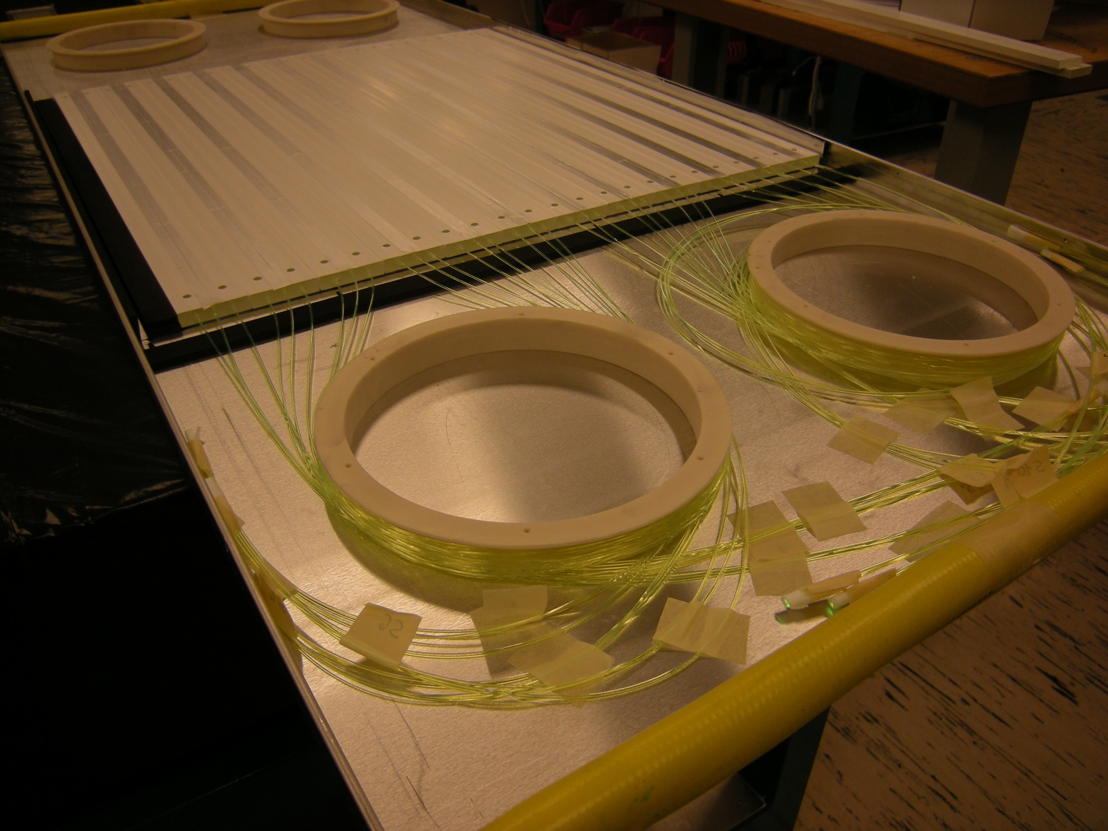
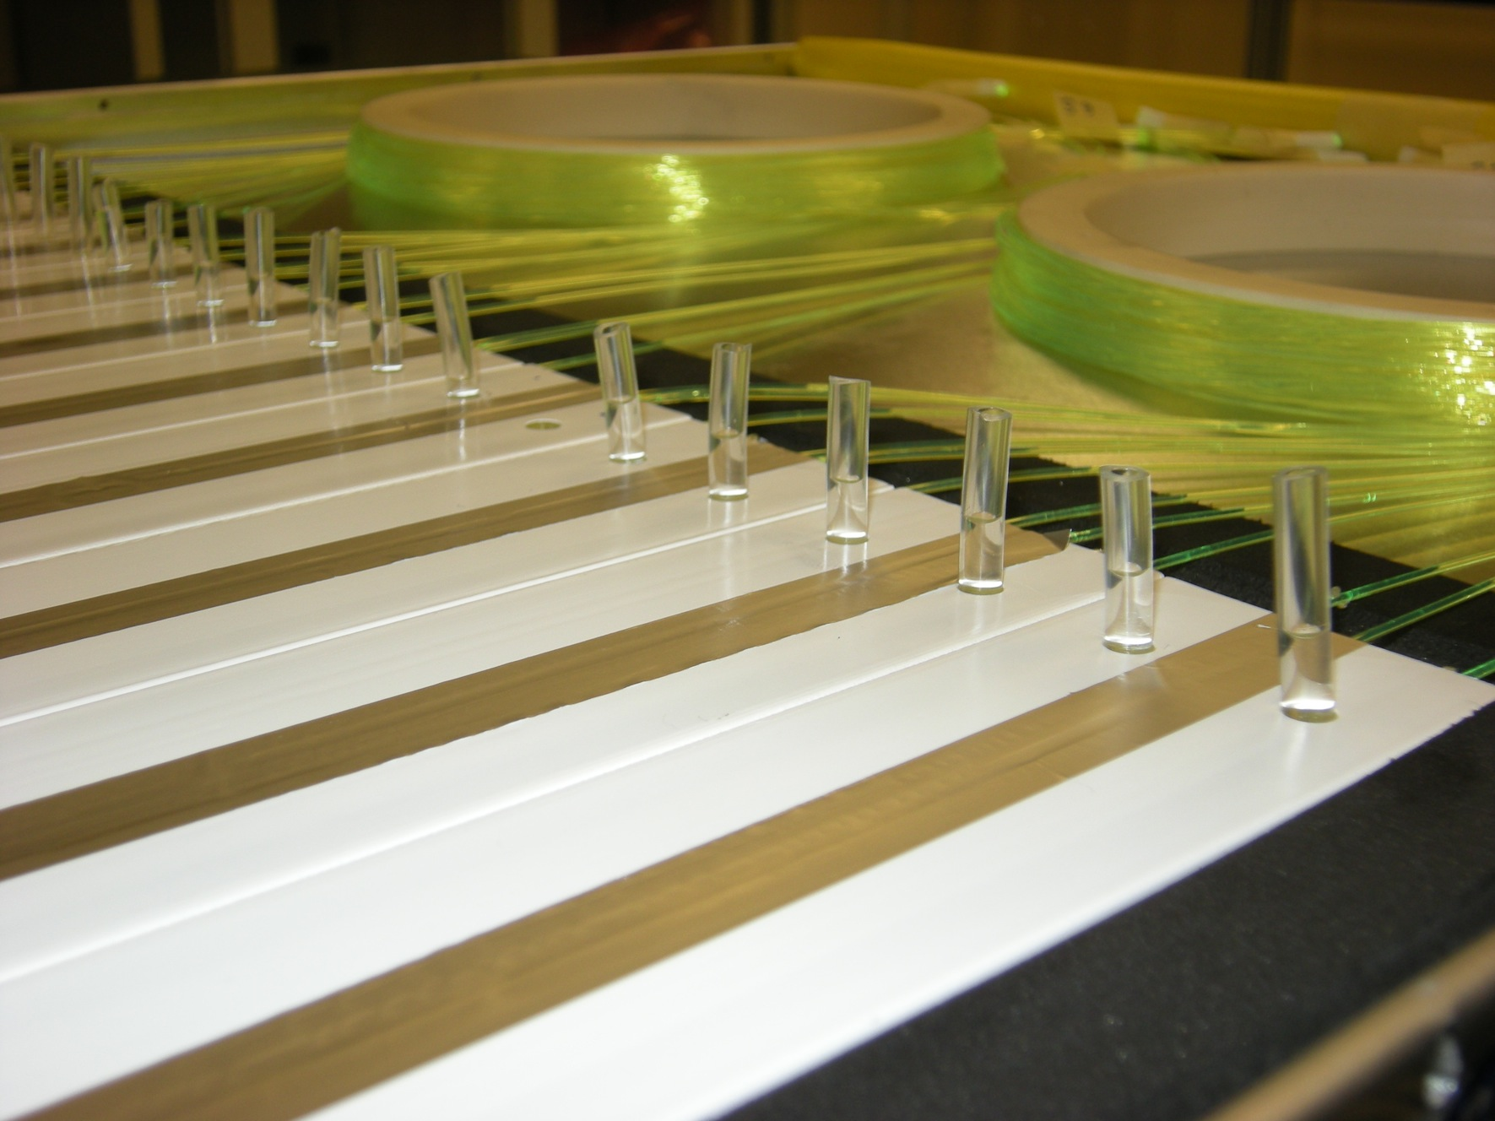
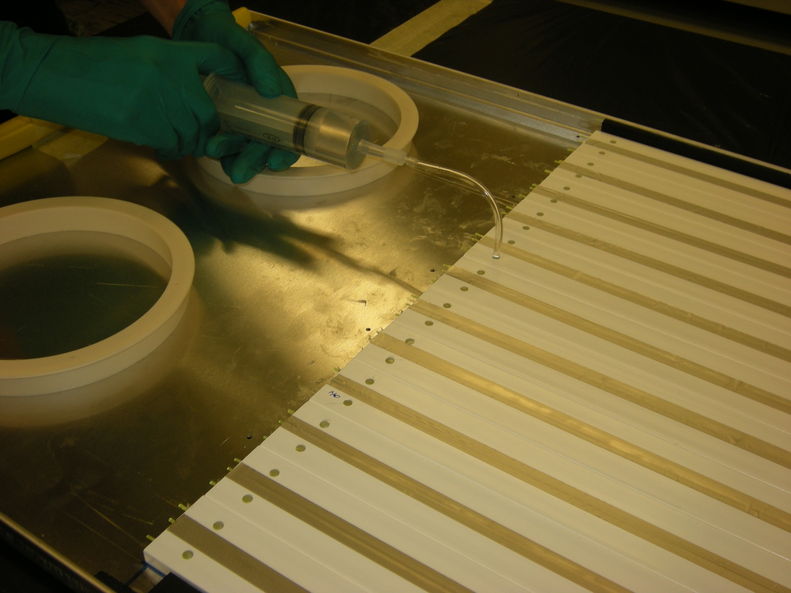
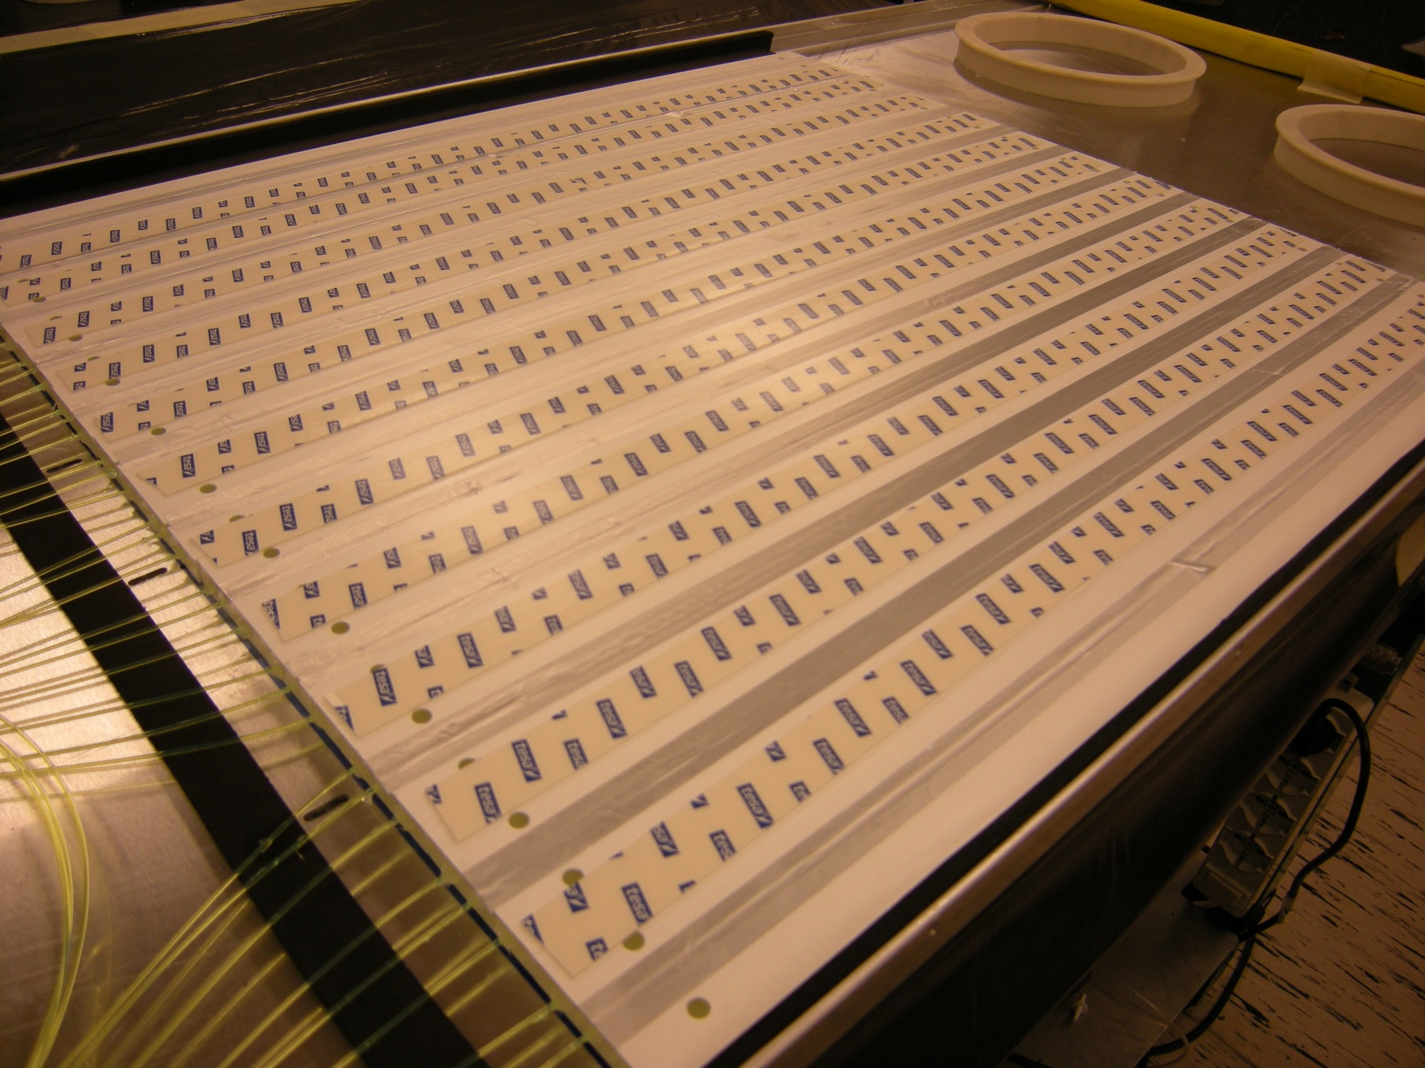
Labeling and collecting
the fibers around the supports
Fill the machined grooves
with optical grease and cover it with stripes of reflecting aluminum (BiRo only)
Various assembling steps
of the active layers
Put double-side adhesive
to fix the second layer
(BiRo only)
Fill with optical glue
the embedded holes

Slide 16
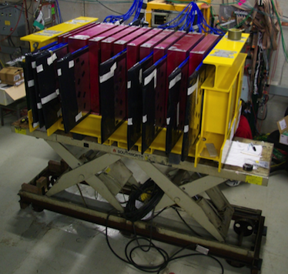


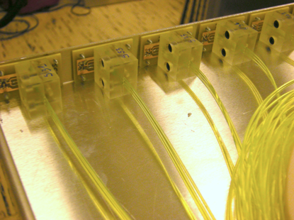
The Beam test of the Prototype
A detector prototype has been built to test the technology on large scale and to validate simulation results
Iron: 60x60x92 cm³, 3cm gaps for the active layers
The prototype at the Fermilab
Beam Test Facility
Up to 9 active layers readout together (about 230 independent electronic channels)
Active modules housed in light tightened boxes ( Pizza Box)
  4 Time Readout modules
  4 Binary Readout modules
  4 special modules to study
different fibers or SiPM
geometry
First Test in Dec. 2010 at the Fermilab Test Beam Facility with muon/pion (4-8GeV)
Active Layer
(“pizza box”)

Slide 17
Beam Test Main Results: Detector Performances
Layers 0,2,4,6,8 Binary Readout, various fibers length (from 110cm to 370 cm )
Layers 1,3,5,7 Time Readout, SiPM on both ends of the scintillator, fibers length: 400cm. This option was eventually discharged
Thresholds: 3.5 p.e.
Very good efficiencies: ≈ 95%
Side view of the Prototype
Layer 0
Layer 8

Slide 19
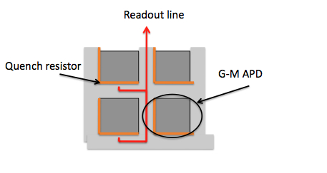
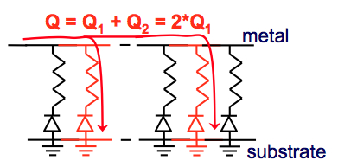
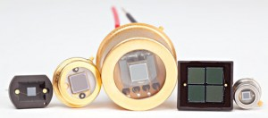
SILICON PHOTO MULTIPLIERS
SiPMs are semiconductor photo detectors composed by a matrix of Geiger Mode Avalanches Photo Diodes (GMAPD)
The output signal is the sum of the charge produced by each fired pixel.
These devices can be custom shaped

Slide 20
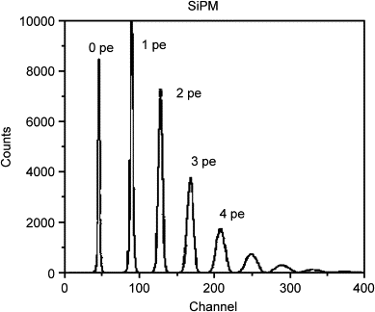
The Sci-Fi with SiPM Readout Technique
The Scintillanting Fibers technique, readout through Silicon Photo Multipliers has many interesting aspects:
  Very fast: time response of few ns
  Cheap:
    fibers: few $/m,
    SiPM: < 50 $/each
  Compact: tipically 1x1 mm²
  No need for HV or Gas:
    Typical Vbias: < 100V
  Many producers:
    Hamamatsu
    SenSL
    AdvasiD
  Quality rapidly improving

Slide 21
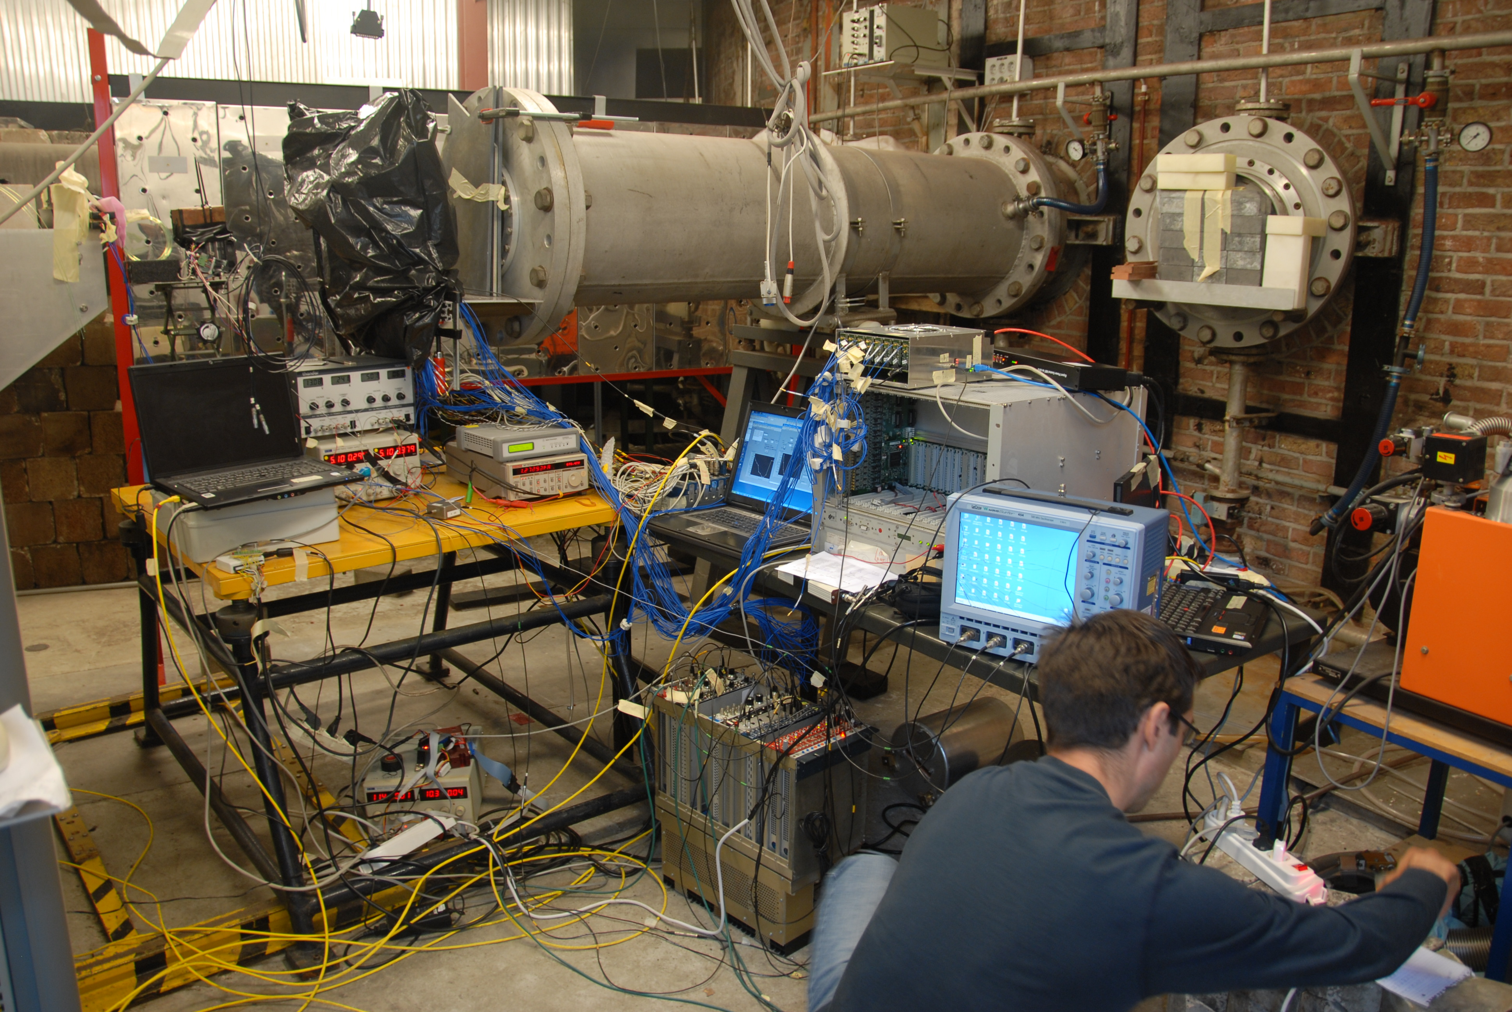
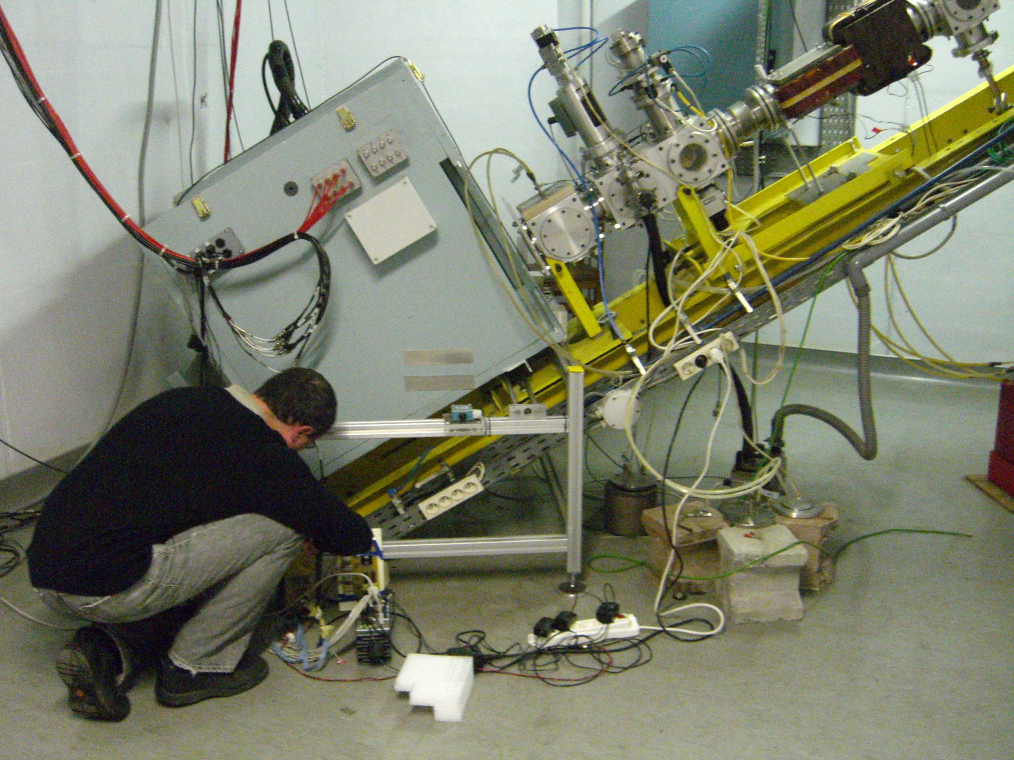
The Sci-Fi with SiPM readout Technique (II)
They do have a few drawbacks though:
  Relatively high dark noise (~ few 100kHz)
  RADIATION DAMAGE
We performed an extensive irradiation campaign to study the radiation damage:
  Frascati Neutron Generator (ENEA-Rome) in 2009
  GELINA (Geel, Belgium)
  Louvain La Neuve (Belgium)
GELINA
Louvain

Slide 22
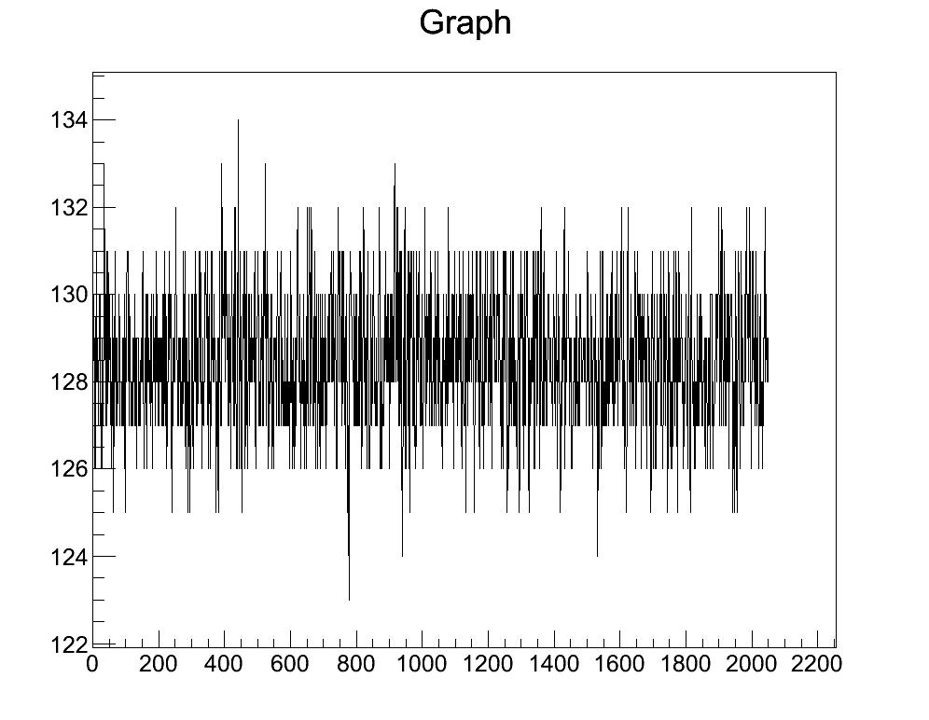
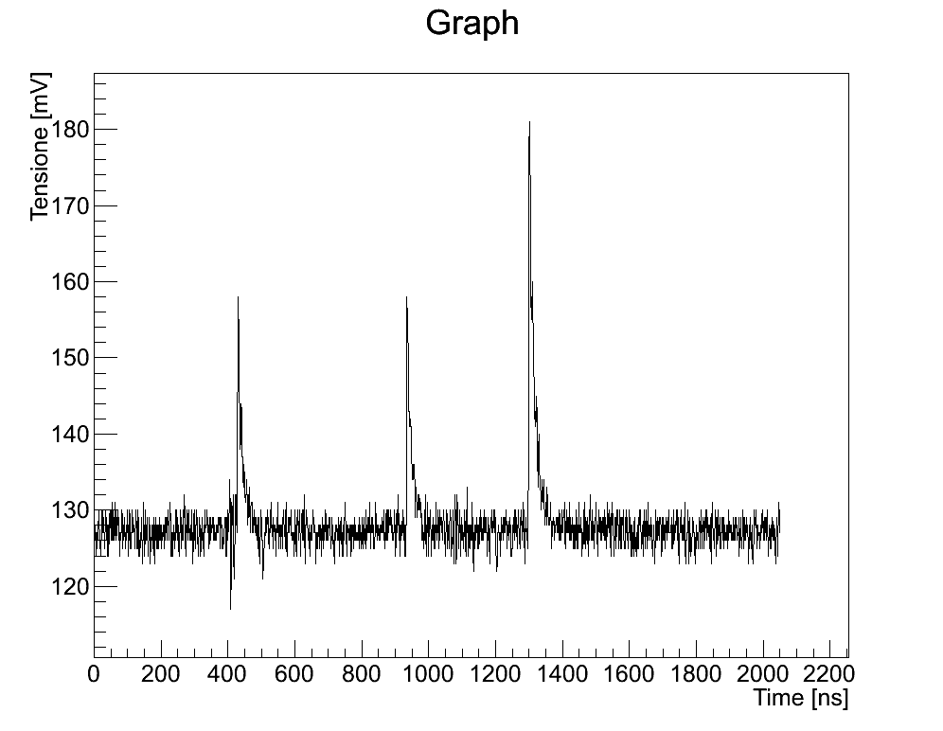
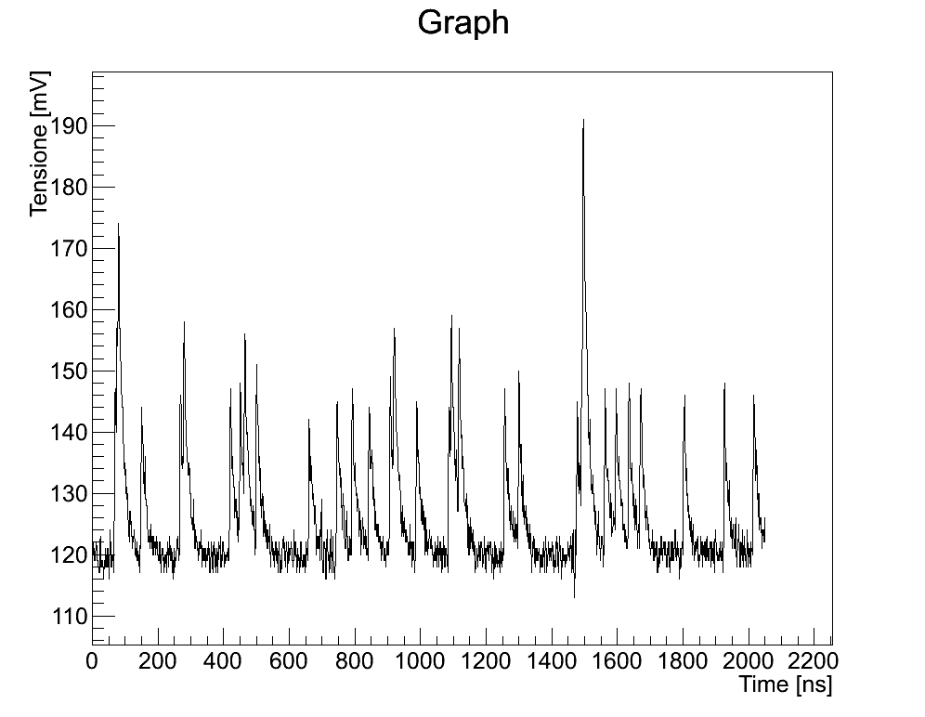
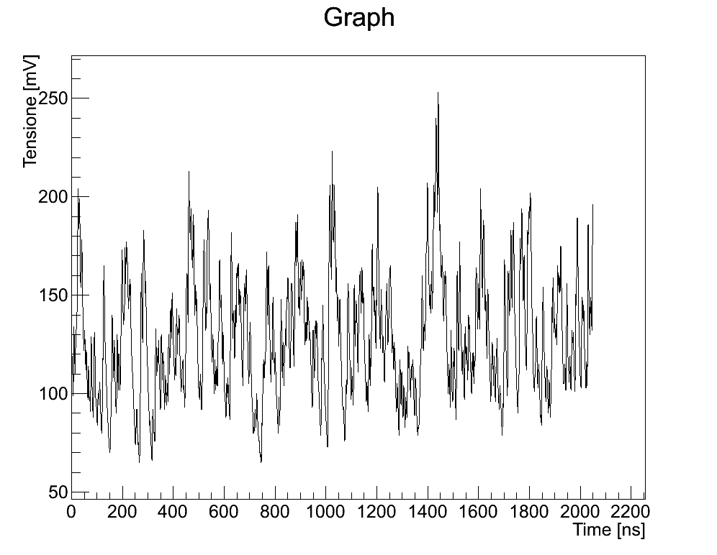
Radiation Effect at a Glance
The radiation damage is very clear looking at the dark noise:
Before irradiation
5 x 10⁸ neq/cm²
5 x 10⁹ neq/cm²
5 x 10¹⁰ neq/cm²

Slide 23
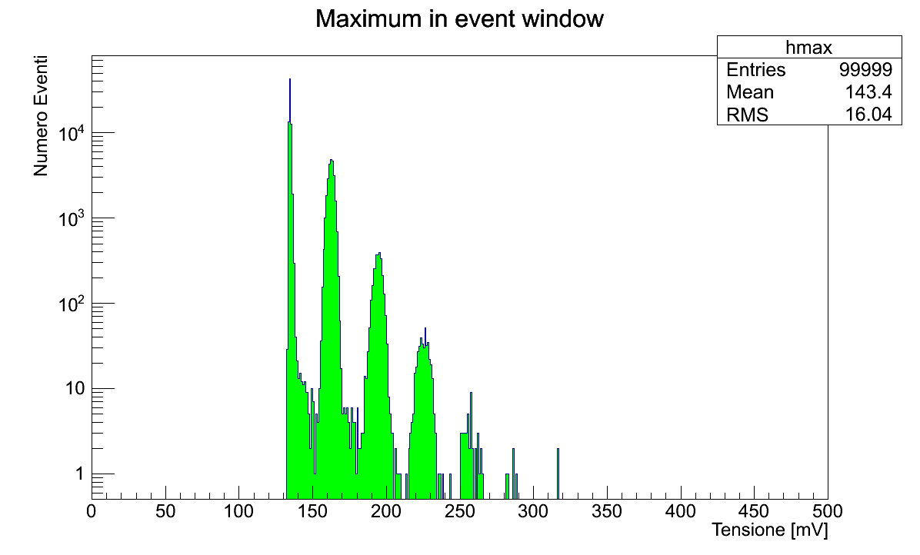
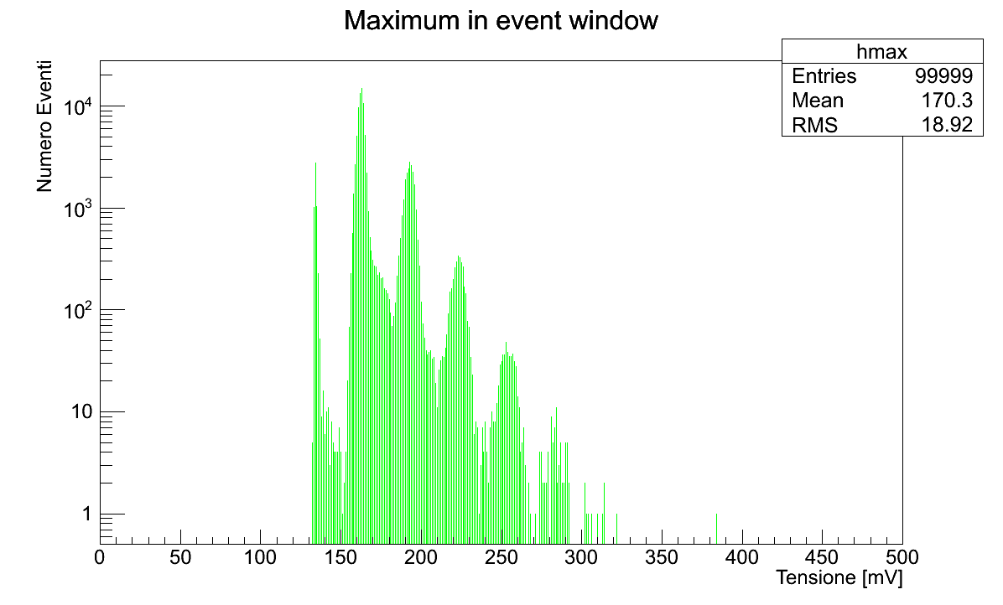
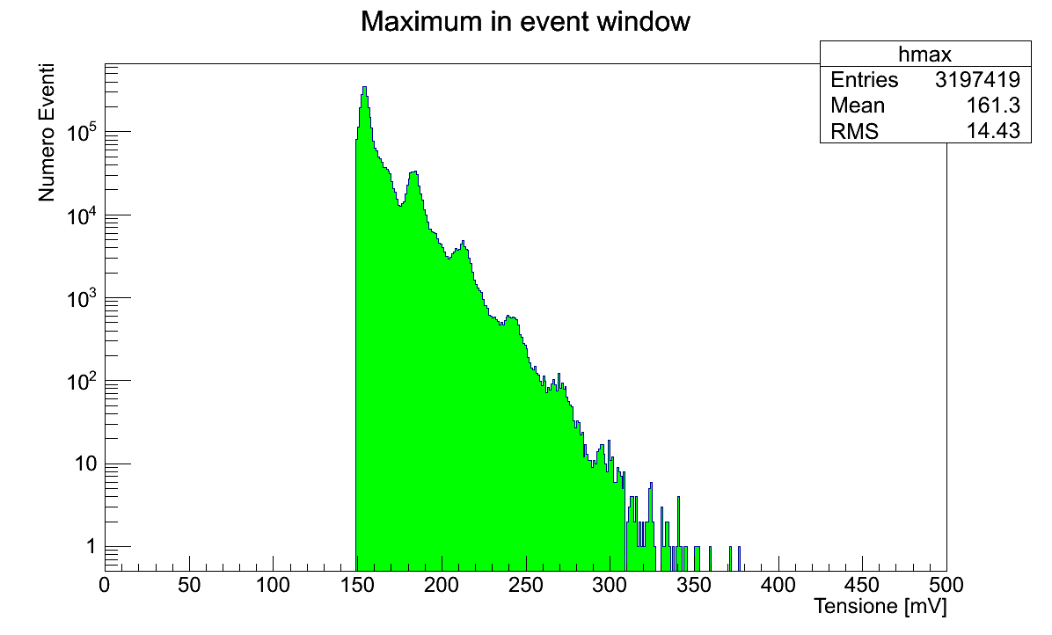
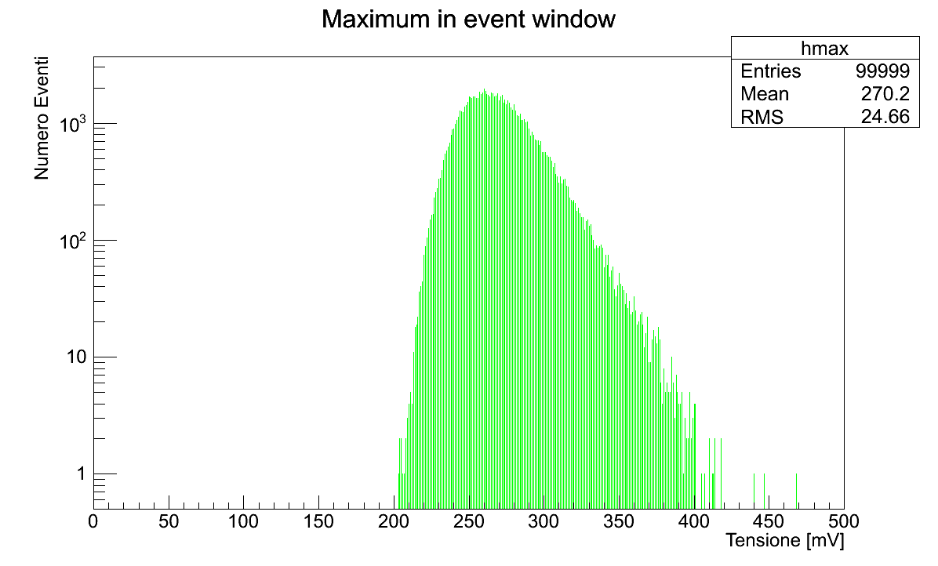
Dark Spectra vs Dose
Before irradiation
5 x 10⁸ neq/cm²
5 x 10⁹ neq/cm²
5 x 10¹⁰ neq/cm²

Slide 24
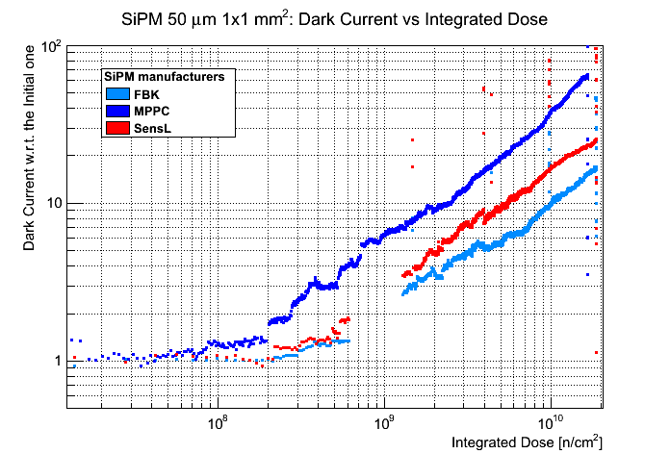
Different Manufacturers
PRELIMINARY

Slide 25
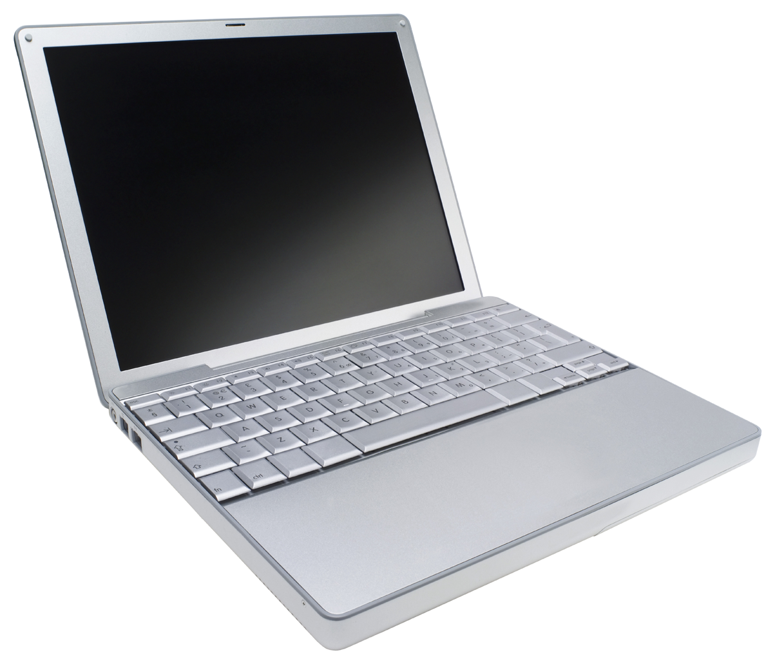

First Ideas for the Beam Monitor
The general Layout could be the usual Scintillating Fiber + SiPMs readout scheme:
Front End
Electronics
SiPM
Various options:
  Fiber:
    250 μm diameter
    500 μm
    1 mm
  SiPMs:
    Pixel size (10, 15, 20, 25, 50 … μm)
    Active area (depending on Fiber diameter)
Scintillating
Fibers
Beam
Tipically fibers are glued on a precisely machined plastic support (e.g. plexiglas)

Slide 26
Very rough estimates…
Usually fiber detectors are hit by ONE particle per fiber and per event.
Here is more “interesting”, as we expect:
  10⁵ Muons in 120ns → ≈ 10³ /nsec in a few cm of diameter
  (very) roughly speaking we expect something of the order of:
  75 muons/fiber/ns in a 250μm fiber
In a 250μm fiber we expect ≈ 5-10 p.e./particle, in linear approx. ≈750 p.e.
For 1mm fibers few 1000 p.e. …
rather challenging also for the Readout electronics
very interesting, not many studies on this topic in
literature

Slide 27
Interesting points
Does the scintillating material show saturation effects?
  light yield of fibers
  transmission of the light
  … ?
can SiPMs deal with such a high photon flux per unit surface (we need small pixels: 10-15μm)
a challenge for the Readout Electronics (very high dinamic range)

Slide 28
Discussion
minimum-maximum number of particle to be detected
R&D done with beam of increasing intensity to observe saturation effects: when the beam will be available? (in reasonably controlled conditions)
timescale of the project
space constraints
is there a material budget to be respected
Any constraint in the type of material

Slide 29
Backup slides

Slide 30
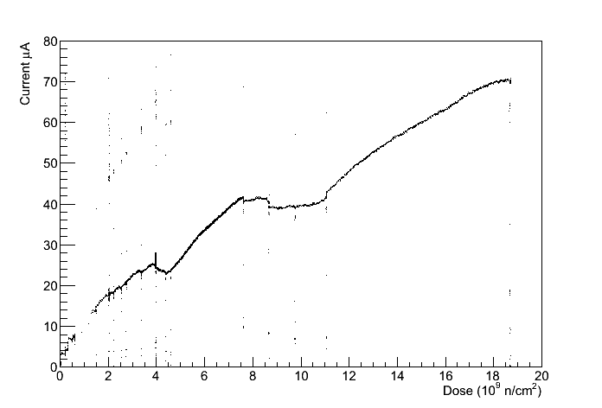
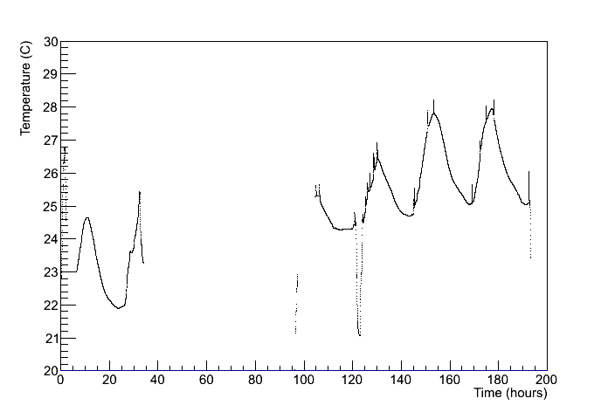
Temperature Effects
Current vs dose
for a 3x3mm² MPPC
It’s well known how well the SiPM gain, current and rates depend on the temperature.
Especially the MPPC can be largely affected by temperature variation.
temperature variation cancels the neutron effect
Temperature vs time
Temperature was monitored but no bias correction has been applied during the test.

