Slide 1
AP30 Resonant Extraction Shield Calculation Status
T. Leveling
1/8/15

Slide 2
outline
Motivation
Model inputs
Vetting the model
MAD vs. MARS model
DUSAF file versions
Preliminary results
Remaining steps

Slide 3
motivation
Radiation shielding & skyshine calculation was completed December 2013
Things have changed:
Outside/in extraction
New D2Q5 magnet
New Lambertson design
New C magnet design
New extraction and circulating beam profiles
Added sagitta to D207 & D208
Cleaned up modeling of pitched/rolled/yawed components
Verified quad positions from previous
New generic TLM model can be placed anywhere in the model
Need to predict TLM response at extraction region

Slide 4
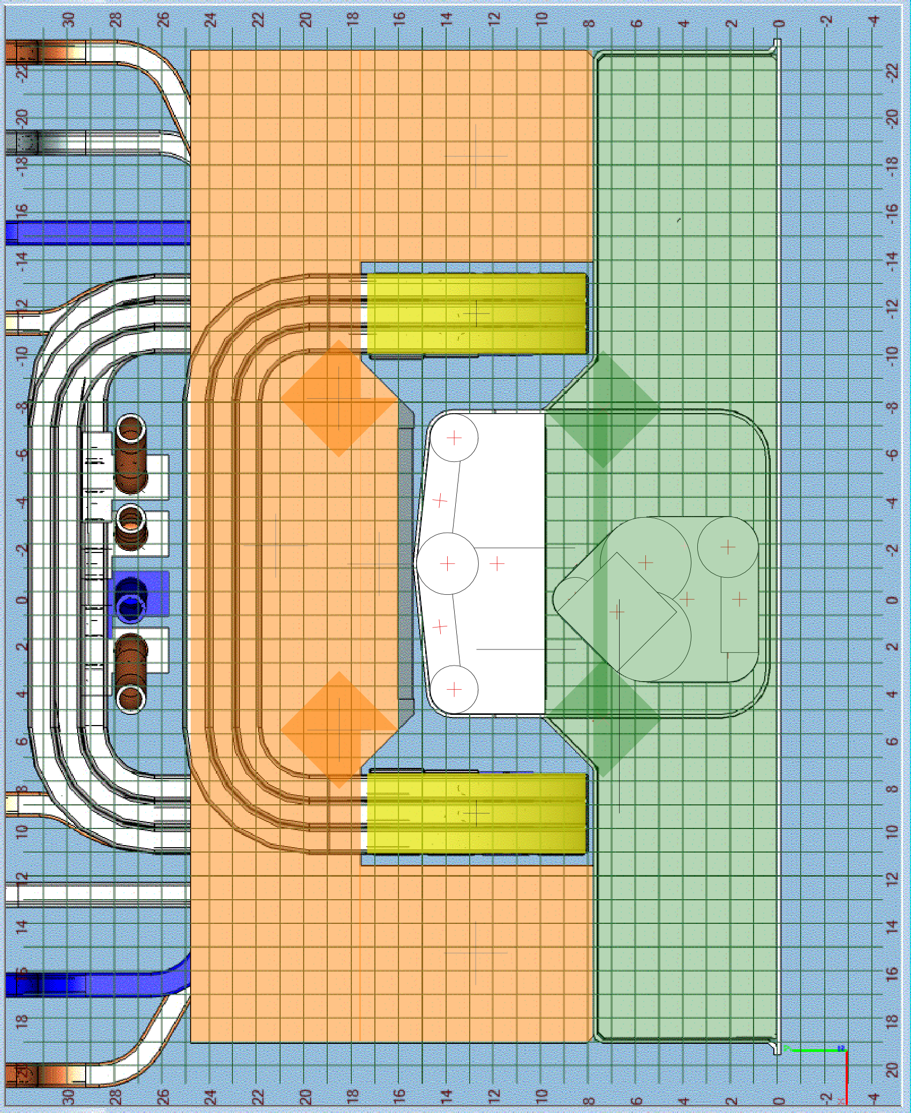
Model inputs
New Lambertson (JPM) modelled in detail

Slide 5
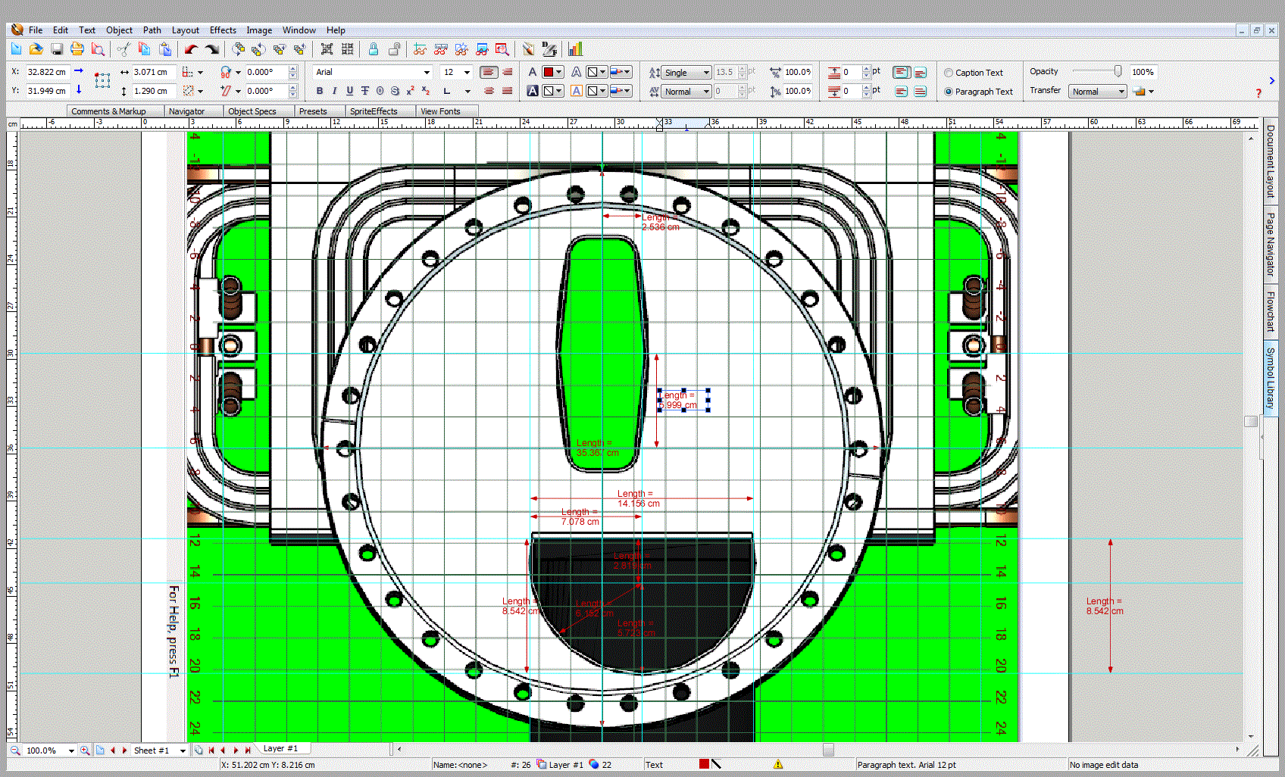
Model inputs
C magnet (JPM)

Slide 6
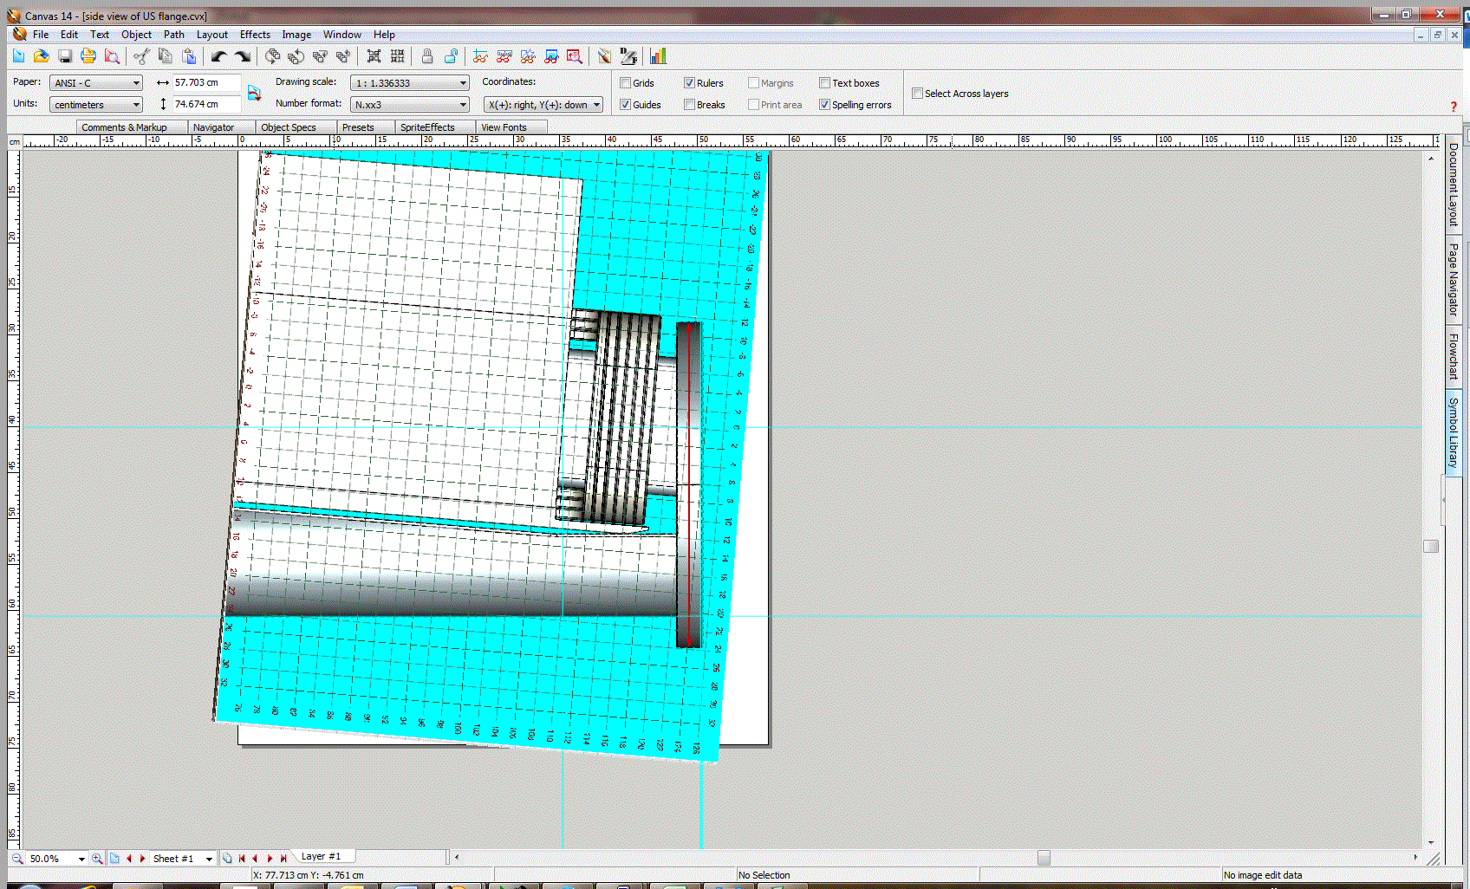
Model input
C magnet

Slide 7
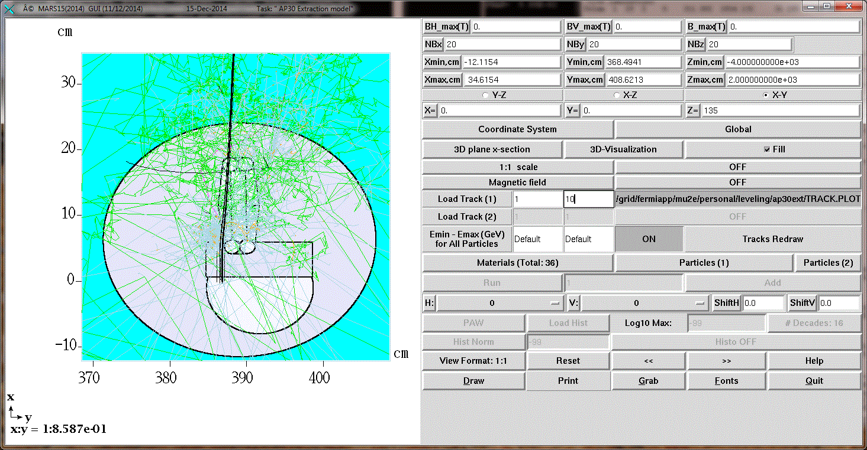
Model input
C magnet US flange

Slide 8
Model input
35 Soda straw penetrations from JB

Slide 9
Model input
TLM
60” left of beam line
30” left of beam line
Over beam line
Original model
simplified model
Three locations

Slide 10
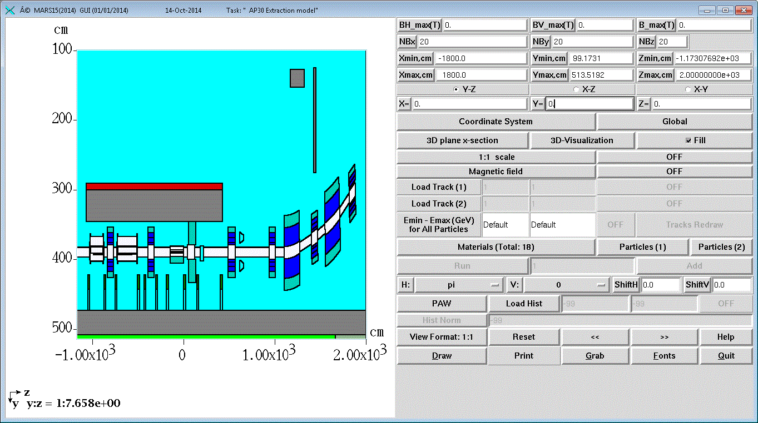
Model input
Obtained drawings from Ollie to create D207&D208 with Sagitta
Beam pipes have not been correctly modeled yet

Slide 11
Model Input
Cmagnet is model with US flange (not in final vertical position!)

Slide 12
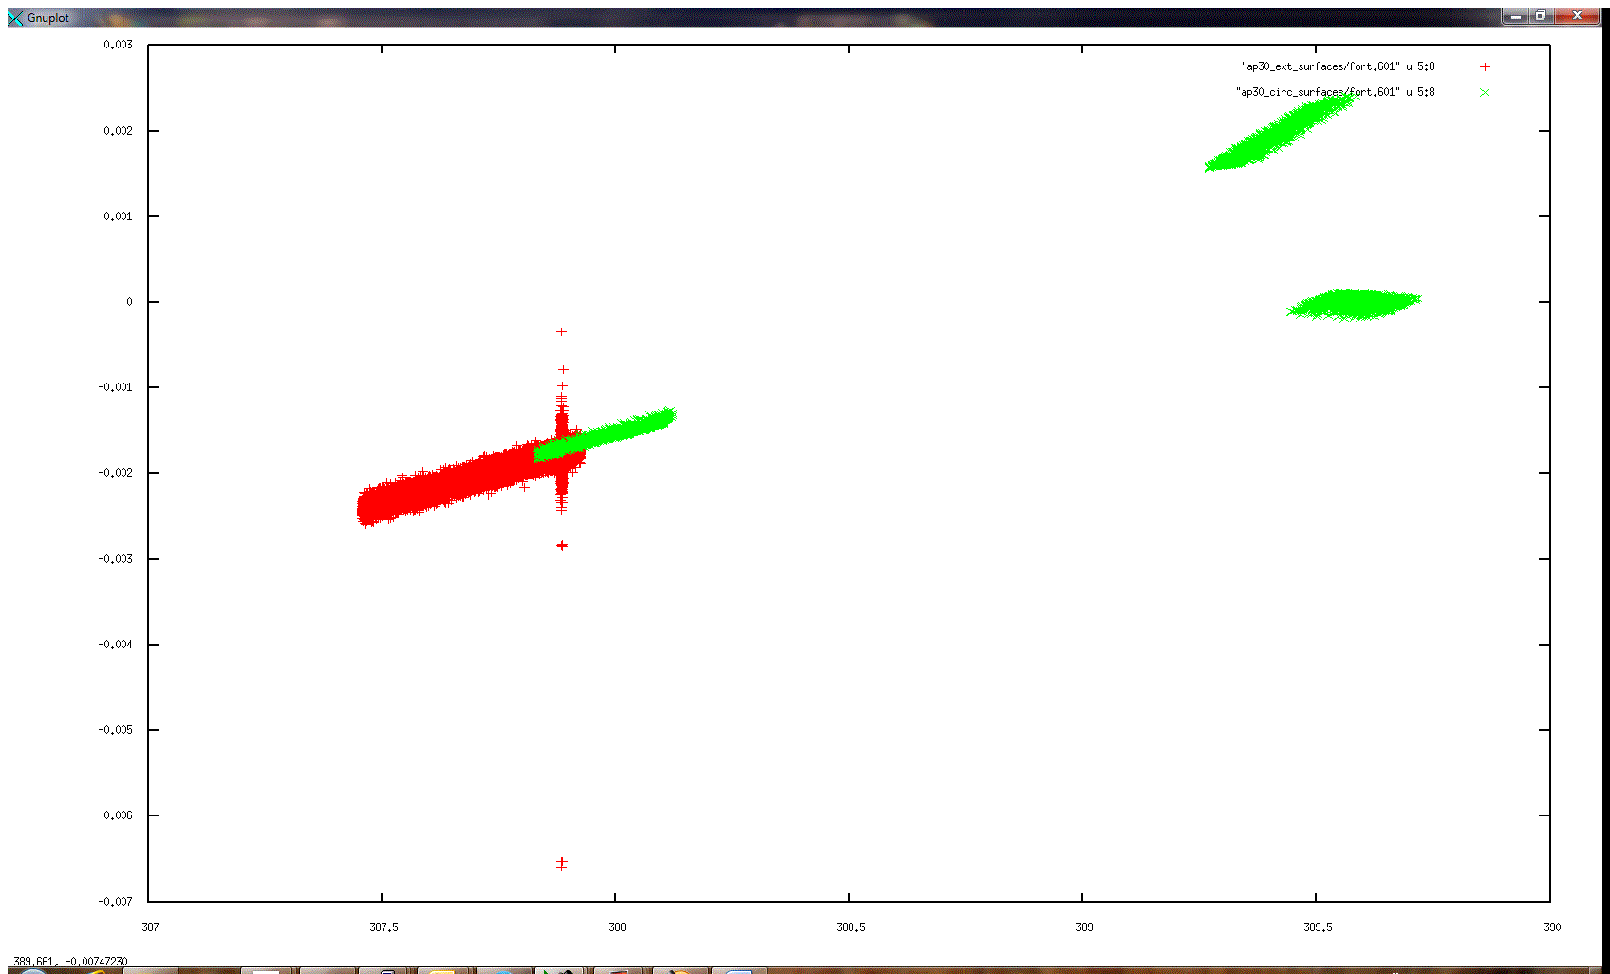
Model input
GNUPLOT of circulating and extraction samples used in simulation

Slide 13
Model input
Circulating and extraction beam samples from Vladimir

Slide 14
Model input
Present septa alignment

Slide 15
Lambertson
Needs a yaw angle from MARS simulation - 0.15 degrees

Slide 16
Vetting the model – work in progress
Compared MAD positions with the present MARS model
Debuncher quads are in agreement with MAD locations
C magnet, Q901, and V901 are off:
Cmagnet is 30.7 cm US of MAD position and is not rolled
Q901 is 13.6 cm DS of MAD position
V901 is 14.1 cm DS of MAD position
It remains to check horizontal offsets
Is there a yaw angle for Lambertson in MAD?

Slide 17
MAD/MARS coordinate comparison

Slide 18
Comparison of coordinates
MAD/MARS (2000) and 2004
 |  |  |  |  |  |  |  | x | y |  | x | y |  | x | y | offset | deltax | deltay
D2Q9 UP | -1670.88 | -15515.9 | 100.783 |  | -0.01425 | 0.014995 |  | 99860.76 | 98707.01
D2Q9 CT | -1662.29 | -15525.9 | 100.781 | 2.187531 |  |  | D2Q9 CT | 99861.48 | 98706.18 | D2Q9_CT | 30437.84 | 30085.7 | 222.0133 | 99861.69 | 98706.36 | 3.349 | -2.507 | -2.221
D2Q9 DN | -1653.69 | -15535.8 | 100.777 |  |  |  |  | 99862.19 | 98705.35
D208 UP | -1626.02 | -15567.8 | 100.774 |  | -0.01224 | 0.002505 |  | 99864.5 | 98702.68
D208 CT | -1605.71 | -15592.4 | 100.768 | 5.317788 |  |  | D208 CT | 99866.19 | 98700.63
D208 DN | -1586.56 | -15617.9 | 100.761 |  |  |  |  | 99867.79 | 98698.51
D2Q8 UP | -1562.07 | -15652.3 | 100.766 |  | 0.021979 | -0.0208 |  | 99869.83 | 98695.64
D2Q8 CT | -1554.46 | -15663 | 100.772 | 2.18753 |  |  | D2Q8 CT | 99870.46 | 98694.75 | D2Q8_CT | 30440.58 | 30082.22 | 222.013 | 99870.67 | 98694.93 | 3.351 | -2.508 | -2.222
D2Q8 DN | -1546.84 | -15673.7 | 100.776 |  |  |  |  | 99871.1 | 98693.86
D207 UP | -1522.37 | -15708.1 | 100.783 |  | 0.012489 | -0.01009 |  | 99873.14 | 98690.99
D207 CT | -1504.5 | -15734.5 | 100.792 | 5.314165 |  |  | D207 CT | 99874.62 | 98688.79
D207 DN | -1487.88 | -15761.7 | 100.797 |  |  |  |  | 99876.01 | 98686.52
D2Q7 UP | -1466.85 | -15798.2 | 100.815 |  | -0.00705 | -0.01843 |  | 99877.76 | 98683.49
D2Q7 CT | -1460.29 | -15809.5 | 100.813 | 2.187496 |  |  | D2Q7 CT | 99878.31 | 98682.54 | D2Q7_CT | 30442.97 | 30078.49 | 222.0141 | 99878.52 | 98682.72 | 3.352 | -2.510 | -2.222
D2Q7 DN | -1453.73 | -15820.9 | 100.812 |  |  |  |  | 99878.86 | 98681.59
D2Q6 UP | -1380.98 | -15946.9 | 100.839 |  | 0.004675 | 0.146906 |  | 99884.92 | 98671.09
D2Q6 CT | -1373.17 | -15960.4 | 100.84 | 2.604145 |  |  | D2Q6 CT | 99885.57 | 98669.97 | D2Q6_CT | 30445.19 | 30074.66 | 222.0148 | 99885.78 | 98670.15 | 3.353 | -2.511 | -2.222
D2Q6 DN | -1365.36 | -15973.9 | 100.842 |  |  |  |  | 99886.22 | 98668.84
D2Q5 UP | -1293.12 | -16099.1 | 100.818 |  | 0.009568 | -0.00585 |  | 99892.24 | 98658.41
D2Q5 CT | -1285.62 | -16112.1 | 100.82 | 2.500037 |  |  | D2Q5 CT | 99892.87 | 98657.33 | D2Q5_CT | 30447.41 | 30070.81 | 222.0143 | 99893.07 | 98657.51 | 3.355 | -2.513 | -2.223
D2Q5 DN | -1278.12 | -16125.1 | 100.823 |  |  |  |  | 99893.49 | 98656.24
D2Q4 UP | -1204.92 | -16251.8 | 100.807 |  | 0.002554 | -0.0281 |  | 99899.59 | 98645.68
D2Q4 CT | -1198.36 | -16263.2 | 100.809 | 2.187516 |  |  | D2Q4 CT | 99900.14 | 98644.73 | D2Q4_CT | 30449.63 | 30066.97 | 222.014 | 99900.35 | 98644.92 | 3.356 | -2.514 | -2.223
D2Q4 DN | -1191.8 | -16274.6 | 100.808 |  |  |  |  | 99900.68 | 98643.79
D2Q3 UP | -1117.76 | -16402.7 | 100.845 |  | -0.0119 | -0.03156 |  | 99906.85 | 98633.11
D2Q3 CT | -1111.2 | -16414.1 | 100.841 | 2.187441 |  |  | D2Q3 CT | 99907.4 | 98632.16 | D2Q3_CT | 30451.84 | 30063.14 | 222.0148 | 99907.61 | 98632.34 | 3.358 | -2.516 | -2.224
D2Q3 DN | -1104.65 | -16425.5 | 100.839 |  |  |  |  | 99907.95 | 98631.21
D2Q2 UP | -1030.44 | -16554 | 100.832 |  | 0.004322 | -0.03466 |  | 99914.13 | 98620.5
D2Q2 CT | -1023.88 | -16565.3 | 100.833 | 2.187518 |  |  | D2Q2 CT | 99914.68 | 98619.56 | D2Q2_CT | 30454.06 | 30059.3 | 222.0146 | 99914.89 | 98619.74 | 3.359 | -2.517 | -2.224
D2Q2 DN | -1017.32 | -16576.7 | 100.834 |  |  |  |  | 99915.22 | 98618.61
D30Q UP | -943.146 | -16705.2 | 100.849 |  | -0.03503 | -0.03051 |  | 99921.4 | 98607.9
D30Q CT | -936.58 | -16716.5 | 100.841 | 2.187574 |  |  | D30Q CT | 99921.95 | 98606.96 | D30Q_CT | 30456.27 | 30055.46 | 222.0148 | 99922.16 | 98607.14 | 3.361 | -2.519 | -2.225
D30Q DN | -930.012 | -16727.9 | 100.833 |  |  |  |  | 99922.5 | 98606.01
D3Q2 UP | -855.996 | -16856 | 100.827 |  | -0.00142 | -0.04425 |  | 99928.67 | 98595.33
D3Q2 CT | -849.433 | -16867.4 | 100.827 | 2.187541 |  |  | D3Q2 CT | 99929.21 | 98594.38 | D3Q2_CT | 30458.49 | 30051.62 | 222.0144 | 99929.42 | 98594.57 | 3.362 | -2.520 | -2.225
D3Q2 DN | -842.868 | -16878.8 | 100.827 |  |  |  |  | 99929.76 | 98593.44
D3Q3 UP | -768.657 | -17007.3 | 100.825 |  | 0.009429 | -0.04734 |  | 99935.95 | 98582.73

Slide 19
Simulation – alignment check
Plan and elevation view, proton tracks for circulating sample
Septa wires modelled as black holes to eliminate extraction noise

Slide 20
Simulation – alignment check
Plan and elevation view, proton tracks for extraction sample

Slide 21
Simulation result
Total flux through beam elevation and penetration elevation

Slide 22
Remaining Steps
Move cmag (and roll), Q901, and V901
Move columns to accommodate new c magnet length and position
Add voids to model to accommodate required power cables for extraction region components

