Slide 1
Introduction to MICE
7 January 2015
K. Long
Imperial College London/STFC

Slide 2
Contents
Motivation
Overview
Reviews and recommendations
Status of construction
[Emphasis on Step IV]
Conclusions

Slide 3
Motivation
MICE briefing

Slide 4
Muon beams for particle physics
Muon beams have the potential to:
  Serve neutrino physics by providing intense beams with:
    Precisely known flavour content;
    Precisely known energy spectrum
  Provide multi-TeV lepton-anti-lepton collisions:
    With extremely small energy spread;
    Most cost-effective means to achieve E_{CM} > 1. TeV
Incremental path to Neutrino Factory
and Muon Collider:
  Articulated by:
    US Muon Accelerator Program—“Muon Accelerator Staging Study”
    International Design Study for the Neutrino Factory collaboration (RDR)

Slide 5
Neutrino Factory & Muon Collider concept

Slide 6
Neutrino Factory
Optimise discovery potential for CP and MH:
  Requirements:
    Large ν_{e} (ν_{e}) flux
    Detailed study of
    sub-leading effects
Unique:
  Large, high-energy
  ν_{e} (ν_{e}) flux
  Optimise event rate
  at fixed L/E
    Optimise MH sensitivity
    Optimise CP sensitivity

Slide 7
Muon Collider
Optimum route to multi-TeV lepton-anti-lepton collisions:
  Muon mass; 200 times that of the electron mitigates:
    Synchrotron radiation;
    Beamsstrahlung
  Muon rigidity allows efficient acceleration
    Results in cost-efficient acceleration to very high energy
Luminosity critical:
  6D ionization cooling essential

Slide 8
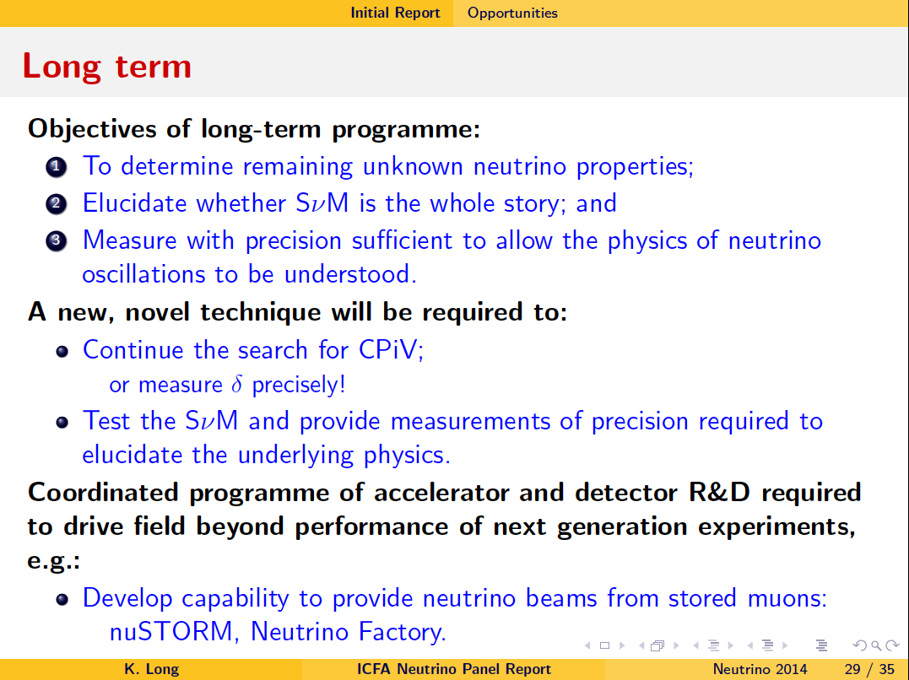
Delivering the capability
Present and next generation programme sufficient to:
  Determine the mass hierarchy; and
  Make an initial survey of the CPiV parameter space
arXiv:1405.7052

Slide 9
ICFA Neutrino Panel
arXiv:1405.7052
The demonstration of ionization cooling that MICE will provide is essential to lay the foundations on which a future Neutrino Factory [and Muon Collider] can be built.
  MICE is therefore at the heart of the accelerator R&D programme.

Slide 10
Overview
MICE briefing

Slide 11
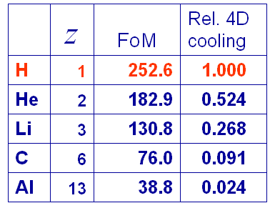
Ionisation cooling formalism
Exponential decrease in normalised emittance:
Competition between:
  dE/dx [cooling] and MCS [heating]
Optimum:
  Low Z, large X₀
  Tight focus
  H₂ gives best
  performance

Slide 12
Muon Ionization Cooling Experiment
MICE approved to:
  Design, build, commission and operate a realistic section of cooling channel
  Measure its performance in a variety of modes of operation and beam conditions
    Results will allow Neutrino Factory [and Muon Collider] complex to be optimised
Requirements:
  Normalised transverse emittance: 0.1%
    Requires selection of 99.9% pure muon sample
MICE

Slide 13
Reviews and recommendations
MICE briefing

Slide 14
Critical reviews, 2014:
May14:
  P5 recommendation:
    … consult with international partners on the early termination of the MICE muon cooling R&D facility.
Aug14:
  DOE review of MAP & MICE:
    Endorsed a reconfiguration of
    MICE that will yield the critical
    demonstration of ionization
    cooling by 2017.
Nov14:
  International review of MICE organised
  by host organisation, STFC:
    MICE Project Board and [international] Funding Agency Committee:
      Endorsed reconfiguration proposed by collaboration.

Slide 15
MICE cooling demonstration
Transmission
MICE:
demonstration of ionization cooling

Slide 16
“Step IV”; data taking 2015/16
Optimised for the study of material properties
that affect cooling

Slide 17
MPB and FAC; November ’14
Reconfiguration endorsed;
Schedule presented by the collaboration:
  Accepted as the basis of the “rebaselined” project;
Scientific programme endorsed
*
* Detector commissioning has started:
“Mock data run” week of 21Jan15

Slide 18
Status of construction
[Emphasis on Step IV]
MICE briefing

Slide 19
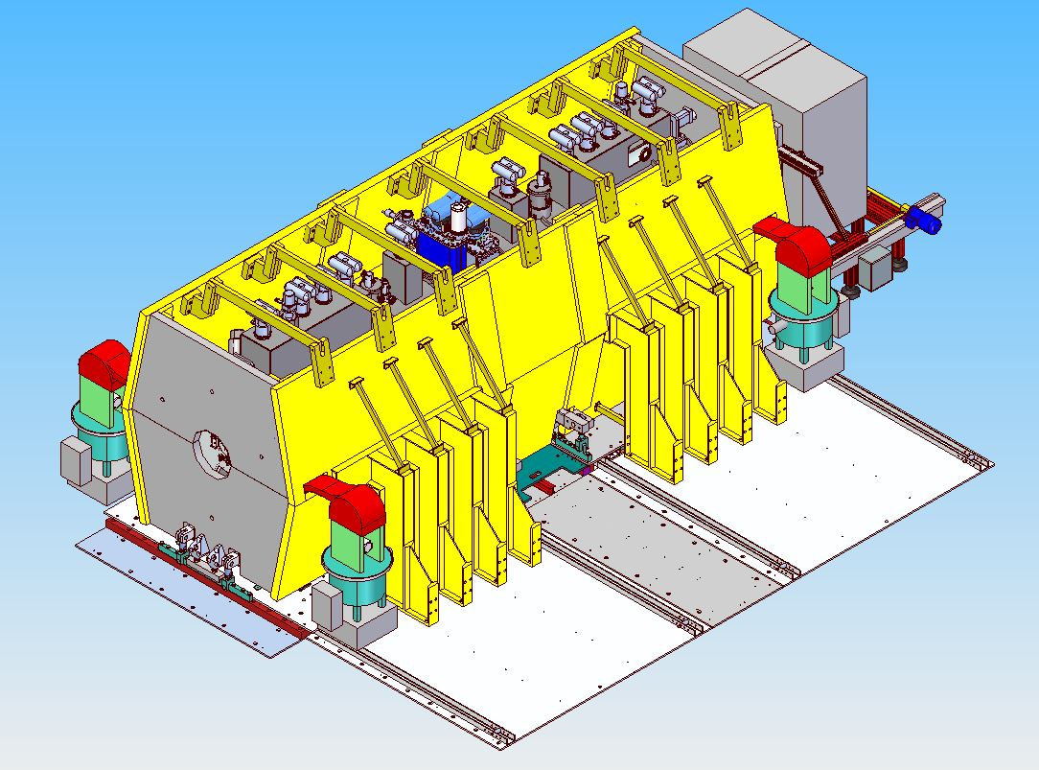
Step IV component status summary
Spectrometer solenoids:
  Upstream:
    Tracker fitted;
    Installed in MICE Hall
  Downstream:
    Tracker fitted;
    Installed in MICE Hall
Focus coil:
  FC1:
    Available at RAL
  FC2:
    Installed in MICE Hall
Partial return yoke:
  Material procurement complete;
  Installation of “below-floor” structures well advanced;
  Above-floor framework complete (at Keller Tools Inc., NY);
  Shielding plates being machined

Slide 20
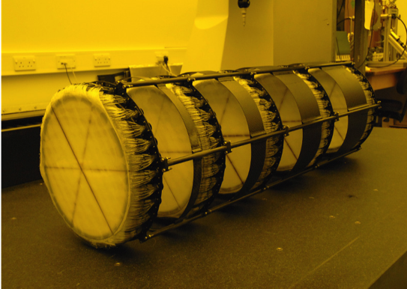
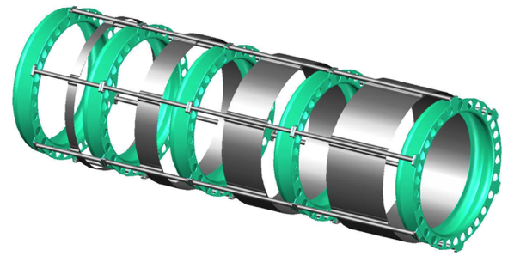
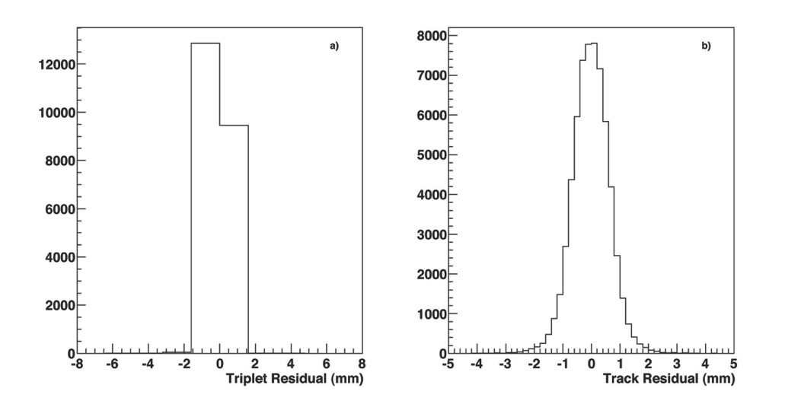
MICE trackers
Nucl.Instrum.Meth. A659 (2011) 136-153
350 μm scintillating-fibre tracker:
  10 p.e./mip demonstrated with cosmics
  470 μm intrinsic resolution per plane
MC: delivers per-mille level emittance measurement

Slide 21
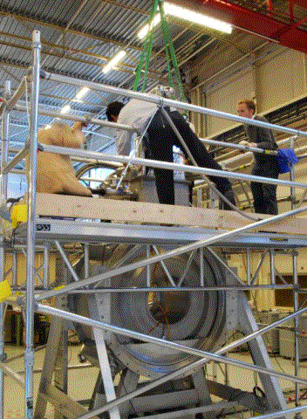
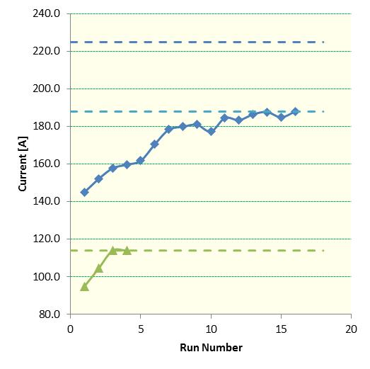
Focus coil:
Focus coil #1:
  “Solenoid mode”:
    Trained to full current
  “Flip mode”:
    Reached nominal current
      Estimate stable operation at
      11%—15% de-rated current
    Sufficient to support programme
Focus coil #2:
  Trained to full current in solenoid and flip modes
  Installed on the beam line for Step IV

Slide 22
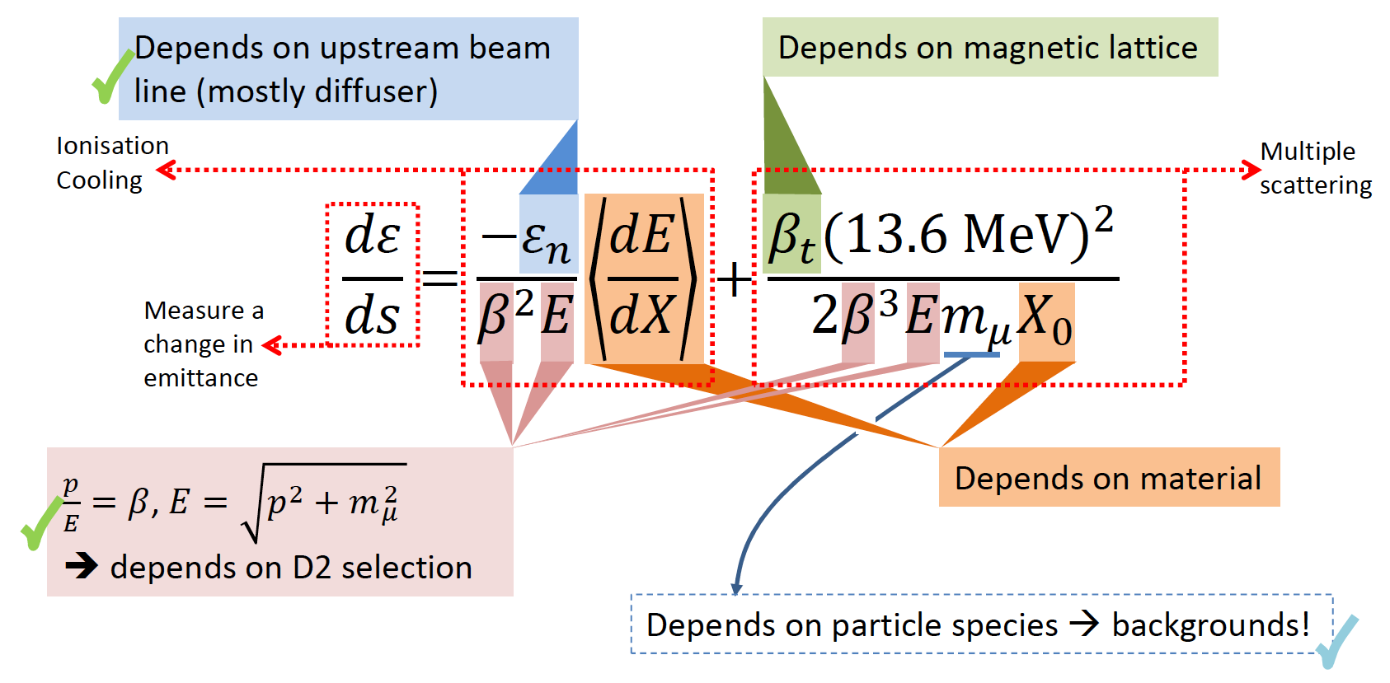
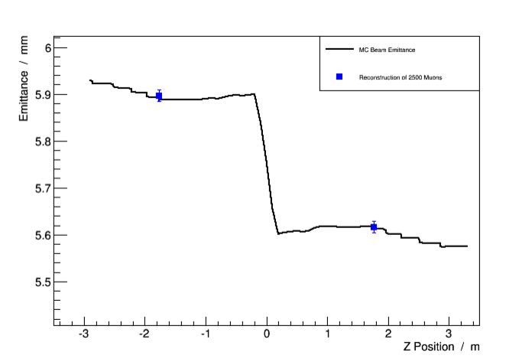
Step IV; scoping the “cooling equation”
Paraxial approximation:
Emittance:
  Varied through MICE Muon Beam optics and diffuser settings
Material:
  Absorber change (LH2; LiH);
p, E and β:
  Vary beam momentum, optics
Study of material, lattice, momentum and emittance (Step IV) will start summer 2015.

Slide 23
Demonstration of ionization cooling
Ionization cooling demonstration:
  Status of preparation of components:
  Cooling demonstration configuration complete: summer 2017
Sub-system | Responsibility
Focus coil #1 and #2 | UK
Primary LiH absorber | US
Secondary LiH absorbers | US
Single cavity modules | US
Two, 201 MHz, RF power systems | UK
Partial return yoke | UK, US
Infrastructure | UK
Known procurement
First cavity under test in MTA
First system commissioned
Responsibilities agreed
Much already implemented

Slide 24
Conclusions
MICE briefing

Slide 25
MICE collaboration [1]
3 regions
8 countries
30 institutes
63 PhD-level
physicists/
engineers *
* Common Fund levy

Slide 26
MICE collaboration [2]
MICE is attracting new groups:
  China:
    IHEP and Sichuan University
  Serbia:
    University of Belgrade
  US:
    New York Institute of Technology
Funding:
  Continuation of funding confirmed in:
    Bulgaria, CERN, Italy, Netherlands, Switzerland
  Bids for continuation of funding required in:
    UK; STFC funding cycle, new award required 01Apr16
    EC; funds to allow Europeans to travel to MICE to be included in EUCARD3
  New bids for funding:
    Proposal to H2020 for an Initial Training Network in preparation;
    Bid to NSF (Kaplan et al) in preparation
      Collaboration will be scientifically impoverished and US will not reap the full benefit from its intellectual, technical and financial input to the project without continued support through the operations and analysis periods.

Slide 27
Conclusions
Muon accelerators have the the potential to:
  Revolutionise the study of the neutrino
  Provide a route to multi-TeV lepton-antilepton collisions
MICE:
  Will prove the essential ionization-cooling technique
  Has been rebaselined through the November 2014, international, MPB and FAC reviews
    Study of the factors that affect ionization cooling (Step IV):
      Construction complete: Spring 2015
      Data taking: Summer 2015—June 2016
    Demonstration of ionization cooling:
      Construction complete: Early 2017
      Data taking start: Spring 2017
Poised to deliver the demonstration of ionization cooling

