Slide 1
The DOE Supported Effort to Complete the MICE Ionization Cooling Demonstration
Mark Palmer
Fermilab
January 7, 2015

Slide 2
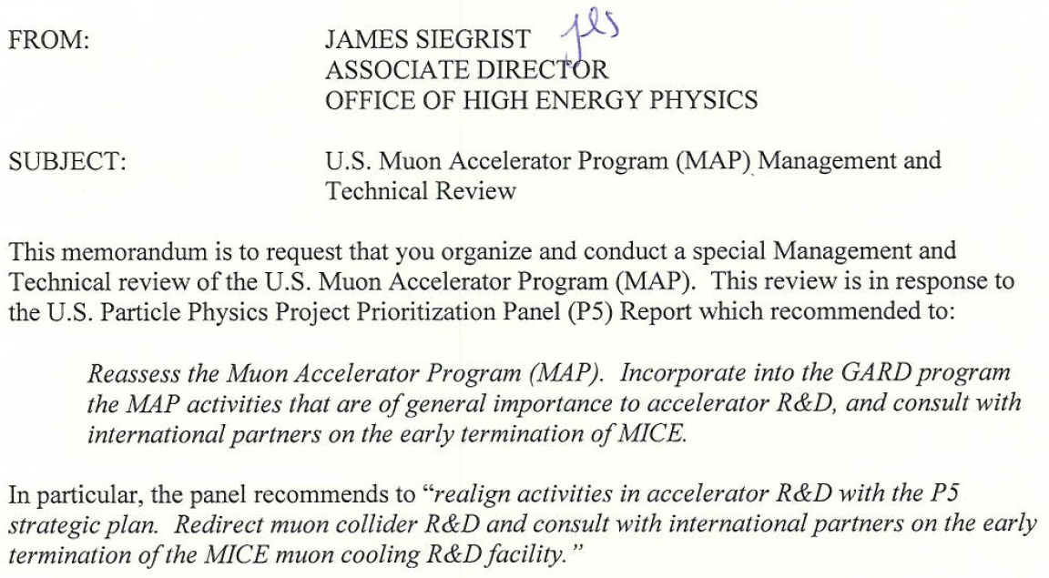
Preface
After the P5 recommendations, Jim Siegrist requested a review to determine how to handle the MAP recommendations:

Slide 3
The Review – I
A review, with an internationally recognized committee of accelerator and project management experts, was convened August 12-14
Reviewers:
Howard Gordon, BNL
Leigh Harwood, TJNAF
Erk Jensen, CERN
David McGinnis, ESS
Ian Robson, STFC
Claus Rode, TJNAF
Mike Syphers, FRIB/MSU
Tom Taylor, CERN
Mark Thomson, Cambridge Univ.
Bruce Strauss (Chair), DOE
Observers:
Mike Procario, DOE
L.K. Len, DOE
Charlotte Jamieson, STFC-UK
Don Hartill (HEPAP Accelerator R&D Sub-Panel), Cornell
MAP/MICE position
A successful conclusion of the MICE effort requires the demonstration of ionization energy loss combined with RF re-acceleration of the muons (the complete cooling process)

Slide 4
MICE Steps IV & V
Plan endorsed by MICE Project Board in April 2014
Legend:
-SS = Spectrometer Solenoid-
-FC = Focus Coil-
-AFC = Absorber-Focus Coil Module-
CCM = Coupling Coil Magnet
-RFCC = RF-Coupling Coil Module-
Operational 2015
-Absorber-
-Tracker1-
-FC-
-Tracker2-
MICE Step IV Configuration
-SS1-
-AFC-
-SS2-
Operational 2018
-Absorber1-
CCM
-Absorber2-
MICE Step V Configuration
-Tracker1-
-FC1-
-FC2-
-Tracker2-
-SS1-
-AFC1-
-RFCC-
-AFC2-
-SS2-

Slide 5
The Review – II
Outcome – the committee felt that:
MICE Step IV would be readily achievable within the DOE budget guidance
MICE Step V remaining risks too great to guarantee data by the conclusion of the proposed budget profile
Potential for delay too large due to construction risks (particularly the novel RFCC module)
Potential lack of US experimental involvement after hardware deployed
An alternative optics with a simplified RF system and no coupling coil was presented and endorsed by the committee
Reduced risk and ability to be taking data for the cooling demonstration by mid-FY17
BUT on the condition that a detailed study to confirm the performance could be provided on a 1-month timescale
Initial report provided to DOE and the committee on Sept 15, 2014 with a final version on Sept 25, 2014. Public version (budget information removed) available at:
Revised Completion Plan for the Muon Ionization Cooling Experiment (MICE) at Rutherford Appleton Laboratory
Suitability for completing the demonstration of ionization cooling confirmed
Plan and budget profile endorsed by DOE and conclusions transmitted to HEPAP on Sept 29, 2014

Slide 6
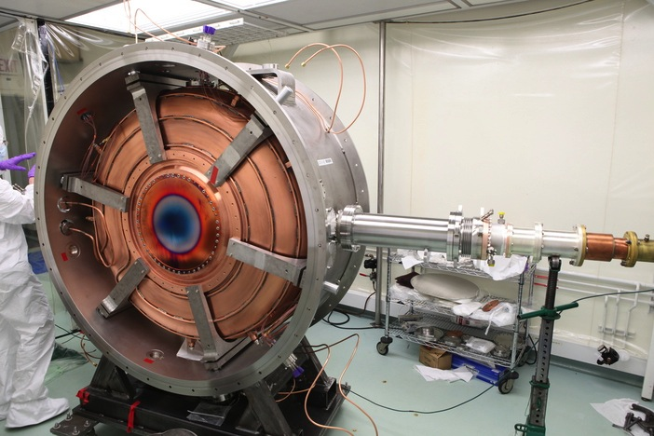
Expedited Muon Cooling Demonstration
Plan developed in response to P5 recommendations
Legend:
-SS = Spectrometer Solenoid-
-FC = Focus Coil-
-AFC = Absorber-Focus Coil Module-
-RFA = RF-Absorber Module-
Operational 2015
-Absorber-
-Tracker1-
-FC-
-Tracker2-
Represents reduced cost and technical risk relative to MICE Step V
-SS1-
-AFC-
-SS2-
Operational 2017
Secondary
-Absorber1-
Secondary
-Absorber2-
Primary
-Absorber-
NEW Expedited
MICE Final Configuration
-Tracker1-
-FC1-
-FC2-
-Tracker2-
-SS1-
RFA1-
-AFC1-
-AFC2-
RFA2-
-SS2-

Slide 7
Moving Forward (DOE Effort) - I
US Construction Project
Both spectrometer solenoids passed their acceptance tests and were delivered to RAL
Now on the floor in the MICE Hall
With Scintillating Fiber Trackers installed in their bore
LiH Disk Absorber delivered to RAL
Needed for Step IV and Final Step
Partial Return Yoke (PRY) Magnetic Shield
Step IV PRY in final stages of fabrication at Keller Technologies
Complete delivery to RAL by early Spring
Final Step PRY conceptual design complete (simple extrapolation of Step IV design) and moving into full engineering stage
Anticipated delivery to RAL by May 2016
Long lead material orders being prepared now
RF modules
2 production modules required for Final Step
Prototype module of essentially identical design being tested at Fermilab’s MuCool Test Area (MTA)
Basic cavity characterization complete (no B-field)
Setting up for tests in magnetic field now (expected to continue through summer 2015)
Note: Production modules essentially identical to prototype being tested
US Construction Budget: $13.4M
Includes all risk and contingency

Slide 8
Moving Forward - II
MICE Experimental Support
Allocated Budget: $3.33M over 3 years
DOE Team:
Primary focus is on supporting research staff required to operate key US systems
Examples:
P. Hanlet, IIT: MICE Integration Scientist, Controls & Monitoring Head
D. Rajaram, IIT: MICE Software Coordinator
Post Doc, FNAL: SciFi Tracker Readout
Realistically, less than 50% of the DOE experimental funds expected to support general analysis efforts
An unequaled opportunity exists for NSF to enable US exploitation of the unique data that will be produced at MICE!
Reap the benefits of the large investment that has been made by both NSF and DOE
And pave the way for
Future high precision long baseline neutrino capabilities
And possibly for multi-TeV lepton collider capabilities if a need is demonstrated by future LHC results

Slide 9
Conclusion
MICE is ready to start collecting its unique data sets in a few months
Step IV data-taking: August 2015 – June 2016
Final Step data-taking: Beginning Spring 2017
Dan Kaplan will outline a modest proposal that would enable US experimenters to play a lead role in exploiting these data sets
Leverages a significant US investment
Will guarantee that the US can make an informed decision about accelerator capabilities required in the mid- to far-term
I sincerely hope that NSF will seriously consider reconnecting to this effort with which it has previously been an integral funding agency participant

