Slide 1
Technical Status: Recent changes & plans
Ewa Skup
January 29, 2015

Slide 2
Outline
Beams available
Beam instrumentation
Beam enclosures and mechanical support
Data acquisition and user support

Slide 3
Beams
Time structure:
  4.2 seconds long spill every 1 minute
  19 nsec RF buckets
  24 hours/day
Primary
120 GeV protons
Secondary
Composition is momentum dependent
1-60 GeV: positive beam pions/protons/kaons/positrons or muon
negative beam pions/kaons/electrons or muons
Tertiary
200 MeV -1 GeV: pions/protons/kaons/electrons and muon
Particle identification information (Cerenkov and TOF used to tag the secondary particles)

Slide 4
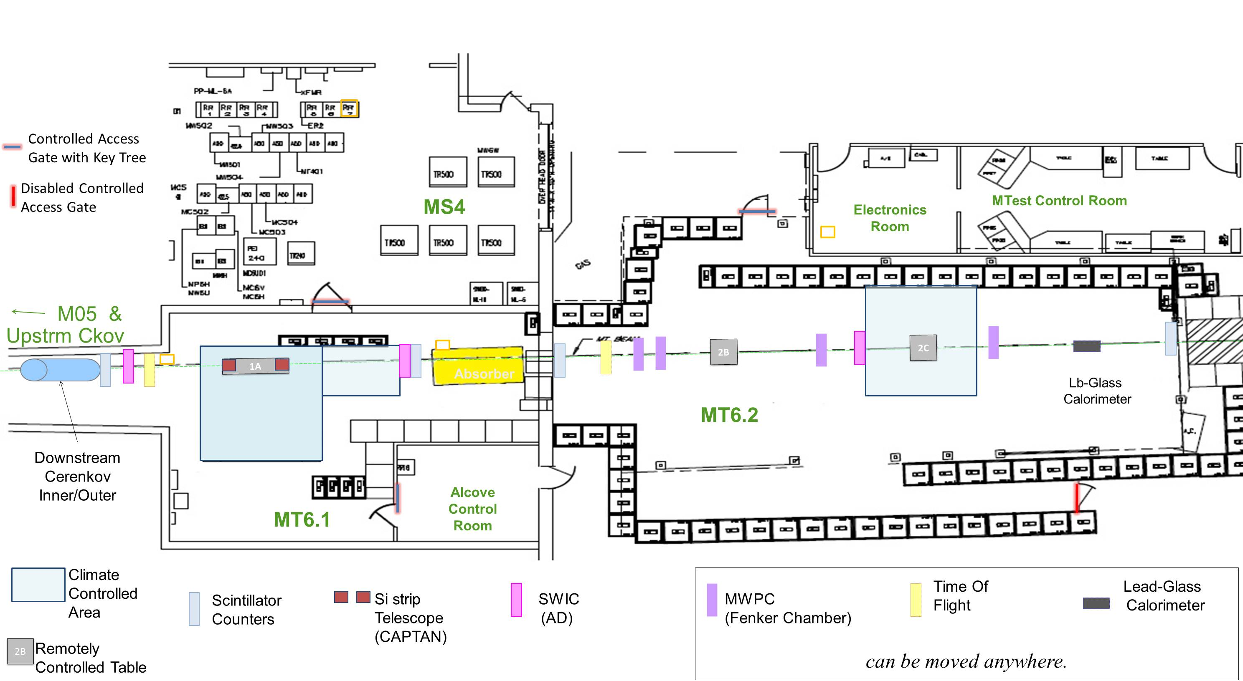
Beam Enclosures

Slide 5
Instrumentation at FTBF
Triggering
  Scintillating Counters
Tracking/position
  MWPC Tracking System
  Silicon Telescopes
Particle identification
  Cerenkov Detectors
  Lead Glass Calorimeter
  TOF
Mechanical support
  Motion Tables (computer controlled)

Slide 6
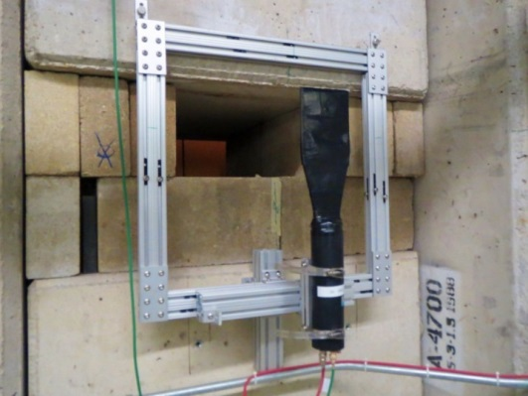
Scintillating Trigger Counters
Four 4 x 4 inches (10.2cm x 10.2 cm)
Trigger (Coincidence of 3 counters) and individual
signals available to users
Improved signal/noise ratio
SC1
SC2
SC3
SC4
Upstream
Beamline
Downstream
Distances between counters
10.47m
4.63m
21.15m
Length of signal
cable from
Counter to
Electronics Room
221 ns
195 ns
208 ns
114 ns

Slide 7
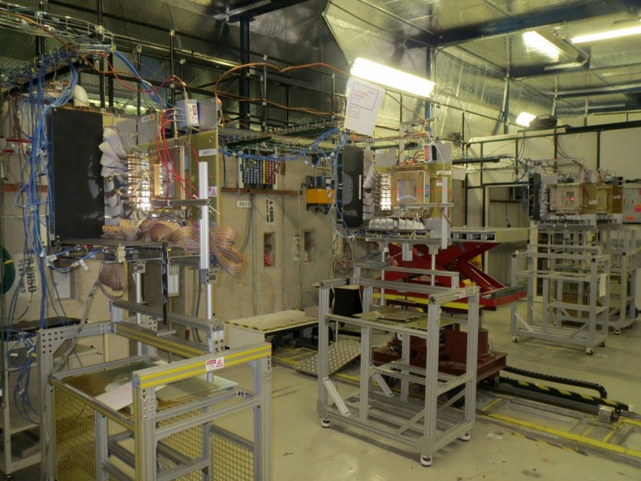
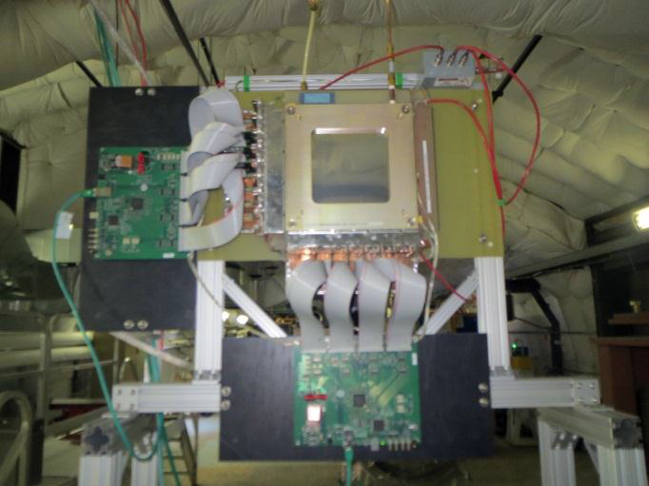
MWPC Tracking System Upgrade:
Beam Particle Position and Direction
MTest – 4 wire chambers
MCenter– 4 wire chambers
Readout electronics
Data Acquisition
Track reconstruction and diagnostic software

Slide 8
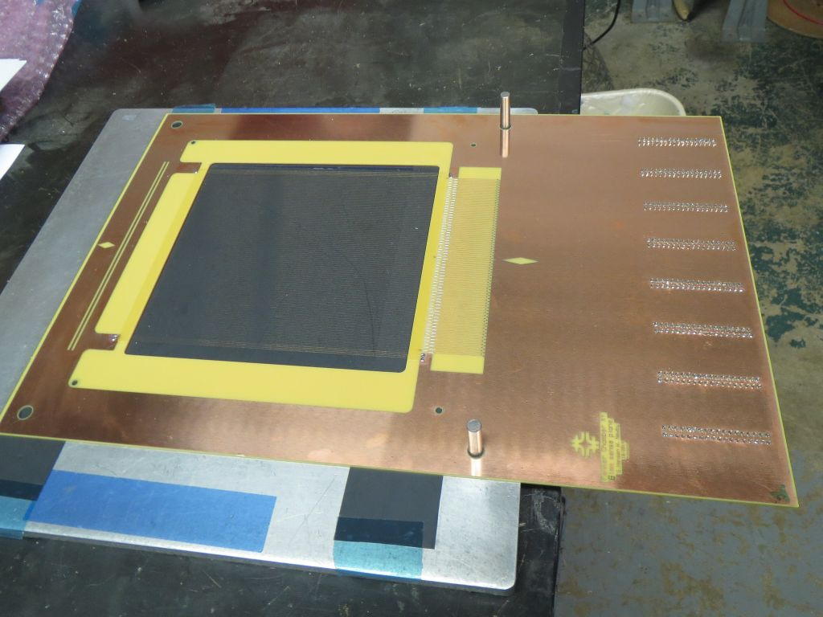
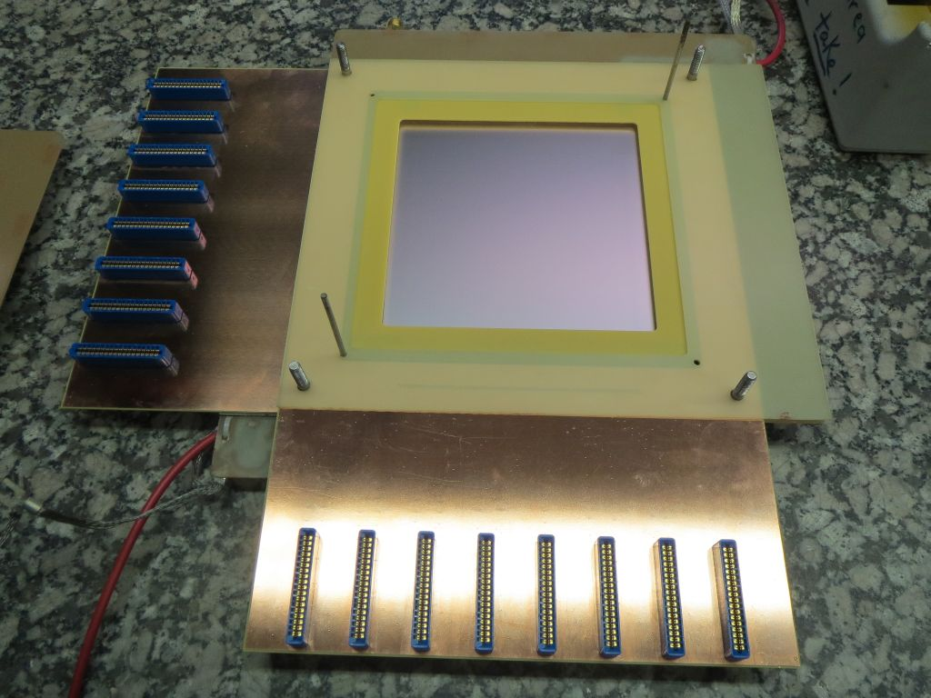
PC board layouts modified with more careful ground layouts and plated through holes.
New Layouts passed first round of testing.
Fabrication of a few of chambers with this new PCB layout possible shortly.

Slide 9
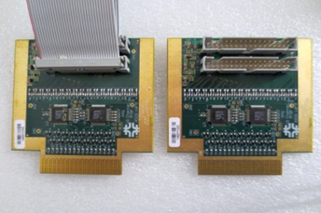
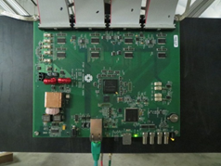
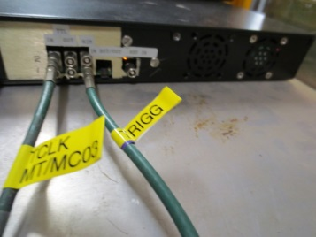
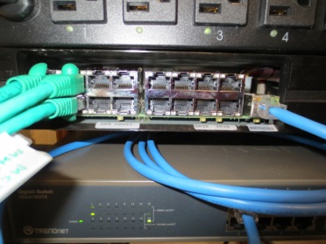
MWPC readout electronics
16 channel amplifier/discriminator cards
64 channel TDC cards
Controller capable of reading out 16 TDCs
Cat-5 cable connecting TDC with the controller and
used for both data communication and power delivery

Slide 10
MWPC System Architecture
Spill
Linux Computer
MWPC 1
(4 TDCs)
Trigger
GUI for Configuration
(python/Qt)
MWPC 2
(4 TDCs)
Readout
Controller
(16 TDCs)
DAQ
(python script)
MWPC 3
(4 TDCs)
Ethernet
connection
to FTBF
network
MWPC 4
(4 TDCs)
Files
120V AC

Slide 11
Improvement?
Linux Computer
Accelerator Division
Readout
Controller
(16 TDCs)
DAQ Server
User DAQ
FTBF Monitoring

Slide 12
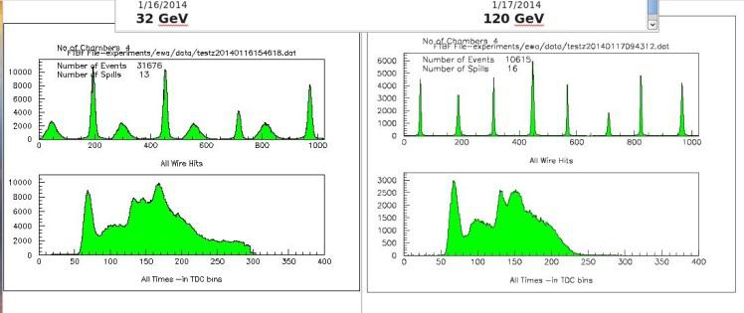
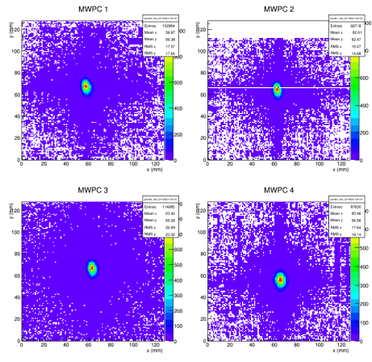
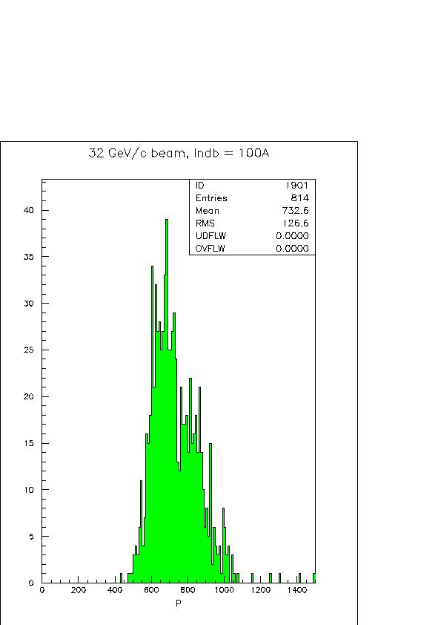
Wire Chambers analysis packages available to users to analyze and visualize the beam phase space. Examples
Raw hits information
Momentum
Distribution
MCenter
Beam position MTest

Slide 13
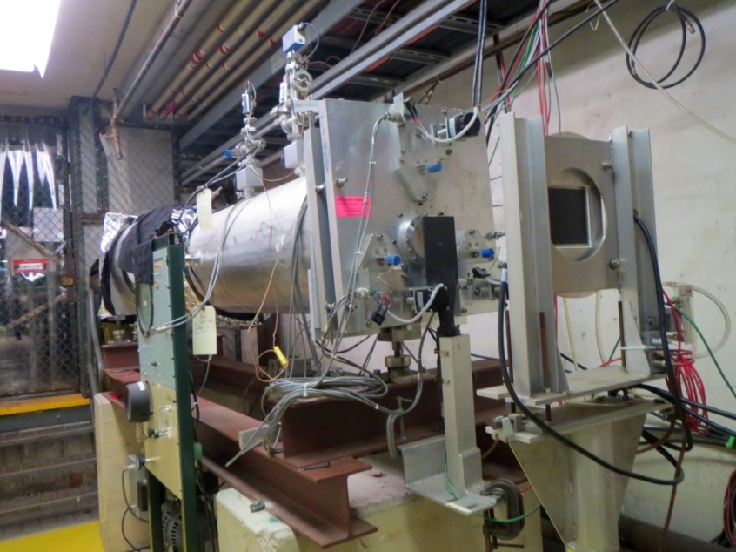
Cerenkov Detectors
Signals amplified inside enclosure to improve signal to noise ratio
Signals available in electronics room and in MT6_2 enclosure
Automated pressure scans using ACNET information (in progress)
Downstream Cerenkov
Differential
Upstream Cerenkov
Threshold
Testing starting this month

Slide 14
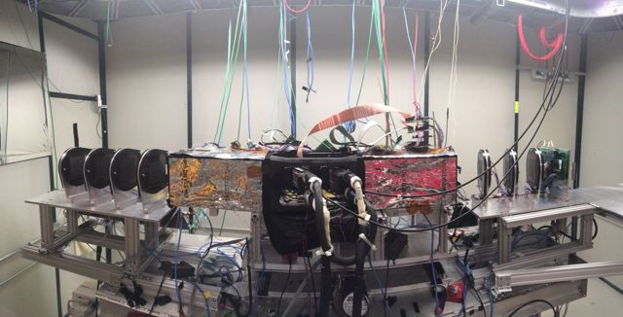
Silicon Telescopes: High Resolution Tracking Info
Silicon Strip Telescope
Pixel Telescope
Plan to retire pixel telescope as soon as commissioning of the strip telescope is finished
- DAQ works with user’s trigger
- Plan to run wire chambers and silicon telescopes with the same trigger to determine the resolution of wire chambers

Slide 15
Silicon Pixel telescope:
  8 XY pixel planes (pixel pitch 100x150 μm²)
  Planes rotated by 25 degrees to maximize charge sharing
  Resolution on the Detector Under Test placed in the middle down to 8 μm with 120 GeV proton beam
  Coverage area 1.6x1.6 cm²
Silicon Strip telescope:
  7 X and 7 Y strip planes (strip pitch 60 μm)
  X Planes rotated by 15 degrees to maximize charge sharing
  Resolution on the detector Under Test when placed in the middle is 4 μm with 120 GeV proton beam
  Coverage area is 4x4 cm²
  Upstream and downstream parts are separated leaving plenty of space for placing large DUTs detectors in the middle

Slide 16
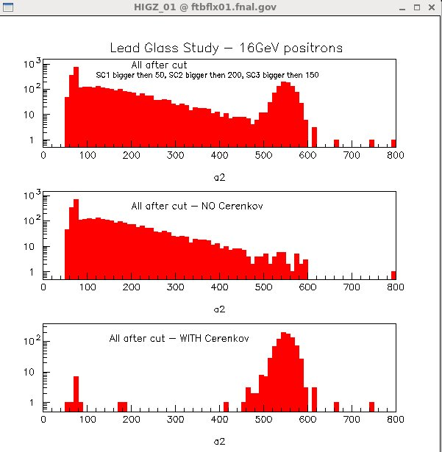
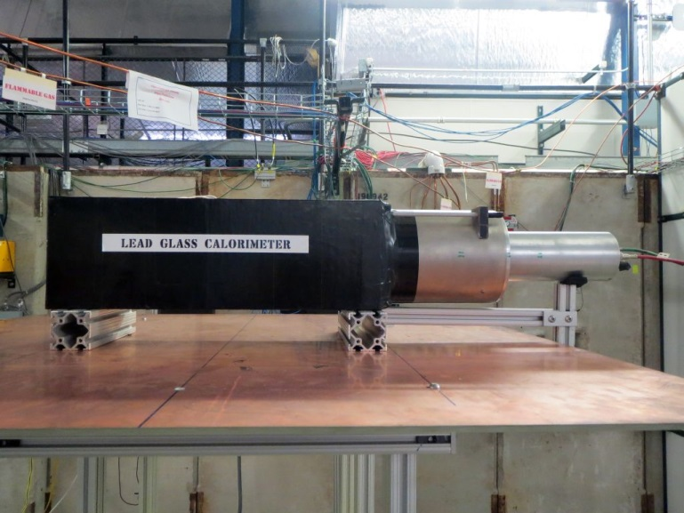
Lead Glass Calorimeter
Energy distribution of electrons identified with the help of Cerenkov

Slide 17
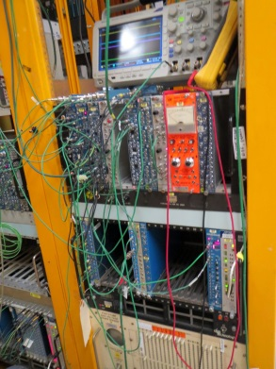
New Instrumentation Diagnostic System
Consists of Camac and C program reading ADCs, TDCs, Scalers
Used last month for characterization of Lead Glass Calorimeter #1 (finding optimal HV for different beam energies)
Testing of Lead Glass Calorimeter #2 starts this week
Forthcoming wire chamber information data. (Possibility of correlation of the particle position and the energy)

Slide 18
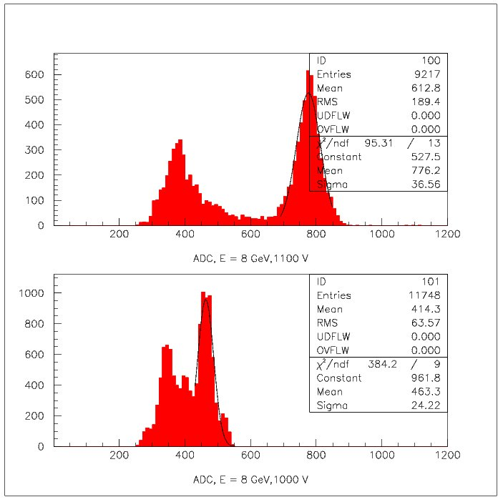
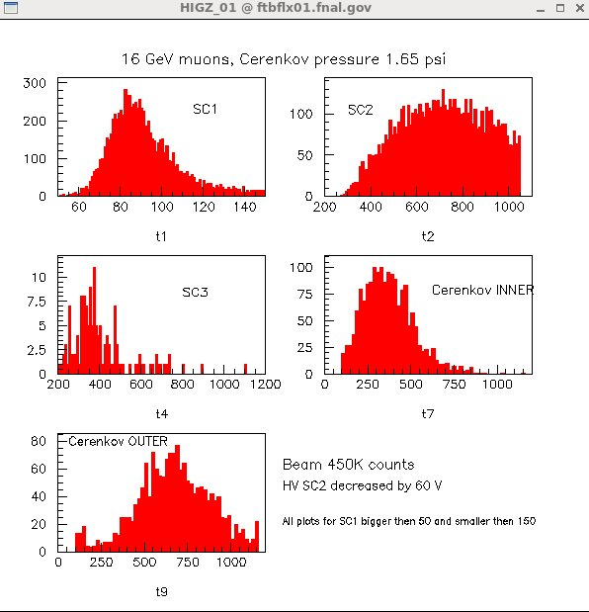
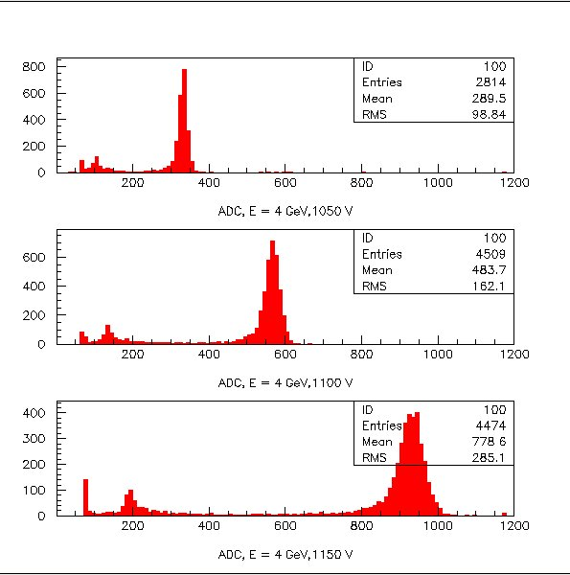
Examples of the beam characterization analyses
Lead Glass HV scan, before noise reduction
Lead Glass HV scan, after noise reduction

Slide 19
Time of Flight
10 ps TOF system (existing at Fermilab) using Photek 240 tubes not easily accessible to users.
200 ps TOF used in the past at MTest taken apart last year and installed at MCenter as LAriat TOF
New TOF being developed currently at FTBF for Minerva’s second testbeam run.

Slide 20
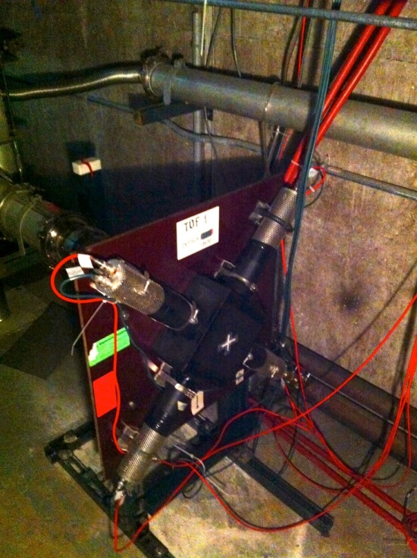
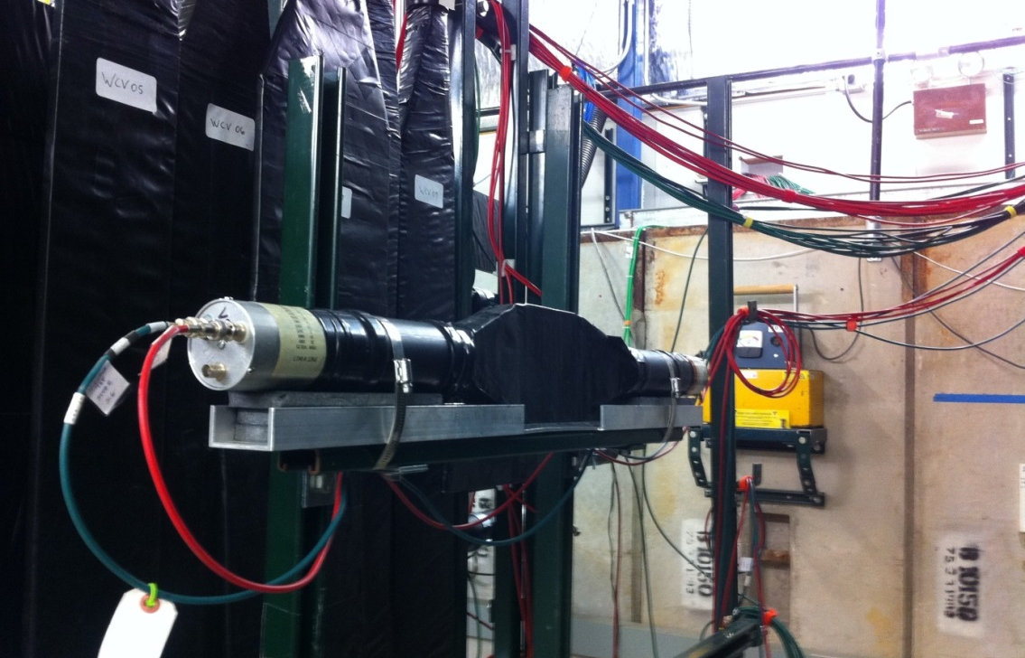
Minerva’s Time of Flight - Description
Upstream station
Location – at M03-4
88 m from MT6.2
5 mm PVT based scintillator
4 fast PMTs
Downstream station
Location – at MT6.2D
In front of Minerva setup
25.4 mm PVT based scintillator
2 PMTs
Readout electronics – constant fraction discriminators and TDC modules

Slide 21
Motion Tables
Motion table control at FTBF evolved during the past year.
Within the original ACNet Console, the controls for each motion table were relocated so that each of 4 tables is now on its own individual screen.
ACNet screens were augmented with orientation and range of motion information specific to each table.

Slide 22
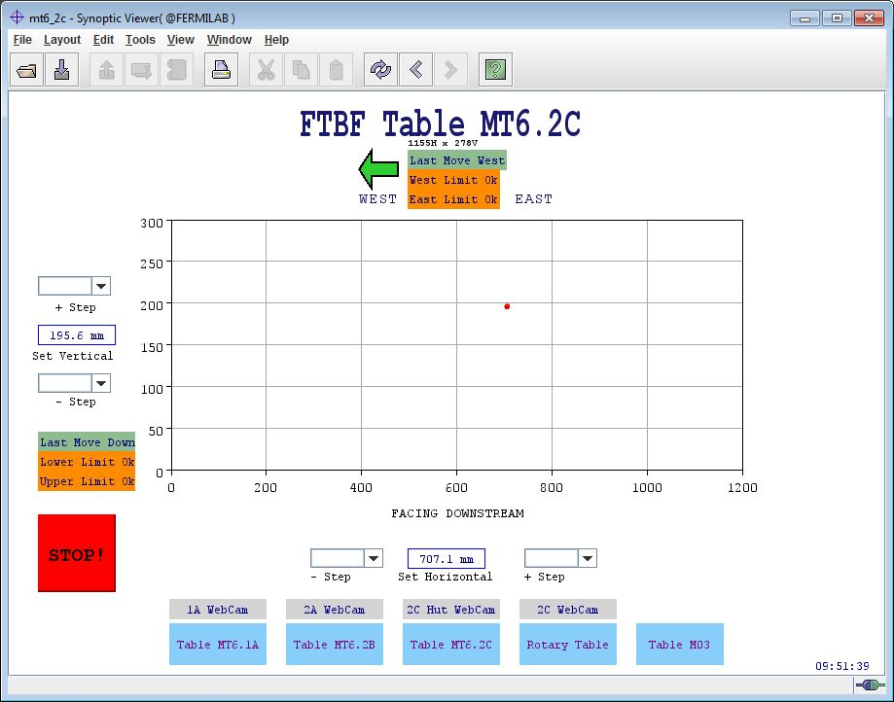
New Graphical Interface
New interface for motion table control was developed using Synoptic.
Synoptic system easier to navigate and less confusing for new users to learn.

Slide 23
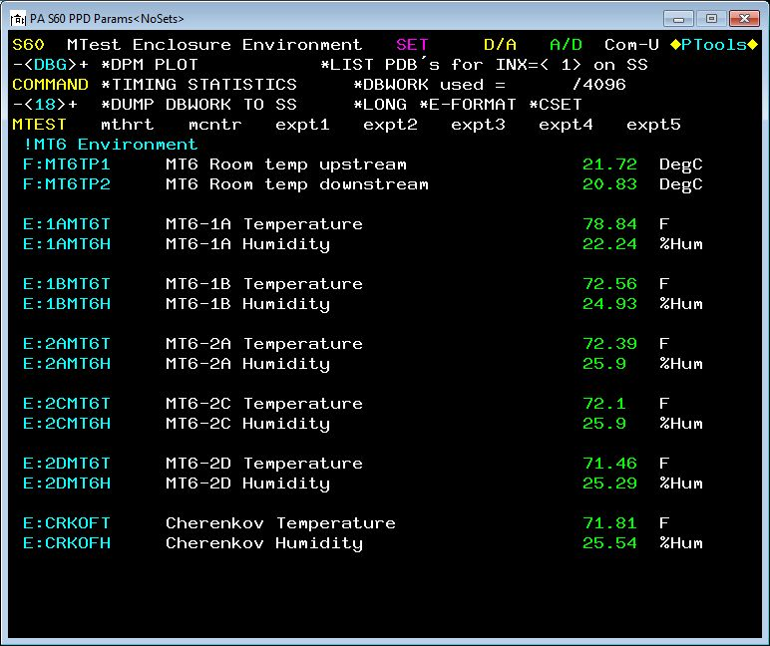
Humidity and Temperature sensors installed in the various areas at MT6 and MC7 were included on Acnet

Slide 24
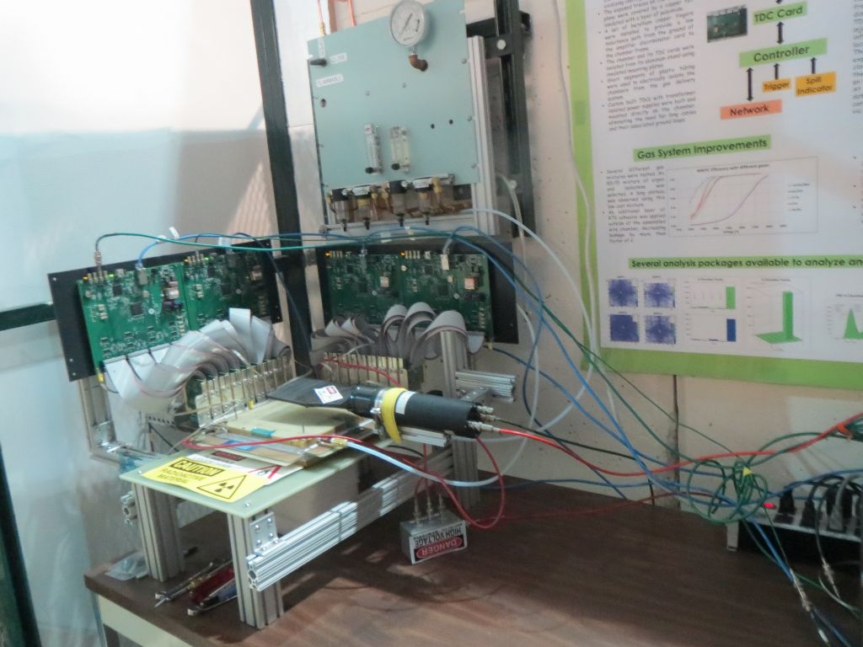
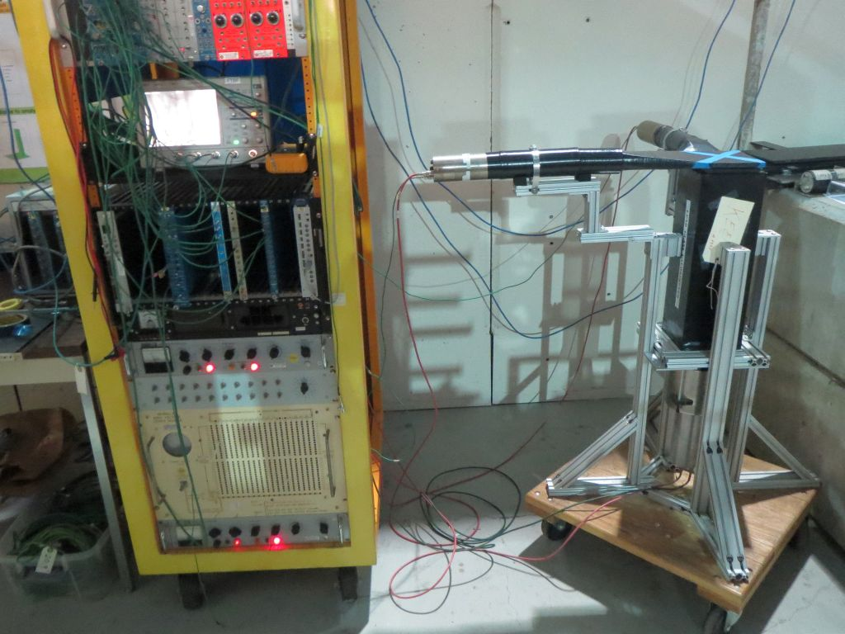
New Testing Area
Lead Glass and Camac - cosmic ray setup, DAQ development
Setup for Initial wire chamber testing

Slide 25
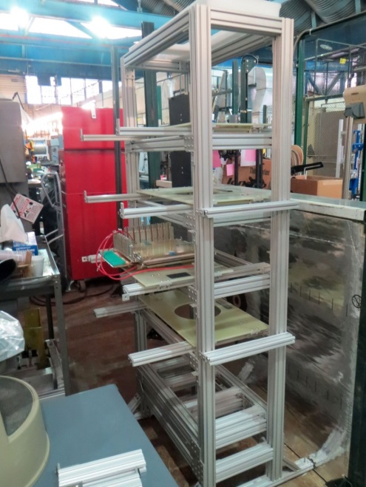
Plans for future
Confirm muon beam rates and size for 4, 8, 16, 32 GeV. Compare with muon G4Beamline simulation.
Automated Cerenkov pressure scans using ACNET information for both Cerenkovs.
Test and document Minerva’s TOF.
Build MWPCs with UV planes to handle multi-track events.
Build Cosmic Ray telescope using 4 wire chambers.
New Structure for Cosmic Ray Telescope

Slide 26
Possible future developments
Building drift chambers
fewer wires (lower mass )
higher resolution (~50 micron ?)
larger aperture ( 32 cm vs. 12.8 cm for the existing chambers )
New NIM module (work in progress - EE hardware, CD software)
- accept up to 24 inputs ( PMT, NIM, TTL )
- use fpga for:
complex trigger decisions
timing the signals ( TDCs )
saving information to a buffer and read out to a computer at the end of a spill
- friendly user interface that has 'look and feel' of a NIM bin.

