Slide 1
Physics at Fermilab Test Beams
Erik Ramberg
29 January, 2015

Slide 2
Test Beam Facility
A critical resource for Detector R&D efforts taking place across the entire HEP community (both in US and beyond)
Allows researchers access to unique particle beams for testing their prototype detectors. (The most versatile test beam in the world?)
Facility infrastructure (e.g. beam instrumentation, gas and high-voltage delivery systems, and an adaptable data acquisition system) allows researchers to conduct their required detector testing in an efficient and straight-forward manner
Facility experts provide guidance to users on configuring particle beams, interfacing to infrastructure systems, and navigating lab safety requirements

Slide 3
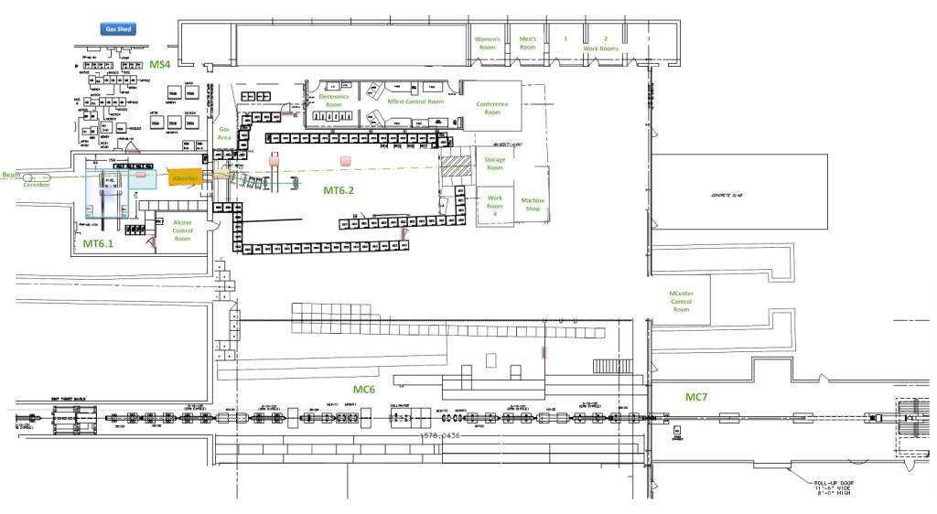
MCenter and MTest Beamlines at the Fermilab Test Beam Facility
Tertiary beam moved to MC7
The electronics and control room in the MWest stub
Installed cable
route for users
Walkway to access MC7
This section of pipe has been removed. Tertiary spectrometer for LariaT is here.

Slide 4
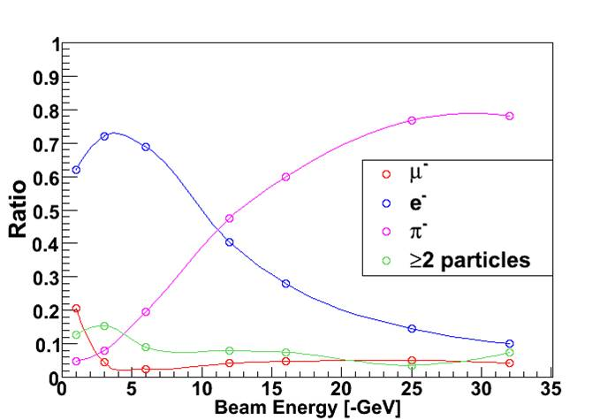
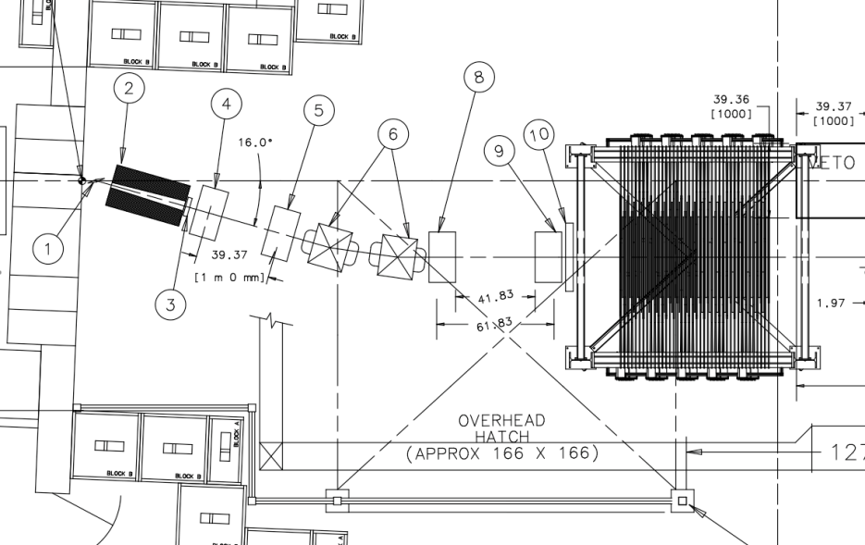
Beams
120 GeV proton beam with 7mm spatial spread, 100 μrad divergence, and tunable rate (100 Hz to 100,000 Hz).
Tunable secondary beams (1- 66 GeV). Beam composition and spread are a function of beam energy
Secondary target and tertiary beam spectrometer for low energy (below 1 GeV) particle beams (MINERVA in MTest shown)

Slide 5
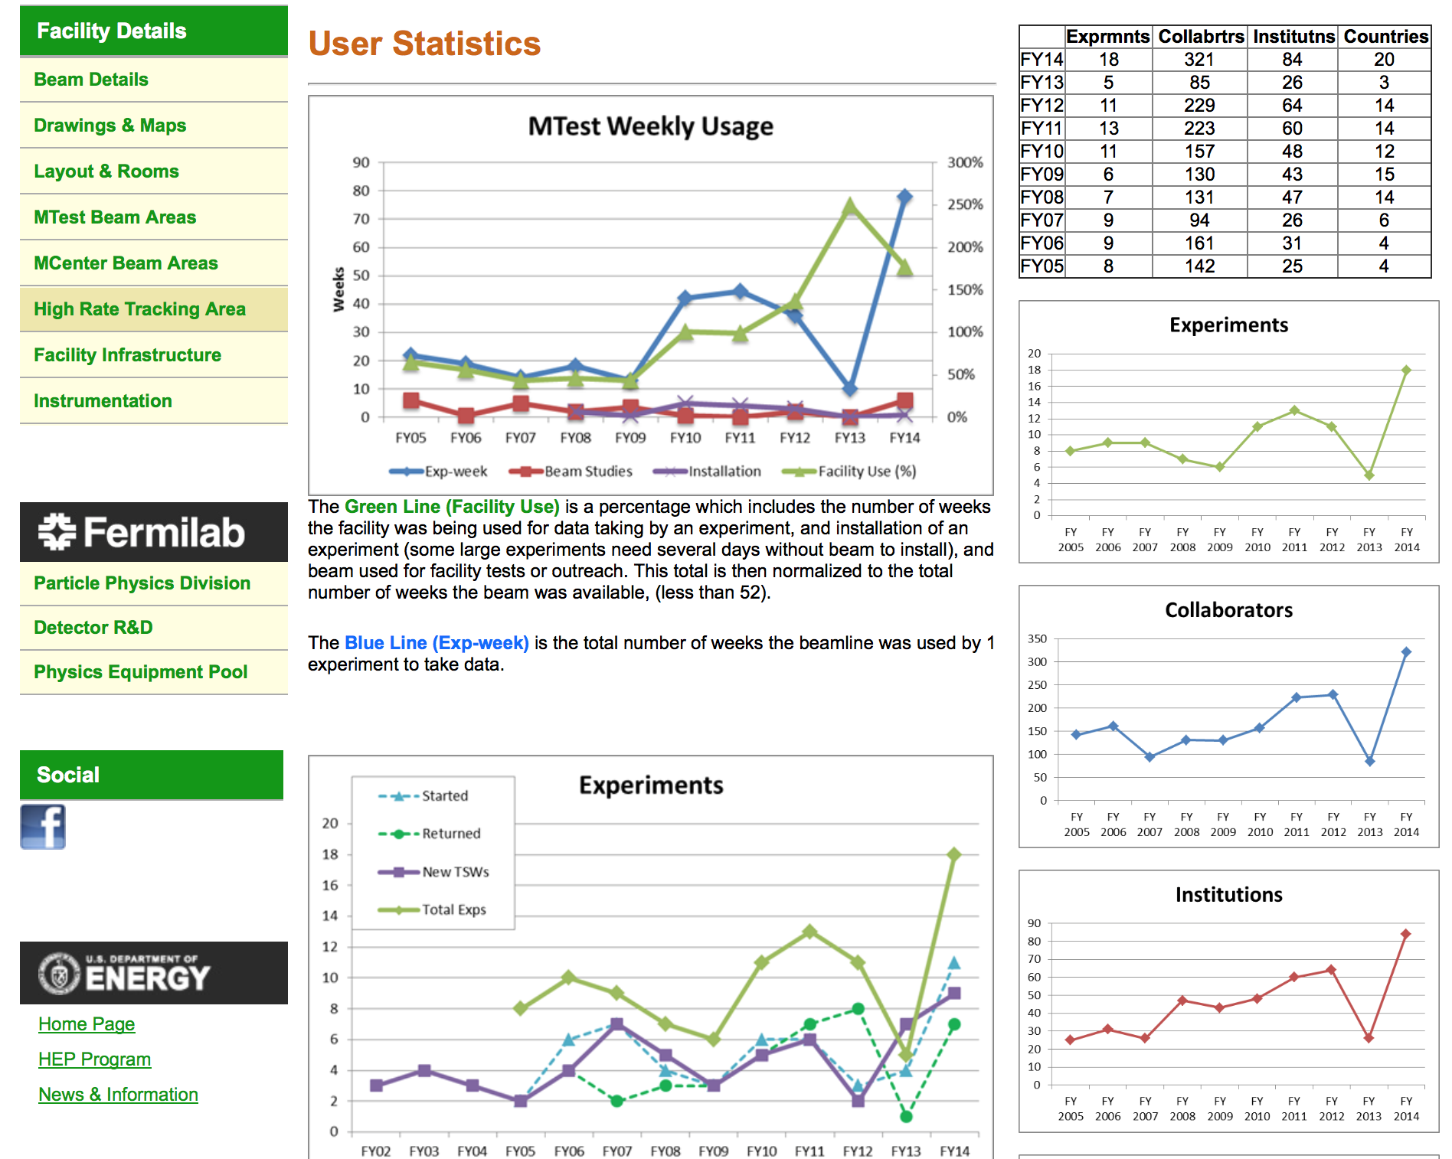
Surge in users, many of which came
from Europe, due to LHC shutdown

Slide 6
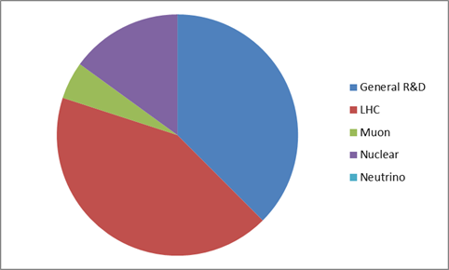
Test Beam Users (FY2014)
T1015 DRO Calorimetry
T1037 FLYSUB-Consortium
T958 FP420 (CMS+ATLAS) Fast Timing Group
T979 Fast Timing w/Cherenkov Counters
T989 DAMIC
T1058 Secondary Emission Calorimeter
T1031 Atlas Tile Calorimeter Electronics
T1036 CMS High Rate Pixel Detector
T1041 CMS Forward Calorimetry
T1049 ATLAS large scale TGC
T1056 ATLAS DBM Module Qualification
T992 Radiation-hard Sensors for the SLHC
T1042 Muon g-2 straw tracker
T1018 Spacordion Tungsten Fiber Calorimeter
T1044 sPHENIX
T1048 PHENIX fast TOF
T1054 sPHENIX Pre-Shower Calorimeter
T994 JASMIN
Two Large Neutrino experiments on schedule for FY15: MINERvA & LAriaT
Good distribution of physics topics

Slide 7
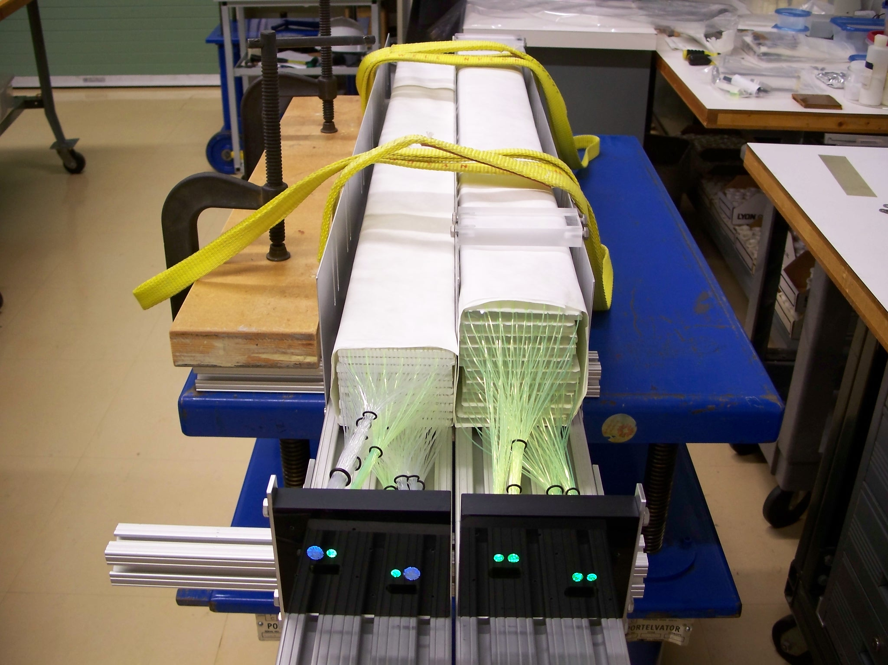
Dual Readout Calorimetry
The two ADRIANO 2014 detectors designed for dual readout/total absorption for high energy experiments were tested at MTEST beam.
Their dimensions (10 cm x 10 cm x 105 cm) correspond to about 3.3 interaction lengths.
Being a dual-readout and totally active calorimeter (no passive absorber of any sort) they are expected to ultimately provide an hadronic energy resolution of the order of 30%/sqrt(E)
Light yield from these modules was good for both scintillation and Cerenkov light.
T1015

Slide 8
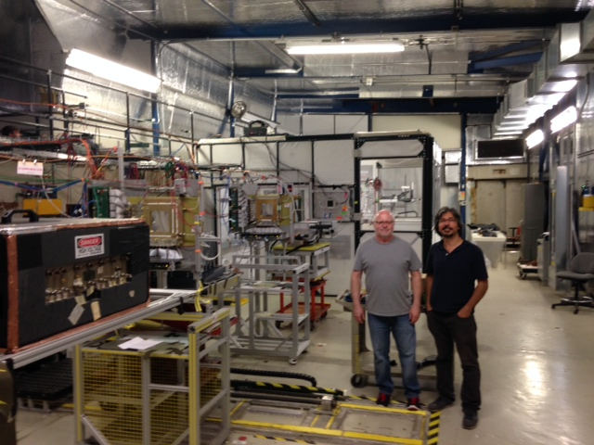
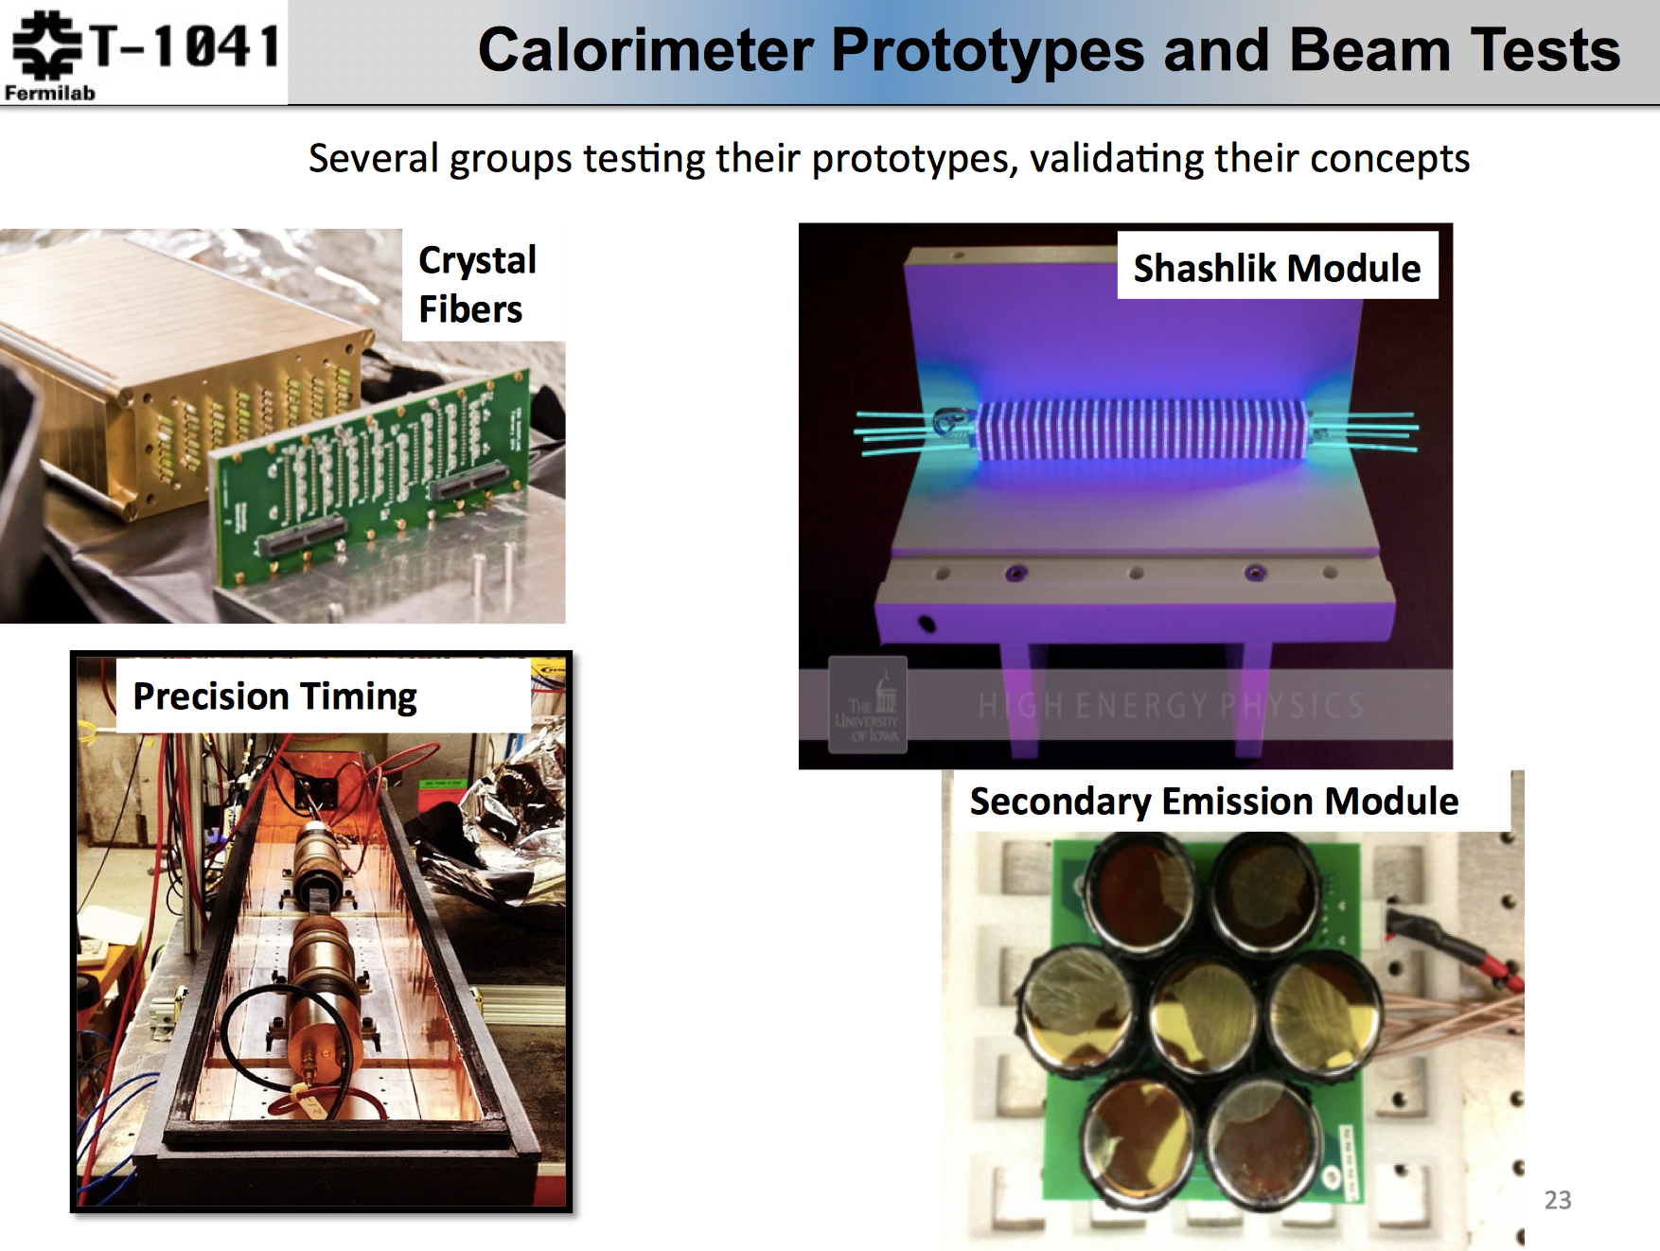
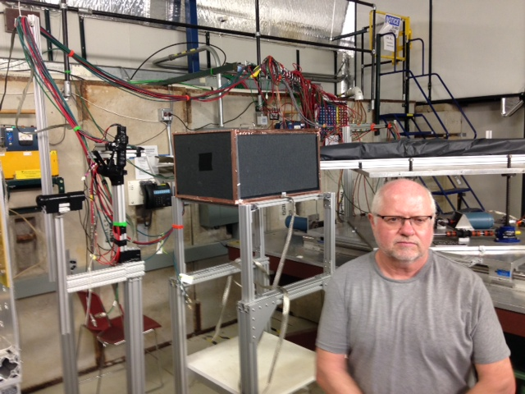
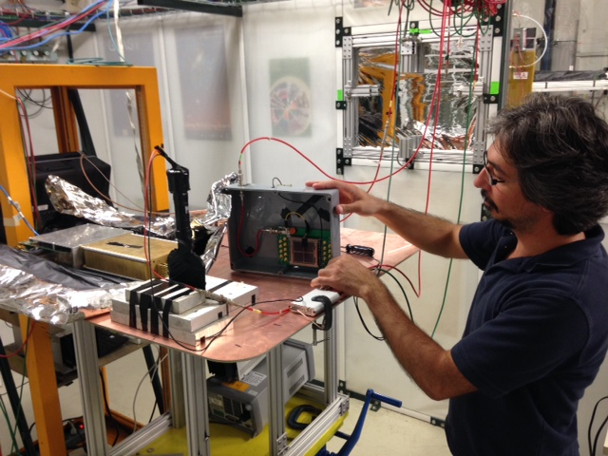
A Day of CMS calorimetry at FNAL Test Beam
T1018
T1041
Jim Freeman new rad-hard scintillator studies. Behind him is TTU fiber based dual readout
Burak Bilki w/ new ANL MCP. Also studying new scintillators.

Slide 9
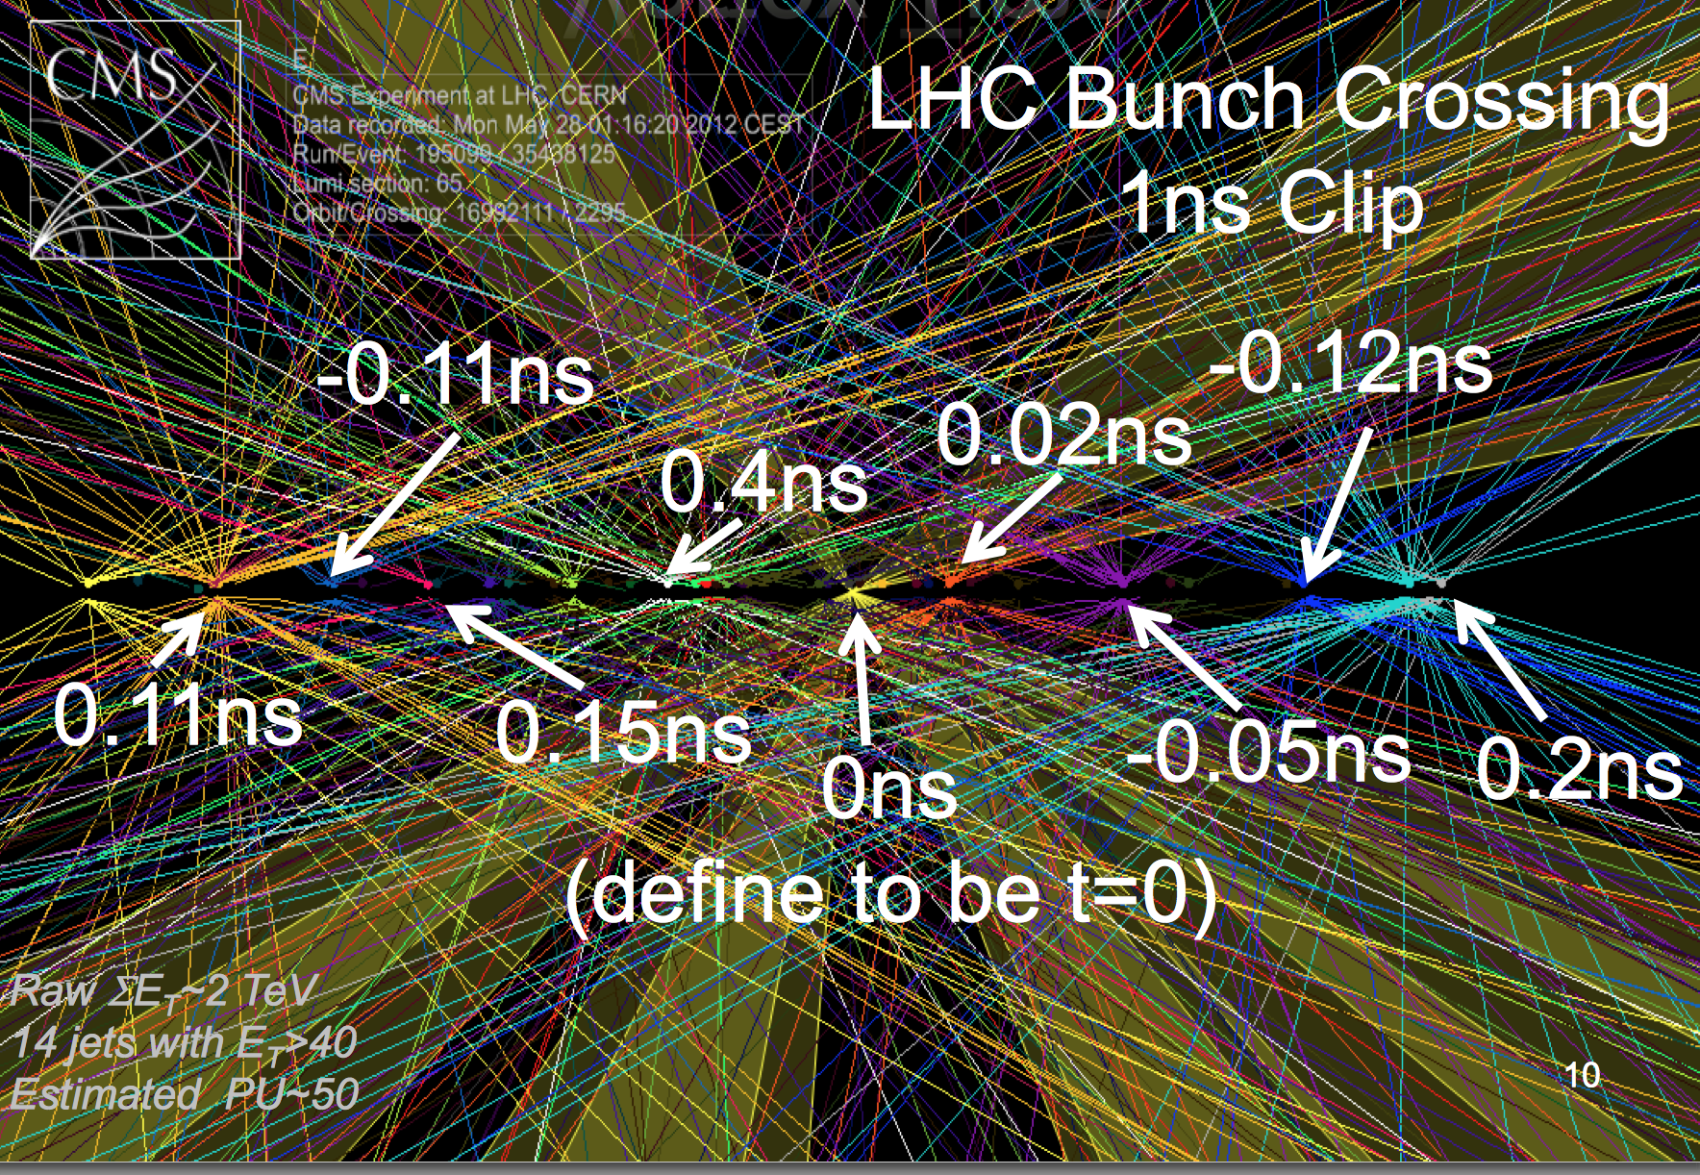
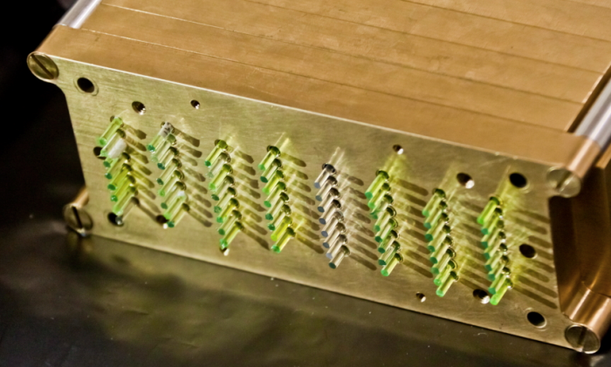
From Chris Tully SSI lecture, 2012 – Fast timing may cure the pileup problem : 150 events in one beam crossing!
T1041
Investigation of fast and radiation hard fibers (LuAG:Pr and YAG:Pr)

Slide 10
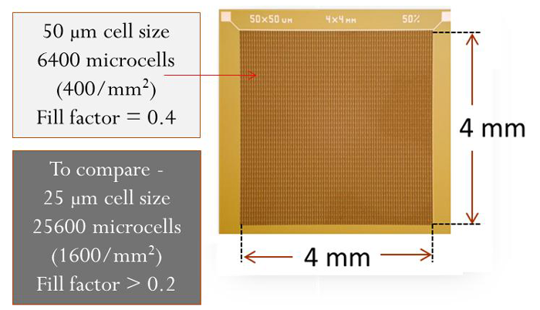
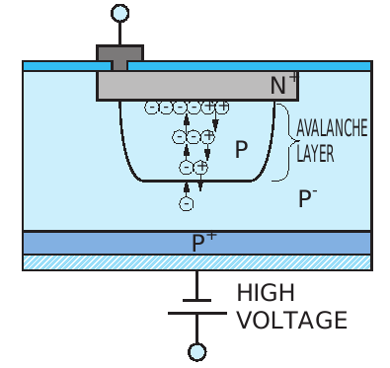
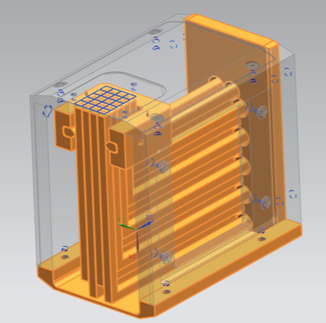
Fast Timing in Solid State
Silicon Photo-Multipliers (SiPM)
PN junction reverse biased beyond the Geiger mode breakdown voltage
Array of thousands of these cells on a single chip that can be tailored for specific purposes
The avalanche region is very close to the surface (~1 micron), so timing can be excellent (<16 psec shown at FNAL test beam).
Fermilab has been studying their potential for TOF and calorimetry for several years. Design and testing occurring now for potential use in FP420 forward tracking at CMS.
10 photons can give
25 psec resolution
(confirmed)
T979
T958
Radiation Soft !!

Slide 11
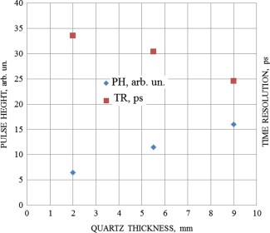
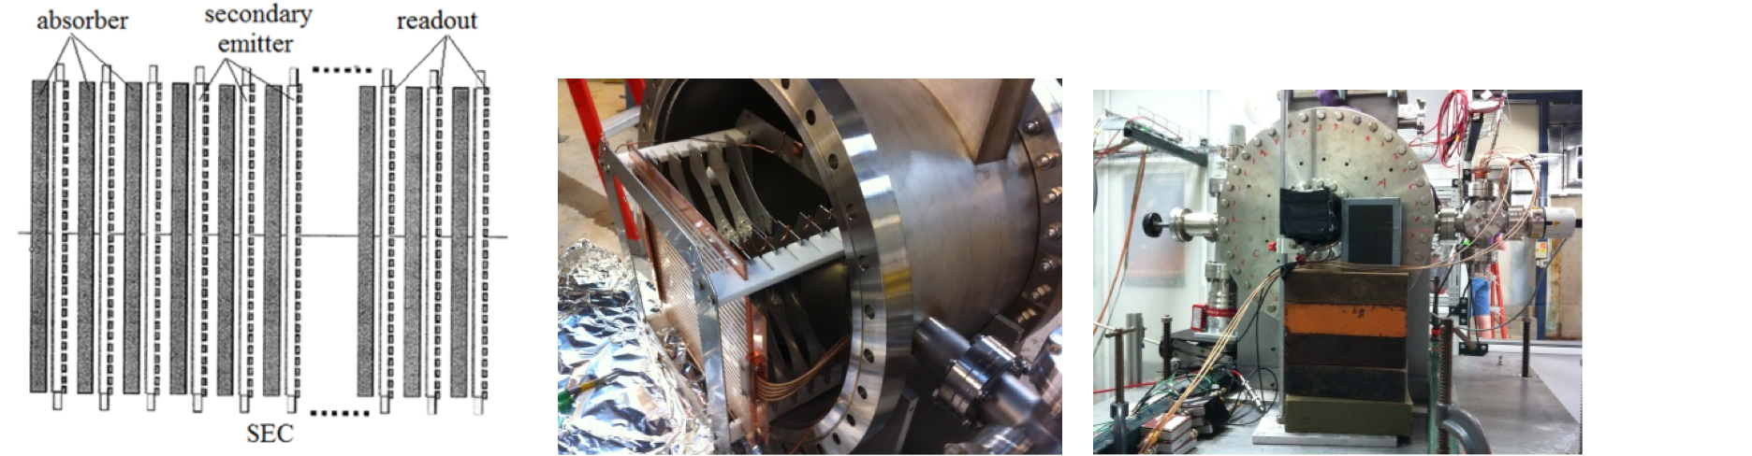
Fast timing using Secondary Emission in pores of a MicroChannel glass plate
Goal is to measure timing in showers to 30 psec, to disentangle pileup effects.
Propose to use bare MCP in vacuum (no scintillator, no photocathode). A simple timing insert into a sampling calorimeter.
Our first tests used 16 channels of a Photonis MCP/PMT with photocathode and varying thickness of radiator
Timing resolution for no quartz window extrapolates to ~37 psec
Pulse height for no quartz window extrapolates to non-zero value
T1058
Anatoly Ronzhin (FNAL), Artur Apresyan, Maria Spiropulu, Si Xie and Adi Bornheim (CalTech), Henry Frisch (UC)

Slide 12
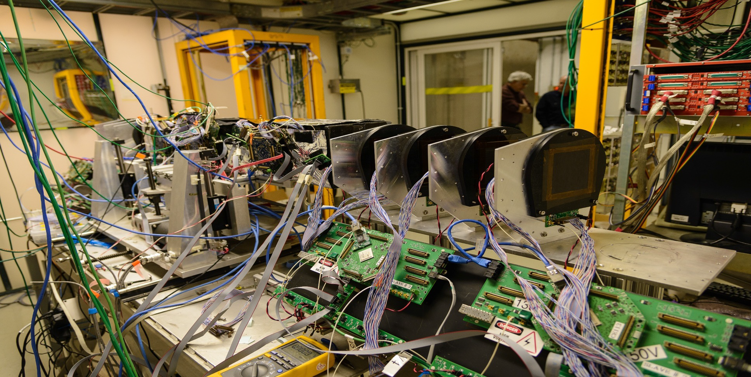
Silicon DAQ at Test Beam
Fermilab Test Beam Facility DAQ:
Old pixel telescope DAQ is based on CAPTAN
  Triggered, 1cm² coverage, and 8µm track resolution
New strip telescope completed in FY14 is based on CAPTAN too
  Dead-timeless, 16cm² coverage, and 5µm track resolution
T992
Used to perform radiation tolerance studies of various pixel sensors (diamond, 3D,MCZ)
New strip telescope encompassing old pixel telescope at FTBF

Slide 13
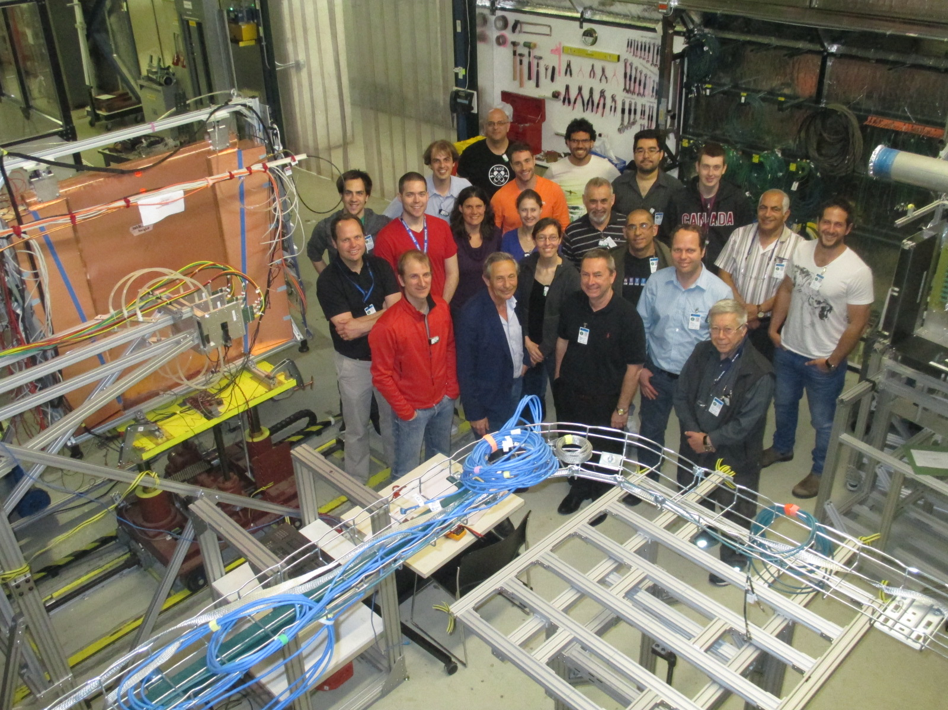
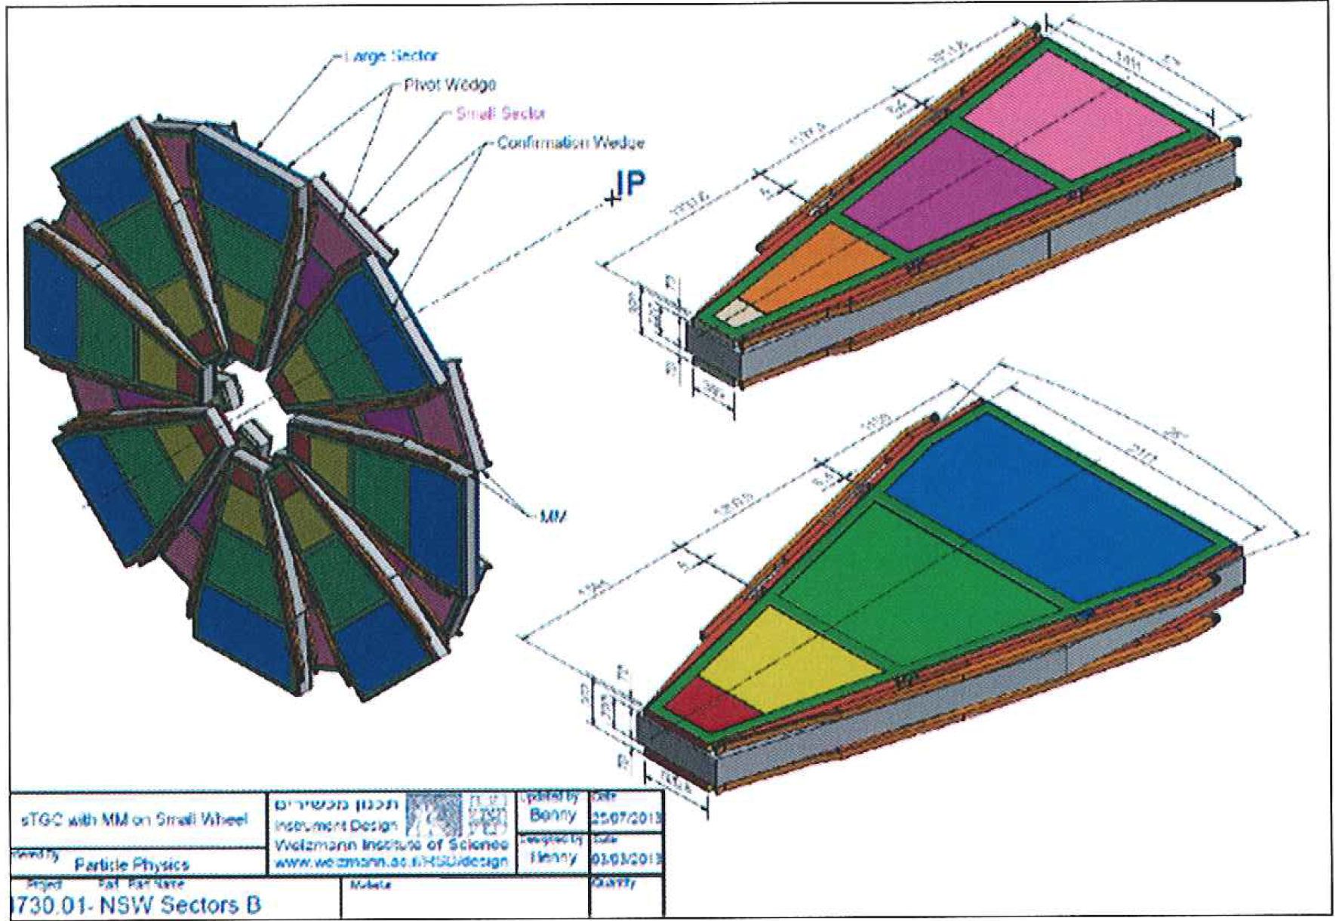
ATLAS Upgrades given Director’s seal of approval !
Test of ATLAS endcap muon “thin gap chambers
1.4 mm between anode and cathode! – 100 micron flatness
T1049

Slide 14
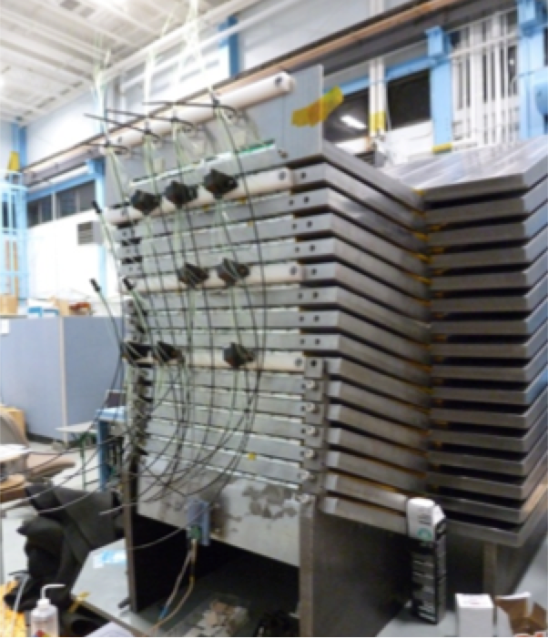
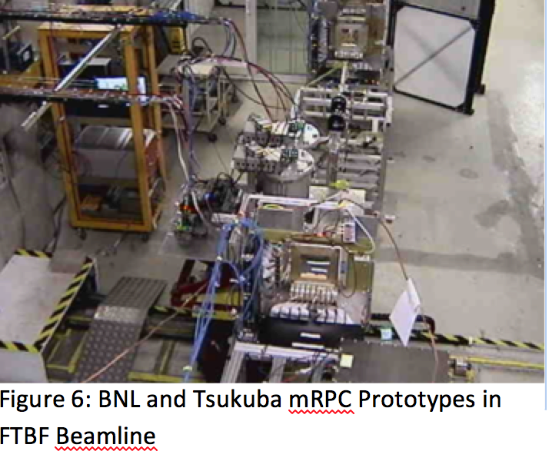
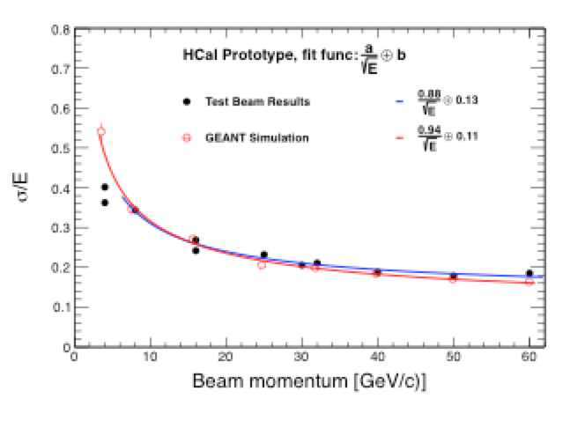
PHENIX upgrade detectors come to FTBF in force!
T1044 - Calorimetry
T1048 – Fast Time of flight
T1054 - Preshower

Slide 15
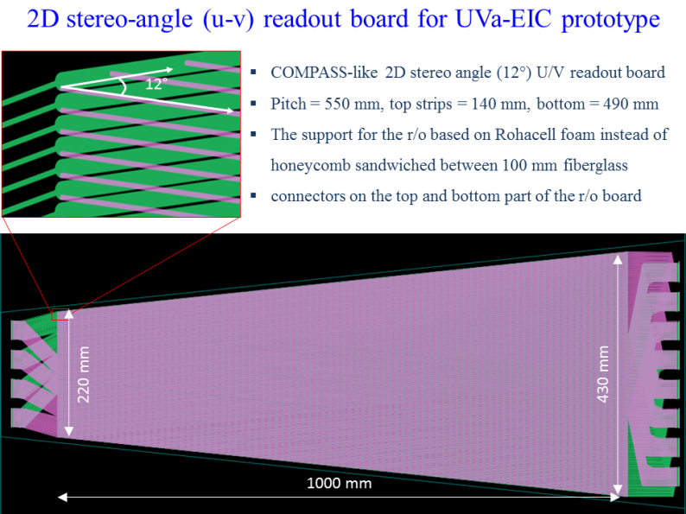
19 tracking stations in the FLYSUB beam test
A collaboration for Electron Ion Collider detector R&D
Groups from BNL, Florida Institute of Technology, Stony Brook University, University of Virginia, and Yale University
  Development of a mini-drift GEM detector for resolving the issue of losing resolution for inclined particle tracks and applying different frontend electronics
  Development of large area planar GEM detectors for endcap tracking
  Development of alternative read-out structures for reducing the number of channel counts but conserving the resolution
  Development of Cherenkov detectors in the forward direction, with particular emphasis on high momentum hadron ID and development of large area low cost VUV mirrors.

Slide 16
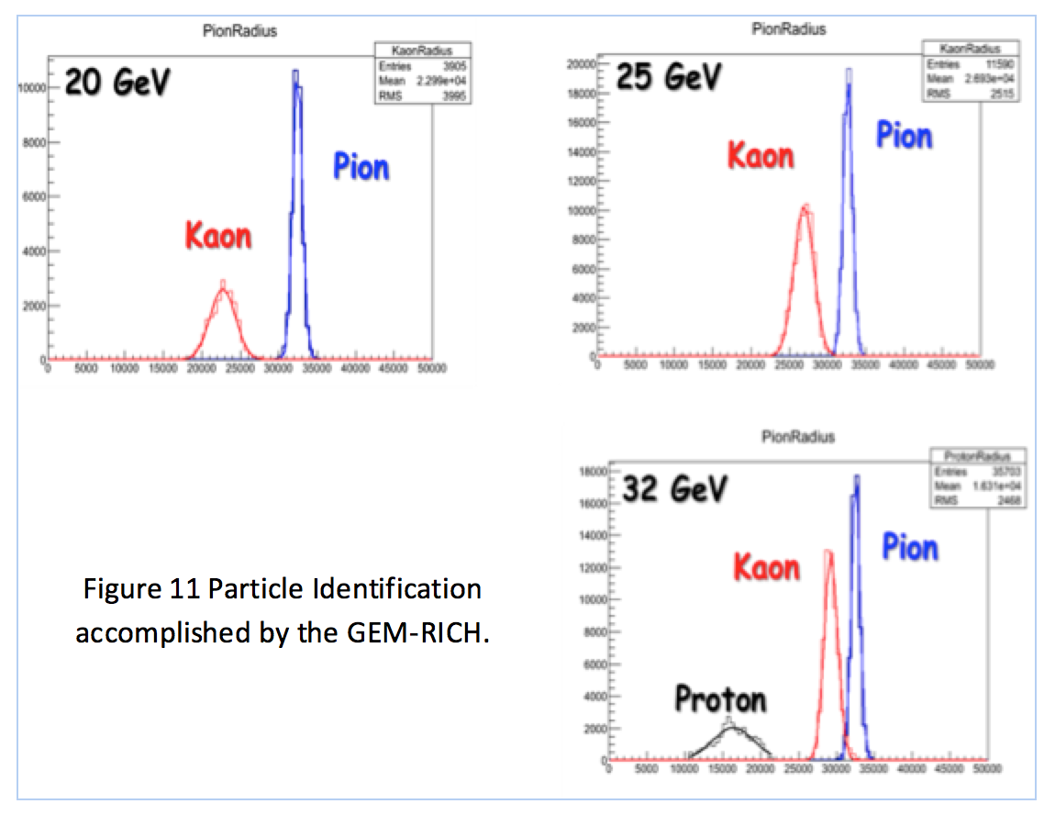
Great results from FLYSUB: should bring GEM technology full time to FTBF

Slide 17
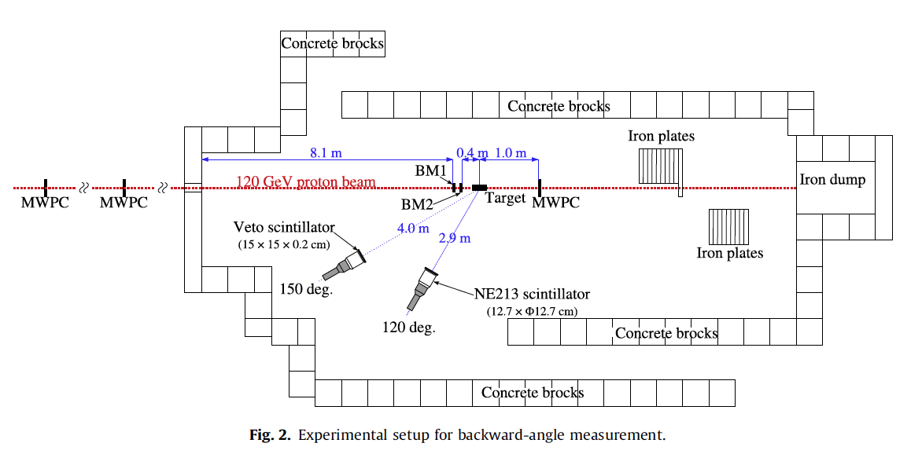
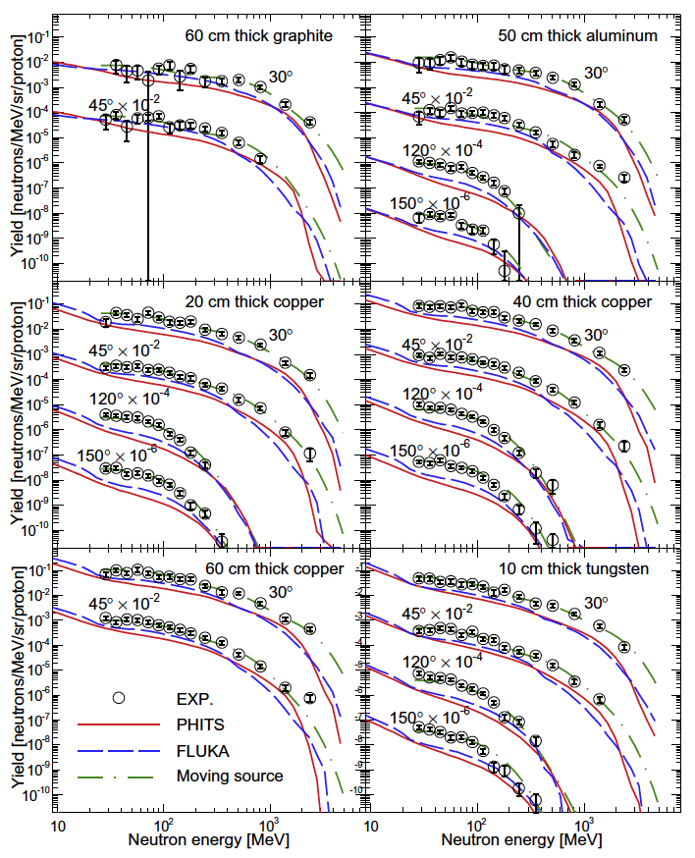
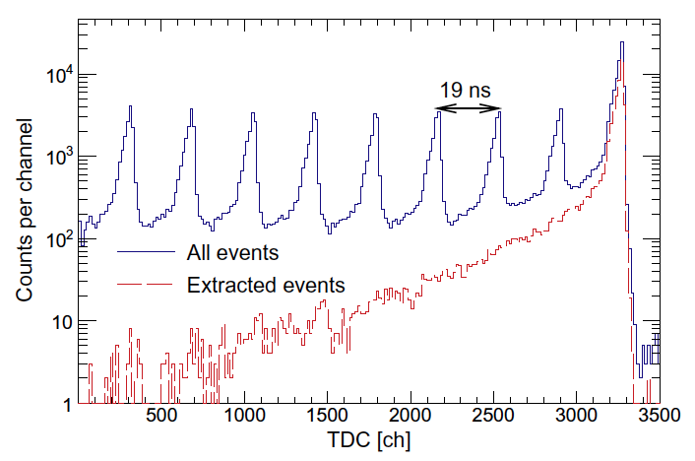
Neutron production with 120 GeV protons – JASMIN!

Slide 18
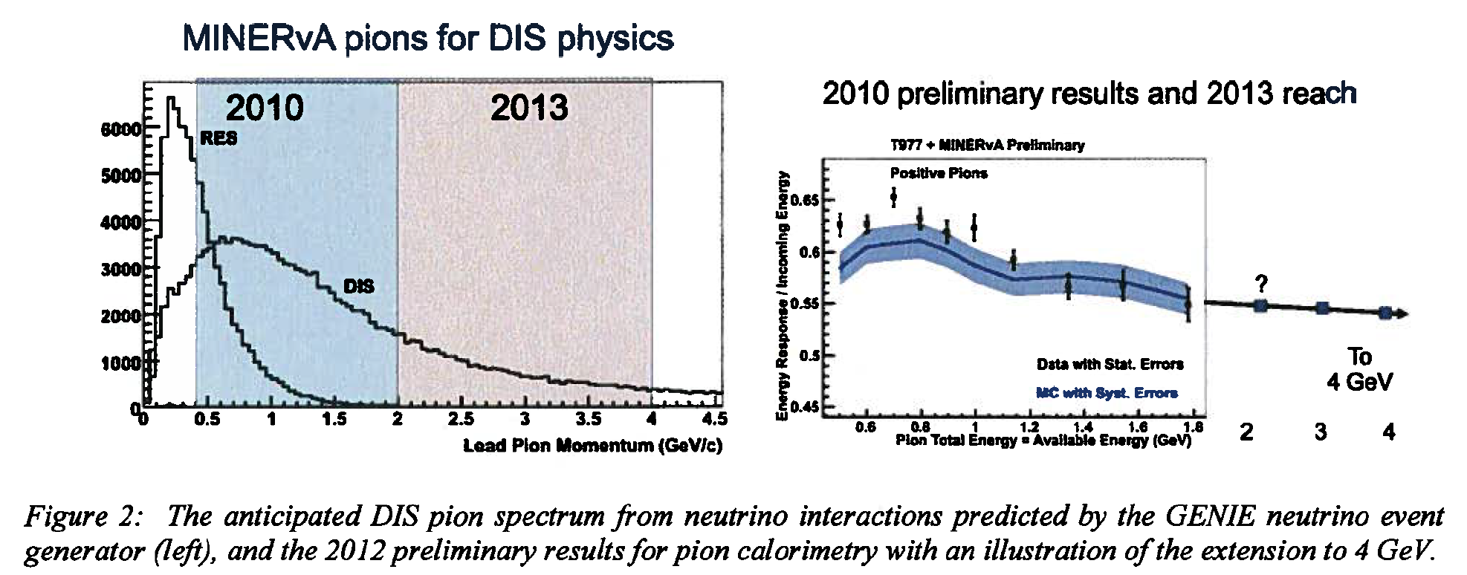
MINERVA Test Beam
In 2010, MINERVA ran test beam with a tertiary spectrometer built specifically for this run in the MTest beamline
TOF measurement allowed for particle i.d. in the 0.5-2.0 GeV range, perfect for the low energy running at that time.
Now they are repeating their tests with the higher energy secondary beam in the range 2.0-4.0 GeV, that will extend their understanding of their experiment in the higher energy regime

Slide 19
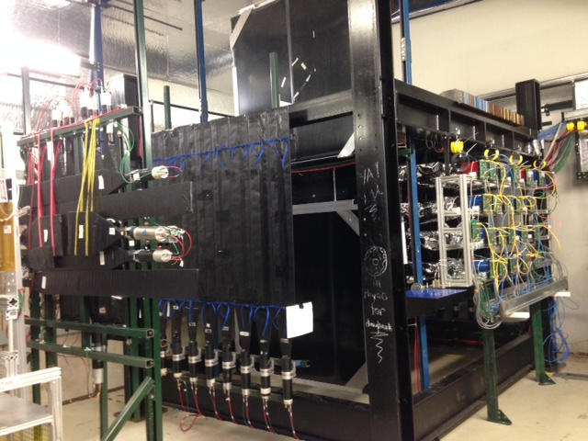
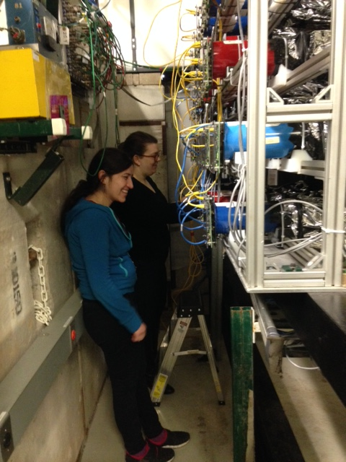
MINERVA test beam
After starting installation at MT6 in FY14, will finish in FY15

Slide 20
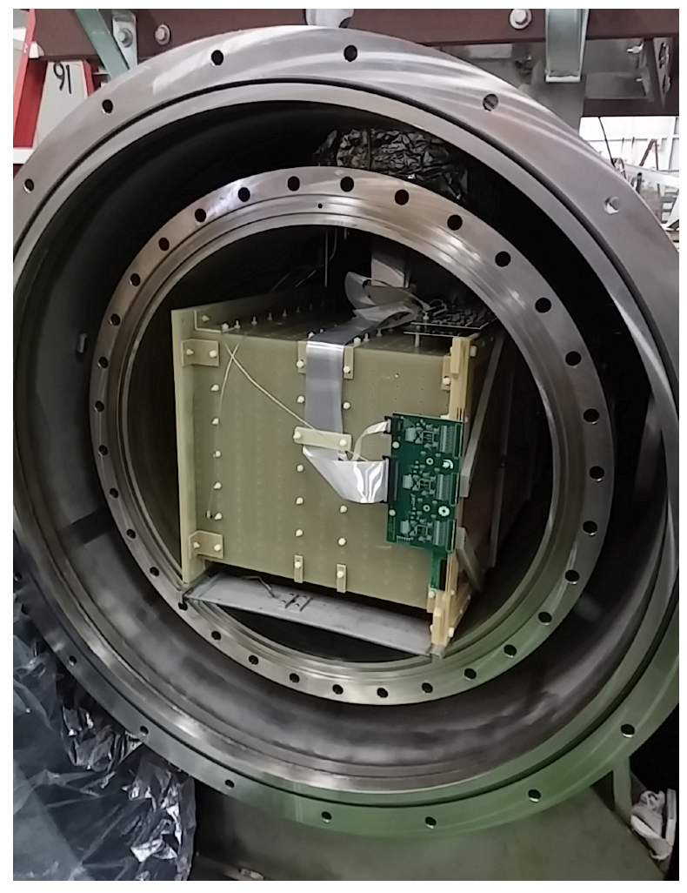
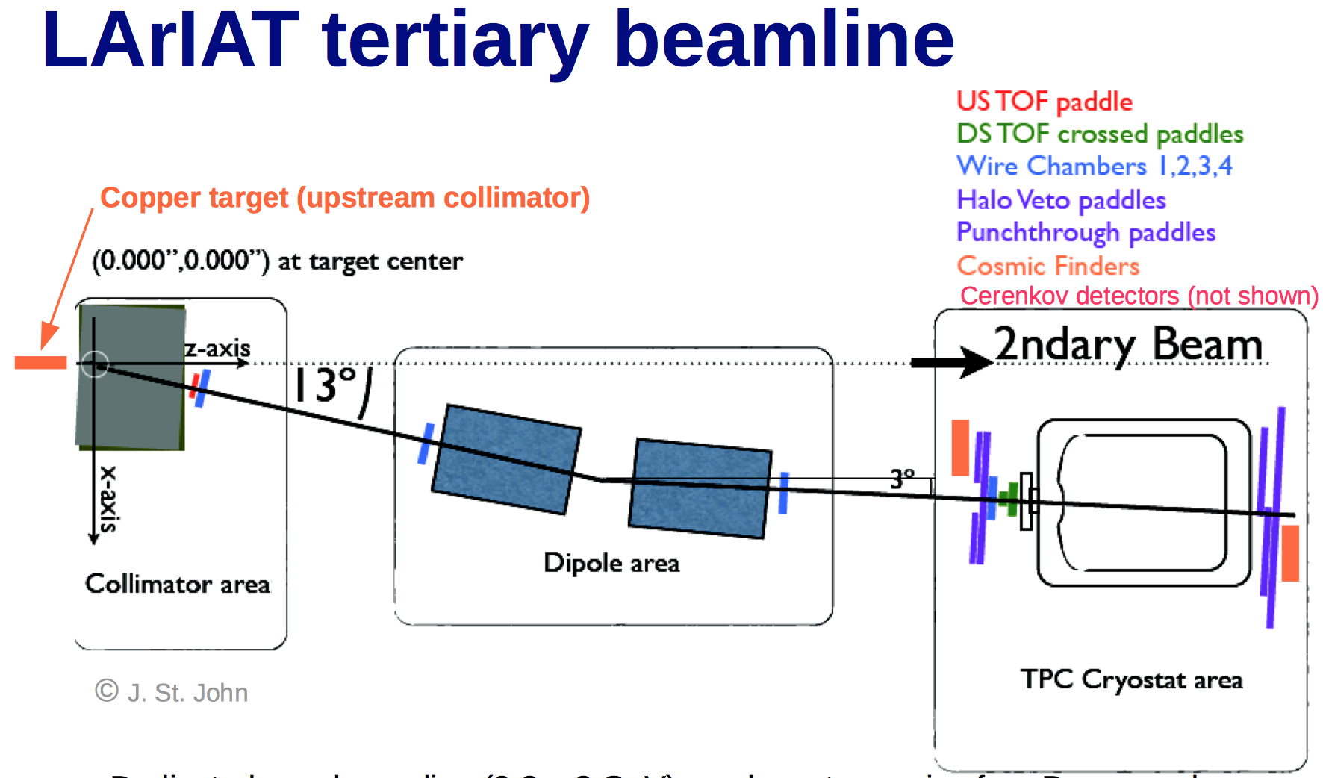
‘Liquid Argon in a Testbeam’=LArIAT
Tertiary beam used by MINERVA in 2010 was moved to new MCenter Test Beam line
TOF Particle I.D. for 0.2-0.8 GeV beam

Slide 21
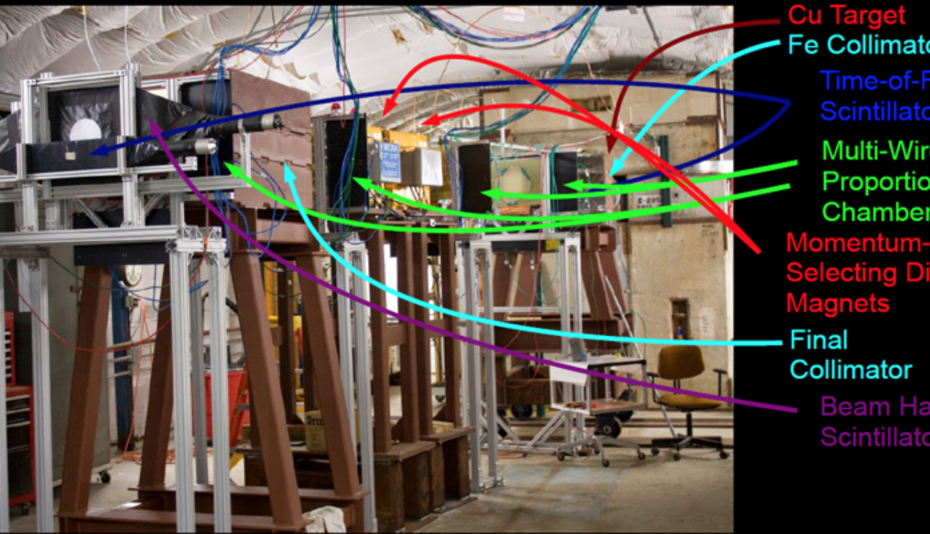
Tertiary spectrometer in MCenter beamline

Slide 22
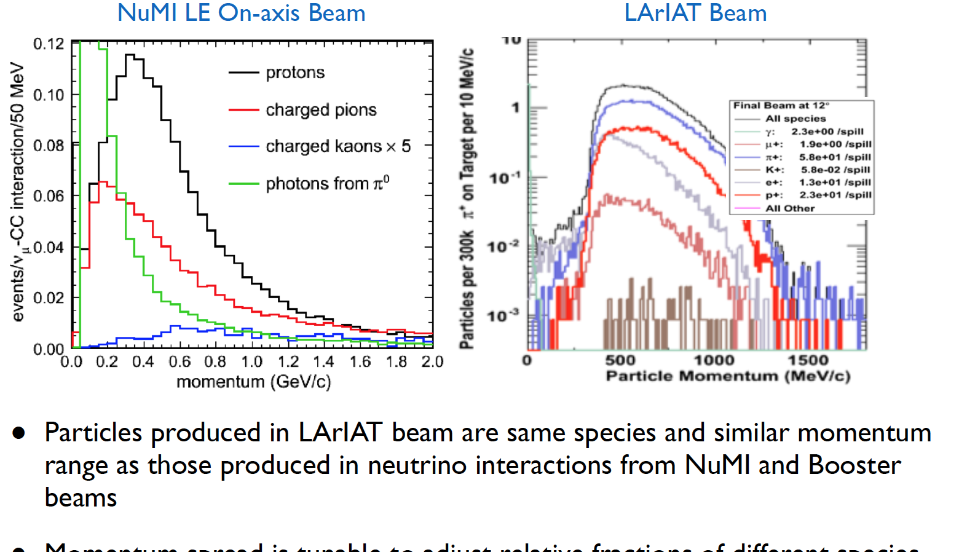
LAriaT beam matches well to neutrino program

Slide 23
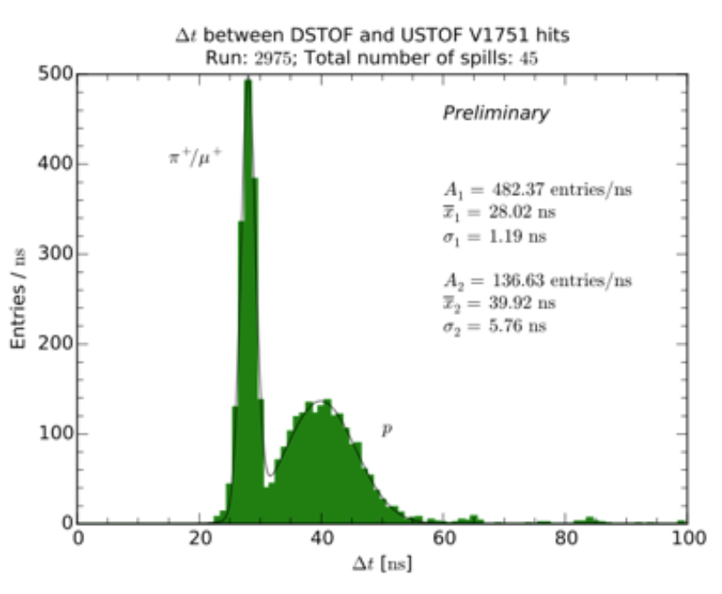
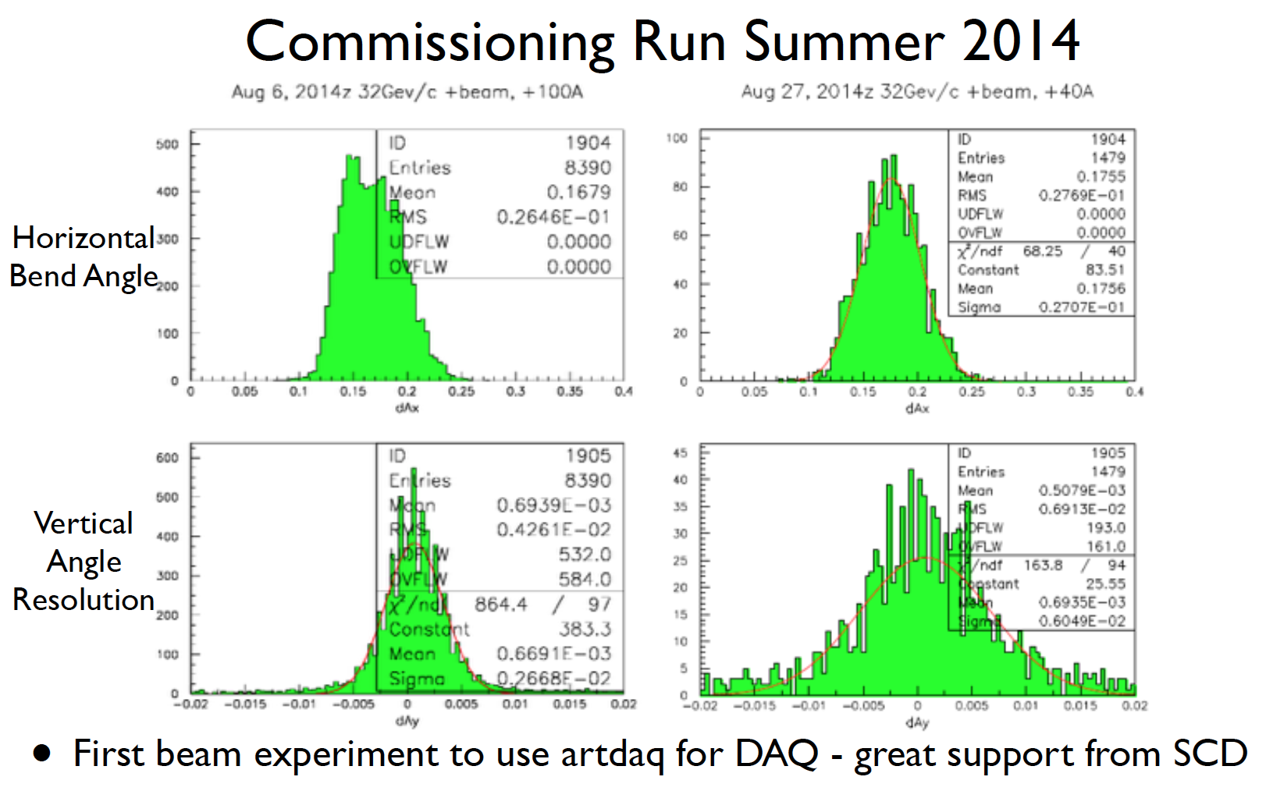
Some results from the Summer, 2014 run
Beam chambers and TOF systems are working. LAriaT should be very productive in 2015

Slide 24
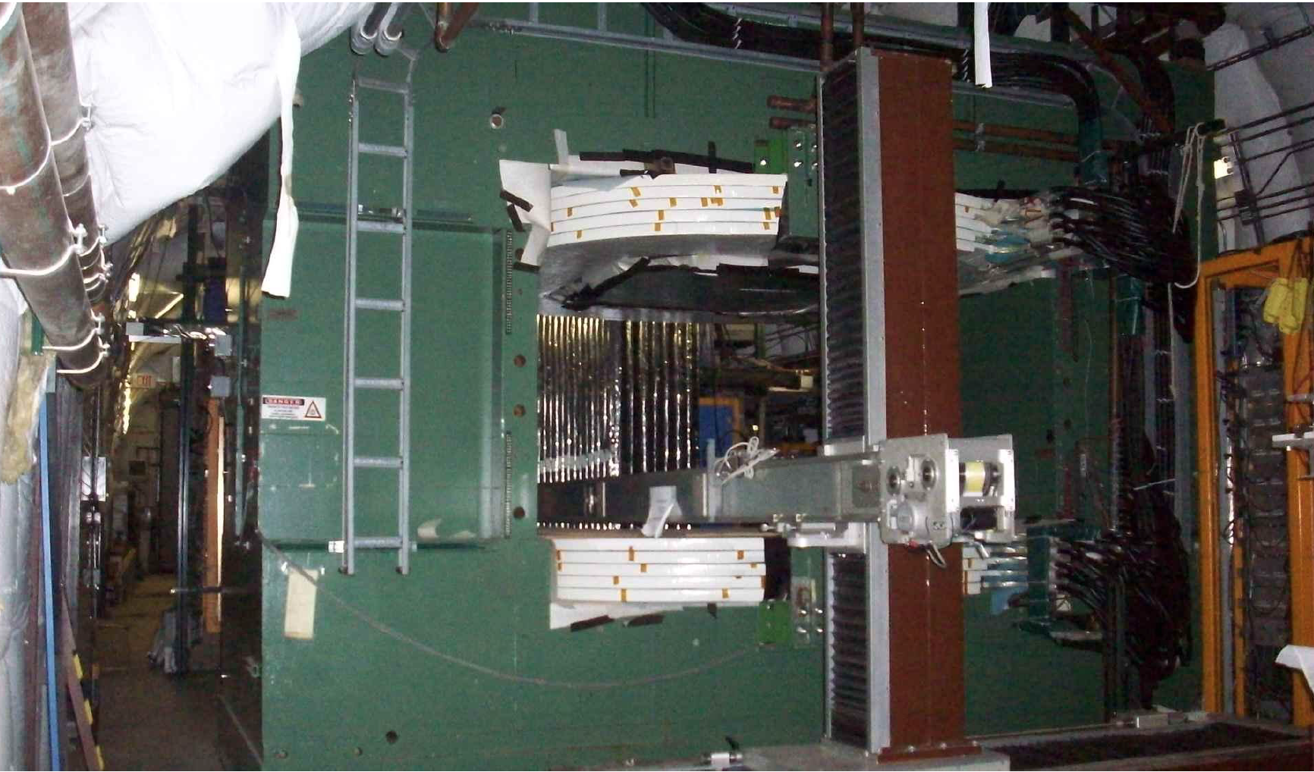
In the future:
Use ‘Jolly Green Giant’ in MCenter as a tertiary analysis magnet, or surrounding a large scale calorimeter:

Slide 25
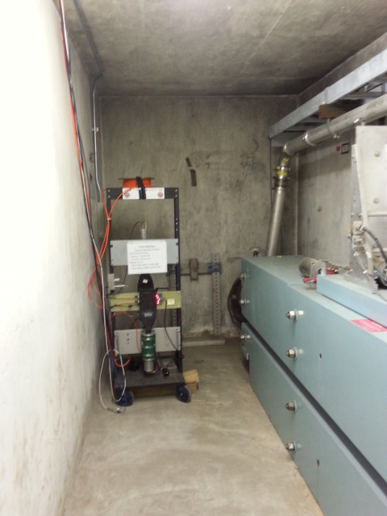
Irradiation of electronics using region near MTest collimator
Rate of neutrons near the primary 120 GeV pinhole colllimator mimics the ATLAS cavern reasonably well.
Mark Oreglia brought electronics for the tile calorimeter to this region to measure the rate of single event upsets.
Results of SEU as predicted – good news!

Slide 26
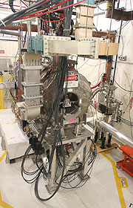
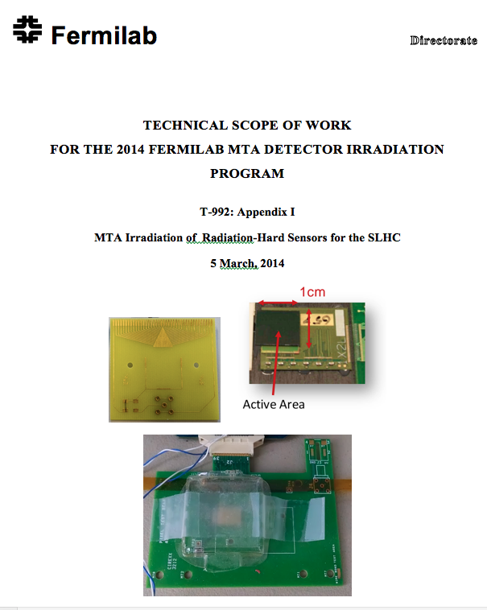
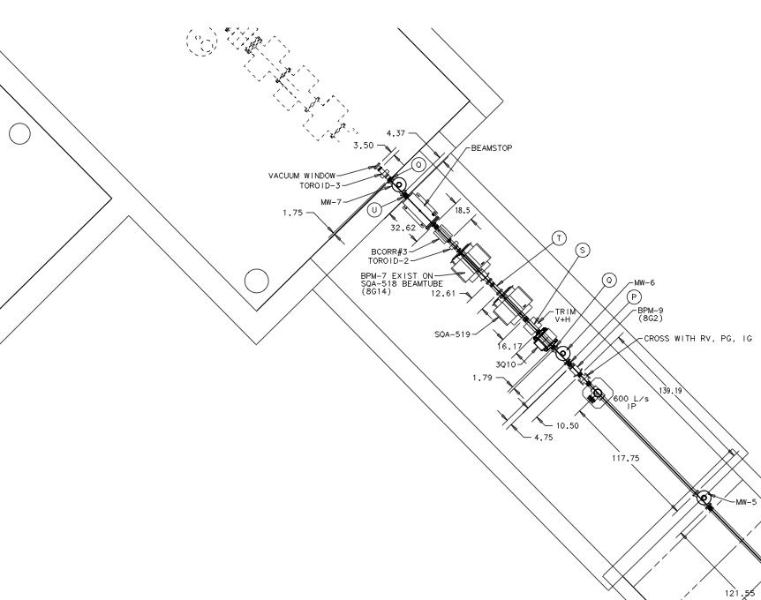
Investigating New Detector R&D Irradiation Capability at MTA at the end of the LINAC
The MTA experimental hall has accepted beam. (400 MeV protons)
It is possible that we will be able to perform detector irradiation studies there. Safety and scheduling issues being studied.
The MAP group has installed a table for supporting detector installations
Flux as high as 10¹⁴ / hour in the experimental hall
First Statement of Work submitted:
Stand for beam stop, collimator and detectors already placed upstream of solenoid
Is this resource useful to the community?

Slide 27
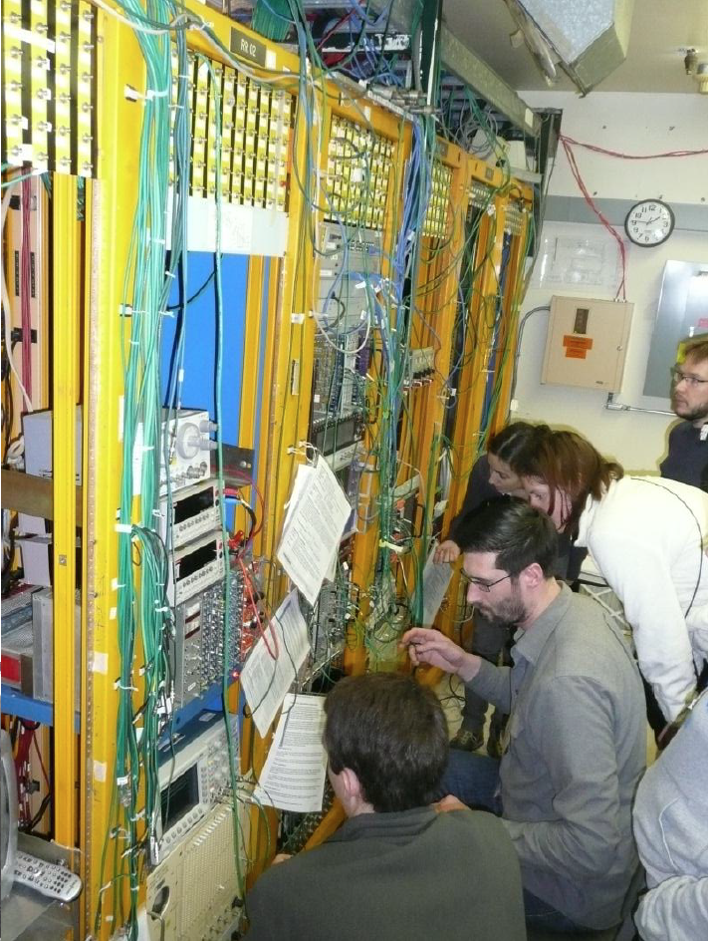
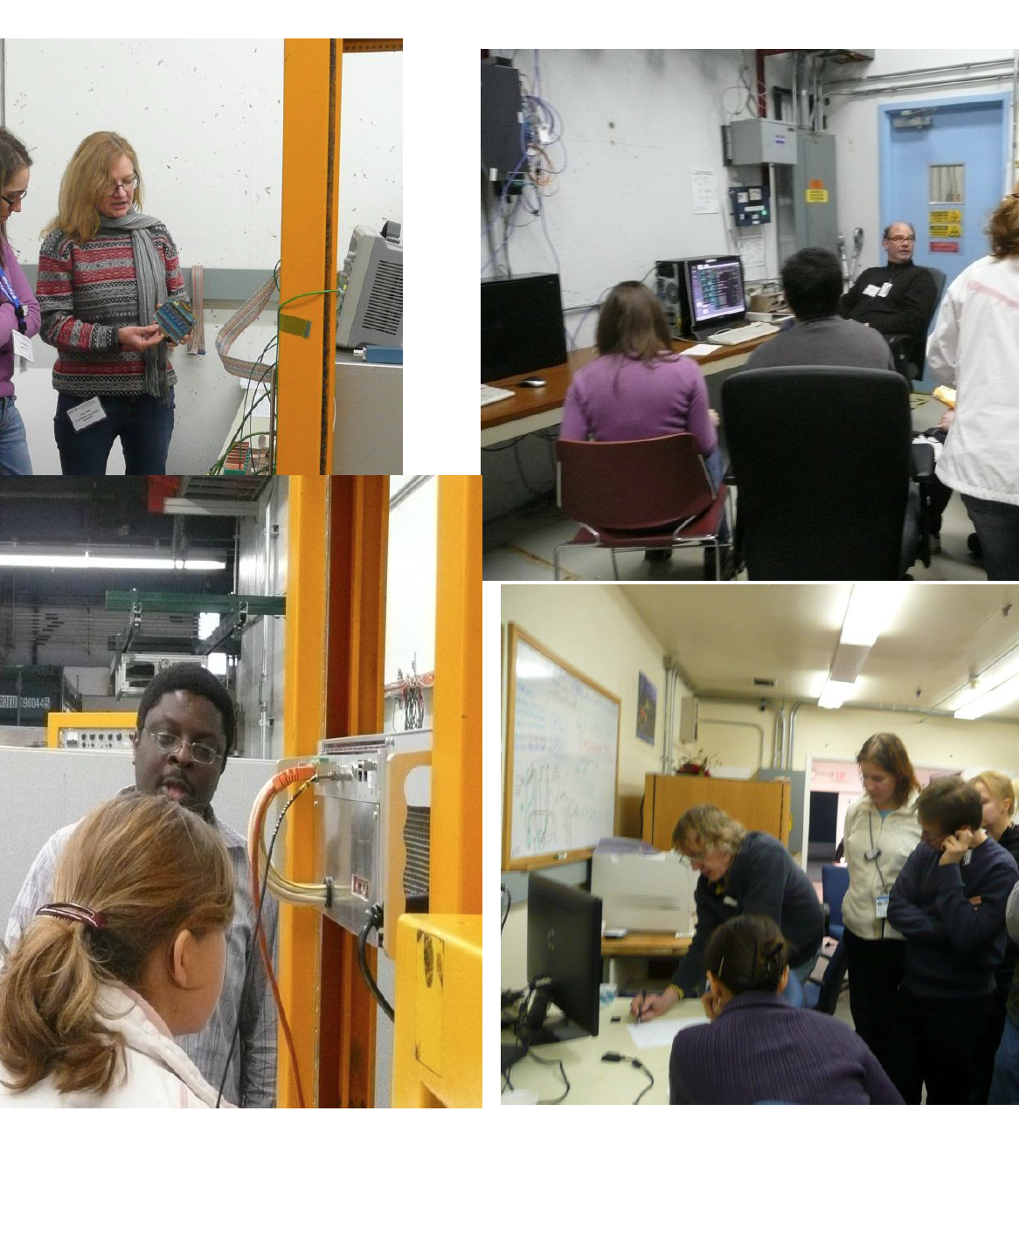
Wonderful forum for educating students, such as the EDIT2012 school

Slide 28
Summary
The FTBF is a very important part of detector research for the global HEP community. FY14 was a particularly busy year.
It is crucial that Fermilab maintain (and improve) this resource for the foreseeable future.
Besides testing of prototype modules, fundamental physics has also been addressed at the facility (neutron production, absolute light yields for air shower flourescence, recoil efficiencies in bubble chamber operations, etc.)
The lab management should consider adding MTA to the test beam facility ‘family’. This would add a primary intensity capability.

