Slide 1
MCenter Facility
Fermilab Testbeam Committee Meeting
July 29, 2015
Jen Raaf, Brian Rebel, LArIAT, Eugene “JJ” Schmidt

Slide 2
MCenter Layout

Slide 3
Cryogenic Facility at MCenter
LN2 dewar placed outside enclosure
  Plumbing from dewar to enclosure
ODH fan installed in MC7
Cryogenic system for recirculation and purification
  Filter skid (MicroBooNE style) with 2 vessels
    1 for oxygen filtration, 1 for water
  Recirculation skid
    Phase separators
    Condenser
    Pump housing
    Flow meter
Tertiary beam

Slide 4
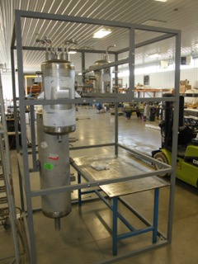
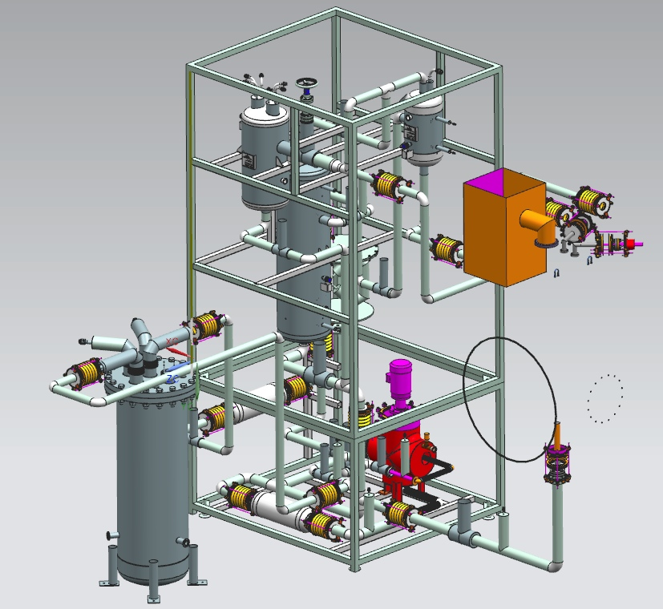
MC7 Cryogenic System
From Eden Cryogenic
Partially completed system at Eden
Experiments attach to system here

Slide 5

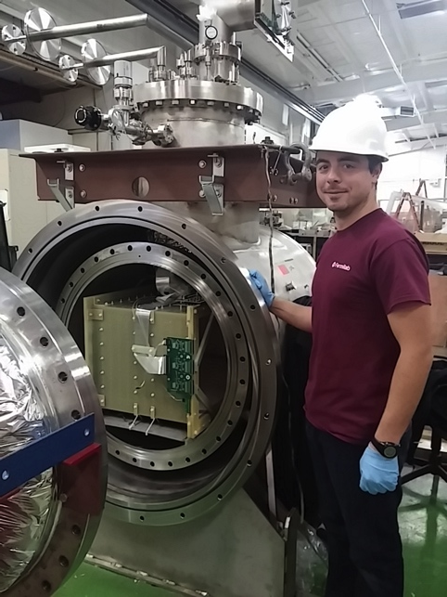
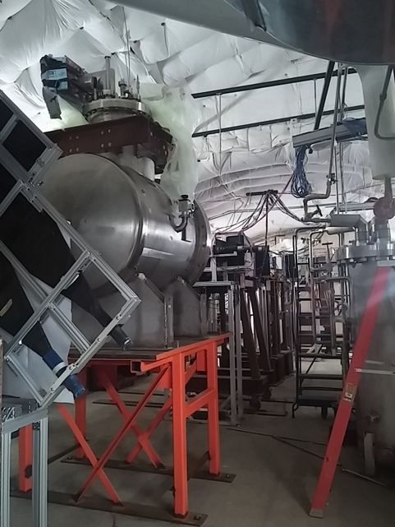
LArIAT T-1034 (Liquid Argon In A Testbeam)
Repurposed 550-𝓁 ArgoNeuT LArTPC detector with modifications for operation in FTBF MCenter charged particle tertiary beam (~200 MeV – 2 GeV).
First customer of MCenter.
MCenter Tertiary Beam (looking upstream)
LArIAT TPC
Goals Characterize LArTPC performance in the range of energies relevant to upcoming SBN and LBN experiments for neutrino physics and for proton decay searches.
Study energy resolution improvement by combining information from scintillation light and ionization charge signals
Experimentally measure e-γ separation
Develop criteria for charge sign determination
Optimize pion and kaon ID capabilities
arXiv:1406.5560 [physics.ins-det]

Slide 6
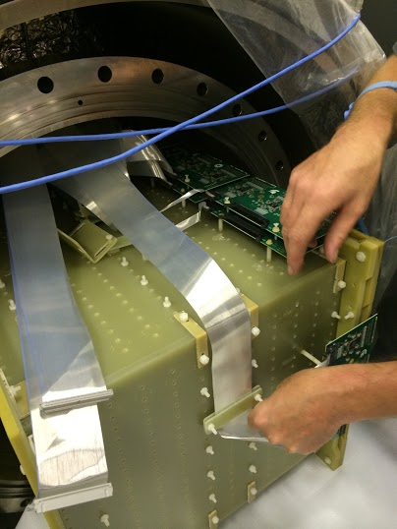
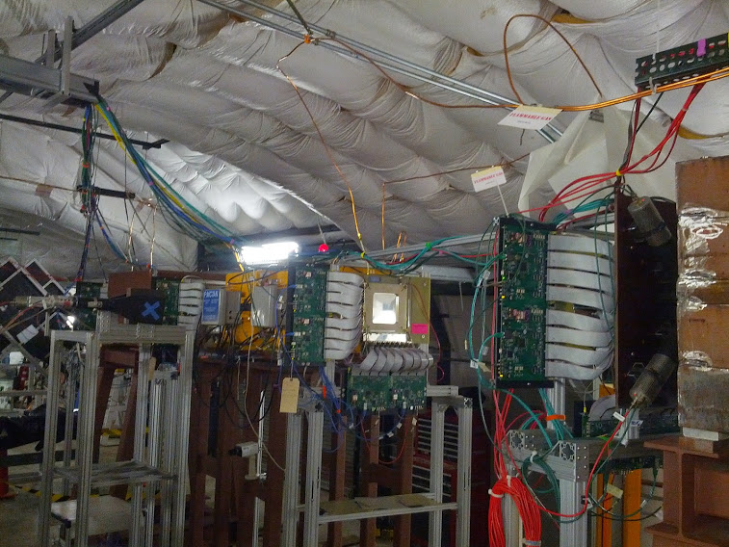
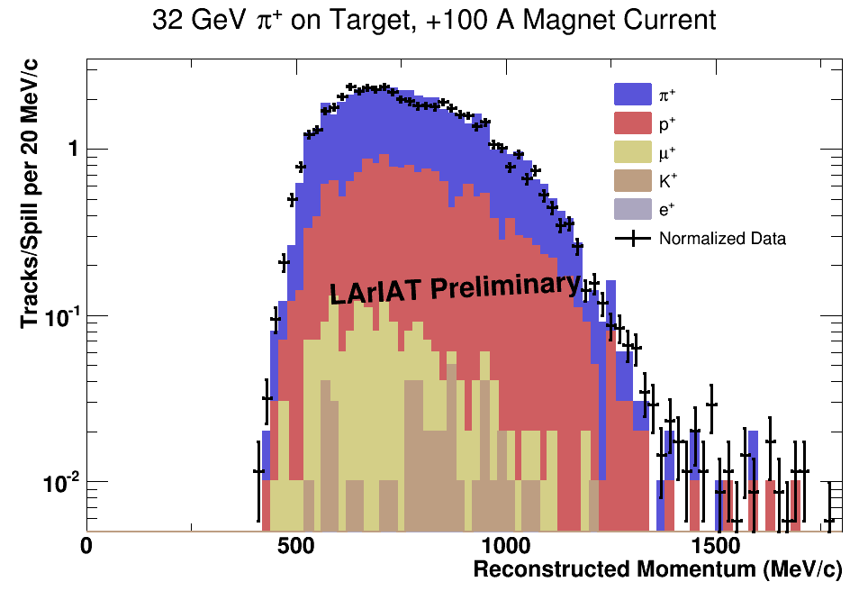
LArIAT Status
Detector refurbishment complete
  New TPC wire planes
  New cold electronics readout
  New light collection system
Installed in MCenter
  Tertiary beam components
    target, collimators, magnets
  Beamline detectors
    wire chambers, time-of-flight system
  Auxiliary detectors
    beam halo veto, punch-through veto
  Cryostat with installed TPC
  Simplified cryogenic infrastructure
First commissioning steps
  MCenter secondary and tertiary beams commissioned/tuned, Summer 2014
  New LArIAT DAQ commissioned during short engineering run (Sept. 2014)
  Good data/MC agreement!
TPC installation
Tertiary beamline instrumented with wire chambers and TOF

Slide 7
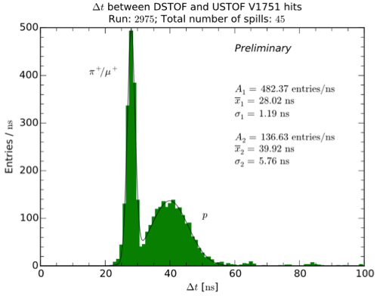
LArIAT program
Run 1: Spring 2015
(~3 mos. beam data w/simplified cryo system)
  Collect data for range of secondary beam energies and tertiary magnet currents (to enhance event rates and tune momentum ranges for particles of interest)
  Use these data to develop improved PID methods using both charge and light collected in the detector
  Study charged particle reconstruction efficiencies
  Investigate hadronic interactions in argon
Shutdown
Install full cryogenic system
Install Cherenkov counters to tag π vs. μ
Run 2: ~Fall 2015
  Revisit Run 1 beam/magnet configurations, with changes or improvements where appropriate, as learned from Run 1
  Charged particle cross section measurements
  Further study and improvement of PID with combined charge and light info
  Electron/photon separation studies
Data from engineering run show good separation of protons from π/μ using time-of-flight system, but can’t distinguish between π and μ themselves.

Slide 8
LArIAT Program
Dates | Beam configuration | Goals
Spring 2015 (March~May) | Run 1: Range of secondary beam energies, range of tertiary magnet currents. Probably 24-hour shift-taking, in order to take full advantage of argon before it boils off (due to simplified cryo system). | Develop improved PID methods using charge and light Study charged particle reconstruction efficiencies Study hadronic interactions in argon
Spring/Summer 2015 | Shutdown | Install full cryogenic system Install Cherenkov counters to tag π vs. μ
~Fall 2015 (after shutdown) | Run 2A: Revisit Run 1 beam/magnet configs, with changes or improvements where appropriate, as learned from Run 1 Data-taking can be more flexible here because full cryogenic system allows purification and recirculation of argon. | Charged particle cross section measurements Electron/photon separation studies Further study and improvement of PID with combined charge and light info
 | Run 2B: Follow-on R&D | TBD (see next slide)

Slide 9
Future: Upgrades and Follow-on R&D
Flexibility in LArIAT data-taking schedule
  Accommodate other experiments running during “off” shifts? Or schedule on/off weeks?
    Run 1 plans to have 24-hour data-taking (3 x 8hr shifts)
    Run 2 data-taking schedule can be more flexible (full cryo system allows more flexibility)
  Need ability to quickly (remotely?) move tertiary target out of beamline
Testing ground for future techniques:
  Wrapped wire planes (a la LBNF concept)
  Light detection schemes (e.g., LAPPDs)
  Cold electronics R&D
  Calibration schemes
  TPC design (e.g., dual phase)
Rapid turn-around for testing other new ideas
  Validation of designs for detectors in review process
Potential for use of facility with other cryogenic liquids
Possible phase-II LArIAT: Larger LArTPC for shower containment studies & larger-scale R&D

Slide 10
Wish List
More electrical circuits (with more outlets) along east wall
A few remote-control cameras (as in MTest), viewable and controllable online
Covered pathway between Meson Building and MC7
Mitigation of summer flooding problem during rain
  Drainage ditches along side of building, with pumps?
Crane or other easier way to move large things in MCenter
Shore up floor in downstream region of MCenter (currently has floor loading limit due to MBottom area beneath)
  Floor beneath Rosie and Jolly Green Giant was strengthened in 2001, but nothing downstream (see next slide)
Remote shifts
  From ROC-West at first? Then truly remote?
  Could increase efficiency of test beam, especially for experiments that have collaborators in Japan (midnight shift is daytime in Japan)

Slide 11
MBottom
Jolly Green Giant
Rosie
LArIAT
Beginning of MBottom
Additional support structure (added 2001)

Slide 12
Use of MCENTER for non-cryogenic experiments
MCENTER beamline could be used for several categories of non-cryogenic experiments during time that cyro system and tertiary beamline are installed in MC7. (indefinite future)
  Experiments that need magnetic field using Jolly Green Giant. See Erik Ramberg’s talk.
  Large semi-permanent installations in far downstream end of MC7. NOvA considered this possibility.
  Use of MCENTER as “extension” of MTEST.
Next slide will consider the “extension” possibility.

Slide 13
MCENTER as MTEST “Extension”
Secondary beamline is not as flexible as MTEST but still has similar options. There is not however a muon absorber that can be dropped into beam.
Upstream area of MC7 (i.e. tertiary beamline/LArIAT) is very crowded. Only simple and small self contained tabletop experiments could be squeezed into this area. Chicago Optical TPC (T1059) is an example.
Infrastructure such as gas system and patch panels to MCENTER control room do not extend to downstream areas.
Switching back and forth (day/night) between tertiary beam and secondary beam would likely required a mechanical system to move tertiary target. One wire chamber used by LArIAT would have to be reconfigured to get electronics out of secondary beam.

Slide 14
MCENTER as MTEST “Extension” (cont’d)
General area downstream of LArIAT would need to be cleared out and support stands of appropriate height constructed.
Would need additional wire chambers, motion table, particle ID systems.
FTBF would gain flexibility if above issues were addressed.
  Ability to handle more experiments if MT6 areas were oversubscribed.
  Flexibility to deal with accelerator downtimes or experiments that do not complete in allotted time slots.
  Ability to schedule dedicated beam study time or facility instrumentation studies/development.

Slide 15
Summary: steady progress on MCENTER and many possibilities for future given demonstrated need and resources.

