Slide 1
MTEST FY15 PROGRAM
PLUS NOTES ON FTBF GROUP
Fermilab Testbeam Committee Meeting
July 29, 2015
Eugene “JJ” Schmidt

Slide 2
Changes in FTBF Group
In late spring 2013, Aria requested a new scientific hire to the Intensity Frontier and Test Beam Group. Hire was targeted to help manage FTBF. Time passes….
In June, 2014, Aria turned over majority of FTBF management to “JJ” Schmidt so she could concentrate on g-2.
In October, 2014, Fermilab reorganization created new Neutrino Division and IFTB lost underground facility responsibilities but also lost physicists Steve Hahn and Bill Lee who performed backup duties for FTBF.
Reorganization also dissolved PPD online support group which moved Geoff Savage (prime DAQ support and advisor on DAQ in general) into Neutrino Division. For time being, Geoff has been told to support FTBF but no real contract with ND for his services.
December, 2014 interviews finally took place for new hire. We do not know when this person will come on board.
Aria will be gone on maternity leave for 12 weeks by April, 2015.
See earlier talk for other notes on staffing.

Slide 3
Support Infrastructure Changes/Upgrades FY15
AD radiation safety requested that areas downstream of MTEST beam dump be limited occupancy areas. We have moved the FTBF shop/work area and Todd’s desk and replaced with storage cabinets.
Todd has been setting up new work areas in Meson West between MTEST and MCENTER beamlines. We will not have final authorization to use this area until rad safety has made beam-on measurements with both MCENTER and MTEST running.
Todd continues to enhance group’s ability to provide quick turn around for experiments by acquiring surplus shop tools.
Ray Safarik has setup remotely controlled rotary table with 12” stage and capacity of at least 1000 pounds.

Slide 4
Support Infrastructure Changes/Upgrades FY15 (cont’d)
New Shop equipment
  Rotex (hole punch)
  Drum Sander
  Milling Machine
  Heavy Duty Pedestal Vise
  Belt Sander
  Utility House Vac
  Stencil Machine
Previous acquired shop equipment
  Brake (18”)
  Corner Shear
  Shear (48”)
  Drop Saw
  Vise
  Bandsaw
  Drill Press
  Disc Sander
  Chop Saw

Slide 5
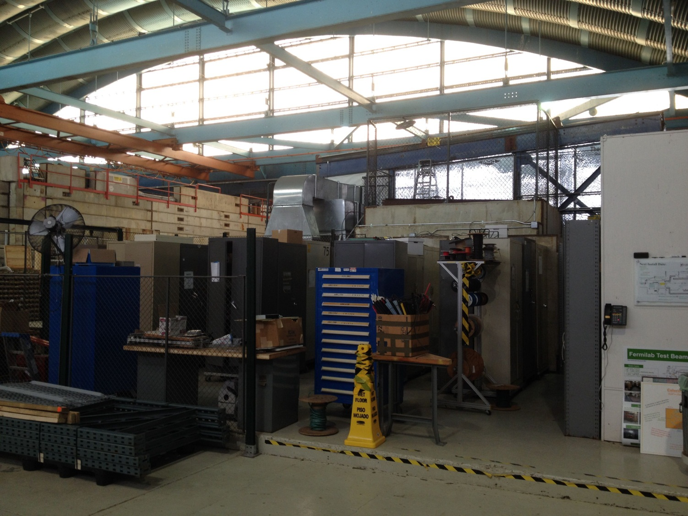
Old shop now storage

Slide 6
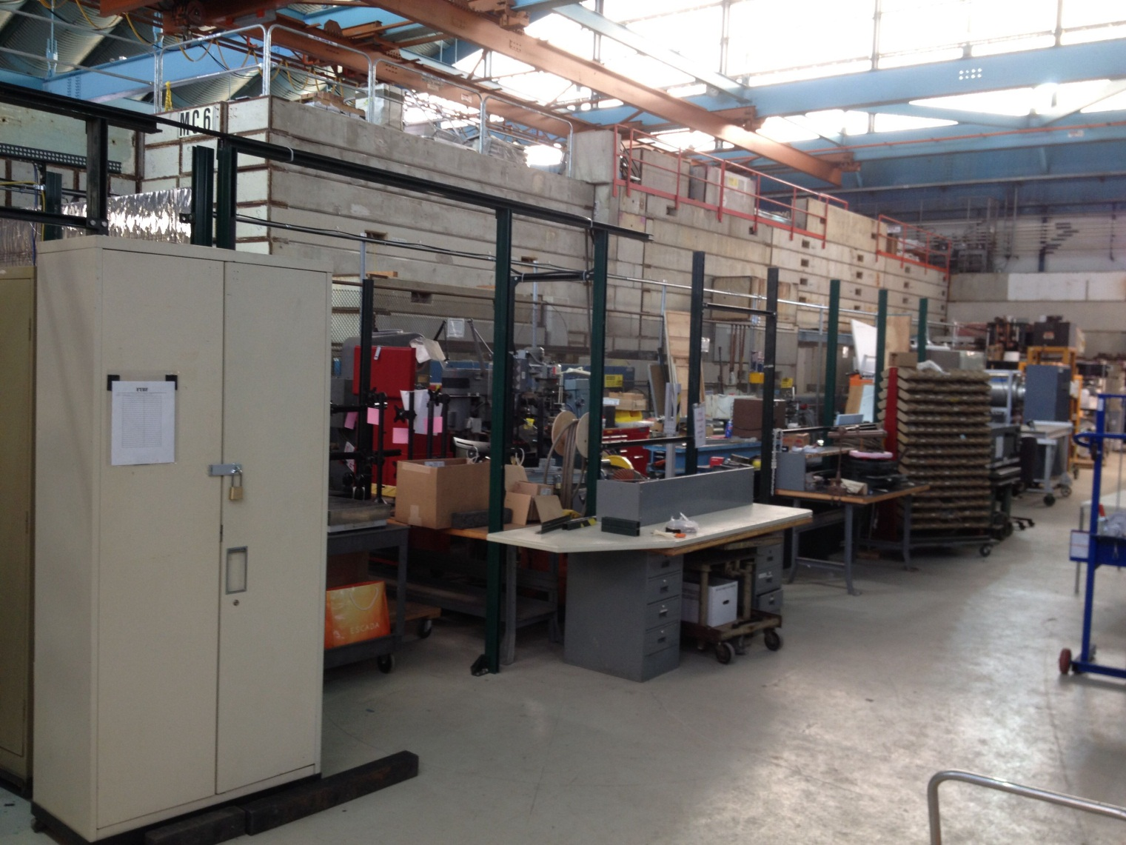
New shop/work area pending rad safety approval

Slide 7
Scheduling for FY15
T0977 (MINERvA) proposed a major installation and run in MT6.2D for beginning of this fiscal year. “The experimenters’ primary need is to calibrate the MINERvA scintillator response (reconstructed energy) to pions and electrons, to measure the resolution in the response, and to reduce and then estimate the bias on the calorimetric shower energy reconstruction for these particles.” Installation, commissioning, and data taking was projected to take from September, 2014 to Feb. 24, 2015 with first two month coinciding with accelerator shutdown.
Knowing this, FTBF reduced activities to promote test beam and did not accept requests until final MINERvA TSW was accepted and signed.
MINVERvA is behind schedule and not taking production data. We have managed to run four experiments alongside the installation process. (verbal discussion of partial ORCs goes here)
Current FY15 schedule follows on next three slides.

Slide 8
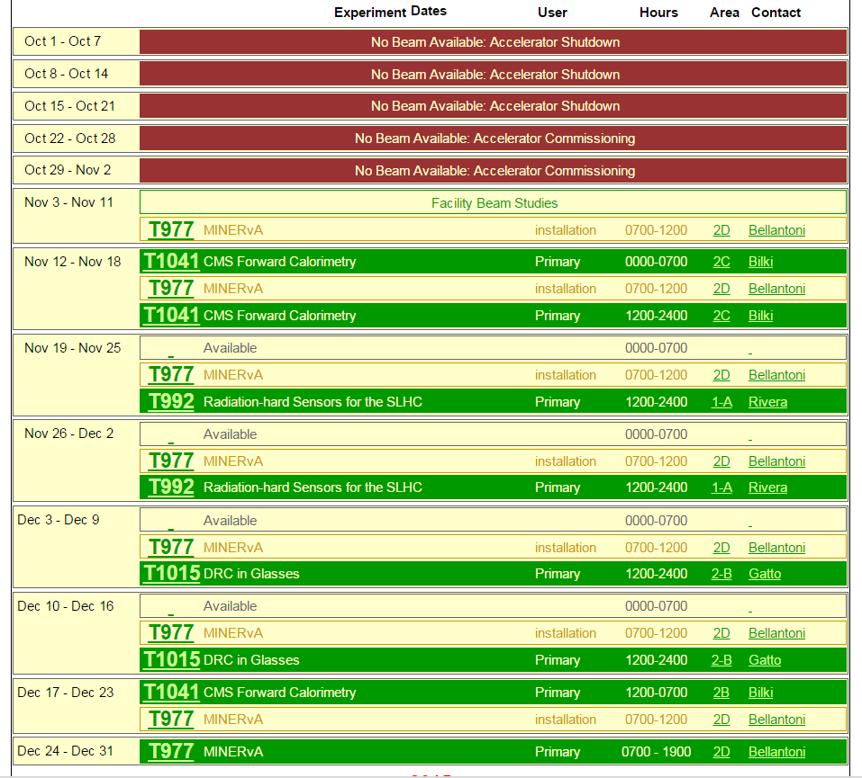
MTEST FY15 Schedule

Slide 9
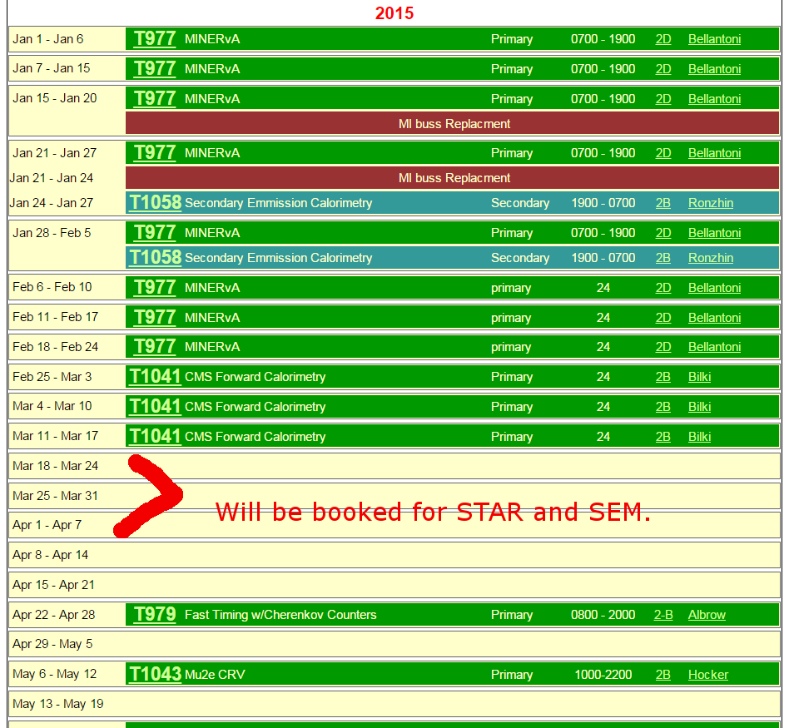
MTEST FY15 Schedule (cont’d)

Slide 10
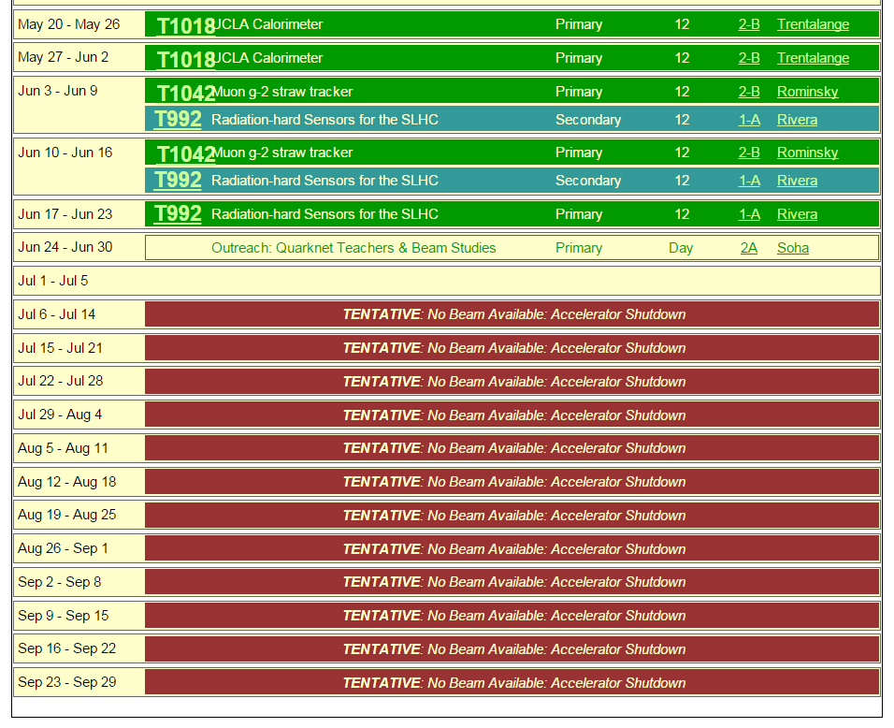
MTEST FY15 Schedule (cont’d)

Slide 11
Scheduling for FY15 (cont’d)
FTBF has four open weeks before FT15 accelerator shutdown and other weeks with open owl shifts. It is likely that these will fill in OR be necessary for additional beam time for MINERvA OR other experiments that lose scheduled slot if accelerator has major problem. Note that FTBF policy is not to slide schedule for accelerator downtimes but look for other times to satisfy experiment’s requests.
(Good place to point out that flexibility of either not being fully booked or having MCENTER as alternate for some experiments would be helpful.)

Slide 12
Summary
MTEST will have a good FY15. It is not yet clear if MINVERvA will have scheduling problems for production data taking.
Facility has been modest but important enhancements to physical infrastructure and instrumentation.

