Slide 1
Model for Future Usage & Metrics
Fermilab Testbeam Committee Meeting
July 29, 2015
Eugene “JJ” Schmidt

Slide 2
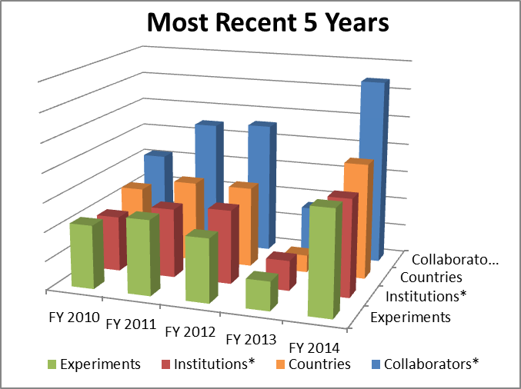
Model for Future Usage
Main information only comes from past usage at the moment.

Slide 3
No obvious reasons to think usage at FTBF will either fall off substantially or increase exponentially.
To make progress on predicting requires staffing levels at FTBF to permit:
Travel to conferences
Interaction with other groups at lab. (Would be nice for example to have time to attend regular meetings of big customers like MINERvA, LArIAT, CD detector group.)
Development of a Users’ Meeting or Forum.
Ideas on metrics are welcome.

