Slide 1
A Few words on the Muon accelerator program (MAP)

Slide 2
Program Mission
The mission of the Muon Accelerator Program (MAP) is to develop and demonstrate the concepts and critical technologies required to produce, capture, condition, accelerate, and store intense beams of muons for Muon Colliders and Neutrino Factories. The goal of MAP is to deliver results that will permit the high-energy physics community to make an informed choice of the optimal path to a high-energy lepton collider and/or a next-generation neutrino beam facility. Coordination with the parallel Muon Collider Physics and Detector Study and with the International Design Study of a Neutrino Factory will ensure MAP responsiveness to physics requirements.
How we are executing this mission?
  By supporting the development of muon accelerator technologies for the full range of capabilities described:
  Short baseline neutrino factory:
    nuSTORM design, costing and proposal –
    a design for which no new technology requirements exist
  Long baseline neutrino factory:
    IDS-NF design – aimed at optimal physics reach
    Staged complex at Fermilab –
    aimed at a realistic (ie, staged) deployment of NF capabilities a NuMAX concept
      Starting with a 1 MW proton driver and no ionization cooling…
  Collider options:
    From a Higgs Factory to…
    A multi-TeV Collider (extending up to energy ranges that may be required by LHC results)
    Again utilizing a staged complex at Fermilab…

Slide 3
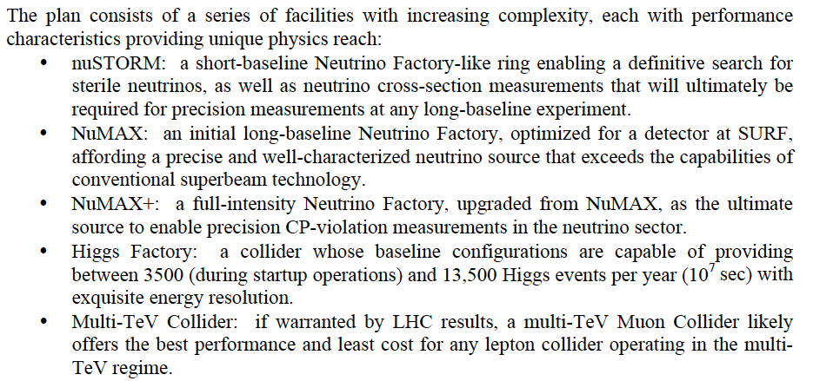
The Staging Study (MASS)
Enabling Intensity and Energy Frontier Science with a Muon Accelerator
Facility in the US - http://arxiv.org/pdf/1308.0494
Ability to utilize some or all stages

Slide 4
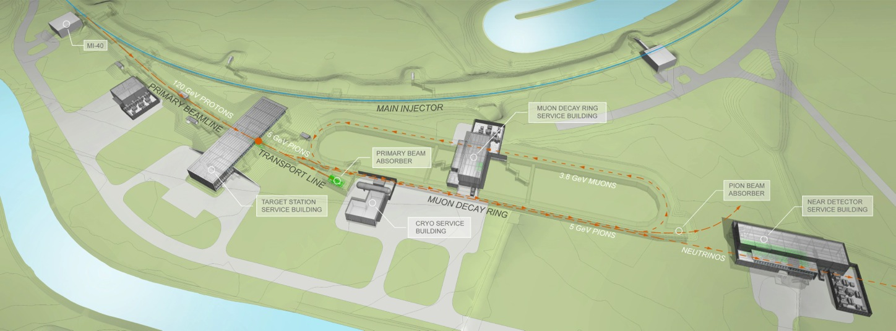
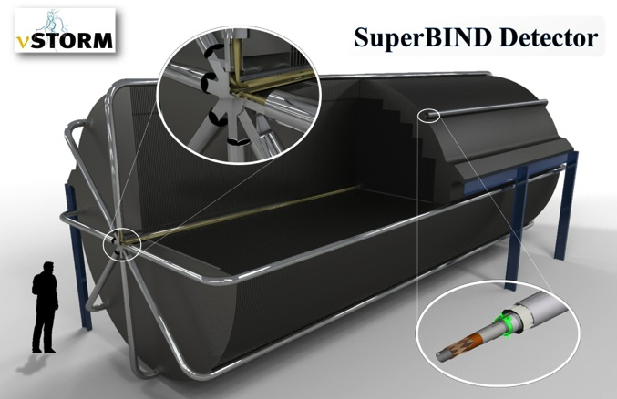
Neutrino Factories
νSTORM – Short Baseline ν factory
Definitive measurement of sterile neutrinos
Precision ν_{e} cross-section measurements
(key systematic for LB SuperBeam experiments)
Muon accelerator proving ground…
Far Detector
To Far
Detector
  NuMAX (Neutrinos from a Muon Accelerator CompleX)
  Long baseline concept developed by MAP
    As part of its Muon Accelerator Staging Study (MASS)
  Evolutionary from IDS-NF Concept a FNAL to SURF baseline
    Magnetized detector (MIND, Mag LAr?)
    CP violation sensitivity optimal for 4-6 GeV beam energy
    Provides ongoing short baseline capabilities

Slide 5
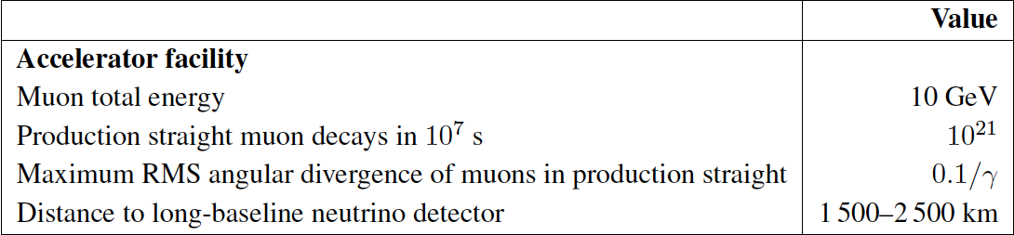
The Long Baseline Neutrino Factory
IDS-NF: the ideal NF
  Supported by MAP
MASS working group:
A staged approach -
NuMAX@5 GeVaSURF

Slide 6
Precision Capabilities for the ν Sector
Both short- (νSTORM) and long-baseline (NuMAX) options provide routes to high precision measurements in the ν sector with very well understood systematics
NuMAX
  Ultimate microscope for the ν sector
  Offers:
    Well-characterized beam
    Energy Flexibility
    Discovery Potential!
Ex: nuSTORM + T2HK offers significantly improved sensitivity vs T2HK alone
GLoBES Comparison of Potential
Performance of the Various
Advanced Concepts (courtesy P. Huber)
  High intensity “precision beams” providing sensitive probes for new physics
NuMAX+ targets equivalent sensitivity to CP violation in the ν sector as has been achieved in the flavor sector

Slide 7
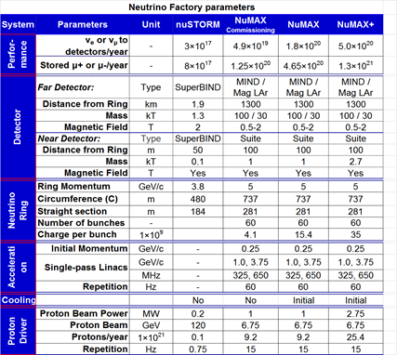
NF Staging (MASS)
6D

Slide 8
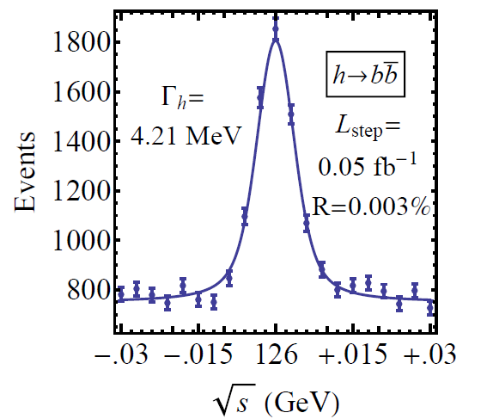
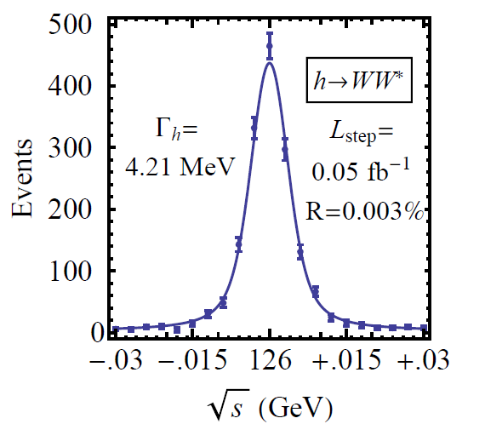

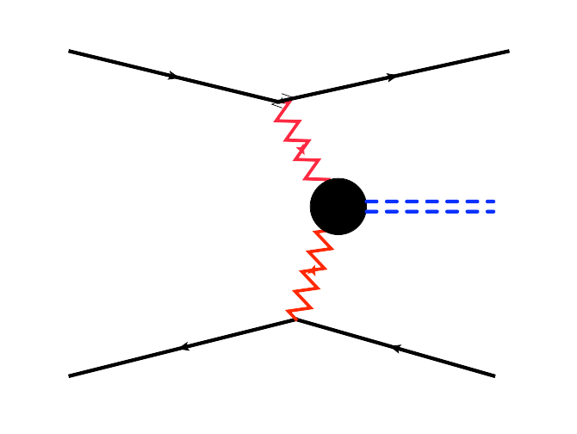
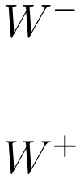


Features of the Muon Collider
Superb Energy Resolution
  SM Thresholds and s-channel Higgs Factory operation
Multi-TeV Capability (≤ 10TeV):
  Compact & energy efficient machine
  Luminosity > 10³⁴ cm⁻² s⁻¹
  Option for 2 detectors in the ring
  For √s > 1 TeV: Fusion processes dominate
  a an Electroweak Boson Collider
  a a discovery machine complementary to a
  very high energy pp collider
  At >5TeV: Higgs self-coupling resolutions of <10%
What are our accelerator options if new LHC
data shows evidence for a multi-TeV particle spectrum?

Slide 9
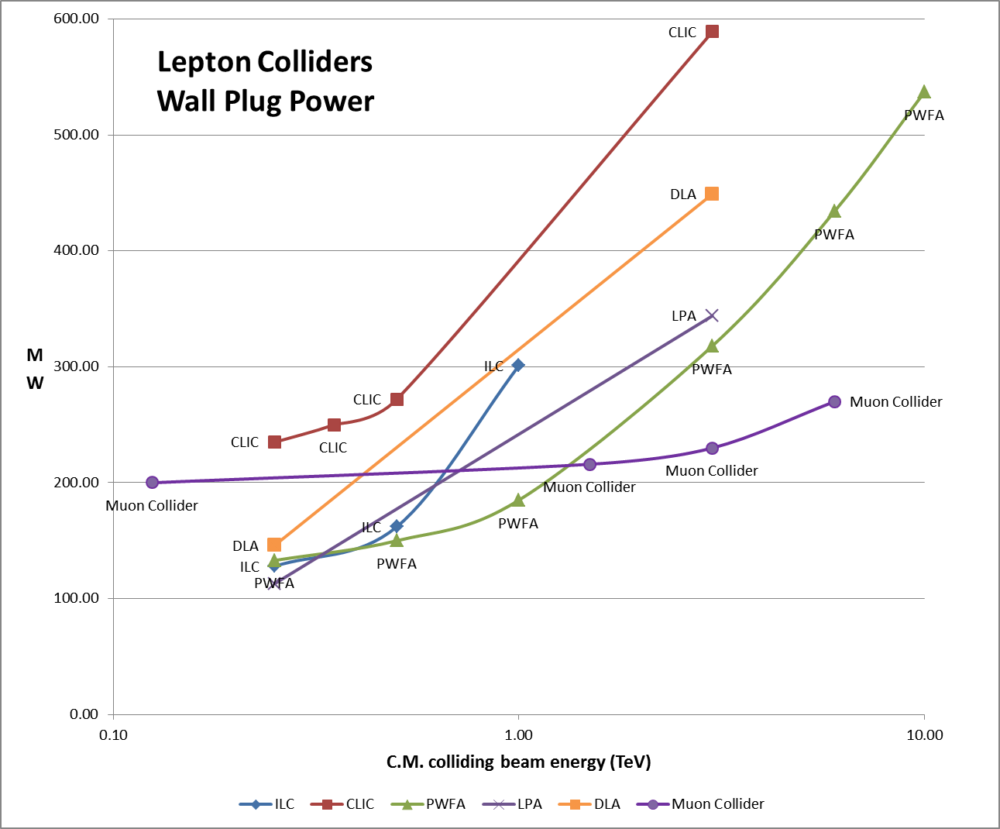
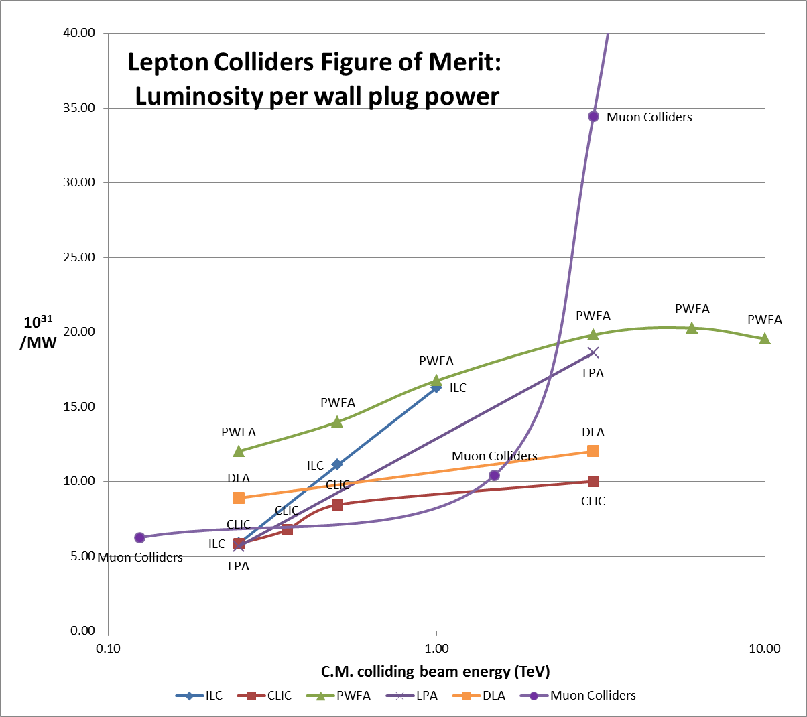
Muon Colliders extending high energy frontier with potential of considerable power savings
J.-P. Delahaye

Slide 10
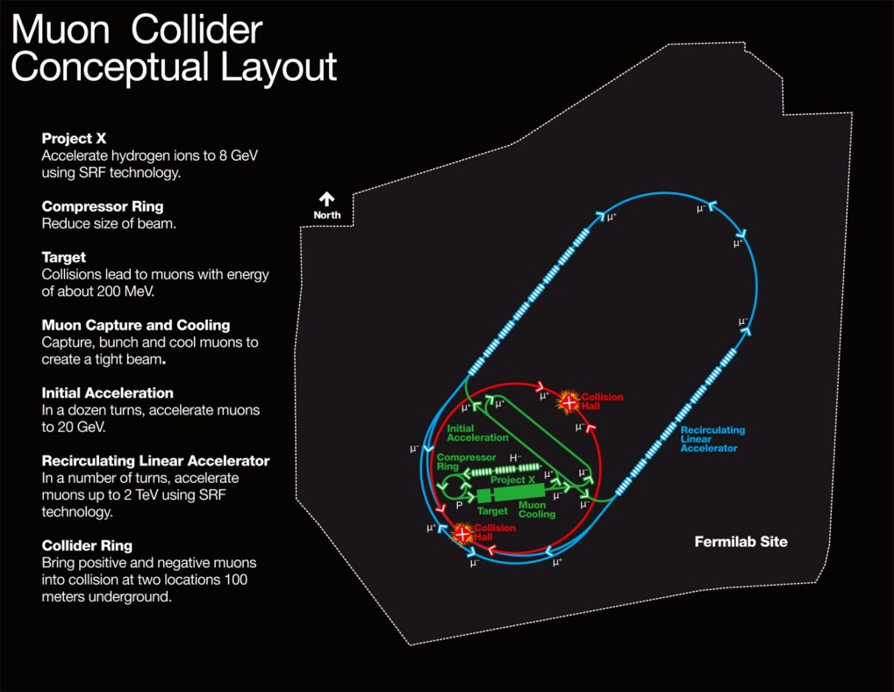
Muon Collider Parameters
Exquisite Energy Resolution
Allows Direct Measurement
of Higgs Width
Success of advanced cooling
concepts a several × 10³²
Site Radiation mitigation with depth and lattice design: ≤ 10 TeV

Slide 11
MAP Timeline a Provide Informed Decision Points
 | 2010 |  | ~2020 |  | ~2030
Muon Accelerator R&D Phase
Proton Improvement Plan @ FNAL
Intensity Frontier
Energy Frontier
MAP Feasibility Assessment
Advanced Systems R&D
Indicates a date when an informed decision should be possible
Muon Ionization Cooling Experiment (MICE)
PIP-II
And Further Proton Source Improvements
IDS-NF RDR
Proposed Muon Storage Ring Facility (νSTORM)
Option for Long Baseline ν Factory (NuMAX)
Collider Conceptual ➔ Technical Design
Option for μ Collider

Slide 12
R&D Effort
Scope – A focused effort to demonstrate feasibility
  Provide:
    Specifications for all required technologies
    Baseline design concepts for each accelerator system (see block diagram to follow)
  For novel technologies:
    Carry out the necessary design effort and R&D to assess feasibility
    Note: a program of advanced systems R&D is anticipated after completion of the feasibility assessment
  Ongoing Technology R&D and feasibility demonstrations include:
    MuCool Test Area experimental program (FNAL): RF in high magnetic fields
    The Muon Ionization Cooling Experiment (MICE@RAL):
      Demonstration of emittance reduction
      Validation of cooling channel codes
    Advanced magnet R&D
      Very high field magnets (cooling channel and storage rings)
      Rapid cycling magnets for acceleration of short-lived beams

Slide 13
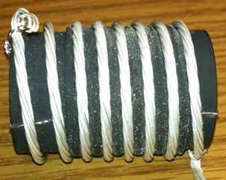
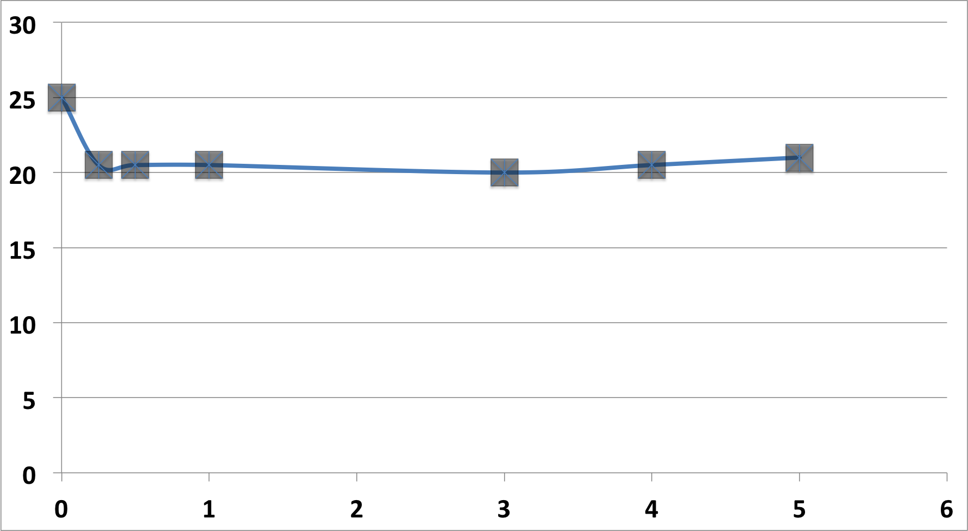
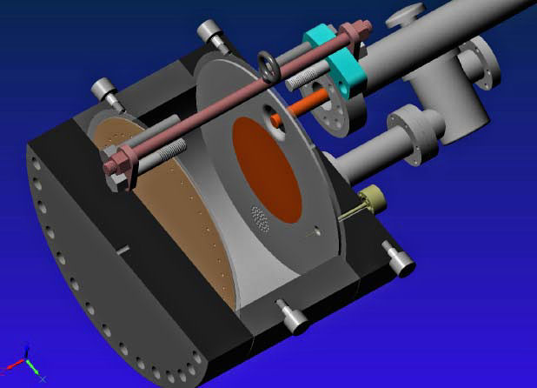
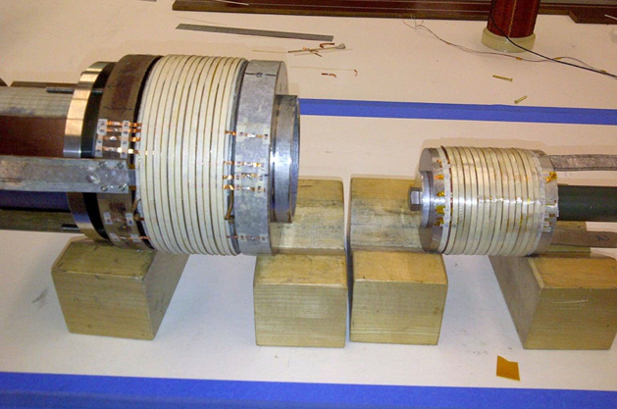
Cooling Channel R&D Effort
>20MV/m operation
in up to 5 T B-field
Successful Operation of 805 MHz “All Seasons” Cavity in 5T Magnetic Field under Vacuum
MuCool Test Area/Muons Inc
World Record
HTS-only Coil
15T on-axis field
16T on coil
PBL/BNL
Demonstration of High Pressure RF Cavity in 3T Magnetic Field with Beam
Extrapolates to
μ-Collider Parameters
MuCool Test Area
Breakthrough in HTS Cable Performance with Cables Matching Strand Performance
FNAL-Tech Div
T. Shen-Early Career Award
The Path to a Viable
Muon Ionization
Cooling Channel
1% Dry Air (0.2% O2) in GH2
Pure GH2
1% Dry Air
(0.2 % O2)
in GH2 at
B = 3T
~50X reduction in
RF power dissipation
E₀ = 25 MV/m

Slide 14
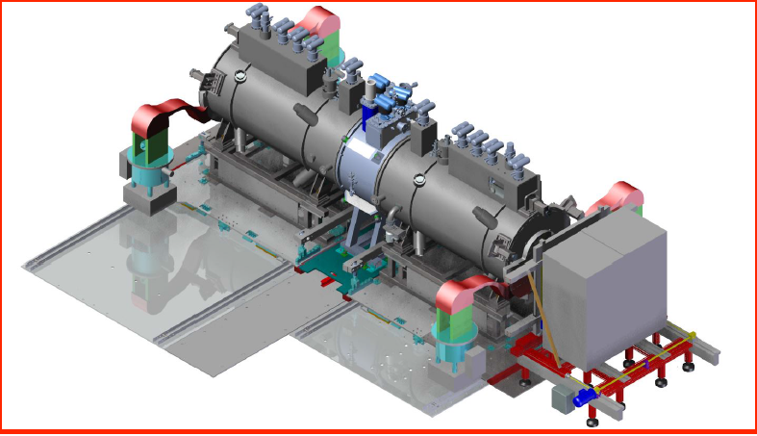
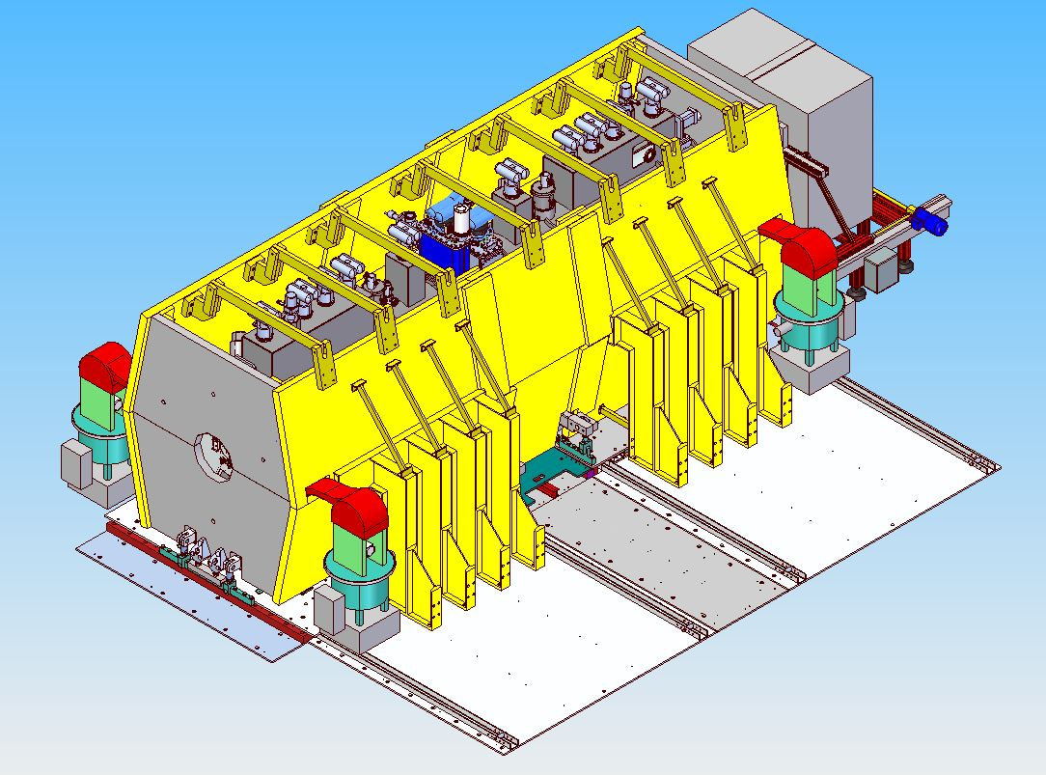
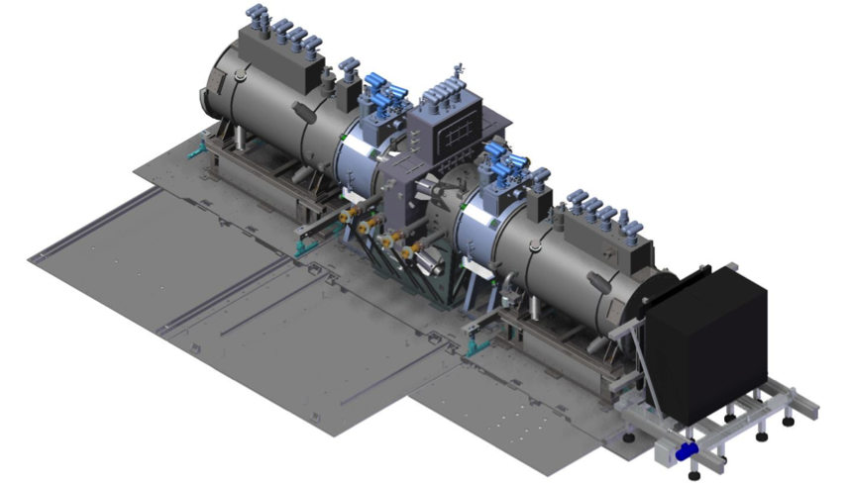
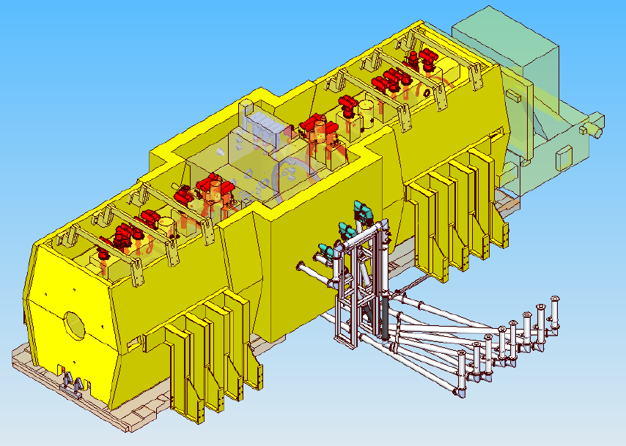
MICE Experiment @RAL
2015 Data
MICE Step IV:
Study of Absorber
Materials
US
US
US-UK
Commission
in 2017
(expedited
schedule)
MICE Step V: Demonstration of Muon Cooling w/RF
re-acceleration
US
US
Bottom Half of Slide No Longer Valid –
MICE Step IV superceded by MICE Ionization Cooling Demonstration Confgiruation
US
US-UK

Slide 15
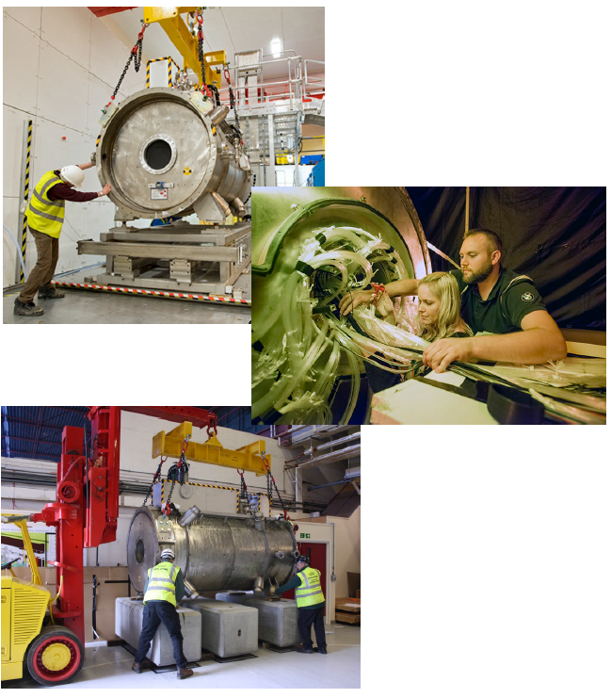
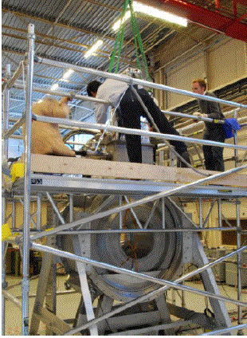
MICE Step IV Integration

Slide 16
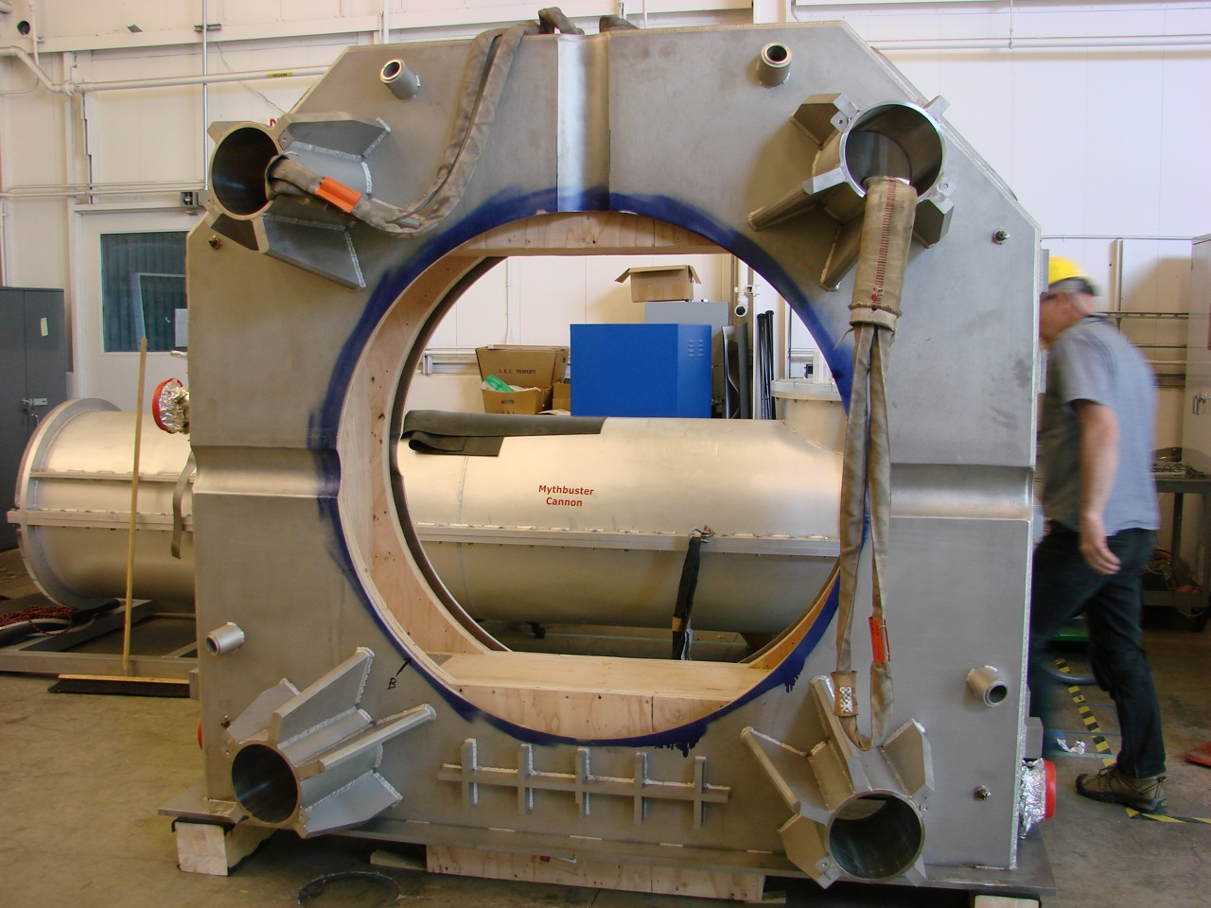
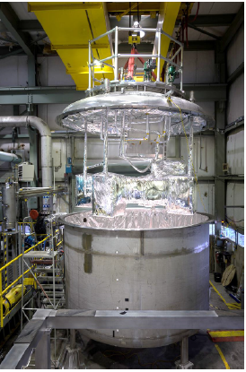
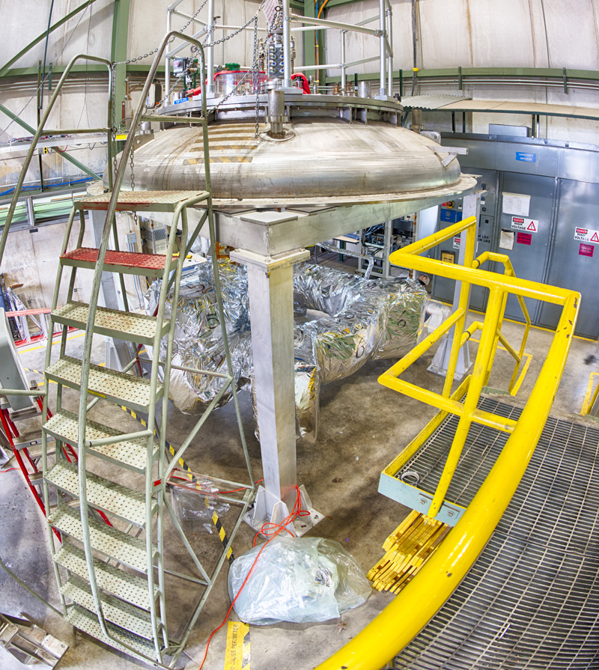
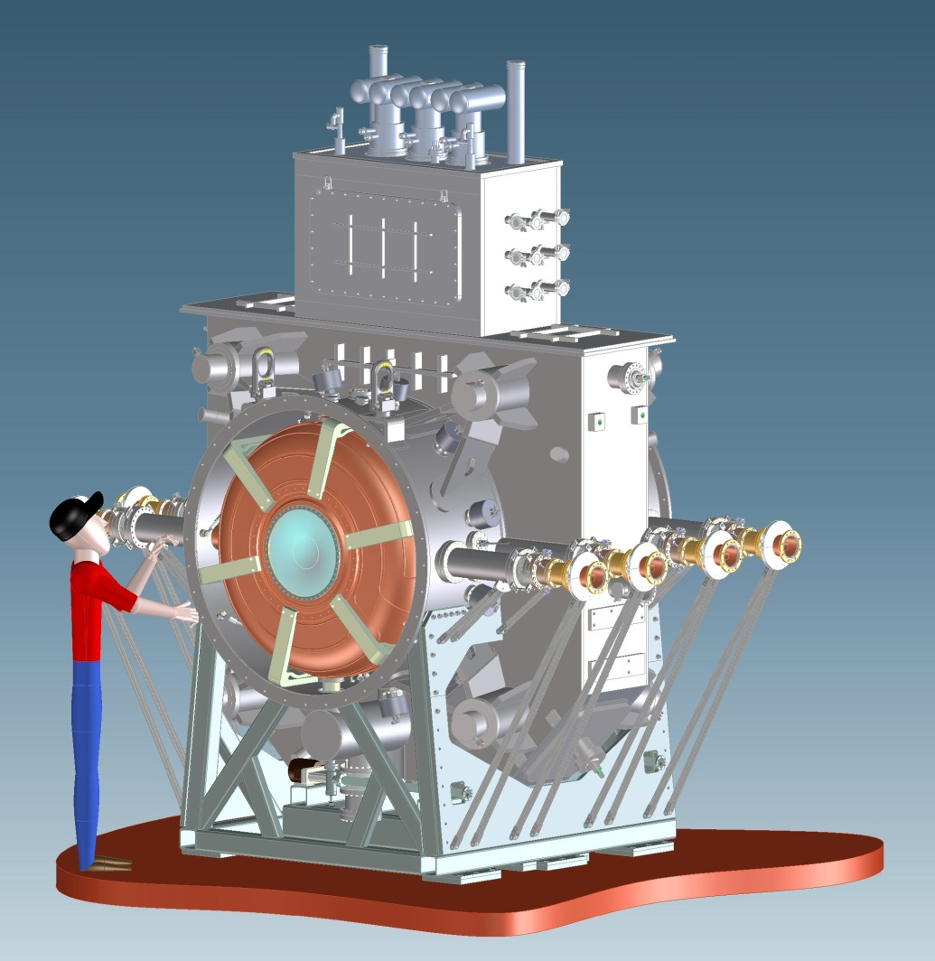
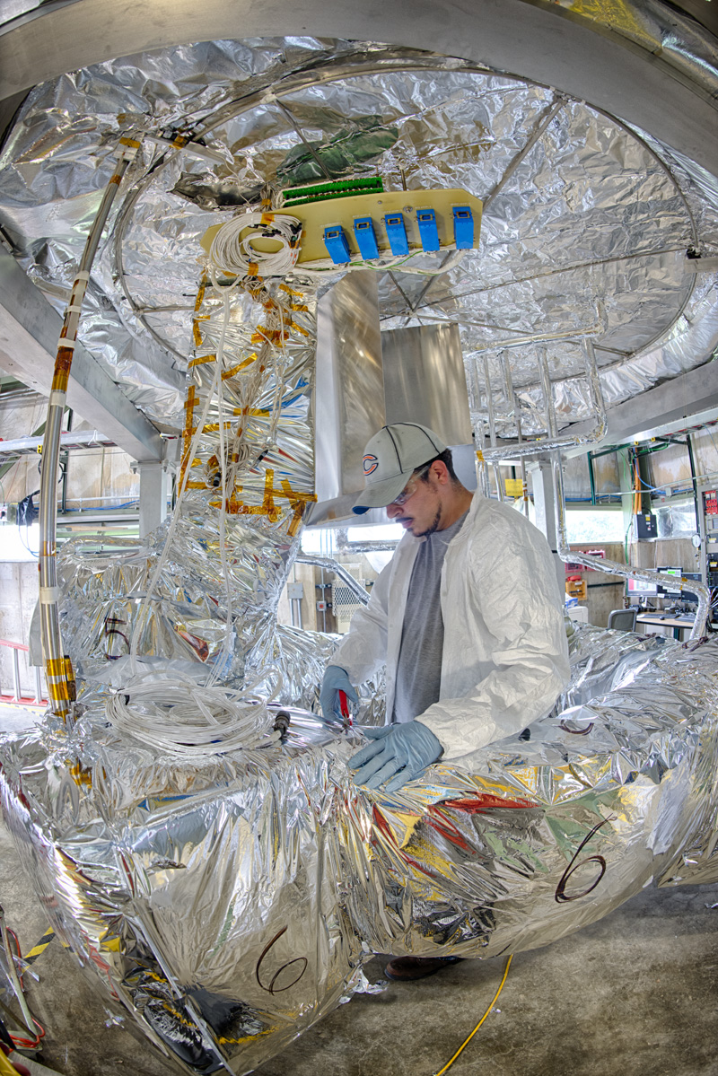
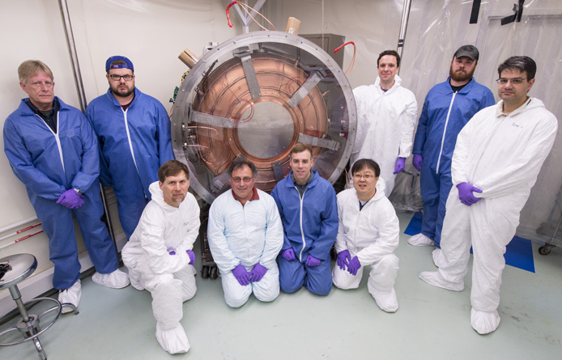
MICE Step V RFCC
Slide No Longer Valid –
MICE Step V now superceded by MICE Ionization Cooling Demonstration Configuration with a simplified cooling channel optics (no RFCC)

Slide 17
The Key Choices
The breadth of science that can be supported by a muon accelerator capability argues for continued support of the directed national accelerator R&D program (integrated with a global R&D effort) which is now in its 3rd year
  Feasibility Assessment available by the end of the decade
NF:
The R&D would support future high precision capabilities with well-understood systematics
MC:
The R&D would prepare for the possibility that LHC running reveals the lowest states of a new particle spectrum
Note that the MC may be the only viable route to a several TeV lepton collider capability in the next 20 years

Slide 18
Comments
Where are we heading now? P5 Recommendations…
  A plan for expedited completion of MICE was already presented to the MICE Project Board in April – endorsed
    Includes Step IV measurements in 2015-16 and deployment of
    Step V configuration by 2017 (demonstration of “cooling with RF”)
  Have been requested by DOE to prepare a transition plan
    Preserve critical investments – both technical and human resources
    Sensitivity to international commitments
    3 Major Thrusts:
      MICE Conclusion
      Critical activities that should be preserved within the GARD program
      Lower priority items that will be deferred
    Review planned in several weeks
      Will serve as input to the Accelerator R&D Panel
      Will determine FY15 budget while awaiting the panel’s report

Slide 19
Backup Slides

Slide 20
Summary I
Muon accelerators can provide unique options for a facility at the intensity and energy frontiers
  Precision neutrino measurements a sensitivity to new physics
  A promising path to a multi-TeV lepton collider:
    if required by (new) physics results
    with reasonable footprint, cost & power consumption
  A TeV-scale collider has complementary discovery potential to a 100TeV pp FCC
    See talk by Estia Eichten: https://indico.fnal.gov/getFile.py/access?contribId=16&sessionId=0&resId=0&materialId=slides&confId=8326)
  MAP Program Execution Plan endorsed by DOE Review in Feb 2014 for completion of feasibility assessment by 2020.

Slide 21
Summary II
MASS: An attractive Staging Path for Muon Accelerators
  A series of facilities with increasing complexity and physics reach – with manageable budget and risk for each stage
  Provides an integrated R&D platform at each stage for validation of the technologies required by subsequent stages
  Dates for informed technical decisions for specific facilities:
    Early 2020s for a long-baseline Neutrino Factory (NuMAX)
    Late 2020s for a Muon Collider
  A facility capable of flexibility in adapting to a range of physics requirements
Uniquely suited to the accelerator complex at Fermilab
  A natural extension of the LBNF concept
  Ability to respond to various physics thrusts

Slide 22
Comments
Where are we heading now? P5 Recommendations…
  A plan for expedited completion of MICE was already presented to the MICE Project Board in April – endorsed
    Includes Step IV measurements in 2015-16 and deployment of
    Step V configuration by 2017 (demonstration of “cooling with RF”)
  Have been requested by DOE to prepare a transition plan
    Preserve critical investments – both technical and human resources
    Sensitivity to international commitments
    3 Major Thrusts:
      MICE Conclusion
      Critical activities that should be preserved within the GARD program
      Lower priority items that will be deferred
    Review planned in several weeks
      Will serve as input to the Accelerator R&D Panel
      Will determine FY15 budget while awaiting the panel’s report

Slide 23
MAP Initial Baseline Selection Process
Now to 2016:
  Explore, develop, and select the Initial Baseline Design (IBS) of all accelerator subsystems
    Clear specifications are absolutely critical to the technology demonstrations that are being undertaken to establish the feasibility of high intensity muon accelerators
    The coupling between design and technology is clearly iterative
    However, given the knowledge that we presently have, it is crucial to clearly define the design concepts for individual systems
  To enhance the quality of the designs, the IBS process will focus primarily on a site-specific implementation at Fermilab which would build on the superconducting linac upgrade presently being planned
    It will also focus on specifications that are compatible with the conclusions of the Muon Accelerator Staging Study (MASS)
In the 2016-2020 timeframe, will launch the next set of feasibility R&D activities (on the basis of the IBS-specified designs)

Slide 24
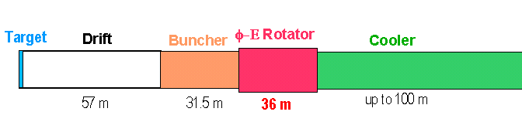
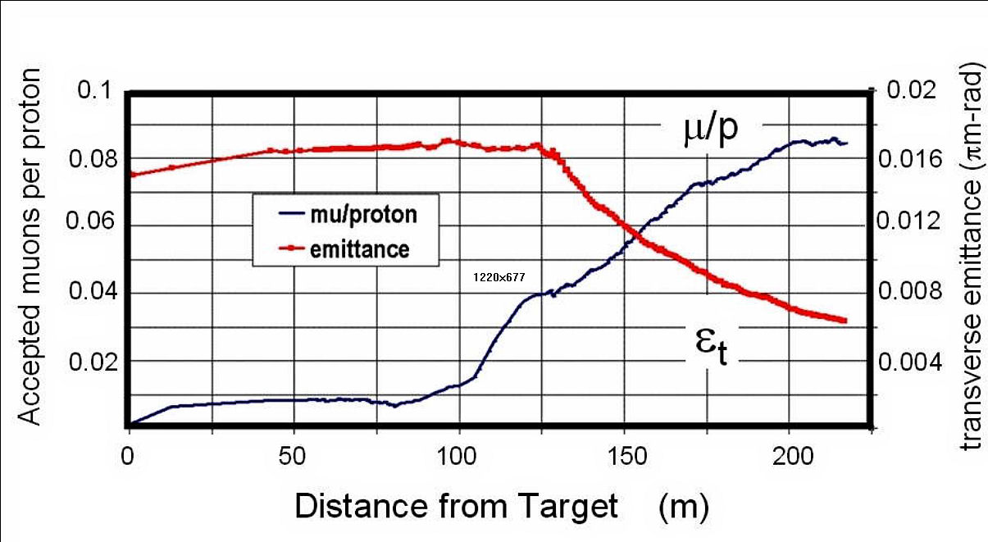
Technology Challenges – Tertiary Production
Neuffer
A multi-MW proton source, i.e., the extension of PIP-II, will enable
O(10²¹) muons/year to be produced, bunched and cooled to fit within the acceptance of an accelerator.

Slide 25
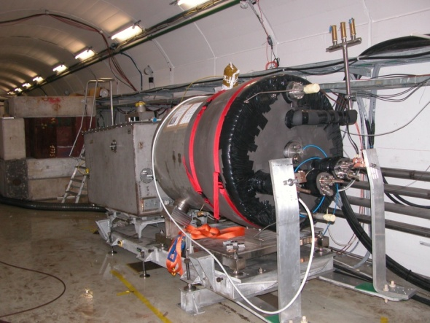
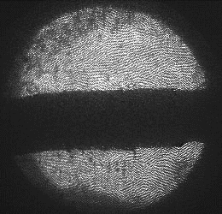
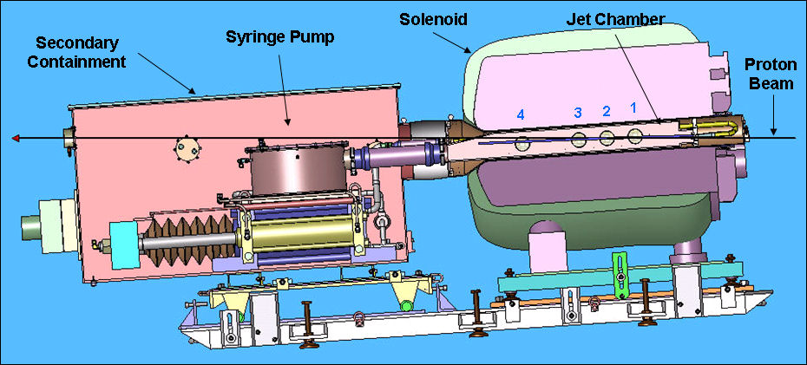
Key Technologies - Target
The MERIT Experiment at the CERN PS
  Demonstrated a 20m/s liquid Hg jet injected
  into a 15 T solenoid and hit with a
  115 KJ/pulse beam!
  Jets could operate with beam powers up to
  8 MW with a repetition rate of 70 Hz
MAP staging aimed at initial 1 MW target
1 cm
Hg jet in a 15 T solenoid
with measured disruption length ~ 28 cm

Slide 26
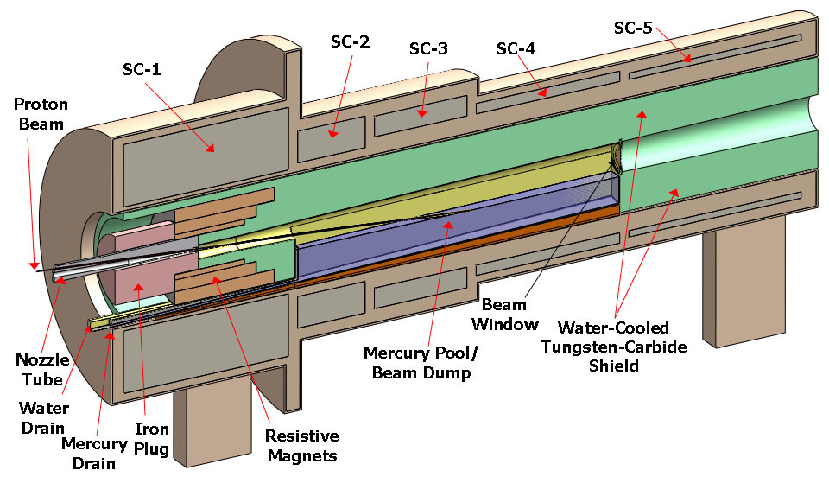
TechnoIogy Challenges – Capture Solenoid
A Neutrino Factory and/or Muon Collider Facility requires challenging magnet design in several areas:
  Target Capture Solenoid (15-20T with large aperture)
  E_{stored} ~ 3 GJ
  O(10MW) resistive
  coil in high radiation
  environment
  Possible application
  for High Temperature
  Superconducting
  magnet technology

Slide 27
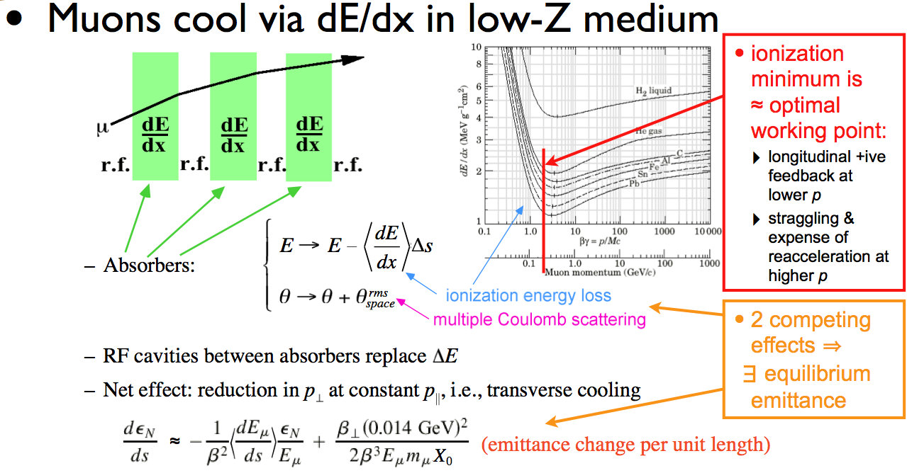
Ionization Cooling
D. Kaplan

Slide 28
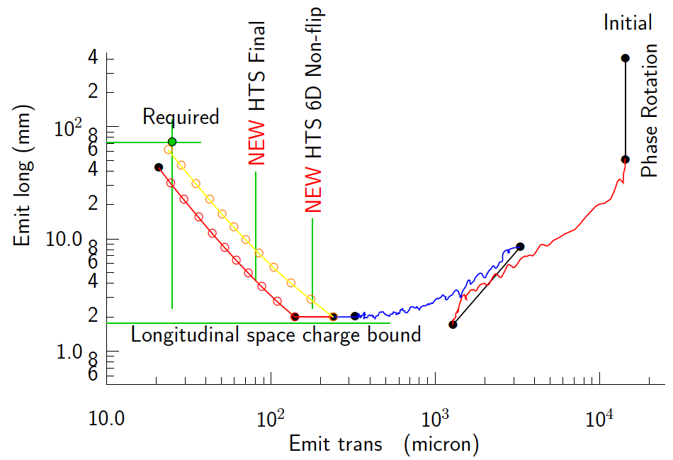
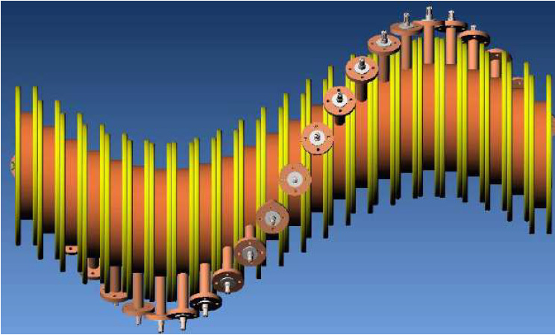
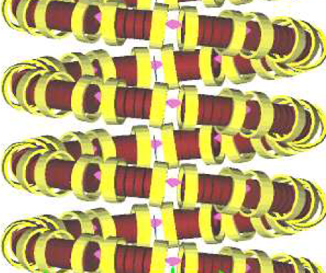
Technology Challenges - Cooling
Development of a cooling channel design to reduce the 6D phase space by a factor of O(10⁶) → MC luminosity of O(10³⁴) cm⁻² s⁻¹
R. Palmer
Emittance Reduction
via Ionization Cooling
Some components beyond state-of-art:
  Very high field HTS solenoids (≥30 T)
  High gradient RF cavities operating in multi-Tesla fields
The program targets critical magnet and cooling cell technology demonstrations within its feasibility phase.
Cooling
Channel
Concepts
HCC
Guggenheim

Slide 29
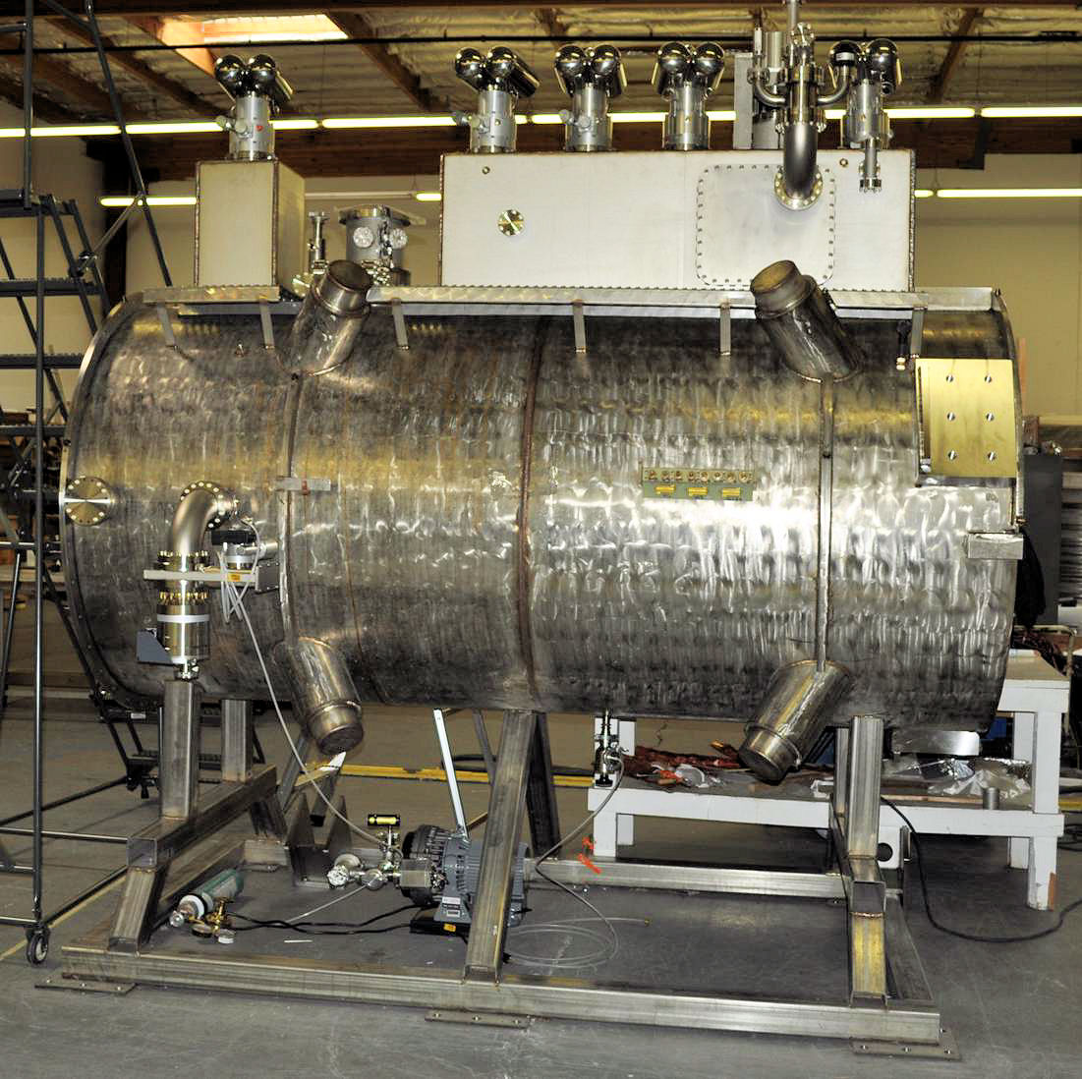
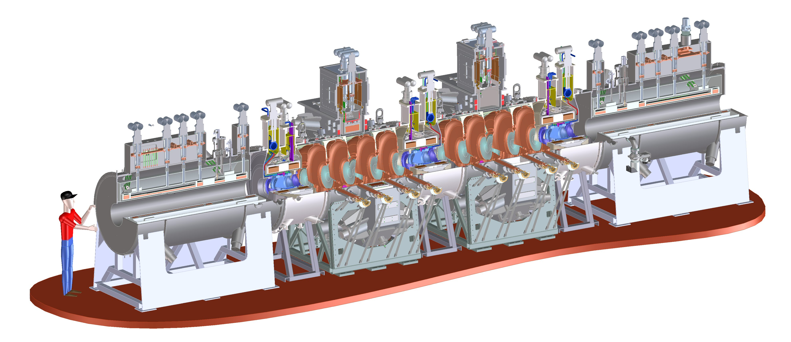
Technology Challenges - Cooling
Tertiary production of muon beams
  Initial beam emittance intrinsically large
  Cooling mechanism required, but no
  radiation damping
Muon Cooling a Ionization Cooling
    dE/dx energy loss in materials
    RF to replace p_{long}
First SS delivered
to RAL for Step IV
Experiments in 2015
MICE
  The Muon Ionization
  Cooling Experiment:
  Demonstrate the
  method and validate
  our simulations
RF-Coupling
Coil (RFCC)
Units
Spectrometer
Solenoids

Slide 30
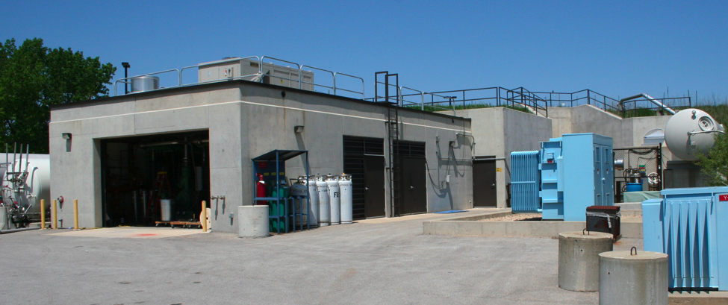
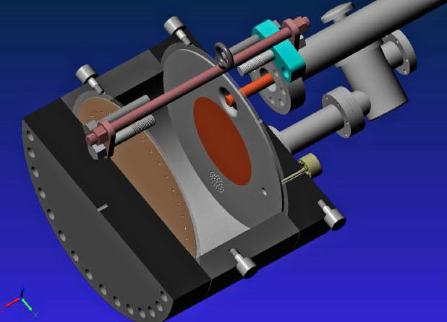
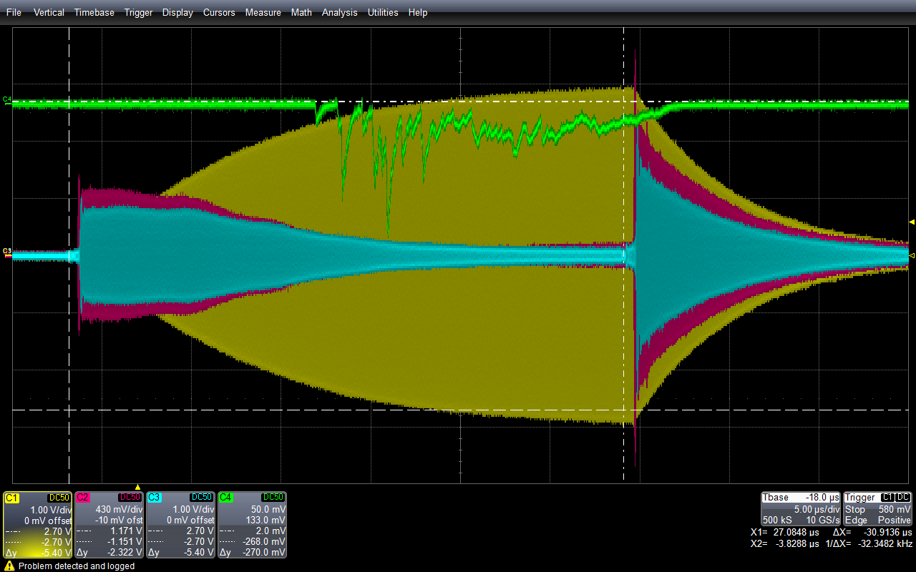
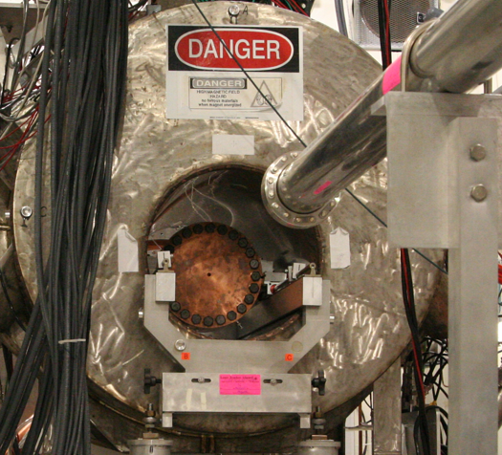
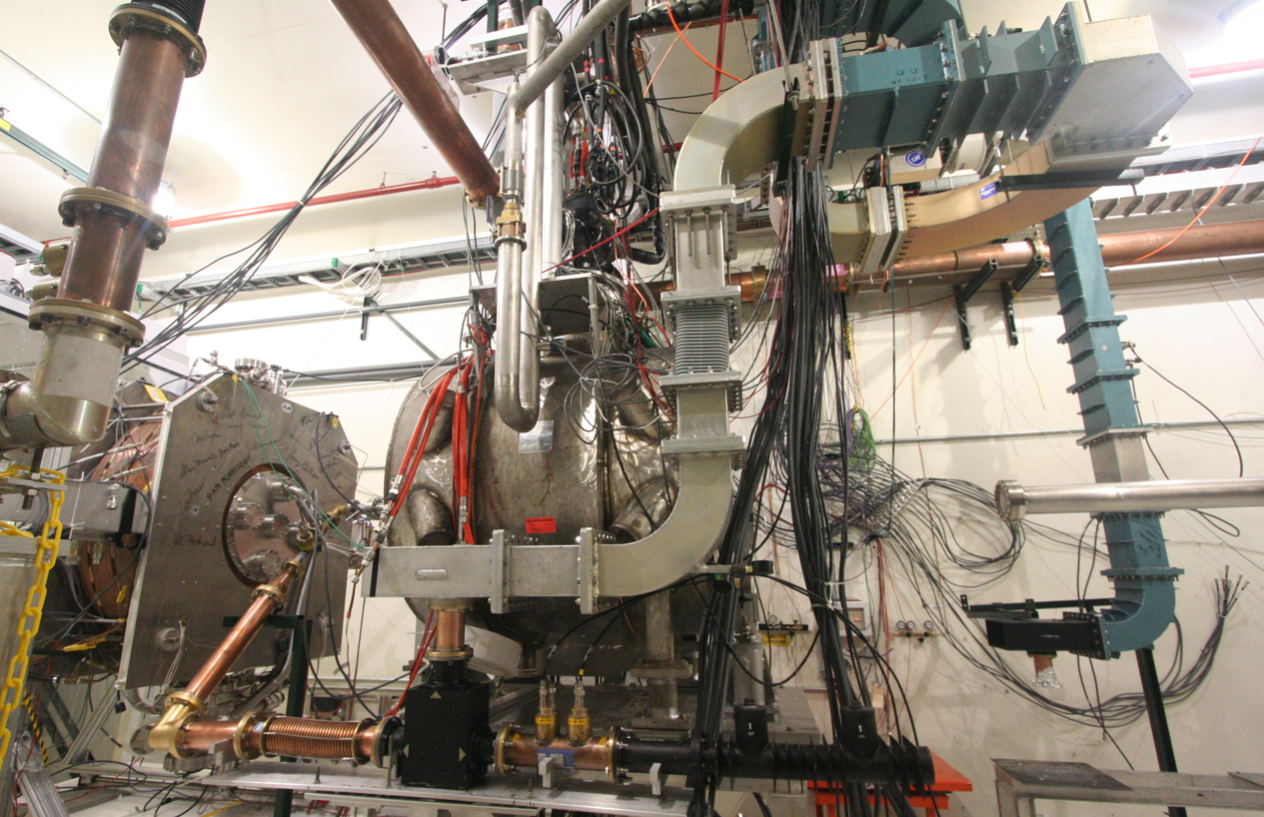
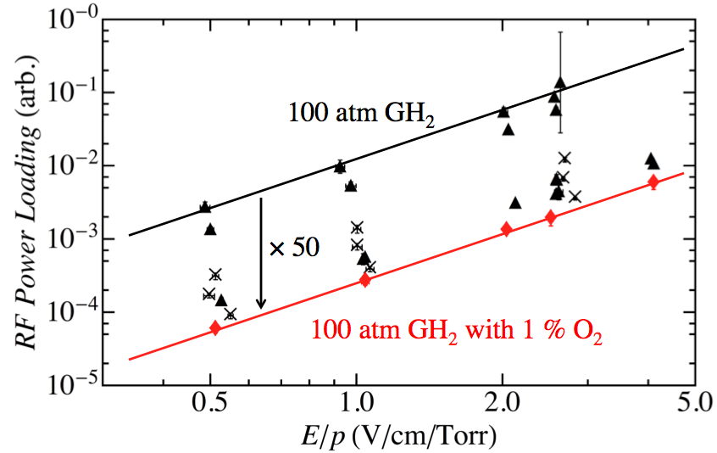
Elements of the R&D Program
MuCool Test Area
Vacuum RF Cavity –
now operational in 5T B-field
Entrance of
MTA exp. hall
Compressor + refrigerator room
400 MeV
H⁻ Beam
20 MV/m in 3 Tesla
MTA Hall
Gas-Filled RF cell
201 MHz cavity
SC magnet
400 MeV H⁻ beam

Slide 31
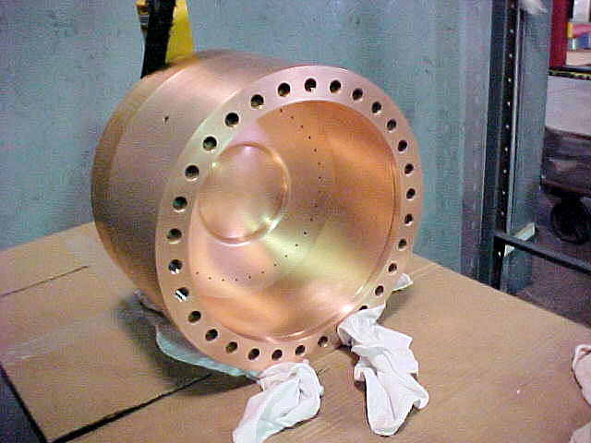
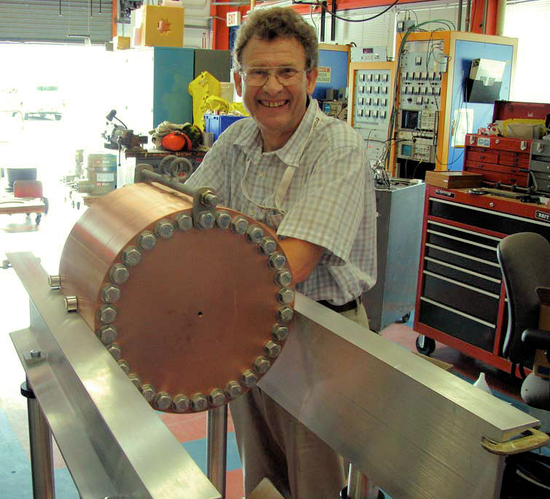
Recent Progress – Vacuum RF
All-Seasons
Cavity
(designed for both
vacuum and high
pressure operation)
Now operated in magnetic fields up to 5T:
  Gradients > 20 MV/m
Demonstrates possibility of successful operation of vacuum cavities in magnetic fields with careful design
Successor design (the 805 MHz Modular Cavity) will be ready for testing during FY14
Also progress on alternative cavity materials

Slide 32
Recent Progress - High Pressure RF
Gas-filled cavity
  Can moderate dark current and breakdown currents in magnetic fields
  Can contribute to cooling
  Is loaded, however, by beam-induced plasma
Electronegative Species
  Dope primary gas
  Can moderate the loading effects of beam-induced plasma by scavenging the relatively mobile electrons
1% Dry Air (0.2 % O2) in GH2
Pure GH2
1% Dry Air
(0.2 % O2)
in GH2 at
B = 3 T
Beam on
~50× change in
RF dissipation
5/22/12
E₀ = 25 MV/m
32
E₀ = 25 MV/m

Slide 33
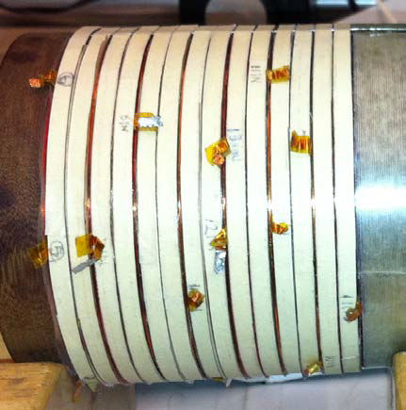
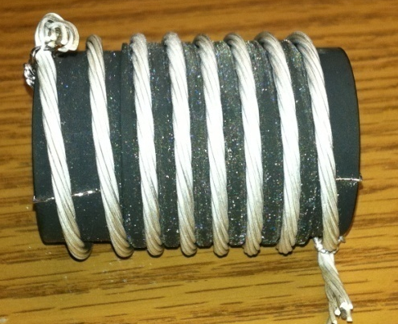

Recent Progress - High Field Magnets
Progress towards a demonstration of a final
stage cooling solenoid:
Demonstrated 15+ T (16+ T on coil)
  ~25 mm insert HTS solenoid
  BNL/PBL YBCO Design
  Highest field ever in HTS-only solenoid (by a factor of ~1.5)
Developing a test program for operating HTS insert + mid-sert in an external solenoid a >30 T
BSCCO-2212 -
New cable fabrication methods with demonstrated J_{E}
Hyperbaric processing to avoid strand damage
Multi-strand cable utilizing chemically compatible alloy and oxide layer to minimize cracks

Slide 34

Technology Challenges - Acceleration
Muons require an ultrafast accelerator chain
a Beyond the capability of most machines
Solutions include:
  Superconducting Linacs
  Recirculating Linear Accelerators (RLAs)
  Fixed-Field Alternating-Gradient (FFAG) Machines
  Rapid Cycling Synchrotrons (RCS)
  RCS requires
  2 T p-p magnets
  at f = 400 Hz
  (U Miss & FNAL)
EMMA – FFAG
JEMMRLA Proposal:
JLAB Electron Model of
Muon RLA with Multi-pass
Arcs

Slide 35


Superconducting RF Development
201 MHz SCRF R&D
Major dia.: 1.4 m
Cavity going into test pit
in Newman basement
(Cornell University)
400mm BT
Cavity length: 2 m
Pit: 5m deep X 2.5m dia.

Slide 36



Technology & Design Challenges – Ring, Magnets, Detector
Emittances are relatively large, but muons circulate for ~1000 turns before decaying
  Lattice studies for 126 GeV,
  1.5 & 3 TeV CoM
High field dipoles and
quadrupoles must
operate in high-rate
muon decay backgrounds
  Magnet designs under study
Detector shielding & performance
  Initial studies for 1.5 TeV, then 3 TeV
  and now 126 GeV
  Shielding configuration
  MARS background simulations
MARS energy deposition studies for Higgs Factory
magnets and IR

Slide 37


Backgrounds and Detector
Much of the background is soft and out of time
Nanosecond time resolution can reduce backgrounds by three orders of magnitude
Requires a fast, pixelated tracker and calorimeter.
Non-ionizing background ~ 0.1 x LHC
But crossing interval 10μs/25 ns a 400x
Slide No Longer Valid –
MARS Timing Bug Discovered mid-2014
Not yet updated, but preliminary studies still indicate that detector technologies along the lines of those being pursued for the LHC luminosity upgrades will be able to extract the key physics from the unique backgrounds of a muon collider
 | Cut | Rejection
Tracker hits | 1 ns, dedx | 9x10⁻⁴
Calorimeter neutrons | 2 ns | 2.4x10⁻³
Calorimeter photons | 2 ns | 2.2x10⁻³
GeV/c
ns

Slide 38
Overview of MAP Magnet Pull
Muon Ionization
6-Dimensional Cooling Channel
Acceleration to the TeV Energy Scale for Muon Colliders
Muon Collider Magnet Needs
Muon Ionization Final Cooling Channel
HTS Magnet Development
Capture Solenoid for Simultaneous mu+ & mu- Beams
High field (15-20T)
Large bore (meter-scale)
Intense radiation environment – NC or HTS insert coil
Characteristics:
Characteristics:
Solenoid-based cooling channel (LH₂/LiH absorbers)
RF cavities integral to focusing channel
Fields ranging from LTS to HTS conductor regime
Characteristics:
Emittance exchange channel for TeV-scale colliders (trade increased longitudinal beam emittance for smaller transverse emittance
Baseline: 30T class HTS solenoids with a>25mm
Characteristics:
Present baseline based on the use of Rapid Cycling Synchrotrons
Requires magnets capable of ~400Hz operation with >1.5T peak fields
Characteristics:
Decaying muon beams mean that luminosity is inversely proportional to circumference
10T dipole a 15-20T dipoles improves luminosity
Radiation environment
Challenging IR magnets
Characteristics:
A MC (w/decaying beams) obtains the greatest performance enhancement of any HEP collider from HTS magnet technology
High quality HTS cables and magnets must be a priority
Feasibility R&D through End of Decade

Slide 39
A Muon Accelerator Capabilities Technical Decision Tree
| Thru ~2020 | ~2020 | ~2025 | Late 2020s |
Success with NF cooling demo (MICE)
a Begin full technical design for a NF-based upgrade to LBNE
If decide to pursue precision ν sector capabilities
a Begin the NF upgrade path
If LHC finds evidence for Supersymmetry AND when MC Engineering Design ready
a Decision point on a return to the EF with a Muon Collider
(which would build on the infrastructure deployed for a NF)
MAP Feasibility Study
Failure a No path to NF and/or MC capabilities
a STOP NF/MC R&D Effort
CDR Completion and success Advanced Systems Tests
a Begin full MC Engineering Design
Success with MC Concepts
a Begin the MC CDR and Advanced Systems Tests
Failure of Advanced Systems Tests
a Terminate MC development

Slide 40
Luminosity Production Metric
Muon
Collider
Luminosity
Metric:
N_{det} × L_{avg} / P_{tot}

