Slide 1
SBN Program Implementation
Peter Wilson
Fermilab PAC
15 January 2015

Slide 2
Outline
SBN Program Motivation – Carlo Rubbia
SBN Oscillation Sensitivity – David Schmitz
This talk:
SBN Program Components
  Far Detector: T600 Refurbishment
  Middle Detector: MicroBooNE commissioning 2015
  Near Detector: LAr1-ND
  Cryogenics
  Buildings
  Possible BNB Improvements
Program Schedule
Program Funding
Organization

Slide 3
Author List

Slide 4
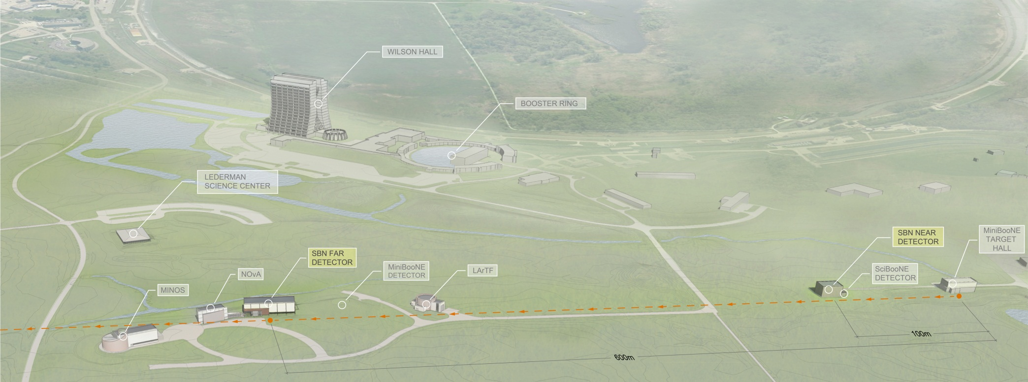
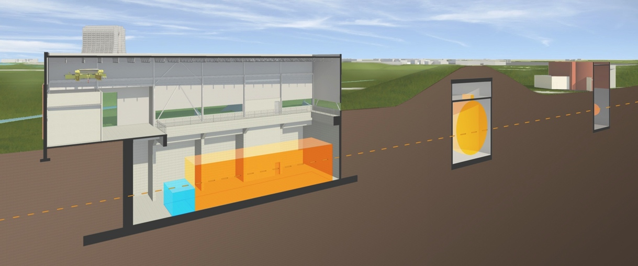
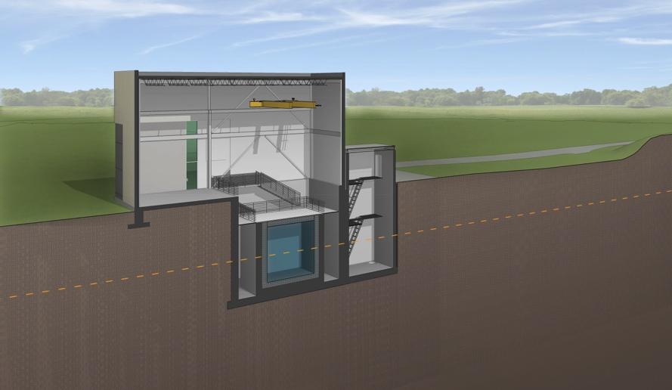
SBN Program Layout
MINOS
MI-12
MicroBooNE (existing)
170t LAr
MiniBooNE
Near Detector Lar1-ND
180t LAr
ν
ν
Far Detector – Icarus
760t LAr

Slide 5
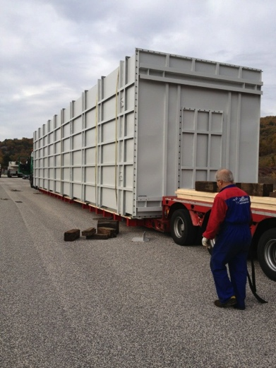
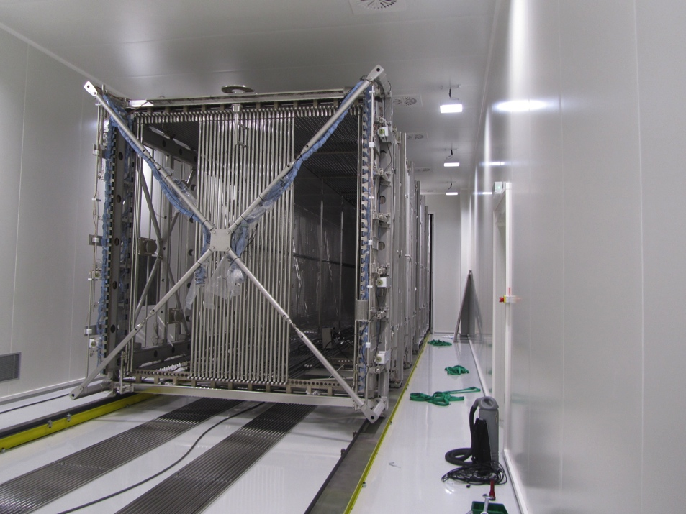
Far Detector: ICARUS-T600
Successful operation at Gran Sasso in CNGS beam
  Achieved electron lifetime >15ms
  Physics program including limits on sterile neutrinos
ICARUS-WA104 collaboration: refurbish at CERN w/new cryostats and electronics, upgraded light detection
  MOU between INFN and CERN approved
  Move from Gran Sasso to CERN Dec 2014
  Refurbishing started
Schedule: TPC delivered to FNAL as soon as the building is available, currently foreseen as early 2017
Ready to leave LNGS
First T300 in Cleanroom at CERN

Slide 6
Near Detector: LAr1-ND
Conceptual design included in proposal
Preliminary designs started
  TPC, cold electronics, laser calibration
  Cryostat
Technical design reviews in 2015
Working on coordination with LBNF designs
  eg cold electronics for CERN prototype compared to LAr1-ND
Schedule: Final TPC assembled at FNAL early 2017

Slide 7
Common Systems: Cryogenics Infrastructure
Cryogenics teams for LAr detectors formed at CERN/INFN and Fermilab
  Coordinated efforts on SBN and LBN
  Fermilab cryogenics engineer based at CERN for calendar 2015
Common designs wherever possible across multiple LAr-TPCs, e.g.
  SBN: LN2 delivery (see right)
  Cryostat design between LAr1-ND, WA104, LBNF CERN prototype
LAr filtration design for LAr1-ND builds on experience from T600, LAPD/LBNE 35ton, MicroBooNE.
Refurbishing for T600 cryogenics
Cryogenics systems scheduled for delivery to Fermilab in early to mid-2017, installation in parallel with the detectors
SBN LN2 Delivery Systems

Slide 8
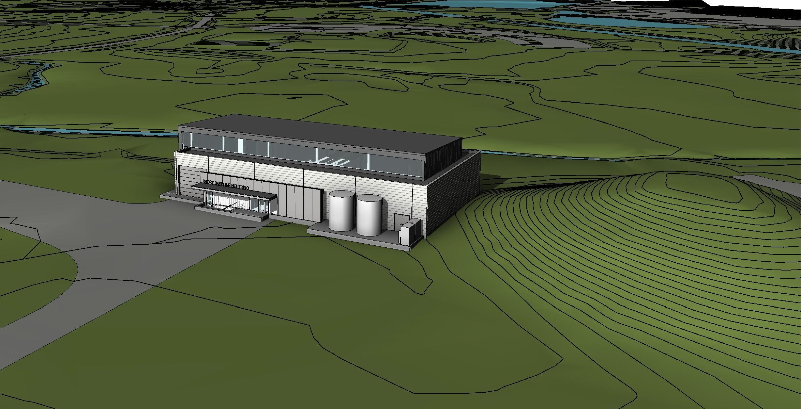
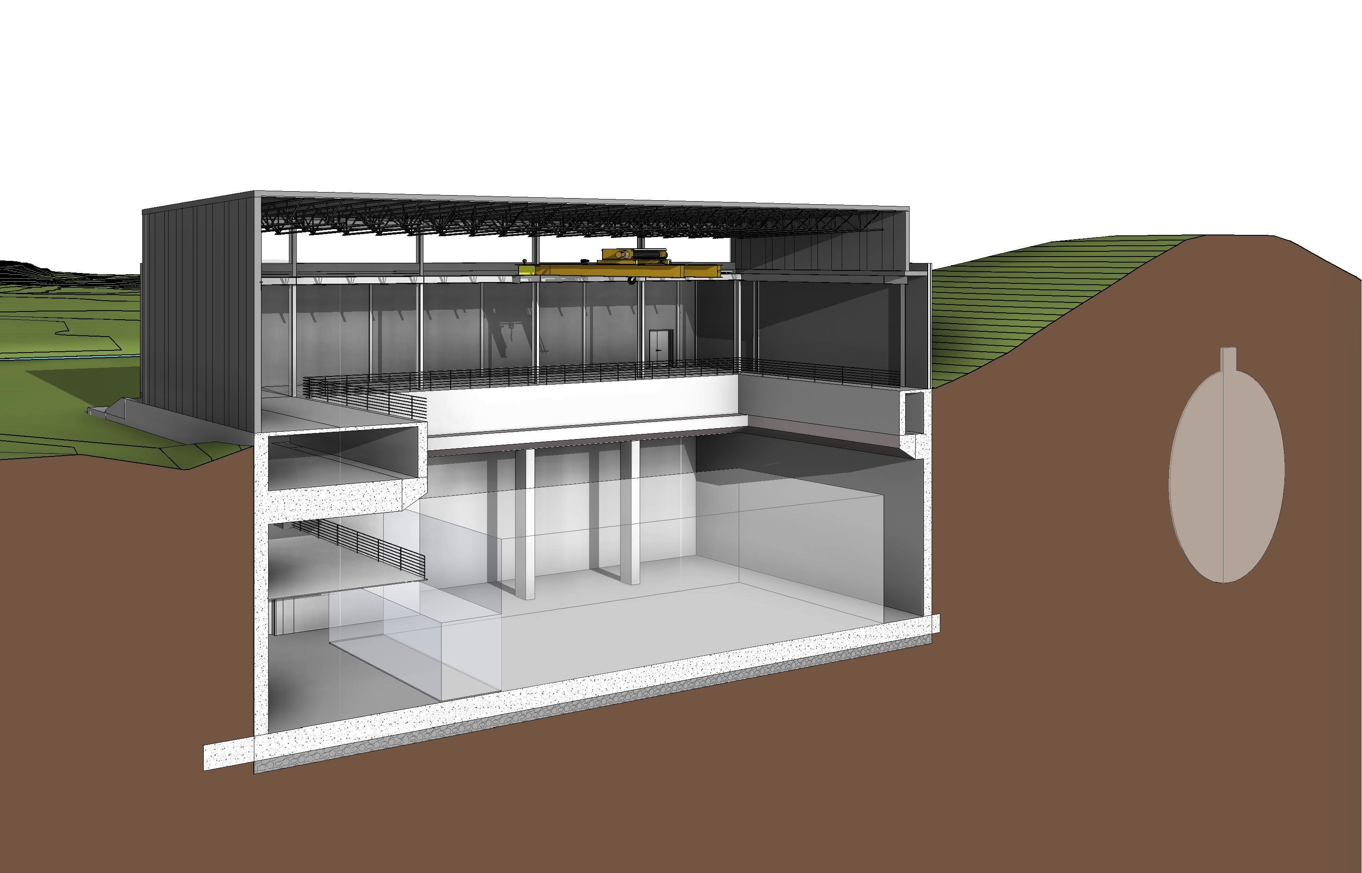
Far Detector Building
Designed with removable roof for installation of T600 cryostats
Structure to support 3m concrete overburden covering detector inside the building
Design status:
  Final design started in November
  Internal review at ~ 60% design completion next week
  Complete by end of March
Break ground in late spring 2015 and beneficial occupancy in fall 2016.
ν

Slide 9
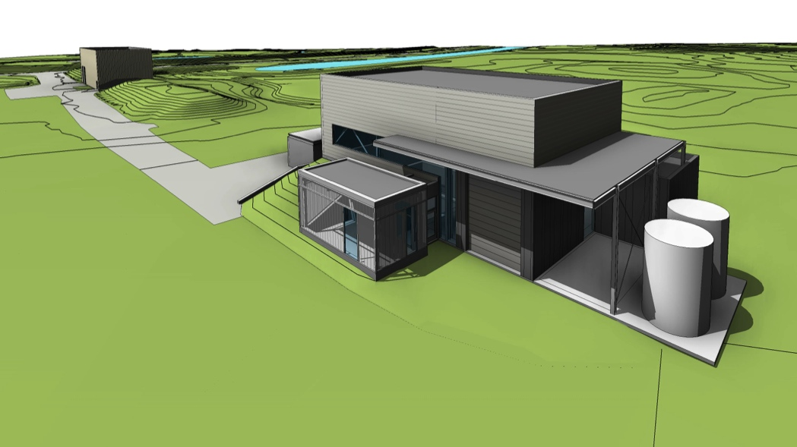
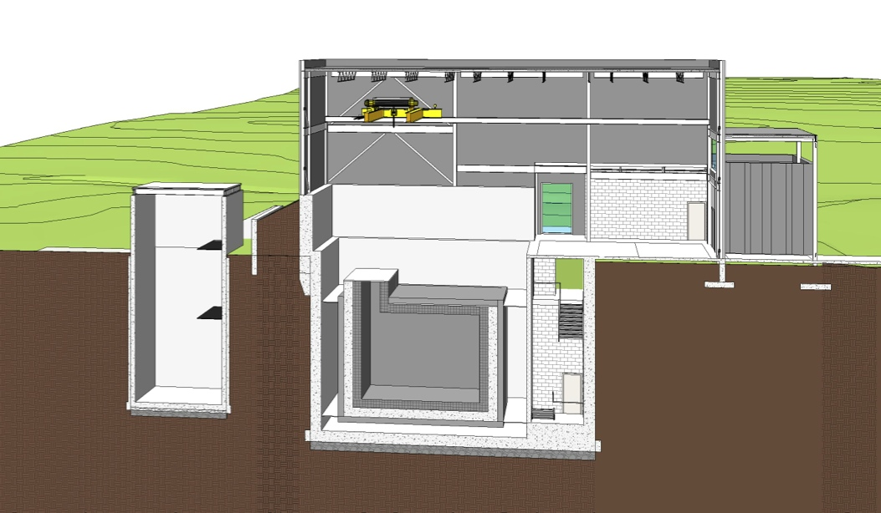
Near Detector Building
BNB Target
Structure to support 3m concrete overburden covering detector inside the building
Design status:
  Final design started in January
  Complete in May 2015
Break ground in late summer 2015 and beneficial occupancy in fall 2016.
Exploring option of cryogenics in surface extension of near detector building
  Preserves SciBooNE hall for a detector rather than infrastructure
  Little or no impact on LAr1-ND cryogenics cost
  Initial estimate of ~$300k additional construction cost
ν
SciBooNE

Slide 10
BNB Improvements
Increased ν statistics would further secure the program sensitivity
  More protons on target
  Higher ν production efficiency
BNB ν energy distribution optimized of MiniBooNE Cherenkov detector
  LAr-TPCs can tolerate high energy tail
Reconfiguration to a two horn system could provide factor of two more ν/p.o.t.
Modest reconfiguration of proton beamline provides space for 2nd horn
Cost will be in new horn(s), power supply(ies) and collimator
Detailed cost and schedule estimate needed

Slide 11
Milestones for Near and Far Detector Delivery
Schedule assumes approval by PAC at this meeting
After the PAC will look for every opportunity to advance this schedule
Detailed schedule based on bottoms up estimate under development
  Starting with near detector and new cryostat/cryogenics work
  Needed for review proposed for spring 2015
Readiness reviews prior to production and installation
✔
✔
✔
✔
Today
✔

Slide 12
Program Schedule
Refurbish T600
Install Far and Near
Commission and Operate
Construct LAr1-ND
MicroBooNE Operations

Slide 13
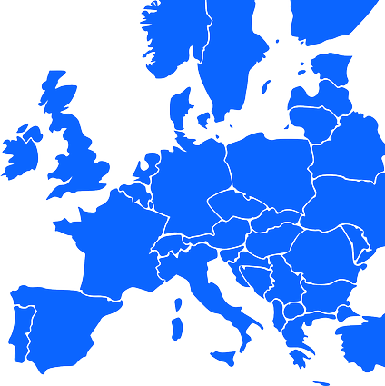

Main Funding Sources
UK STFC
US DOE & NSF
CH NSF
CERN
INFN

Slide 14
Main International Agreements
UK STFC
US DOE
CH NSF
CERN
INFN
Agreement Status
Signed
In discussion
Discussion to be started

Slide 15
SBN Institutions and Authors
Russia 1
US 22
UK 6
Poland 5
CH 1
CERN
Italy 9
Collaboration | Authors | Overlap
ICARUS-WA104 | 57
LAr1-ND | 108
MicroBooNE | 118
All SBN (excl overlaps) | 218
6
59

Slide 16
FTEs for Delivery of Detectors
Total effort of about 75 FTE per year covering T600, LAr1-ND and infrastructure
  Includes scientific and technical labor
Effort not included:
  Work on: MicroBooNE, BNB, and civil construction
  Contracted labor

Slide 17
SBN Organization
SBN task force was charged by Fermilab, CERN, and INFN with delivery of the SBN proposal to the PAC.
  The SBN proposal is the product of a close collaboration between members of all three experimental collaborations
  Mission will (hopefully) be completed at this meeting
Moving forward need to execute two distinct aspects of the program leading up to beam operations:
Completion of the three detectors: MicroBooNE commissioning, ICARUS refurbishing and LAr1-ND construction. Requires:
  Completion of international agreements
  Establish international oversight and review
Preparations for the physics analysis program including Monte Carlos, reconstruction software etc

Slide 18
Conclusions
The SBN program can make a definitive statement on the LSND and MiniBooNE anomalies with the potential for a ground breaking discovery in neutrino physics.
The SBN program brings together three LAr-TPC detectors developed by leading teams of scientists and engineers from Europe and the US:
  ICARUS - the only large-scale LAr-TPC in the world exposed to a neutrino beam
  MicroBooNE - the largest LAr-TPC built in the US, starting operations in 2015.
  LAr1-ND - providing a new opportunity for development on the path to LBNF
The combination of these three detectors and associated collaborations represents a tremendous scientific and R&D opportunity toward the future LBN program.

Slide 19
Conclusions
We have outlined today an exciting opportunity for Fermilab and the international neutrino community. We request the following actions:
Approval of the three detector SBN program to move forward quickly to next steps.
Approval of T600 as far detector.
Approval of LAr1-ND (T1053) as near detector to move to a technical design to be reviewed in 2015.
Approval to complete final design of the near and far detector buildings and start construction of the far detector building in spring 2015 and near detector building in summer 2015.
Provide resources to develop a cost and schedule for BNB reconfiguration into a two horn system in collaboration with CERN. Study to be completed before Summer PAC.

Slide 20
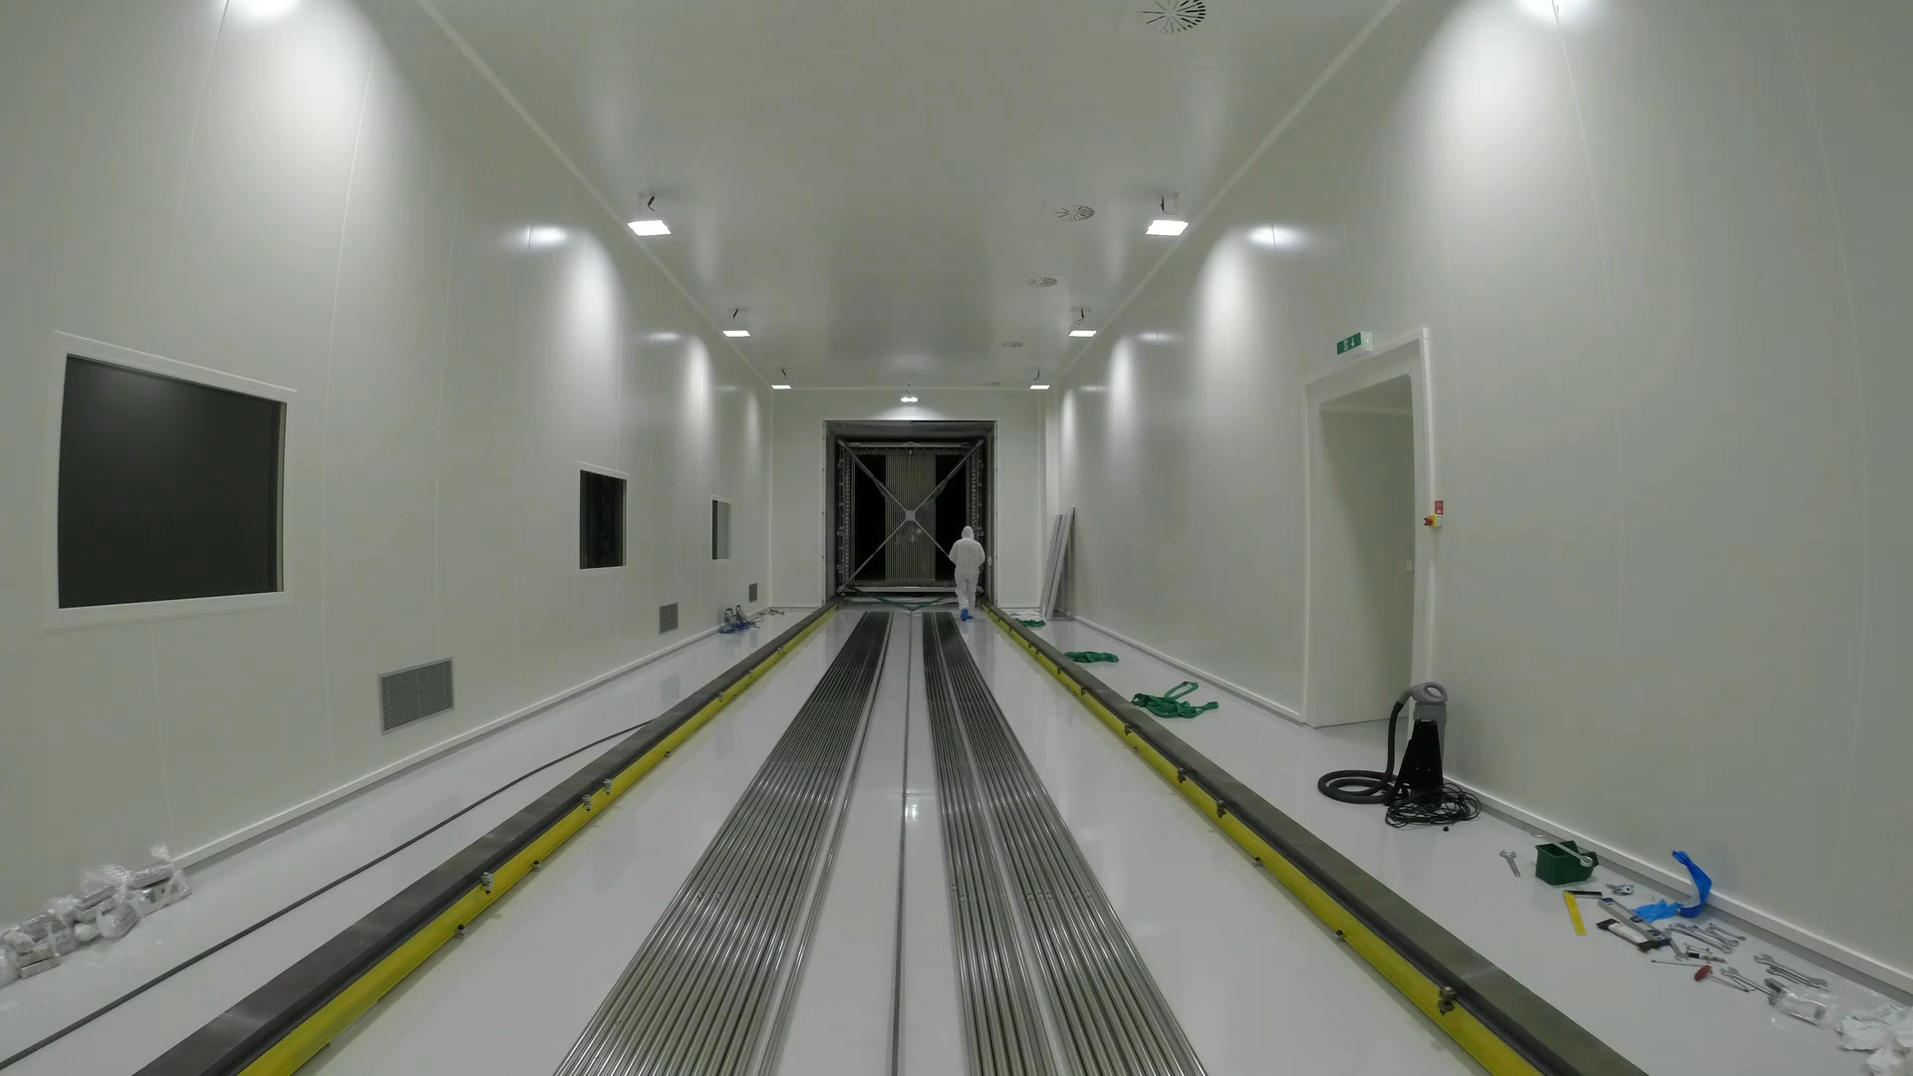
T600 Entering CERN Cleanroom

Slide 21
Institution List

Slide 22
SBN Authors and Institutions
Collaboration | Authors | Overlap
ICARUS-WA104 | 57
LAr1-ND | 108
MicroBooNE | 118
SBN Total (excl overlaps) | 218
6
59
Country | Institutions
International (CERN) | 1
Italy | 9
Poland | 5
Russia | 1
Switzerland | 1
UK | 6
USA | 22
SBN Total | 45

