Slide 1
Keeping a 20 tick NOvA cycle and using the TLG to flex the duty cycles to the experiments

Slide 2
Muon Campus era TLG usage
Instead of locking the complex into one of the considered scenarios, allow multiple scenarios
Build time lines that allow easy switch between the scenarios
If flexible operation can be made to work, this becomes purely a Program Planning issue with complete greatly increased freedom
Consider the 20 tick NOvA cycle scenarios to maximize flexibility

Slide 3
20 tick NOvA cycles to consider
g-2
Scenario A
12 Booster batches to NOvA (100% of baseline)
3 Booster batches to g-2 (75% of baseline)
5 Booster batches to bnb (125% of baseline)
Scenario B
11 Booster batches to NOvA (92% of baseline)
4 Booster batches to g-2(100% of baseline)
5 Booster batches to bnb(125% of baseline)

Slide 4
20 tick NOvA cycles to consider
Mu2e (allows for 54 msec spill)
Scenario A
12 Booster batches to NOvA (100% of baseline)
1 Booster batches to Mu2e (50% of baseline)
7 Booster batches to bnb (117% of baseline)
Scenario B
10 Booster batches to NOvA (83% of baseline)
2 Booster batches to Mu2e (100% of baseline)
8 Booster batches to bnb (133% of baseline)

Slide 5
A
g-2 Scenarios
20
1
5
8
20
1
5
8
1D
1C
1C
1D
1D
1C
1D
1D
19
19
19
19
19
19
19
19
19
19
19
19
1D
1C
1C
1D
1D
1C
1D
1D
19
E9
Ex
E3
E9
Ex
E3
To MI for NOvA
To MI for NOvA
20
1
5
9
20
1
5
1D
1C
1C
1D
1D
1C
1C
1D
1D
19
19
19
19
19
19
19
19
19
19
19
1D
1C
1C
1D
1D
1C
1C
1D
1D
E9
E9
Ey
E9
E9
To MI for NOvA
To MI for NOvA
B
MI ramp
Scenario A – Nova gets 12 (100%)/g-2 gets 12 (75%) / bnb gets 5 (125%)
Scenario B - Nova gets 11 (92%)/g-2 gets 16 (100%) / bnb gets 5 (125%)

Slide 6
A
Mu2e Scenarios
8
19
20
1
8
1C
1D
1D
1D
1D
1D
1D
19
19
19
19
19
19
19
19
19
19
19
19
1D
1C
1D
1D
1D
1D
1D
1D
19
19
E9
E3
E9
E3
To MI for NOvA
8
10
1C
1C
1D
1D
1D
1D
1D
1D
1D
19
19
19
19
19
19
19
19
19
19
1D
1C
1C
1D
1D
1D
1D
1D
1D
1D
Ex
Ey
Ex
B
To MI for NOvA
MI ramp
Scenario A – Nova gets 12 (100%)/Mu2e gets 4 (50%) / bnb gets 7 (117%)
Scenario B - Nova gets 10 (83%)/Mu2e gets 8 (100%) / bnb gets 8 (133%)

Slide 7
Considerations
At least two new TLG RR resets would be required
MI ramp waveform never changes
Transfer from MI to RR always occurs at the same time in every module
More RRBS events will be needed
Pulsed devices will have to be flexible, but g-2 scenario A contains all of the complications by itself

Slide 8
Flexibility
Allows a wide choice in allocation of protons between NOvA and Muon Campus
Allows easy shift of beam cycles from one experiment to another.
Allows either experiment to run at 100% of baseline if the other is down.
If switching between scenarios is transparent, a mix of scenarios can be placed in one time line.
If the switch is less transparent, program planning could choose to run with one scenario for some time and then with another at a later time. This would still allow a freedom to allocate protons throughout the run.

Slide 9
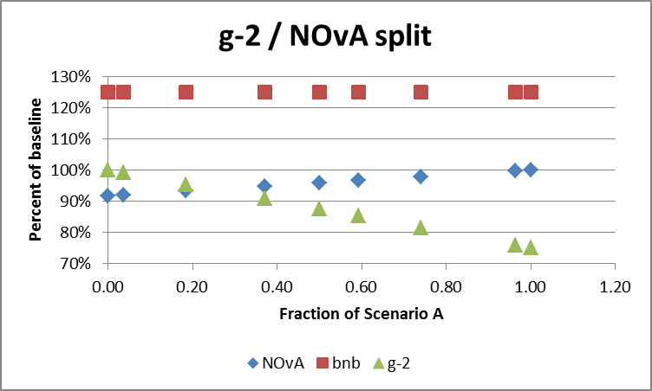

Slide 10
