Slide 1
Conceptual Design of MICE RF Module (RFM) Vacuum System
January 27th, 2015
Andrew Lambert

Slide 2
MICE Vacuum Vessel
Original vacuum vessel design proved unable to reach acceptable vacuum
  Dual pumping on both interior and exterior vacuum with getter pump
  Large conductance from exterior vacuum to interior vacuum
    Causes two vacuum volumes to trend towards equalization – protection in cause of fault
    Eliminate this feature to improve cavity vacuum, instead rely on burst disk line and bypass valve line for protection in failure scenario

Slide 3
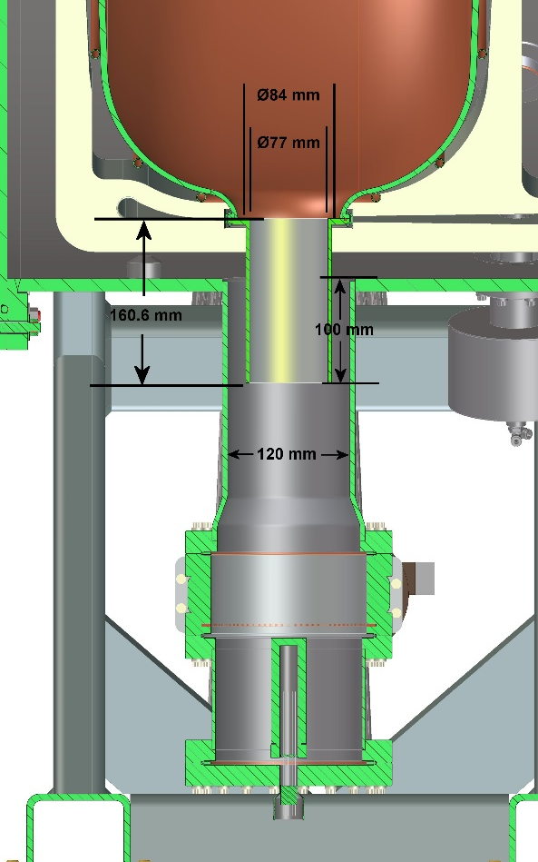
Original RFM Vacuum Design
Conductance between the two vacuum volumes
  Exterior vacuum spoils the interior vacuum
  Annular clearance has very large conductance
  Instead pump on only the cavity with getter pump, use roughing system for exterior vacuum

Slide 4
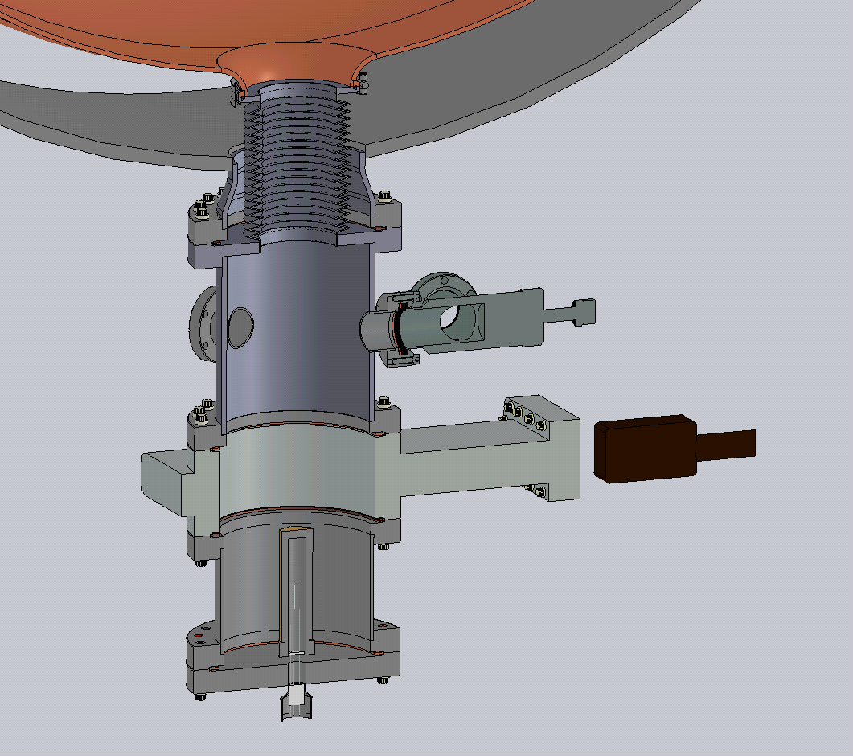
New RFM Vacuum Design
Bellows connects the getter pump directly to the cavity
  Getter only pumps on the cavity
  Improve vacuum in the cavity
Burst disk line will connect the two vacuum volumes
  Protection in case of fault scenario
  Burst disk should be sized to rupture at 0.5 psi
Bypass line
  Coat bypass line with getter material
  Throttle valve allows for manipulation of the conductance from exterior vacuum to interior vacuum
Burst Disk/Bypass Line Ports
Bellows
Roughing Valve
Getter
pump

Slide 5
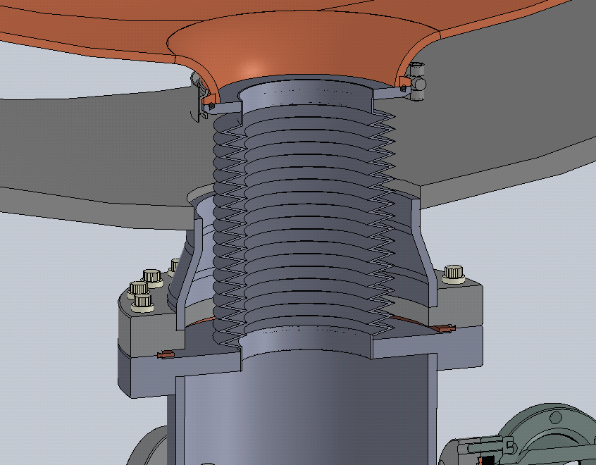
New RFM Vacuum Design
Bellows welded to flange, then clamped to MICE RF cavity
Welds
Bellows welded to
CF flange

Slide 6
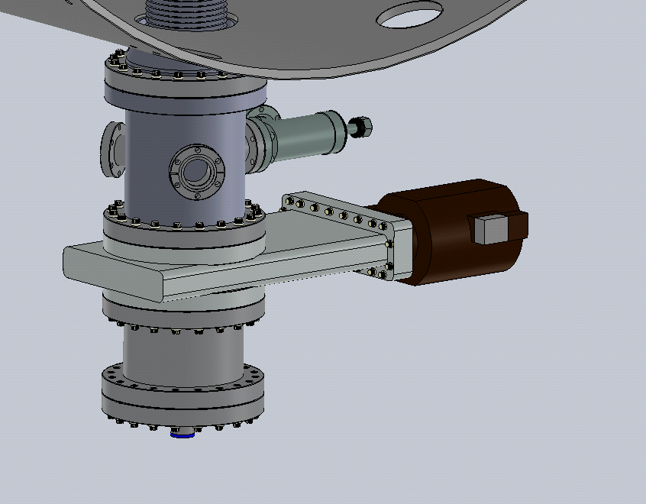
New RFM Vacuum Design
Bypass Line
Roughing valve
Burst Disk Line
Getter pump

Slide 7
Summary
The MICE RF module vacuum design has changed in three essential ways
  Connection of the getter to the cavity via the bellows isolates the cavity vacuum and ensures that the getter only pumps on the cavity volume
  Instead of an annular bypass region, the system will now use a bypass line coated with getter material and regulated with a throttle valve
  0.5 psi burst disk will provide protection of the Be windows in a fault situation
These changes to the vacuum system should ensure that we can pump the interior cavity down to operating vacuum while minimizing leakage from the exterior vacuum

