Slide 1
Plan and Schedule of the MICE RF Modules
Soren Prestemon

Slide 2
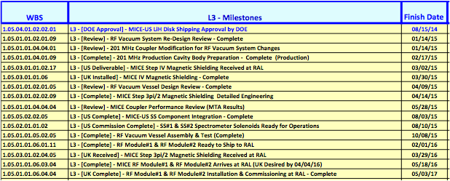
L3 milestones

Slide 3
Plans for RF system design
Incorporate design improvements from this review
Perform vacuum calculations per review comments
Proceed with detailed design and specifications
Shoot for final vacuum vessel design review late March/early April

Slide 4
RF Cavity preparation work
Proceeding well:
Three cavities have been identified for Electropolishing
selection based on inspection and frequency measurements
EP setup is ready
Should meet 2/17 milestone for cavity preparation readiness

Slide 5
Key milestones moving forward
Delivery of two RFA modules to RAL: Mid-May 2016 (see MICE WBS)
Full characterization tests of tuners after assembly
RFA module assembly starts in the fall of 2015
All hardware components ready by Oct. 2015
RFA vessel fabrication readiness review: Mid-April 2015
–RF coupler final review (experience from MTA): May 2015
Cavity (with beryllium windows) selection and EP: Mid-June 2015
Production of actuators: Starts March 2015

