Slide 1
OSG Networking Area Planning and Discussion
Shawn McKee/University of Michigan
OSG Retreat / Madison, WI
May 18th 2015

Slide 2
Review: OSG Networking Motivations
Networks underlie our distributed computing model but are historically only indirectly visible. This led many to feel most problems with a WAN involved were network problems (and sometimes that was true).
perfSONAR is part of an evolving infrastructure where the network plays a much more visible role. With perfSONAR we can monitor our network, understand capacity, find bottlenecks and detect problems. It is NOT the only thing we need.
With Software Defined Networking slowly creeping into our network hardware we will have more opportunity in the future to integrate the network we need into our end-to-end systems.
Our long-term goal in OSG is to make the network visible and controllable to improve our infrastructure, avoid congestion, work around failures and improve efficiency.

Slide 3
OSG Networking Area Mission
The “Mission” is to have OSG become the network service data source for its constituents
Information about network performance, bottlenecks and problems should be easily available.
Should support our VOs, users and site-admins to find network problems and bottlenecks.
Provide network metrics to higher level services so they can make informed decisions about their use of the network (Which sources, destinations for jobs or data are most effective?)

Slide 4
OSG Networking Area Effort
The smallest area in OSG. Currently 40% of me.
Also draws upon other OSG areas as appropriate (Operations, Technology and Software)
Significant help recently for Datastore development, bug fixes and optimization from Soichi, Edgar and Brian. Rob, Thomas, Gabriele and Chander also contributing to oversight and hardware acquisition.
This area is leveraging effort in Internet2/ESnet (perfSONAR development) and HEP/WLCG (perfSONAR global deployment and efforts in ATLAS and CMS)
New PuNDIT satellite project: targeting problem identification/localization
Leveraging external effort nice, BUT that makes us very dependent upon effort we don’t control. However we have the possibility to do more than we otherwise could…

Slide 5
Some Concerns
Aaron Brown is leaving perfSONAR team
Getting fixes and features added to perfSONAR may be harder/slower in the future
Continuing challenges to using perfSONAR at our scale.
Good news is remaining problems seem to be getting subtler and impacting less sites
Getting data “published” appropriately for WLCG VOs may require outside work because of VO requirements
Currently have an effort initiated by LHCb to read and push network data on a message bus.

Slide 6
Status After Year-3
We have instrumented ~130 sites with perfSONAR (see status: http://grid-monitoring.cern.ch/perfsonar_coverage.txt)
A Network Service is hosted by OSG
Almost production ready datastore
Mesh-configuration management GUI (OSG developed)
perfSONAR metrics visualization via MaDDash
System and service monitoring via OMD/Check_mk + custom scripts
Documentation on installation, configuration, troubleshooting and procedures in place
Lingering from year-3:
Production datastore
Prototype alerting/alarming component
Broad non-WLCG OSG deployment

Slide 7
Overview: OSG Networking Service
OSG is building a centralized service for gathering, viewing and providing network information to users and applications.
Goal: OSG becomes the “source” for networking information for its constituents, aiding in finding/fixing problems and enabling applications and users to better take advantage of their networks
The primary component is the datastore to organize and store the network metrics and associated metadata
perfSONAR stores data in a MA (Measurement Archive)
Each host stores its measurements (locally)
OSG (via RSV probes) is gathering relevant metrics from the complete set of OSG and WLCG perfSONAR instances
This data must be available via an API, must be visualized and must be organized to provide the “OSG Networking Service”

Slide 8
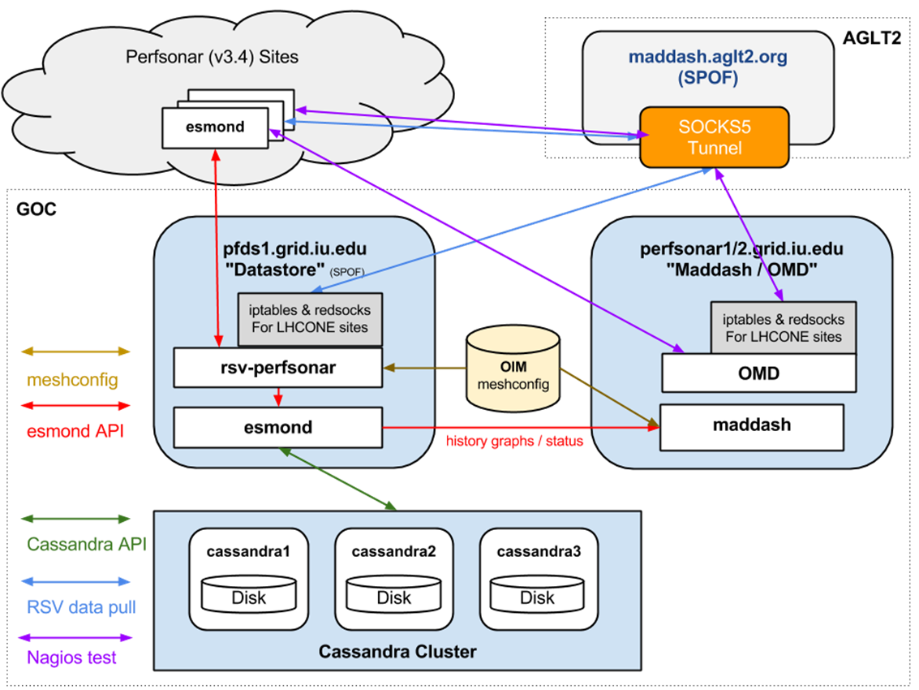
OSG Network Datastore
A critical component is the datastore to organize and store the network metrics and associated metadata
OSG is gathering relevant metrics from the complete set of OSG and WLCG perfSONAR instances
This data will be available via an API, must be visualized and must be organized to provide the “OSG Networking Service”
Operating now
Targeting a production service by end of July

Slide 9
Datastore Status
Has taken longer to get into “production” than originally estimated
Challenges in using RSV to gather data: load on systems, data coverage and accuracy, Esmond API quirks
Data volume and service requirements need new hardware
Esmond “new”, built upon Cassandra, unfamiliar to OSG Ops
Gabriele started ~weekly meetings on getting the datastore into production in mid February. Progress tracked in https://www.dropbox.com/s/uo13ogm49fyb0yn/OSG%20Networking%20Dashboard%20to%20Production.pdf?dl=0
Significant progress in addressing all known issues. On schedule to have a July production release

Slide 10
OSG Year 4 Goals Regarding Data
We have instrumented (most of) our networks.
By the end of year 4 we need to have all selected network metrics:
Consistently collected (challenges in perfSONAR toolkit)
Available via API (July?)
Visualized in a way that allows users, sites, admins to see the status of the network. (MaDDash, custom MyOSG?, topology?)
Part of 1) means someone is alerted if data that should be available and collected is NOT available or NOT collected.
Have initial scripts validating datastore. Need more in this area
Closely related to alerting and alarming components (details later)

Slide 11
Longer Term OSG Networking Plans
Years 4-5 need to build upon the first 3 years.
What kinds of capabilities can we enable given a rich datastore of historical and current network metrics?
Users want "someone" to tell them when there is a network problem involving their site or their workflow.
Can we create a framework to identify when network problems occur and locate them? (*Must* minimize the false-positives).
Issues that seem like "network issues" can often be due to problems at the ends (on the servers, in the software, in the configuration) or at least not WAN problems but LAN problems.

Slide 12
OSG Networking Year 4+ Possibilities
Continue to do what we do now, and:
Support higher-level network services
We have proto-typed a proximity service to find nearest SE given perfSONAR or to find the nearest perfSONAR give and SE
Develop effective Alarming and Alerting
Improve the ability to manage and use network topology
Gather, organize and export network diagnostic work
Enable OSG researchers to find/fix End-to-End issues
Prepare-for and integrate Software Defined Networking

Slide 13
Continuing to Do What We Do…
Basic things still need to happen in all years:
Upgrades and bug-fixes to tools that gather, display and provide network metrics
Tuning and optimizing existing testing
Maintenance and creation of documentation
Support for new ideas and feature requests.
Exploring needs for new metrics to better meet researcher needs.
But what interesting possibilities should we focus on given OSG’s unique position regarding our hosting of network metrics from all of OSG and WLCG?

Slide 14
Higher Level Service Support
OSG needs to be able to support "higher-level services" that require network metrics to make decisions regarding data transfers and higher-level workflow optimizations involving the network.
Proximity service prototyped identify “close” SEs and perfSONARs e.g: http://proximity.cern.ch/api/0.1/trace/tracepath?src=atlas-npt2.bu.edu&dst=heplnx130.pp.rl.ac.uk
What metrics and with what timeliness are best for meeting this need?
This can be very complicated to answer in practice.
We will need to work closely with the developers of such services and iteratively adapt what is provided to make this as effective as possible.
Basic need is a network “cost-matrix” of source-destination pairs
Interaction with users will point the way to missing components

Slide 15
Alarming and Alerting on the Network
Being able to "alarm" on real network problems is a good target: indicate (via monitoring) there is a network problem
The next step is to actually "alert" on network problems.
The difference between an alarm and an alert is the target. An alarm can appear in some monitoring system for an operator to respond to while an alert is targeted at a person or list of persons (email, page, etc.).
To effectively alert requires that we first have a valid 'network' alarm AND that we be able to localize the problem more specifically than "along the end-to-end path". Alerts should be only sent to those able to fix the problem.

Slide 16
OSG Satellite Project: PuNDIT
Since our meeting last year PuNDIT was funded by the NSF (SSE-SI2) program:
“PuNDIT will build upon the de-facto standard perfSONAR network measurement infrastructure to gather and analyze complex real-world network topologies coupled with their corresponding network metrics to identify possible signatures of network problems from a set of symptoms.”
Website at http://pundit.gatech.edu/ Upcoming CHEP 2015 paper provides lots of details.
PuNDIT is currently using a number of OSG sites as a testbed.
Project has 1.3 more years. Targeting initial deployment as part of perfSONAR v3.6 (~Winter 2016)
Goal is to enable PuNDIT for OSG/WLCG to find net issues

Slide 17
New Network Tools/Capabilities
Some important and interesting possibilities for what OSG might provide in the future include the creation of tools and visualization systems which manage network topologies (which are time-dependent)
Combining topology and metrics is powerful for identifying and localizing network problems; currently a very manual process.
Using these tools users can look for correlations with the metrics measured across those topologies.
This type of tool can be used to help localize problems.
Note it is only by using the complete set of OSG network metrics that this becomes possible.

Slide 18
Using Our Data
Host A is getting poor performance to Host B and seeing 3% packet loss
Normally we would start to investigate partial paths to isolate the problem
However we also see Host D to Host C is having problems and 2% packet loss:
And there is a third pair (Hosts E and F) having 1% packet loss:
Let’s correlate these paths
Host A
128
613
481
772
016
835
Host B
Host D
340
907
613
481
746
592
Host C
Host E
419
481
772
109
079
Host F

Slide 19
Topology View
Host C
Host E
592
419
746
Host A
128
613
481
772
016
835
Host B
907
109
Solution:
2% loss from 613-481
1% loss from 481-772
Contact these link owners!
340
079
Host D
Host F

Slide 20
Understanding Network Topology
Can we create tools to manipulate, visualize, compare and analyze network topologies from the OSG network datastore contents?
Can we build upon these tools to create a set of next-generation network diagnostic tools to make debugging network problems easier, quicker and more accurate?
Even without requiring the ability to perform complicated data analysis and correlation, basic tools developed in the area of network topology-based metric visualization would be very helpful in letting users and network engineers better understand what is happening in our networks.

Slide 21
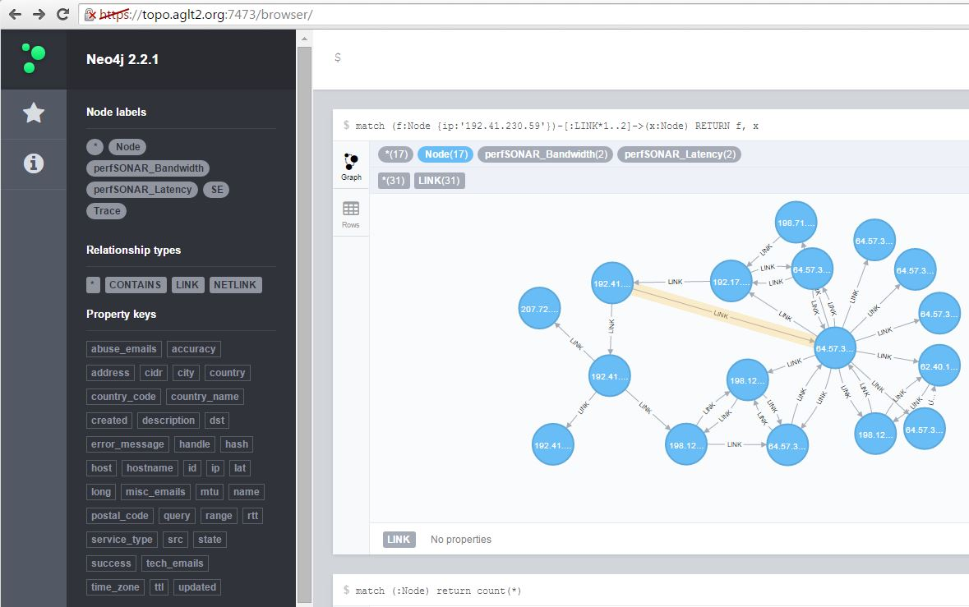
Graph Databases: Neo4j

Slide 22
Gather, Organize and Export Net Diagnostic “Work”
In general, diagnosing and localizing network issues is difficult, even for experts.
OSG should plan on making this process as straightforward as possible:
Collecting and organizing relevant information, automating as much of the process as possible.
Mimic what net engineers do in gathering data and identifying issues.
Providing tools and tips to help describe, localize and characterize the problem
Package all the diagnostic information gathered to make it easy to hand off any debugging effort already worked on to other experts.

Slide 23
OSG Networking and End-to-end
Most scientists just care about the end-to-end results:
How well does their infrastructure support them in doing their science?
Network metrics allow OSG to differentiate end-site issues from network issues.
There is an opportunity to do this better by having access to end-to-end metrics to compare & contrast with network-specific metrics.
What end-to-end data can OSG regularly collect for such a purpose? Should we?
Is there some kind of common instrumentation that can be added to some data-transfer tools? (NetLogger in GridFTP, having transfers "report" results to the nearest perfSONAR-PS instance?, etc)

Slide 24
Supporting non-WLCG OSG Sites
The non-WLCG sites haven’t yet been “encouraged” to deploy perfSONAR: we want to make sure we have something production ready and immediately useful for them
When a non-WLCG OSG site deploys perfSONAR we don’t have an automatic way to determine what network tests make most sense for the site. Generically they should:
Test to their campus border (does campus have a perfSONAR?)
Test to their nearest R&E backbone perfSONAR
Test to one or two collaborating institutions
With the OSG “auto-mesh” system and the new proximity service we may be able to automate setting up tests for new sites
Sites can further tweak if they have additional logical test partners

Slide 25
Software Defined Networks and OSG
Within the next few years evolving technology in the area of Software Defined Networking(SDN) may be able to provide researchers with the ability to construct their own Wide-Area networks with specified characteristics.
What will OSG be able to do to integrate this type of capability with the rest of the OSG infrastructure?
We need to plan for how best to enable evolving capabilities in the network for OSG users and admins
What is the impact on the OSG software stack?
What strategic modifications/additions are useful?

Slide 26
OSG Network Work Plan
There are a number of options to explore listed above. How much effort are we willing to devote for other possibilities?
Some argument to be made for adjusting as we move forward
Effort to-date in OSG networking a combination of me, Operations and Technology
As we add sites there will be a support load (me+Operations)
Exploring new capabilities may require help from Technology
We leverage other efforts (WLCG, perfSONAR-PS developers, ESnet/MaDDash, satellite proposals)
We must ensure we continue to reliable gather and provide network metrics moving forward.
Given this unique datastore, we want to fully exploit it to aid our researchers in every way possible

Slide 27
OSG Networking Work Plan
Priority 1: Support higher-level services. Involves?
This is critical and primarily means providing an API the users and applications need to access the network information they need.
Will require optimization to effectively support almost “real-time” data gathering that some services may require to steer their workloads or data transfer decisions.
Must support end-site,VO based, test based and time-based queries
Must function with OSG operational realities (access, resources)
How?
Build upon the datastore and proximity service work
Use ANSE and WLCG as initial clients to create/tune the API
Will require Operations effort; may require Technology input?

Slide 28
OSG Networking Work Plan
Priority 2: Develop tools to better support user experience in understanding, fixing and using the network
Work on automating perfSONAR configs for non-WLCG OSG sites
Improve visibility and usefulness of metric visualization
Expose topology information for diagnosis and network visualization
Create a way to “package” diagnostic information to hand-off initial problem troubleshooting to experts.
Documentation will need to be augmented as we add capabilities for users
The auto-mesh GUI should be provided as a standalone package to allow VOs and campuses to manage their perfSONAR deployments
Work with Wisconsin and Soichi

Slide 29
OSG Network Work Plan
Priority 3: Develop alarming and alerting for network problems
What:
Develop the ability to recognize network problems and set alarm
When network problems can be localized, generate an alert
Timescale to target prototype system: end of year 4
How:
Utilize “custom notification” features of Check_MK (in OMD) to define specific criteria to alert when there are obvious problems
Work with PuNDIT to enable for OSG
Test ability to localize and alert and if successful, enable alerts
Integrate with MyOSG/OIM to leverage existing capabilities

Slide 30
OSG Networking Work Plan
What other options should we focus on?
How much effort?
Adapt as we move forward (feedback from users, higher-level services; technology input for what is feasible/available)
SDN may only start to be “real” in year 5+
Continuing need to do better at simplifying the process for finding and fixing problems in the network. Can we make a real change in how this is handled?
Further discussion?

Slide 31
Work with ESnet
Core is our work with perfSONAR
OSG provides lots of very useful feedback to the perfSONAR project and works close with Andy Lake/ESnet (as well as Jason Zurawski and Brian Tierney)
Important because perfSONAR developers are targeting 100K deployments as the scale to support
Main user (outside of ESnet) of MaDDash
ESnet would really like Soichi’s mesh-mgmt GUI as a package
Sharing goes both ways…
Working with ESnet closely on LHCONE and point-to-point network testbed
Initial tests of “software-defined network” capabilities
ESnet now serving US LHC Tier-2 sites

