Slide 1
Beam Test Facilities Operations - ASTA/A0/PXIE
Elvin Harms
Mini-review of Fermilab Accelerator Test Facilities Program
17 March 2015

Slide 2
Talking points
Details of each Facility (scope, users, cost, status, etc.)
  ASTA/IOTA
  PXIE
  AO/High Brightness Electron Source Laboratory (HBESL)
Summary

Slide 3
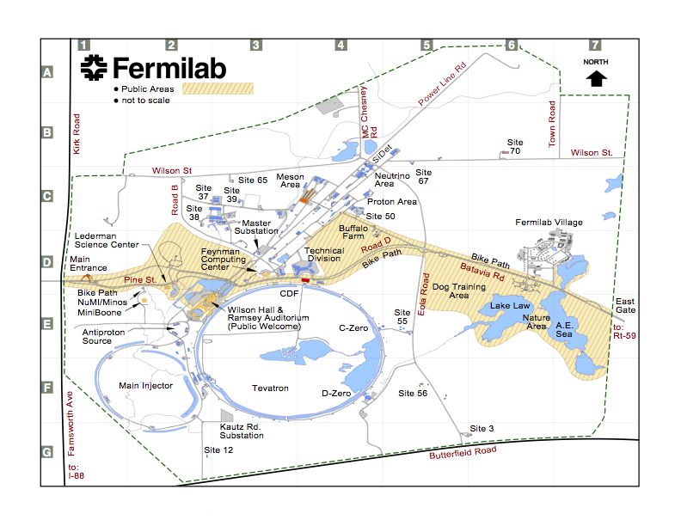
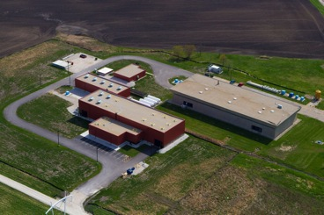
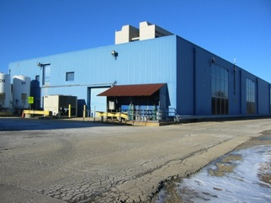
Beam-based Test Facilities
PXIE
ASTA/IOTA
A0/HBESL

Slide 4
Cost Model
Each Test Facility has two Distinct Costs
  Cost to maintain the building, infrastructure and subsystems in a “ready to operate” state (Jerry’s talk)
    Maintenance and upkeep of building
    Operation and maintenance of utilities (air, water, HVAC, etc.)
    Support of office space, meeting rooms, etc.
    Minimal labor for accelerator system support to keep in an operational state (RF, Controls, safety systems, etc.)
  Cost to Operate the Test Accelerator (this talk)
    This may or may not be part of the Test Facilities B&R, depending on the user/customer and purpose of the specific Test Facility
    M&S needed to operate the accelerator or test stand (cryogens, laser systems, RF, controls, instrumentation, etc.)
    Labor needed to operate the accelerator or test stand (operators, scientists, engineers, technicians, etc.)

Slide 5
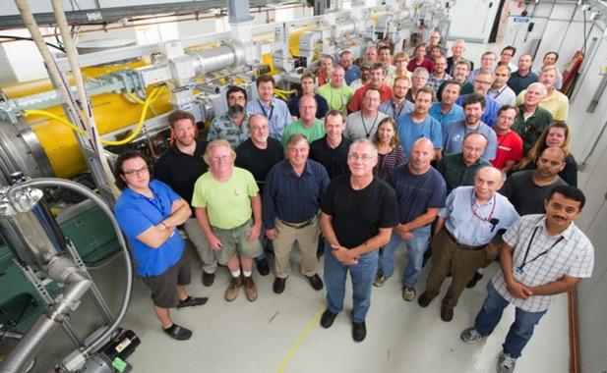
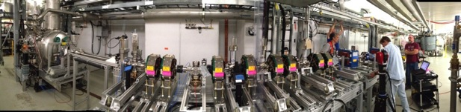
IOTA/ASTA Overview (courtesy V. Shiltsev)
Fermilab’s Major Accelerator R&D Beam facility
  Unique R&D facility close to completion: IOTA ring, high-brightness photo-injector, SRF cryomodule, proton RFQ
  ~90M$ invested by OHEP since 2006
  Science goal: Experimentally demonstrate novel techniques of integrable beam optics and space charge compensation, SRF research
  Technical challenge: fabrication high-precision nonlinear magnets; injector for delivery of pencil electron beam and high-current low energy proton beam, beam thru SRF CM
  FY15 highlights: Big part of IOTA ring built; commissioned 55 MeV e- injector and SRF CM2 at 250 MV
  Operations start: 2017 (full IOTA)
Partnerships
  DOE labs: ANL, BNL, ORNL, Jlab, LBNL
  U.S. universities: 6
  International: 4

Slide 6
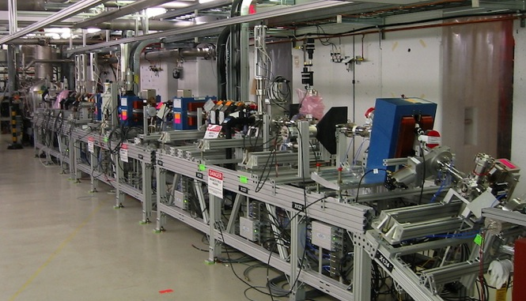
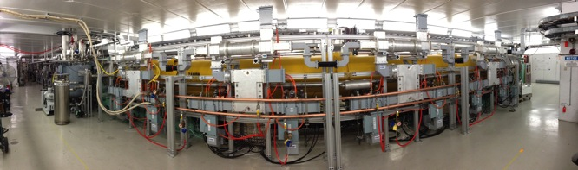
IOTA/ASTA Status
Electron operation to 5 MeV routine
Installation of 50 MeV injector complete
Beam commissioning to up to 55 MeV planned for the coming weeks
CM2 demonstrated average cavity gradient of 31.5 MV/m (> 250 MeV acceleration)

Slide 7
IOTA/ASTA schematic – plans through FY17

Slide 8
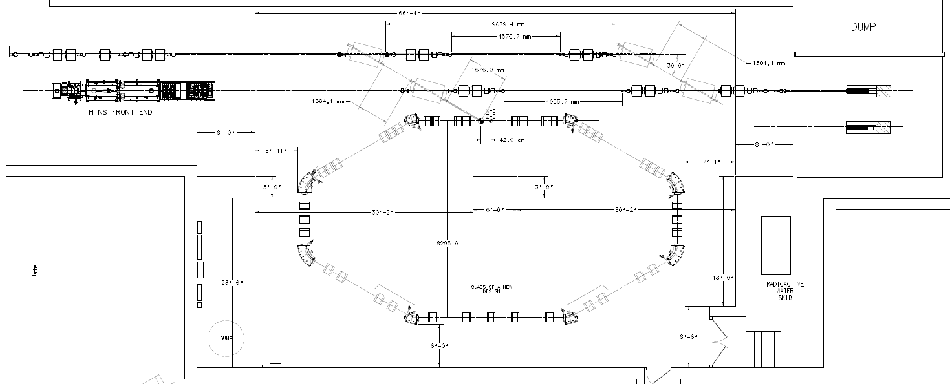
IOTA Ring: 2.5 MeV p+ or 150 MeV e- / 40 m
e- beam line
p beam line
2.5 MeV RFQ

Slide 9
Integrable Optics Test Accelerator
Unique features:
  Can operate with either electrons or protons (up to 150 MeV/c momentum)
  Large aperture
  Significant flexibility of the focusing lattice
  Very tight control of the optics quality and stability
  Set up for very high brightness operation (with protons)
Based on conventional technology (magnets, RF)
Cost-effective solution
  Balance between low energy (low cost) and discovery potential

Slide 10
IOTA Goals for Integrable Optics
The IOTA experiment has the goal to demonstrate the possibility to implement nonlinear integrable optics with a large betatron frequency spread ΔQ>1 and stable particle motion in a realistic accelerator design
Benefits of nonlinear integrable optics include
Increased Landau damping
Improved stability to perturbations
Resonance detuning

Slide 11
ASTA/IOTA Accelerator Operations
The ASTA Accelerator Operations budget supports operation of the ASTA accelerator, including gun, laser lab, injector, cryomodule and beamlines
IOTA to come on-line in FY17
Description | Direct M&S FY14 - actual ($k) | Direct M&S FY15 ($k) | Direct M&S FY16 ($k) | Direct M&S FY17 ($k)
Cryogens (Helium & Nitrogen) | 184 | 104 | 107 | 220
Commissioning/Experimental Support | 22 | 20 | 30 | 30
RF Operations (High and Low Level) | 19 | 10 | 25 | 25
Controls | 12 | 23 | 20 | 15
Instrumentation incl. Machine Protection System | 7 | 20 | 20 | 20
Laser Lab | 35 | 20 | 30 | 30
General Operations Support (elec., mech., misc.) | 10 | 17 | 20 | 20
Total Direct M&S ($k) | 289 | 214 | 252 | 360
Labor (FTE’s) | 3.8 | 2.8 | 4.1 | 4.5

Slide 12
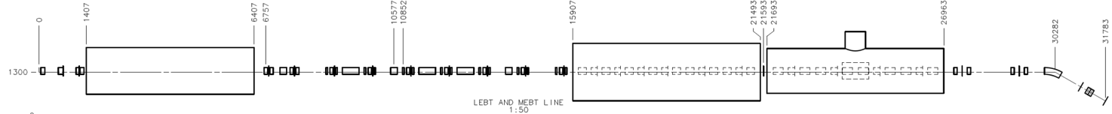
PXIE overview (courtesy of Paul Derwent)
Is a key element of the PIP-II R&D
Goal: PIP-II construction start in 2019
Goal of the R&D Program is to mitigate risk: technical/cost/schedule
Technical Risks
  Front End
    CW ion source through SSR1
  H- injection system
  High Intensity Recycler/Main Injector operations
  High Power targets
Cost Risks
  Superconducting RF
    Cavities, cryomodules, rf sources – CW to long-pulse
PXIE
LEBT
RFQ
MEBT
HWR
SSR1
HEBT
~ 40 m long

Slide 13
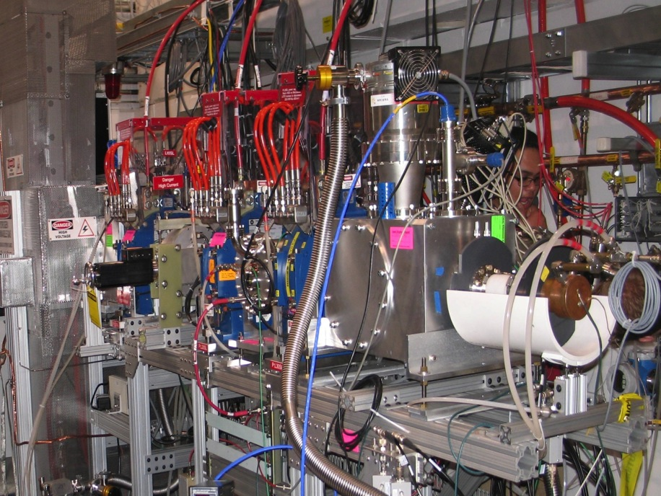
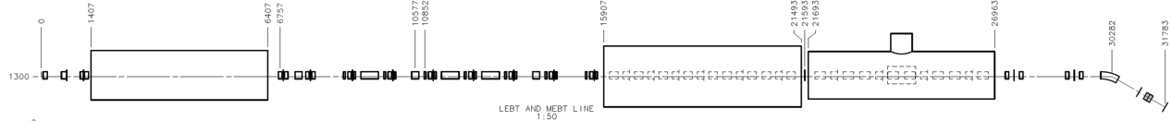
PXIE overview (courtesy of Paul Derwent)
Emittance scanner (not visible)
Water-cooled donut connectors
DCCT
Gate valve
Chopper assembly
‘Diagnostics’ box

Slide 14
PXIE Goals (courtesy of Paul Derwent)
Validate the PIP-II concept and eliminate technical risks
  CW RFQ
  Bunch-by-bunch chopper (2 kickers and absorber)
  MEBT vacuum level and MEBT/HWR interface
  High-current beam acceleration in HWR and SSR1
    Complications can be due to beam loss of RFQ tails in SC linac
  Extinction for the removed bunches better than
    10⁻⁴ – specified by the PXIE Functional Requirement Specification and determined by multi-experiment operation
    <10⁻⁹ – as desired by μ-to-e experiment (no formal specification)
Obtain experience in design and operation of SC proton linac
  SSR1 cryomodule will be designed and built by Fermilab

Slide 15
PXIE time line (courtesy of Paul Derwent)
Stage 1 complete – early FY17 (~Nov 2016)
  Ion source, LEBT, prototype chopper
  RFQ at full power
  beginning installation of SSR1 cryomodule
    SSR1 CM – cold and rf powered, no beam
  Full MEBT with prototype kickers, (possibly) prototype absorber, temp. dump, bunchers, diagnostics
  Cryo system
  Beam delivered to the end of MEBT with nearly final parameters (2.1 MeV, 1 mA CW, 80% arbitrary chopping)
Stage 2 complete – Mar 2018
  installation of HWR cryomodule, cold and ready for beam
  HWR CM – cold and rf powered, no beam
Stage 3 complete – September 2018
  Full diagnostics line
  final MEBT kickers, final 50 kW beam dump, 1-mA CW beam delivered to the dump

Slide 16
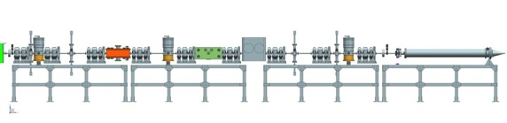
MEBT plan (technically driven, with no contingency)
Aug 2015 – pulsed beam from RFQ
Nov 2015 – CW beam
Dec 2015 – Feb 2016 – installation of full – length MEBT
  With prototype kickers (50 Ohm and 200 Ohm) and 5 kW prototype absorber
  Final bunching cavities, final magnets, SNS beam dump at the end
  Incomplete diagnostics (e.g. no wire monitors, extinction monitor, laser wire etc.)
Mar – Jul 2016- initial MEBT commissioning
  The main goal is to pass the beam to the chopper to test its elements
  Make decision on the kicker technology; start the final chopper design
Aug- Nov 2016 – all cryo work and SSR1 installation
Dec 2016- Aug 2017 – MEBT characterization
  In parallel with SSR1 commissioning
Sep – Dec 2017 – final MEBT installation (concurrent with HWR’s)
FY18 – demonstration of bunch-by-bunch separation

Slide 17
PXIE Deliverable
Major PXIE deliverable is the first 25 MeV of the PIP-II linac
  Current plan is to move PXIE (from the ion source through SSR1) from CMTF to the new linac gallery
Secondary Deliverables (assumed in meeting the major one!)
  CW RFQ
  Demonstration of bunch by bunch chopping
  Vacuum interface between MEBT and Cryo section

Slide 18
PXIE Milestones
Milestone | Estimate
Beam through the LEBT* | Q1 FY15
LEBT Beam Meets Specs | Q2 FY15
LEBT Beam Commissioning Complete | Q3 FY15
Beam through the RFQ* | Q3 FY15
RFQ Commissioning Complete | Q2 FY16
Beam through the MEBT* | Q4 FY16
MEBT Chopper Technology Finalized | Q4 FY16
PXIE Stage 1 Complete* | Q2 FY17
MEBT Beam meets Specs | Q1 FY17
PXIE Stage 2 Complete* | Q4 FY17
Beam through the HWR | Q2 FY18
Beam through the SSR1 | Q3 FY18
MEBT Commissioning Complete | Q2 FY17
PXIE Stage 3 Complete* | Q4 FY18
HWR Commissioning Complete | Q4 FY18
SSR1 Commissioning Complete | Q4 FY18
PXIE Beam Commissioning Complete* | Q4 FY18

Slide 19
PXIE Accelerator Operations
The PXIE Accelerator Operations budget supports operations and maintenance of PXIE specific support systems and infrastructure (PXIE specific chillers, hydrogen system, vacuum equipment, etc.) including cost of cryogens for operations. (Test Facilities – New)
Philosophy: PIP-II pays to build, Test Facilities Operations pays to operate and maintain
Description | Direct M&S FY14 - actual ($k) | Direct M&S FY15 ($k) | Direct M&S FY16 ($k) | Direct M&S FY17 ($k)
Cryogens (Helium & Nitrogen) | 0 | 0 | 0 | 150
PXIE-specific water chillers (Ion Source, RFQ, etc.) and Hydrogen system (ion source) | 0 | 0 | 20 | 20
RF Operations (High and Low Level) | 0 | 0 | 15 | 15
Controls | 0 | 0 | 15 | 15
General Operations Support (elec., mech., misc.) | 0 | 0 | 20 | 20
Total Direct M&S ($k) | 0 | 0 | 70 | 220
Labor (FTE’s) | 0.0 | 0.0 | 0.5 | 1.0

Slide 20
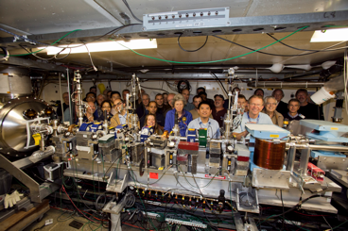
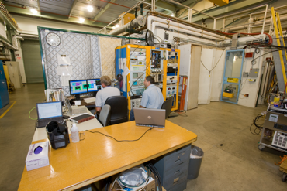
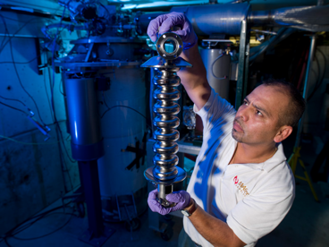
A0/HBESL Overview
A0 is the birthplace of SRF activities at Fermilab
  Photoinjector – 14 MeV SRF facility for AARD
  Clean room for parts cleaning, assembly, cavity test prep, and storage
  ‘North cave’ for SRF cavity tests
  Coupler test stand (3.9 GHz input couplers)
Storied history for AARD, PhD’s at Fermilab
‘Ground zero’ for many FLASH/ACC39 activities

Slide 21
A0/HBESL Status
Photoinjector gun repurposed as HBESL
‘Capture Cavity 1’ upgraded and to be installed as part of ASTA Injector
Coupler stand in operation by means of a Work For Others agreement with DESY for assembling and conditioning XFEL 3.9 GHz couplers
Occasional North cave operation
  3.9 GHz spare cavity qualification (for DESY/FLASH)
  3.9 GHz cavity R&D (single and 9-cell)
  2.4 GHz magnetron testing
  other ‘niche’ tests
Future of these facilities very murky
  possible HBESL relocation to IARC
  3.9 GHz test capability being developed at IB1/TD
  A0 to be repurposed
  Clean room activities (incl. staff) largely moved to CMTF

Slide 22
A0/HBESL Operations
The A0/HBESL Operations budget is minimal in support of HBESL (GARD – Test Facilities) and 3.9 GHz SRF work
WFO with DESY is full cost recovery
Description | Direct M&S FY14 - actual ($k) | Direct M&S FY15 ($k) | Direct M&S FY16 ($k) | Direct M&S FY17 ($k)
Cryogenic Operations & Maintenance (3.9 GHz) | 0 | 0 | 45 | 0
Consumables for 3.9 GHz SRF tests | 0 | 0 | 9 | 0
HBESL RF Support | 1 | 2 | 2 | 0
HBESL Laser operations | 4 | 4 | 4 | 0
HBESL General Infrastructure/misc. | 22 | 6 | 6 | 0
Total Direct M&S ($k) | 27 | 12 | 66 | 0
Labor (FTE’s) | 0.3 | 0.2 | 1.3 | 0.0

Slide 23
AD Test Facilities Budget Summary

Slide 24
Summary
Fermilab has a set of unique beam-based test areas that are de-coupled from the main accelerator complex
DOE has made a significant investment in ASTA/IOTA that is well on its way to showing a return
PXIE is a well defined program intended to address technical risks for PIP-II
A0/HBESL support is diminishing, but activities pioneered there still have validity
Funding plan and schedules reflects these realities, the next couple of years are critical

Slide 25
Thank you….

Slide 27
Backup slides

Slide 28
IOTA Parameters
Nominal kinetic energy | 150 MeV e-, 2.5 MeV p+
Nominal intensity | e⁻: 1×10⁹, p: 1×10¹¹
Circumference | 40 m
Bending dipole field | 0.7 T
Beam pipe aperture | 50 mm dia.
Maximum b-function (x,y) | 12, 5 m
Momentum compaction | 0.02 ÷ 0.1
Betatron tune (integer) | 3 ÷ 5
Natural chromaticity | -5 ÷ -10
Transverse emittance r.m.s. | e-⁻: 0.1 μm, p+: 2μm
SR damping time | 0.6s (5×10⁶ turns)
RF Voltage, freq.,harmonics | e⁻: 1 kV, 30 MHz, 4
Synchrotron tune | e⁻: 0.002 ÷ 0.005
Bunch length, momentum spread | e⁻: 2 cm, 1.4×10⁻⁴

Slide 29
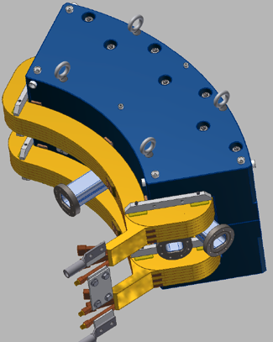
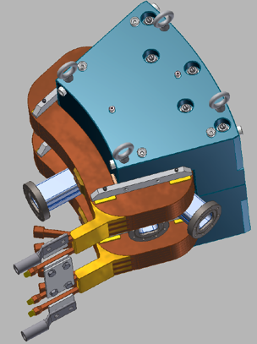
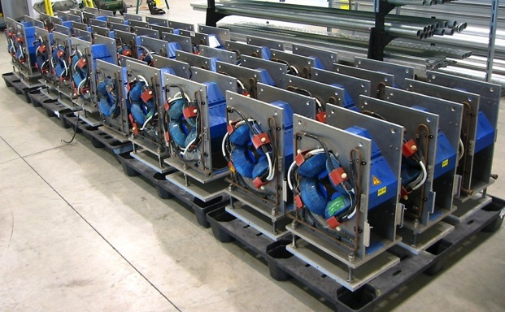
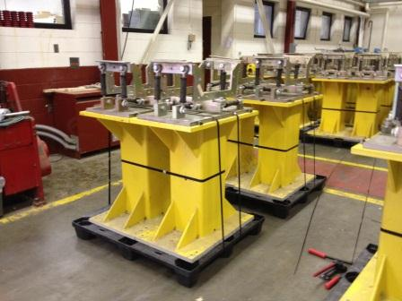
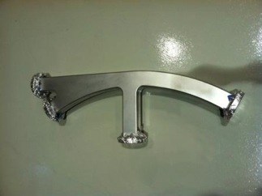
IOTA Ring Elements in Hand
32 quads from JINR (Dubna) received
Dipole magnets (ordered)
Magnet support stands
from MIT (received)
Also:
BPM bodies and electronics
Vacuum system
Dipole power supply
Corrector power supplies
Vacuum chambers
for dipoles (received)

Slide 30
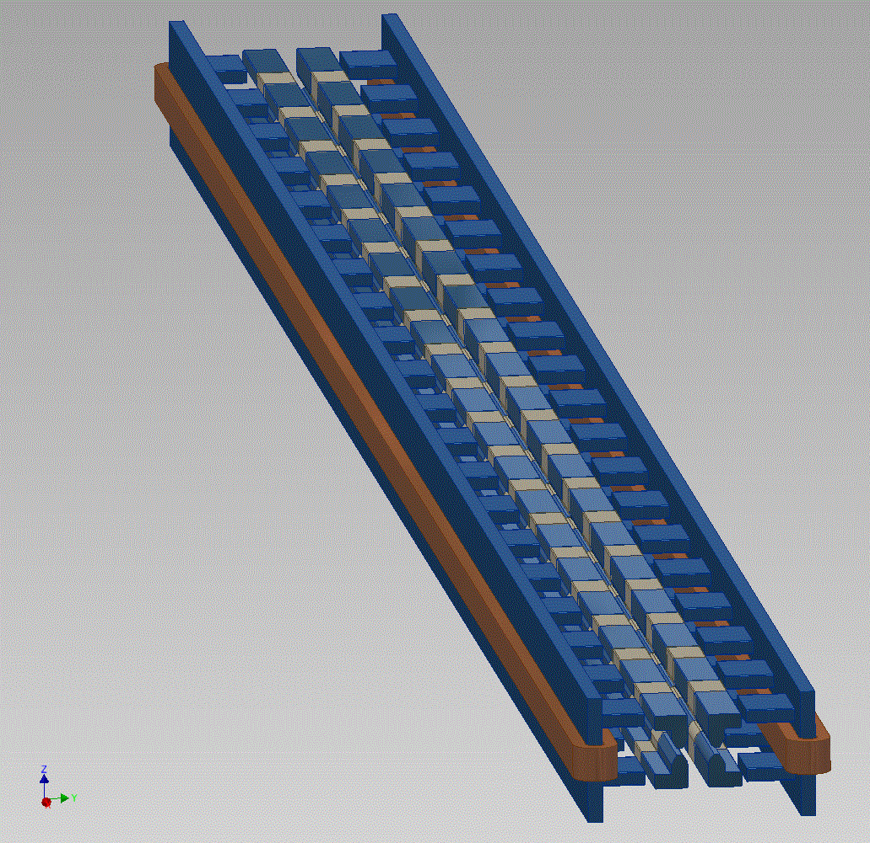
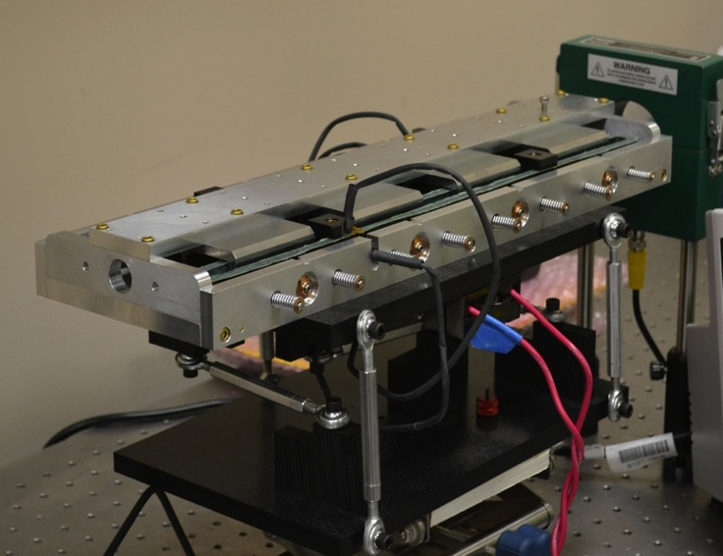
IOTA Nonlinear Magnet
Joint effort with RadiaBeam Technologies (Phase I and II SBIR)
FNAL Concept: 2-m long
nonlinear magnet
RadiaBeam short prototype. The full 2-m magnet is designed and fabricated in Phase II
Notes:
mention delivery of actual magnet in phase II

Slide 31
IOTA Staging – Phase I
Phase I will concentrate on the academic aspect of single-particle motion stability using e- beams
  Achieve large nonlinear tune shift/spread without degradation of dynamic aperture by “painting” the accelerator aperture with a “pencil” beam
  Suppress strong lattice resonances = cross the integer resonance by part of the beam without intensity loss
  Investigate stability of nonlinear systems to perturbations, develop practical designs of nonlinear magnets
  The measure of success will be the achievement of high nonlinear tune shift = 0.25
Notes:
color pencil beam

Slide 32
IOTA Staging – Phase I
The magnet quality, optics stability, instrumentation system and optics measurement techniques must be of highest standards in order to meet the requirements for integrable optics
  1% or better measurement and control of β-function, and 0.001 or better control of betatron phase
This is why Phase I needs pencil e⁻ beams as such optics parameters are not immediately reachable in a small ring operating with protons
High quality electron beam at a certain energy and phase-space quality is absolutely essential to characterize the IOTA ring

Slide 33
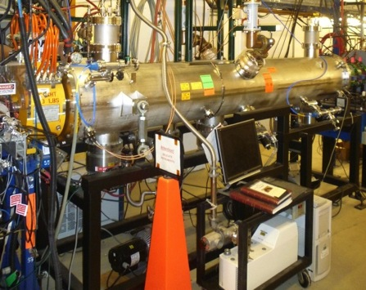
IOTA Staging – Phase II
After the IOTA commissioning, we will move the existing 2.5 MeV proton/H- RFQ into the ASTA hall to inject protons into the IOTA ring.
Allows tests of Integrable Optics with protons and realistic space charge beam dynamics studies
Allows space charge compensation experiments
Unique capability
ΔQ_{SC} =0.6 for one-turn injection
*multi-turn injection possible
2.5 MeV RFQ
Notes:
multi-tun injection possible

Slide 34
PXIE layout
LEBT
RFQ
MEBT
HWR
SSR1
HEBT
~ 40 m long
CW H- source delivering 5 mA at 30 keV
LEBT with beam pre-chopping
CW RFQ operating at 162.5 MHz and delivering 5 mA at 2.1 MeV
MEBT with integrated wide-band chopper and beam absorbers capable of generating arbitrary bunch patterns at 162.5 MHz, and disposing of 4 mA average beam current
Low beta superconducting cryomodules: 1 mA to ~25 MeV
Beam dump capable of accommodating 2 mA at 25 MeV (50 kW) for extended periods.
Associated beam diagnostics, utilities and shielding

Slide 35
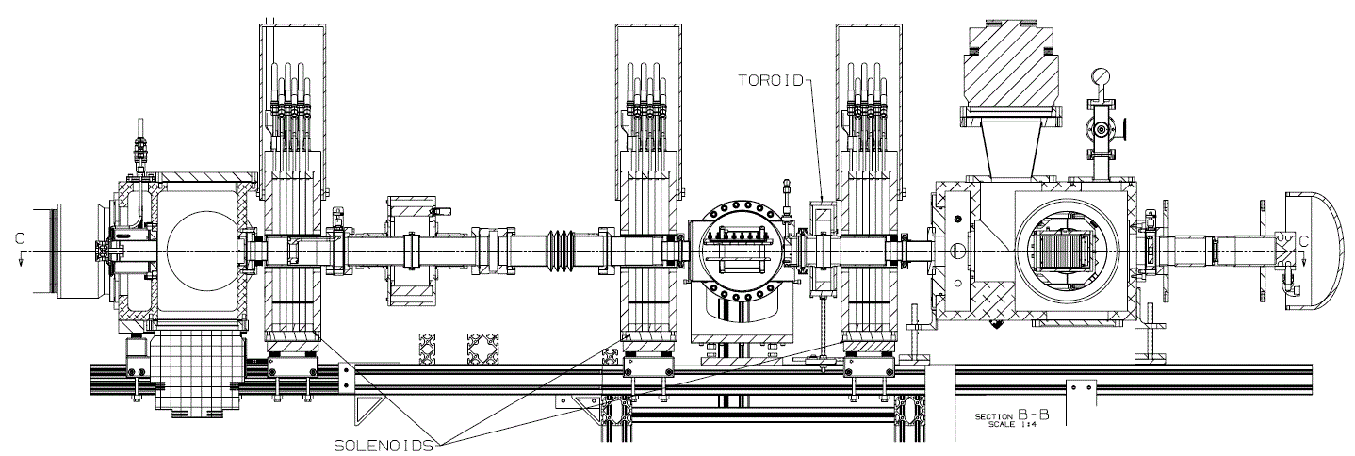
PXIE Current setup: LEBT installed (30 keV)
All focusing elements, chopper, instrumentation have been installed except for the LEBT/RFQ Interface and its ‘scraper’
  Also, most of the controls, PS… have been moved to their final location
  The construction and installation of the bend has been delayed until FY16
Emittance scanner
Gate valve
Collimator
Water-cooled donut
DCCT
Chopper
Faraday Cup
T. Hamerla
~3.5 m

Slide 36
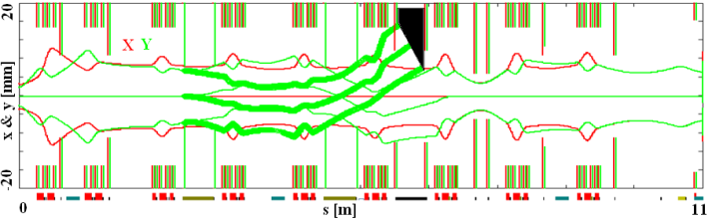
PXIE MEBT layout: to be built 2015-16
HWR
Bunching cavity
Absorber
Scrapers
RFQ
Quadrupoles
Kickers

Slide 37
PXIE Summary
PXIE is a well defined program to address technical risks for PIP-II
  25 MeV H- Linac
  Bunch by bunch chopping
  Operation of SRF in close proximity to absorber
Set of milestones and goals
  focus in FY15 is delivery and commissioning of RFQ
  focus in FY16 is building out the full MEBT

