Slide 1
Fermilab Accelerator Division: Test Facilities Summary
Sergei Nagaitsev
Mini-Review of Fermilab’s Accelerator Test Facilities Program
March 17, 2015

Slide 2
AD test facilities
Three categories:
Common cryo infrastructure (ops, maintenance and upgrades);
Facilities ops in support of SRF fabrication and testing;
Beam-based test facilities (ops) for Accelerator Science, GARD, and project-specific R&D

Slide 3
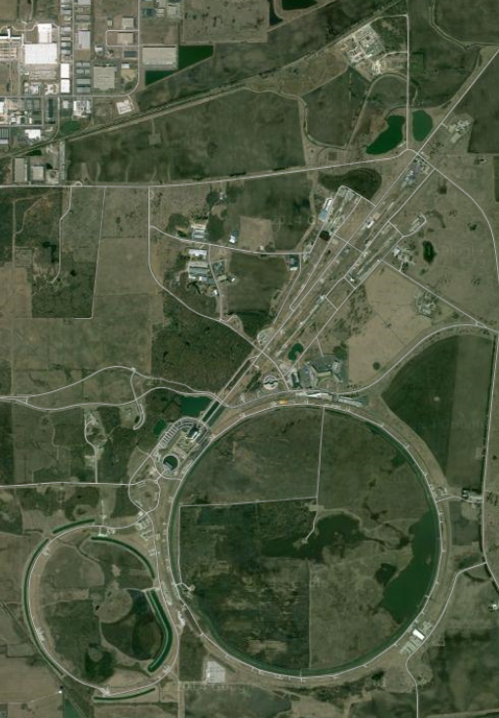
CMTF
AD Test Facilities
MW9
Cryo dept base
NML
MDB
CHL
MTA
A0

Slide 4
Accelerator Test Facilities and Uses 2015-2020
 | LCLS-II | CLAS12 | Mu2e | g-2 | LARP | FNAL Complex | PIP-II | US-HiLumi | MAP/ MICE | SRF R&D | HFM R&D | Accel Sci | Detector R&D
Cavity Processing | X |  |  |  |  |  | X |  |  | X
VTS-1, 2, 3 | X |  |  |  |  |  | X |  |  | X
String Assembly | X |  |  |  |  |  | X |  |  | X
Cryomodule Assembly | X |  |  |  |  |  | X |  |  | X
HTS1 & HTS2 | X |  |  |  |  |  | X |  |  | X
Spoke Test Cryostat | X |  |  |  |  |  | X |  |  | X
CMTS1 | X |  |  |  |  |  | X |  |  | X
Strand & Cable Lab |  |  | X | X | X |  |  | X |  |  | X
Magnet fabrication | X | X | X | X | X | X | X | X |  |  | X
MTF - warm | X |  | X | X |  | X
MTF - cold | X |  |  |  |  |  | X | X
Vertical MTF |  |  |  |  | X |  | X |  |  |  | X
Solenoid TF |  |  | X
PXIE |  |  |  |  |  |  | X |  |  | X
NML Injector & CM | # |  |  |  |  |  |  |  |  | X |  | X
IOTA |  |  |  |  | # |  |  |  |  |  |  | X
A0 (3.9 GHz) | X |  |  |  |  |  |  |  |  | X
MTA |  |  |  |  |  |  |  |  | X |  |  | X | X
Cryo plants | X |  | X | X | X |  | X | X | X | X | X | X
# indicates strong interest but no commitment

Slide 5
request
request
request
FY15 Lab plan: $5.1M
MTA FY14 (actual): $1,129k (paid by MAP)
MTA transitions to Test Fact ops in FY16 (50%) and FY17 (100%)

