Slide 1
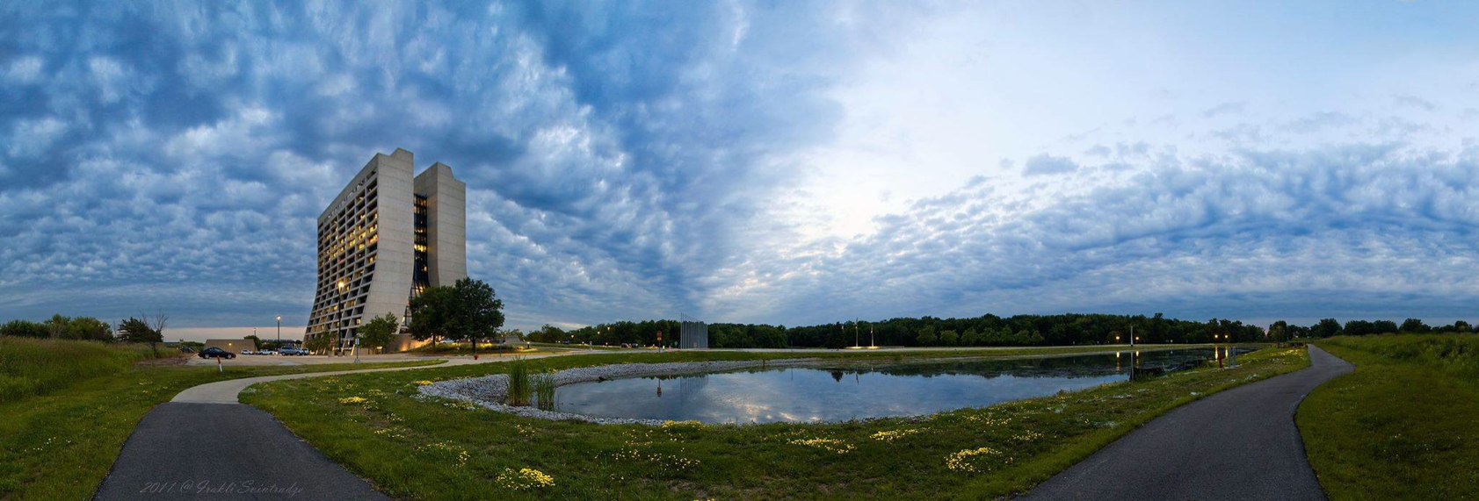
Welcome
T.I. Meyer | Chief Operating Officer, Fermilab
Mini-Review of Accelerator Test Facilities | 17 March 2015

Slide 2
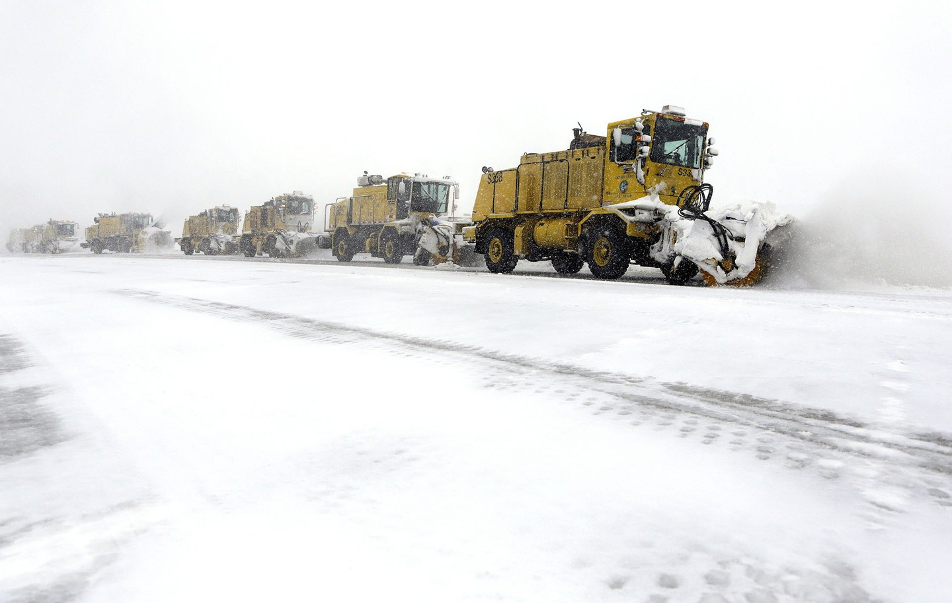
Feb 3, 2015

Slide 3
Context
We are at a special and critical moment in U.S. HEP history
P5: Future of U.S. particle physics is long-baseline neutrinos
Without LBNF, no major thrust in U.S. for at least two decades
LBNF proceeding more rapidly than anticipated
Partners are aligned
International funding agencies “almost” at the table
➔ Seek to cement global team with U.S. constr. start in FY2017
Simultaneously…
Execute the current program

Slide 4
The whole is greater than the sum of the parts
Fermilab is a research lab
Fermilab is an operations lab
Fermilab is a projects lab
Excellence in each strengthens the others
The user community is fully engaged on all three

Slide 5
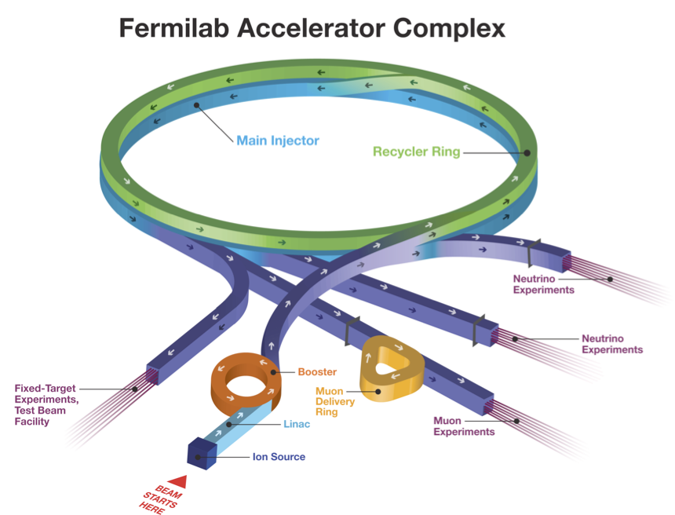
…Fermilab is an operations lab
Accelerator
Detector
Computing
Off-site operations
Test facilities

Slide 6
Charge & Expectations
The purpose of this mini-review is to outline the full scope of activities that fall within the Accelerator Test Facilities Program, examine resource needs and gaps, and discuss priorities and plans for the next few years.
Comment on the budget and cost estimates presented for the primary activities. Do they seem fair and reasonable?
Suggest relative priorities and/or trade-offs, taking into account the cross-cutting nature of the facilities and operational activities.
Advise on strategies for supporting the program including considerations for engaging DOE.
A short, written report should be prepared within a week.

Slide 7
Structure of the day
Deluge of information
Lunch & discussion
Further deluge
Strategy session
Executive session
Outbrief

Slide 8
Tough love
Above all, we request that you
Listen carefully
Challenge our assumptions
Critique our arguments
Press us on our conclusions

