Slide 1
Fermilab Accelerator Division:
Test Facilities Introduction
Sergei Nagaitsev
Mini-Review of Fermilab’s Accelerator Test Facilities Program
March 17, 2015

Slide 2
AD test facilities
Three categories:
  Common cryo infrastructure (ops, maintenance and upgrades);
  Facilities ops in support of SRF fabrication and testing;
  Beam-based test facilities (ops) for Accelerator Science, GARD, and project-specific R&D

Slide 3
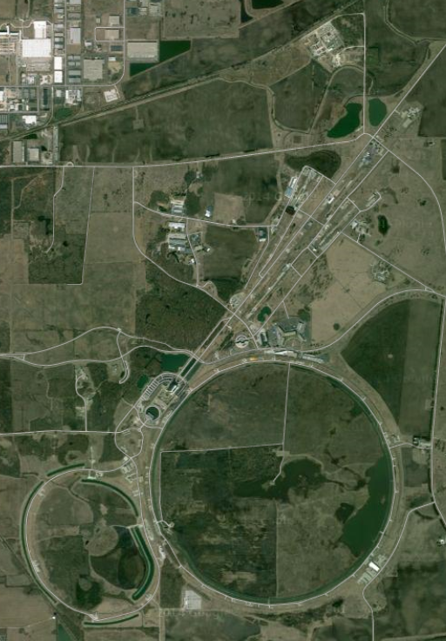
CMTF
AD Test Facilities
MW9
Cryo dept base
NML
MDB
CHL
MTA
A0

Slide 4
Accelerator Test Facilities and Uses 2015-2020
 | LCLS-II | CLAS12 | Mu2e | g-2 | LARP | FNAL Complex | PIP-II | US-HiLumi | MAP/ MICE | SRF R&D | HFM R&D | Accel Sci | Detector R&D
Cavity Processing | X |  |  |  |  |  | X |  |  | X
VTS-1, 2, 3 | X |  |  |  |  |  | X |  |  | X
String Assembly | X |  |  |  |  |  | X |  |  | X
Cryomodule Assembly | X |  |  |  |  |  | X |  |  | X
HTS1 & HTS2 | X |  |  |  |  |  | X |  |  | X
Spoke Test Cryostat | X |  |  |  |  |  | X |  |  | X
CMTS1 | X |  |  |  |  |  | X |  |  | X
Strand & Cable Lab |  |  | X | X | X |  |  | X |  |  | X
Magnet fabrication | X | X | X | X | X | X | X | X |  |  | X
MTF - warm | X |  | X | X |  | X
MTF - cold | X |  |  |  |  |  | X | X
Vertical MTF |  |  |  |  | X |  | X |  |  |  | X
Solenoid TF |  |  | X
PXIE |  |  |  |  |  |  | X |  |  | X
NML Injector & CM | # |  |  |  |  |  |  |  |  | X |  | X
IOTA |  |  |  |  | # |  |  |  |  |  |  | X
A0 (3.9 GHz) | X |  |  |  |  |  |  |  |  | X
MTA |  |  |  |  |  |  |  |  | X |  |  | X | X
Cryo plants | X |  | X | X | X |  | X | X | X | X | X | X
# indicates strong interest but no commitment

Slide 5
request
request
request
FY15 Lab plan: $5.1M
MTA FY14 (actual): $1,129k (paid by MAP)
MTA transitions to Test Fact ops in FY16 (50%) and FY17 (100%)

Slide 6
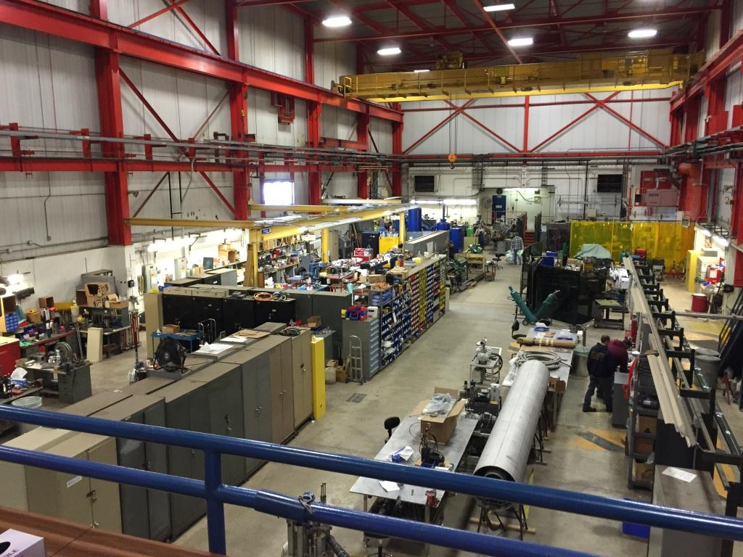
Cryo Services and Assembly Building – MW9
MW9 - this facility is home for all cryo design, fabrication, assembly and maintenance services.
Provides on-demand/on-call staff to support operations of five AD cryogenic test facilities
Provides full-time staff to support all maintenance and upgrades of cryogenic rotating equipment, components and controls for all AD cryogenic facilities
Coordinates helium distribution to all AD test facilities (Cost of helium is paid by project running the test)

Slide 7
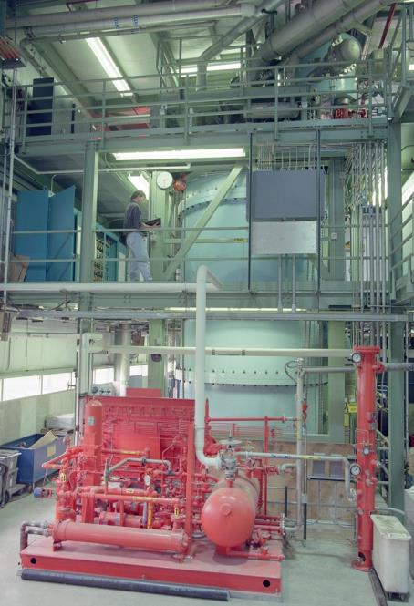
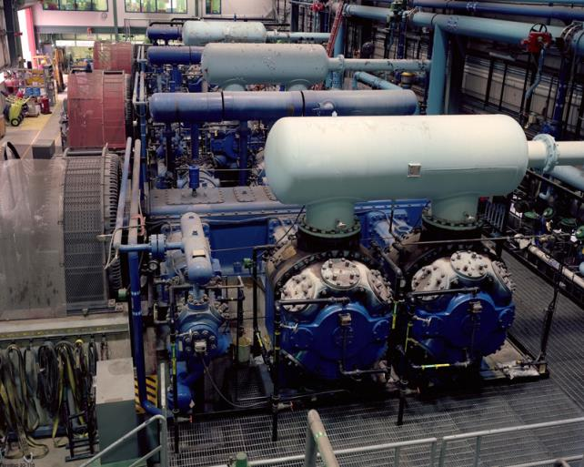
Solenoid Test Facility at Central Helium Liquefier (CHL)
CHL – provides LHe for Mu2e solenoid testing. In the future, the CHL will be used for the PIP-II linac.
FY16
Controls and equipment upgrades
Master Substation overhaul, thus no power at CHL
FY17
Mu2e solenoid testing. Project pays for helium and operations, but not for facility upgrades, repairs or maintenance.

Slide 8
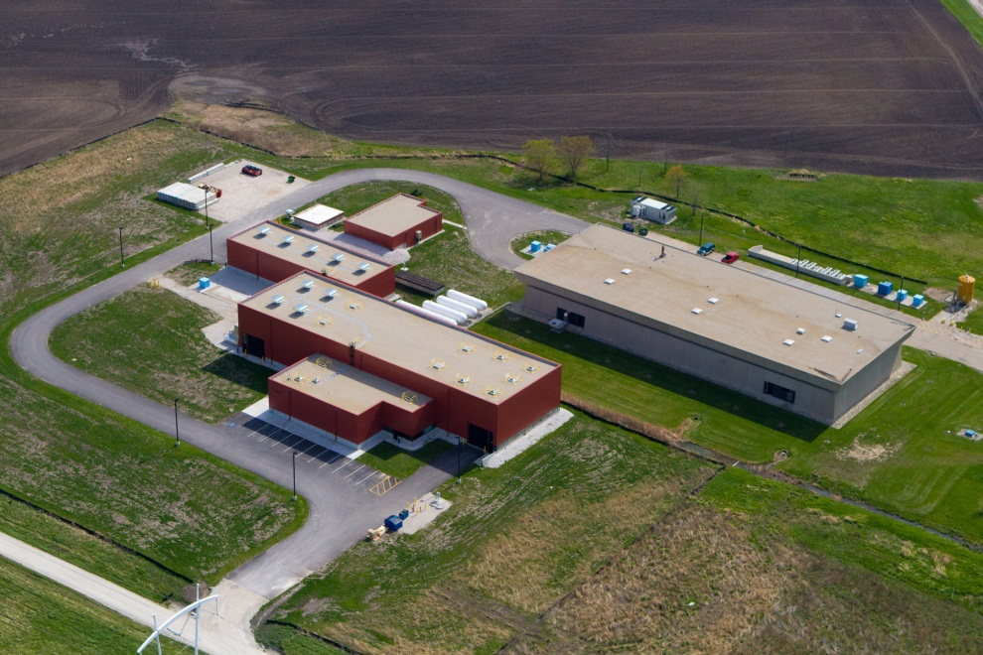
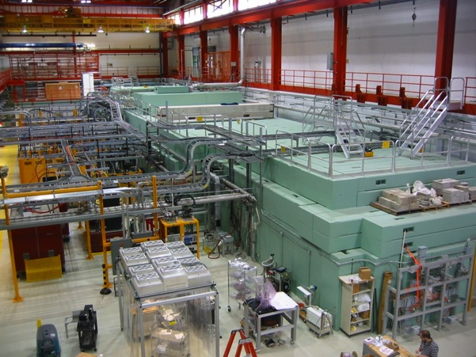
NML Test Facility
NML – this facility is home of FNAL Accelerator R&D program which includes IOTA ring (under construction) and SRF R&D testing with its 250-MeV electron injector (25-MeV operational at present)
FY16
• Operate 25-50 MeV photo-injector
• Operate CM2 with beam (6 months)
• Complete construction of IOTA Ring
• Maintain facility support systems
FY17
• Operate full 250-MeV accelerator
• IOTA – commission with electrons and begin installation of proton injector • Maintain facility support systems

Slide 9
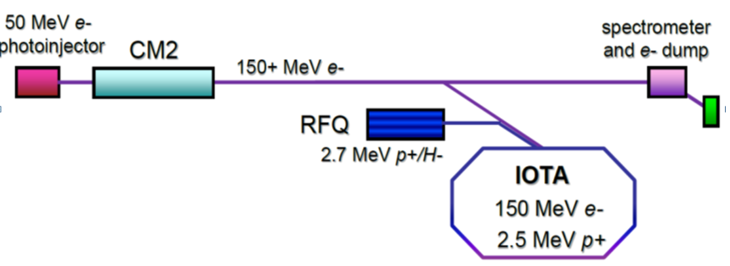
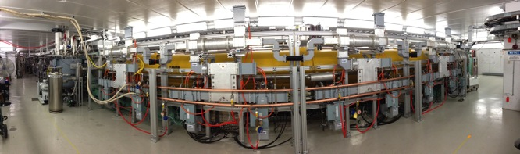
IOTA/ASTA Accelerator R&D
IOTA (Integrable Optics Test Accelerator) – storage ring with e- and p+ injectors to carry out transformative R&D towards future multi-MW proton accelerators
Full R&D Program
• Will begin in FY18
• 9 mo/yr, with e- and p+
FY16-17
• Extensive installation and commissioning activities:
CM2-based SRF e- injector
IOTA ring
2.5 MeV RFQ Proton Injector

Slide 10
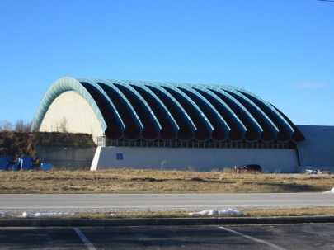
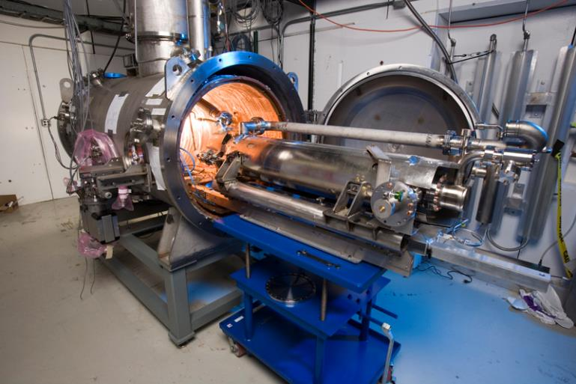
Meson Detector Building (MDB) Facility
MDB - an SRF Test Facility that includes two horizontal cavity test stands (HTS1 & HTS2) and a spoke cavity test stand (STC)
FY16
• Complete assembly of HTS2
• Test cavities for LCLSII and PIPII
• Maintain facility support systems
FY17
• Test cavities for LCLSII and PIPII
• Maintain facility support systems

Slide 11
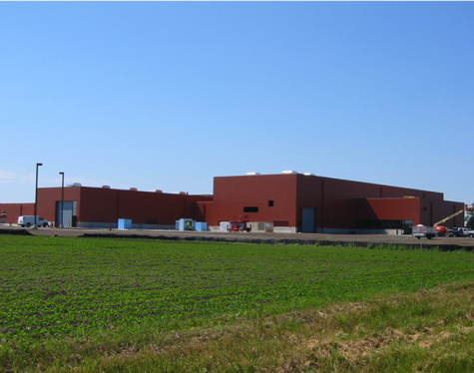
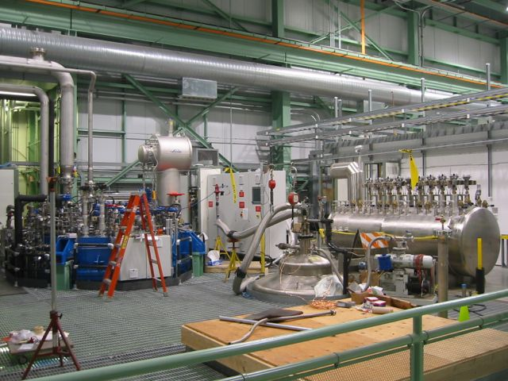
Cryomodule Test Facility (CMTF)
CMTF - an SRF Accelerator R&D Test Facility that includes a Cryoplant and two cryomodule test stands -- PXIE and CMTS1
FY16
• PXIE – Operate LEBT, MEBT and RFQ with beam
• Commission cryomodule test stand (CMTS1) for LCLSII CM testing
• Maintain facility support systems
FY17
• PXIE – Extend cave to include HWR and SSR
• Test LCLS-II cryomodules in CMTS1
• Maintain facility support systems

Slide 12
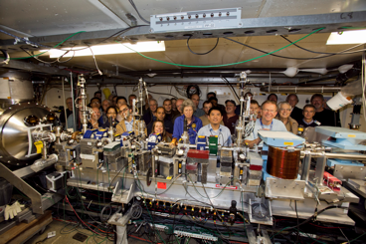
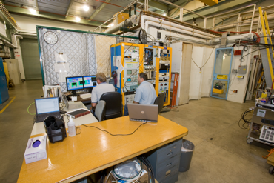
A0/HBESL Test Facility
A0/HBESL – birthplace of many SRF activities at Fermilab, including first deliverable 3.9-GHz cryomodule to DESY/FLASH, 14 MeV photoinjector (now relocated to NML), High Brightness Electron Source Lab (HBESL), and Clean room.
FY16
• Operation of HBESL
• Conduct 3.9 GHz and misc. SRF cavity tests
• Coupler assembly & testing for XFEL (funded by WFO with DESY)
FY17
• All test activities relocated to other locations
• Area repurposed to support AD vacuum operations

Slide 13
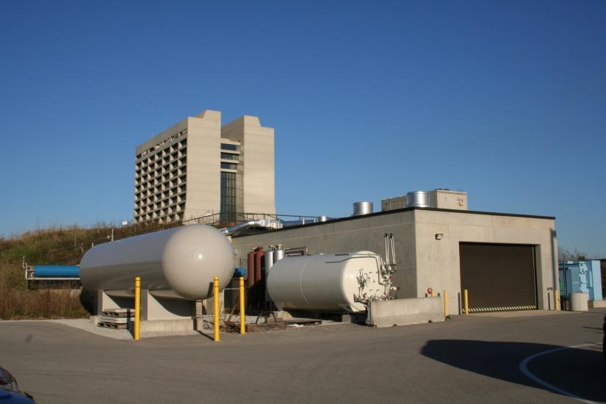
Muon Test Area (MTA)
MTA – Test facility to provide RF test capability in high magnetic fields and to deliver Linac beam for RF and detector testing. Supports separate as well as combined beam and magnetic field testing.
FY16
Thru Mar 31,2016 – MAP fully
supports facility operations
  Focus on MICE RF Module Characterization
Apr 1, 2016 onwards a
AD Test Facility for detector development (in B-field, with beam) & high gradient RF R&D
FY17
Ongoing operation for detector development & high gradient RF R&D

