Slide 1

CRAB cavities
Tuner design and status
Kurt Artoos
  ( (CERN) Rama Calaga, Ofelia Capatina, Teddy Capelli, Federico Carra, L. Dassa, Norbert Kuder, Raphael Leuxe,
  P. Minginette
  Colleagues USLARP , STFC
  Remark: pretuning sensitivity DQW rectified in slides after meeting

Slide 2
Contents
Tuning principle
DQW and RFD Tuning forces, stress and range
DQW pre tuning
Status SM18 tuner
Studies SPS tuner

Slide 3
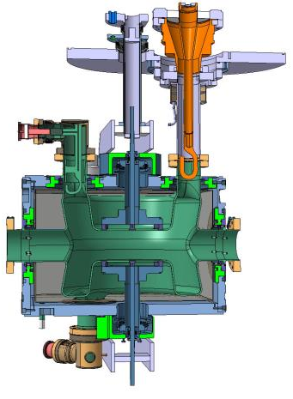
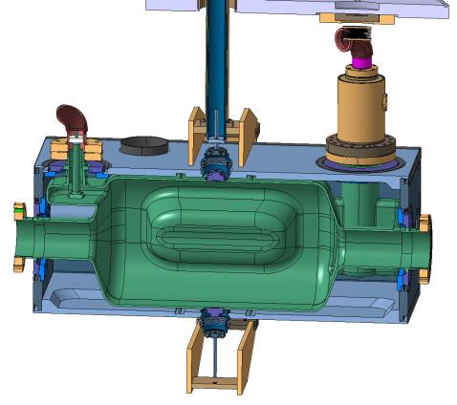
Symmetric actuation on cavity through tuner frame and concentric tubes.
Motorization outside cryostat
Centre of the actuation is floating
DQW : 186 kHz/mm *
S. Vérdu Andrés
RFD : 345 kHz/mm *
H. Park
* Measured as tuner stroke or Δdistance between 2 plates

Slide 4
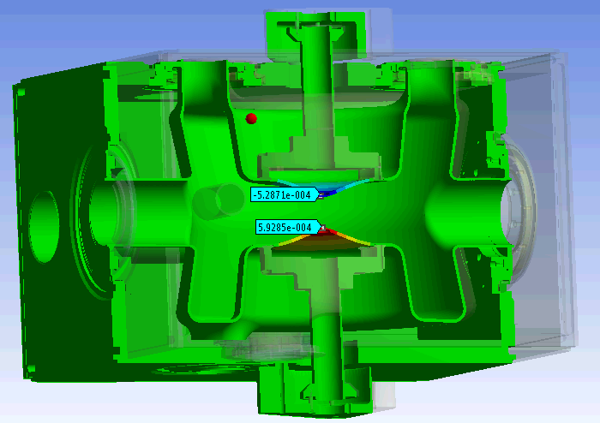
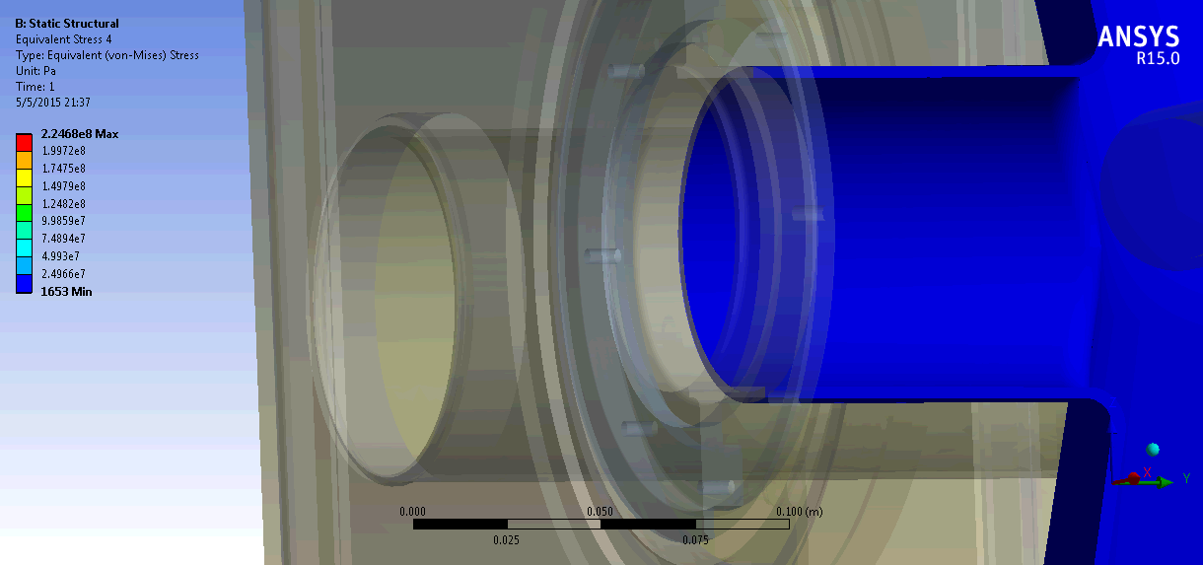
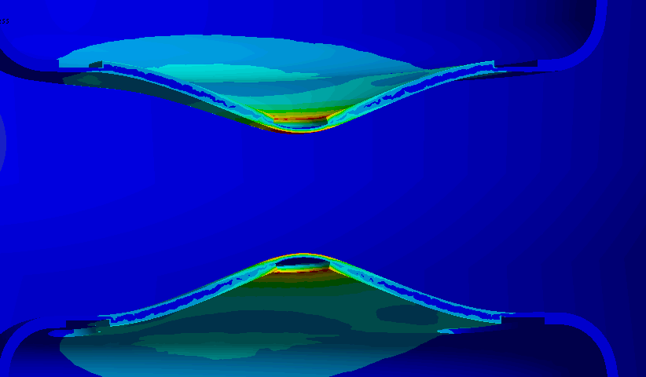
DQW
Cavity (RT , no PCB) with He vessel + pretuning device
Input force 2.5 kN
Displacement z 0.53/0.6 mm
Maximum eq. Stress 225 MPa
Corresponds to about 0.21 MHz (0.42 MHz pp) *
For 400 MPa/1.2= 333 MPa -> 0.31 MHz (0.62 MHz) range (linear), 3.7 kN
Force/tuner stroke 2.2 kN/mm
199 MPa/mm
At RT for 50 MPa , 0.25 mm maximum tuner stroke for 0.5 kN

Slide 5
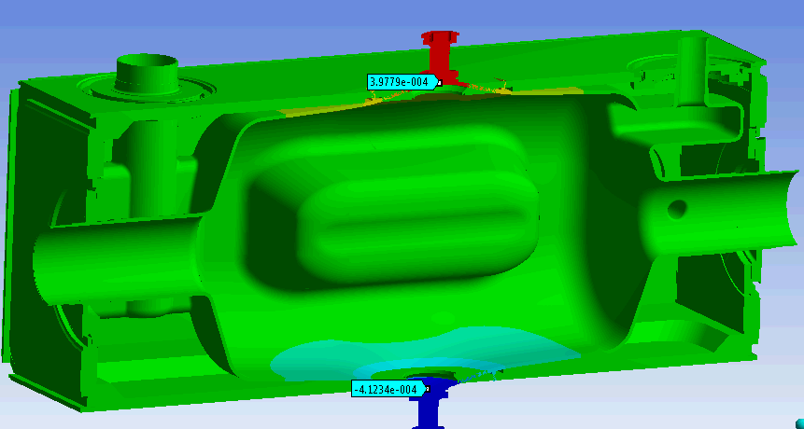
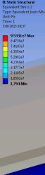

RFD
Cavity (RT , no PCB) with He vessel
Input force 2 kN
Displacement z 0.4/0.41 mm
Maximum eq. Stress 95 MPa
Corresponds to about 0.280 MHz (0.560 MHz pp)
For 400 MPa/1.2= 333 MPa -> 0.980 MHz (1.96 MHz) range (linear), 7 kN
Force/tuner stroke 2.5 kN/mm
115 MPa/mm
At RT for 50 MPa , 0.42 mm max tuner stroke for 1 kN

Slide 6
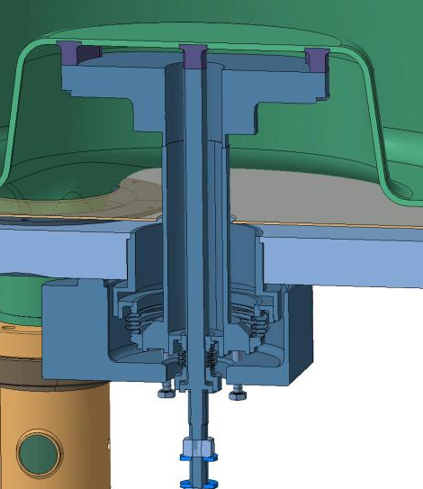
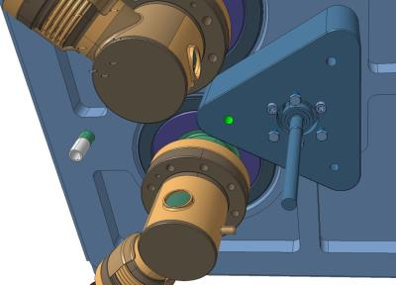
Pre tuning DQW
At warm
Bellows are now outside of the helium vessel
3 M6 screws (pull) and studs (push)
Pitch 1 mm
Bellows (Ti) will be probably edge welded
Sensitivity 0.8023 MHz/mm (Binping Xiao)

Slide 7
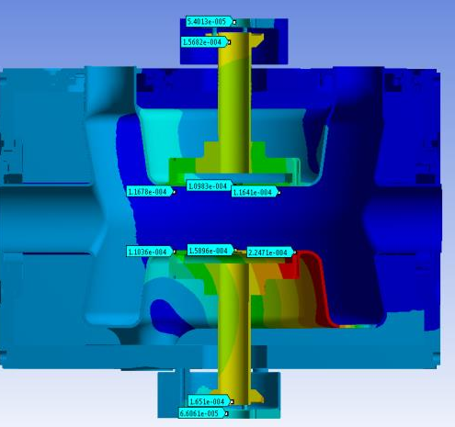

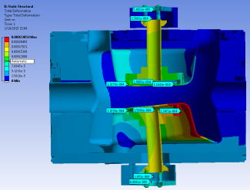
Deformation
Top : 0.21 mm screw motion
-> 0.11 mm plate deformation
Bottom: 0.23 mm screw
-> 0.16 mm centre plate def.
Force: about 3 kN /screw M6x1
σ_{i} screw = 178 MPa (0.3 friction)
Flexibility gives the resolution
0.8023 MHz/ mm

Slide 8
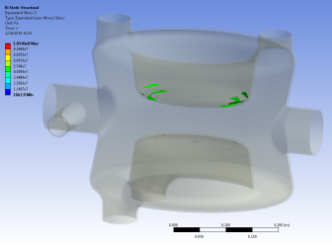
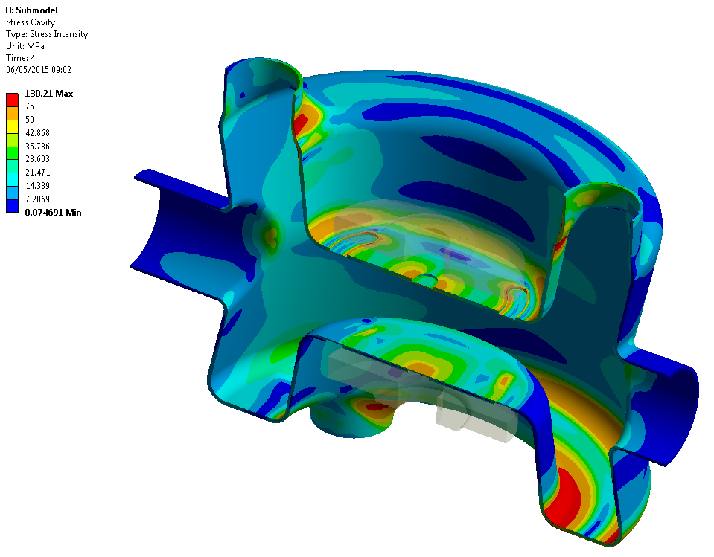
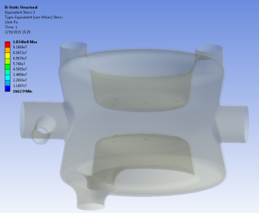
Pretuning stress
Pre-tuning 0.2 mm (distance plates) + pressure
> 50 MPa
Ref. L. Dassa For the helium vessel as pressure vessel
this would be a limit (needs some thinking)
0.15 MHz (0.3 MHz) for 0.8 MHz/mm
> 75 MPa
https://indico.cern.ch/event/391211/session/4/contribution/11/material/slides/4.pptx

Slide 9
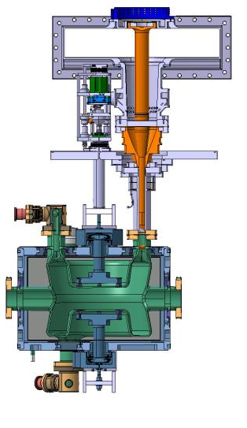
Tolerances tuner axis
= 1.49°
545 mm→14 mm
212 mm→ 5.5 mm
Requirements off set bellows
Introduce hinges (flexural)

Slide 10
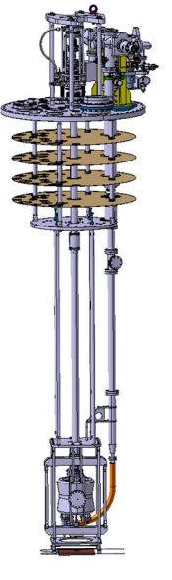
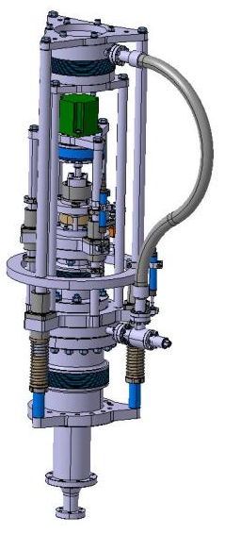
Status SM18 p.o.p. tuner
Design: P. Minginette
Motor 1.3 Nm Bipolar Nema 23
(1.8 deg/step)
HD HFUS-20-100-2SO
Ratio i : 0.01 ,
repeat. peak Torque 82 Nm, average torque 49 Nm
Accuracy < 1 arcmin, precision <0.1 arcmin
Fa Dyn 7.7 kN, η=~0.80 (grease, 20 °C)
Roller screw Rollvis RV 12 x 1
η=0.79 , static load capacity 17 kN
M= p i F/2000 π η = 0.01 Nm F= 4 kN, p= 1
Detend torque 0.017 Nm, self locking

Slide 11
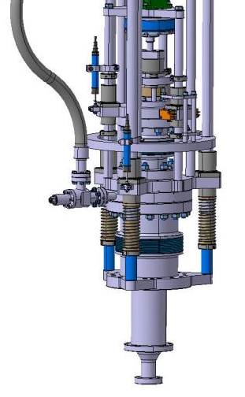
Instrumentation
Design: P. Minginette
Precision motorisation:
1 step= 1.8° x 0.01 → 0.1 μm (p=1 mm)
Precision HD 0.1 arcmin or 0.0017° → 10 nm
Altered by friction in guides
DQW ~ 20-2 Hz
RFD ~ 35-3.5 Hz
Instrumentation:
Potentiometer Megatron RC13-25 M
25 mm range , 1 kΩ, resolution ~10 μm
Load cell Kistler
4576A55C1 class 0.1
DQW (2.2 kN/mm) →1.5 μm precision
RFD (2.5 kN/mm) → 1.3 μm precision
limit switches
Mechanical stops

Slide 12
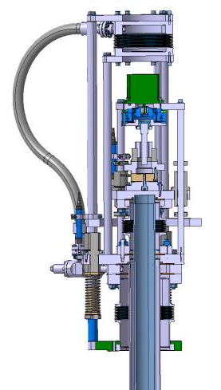
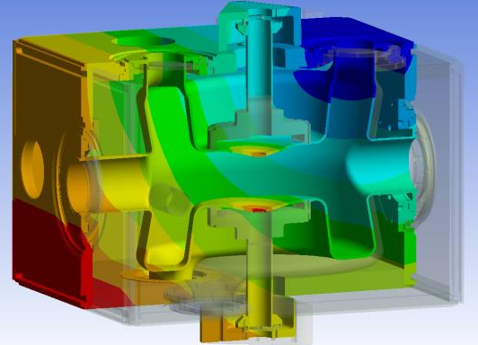

Pressure compensation
1 atm = 101.325 kPa , Force = 844 N (on 2 tuning tubes)
Day variations 3 mbar 2.5 N
Week variations 10 mbar 8.3 N
R = 51.5 mm
10 mbar variation
Surface 0.0083 m²
1 atm = 0.19 mm on each plate
Load compensating springs : 3 x 5 N/mm

Slide 13
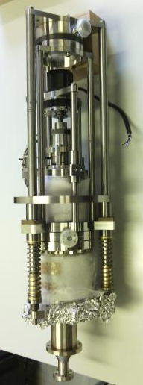
Status p.o.p. tuner test
Motorisation:
All parts available and test mounted
Some improvements identified, some small parts to be machined
Qualification tests to be made.
Tuning frame and actuator tubes cryostat:
Production drawings ready and approved
Production being launched at the moment
Linked to production new cryo inserts for SM18
Earliest (own) guess parts available end of August

Slide 14
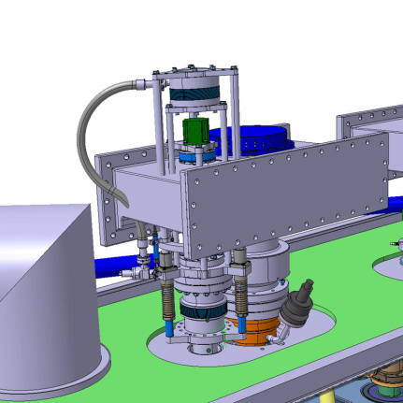
Drawbacks first design:
Size …
Mass ~15 kg + 15 kg frame
Static : compensated
Dynamic First mode on cavity ~ 41 Hz
Motorisation can not be replaced
without opening cryostat (maintainability)

Slide 15
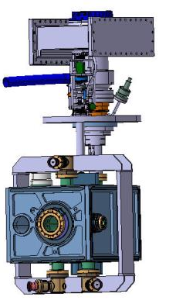
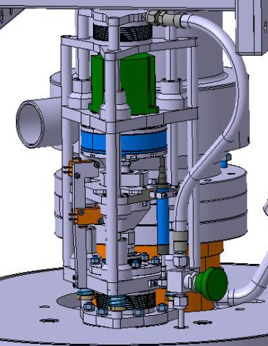
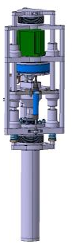
Status design for SPS test (v1)
Size ok
Smaller mass
Can be dismounted from cryostat
Design: P. Minginette

Slide 16
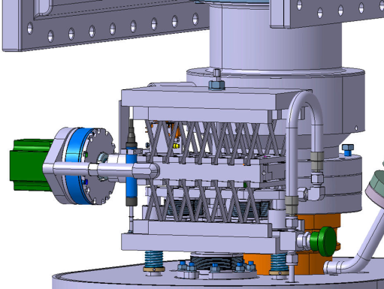
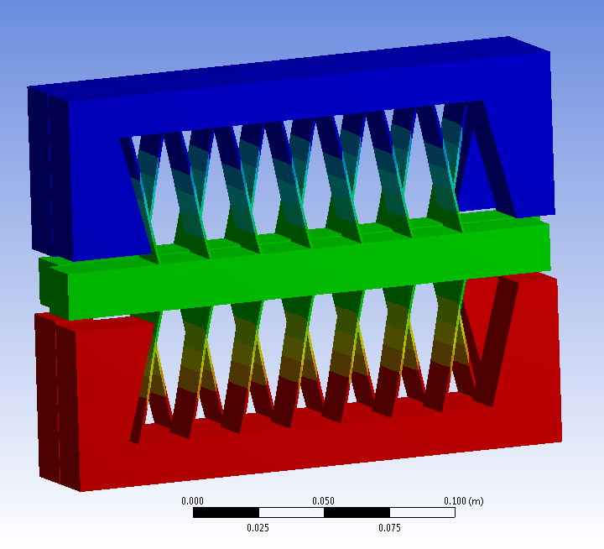
Status design for SPS test (v2)
Compact
10 to 20 times better resolution
Centre of actuation is materialised
Dismountable
Design: P. Minginette

Slide 17
Piezo
At the moment not included.
Maximum input speed
Assuming very stiff actuation:
HD 6500 rpm : ~1 mm/s
Resolution to be tested but at best some Hz, can be improved
What resolution do we need ? How fast ?

Slide 18
Conclusions
Calculations for DQW and RFD show the tuning ranges available that are smaller than the error on p.o.p.
A first prototype of the tuner motorisation has been built, tests with p.o.p. DQW autumn 2015 *
Options for the SPS tuner are under study, taking care of integration, resolution, pressure and load compensation and instrumentation
To be included in study: radiation, thermal optimisation
Test program to be prepared

Slide 19

Thank you

