Slide 1
Joint HiLumi LHC-LARP Annual Meeting
Crab cavities cryomodules developments
Ofelia Capatina, on behalf of WP 4 collaboration

Slide 2
Outline
Introduction
Schedule
Some cryomodule engineering
Conclusions

Slide 3
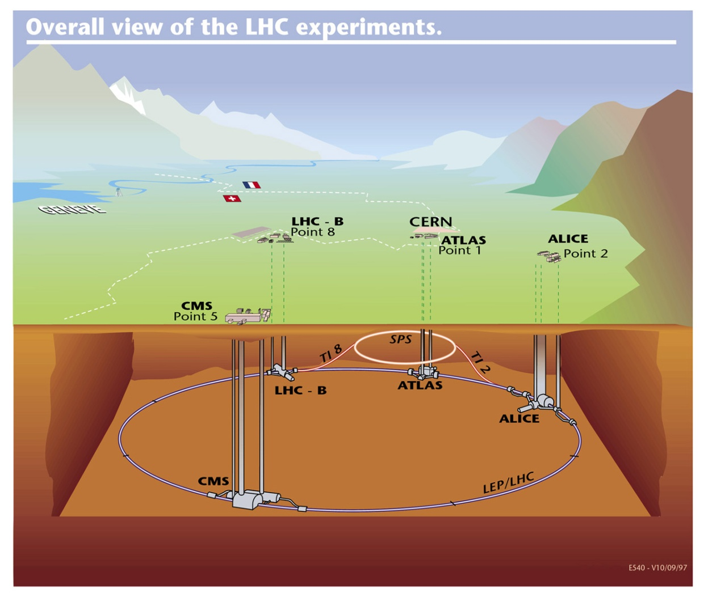
SM18 Area
Cavity cold testing, clean room facilities & cryomodule qualification
SPS Test Prototype Module(s) before LS2
LHC Point 5 (horizontal)
4 cavities / IP side/ beam
to be installed during LS3
LHC Point 1 (vertical)
4 cavities / IP side/ beam
to be installed during LS3

Slide 4
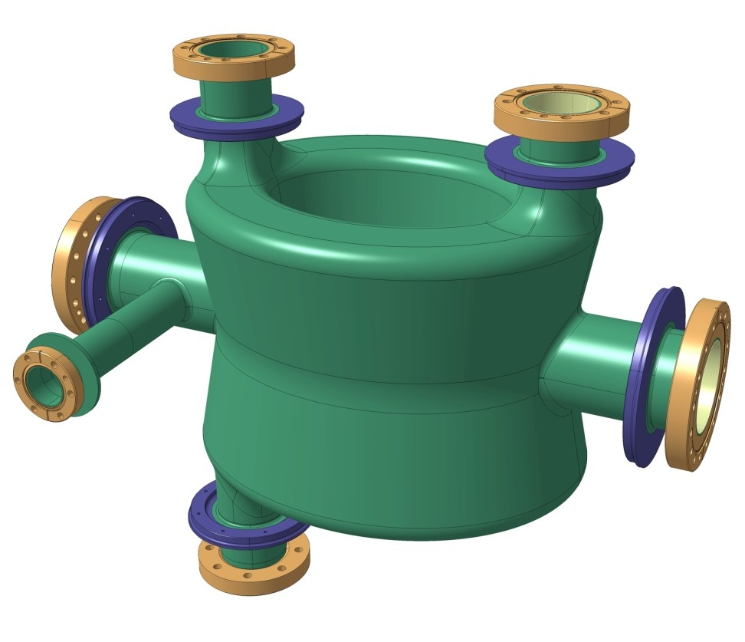
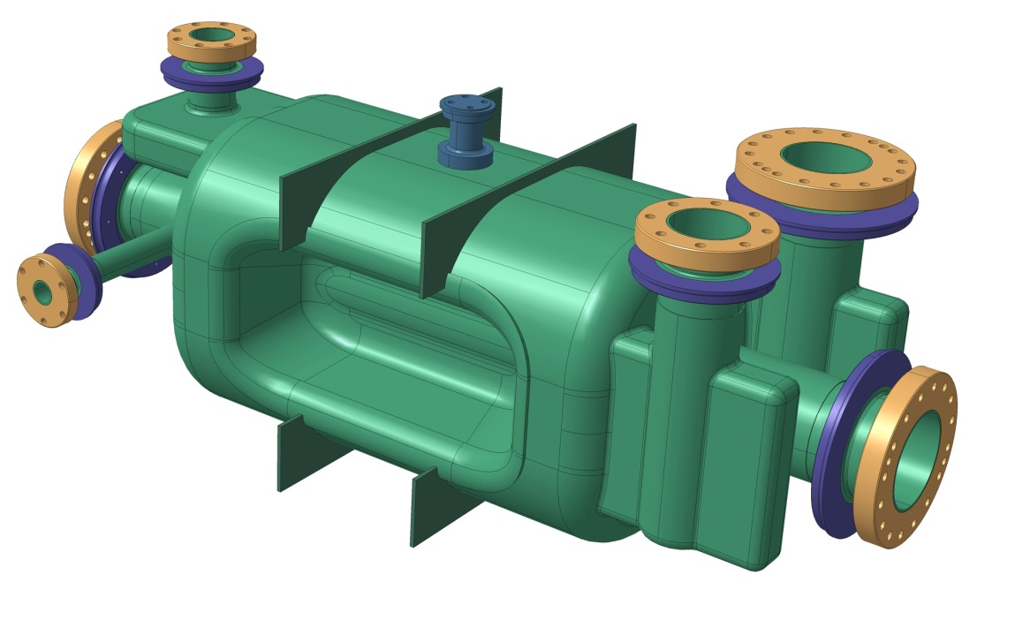
Cavities
Baseline : adopt both cavity types and exploit their natural RF topology
Double Quarter Wave (DQW) cavity – Vertical – to be used in Point 1 (ATLAS)
RF Dipole cavity – Horizontal – to be used in Point 5 (CMS)

Slide 5
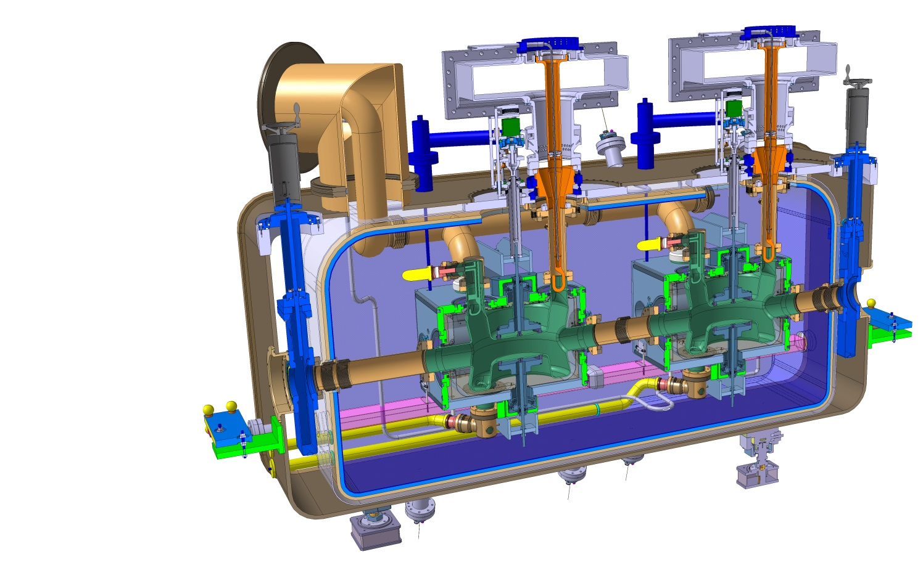
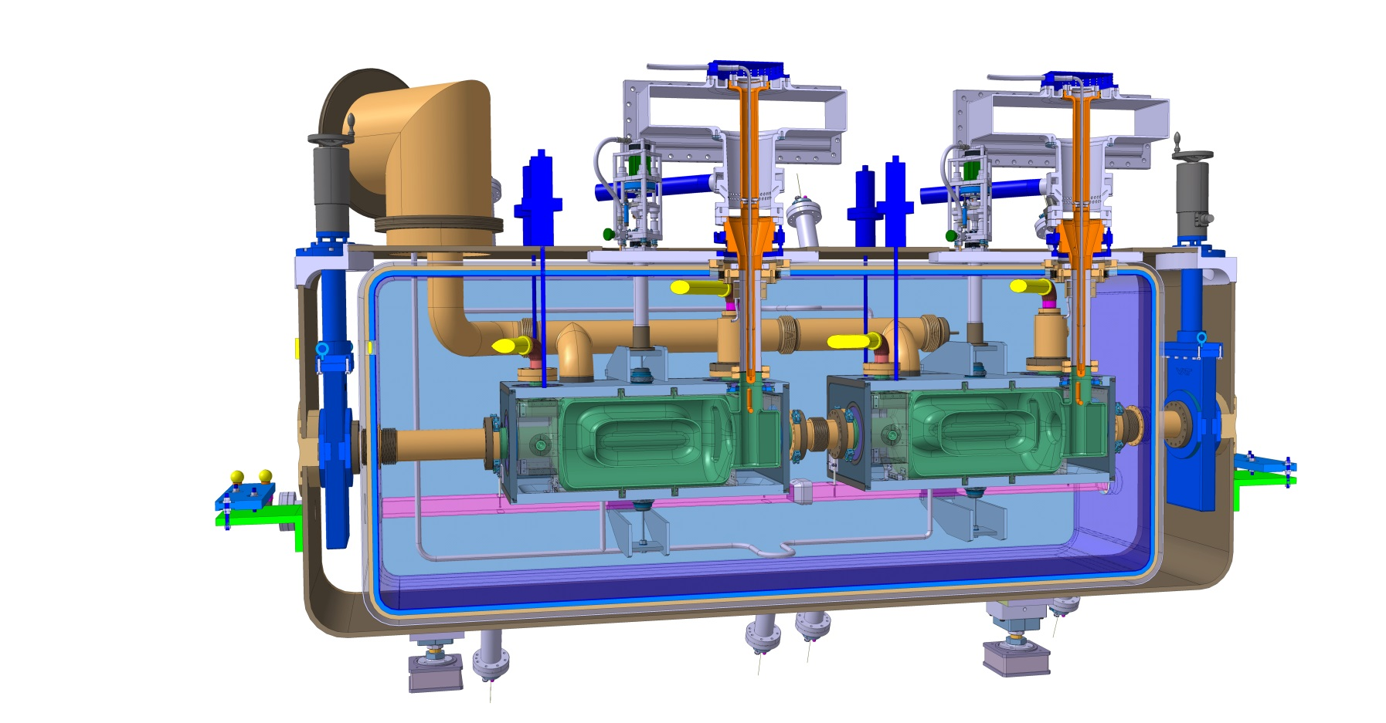
Cryomodules
Double Quarter Wave, Vertical Deflection
RF Dipole,
Horizontal Deflection

Slide 6
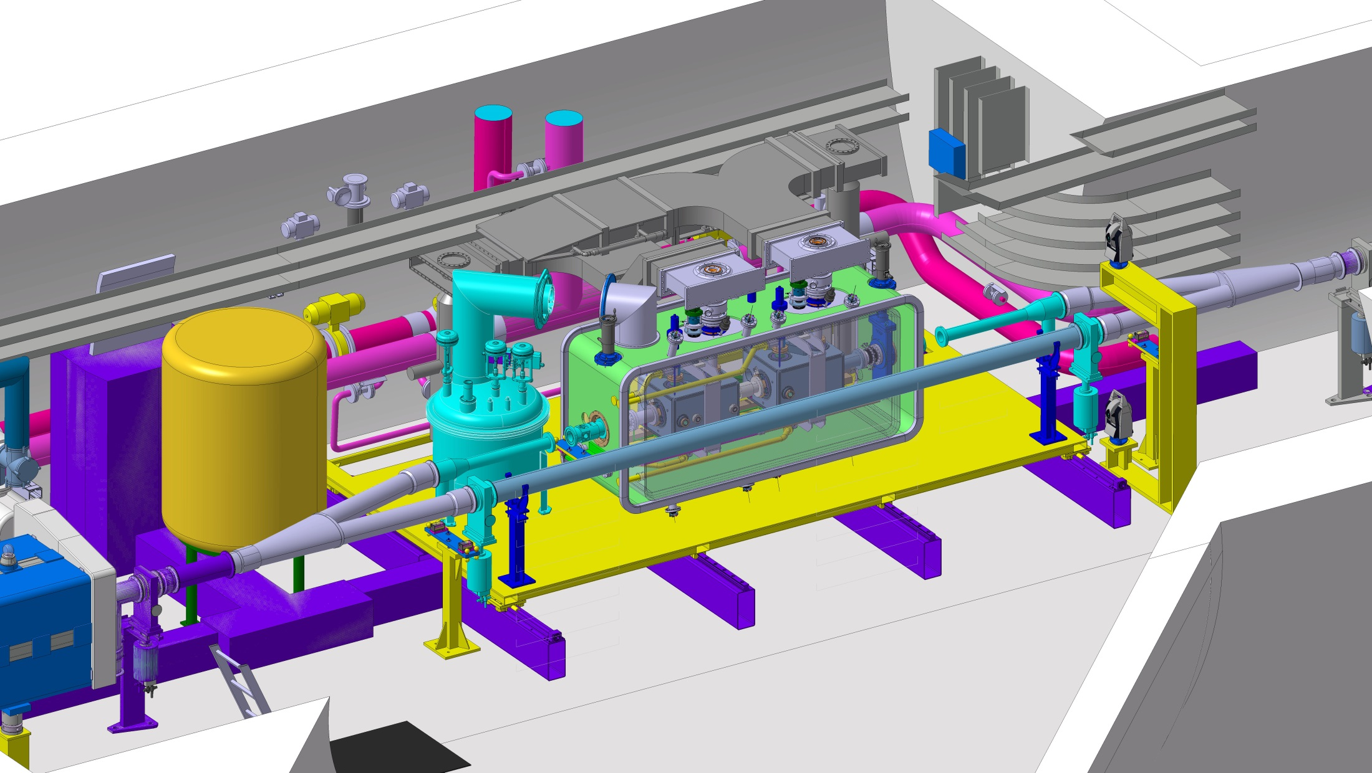
SPS: parking

Slide 7
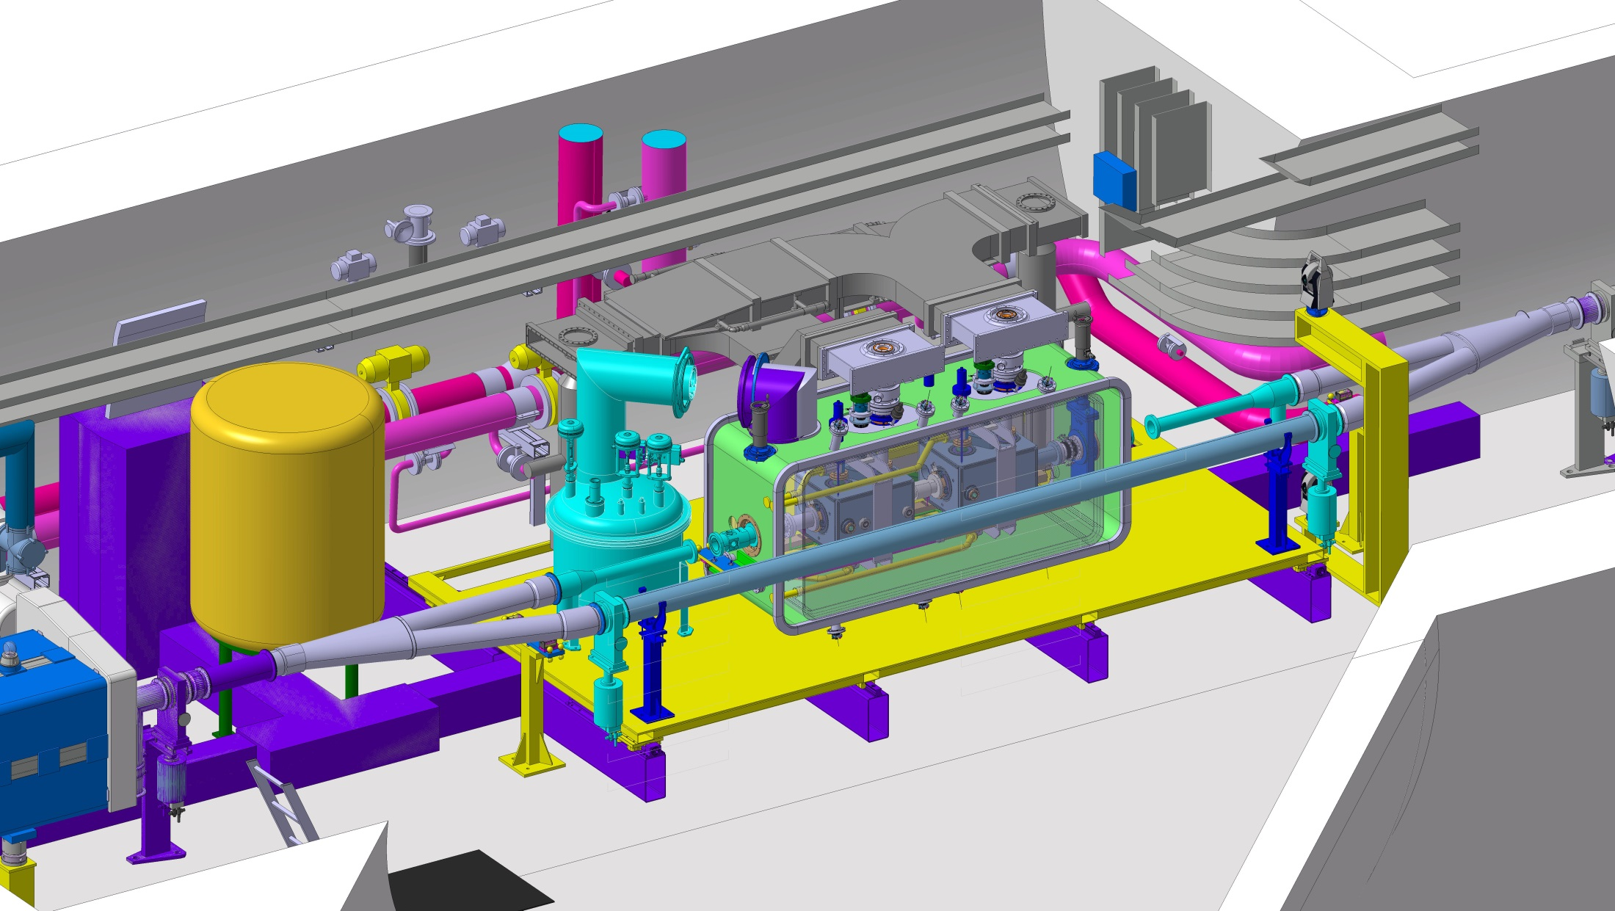
SPS: operation

Slide 8
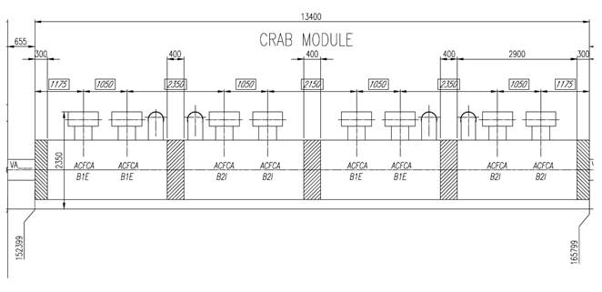
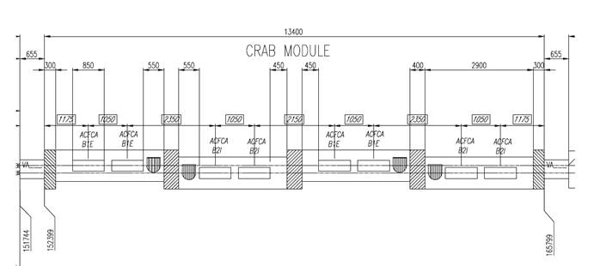
LHC
LHC layout: 4 “SPS like” cryomodules x 2 cavities each / IP side (high modularity)
Lateral view
Top view

Slide 9
General plans
2 cryomodules for SPS tests
1 cryomodule with 2 identical cavities (type «vertical» - DQW)
1 cryomodule with 2 identical cavities (type «horizontal» - RFD)
2 cryomodules pre-series for LHC (one of each type)
16 cryomodules for installation in LHC (8 of each type) + spares
2015
2016
2017
2018
2019
2020
2021
2022
2023
2024
2025
2026
EYETS
Run 2
LS2
Run 3
LS3
Run 4
SPS test prototype
LHC series production
tests
Fabrication & tests
preparation
Installation
LHC pre-series

Slide 10
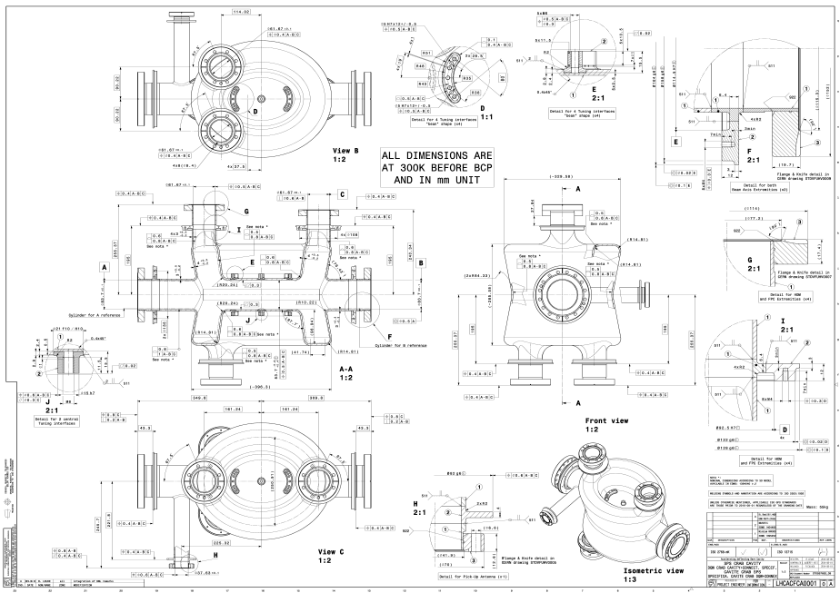
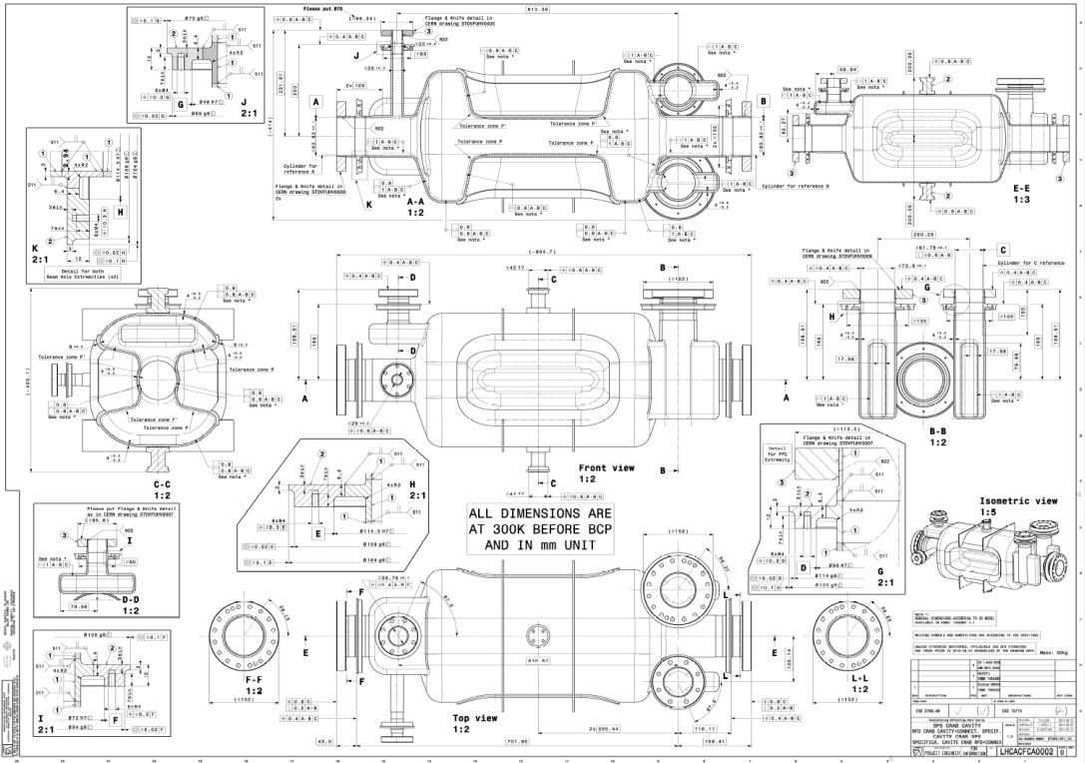
Bare cavities
DQW Specification drawing – LHCACFCA0001
Approved
RFD Specification drawing – LHCACFCA0002
Updating ongoing beam pipe length increase and interfaces to helium vessel

Slide 11
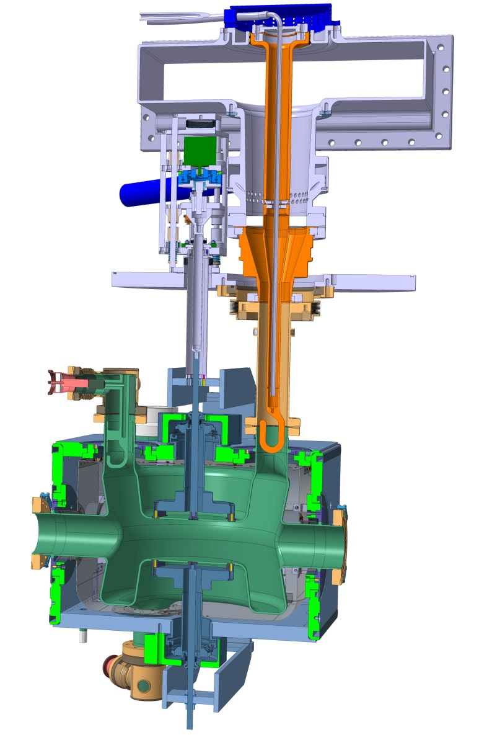
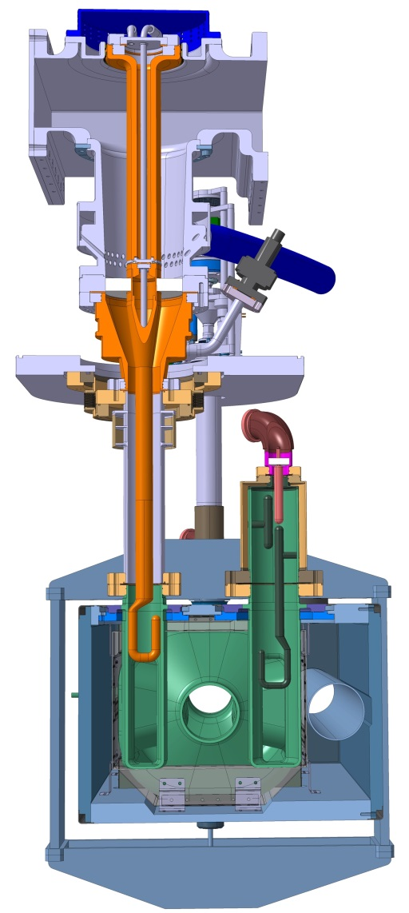
DQW
Dressed cavities
RFD
SPS Cavities under production by LARP
HOM prototyping to be launched (JLAB or CERN); production for SPS will be done by CERN
Helium vessel to be checked (engineering)
Tuning system will be produced by CERN
Magnetic shielding to be finalized by STFC
SPS Cavities under production by LARP
HOM prototyping ongoing at CERN; production for SPS will be done by CERN
Started manufacturing drawings of helium vessel
Tuning system will be produced by CERN (prototype to be tested)
Magnetic shielding to be finalized by STFC

Slide 12
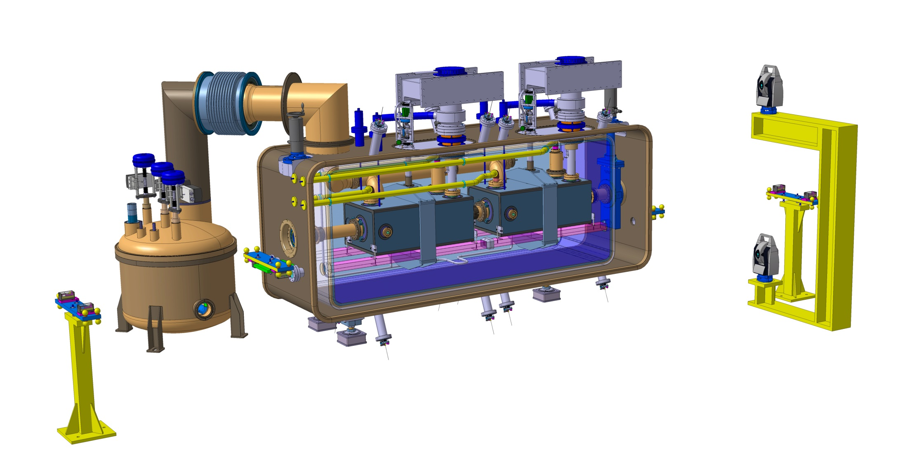
Cryomodule

Slide 13
Cryomodule

Slide 14
Cryomodule

Slide 15
Cryomodule

Slide 16
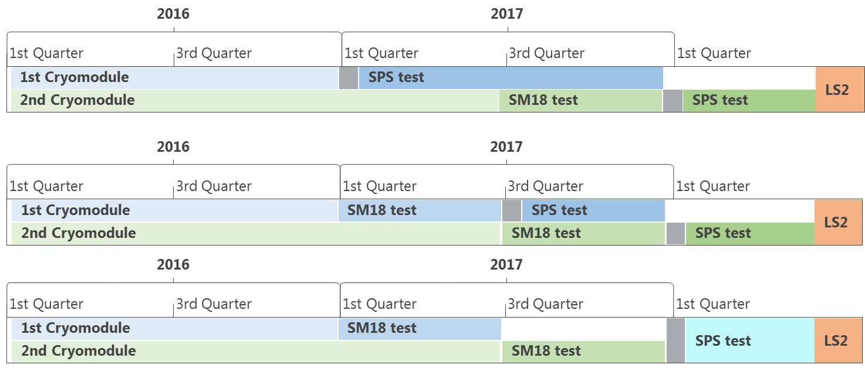
Schedule for SPS
We work based on the 3rd scenario
We consider both cavities validated if:
one cavity type has been successfully tested with beam
the other cavity type has been successfully tested in SM18
We however work out the possibility of testing both cavities with beam

Slide 17
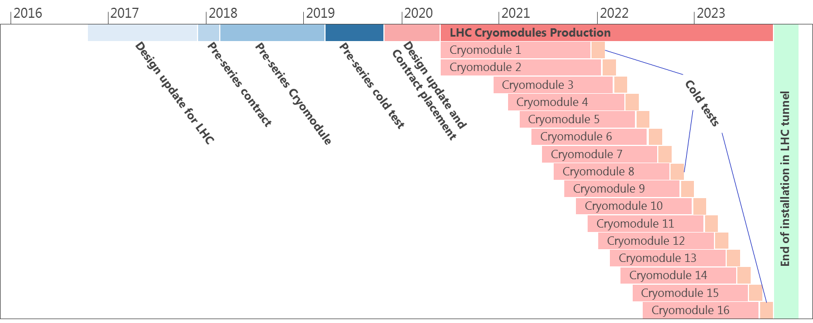
Schedule for LHC
Pre-series and series for LHC

Slide 18
Schedule
Preseries cryomodules for LHC
2 cryomodules planned to be built and cold tested (one of each type)
One cryomodule will be assembled at CERN
One cryomodule will be assembled at Daresbury
Both will be cold tested at CERN
Pre-series will be used as much as possible to qualify companies for dressed cavities production in view of the LHC series

Slide 19
Some engineering of the cryomodules

Slide 20
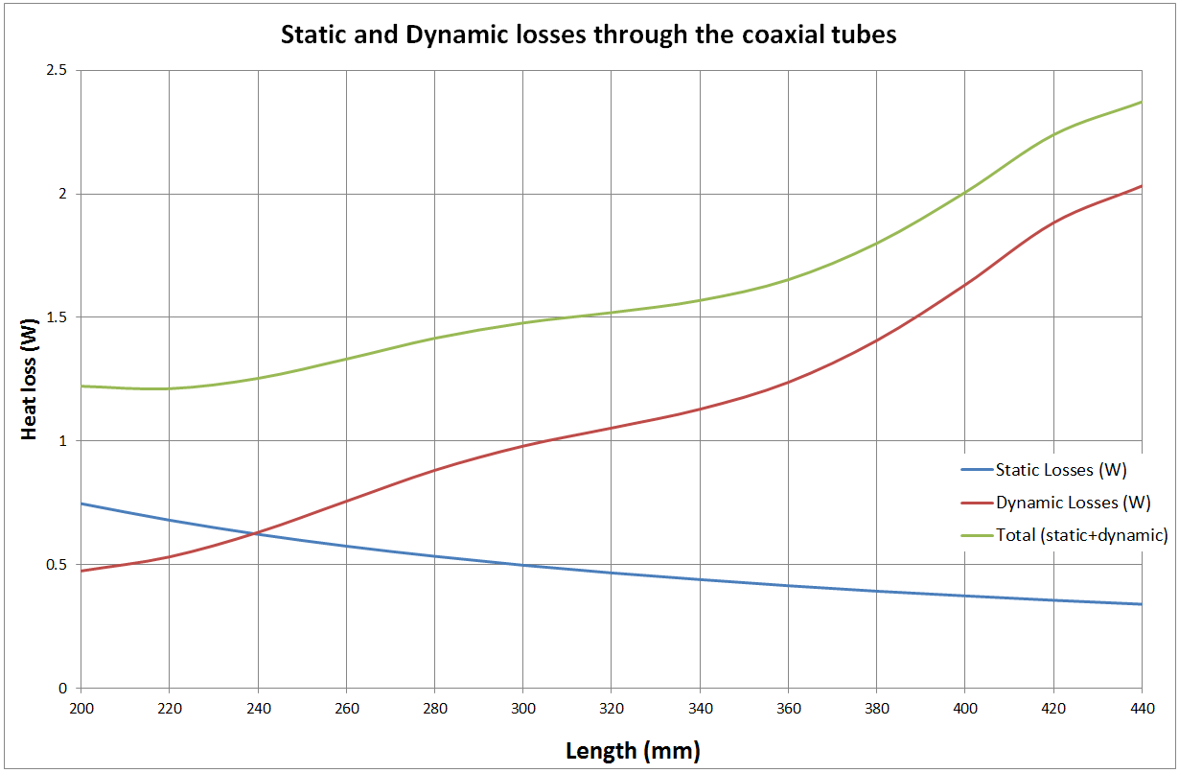
Optimisation of thermal performance
Cryomodule thermal performance detailed optimization:
Example : HOM coaxial line – static and RF losses – geometry and thermalisation optimisation
EDMS 1405244 v.1
Total losses @ 2K : ~ 32 W (static + dynamic)

Slide 21
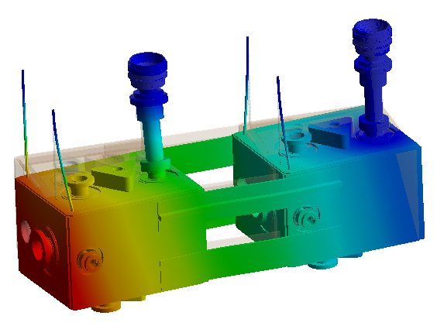
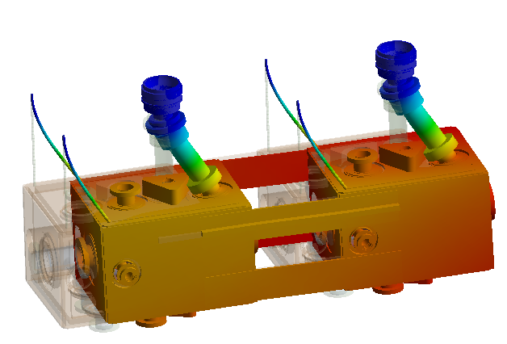
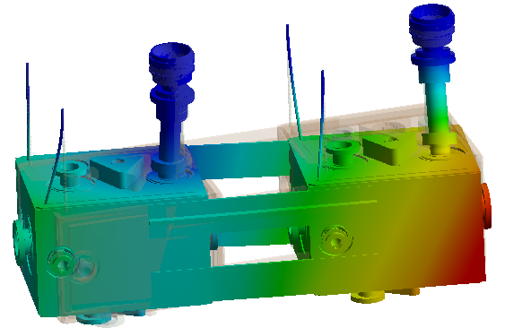
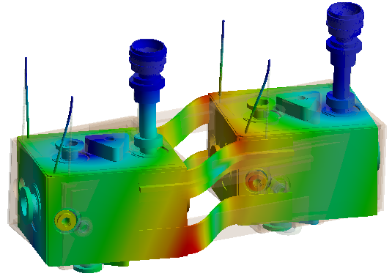
Supporting system - Vertical Rods and Inter-cavity Link
25 Hz
33 Hz
36 Hz
94 Hz

Slide 22
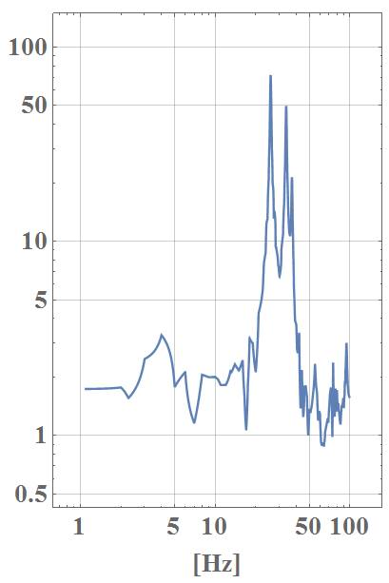
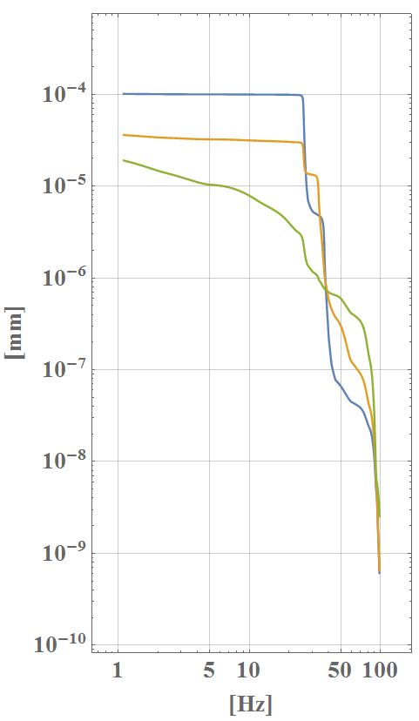
Supporting system - Vertical Rods and Inter-cavity Link
Transfer Function
(ground to total motion)
Integrated Displacement
(Diamond)

Slide 23
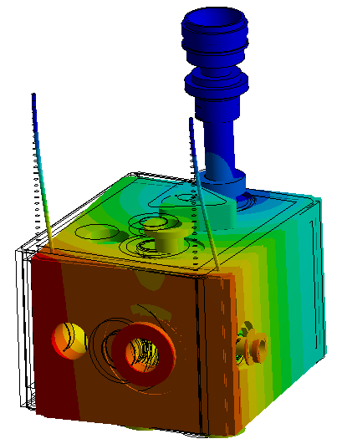
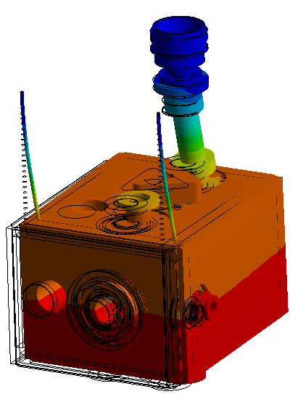
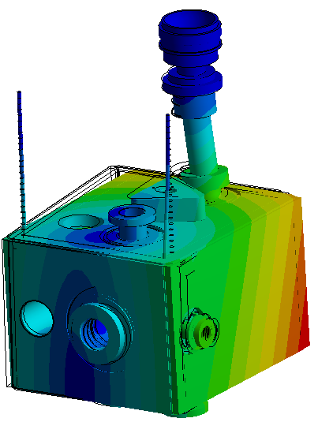
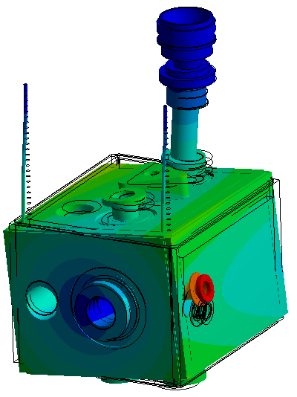
Supporting system - Vertical Rods and No Link
15 Hz
33 Hz
40 Hz
119 Hz

Slide 24
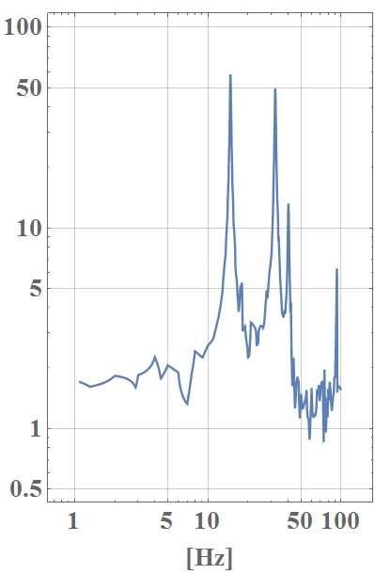
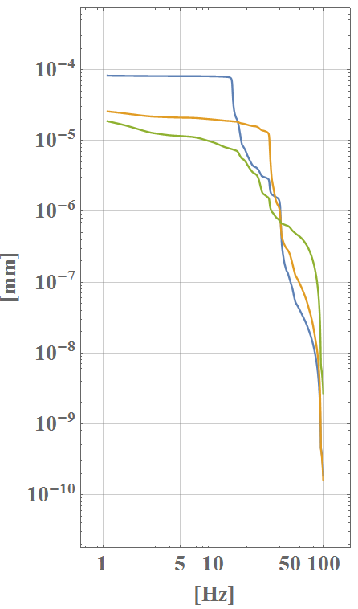
Supporting system - Vertical Rods and No Link
Transfer Function
(ground to total motion)
Integrated Displacement
(Diamond)

Slide 25
Comparison: transfer functions
No Connection
With Connection

Slide 26
Comparison: integrated displacement
No Connection
With Connection

Slide 27
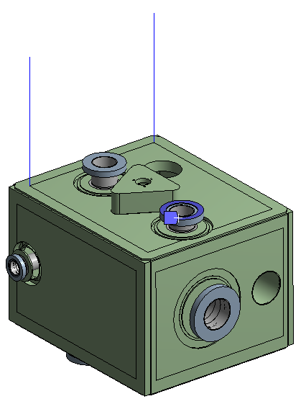
Vertical Rod: extreme cases
Infinite stiff FPC 1st mode: 30.5 Hz

Slide 28
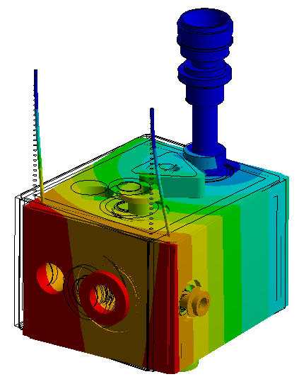
Supporting system
The intercavity connection increases the transferred displacement and the frequency of the 1st mode.
It also adds complexity and uncertainties during cool down
Effect of tuning system seems not big, but proper damping needed
Baseline:
Rods but no intercavity connexion
Foresee the possibility to add an intercavity connexion if first tests results show it is needed

Slide 29
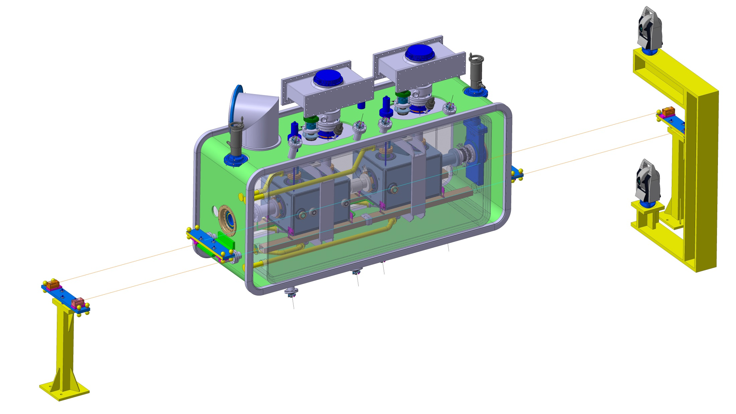
Alignment Monitoring System: BCAM*
*Brandeis CCD Angle Monitor

Slide 30
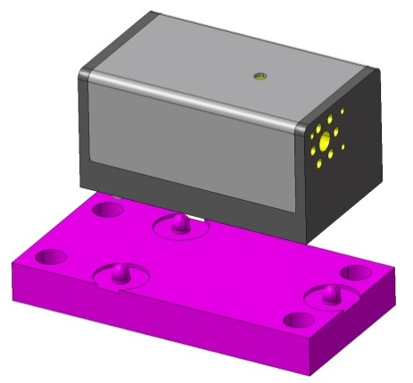
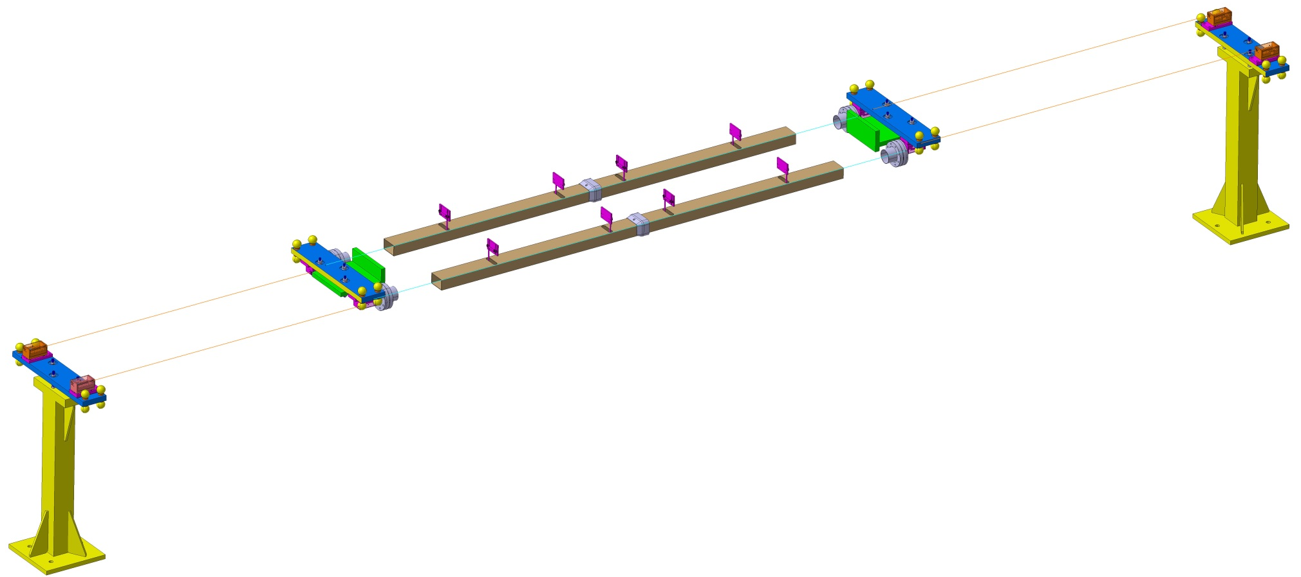
Alignment Monitoring System: BCAM
4X BCAM on floor
4X Targets / Tank
4X Tubes 80 X 50 X 2 mm (avoid reflections)
4X BCAM on Cryomodule
4X Windows

Slide 31
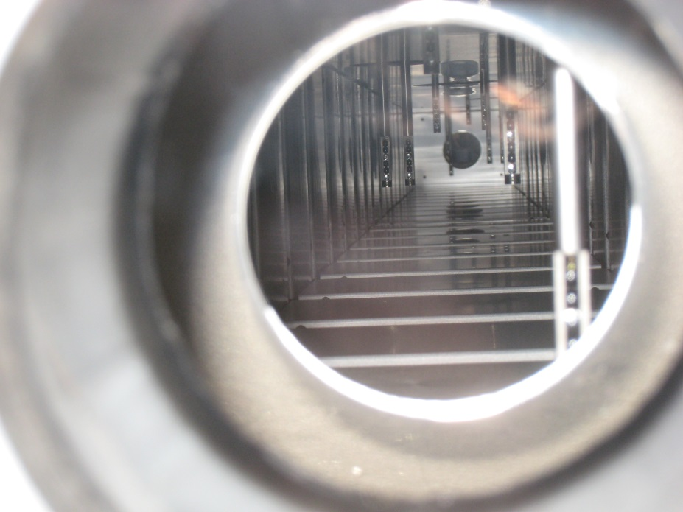
Alignment Monitoring System: BCAM*
Picture of targets on HIE-Isolde cavities
Courtesy of Vittorio Parma
*Brandeis CCD Angle Monitor

Slide 32
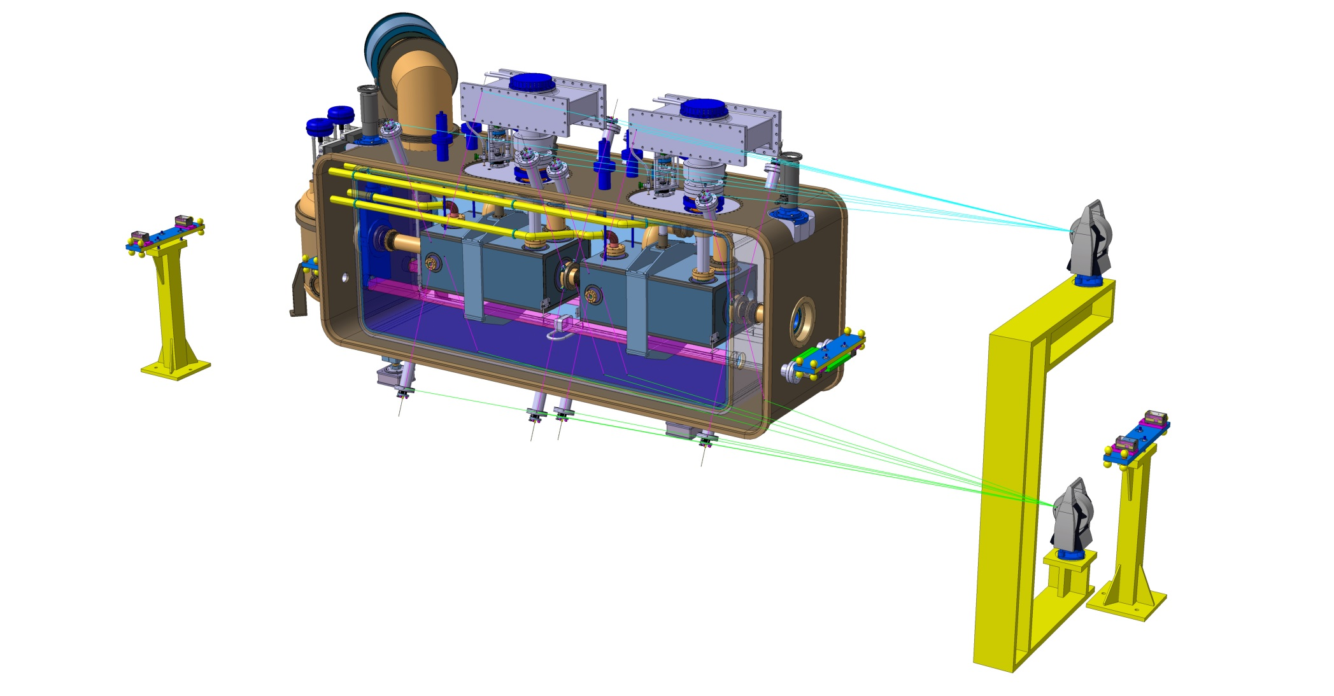
Alignment Monitoring System: FSI*
*Frequency Scanning Interferometry

Slide 33
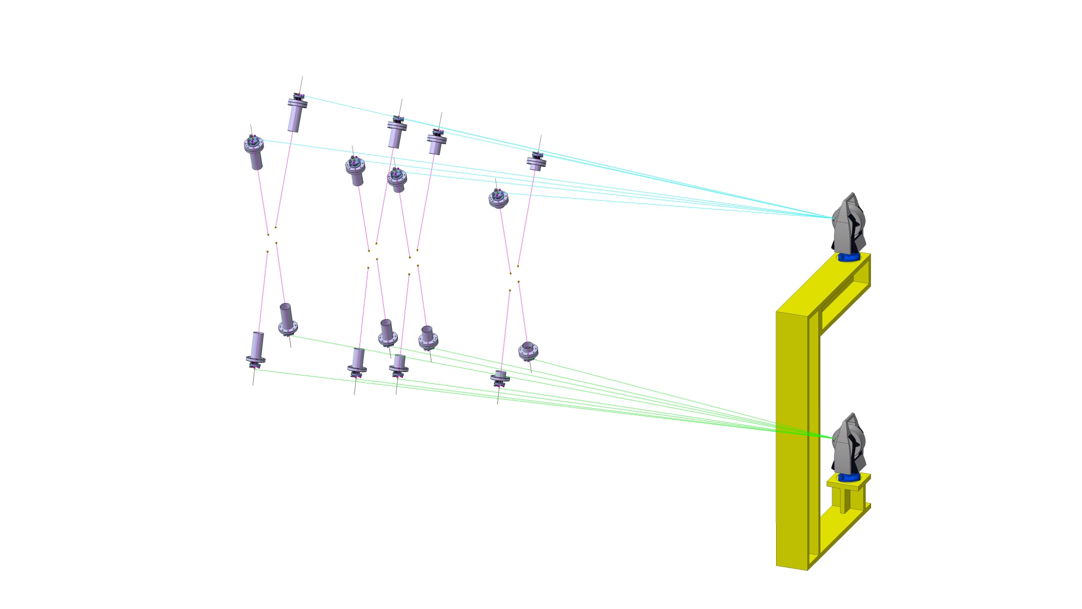
Alignment Monitoring System: FSI
4X targets on flanges
(4 Flanges)
AT 401 Device
(2 positions)
16X FSI devices

Slide 34
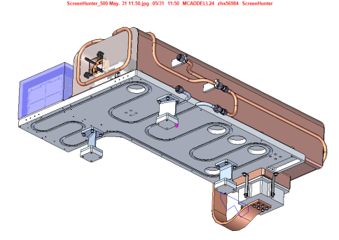
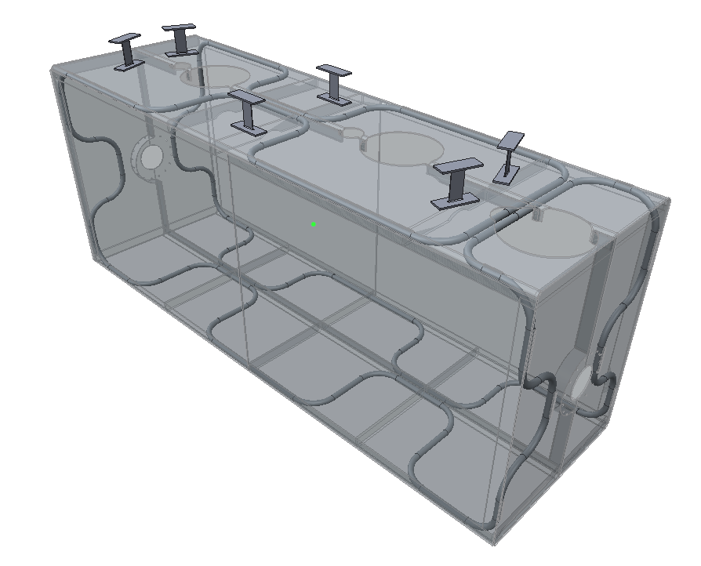
Thermal shield overview
BY STFC
Flexures optimised for maximum stiffness at 1W heat leak – 2mm thick x 40mm chosen
Flexure mounts arranged such that they create a fixed point at the centre of the shield.
Ref: Thomas Jones SPICE thermal test design
Thermal shield “Window frame”
Entire shield = 116Kg
Aluminium alloy tubing
1050 Aluminium shield
Removable side panels (fitted to frame during initial assembly)
Work performed by Manchester University undergraduate Andy May
Panel mass = 14Kg each at 6mm thick

Slide 35
Thermal shield analysis – Steady state
Pipes set at 80K
Calculated radiation load of 5 W/m2 applied to outer surfaces
5W to beam pipe intercepts
Convection coefficient of 5 W/m2K @300K to OVC (not shown)
Heat leak ~1W per flexure

Slide 36
Thermal and gravitational load applied
Maximum deformation 2.9mm
Uniform shrinkage

Slide 37
Very localised max stress in shield following cool down 116MPa which is still below 80K yield for tempered 1050 Aluminium (120MPa)
Real stress in shield looks far lower ~30MPa

Slide 38
Flexure design
Yield of Grade 5 at RT.
Maximum stress in flexures at 2mm thick by 40mm wide – 521MPa
Yield of Grade 5 Titanium at 300K is 868MPa

Slide 39
Cool down stresses
A full transient analysis of the shield will be performed.
However, as an initial estimation an analysis was run with one end of the shield at 80K and the other set to 300K
Maximum stress of 612MPa is in flexures and is acceptable.
Stresses in Aluminium panels are also at acceptable levels at ~40MPa.

Slide 40
Conclusions
Complex new objects, never tested with beam
3 main phases of the project - progressive learning curve essential to mitigate technical risks
SPS prototypes for validation with beam
LHC pre-series
LHC series
Tight schedule for the entire project – LARP contribution is essential to meet the deadlines, in particular the SPS tests prior LS2
We plan a cryomodule review close to the HL-LHC collaboration meeting in October this year at CERN

