Slide 1

Cryogenic update before Fermilab meeting
(and after the helium tank review)
HiLumi-LHC-CC-Cryo-PPT-18_v1
Coordination meeting
6th May 2015
K. Brodzinski

Slide 2
Contents
Main refrigerator – update after cost and schedule review
  Heat load evolution and limitations
Helium tank review and remarks
Flow diagrams and interfaces for SM18 and SPS
Work progress and conclusions

Slide 3
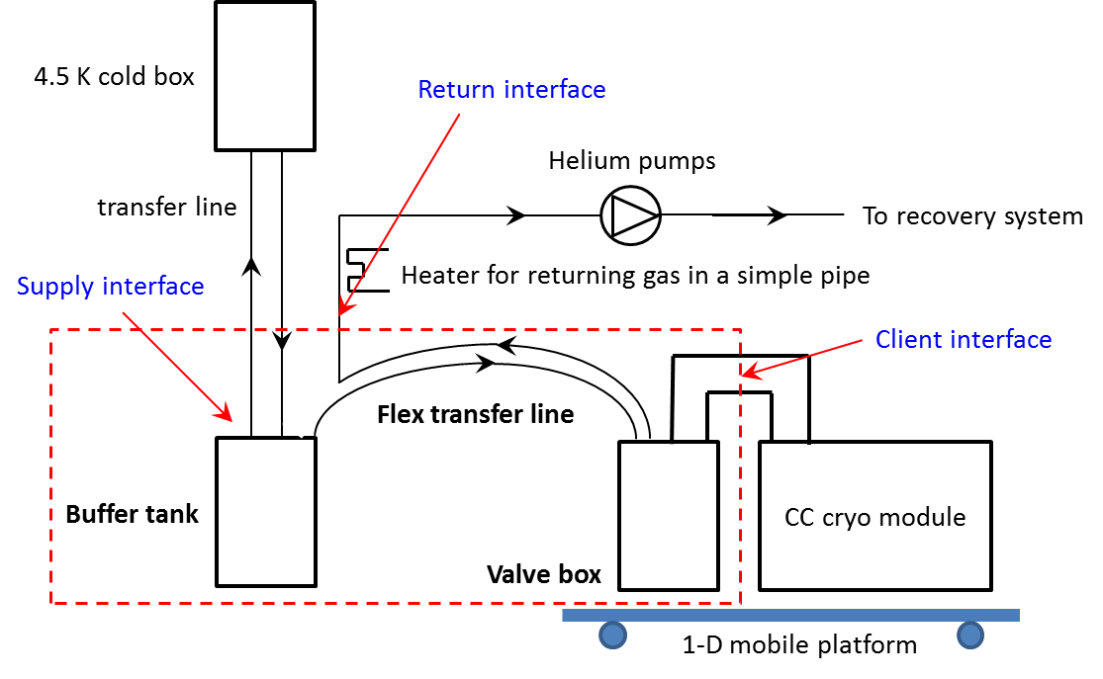
Infrastructure – SPS simplified layout
After cost and schedule review, taking into account present possibilities of helium liquefaction for SPS test, it was preliminarily approved to orient the solution of cold box selection to a new refrigerator. The refrigerator will be configured as mobile plug and play mobile cold box with capacity of ~800 – 1000 W @4.5 K i.e. ~10 g/s of liquefaction rate.

Slide 4
Heat load summary table
The summarized heat load overview concerns the evolution of heat inleak analysis into the Crab Cavity SPS test module over design period between 2012 and 2015.
Additional information:
Column B – calculation done for BA4 with ~10m long transfer line
Column C – represents required liquefaction at 2 K to cover heat load from column A
Column D – represents required liquefaction at 4.5 K to cover heat load from columns B
Column E – represents converted from 2 K to 4.5 K required liquefaction to cover heat load from column A
Column F – represents total required liquefaction rate at 4.5 K, sum of values from columns D and E
Column G – represents total required liquefaction rate from column F multiplied with factor 1.5

Slide 5
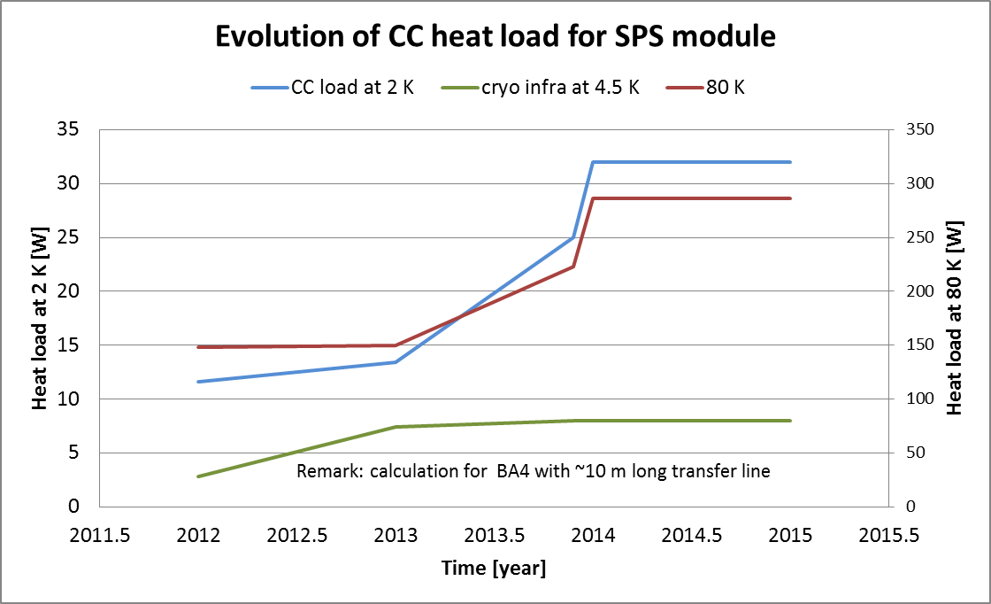
Heat load evolution curve
The summarized heat load overview concerns the evolution of the analysis of the heat inleak into the Crab Cavity SPS test module over design period between 2012 and 2015.

Slide 6
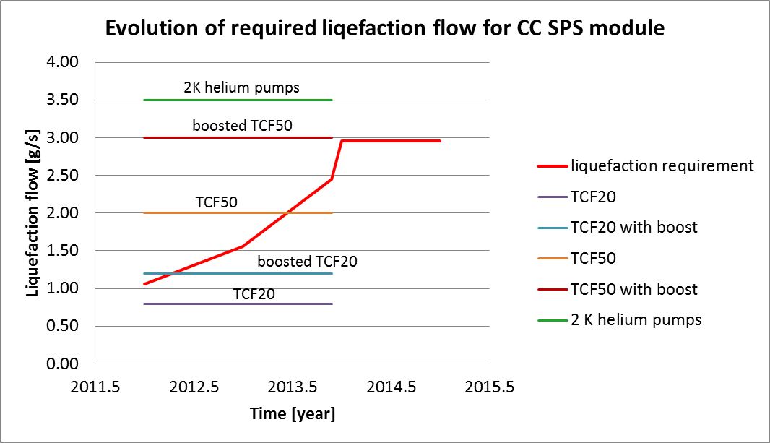
Required liquefaction rate and cold boxes capacity
The new proposed mobile cold box is not included in the above curve. It will have liquefaction capacity of about 8-10 g/s and will allow for using of full capacity of 2 K pumping units (~3.5 g/s @30 mbar) as well as to cover requirements for 80 K screen cooling with helium gas.

Slide 7
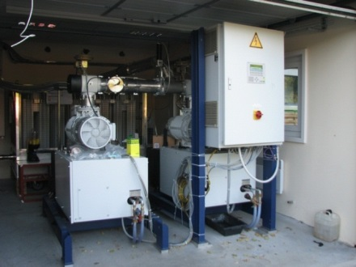
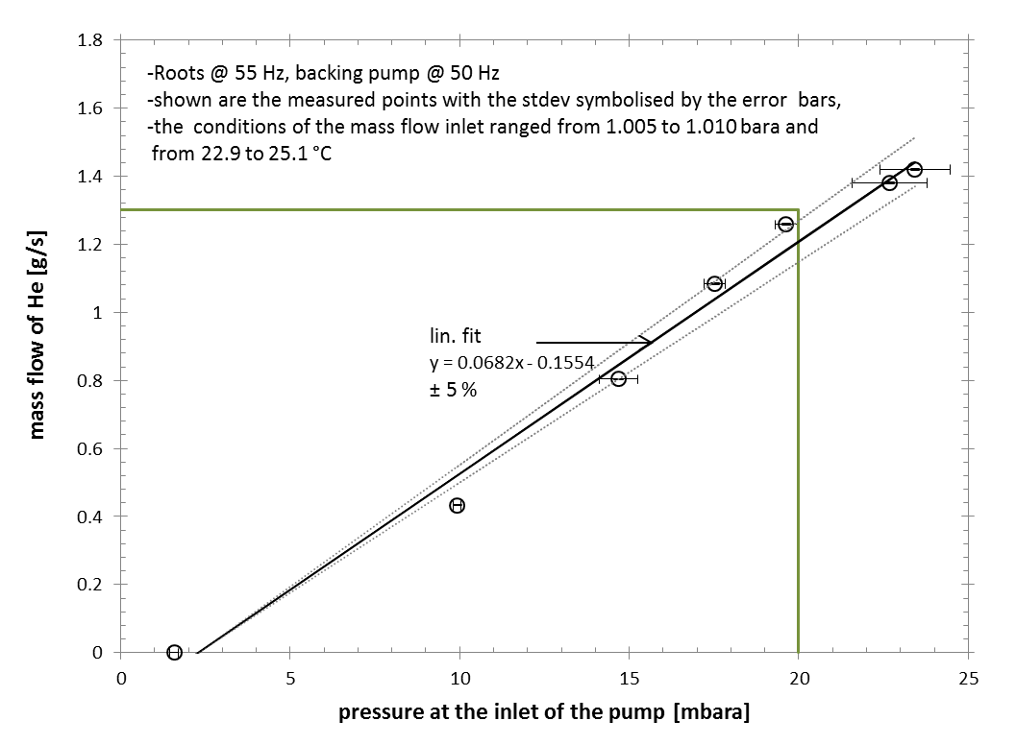
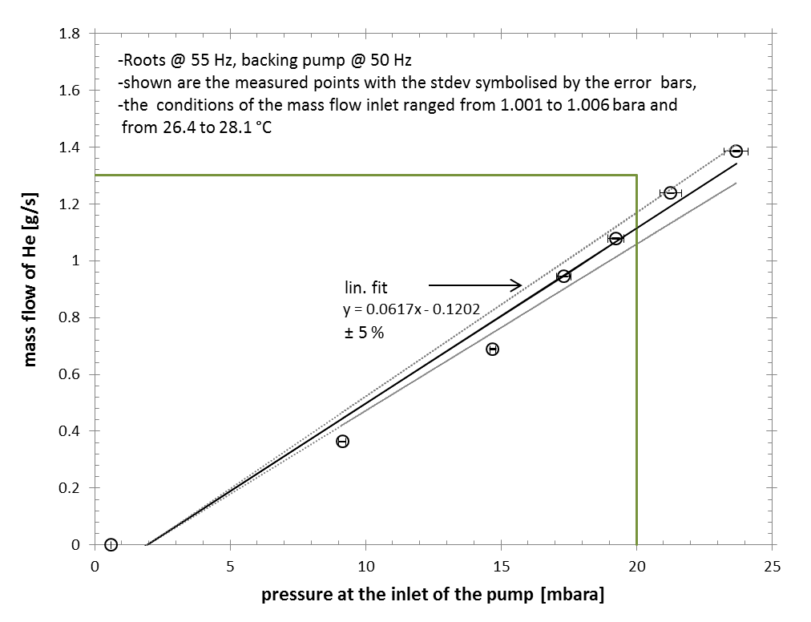
2 K helium pumps
KEK 2014
Capacity >2.9 g/s -> OK for CC SPS test
The check shows that assuming inlet pressure of 20 mbar two pumping units are capable to pump ~2.3 g/s of helium, what gives ~3.5 g/s at 30 mbar (2 K saturation)

Slide 8
Helium tank review
General remark: very interesting, with nice progress of work
Specific remarks:
Superfluid helium layer above the cavity should be maximized between the cavity and the tank wall,
Magnetic shield should be with min. distance from cavity wall of 5 mm,
Cool down line to be connected in the middle of enlarged bypass between the helium tanks,
Helium head above the cavity is to be reviewed and redesigned – requirements from Fermilab 2012 meeting are not respected because of integration geometrical problems.
  Probably additional helium tank of ~8 L will be necessary to be integrated between the cavities – tbd. see next slides. The goal is to design the He head in the way to allow linear lowering of the level over the head height (necessary for reliable regulation reasons).

Slide 9
Helium volume
Estimation of needed helium volume in the cryostat – for one cavity.
Fermilab 2012
Assumptions:
Cavity in shape of a cylinder (D=175 mm, Lcav=700 mm)
Helium layer of L mm of thickness analyzed (see data below)
Head of additional Lc=50 mm layer of He taken above the cavity (see figure below)
Lc
Volume C
L
Volume B
D
Lcav
Volume A
L
L | A | B | Lc | C | total He volume
mm | dm3 | dm3 | mm | dm3 | dm3
10 | 4.66 | 2.94 | 50 | 7.02 | 14.62
20 | 10.02 | 3.68 | 50 | 7.96 | 21.66
30 | 16.12 | 4.51 | 50 | 8.93 | 29.56
40 | 22.99 | 5.45 | 50 | 9.95 | 38.39
50 | 30.66 | 6.5 | 50 | 11 | 48.16
Volume A – layer of L mm of helium,
Volume B – additional helium volume
Volume C – additional head of helium for transients
(for C=7dm3 -> ~30 min for head evaporation, loading at 20 W)
“The CC x 2 cryostat should not be bigger than 40 dm3 (if reasonably possible)”
Operation with one buffer tank of 8 m3 is limited …
9

Slide 10
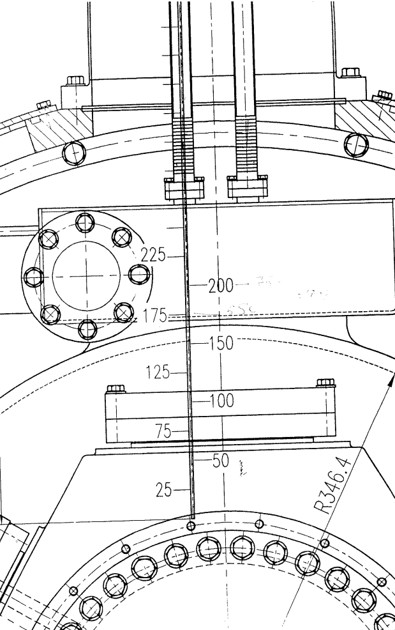
GHe return collector
Fermilab 2012
Recommendations coming from LHC cryogenics operation.
LHC RF GHe return line (too low for reliable level regulation)
Volume of ~10 – 15 liters is to be respected (without collector)
~ 30 mm
~100 mm
GHe return collector should be placed on side as presented in above sketch, with reasonable distance above LHe level (~ 100 mm) ➔ for reliable level regulation (avoiding LHe presence in return line). The supply tapping is recommended to be placed in gas volume “far” from outlet pumping ports for efficient separation during the filling.
10

Slide 11
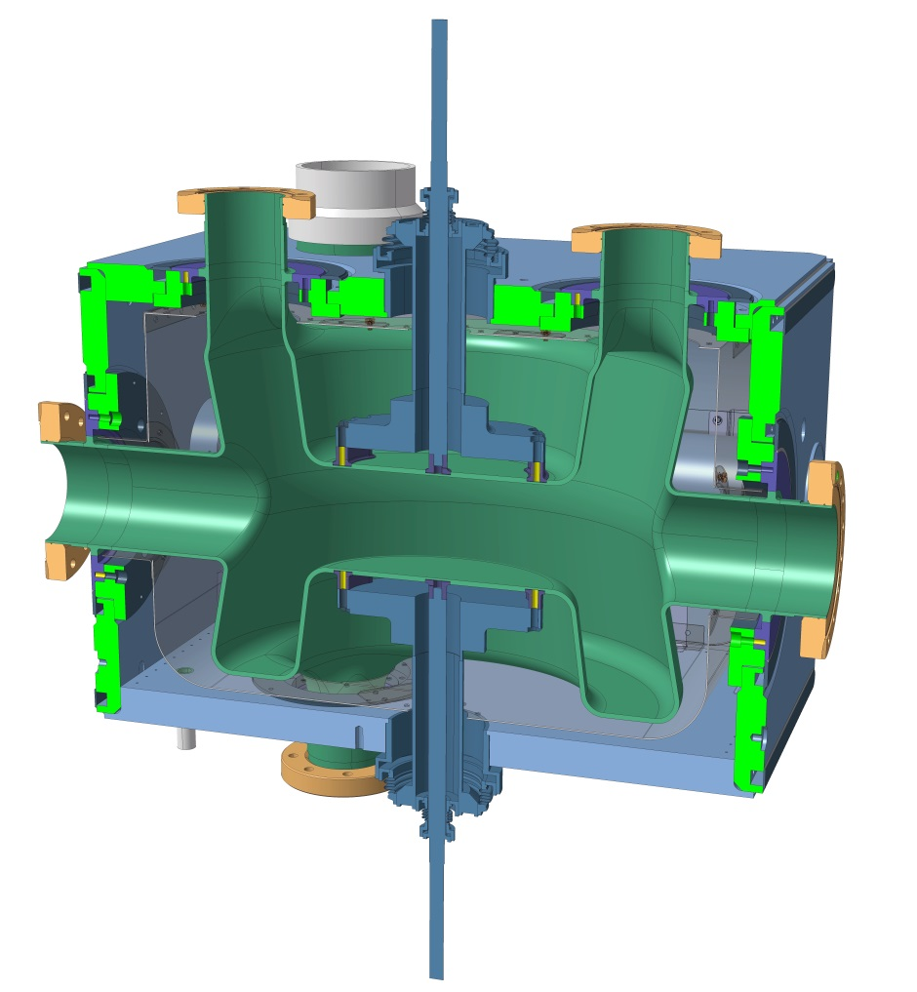
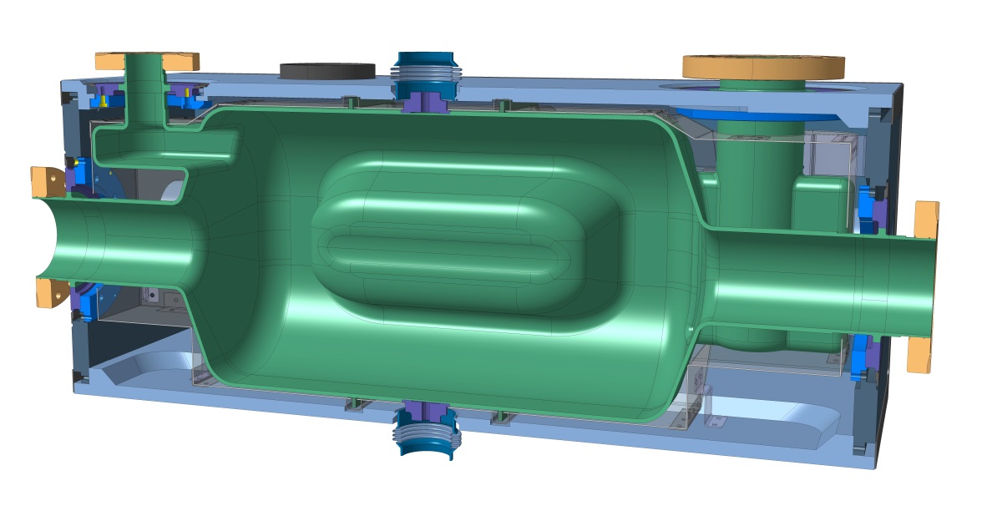
1. Main Views of DQW & RFD Designs
DQW
RFD

Slide 12
Helium head – options
Level decrease profile - sketch
Level decrease profile - sketch

Slide 13
SPS PFD for crabs
4.5 K cold box
Compressor and pressure management panel
Helium storage
TT
To recovery system
TT
4.5 K transfer line
Heater for returning gas
50/80 K transfer line
Valve box
CC module
flex
VLP 2 K, 30 mbar
1.3 bar
flex
Supply 2 K, 30 mbar
> 150 L dewar
TT
PT
LT
TT
LT
EH
PT
C-D supply 4.5 K, 1.3 mbar
EH
flex
Return 80 K, 4 bar
TT
flex
Supply screen 50 K, 4 bar
Shuffling module

Slide 14
SM18 interface for crabs
Double channel coaxial bayonet
VLP 3 K, 30 mbar
Screen supply 5 K, 1.2 bar
Screen return 80 K, 1.1 bar
Vapor return 4.5 K, 1.1 bar
Internally sealed flange, externally sealed mobile sleeve
Liquid supply 4.5 K, 1.35 bar
Internally welded, externally sealed mobile sleeve
Valve box
CC module
flex
VLP 2 K, 30 mbar
1.35 bar
flex
Supply 2 K, 30 mbar
> 150 L dewar
TT
PT
LT
TT
LT
EH
PT
C-D supply 4.5 K, 1.3 mbar
EH
flex
Return 80 K, 1.1 bar
TT
flex
Supply screen 5 K, 1.2 bar

Slide 15

Work progress and conclusions
Work is progressing well, specification for cold part of the infrastructure advanced in ~50 %, order to be done in Autumn 2015, produced by end of 2016 for SM18 test on the beginning of 2017,
New cold box to be ordered in Autumn 2015 to be delivered at CERN by mid 2017,
Regular progress meeting between CRG and MME necessary from mid May 2015 (every week or 2 weeks),
Close collaboration between CRG and MME concerning the CC cryomodule in place and to be continued,
Definition of location for SPS test strongly needed!

