Slide 1
MQXFA prototypes Structure and Plan
H. Felice, D. Cheng, S. Kincaid, S. Myers
G. Ambrosio, P. Ferracin

Slide 2
Overview of the MQXF family Short and Long models and prototypes
 | LARP Short model MQXFS1/2 | LARP Short model MQXFS4 | LARP 1st prototype MQXFA01 | LARP Prototype MQXFA-02 and 3
Coil X-section design | v1 | v2 | v2 | v2
Coil Magnetic length RT/1.9 K (mm) | 1198/1194.4 | 1200/1196.4 | 4000/3988 | 4212.6/4200
Coil Physical length RT (mm) | 1510 | 1510 | 4312 | 4522.6
Structure (yoke) length RT (mm) | 1550 | 1550 | 4562.6 | 4562.6
From 1st to following prototypes:
Different coil length
Same structure length
A unique support structure is being designed

Slide 3
Road Map of the MQXFA structure development
From MQXFS to MQXFA:
Shell arrangement ( ½ segment in the end)
Tooling cutouts and welding block cutouts dimensions
Magnetic optimization
CAD Baseline model v0
Provide an accurate baseline model for BNL test facility
MQXFA specific
Shell segment length optimization => ANSYS Analysis ongoing
MQXFA01-02
Yoke and pads: thick laminations
MQXFA-03
Structure optimization based on first prototypes results
Yoke thin laminations => pending validation in short model
LHe containment: stainless steel shell
MQXFA01 specific
Coil longitudinal positioning optimization

Slide 4
Road Map of the MQXFA structure development
From MQXFS to MQXFA:
Shell arrangement ( ½ segment in the end)
Tooling cutouts and welding block cutouts dimensions
Magnetic optimization
CAD Baseline model v0
Provide an accurate baseline model for BNL test facility
MQXFA specific
Shell segment length optimization => ANSYS Analysis ongoing
MQXFA01-02
Yoke and pads: thick laminations
MQXFA-03
Structure optimization based on first prototypes results
Yoke thin laminations => pending validation in short model
LHe containment: stainless steel shell
MQXFA01 specific
Coil longitudinal positioning optimization

Slide 5
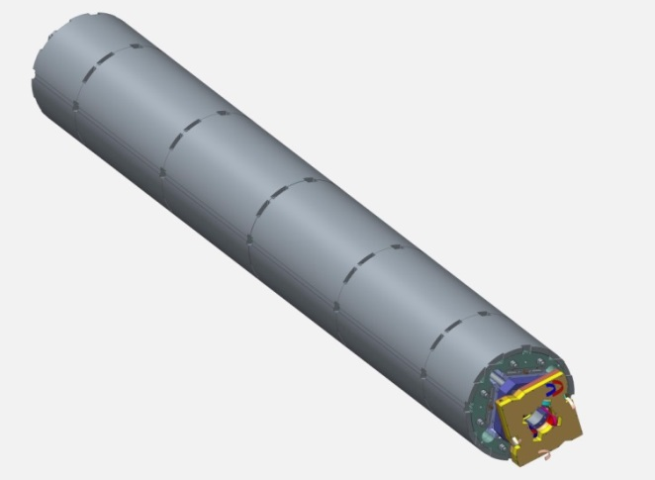
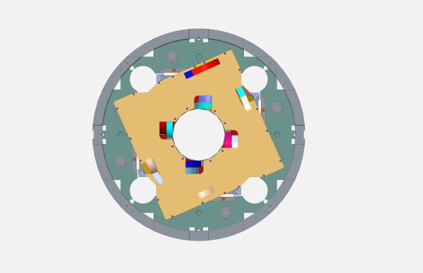
Solid model
Baseline model of MQXFA01 (v0)
Splice box (MQXFS)
Endplate
Bolts on return end
Threaded endplate on lead end
Buffer between endplate and splice box (45 mm) to be reduced for compatibility with CERN requirements
Overall length: 4962.7 mm
Weight ~ 7000 kg

Slide 6
Baseline model v0 Based on v0
4962.7 mm
4563 mm
911.8 mm
230.18 mm
169.52 mm

Slide 7
Consistency with Q1/Q3 CERN length requirements
From P. Fessia and H. Prin
In black box: cold dimensions
No box: warm dimensions
230.18 mm presently which can be reduced to 215.18
Presently 169.52 mm
Baseline v0 MQXFA dimensions consistent with Hi-Lumi LHC baseline

Slide 8
Road Map of the MQXFA structure development
From MQXFS to MQXFA:
Shell arrangement ( ½ segment in the end)
Tooling cutouts and welding block cutouts dimensions
Magnetic optimization
CAD Baseline model v0
Provide an accurate baseline model for BNL test facility
MQXFA specific
Shell segment length optimization => ANSYS Analysis ongoing
MQXFA-01-02
Yoke and pads: thick laminations
MQXFA-03
Structure optimization based on first prototypes results
Yoke thin laminations => pending validation in short model
LHe containment: stainless steel shell
MQXFA01 specific
Coil longitudinal positioning optimization

Slide 9
ANSYS model status
In CAD Baseline v0:
Preliminary ½ + 4 + ½ configuration
Shell length: 911.8 mm
ANSYS 3D model is ready for detailed analysis
+ Extensive parametric study from Mariusz Juchno
Required optimization and study
MQXFA: Structure segment length / number of segments
Tolerance analysis
MQXFA01: coil longitudinal position
Aligned with lead end
Centered with respect to the structure
Decision based on
Stress distribution
Assembly (lead support…), field quality

Slide 10
Road Map of the MQXFA structure development
From MQXFS to MQXFA:
Shell arrangement ( ½ segment in the end)
Tooling cutouts and welding block cutouts dimensions
Magnetic optimization
CAD Baseline model v0
Provide an accurate baseline model for BNL test facility
MQXFA specific
Shell segment length optimization => ANSYS Analysis ongoing
MQXFA-01-02
Yoke and pads: thick laminations
MQXFA-03
Structure optimization based on first prototypes results
Yoke thin laminations => pending validation in short model
LHe containment: stainless steel shell
MQXFA01 specific
Coil longitudinal positioning optimization

Slide 11
Proposal for Thin Lamination and LHe vessel implementation
FY15
FY16
FY17
FY18
LARP
MQXFSD1
Mech model
May to Dec 2015
MQXFS1
Dec to April
2016
MQXFS1b
June to October 2016
MQXFS2
½ + 1 + ½ shell
MQXFD1 structure
Thick Lamination for yoke, collar and pad
Coil replacement or preload adjustment
LHe containment at FNAL
Thin lamination ?
MQXFAD
mechanical model
Sept 2016 to May 2017
MQXFA01
June 2017
Feb 2018
MQXFA02
Jan 2018
Jul 2018
MQXFA03
MQXFA procurement
CERN
MQXFSD0
Mech model
MQXFSD2
Mech model
MQXFS3
Using MQXFD2
Or MQXFD3
Demonstration in short model between CERN and LARP
Implementation in long model/prototype
MQXFA02: LHe vessel ?
MQXFA03: thin lamination and LHe
1 + 1 shell
MQXFD0 structure
½ + 1 + ½ shell
MQXFSD3
Mech
model
½ + 1 + ½ (2nd shell)
Yoke Thin lamination
x2?

Slide 12
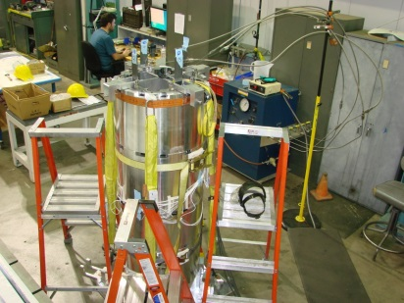
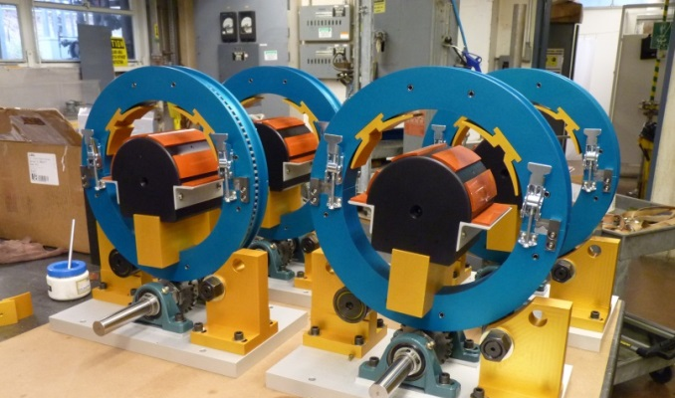
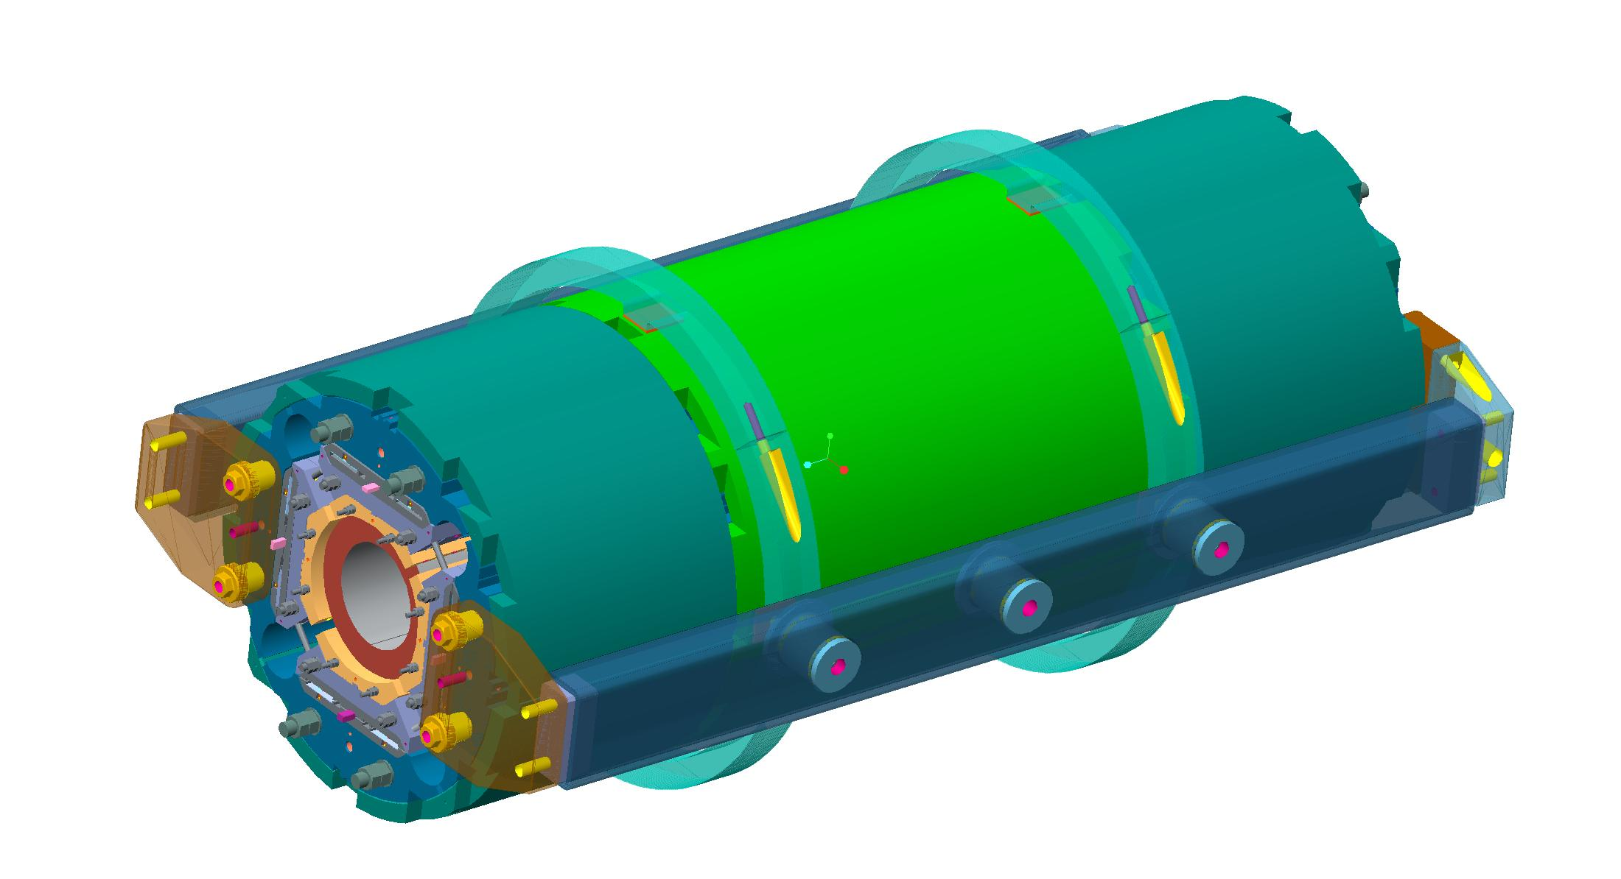
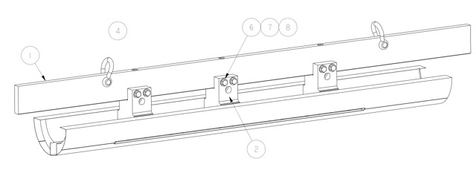
Assembly and tooling preparation
Based on principle tested in MQXFD1 or to be tested in MQXFS1
Yoke shell subassembly vertical => MQXFD1
Tooling will be revised
Coil assembly tooling
Coil roll-over tooling
Coilpack insertion
Magnet lifting Tooling

Slide 13
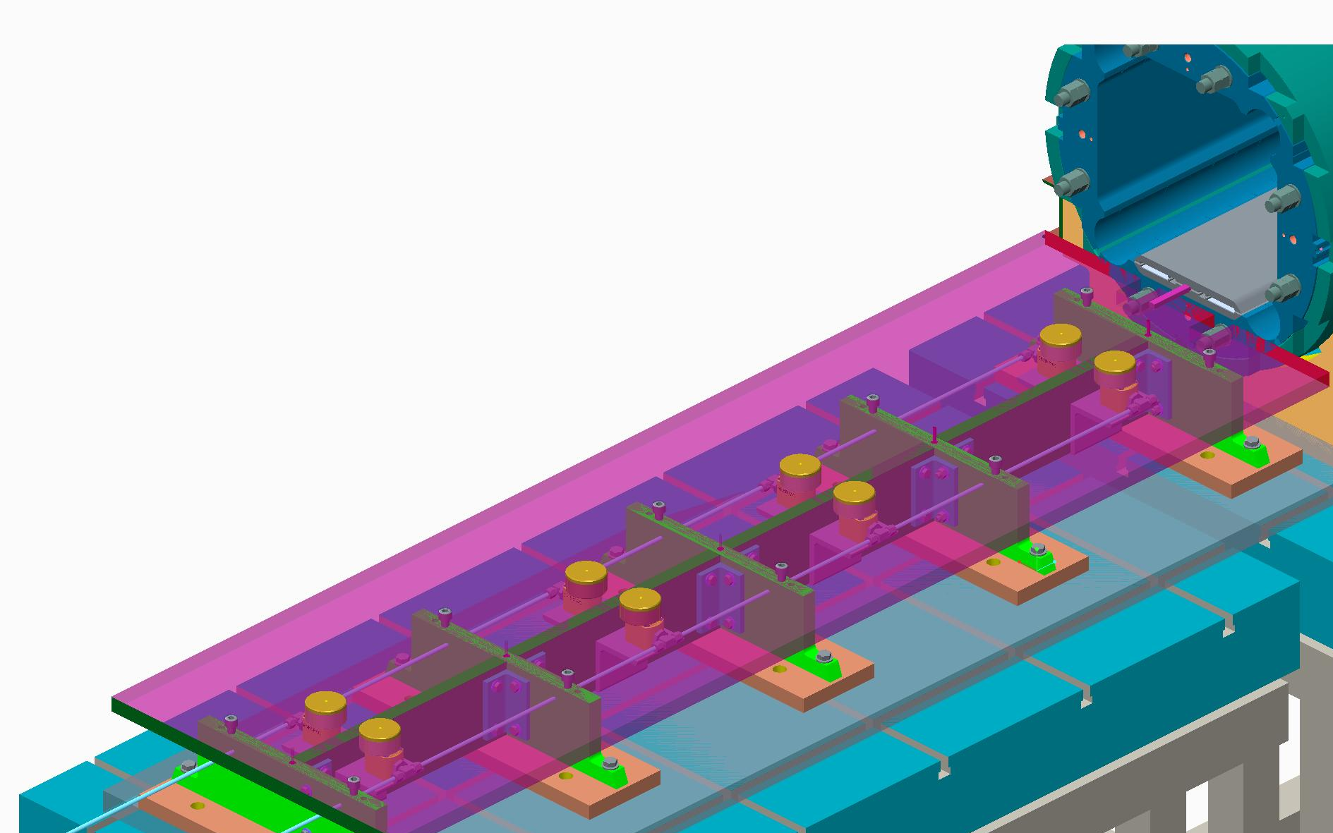
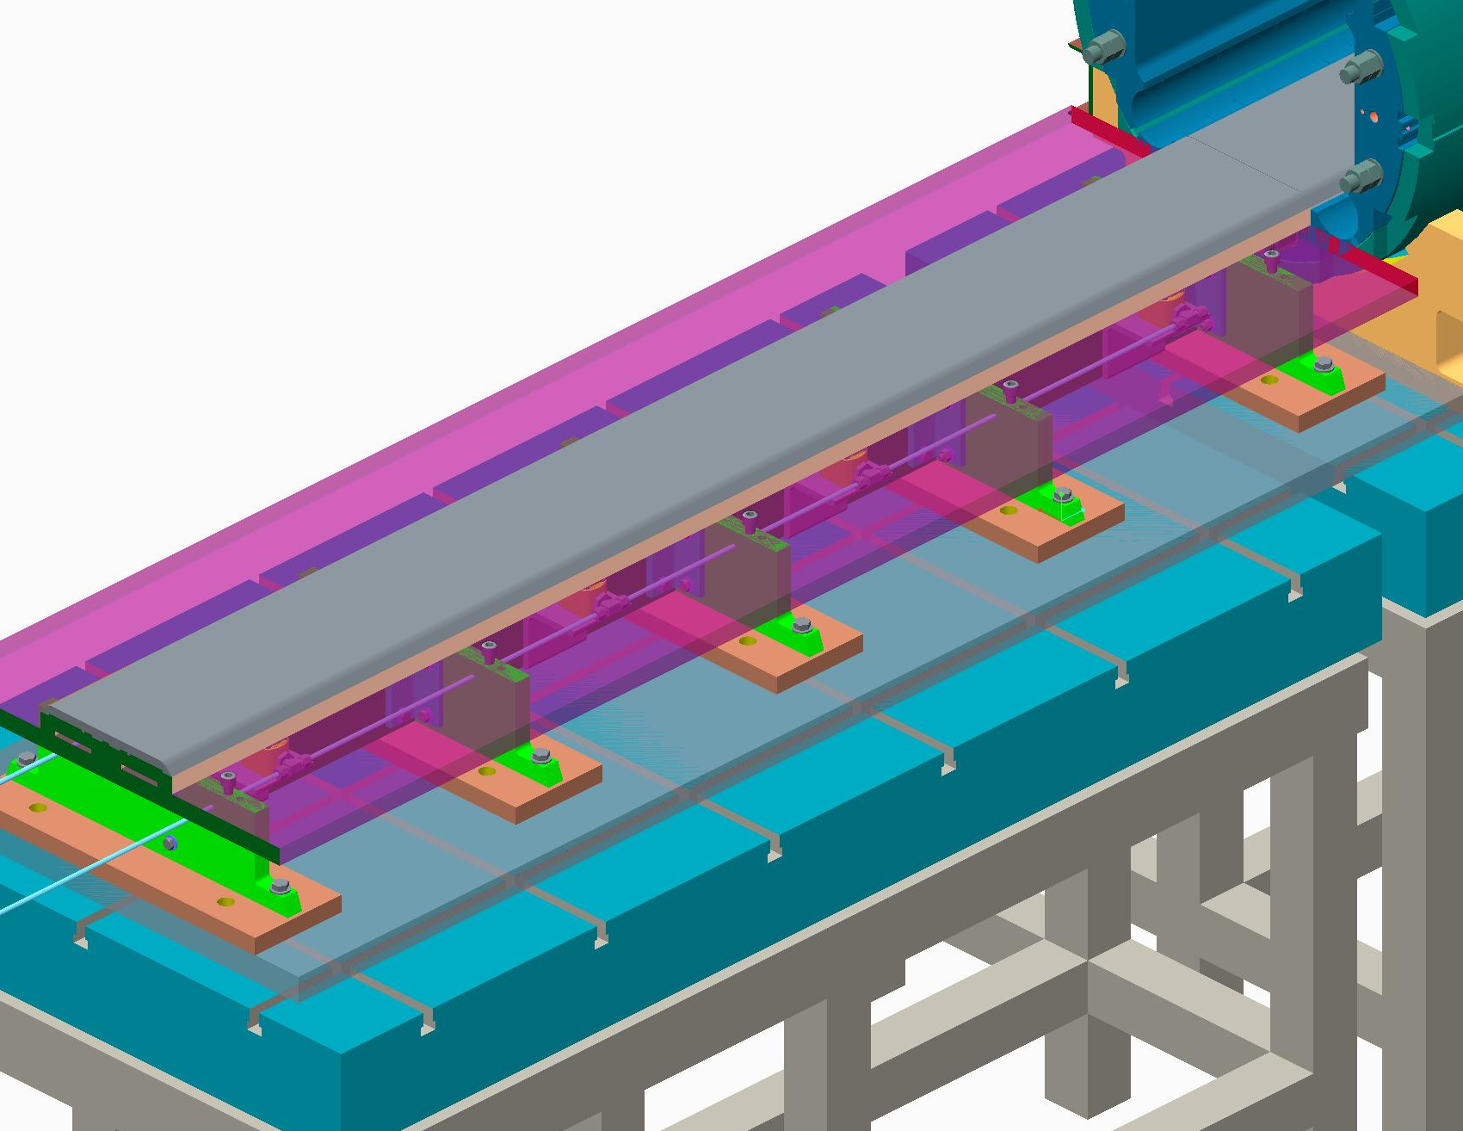
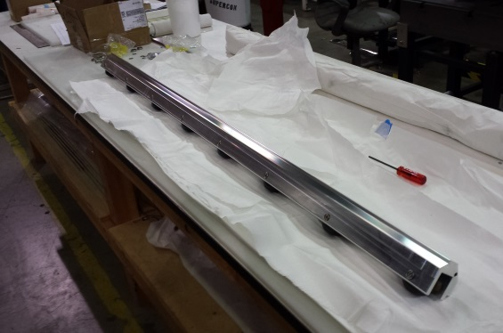
Coil-pack Insertion
Assembled coilpack
Pre-assembled master key in magnet
Hydraulic actuators
Assembly master

Slide 14
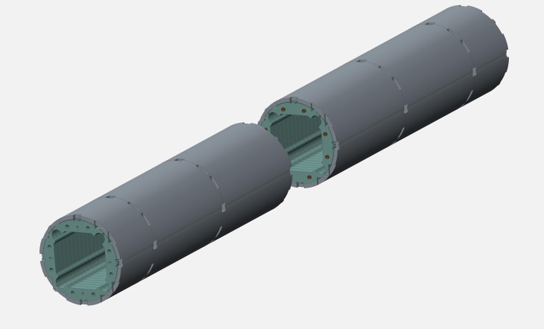
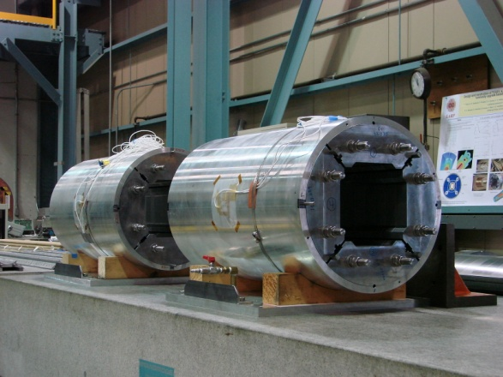
Long structure specific tooling and assembly processes
Yoke shell sub-assembly performed on half magnet (2281 mm) vertically
Assembly of 2 sub-assemblies performed horizontally
Model and design ongoing
Long coil pack assembly procedure to be defined

Slide 15
MQXFL1 schedule
MQXFA structure review 7/16/2015
Drawings and RFQ
Procurement
Mechanical Model
4 coils ready
Assembly
Sept to Jan
MQXFL1 ready end of 01/2017
Structure on critical path
Way to speed up the process are investigated: instrumentation by vendors, start long lead items procurement asap after the review

Slide 16
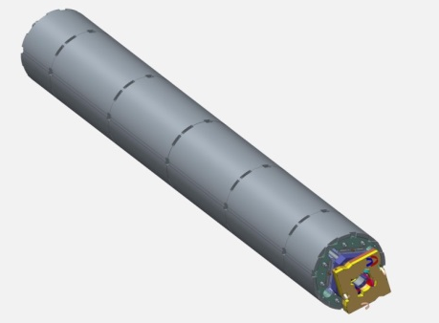
Summary
1st model MQXFA01 based on MQXFS
Thick laminations for yoke
Shell length to be optimized => ANSYS
Preliminary CAD baseline v0 available
Baseline for BNL test facility
Consistent with CERN LHC Q1/Q3 length requirements
Proposal to implement
LHe containment in the program
Thin laminations
Joint effort with CERN
Schedule
MQXFA structure review on July 16th 2015
MQXFA01 ready for test at the end of January 2017
Structure on critical path
Possible ways to speed up the process being investigated

