Slide 2
MQXFB Coils Fabrication status and plans at CERN
J.C Perez
On behalf of MQXF collaboration team
Joint HiLumi-LARP Meeting & 24th LARP Collaboration Meeting
11-14 May 2015 Fermilab- Wilson Hall

Slide 3
OUTLINE
Preparation for MQXFB coils production
  Building 180 layout modification
  Coil and coil components design status
  Winding machine
  Winding and curing tooling
  Curing press
  Reaction oven
  Impregnation system
  Reaction and impregnation tooling
Production plans
Summary

Slide 4

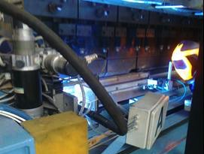
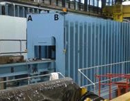
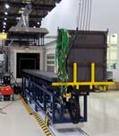
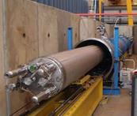
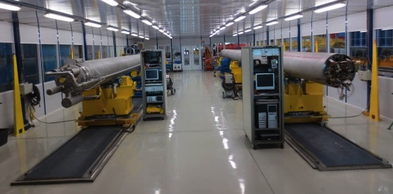
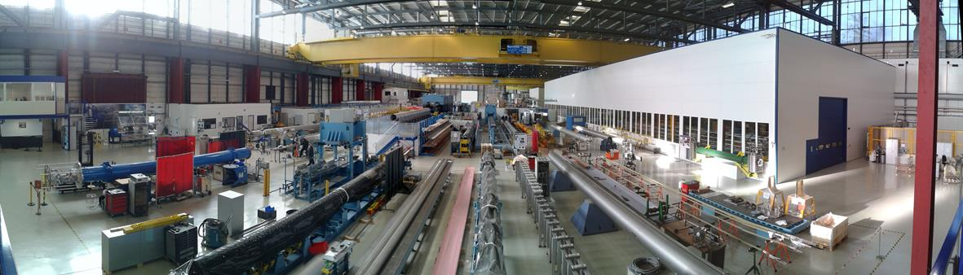
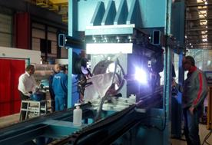
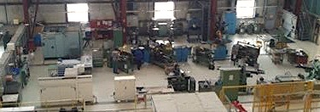
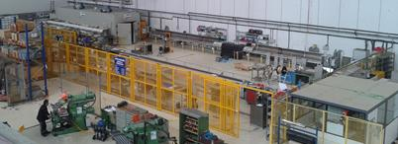
Building 180 - Large Magnet Facility
Finishing benches
Geometry measurements
15m Welding press
15m Collaring press
Nb3Sn Reaction furnace
Pressure/leak bench
“Winding house”
cold mass magnetic measurement bench
Half Yoke returning bench
Cold mass assembly bench
Collared coil returning bench
Collared coil magnetic measurement bench
Welding press for 2m models
Mechanical workshop
Busbars workshop

Slide 5
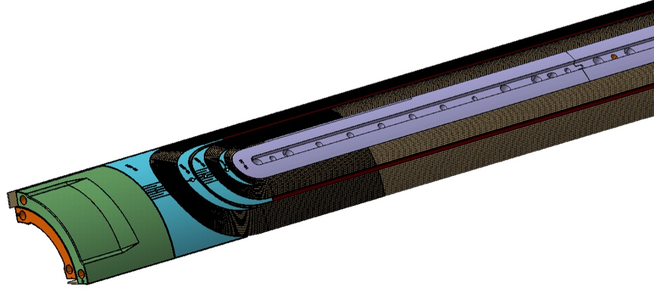
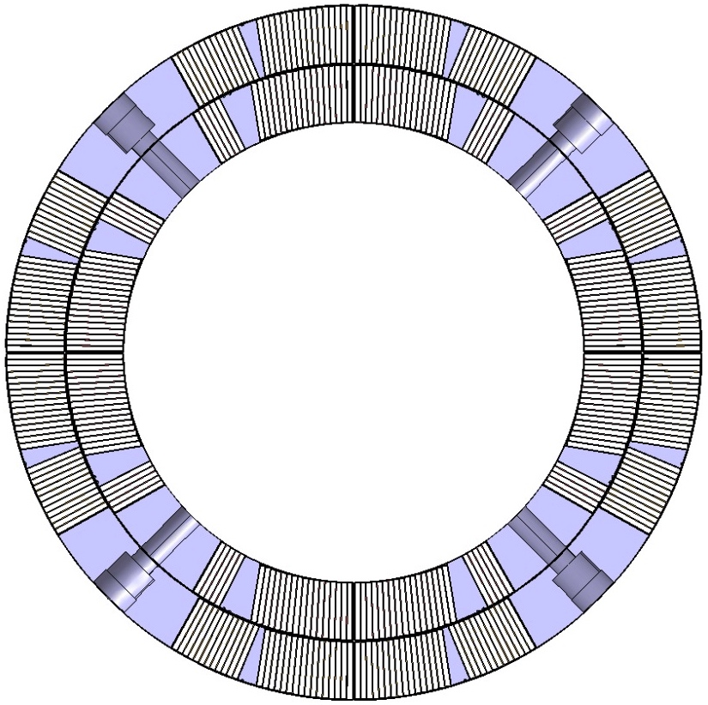
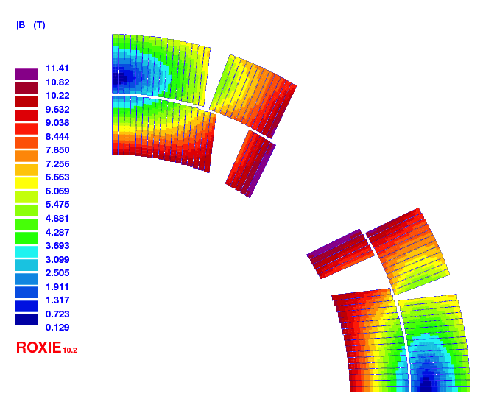
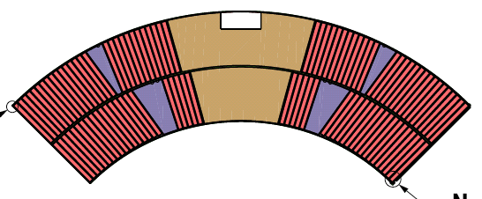
New Coil design
Coil design for MQXFB, with second cable geometry, will be ready by end of Mai
Final drawings for new set of spacers will be ready by end of June
3D printed spacers will be used for 4 to 5 coils (prototype magnet construction)
Spacers for series magnet will be machined
Wedges will be extruded (pieces ≈2 meters. Production process being improved during MQXFS wedges fabrication)

Slide 6
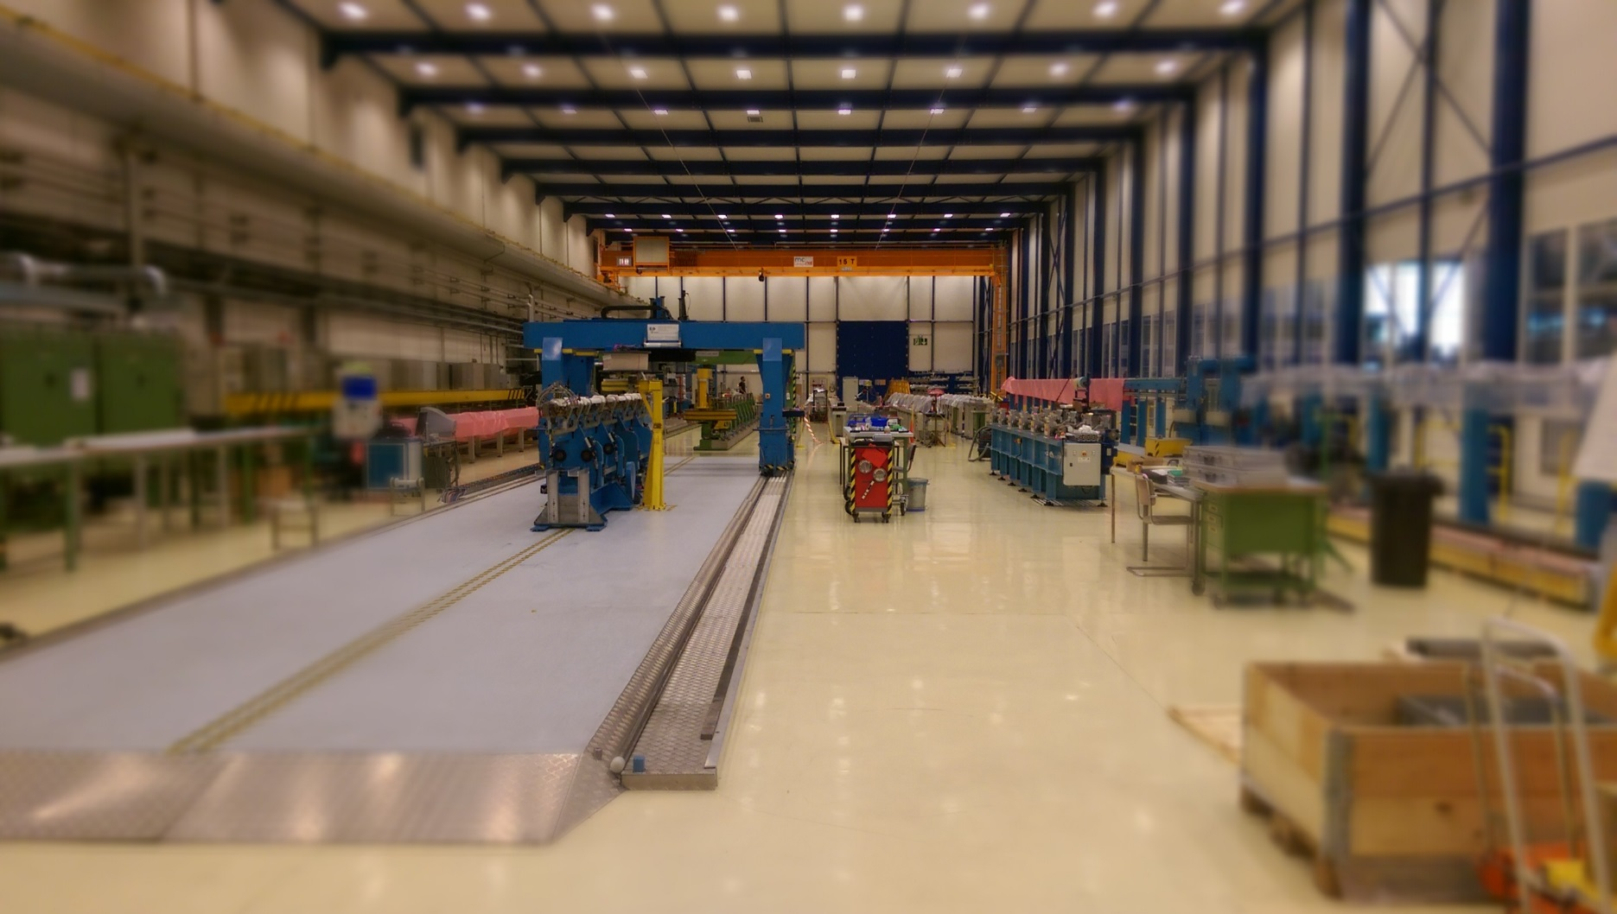
LMF - Winding house
Re-arrangement for 11T and QXF coil production is ongoing

Slide 7
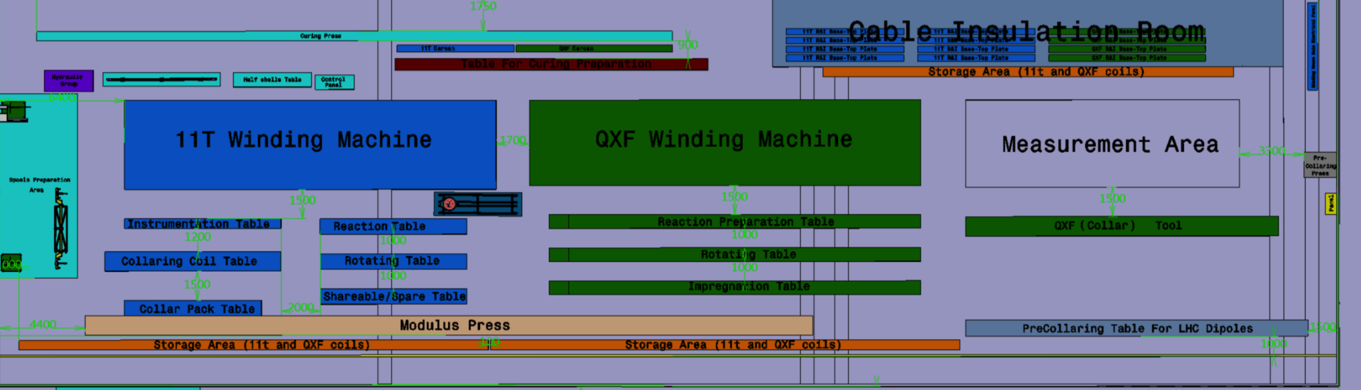
LMF - Winding house - refurbishment
11T – winding zone
QXF – winding zone
Re-arrangement of existing winding infrastructure for simultaneous winding operations.
Task launched in March 2015, subsequent adaptation of zone.

Slide 8
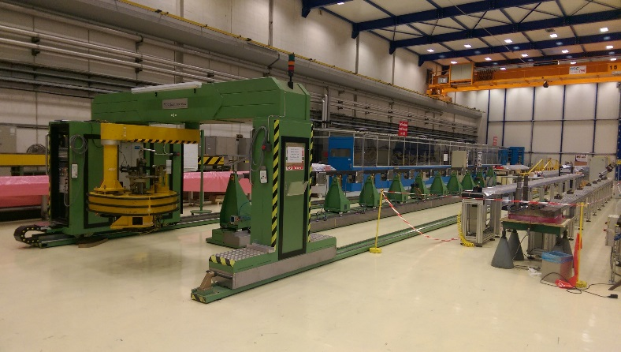
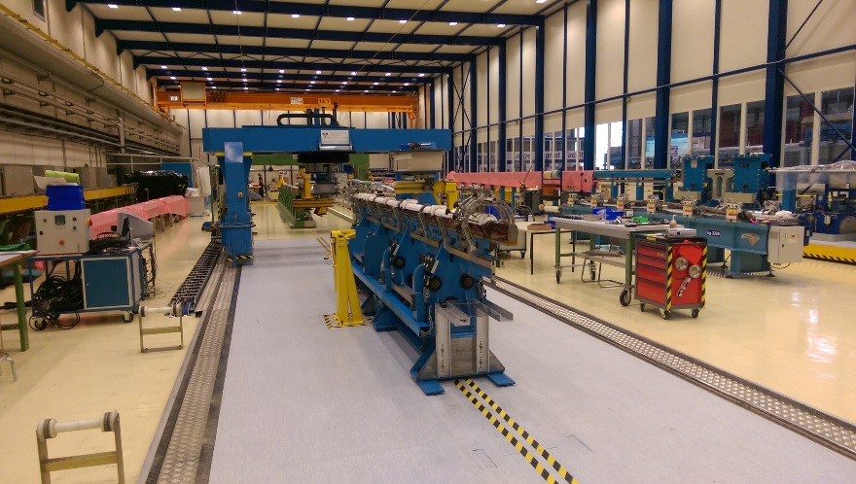
LMF - Winding machine - refurbishment
New winding table (LMF)
QXF – ongoing refurbishment
Refurbished winding machine – 11T
11T winding machine was fully refurbished, 11T coil production has been launched.
Refurbishment of 15 m LHC dipole winding machine:
Adaptation for full compatibility with the MQXFB coil design
New winding table, increased mechanical stability (in-house production)
Replacement of control soft- and hardware including all drive systems
Implementation of improved force tensioning system
PE will be launched in week 20, contract termination foreseen in Nov. 2015.
Courtesy of Friedrich Lackner

Slide 9
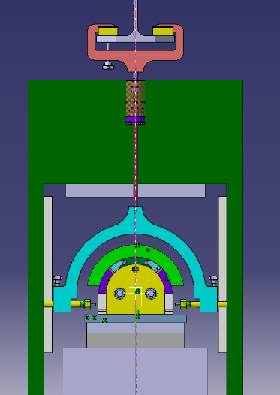
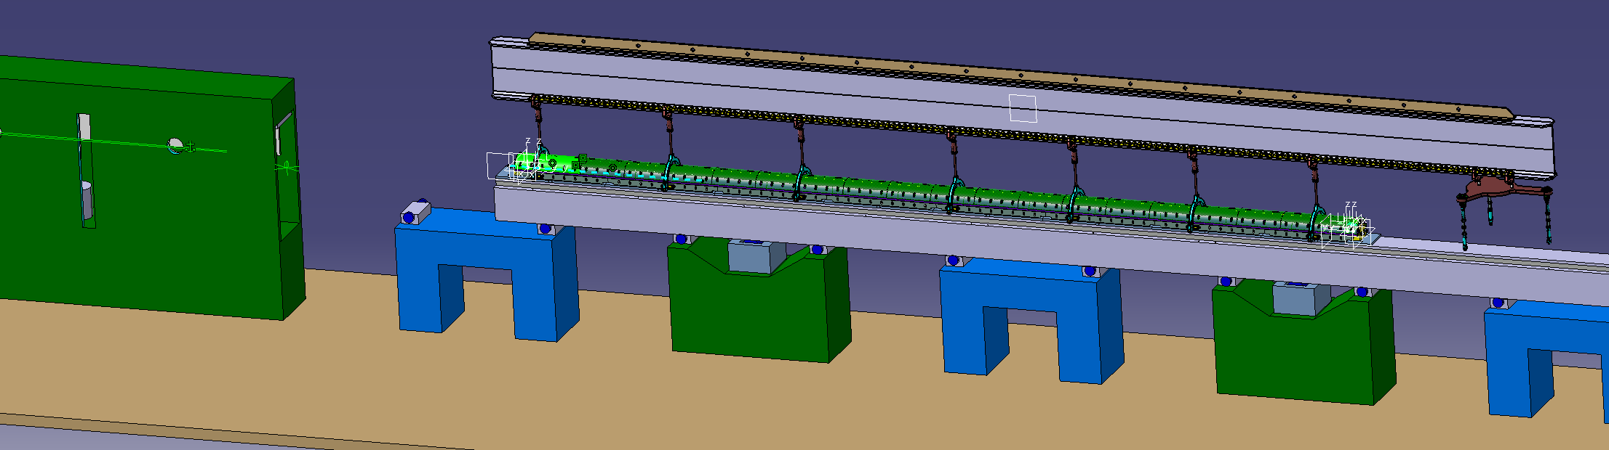
Winding and Curing major tooling status
Item | Status | Remark
Winding Mandrel | In procurement
Curing Tool | In procurement
Lifting Beam | Available | 11T dipole project
Lifting tool clamps | Design finished
Lifting tool coil | Design ongoing
Interlayer former | Design finished
Coil lifting beam and curing press
Courtesy of Philipp Revilak

Slide 10

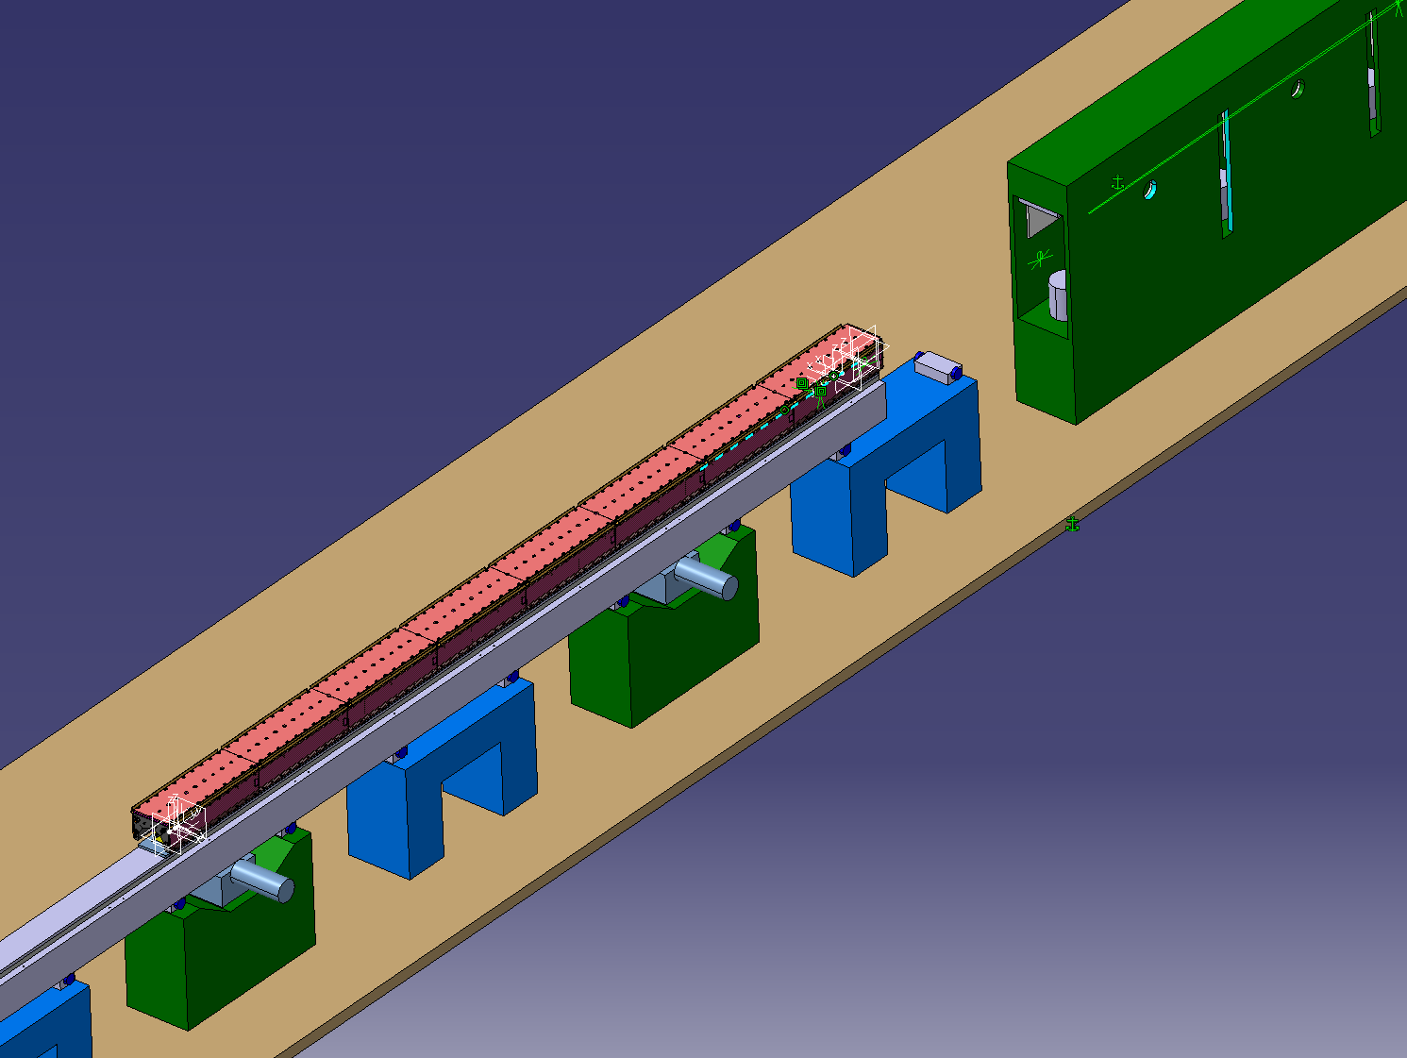
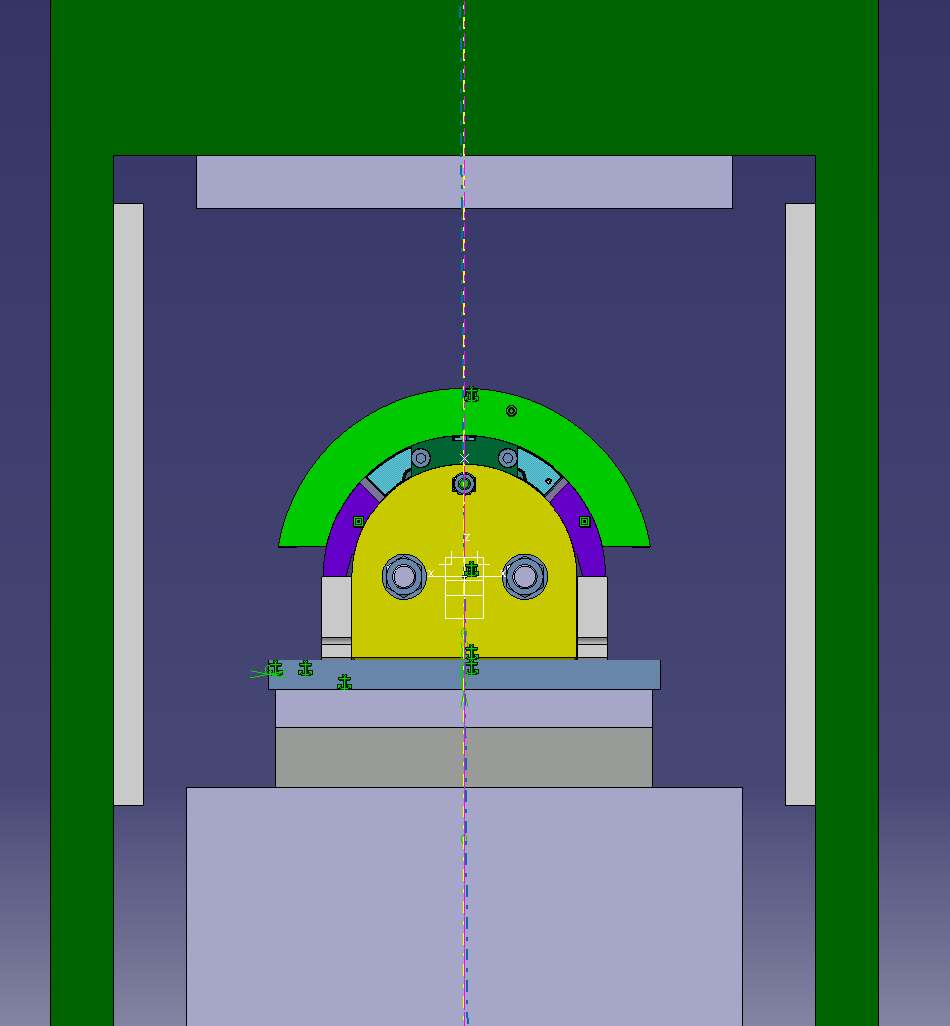
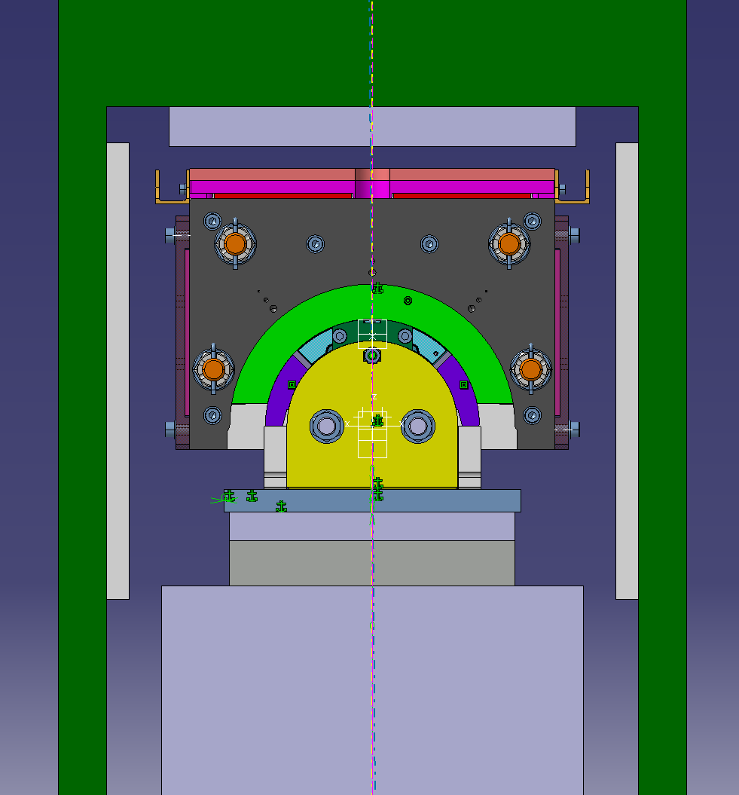
Curing steps
Mounting of coil for curing of the Inner layer
Courtesy of Philipp Revilak

Slide 11
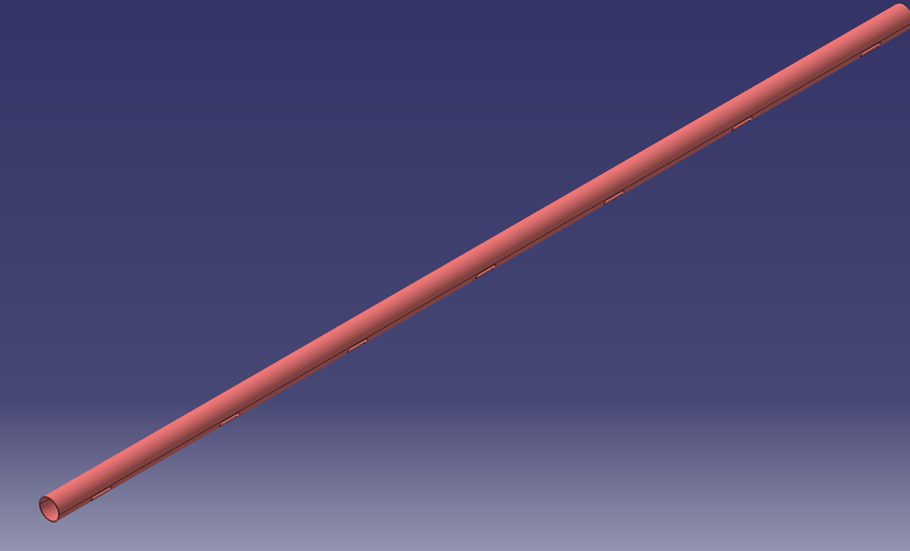
Winding and Curing: Interlayer former
Machined from thick-walled Aluminium pipe

Slide 12
MQXFB curing mold
Comparison curing tool short model and long prototype. Changes due to different requirements for the press at LMF
Resistive heating
Oil heating
Vertical pushers
Curing base
Baseplate press beam
Reasons for the design changes:
  Limitations in the available volume of the curing press (Limitation in outer boundaries of the carcan)
  Keeping compatibility of the curing press to the other magnet types to be produced
  Requirements for the stability of the winding mandrel for a 8m long coil

Slide 13
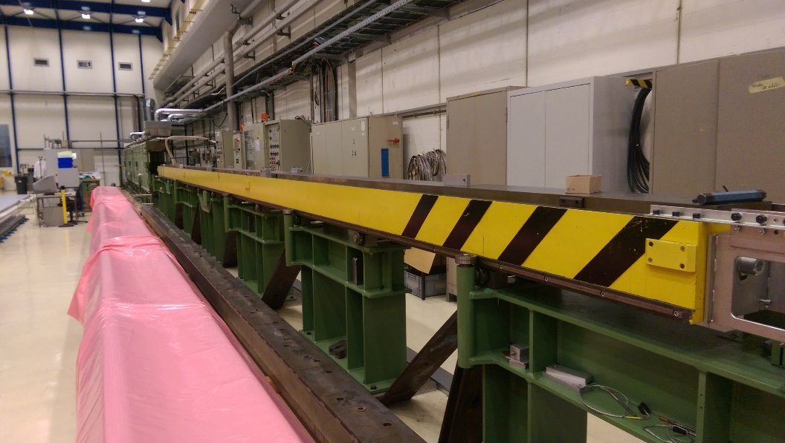
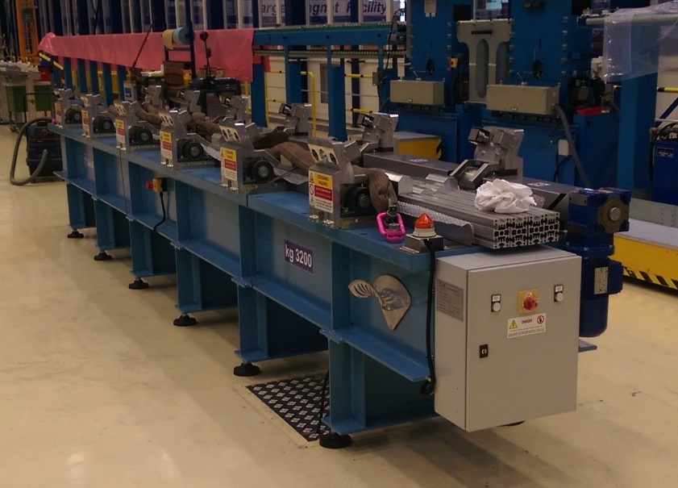
Curing press
Hydraulic sectoring was finalized for full compatibility with QXF and 11T coil design.
New rotation table received and installed inside the winding house in May 2015.

Slide 14
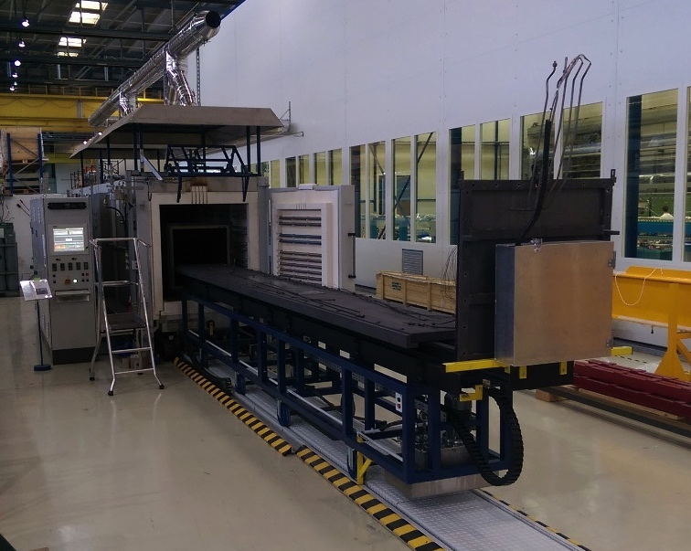
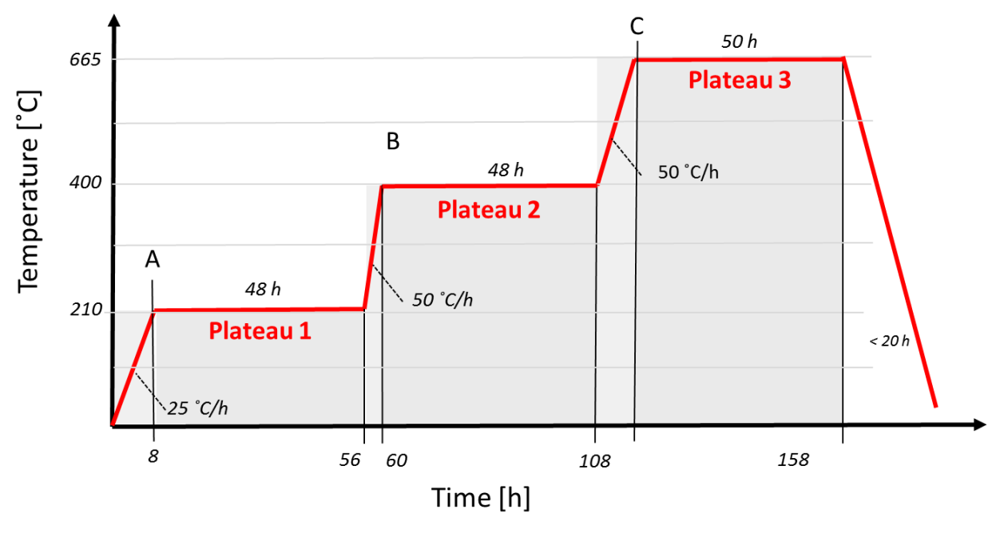
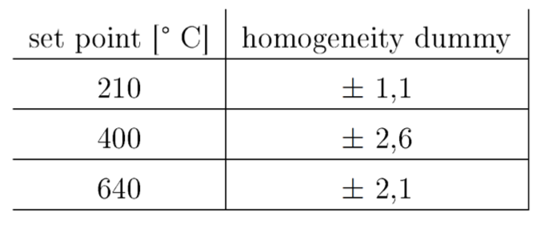
LMF - Reaction furnace for 11T
Length: 6.5 m
Cross-section: 0.5 x 0.6 m
Inert gas: Ar
Recirculation fans: 2
Heating zones: 5
Max. heating power: 350 kW
Max. operating temperature: 900°C
Measured temperature homogeneities during the heat cycles at
CERN inside the dummy mass, neglecting the thermocouple number 30.
Fully operational according technical requirements. Final acceptance test was performed in December 2014. Several heat treatments were already performed in 2015. First copper based 11T coil reacted in April 2015.

Slide 15
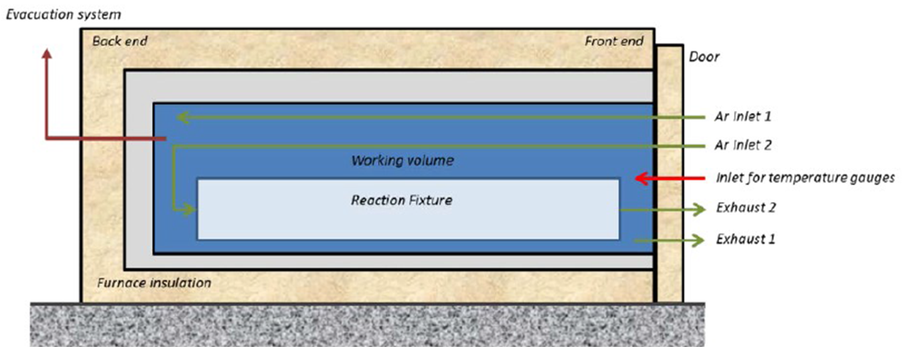

LMF - Reaction furnace QXF - Specification
Contract launched in April 2015 – Operational in March 2016
Plateaus 210°C; 400°C; 665°C; +-3°C
Heated length Ø1 m; l 10,5 m; 700 kg/m
Width < 4 m; l < 30 m; h< 4 m
40 probe TCs
Evacuation at RT to 10⁻² mbar; 700 l/s (new in comparison to existing furnaces)
Loading and unloading automatic 20mm/s², 0,5 mm/m
Oxygen reduction in < 10 h, 1 ppm including detection
Heat treatment start oxygen level < 10 ppm
52 weeks delivery
Technical Specification
Main criteria:
Courtesy of Friedrich Lakner

Slide 16
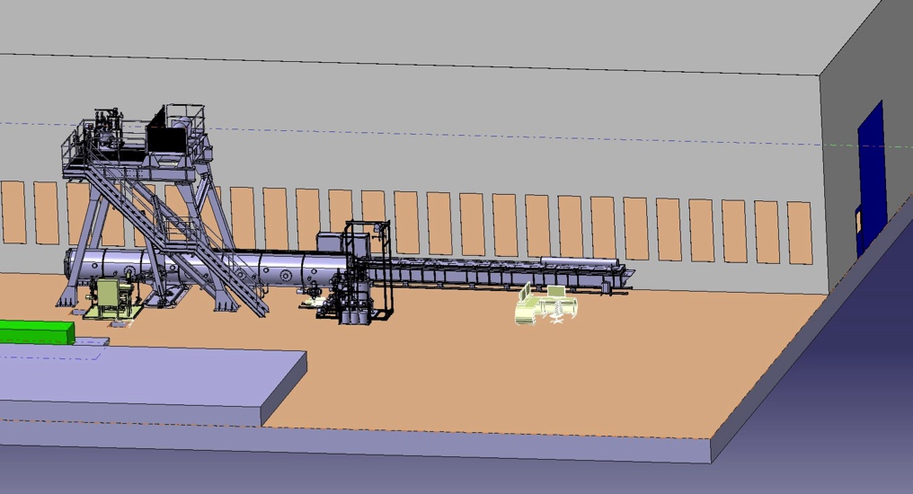
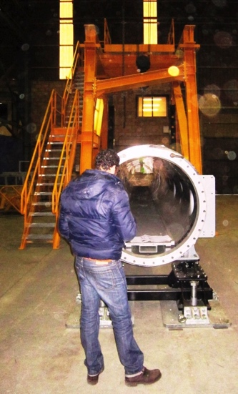
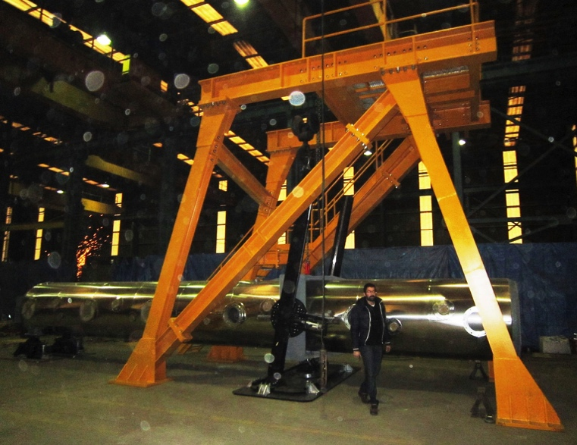
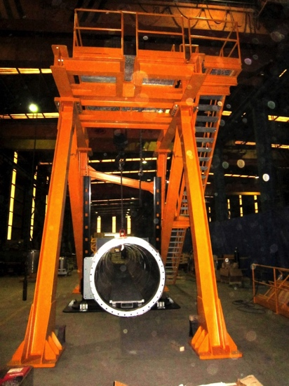
Impregnation tank
The new impregnation system produced by Elytt will be delivered and commissioned at CERN in June 2015

Slide 17
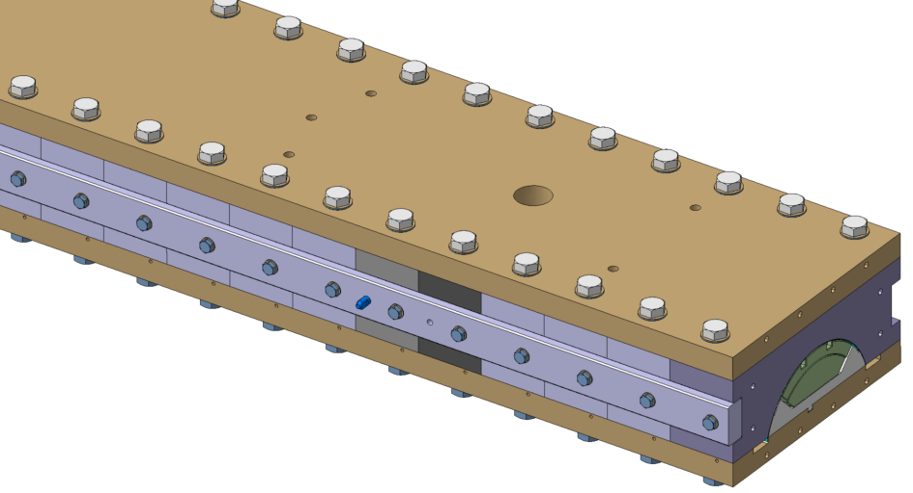
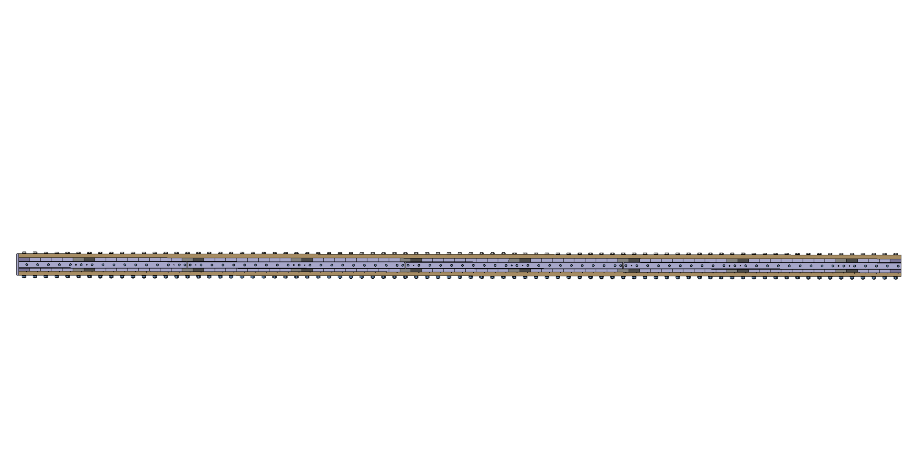
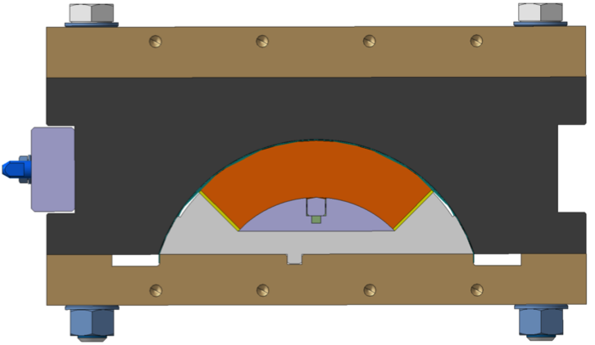
Reaction tooling
Outline:
  81 mandrel blocks
  81 form blocks
  162 M20 silver plated screws
  Total weight: around 4100kg
7857mm
Design mainly based on LARP design:
  Cavity unchanged, same shimming as short coils.
  Longer form blocks and mandrel blocks: 97mm instead of 49.6mm,
  Light modifications for handling and EHS purposes.
Fixture is designed to be tight if needed, but it can be used open as reaction retort has vacuum capabilities.
Courtesy of Vincent Letellier

Slide 18
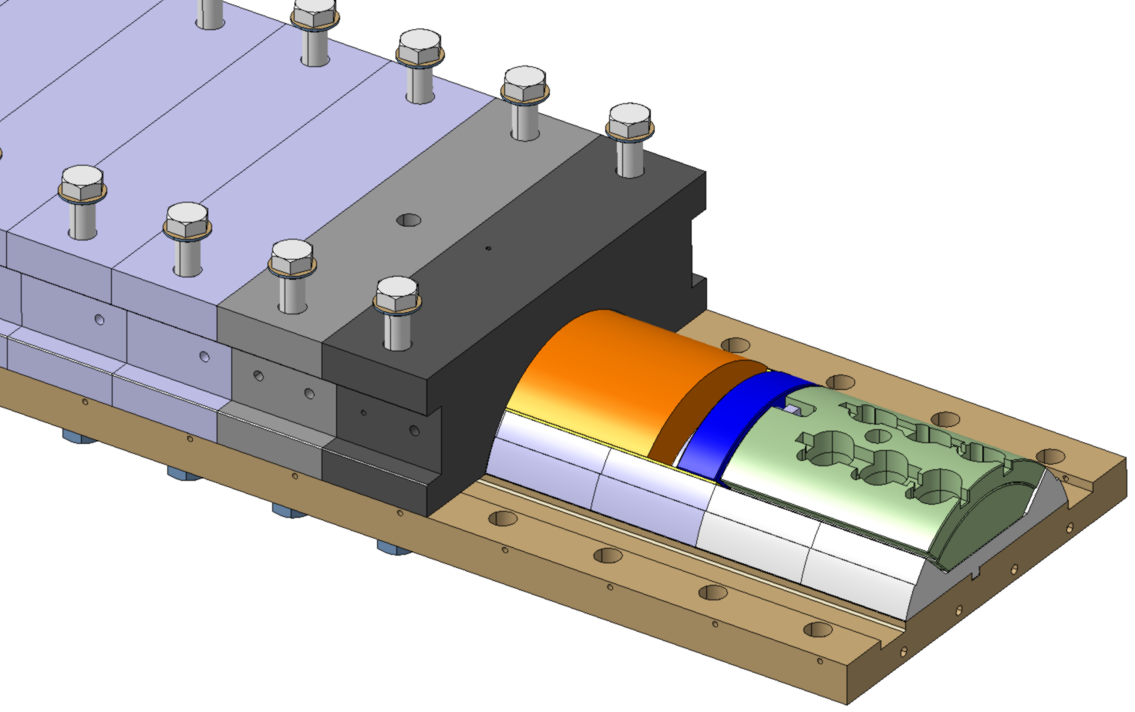
Reaction tooling
Integration of VAMAS in the fixture
  6 possible VAMAS on Leads end,
  4 possible VAMAS on return end.
8 blocks with coil centering pins
8 blocks with holes for thermocouples.
Centering pin hole
VAMAS block
Thermocouples
Courtesy of Vincent Letellier

Slide 19
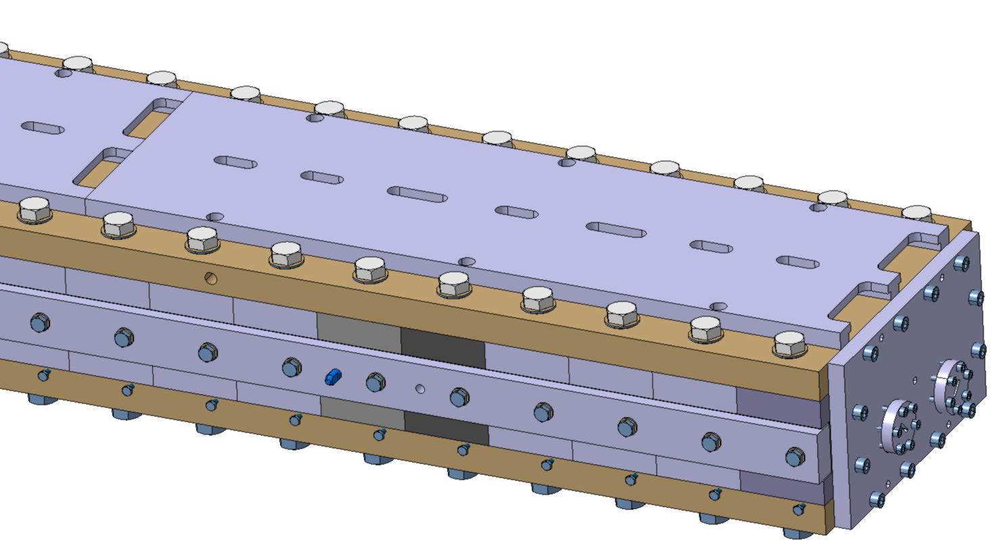
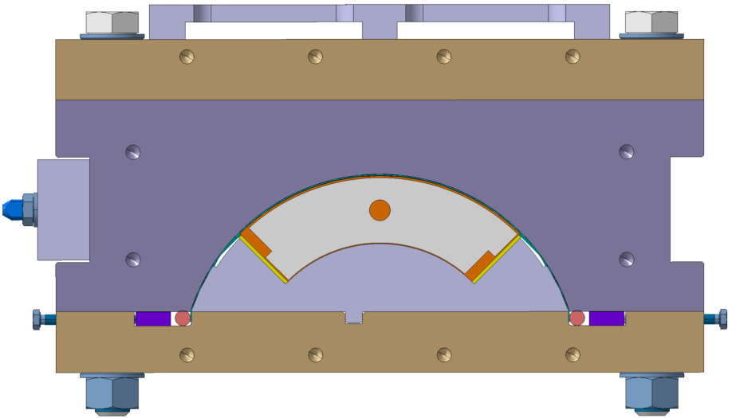
Impregnation tooling
Basically same design as reaction fixture except:
  End plates to tightness reasons
  O ring to make the fixture tight
Plates for heaters
Courtesy of Vincent Letellier

Slide 20
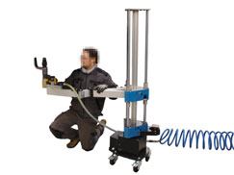
Handling tooling
Arm to assist handling of formblocks (> 20kg):
  Example: https://www.youtube.com/watch?v=GOC2TNwvGZM
Slight improvements of cutting and splicing tools based on short coils experience feed back.
2 long tables (≈ 17m) for preparation ( 1 for reaction, 1 for impregnation) + 1 rotating table.

Slide 21
OUTLINE
Preparation for MQXFB coils production
  Building 180 layout modification
  Coil and coil components design status
  Winding machine
  Winding and curing tooling
  Curing press
  Reaction oven
  Impregnation system
  Reaction and impregnation tooling
Production plans
Summary

Slide 22
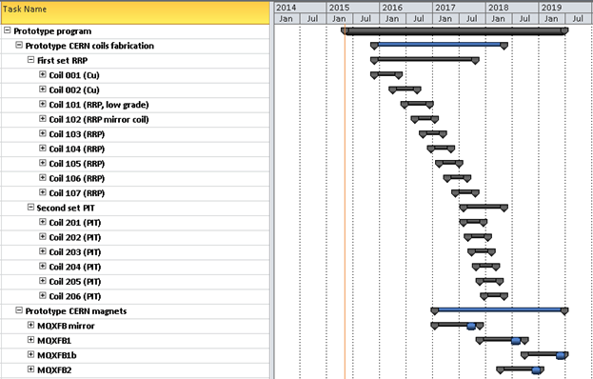
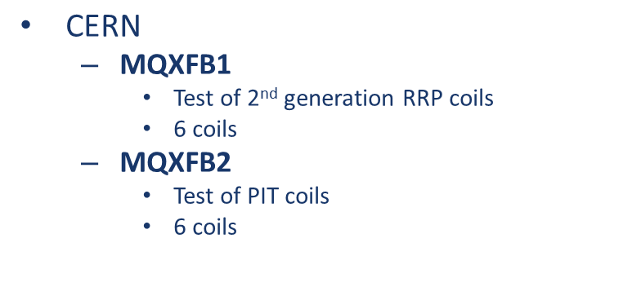
Prototype program

Slide 23
OUTLINE
Preparation for MQXFB coils production
  Building 180 layout modification
  Coil and coil components design status
  Winding machine
  Winding and curing tooling
  Curing press
  Reaction oven
  Impregnation system
  Reaction and impregnation tooling
Production plans
Summary

Slide 24
Summary
MQXFB coil design with new cable geometry ready. Production drawings for coil components will be finished by end of June
Winding machine modification will be completed in October 2015
Winding and curing tool will be ready by November 2015
Curing press fully operational
Reaction tooling delivery scheduled in Q1_2016
Reaction oven commissioning foreseen in March 2016
New impregnation system will be full operational in June 2015
Coil fabrication will start in December 2015

Slide 25


Thank you for your attention
The HiLumi LHC Design Study is included in the High Luminosity LHC project and is partly funded by the European Commission within the Framework Programme 7 Capacities Specific Programme, Grant Agreement 284404.

