Slide 1
MQXFA Functional Requirements
Ruben Carcagno
May 13, 2015

Slide 2
Functional Requirements
A clear specification of functional requirements for U.S. deliverables is needed to support the DOE Order 413.3B project management process for the US-HiLumi project
These requirements should not be embedded in other documents (e.g., design reports) or mixed with requirements for other systems
  Functional requirements for the U.S. project deliverables should be documented in a stand-alone document
  These requirements should be such that their verification means that the project deliverable(s) are fit for the intended use
    They do not include design parameters, only the functions that the deliverable must satisfy
  Functional Requirements must be reviewed and approved by the end user (CERN), well in advance of the project baseline establishment for the CD-2 DOE review
    A signed document should be finalized in less than a year from now

Slide 3
Main Project Planning Documents
Mission Need Statement (MNS)
Project Management Plan (PMP)
Functional Requirements Specification (FRS)
Performance Baseline (PB)
Risk Management Plan (RMP)
Scope Baseline
Acquisition Strategy (AS)
Design: Reports (CDR, PDR, FDR) Drawings, Specifications, etc.
KPPs, WBS, WBS Dictionary
Quality Assurance Plan (QAP)
Cost and Schedule Range, Key Milestones
Schedule Baseline
Value Engineering
Alternatives and Risk Analysis
Change Control Management Plan
BOEs, RLS, Milestones, Constraints, Contingency
Manufacturing: Manufacturing Plan (MP), Procedures, etc.
Project Execution Plan (PEP)
Procurement Management Plan
Cost Baseline
Procurement: Procurement Plan (PP), etc.
Key Assumptions, KPPs, Baseline, Funding Profile, PM Strategy
Integrated Safety Management Plan
BOEs, Time-Phased, Escalation, Contingency
Risk Registry (RR), Risk Analysis
OBS, RAM, CAMs

Slide 4
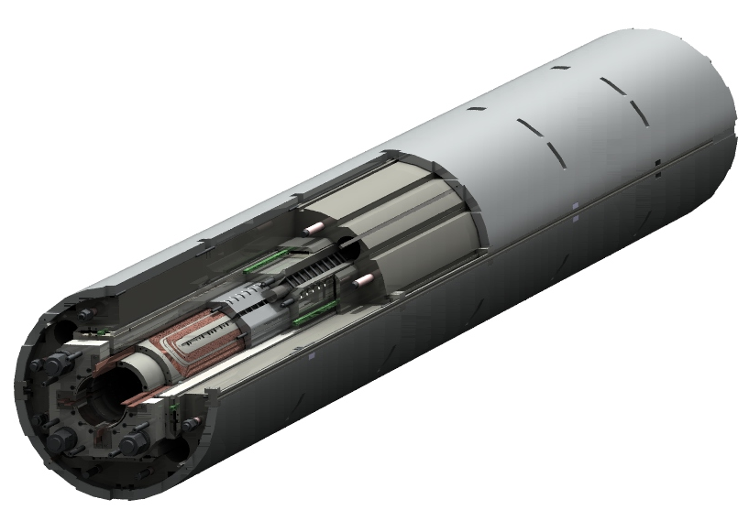
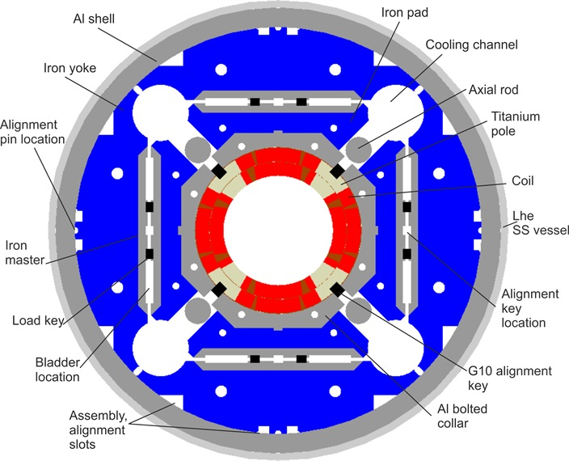
Scope
This presentation is for the MQXFA functional requirements for Q1 and Q3 only:
The MQXFA magnets for Q1 and Q3 are assumed to be identical
A separate, similar functional requirements document is also needed for the Q1, Q3 Cold Mass Assembly (LMQXFA/B)
SS vessel not part of MQXFA

Slide 5
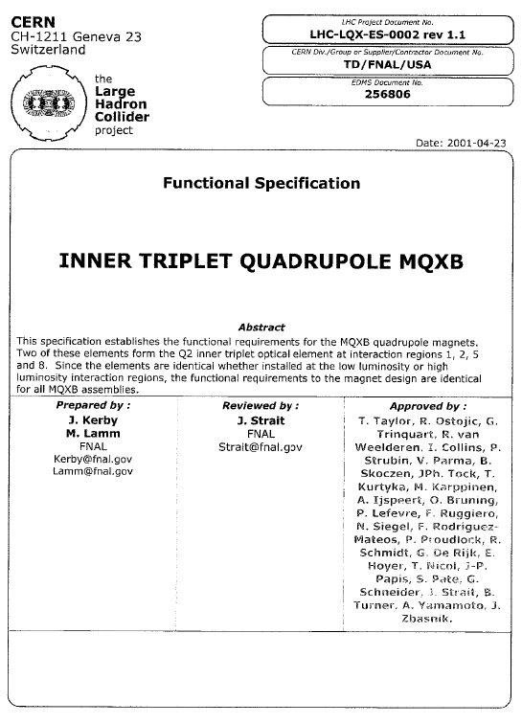
Previous Example: MQXB FRS
Example of a previous FRS for the present Inner Triple Quadrupole MQXB for Q2
Some parameters for MQXFA FRS were taken from the MQXB FRS, but they need to be confirmed by CERN

Slide 6
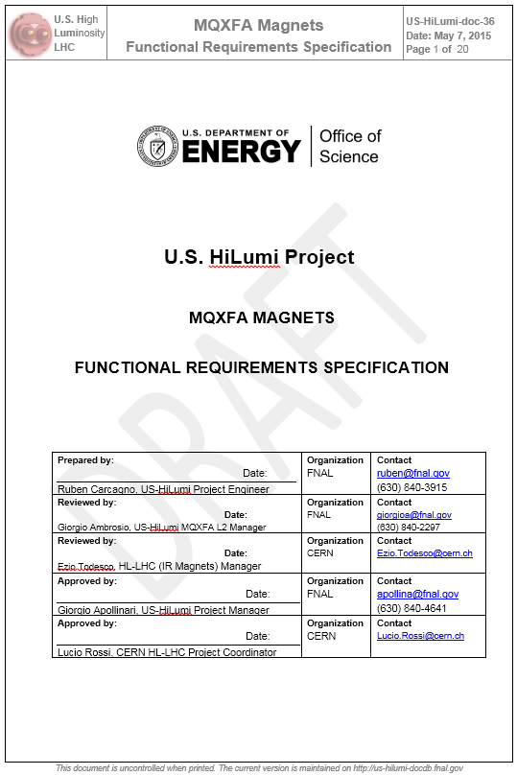
MQXFA FRS
https://us-hilumi-docdb.fnal.gov:440/cgi-bin/ShowDocument?docid=36
Draft prepared as a US-HiLumi project document to start discussions
Attempts to collect all the functions that the MQXFA magnet must satisfy
  A total of 38 functional requirements were identified
Several parameters need definition and confirmation by CERN

Slide 7
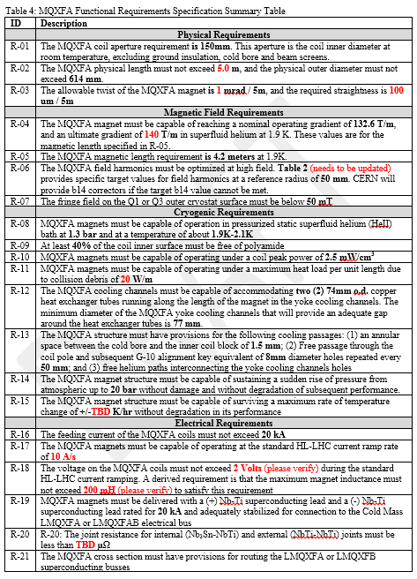
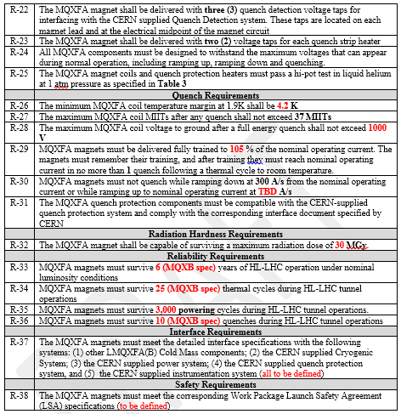
MQXFA FRS Table
Parameters in black are more certain. Parameters in red less certain or still under discussion

Slide 8
Next Slides
Next slides will provide an overview of the draft MQXFA requirements
  These requirements should be such that their verification means that the MQXFA magnet deliverables are “fit” (suitable) for the intended purpose, i.e., they will satisfy CERN’s needs for HL-LHC
The purpose is to generate discussions and answer questions such as:
  Are there any missing requirements?
  Are requirements properly stated?
  Are requirements verifiable?
  Is there agreement/confirmation of parameters in blue?
  Is there enough information to specify parameters in red?

Slide 9
MQXFA Physical Requirements
150 mm aperture, ≤ 5.0 m long, ≤ 614 mm diameter, ≤ 1 mrad/5m twist, ≤ 100 um/5m straightness

Slide 10
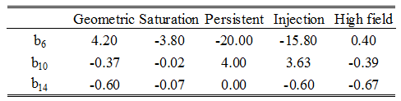
Magnetic Field Requirements
Magnetic length is 4.2 m, nominal gradient 132.6 T/m, ultimate gradient 140 T/m (5% above nominal) in superfluid helium at 1.9K, fringe field < 50 mT
Field Quality Targets (tables need to be updated):
CERN will provide b14 correctors if the target b14 value cannot be met
Random
Systematic

Slide 11
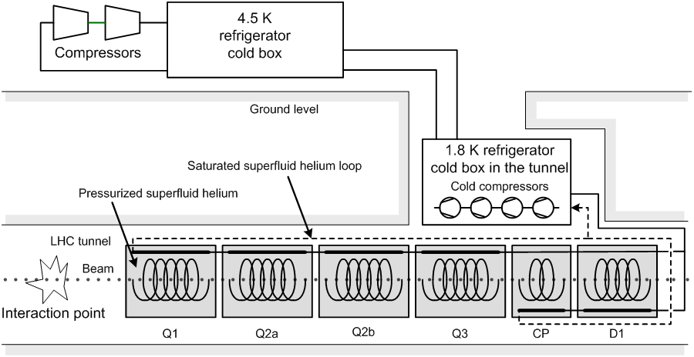
Cryogenic Cooling System

Slide 12
Cryogenic Requirements
Superfluid helium bath at 1.3 bar and 1.9-2.1K, 40% of coil inner surface free of polyamide, coil peak power 2.5 mW/cm³, maximum heat load 20 W/m (assumes CERN-provided beam screen with tungsten absorber)
Minimum cooling channel diameter is 77mm to accommodate two 74mm O.D. copper heat exchanger tubes, provisions for cooling passages (8mm pole holes every 50 mm, etc.)
20 bar peak pressure
Maximum rate of temperature change +/- TBD K/hr

Slide 13
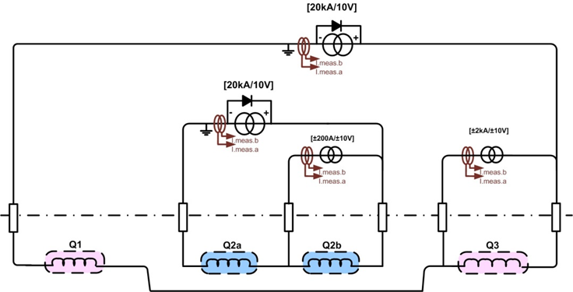
Power System

Slide 14
Electrical Requirements
Feeding current < 20 kA (expected nominal is 17.46 kA), ramp rate of 10 A/s with < 2 volts during ramping (means inductance < 200 mH), Nb-Ti leads for connection to the bus, joint resistance < TBD µΩ, provisions for routing SC bus in cooling channels without heat exchangers
Instrumentation: three quench detection voltage taps, two voltage taps for each quench strip heater (VTs for joints?)
Voltage limits in table below. Must pass hipot test in liquid helium at 1 atm according to:
Impulse test?
Is inductance range/value a requirement or is inductance a derived requirement?
Circuit Element | Vmax | V hi-pot | I hi-pot
Quench Protection Heaters - Coil | 500 V | TBD | < TBD µA
Magnet Coil - Ground | 1,000 V | TBD (2,500 V?) | < TBD µA

Slide 15
Quench Requirements
Temperature margin ≥ 4.2K, MIITs ≤ 37, coil voltage to ground after quench < 1,000 Volts
Training to 105% of nominal operating current (18.3 17.3 kA, operating current is 17.46 16.5 kA). Must remember training and reach nominal operating current in no more than 1 quench after a room temperature thermal cycle
Must not quench while ramping down at 300 A/s from nominal current and up at TBD A/s to nominal current

Slide 16
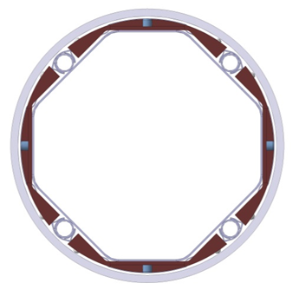
Radiation Hardness Requirements
Survive maximum radiation dose of 30 MGy
  Assumes beam screen with tungsten absorber (provided by CERN):

Slide 17
Reliability Requirements
Survive 6 years under nominal luminosity conditions, 25 thermal cycles, 3,000 powering cycles, and 10 quenches

Slide 18
Interface Requirements
Comply with Interface Specifications for:
  Other LMQXFA(B) cold mass components
  CERN Cryogenic System
  CERN Power System
  CERN Quench Protection System
  CERN Instrumentation System
All these interface specifications To Be Defined

Slide 19
Safety Requirements
Comply with the corresponding CERN Work Package Launch Safety Agreement (LSA) specification (TBD)

Slide 20
Path Forward
Are there any missing requirements?
Are requirements properly stated?
  Is there agreement/confirmation of parameters in black/blue?
  Is there enough information to specify parameters in red?
Are requirements verifiable?
What is the process to converge on a final set of requirements acceptable to CERN?
US-HiLumi is going to need a final, approved MQXFA requirements document in less than a year from now
  Goal to complete draft by next collaboration meeting (Sep 2015)?

