Slide 1
Dressed Cavity Engineering Design DQW & RFD
12/05/2015
Niklas Templeton - STFC Daresbury Laboratory
UK Collaborator
Notes:
Tues 12th May 10.45 – 11.25 Hornet’s Nest WH8XO

Slide 2
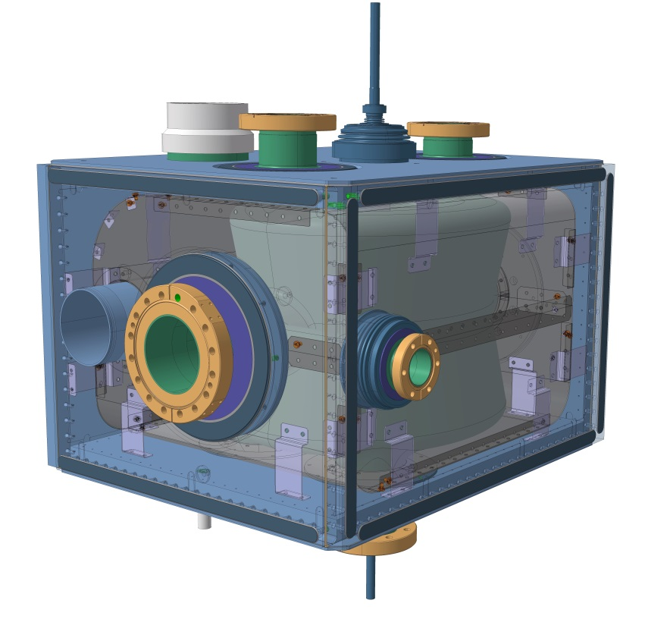
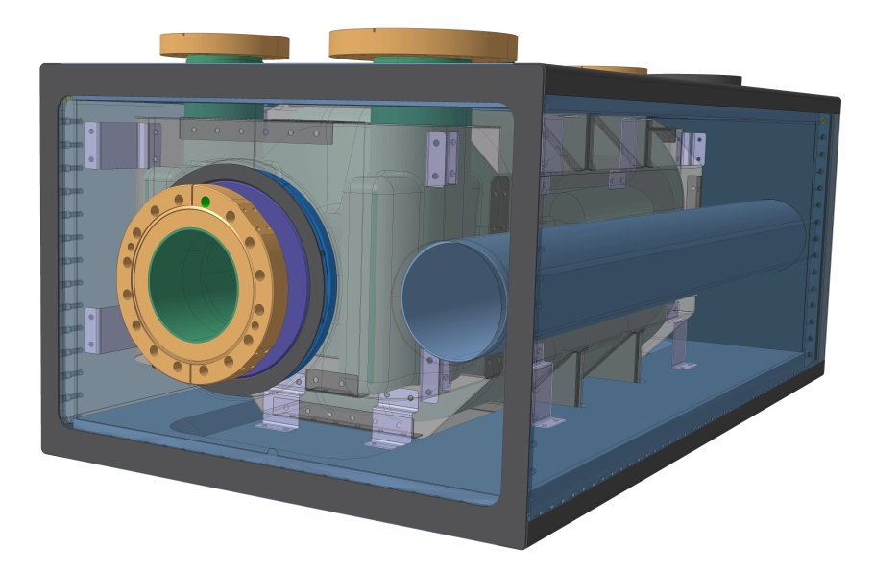
Content
Overview Dressed Cavities
Crab Cavity Design & Status
Cryogenic Magnetic Shielding
Helium Vessel Design
Analysis & Testing
Assembly Procedures
Cavity Support System

Slide 3
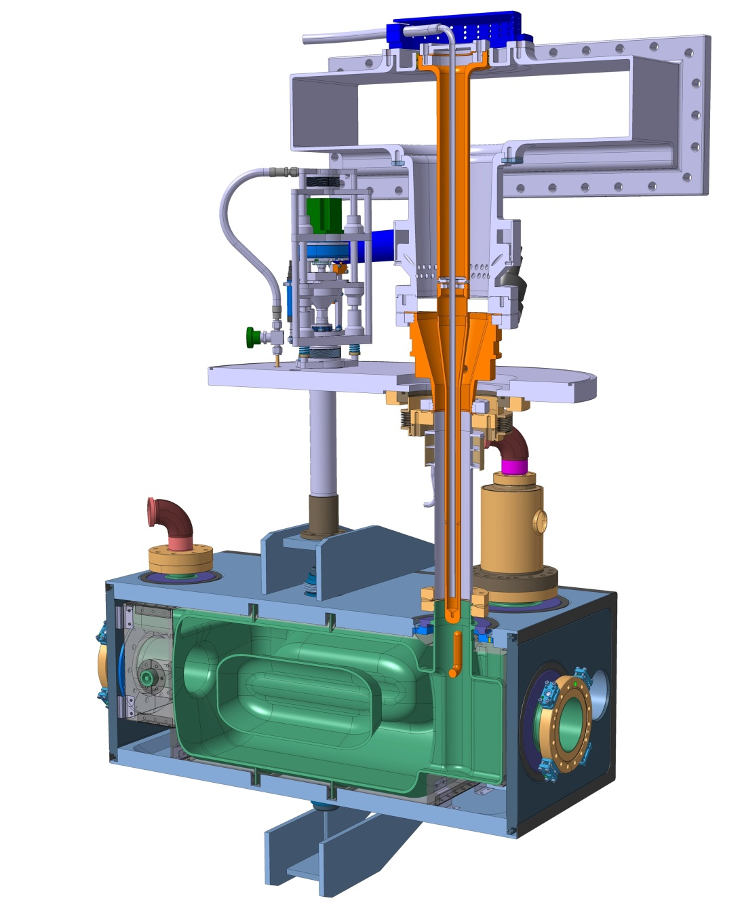
Dressed Cavity Overview
Active (warm) Tuner Mechanism
Fundamental Power Coupler
HOM Coupler
OVC Interface
Helium Vessel
Cavity
Cold Magnetic Shield
Passive (cold) Tuning Component

Slide 4
Cavity Designs
Fundamental Power Coupler Port
Coupler & Probe Ports
Double Quarter Wave
Tuner interface
Niobium RRR300 Cavity – 4mm wall thickness
Niobium-Titanium Transition pieces
Survey & Alignment Mounting Points
RF Dipole
Cavity Stiffening Ribs

Slide 5
Double Quarter Wave
Cavity Design by BNL
Detailed drawings by CERN
Drawings finalised
Currently being manufactured by Niowave
659.6
410.5
495.7
Mass: 55kg

Slide 6
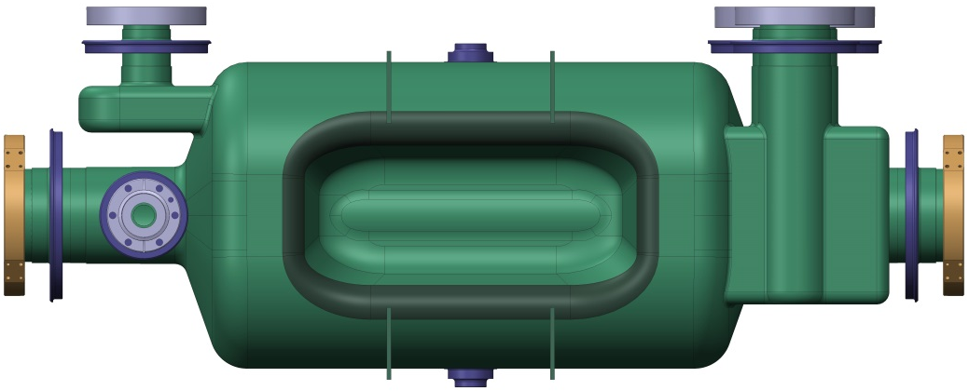
RF Dipole
Cavity design by ODU
Detailed drawings by CERN
Drawings finalised
Currently being manufactured by Niowave
904.7
414
351
Mass: 50kg

Slide 7
Cold Magnetic Shielding
Specification
<1µT on cavity surface
To be achieved in conjunction with 3mm warm MuMetal shield
Constraints
Internal to Helium Tank
Suspended in 2K Helium
Mounted off Helium Tank – no cavity connection
Operating Conditions
>200µT – Earth’s magnetic field + shielded local sources

Slide 8
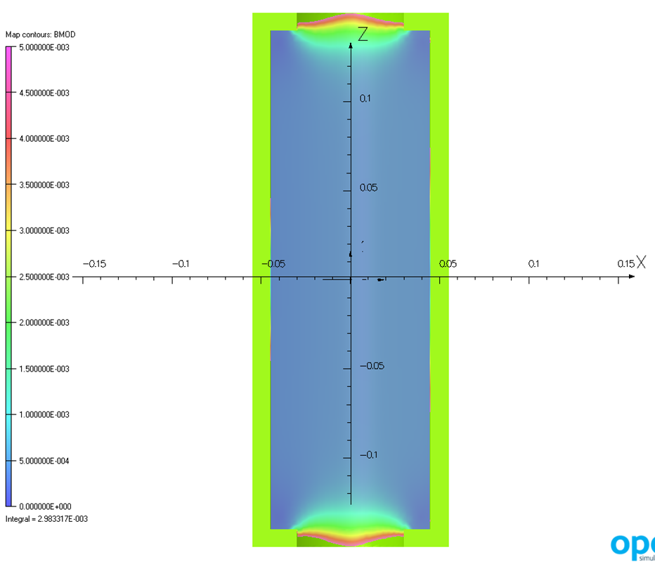
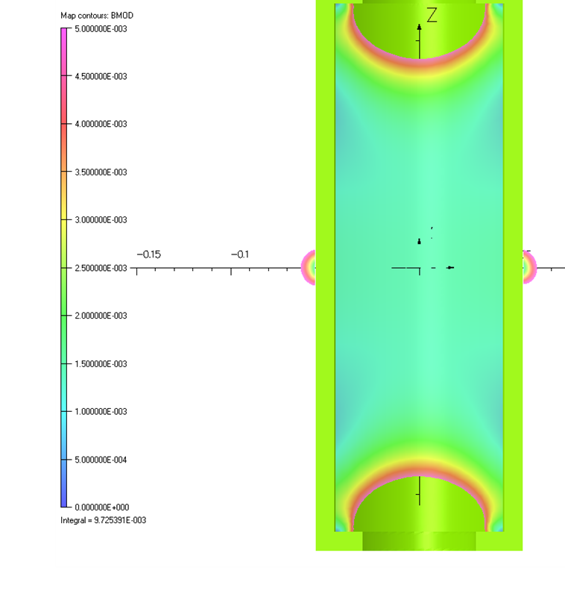
Initial Opera Shield Analysis by Kiril Marinov ASTeC Daresbury Lab.
Cryomodule orientation comparison
Shielding effect is anisotropic - A cylinder is twice as effective against radial field as against axial field
Axial field provides worst case scenario
B
B
Radial Field
Axial Field

Slide 9
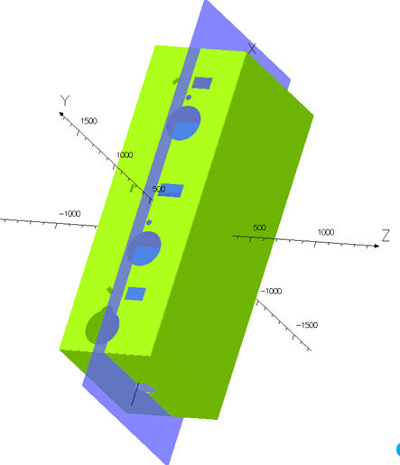
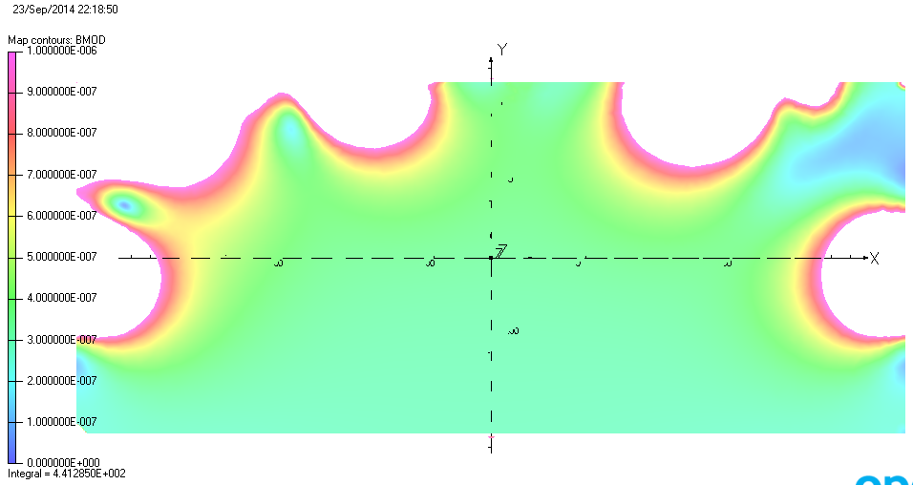
Single Layer Solution
3mm MuMetal shield model with accurate size and penetrations analysed in worst case orientation
60µT field applied in axial direction (B_{Earth N-S} = 48µT + safety margin)
Single layer shield is within spec. Analyses shows ~0.5µT at cavity locations
B>1µT
B = 60µT

Slide 10
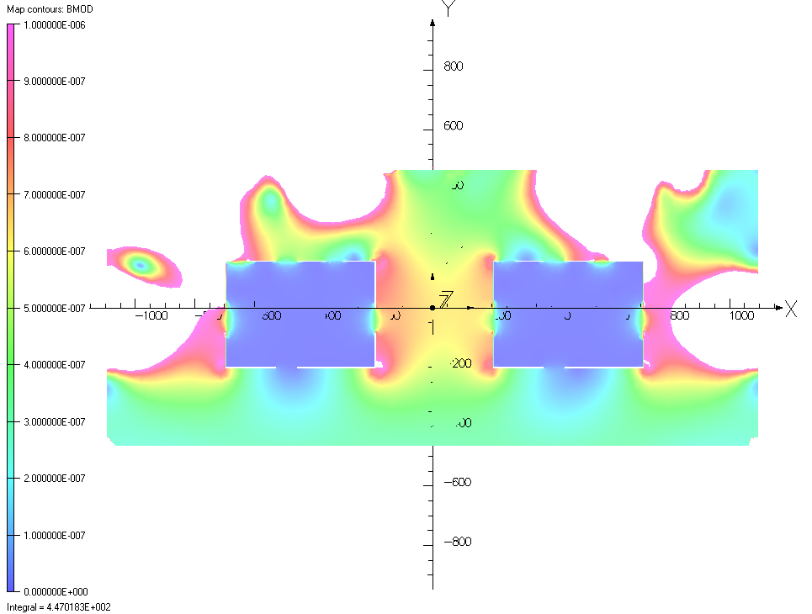
Double Layer Solution
Warm & Cold Shield models with accurate size and penetrations analysed in worst case orientation
60µT field applied in axial direction (B_{Earth N-S} = 48µT + safety margin)
Field at cavity surface is extremely low (<<0.1µT) even before design optimisation
Double layer solution should be suitable even with increased ambient fields – further analyses required for design & optimisation
B>1µT
B = 60µT

Slide 11
Cold Shield Design Approach
Minimise number & size of penetrations
Ease of manufacture & assembly
Minimise number of panels
Fabricated from Bent / Folded sheet
Pressed panels possible future batch shield orders
Maximise penetration attenuation
Maximise curvature
Shield | No. Penetrations | No. Panels
DQW | 11 | 7
RFD | 7 | 10

Slide 12
Common Design Features
1mm Cryophy Panels
Panels to be manufactured from Cryophy sheet metal which is cut, bent/folded, and fastened using self clinching nuts & spring washers
Helium Holes
Shield perforated with at least 142 x Ø3mm holes on 50-100mm pitch for helium transfer
142 holes give 10cm² transfer area, so that at worst case heat load (10W) heat flow is at least 1W/cm²
Close fitting Shield
The shielding factor is inversely proportional to the shield diameter $A≈\frac{μt}{d}$
Allows more space for connections, mounts & attenuation parts

Slide 13
Common Design Features
Additional Cover Strips
Overlapping joints prevent gaps & allows magnetic flux to follow a continuous low-reluctance path
Tubular Shielding
Prevents field penetration through openings.
Ideally H > ØD
Flexi-Mounts
Flexible Gr2 Titanium mounts connect the shield to the Helium Vessel. 8 mounting pairs are utilized in 3 orientations for maximum shield stability
Panel Curvature
More effective at containing channelled magnetic flux. Also increases structural rigidity of assembly

Slide 14
Crab Cavity Helium Tanks
Design by T. Capelli & R. Leuxe
Specification
Cooling capacity
Pressure vessel standards
Leak tightness
Stiffness for tuning
Minimal weld distortion on cavity
Constraints
Fabricated cavity geometry & tolerances
Cryomodule & SPS spatial constrains
Cavity interfaces and ports
Stiffening features
Clearance for cold magnetic shield
Helium volume

Slide 15
Helium Tank Overview
2 phase line interface
Cavity & Cold Magnetic Shield
Passive Tuning Component
Helium Vessel Walls
Dummy Beampipe
Thin cap seals
Split Ring Reinforcements
DQW Helium Vessel – Exploded View

Slide 16
Reasons for Bolted Helium Vessel
Nature of compact crab cavity design requires a stiff helium tank for pressure testing and tuning.
Thin walled vessel requires large number stiffening ribs.
Manufacturers advised that thin walled design would result in large weld distortions.
Weld distortions would be detrimental to cavity, thin walled design deemed too high risk.
Notes:
I would say that the helium vessel concept has evolved until we found a suitable solution (insuring limited stress in the cavity during operation and limiting the detuning of the cavity during assembly), not that we had several suitable solutions and we had to choose one.
We have several 3D designs versions stored in our CAD management system, several ANSYS calculations stored in our calculation folders and several manufacturing tests results. We are preparing a technical note summarizing all the designs that have been calculated indicating all the steps we have passed through but it’s still far from being finished. I think the table you suggest should be included in this note.
For the presentation next week, we will be there and will answer this type of questions, if any.

Slide 17
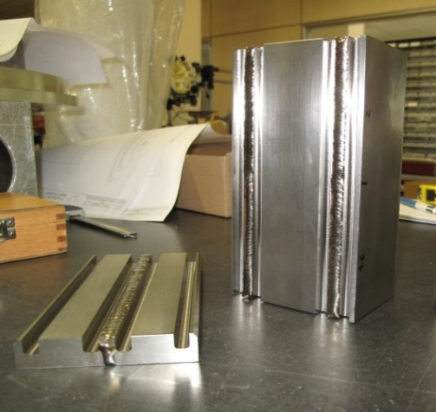
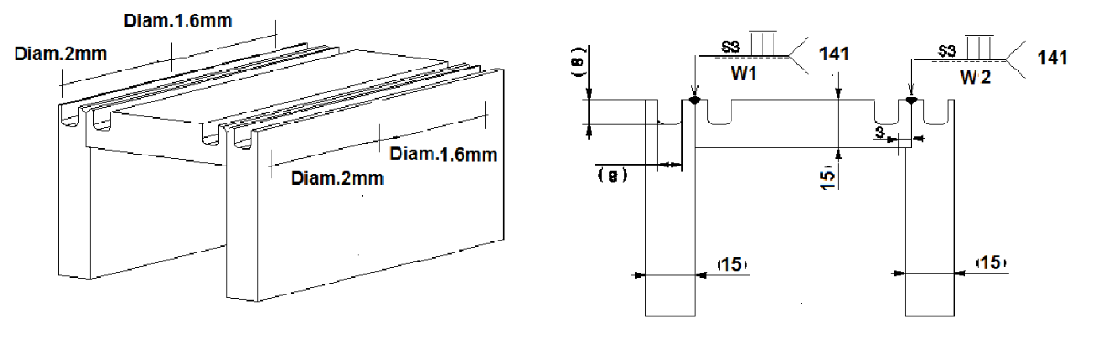
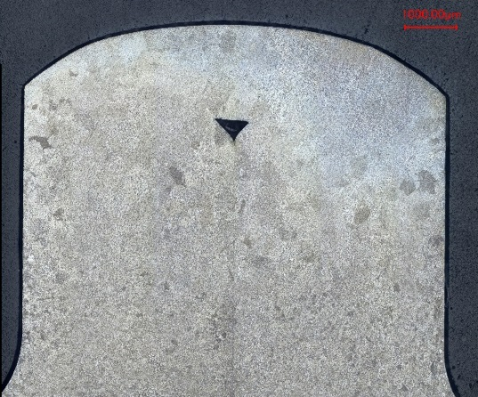
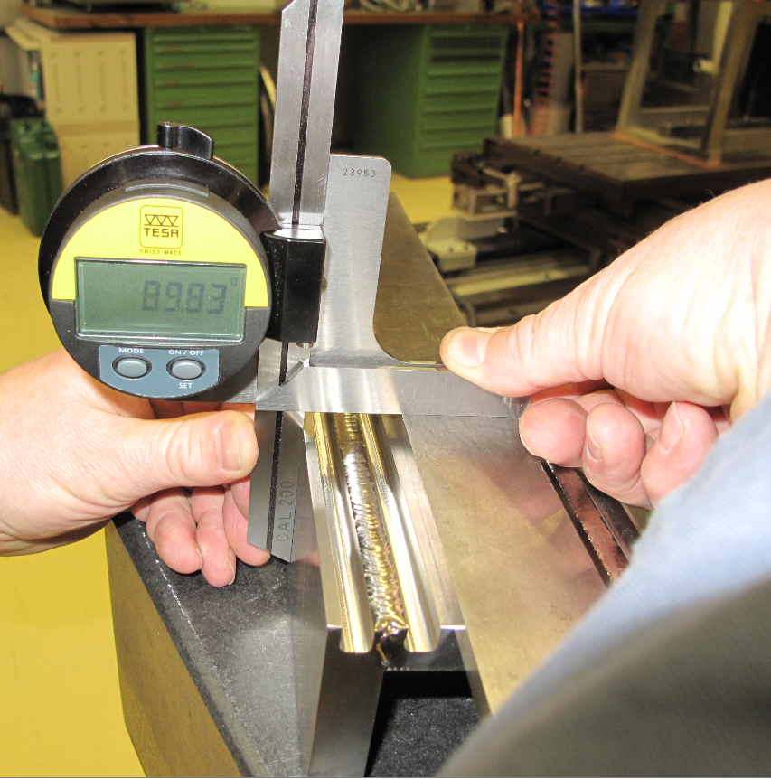
Reasons for Bolted Helium Vessel
Weld testing of thin walled design
Two samples have been welded with the following configuration and different diameters of filler metal:
3mm Test Piece
The dimensional control show some
deformations: Angular and longitudinal
Unsuccessful Metallographic test

Slide 18
Double Quarter Wave Helium Vessel
30mm
Thin Caps
20mm
20mm
30mm
Split Ring Connection
20mm
20mm

Slide 19
RF Dipole Helium Vessel
30mm
30mm
20mm
Thin Caps
20mm
Split Ring Connection
30mm
20mm
20mm

Slide 20
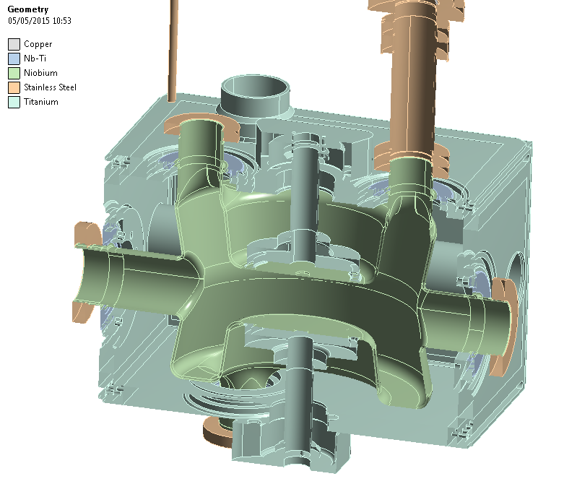
Cavity & Helium Vessel Analysis
Analysis by F. Carra, L. Dassa, N. Kuder
Design in accordance with:
CERN Spec. for Category 1 Helium Vessel
BS EN 13458 – Cryogenic Vessels
VDI 2230 Part 2 – Systematic Calculation of Highly Stressed Bolted Joints
Analysis
Preload, Pressure & Pretuning
Cool Down
Cavity Buckling
Thin Cap Welds
Fastener Strength

Slide 21
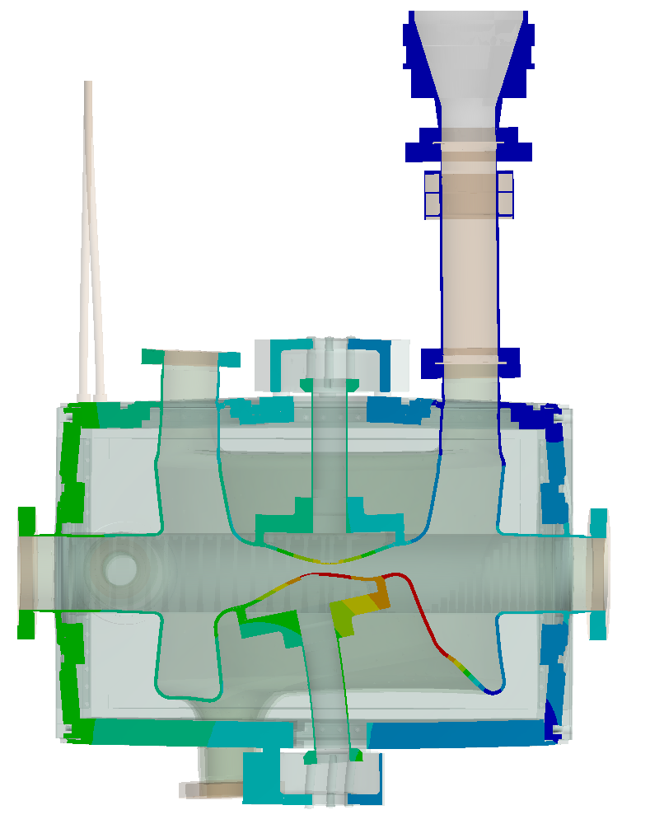
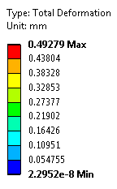
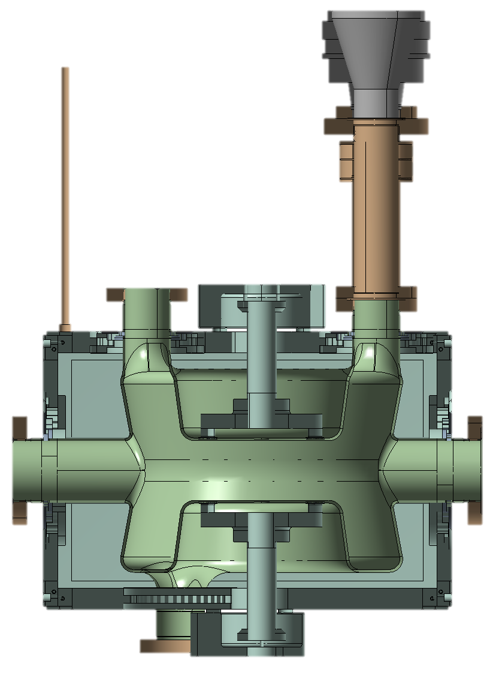
Loads & Boundary Conditions
Combining effect of bolt pretension, pressurization and pretuning
Bolt pretension 3800 N
Scale x100
Gravity 9806.6 mm/s²
Fixed support
Pressure 0.18 MPa
Thermal expansion 0.2 mm
0.2 mm
Cavity submodel

Slide 22
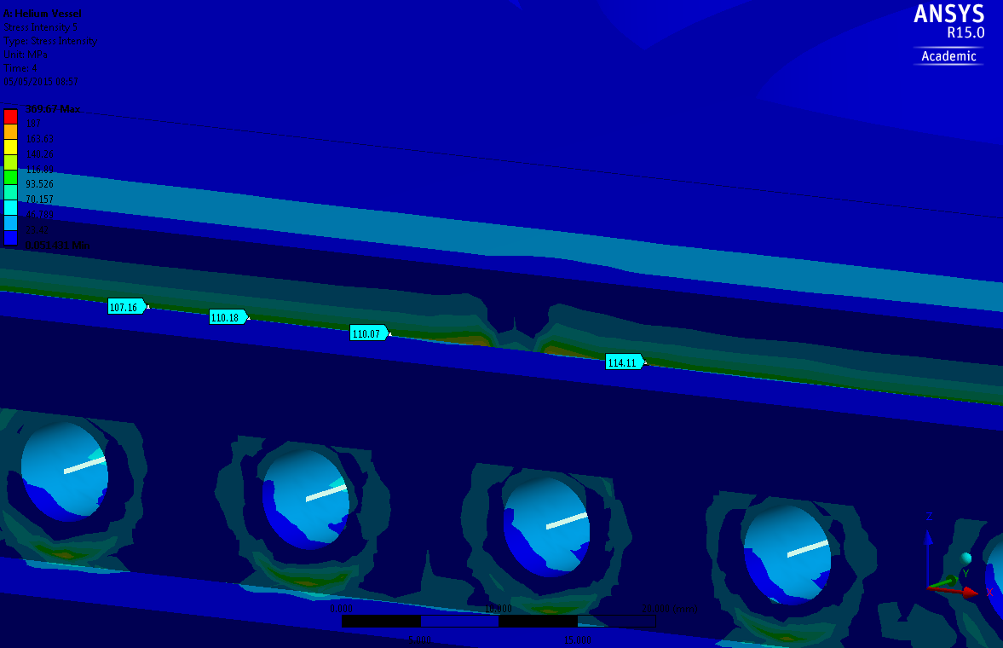
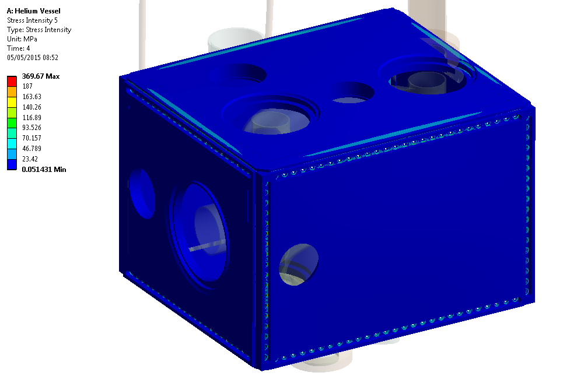
Helium Vessel Stress Intensity
Maximum stress: 110 MPa
Max allowable stress: 187 MPa (Ti Grade 2)

Slide 23
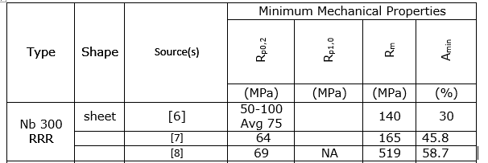
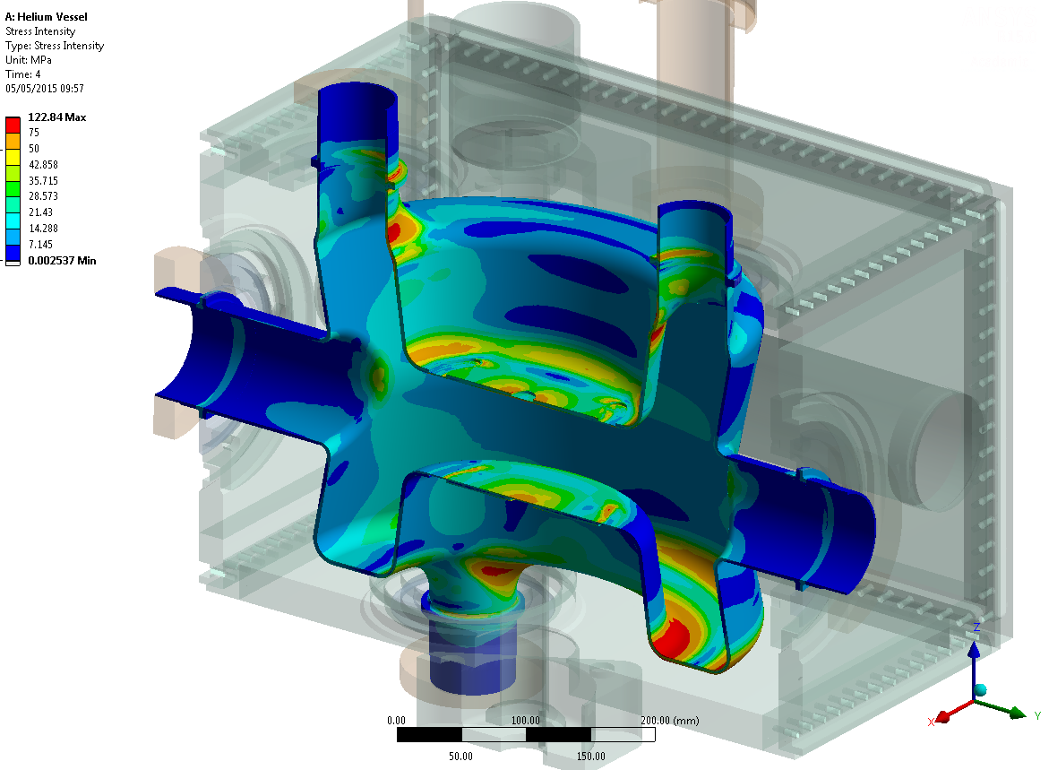
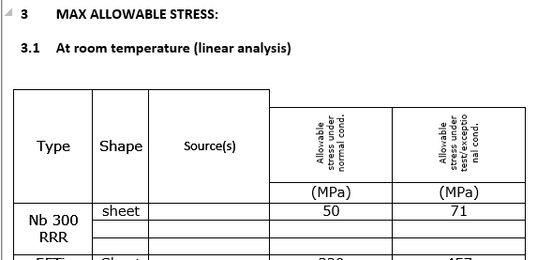
Cavity – Stress 1
Stress Intensity: “preload + pressure + pretuning”

Slide 24
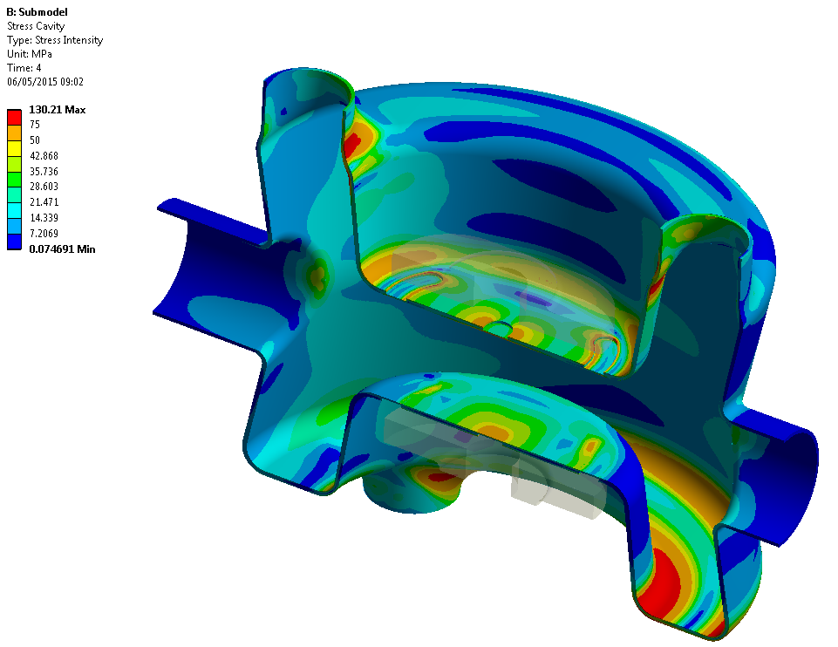
Cavity – Stress from sub-model (1)
Stress Intensity: “preload + pressure + pretuning” -> sub-model
Model re-evaluated in terms of primary & secondary stress in accordance to BS EN 13458

Slide 25
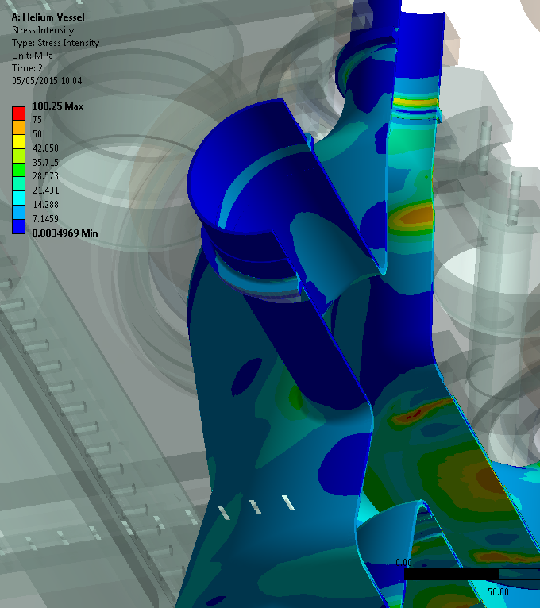
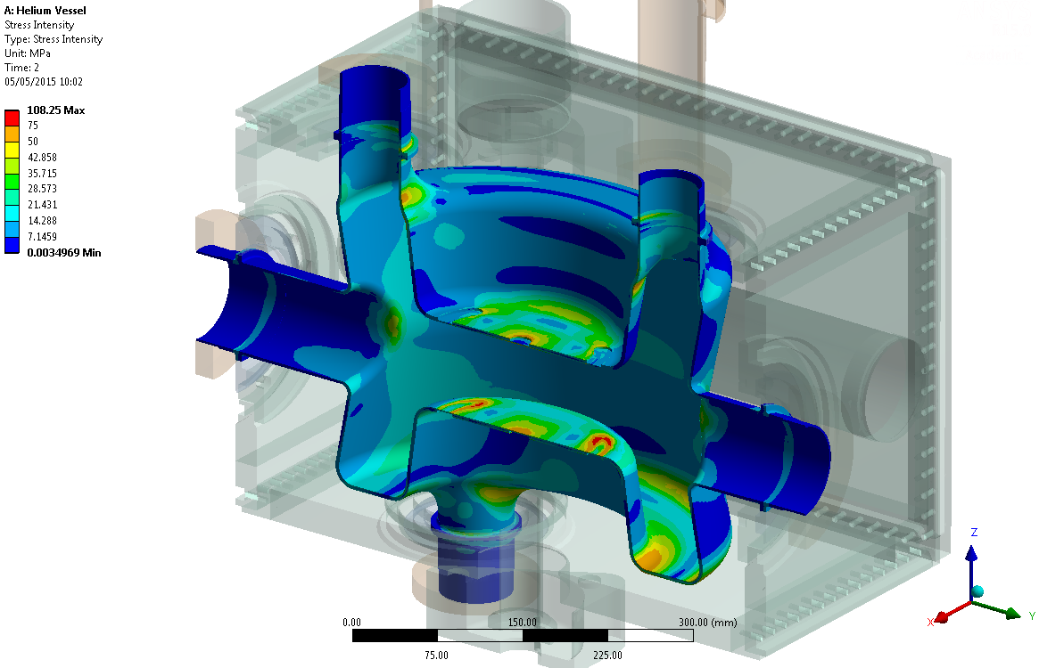
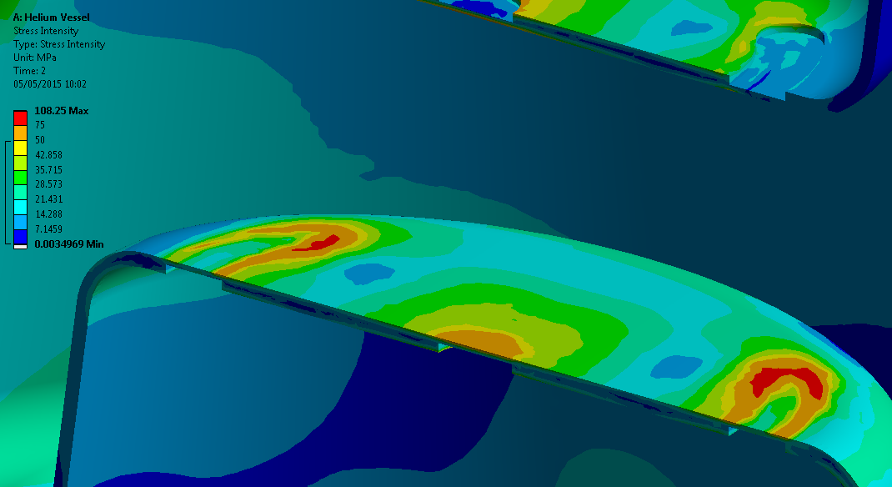
Linearized Cavity Stress 2
Stress due to pressure (primary stress) - Pre tuning (secondary) stress not present
Stress Intensity Limits
Primary Membrane | 50MPa
Primary Local + Primary Bending | 75MPa
Primary + Secondary | 150MPa

Slide 26
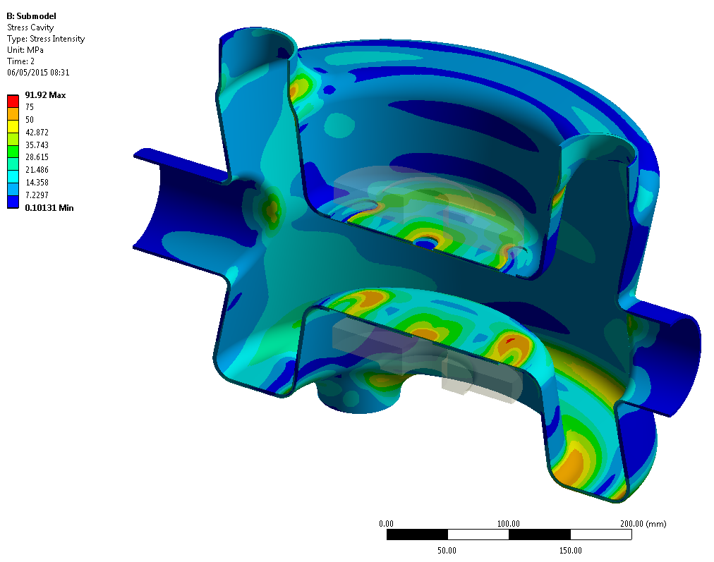
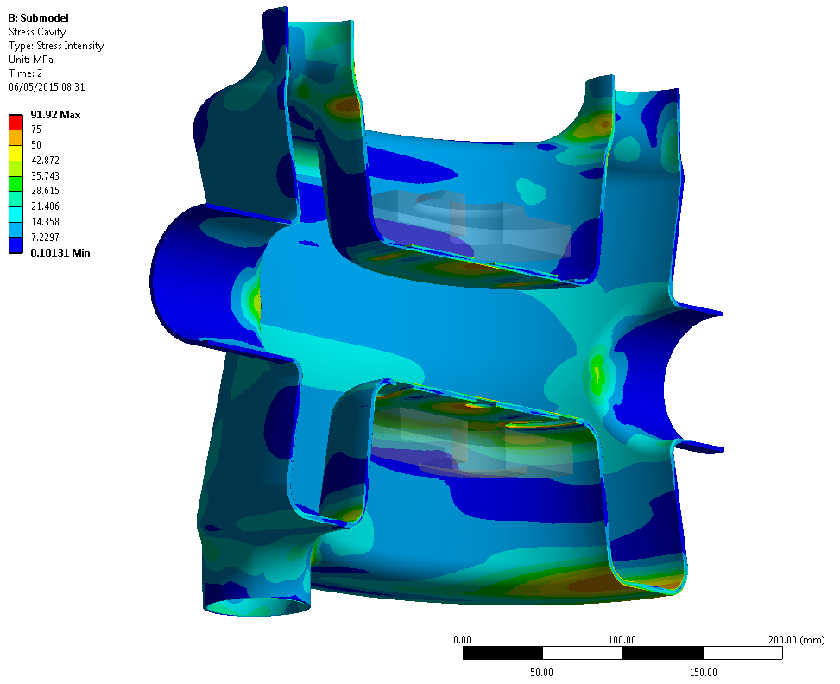
Cavity – Stress from sub-model 2
Stress due to pressure (primary stress) - Pre tuning (secondary) stress not present.
Stress over 75MPa (in Red) are out of spec. No such stress visible. Max Stress in due to mesh error.

Slide 27
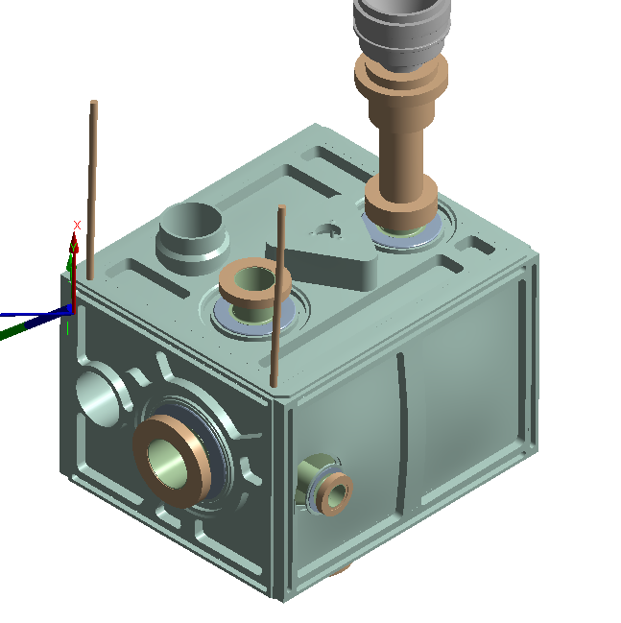
Further Analysis
Weight Saving Optimisation - up to 30kg
Analysis to be repeated for RFD Cavity & Helium Vessel

Slide 28
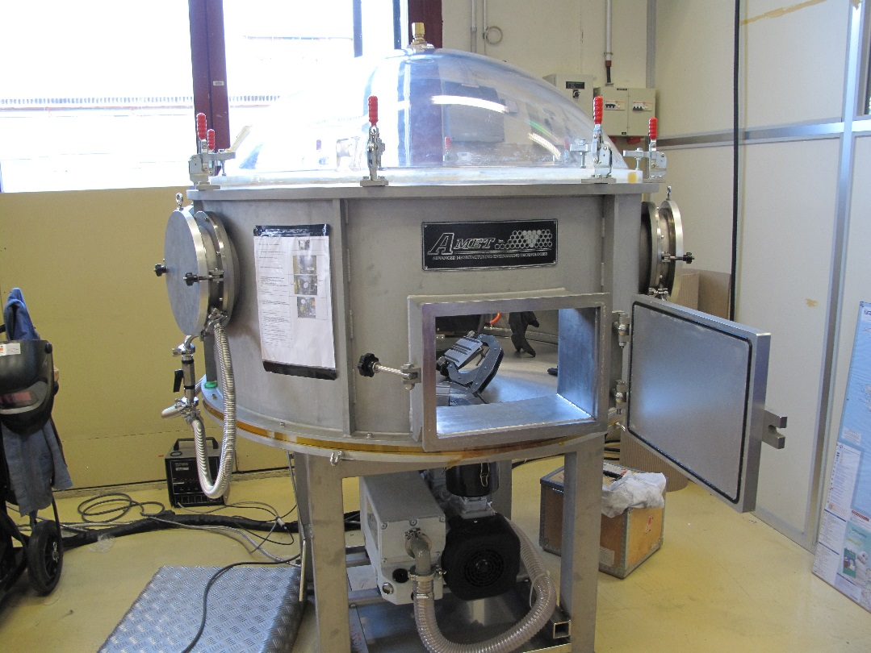
Planned Testing Procedure
To understand and define the limits of critical dressed cavity components, including:
Fastener Strength
Welding
Thin Caps
Tuner and Beampipe
Prototype Helium Vessel
Pressure & leak tightness
Magnetic Shield stress effects
TIG Welding Chamber

Slide 29
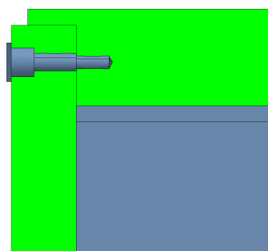
Fastener Strength
TiGr2 screws to be tested at RT & 4K in order to determine their strength and behaviour in conditions similar to those experienced in the Helium Vessel.
Tests include:
Tractions tests for tensile strength
Torque tests for friction and preload
Shear tests for…
Bending tests for lateral loads
Screw coating to prevent galling
Fastener & Helium Vessel
Testing rig to be used in various configurations

Slide 30
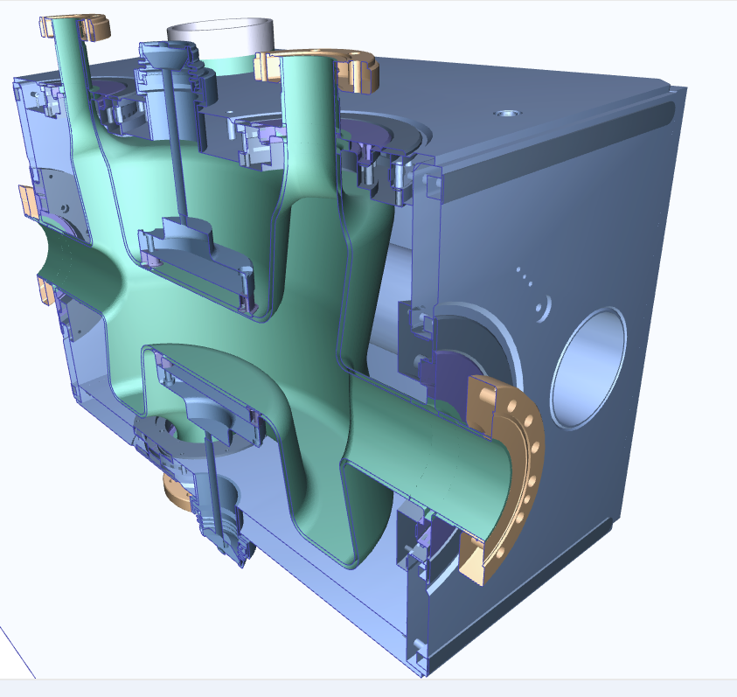
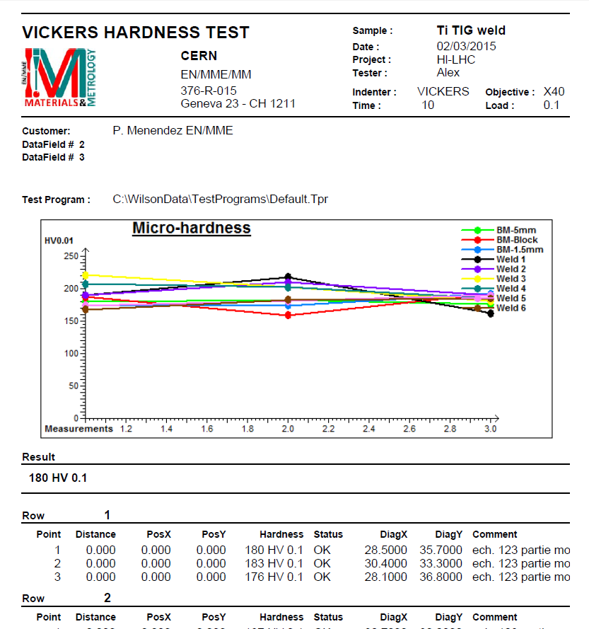
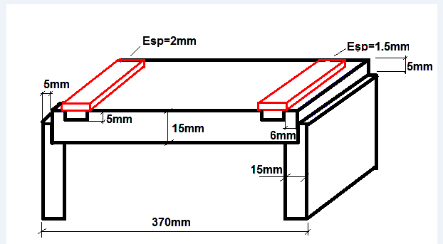
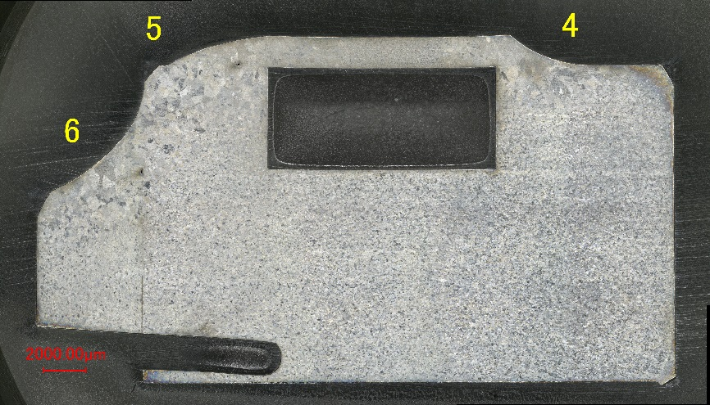
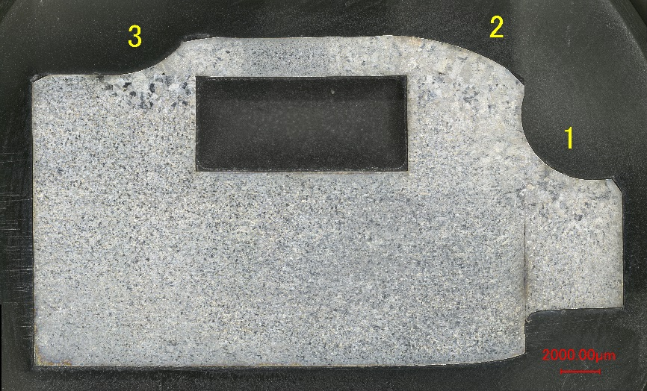
Weld Testing – Thin caps
Welding test to determine thickness of the plates, welding configuration & geometry, size and quality of the weld, parameters of the WPS.
Welds performed with and without filler metal (ERTi-2) in both cases:
Section required for design achieved (a=1mm)
Weld distortion is negligible
Metallographic & Hardness TEST

Slide 31
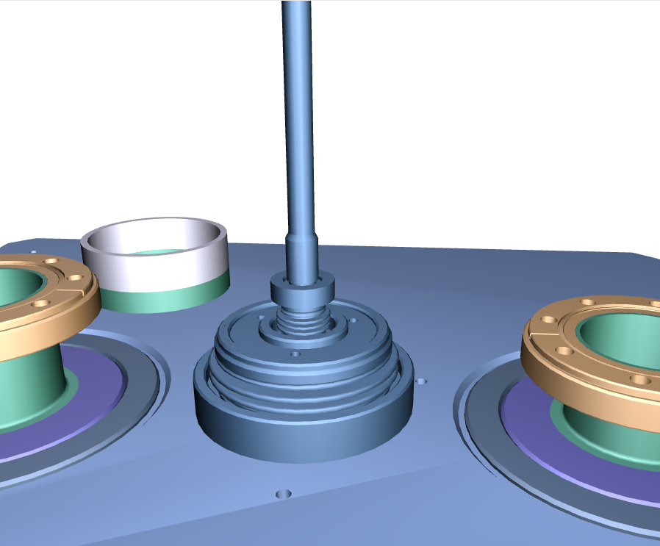
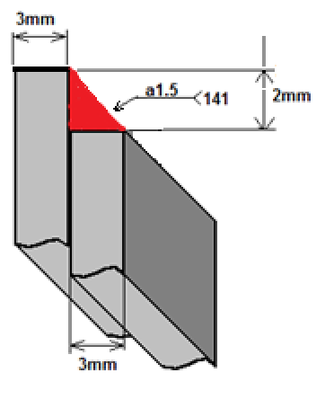
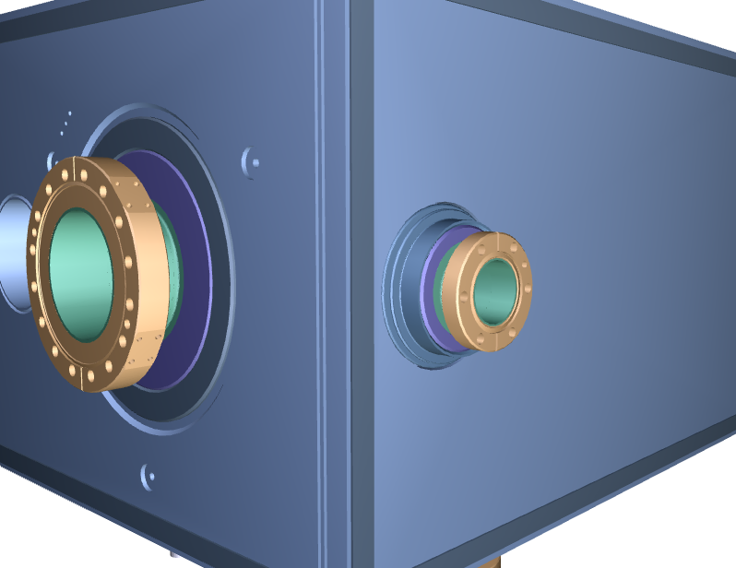
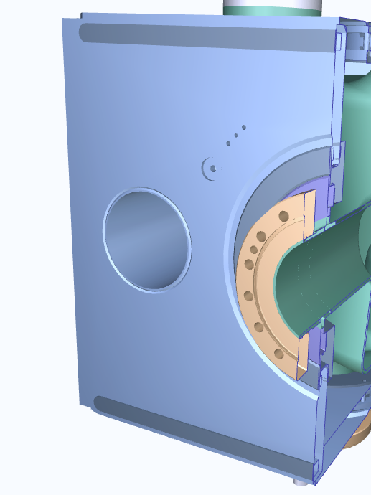
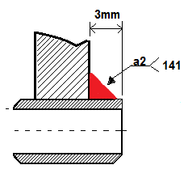
Weld Testing
Ti
Ti
Tuning Interface
NbTi
NbTi
Nb
Nb
Transition zones
Dummy Beampipe

Slide 32
DQW Assembly Procedure
Split ring reinforcements are fastened to the cavity transition pieces along with passive tuner component
Z
X
Y

Slide 33
DQW Assembly Procedure
2 Bottom Panels assembled 1st
Cavity orientation shown upside down for clarity
Z
X
Y

Slide 34
DQW Assembly Procedure
Shield & cavity mounted to base plate of the Helium Vessel
Top End caps are attached as well as bottom side panel and Dummy beam pipe attenuation sleeve.
Y
Z
X

Slide 35
DQW Assembly Procedure
Final 2 top panels are brought into place and remaining cover strips and brackets are fastened

Slide 36
DQW Assembly Procedure
Side and top Vessel walls are assembled with remaining Flexi-Mounts before Helium Vessel is closed

Slide 37
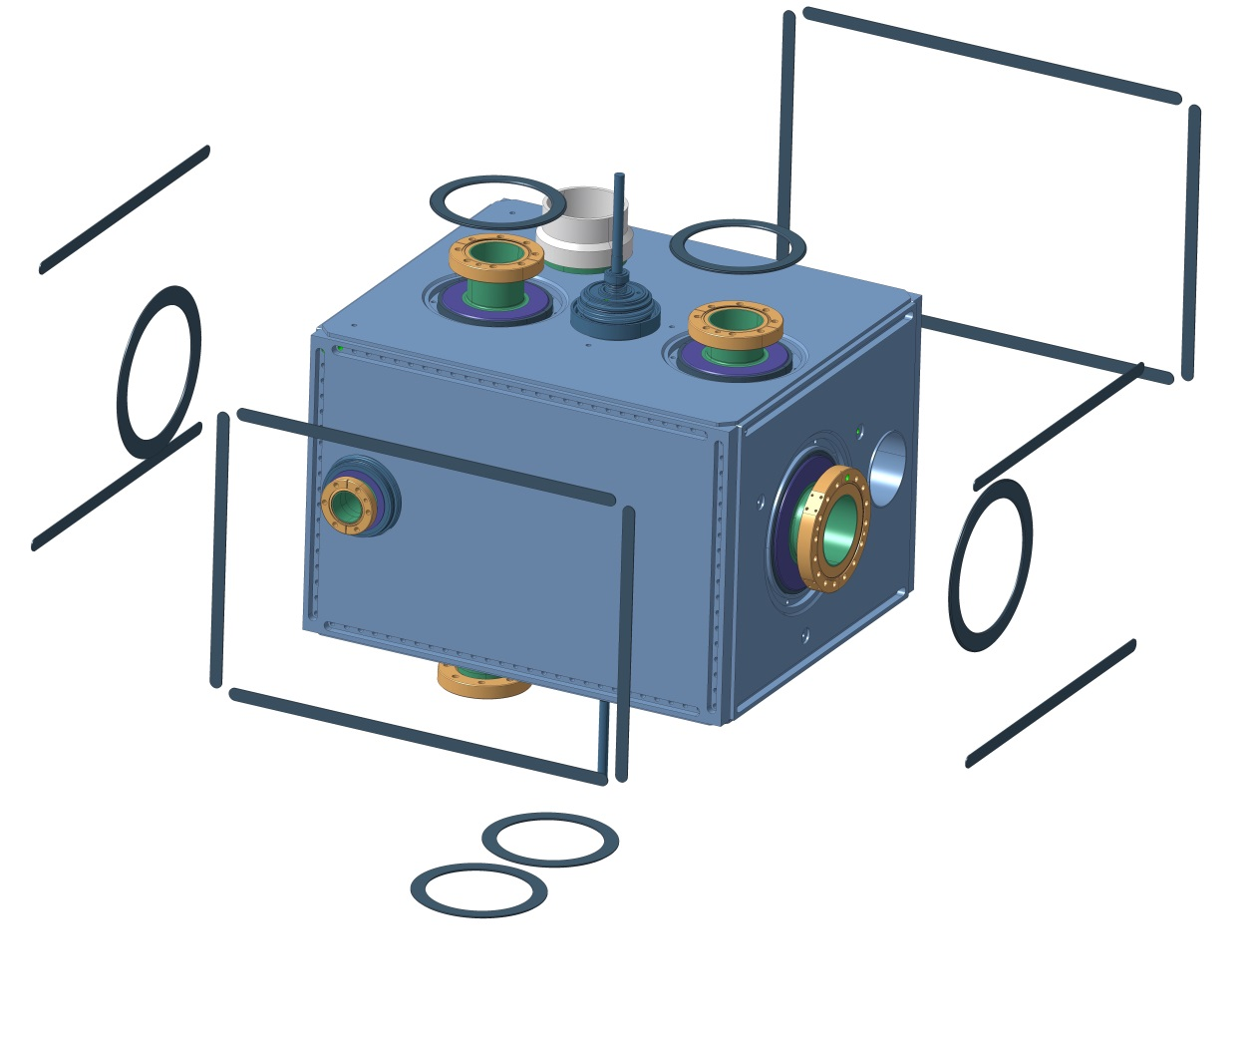
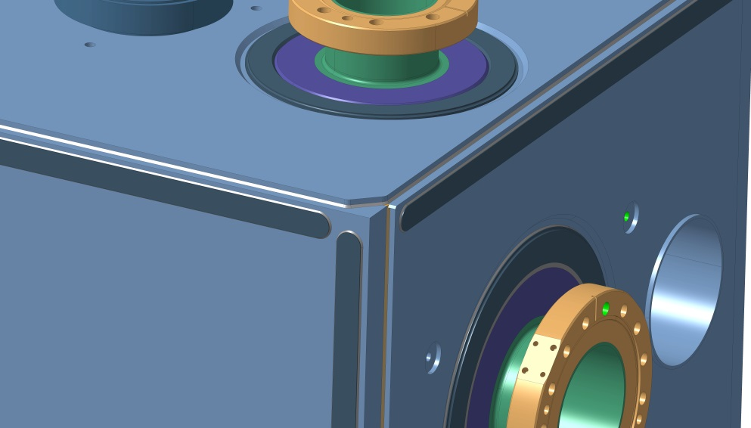
DQW Assembly Procedure
Thin caps are TIG welded over the fastener slots
Vessel is sealed

Slide 38
RFD Assembly Procedure
Split ring reinforcements are fastened to the cavity transition pieces

Slide 39
RFD Assembly Procedure
Pre-assembled shield body is assembled Top and Bottom

Slide 40
RFD Assembly Procedure
Shield body is mounted to Helium Vessel base

Slide 41
RFD Assembly Procedure
Split folded-end panels are assembled around 3 ports
End Cover is assembled to main body and fastened with cover panels and brackets

Slide 42
RFD Assembly Procedure
2 Curved-End panels are assembled around Beam Pipe

Slide 43
RFD Assembly Procedure
Split panels complete the Shield at the FPC & HOM Ports
Remaining cover strips are assembled

Slide 44
RFD Assembly Procedure
Flexi-mounts are connected and Helium Vessel is assembled

Slide 45
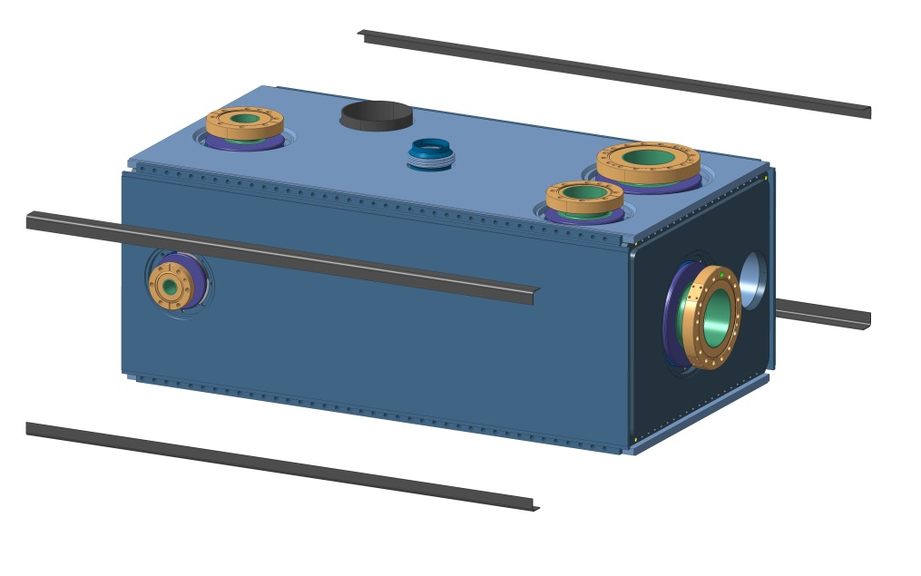
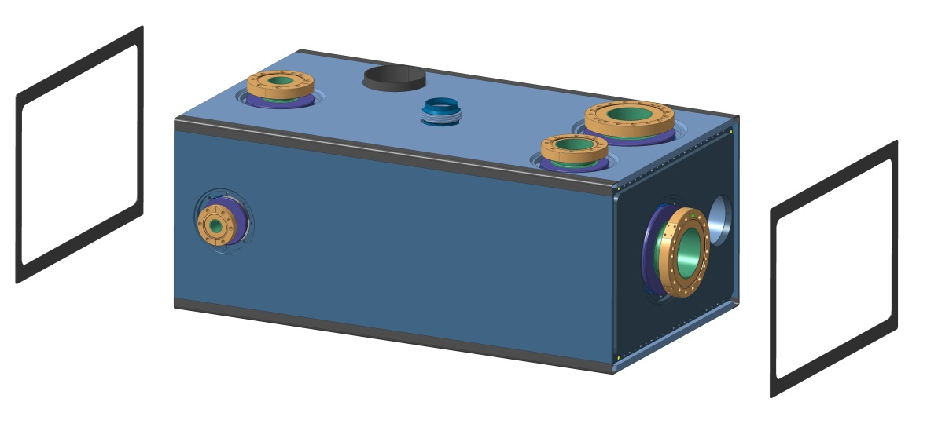
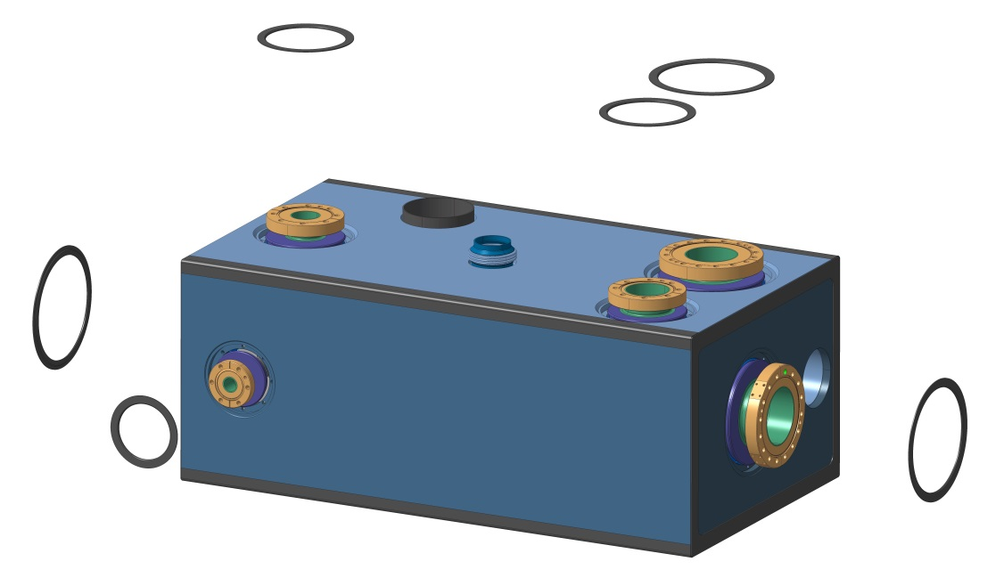
RFD Assembly Procedure
Thin caps are TIG welded over the fastener slots
Vessel is sealed

Slide 46
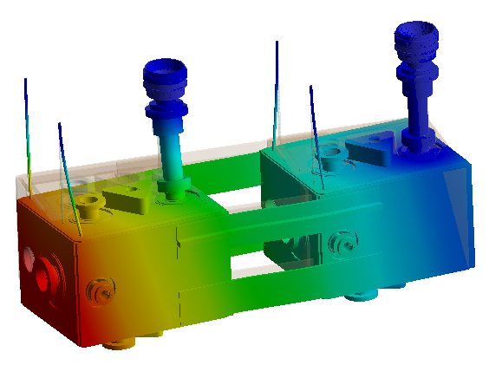
Dressed Cavity Support System
Approach
Minimise stress of FPC
Minimise heat leak to cavity
Active alignment & adjustment
Thermally neutral on cool down
Maximise modal stiffness
Minimise vibration response magnitude
Rigid FPC – Fixed point for Adjustment
Suspension rods compensate offset load
Fundamental Mode Shape
Additional inter-cavity support can increase system stiffness

Slide 47
Thank You!
Questions?
For more details and summary of actions see https://indico.cern.ch/event/391211/

