Slide 1
HQ Field Quality Measurements
11May2015
J. DiMarco, G. Chlachidze, T. Holik, G. Sabbi, S. Stoynev, X. Wang

Slide 2
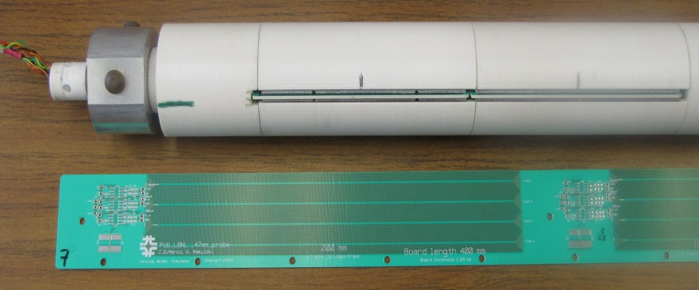
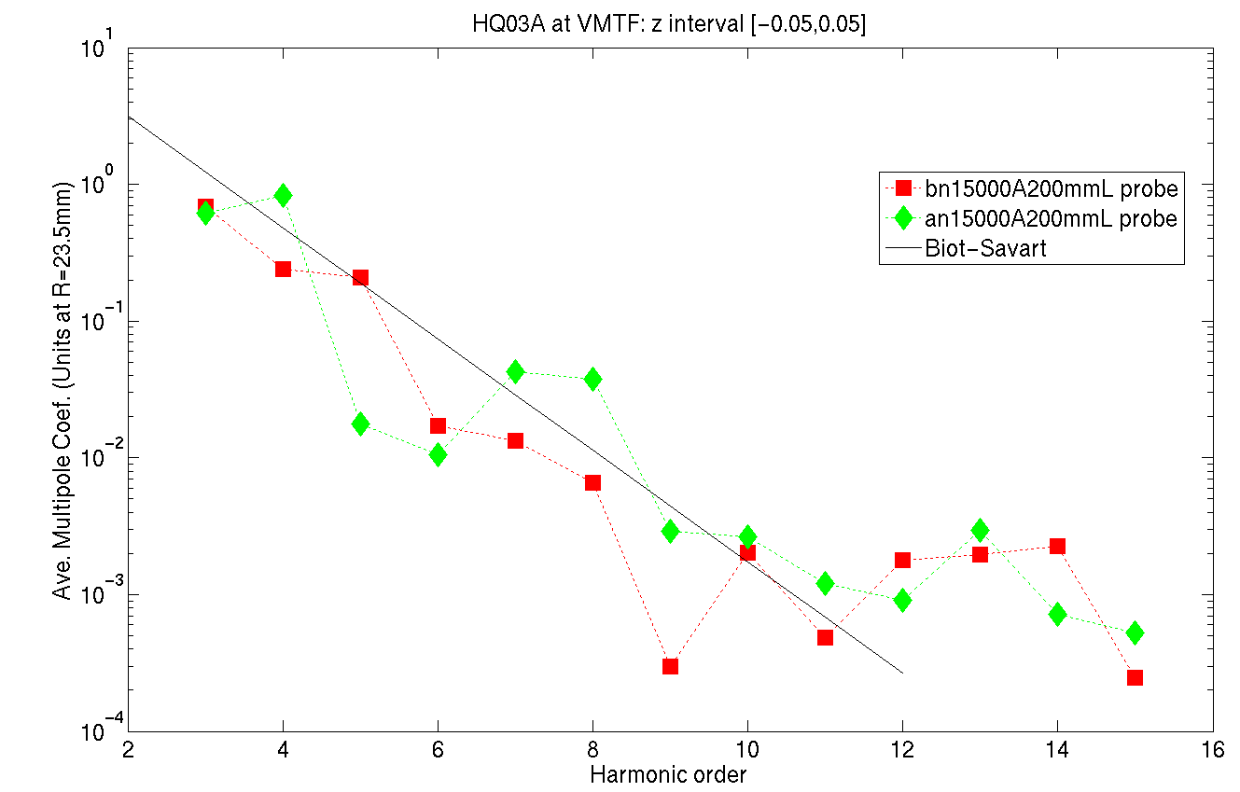
Magnetic Measurements System at FNAL
Printed Circuit Board (PCB) Probe - 1Hz Rotation Rate
Probe radius 23.5mm (limited by warm bore size).
Harmonics reported at R=40mm
200mm and 100mm long probes sampled simultaneously
Harmonics compared to expected fall-off from Biot-Savart
Resolution ~0.002 units at probe radius (about 0.3 units at R=40mm )

Slide 3
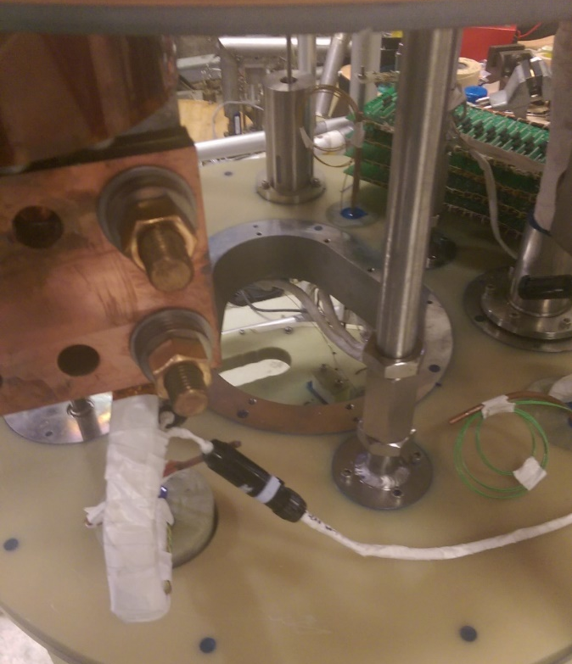
For QXF, similar probe is being developed – WBT will be upgraded so that probe can rotate at reference radius
New header can accommodate larger WBT

Slide 4
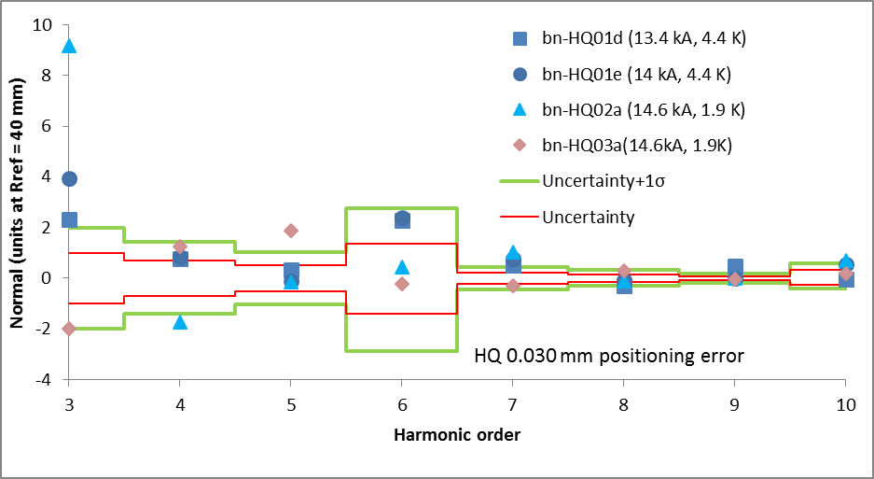
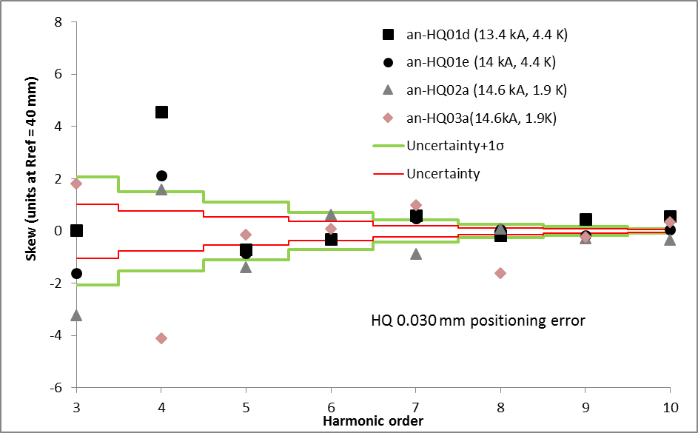
14.6kA Harmonics in the Straight Section
Normal
HQ01-03 comparison
Skew
Harmonics s.d. limits generated from coil positioning errors achievable during fabrication (30 microns) (not actual requirements).
Allowed harmonics:
systematics from ROXIE calc.
s.d. are 4 times coil fab. limit.

Slide 5
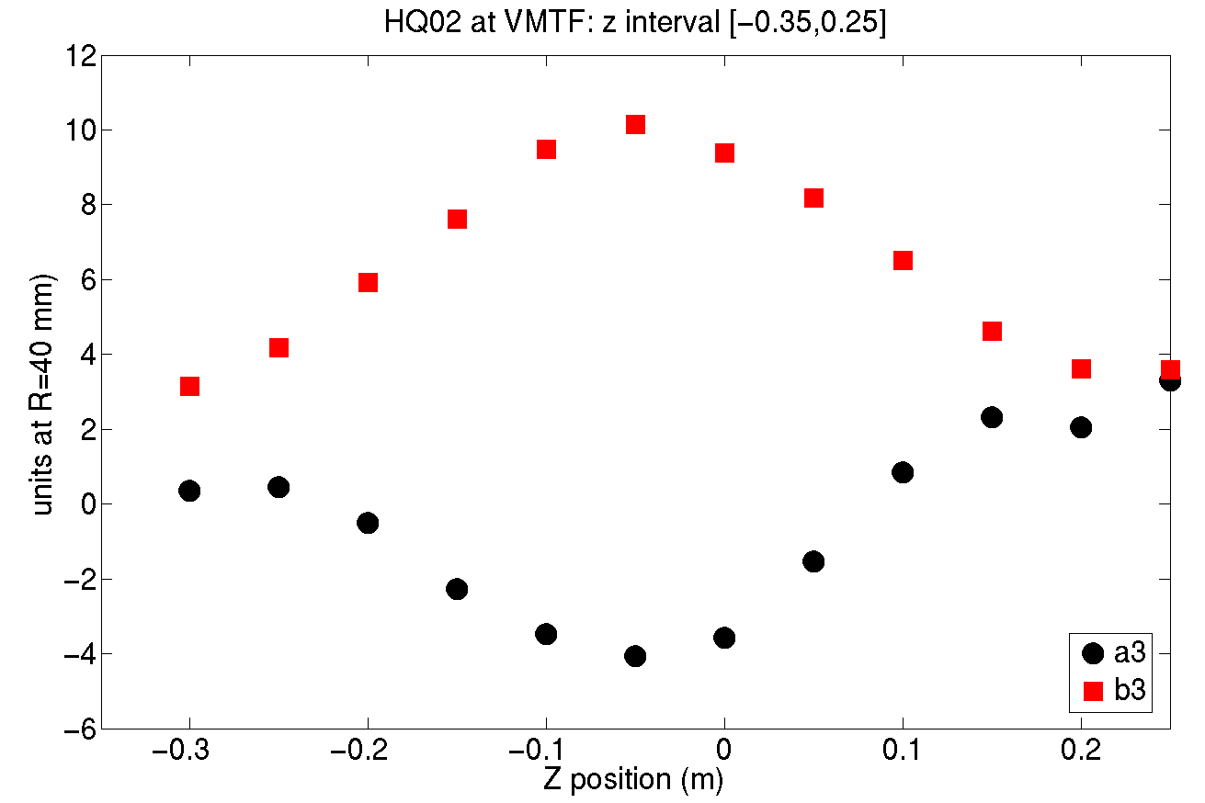
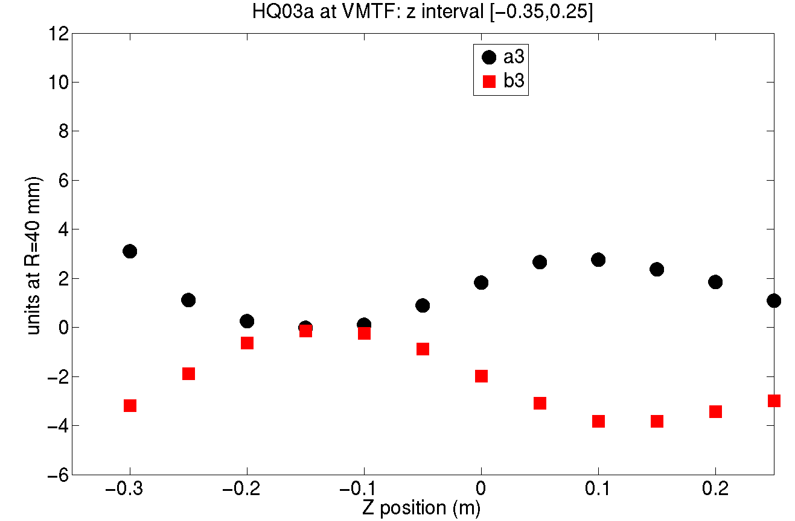
Harmonics in the Straight Section 14.6kA, 100mm probe
a3, b3
HQ03a amplitude and variation about a factor 2 smaller than HQ02
HQ02
HQ03a

Slide 6
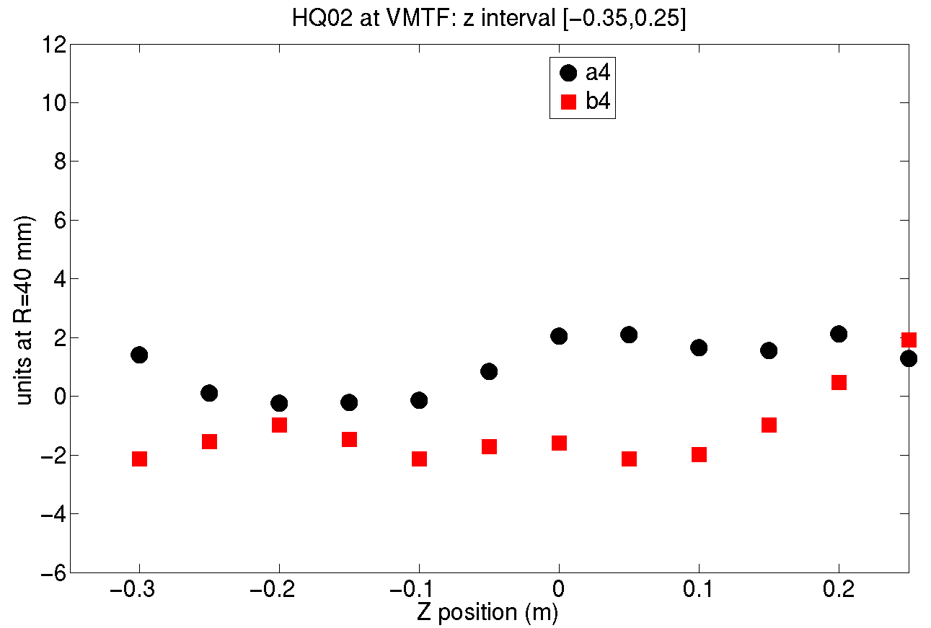
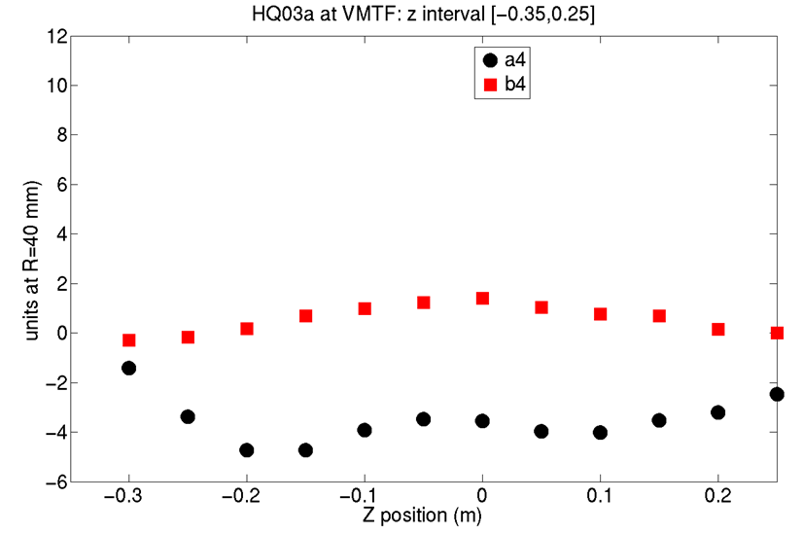
Harmonics in the Straight Section, 14.6kA, 100mm probe
HQ02
a4, b4
a4 of HQ03a is significantly larger than HQ02: -4 units
HQ03a

Slide 7
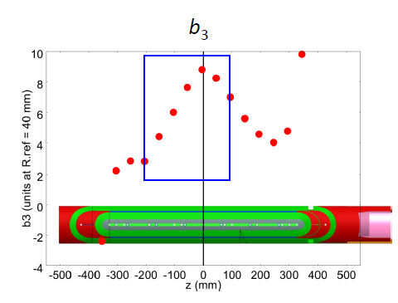
There is an ongoing effort to correlate HQ02 results to conductor locations obtained from magnet cross section (“cookie”) data
Example of proposed location of a cut

Slide 8
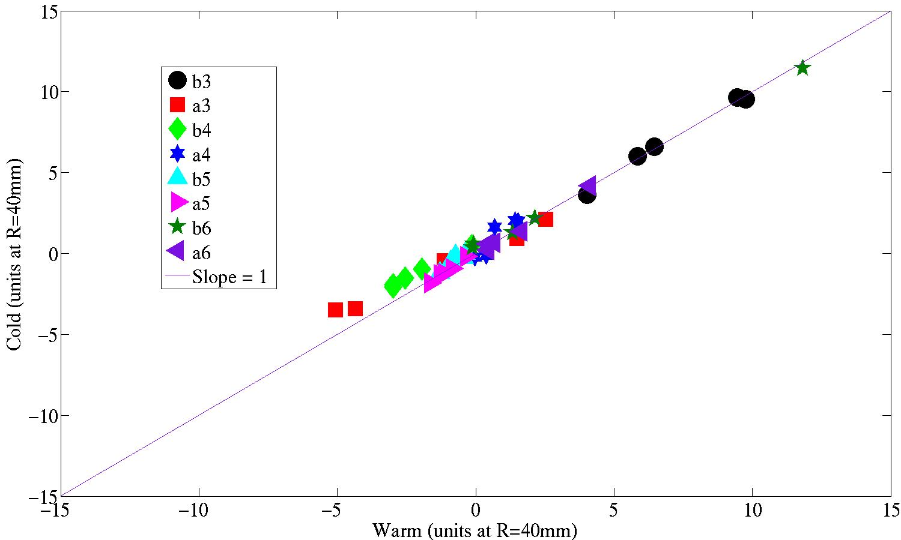
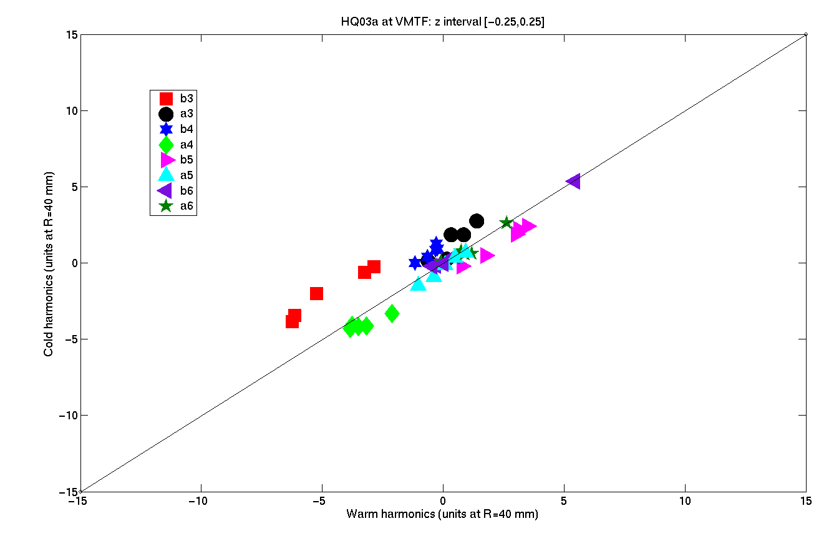
Warm – Cold Correlation (10A, 300K vs 14.6kA, 1.9K)
HQ02
Larger changes warm/cold in HQ03 compared to HQ02: Δb3 as large as ~3 units
HQ03

Slide 9
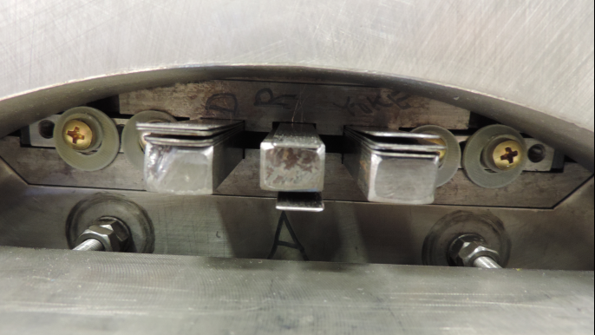
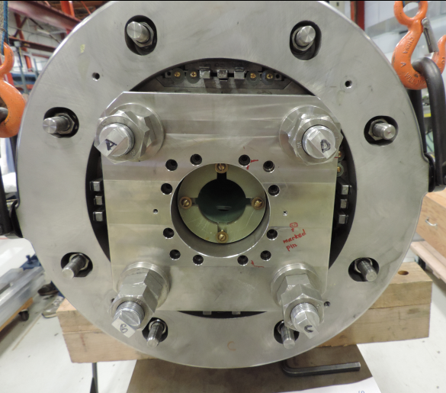
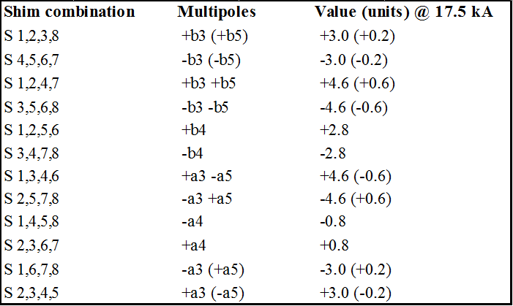
Magnetic shims are added for second TC of HQ03 – testing coming up summer 2015

Slide 10
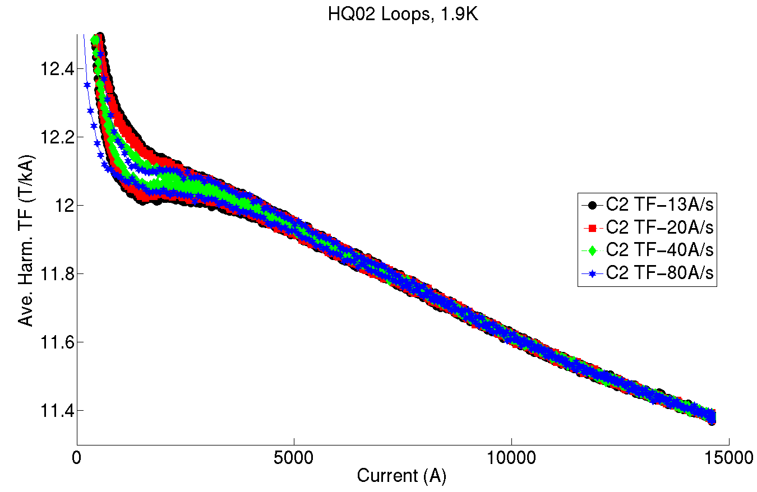
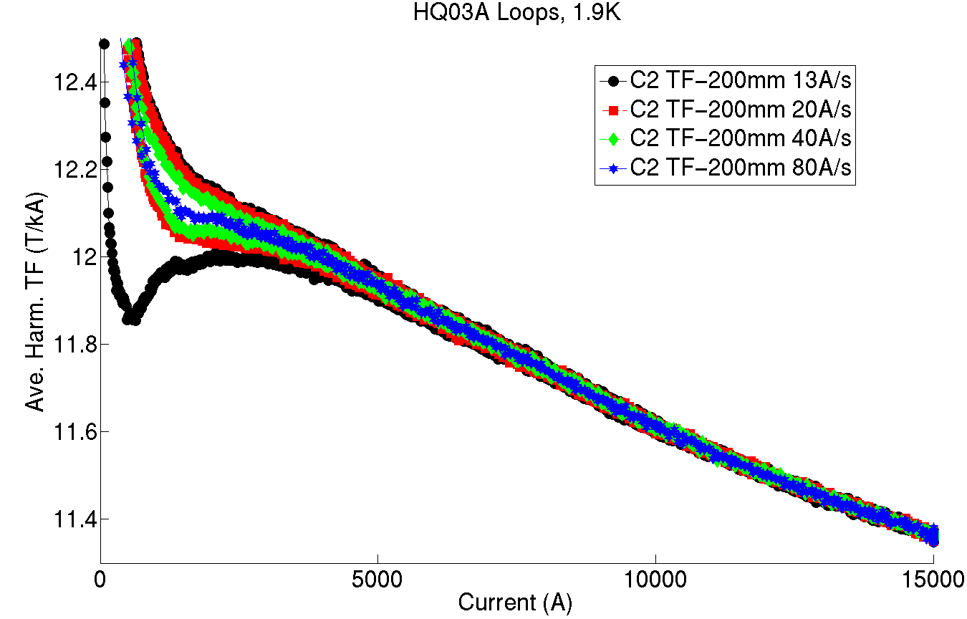
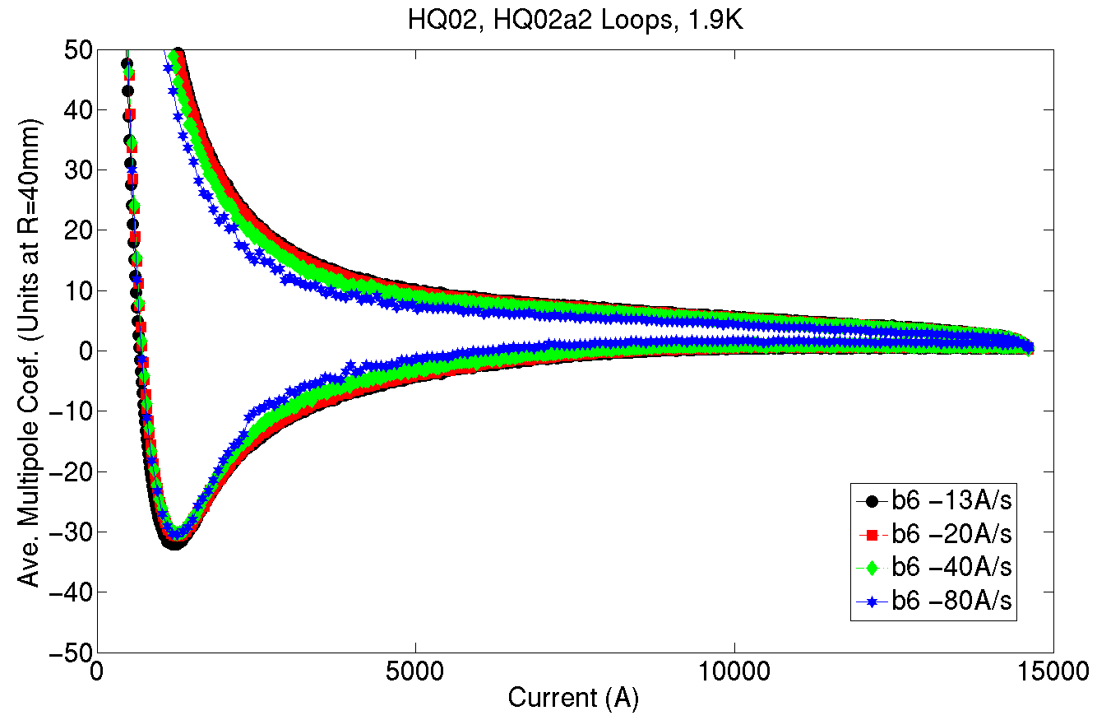
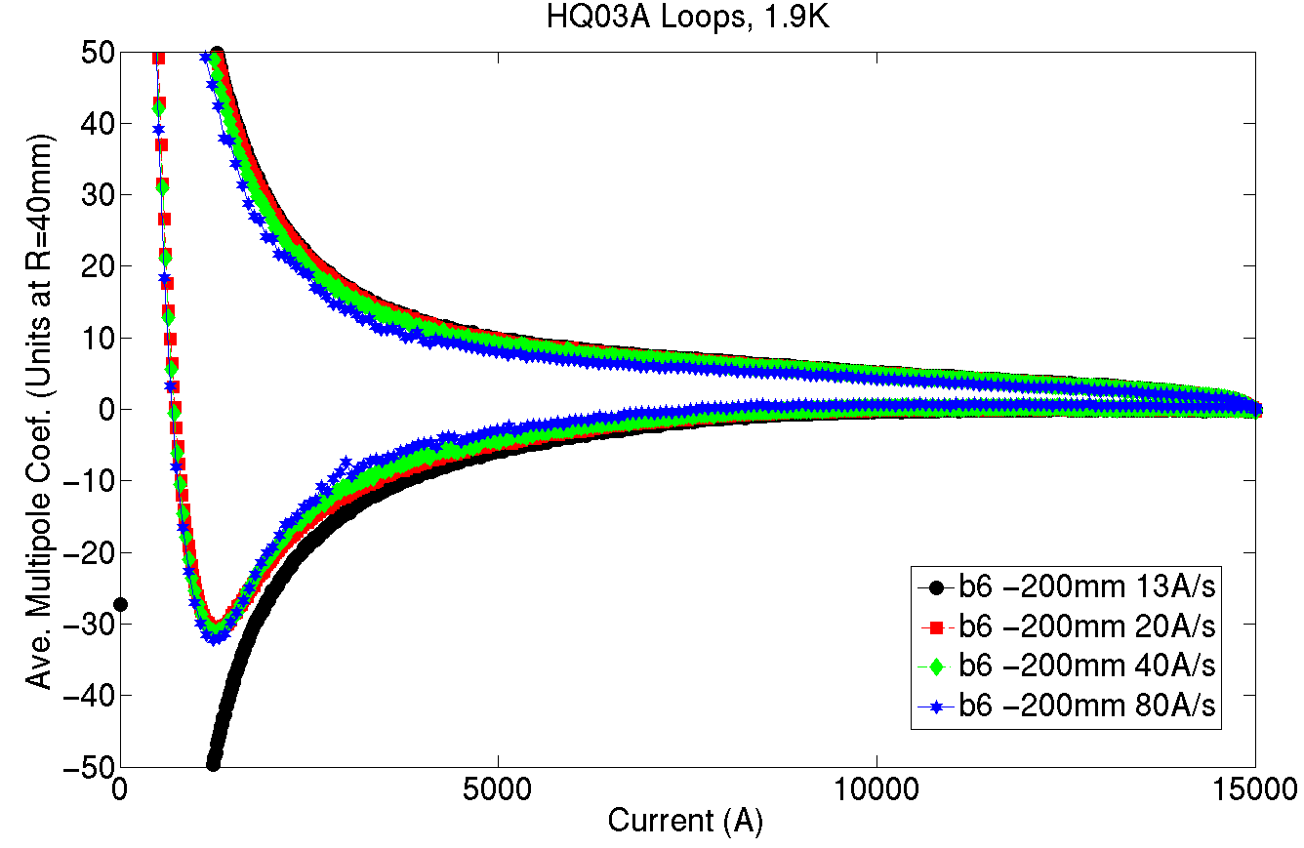
HQ02a
HQ03a
TF
TF
b6
b6

Slide 11
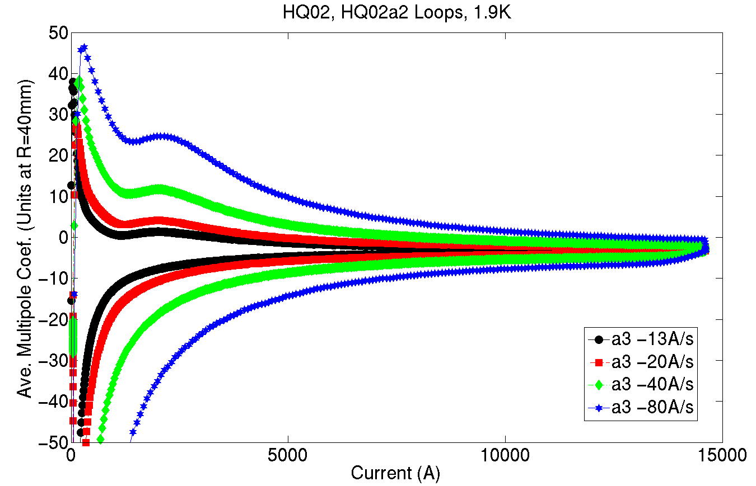
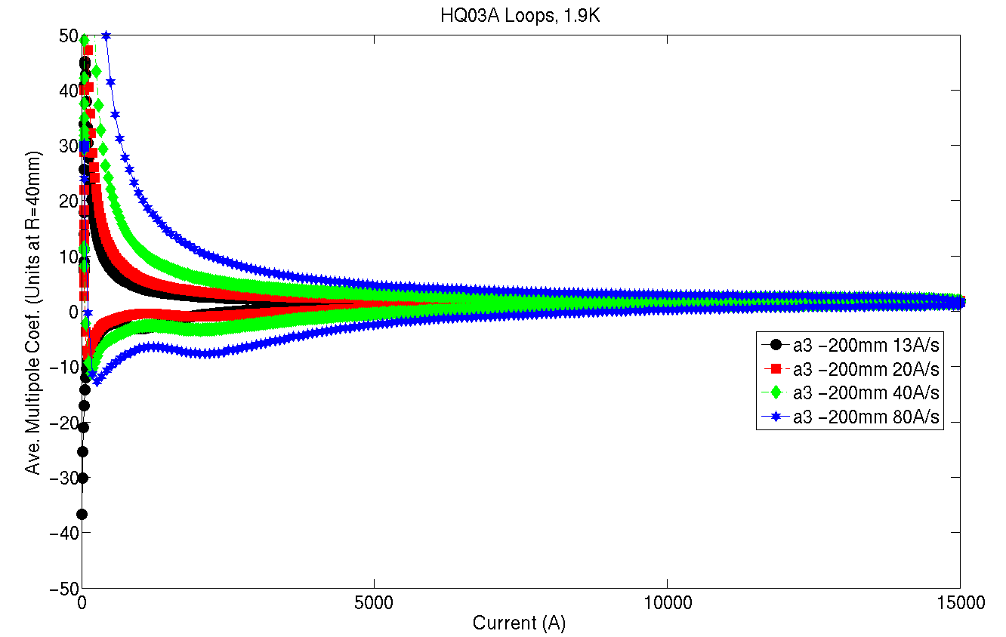
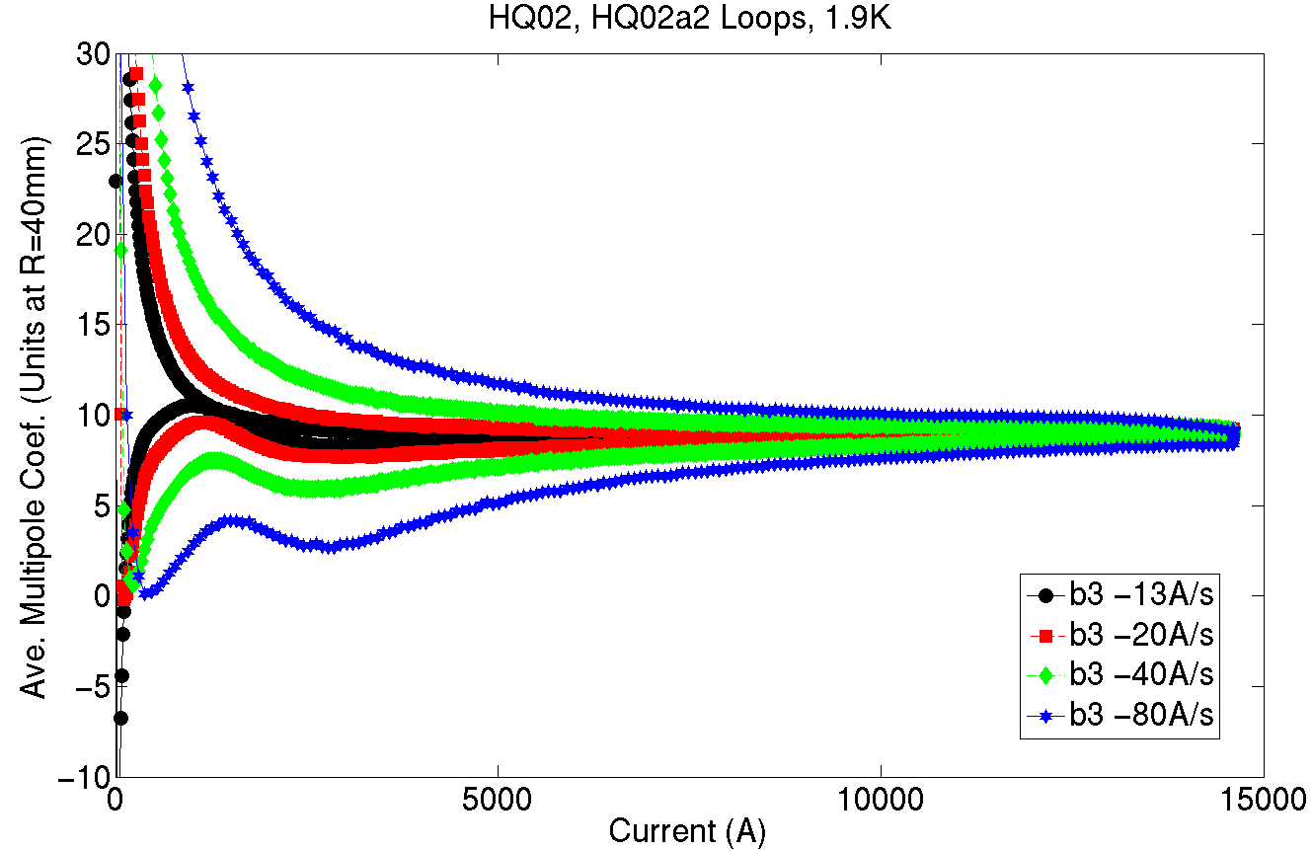
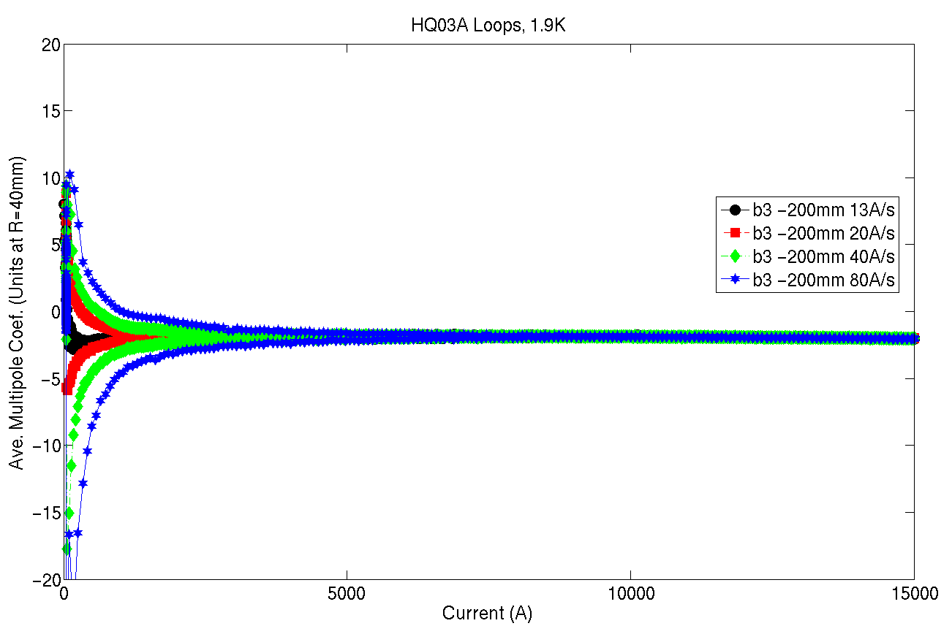
HQ02a
HQ03a
a3
a3
b3
b3

Slide 12
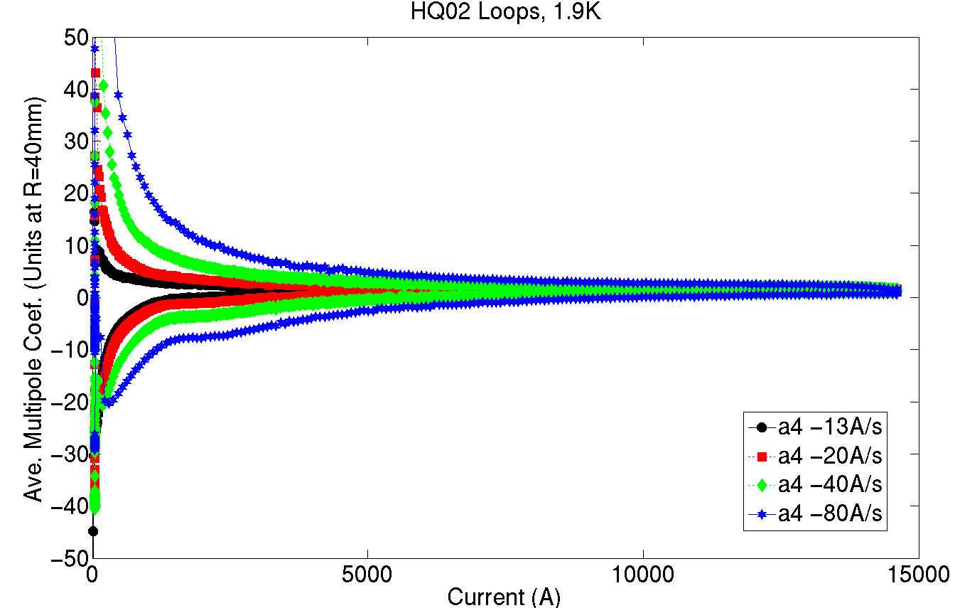
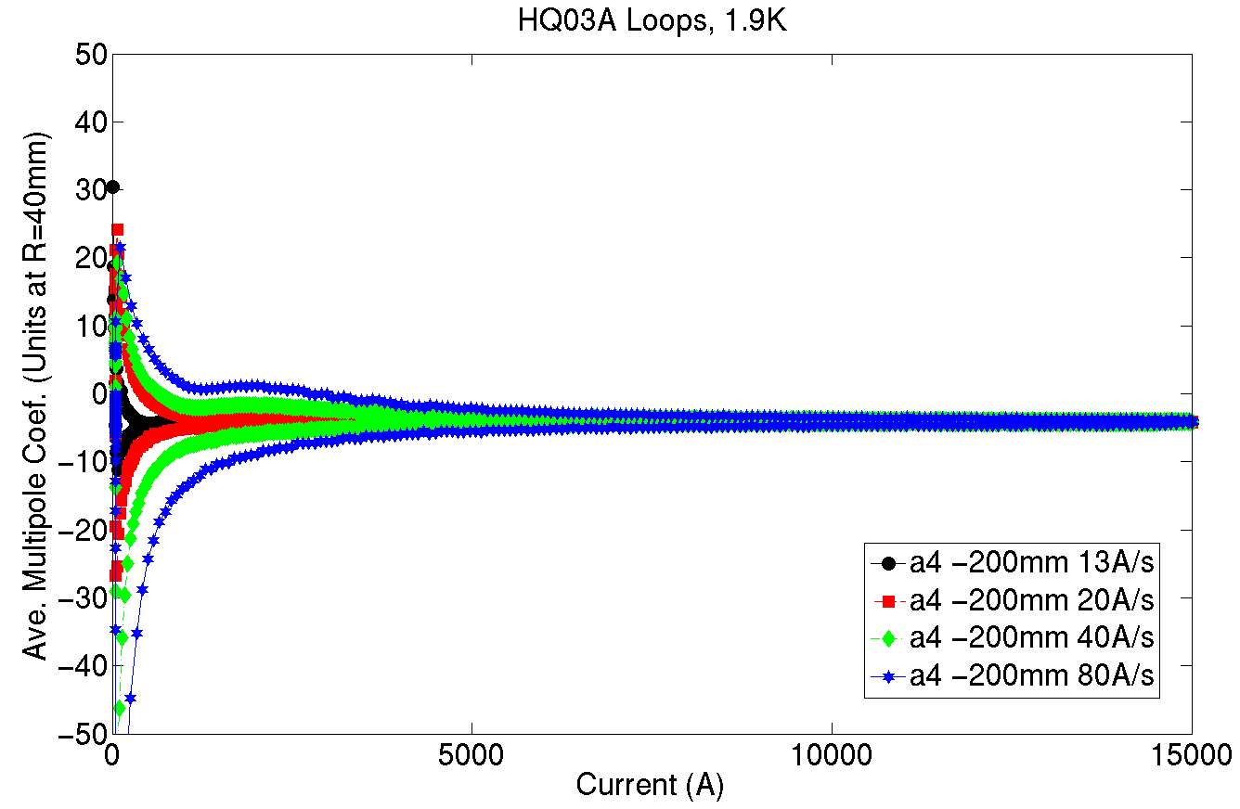
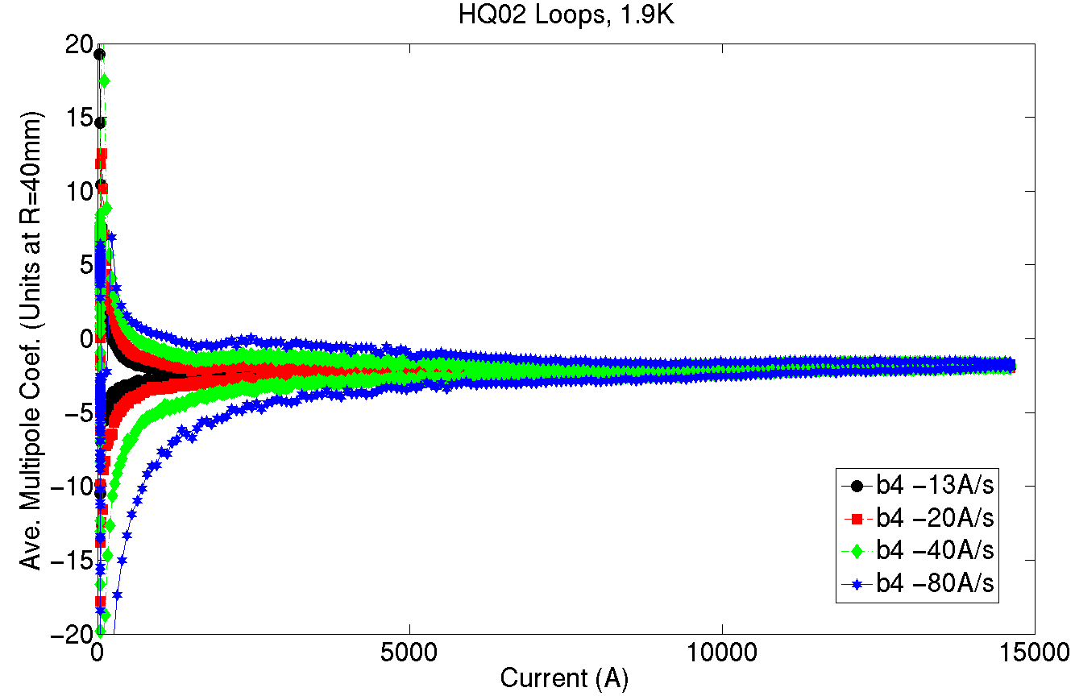
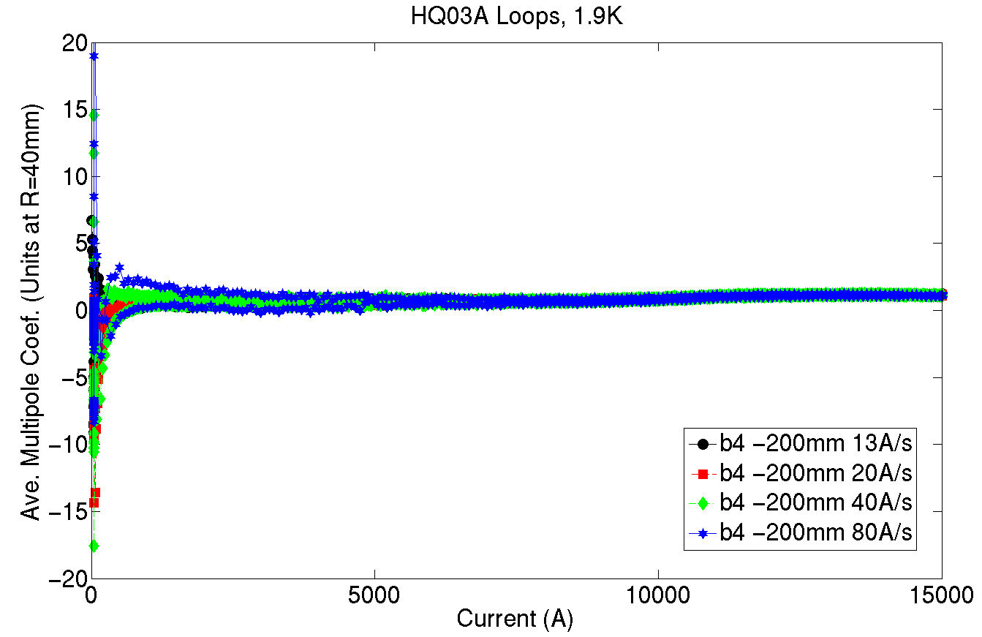
HQ02a
HQ03a
a4
a4
b4
b4

Slide 13
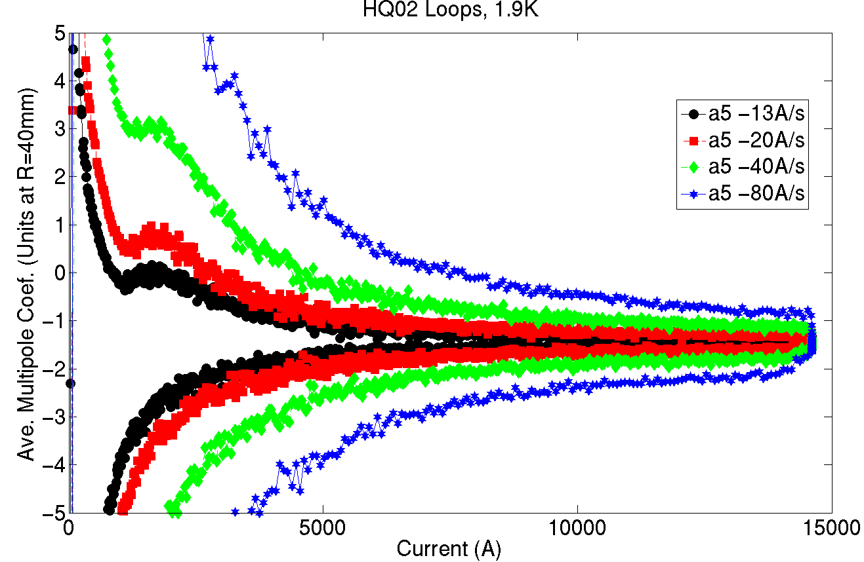
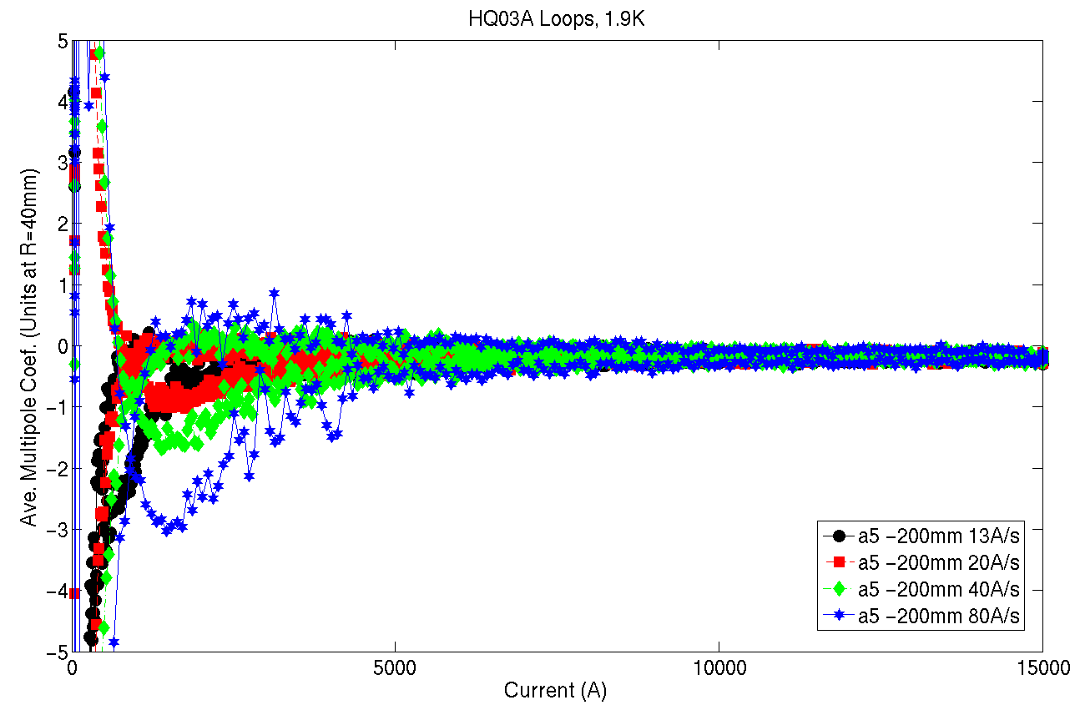
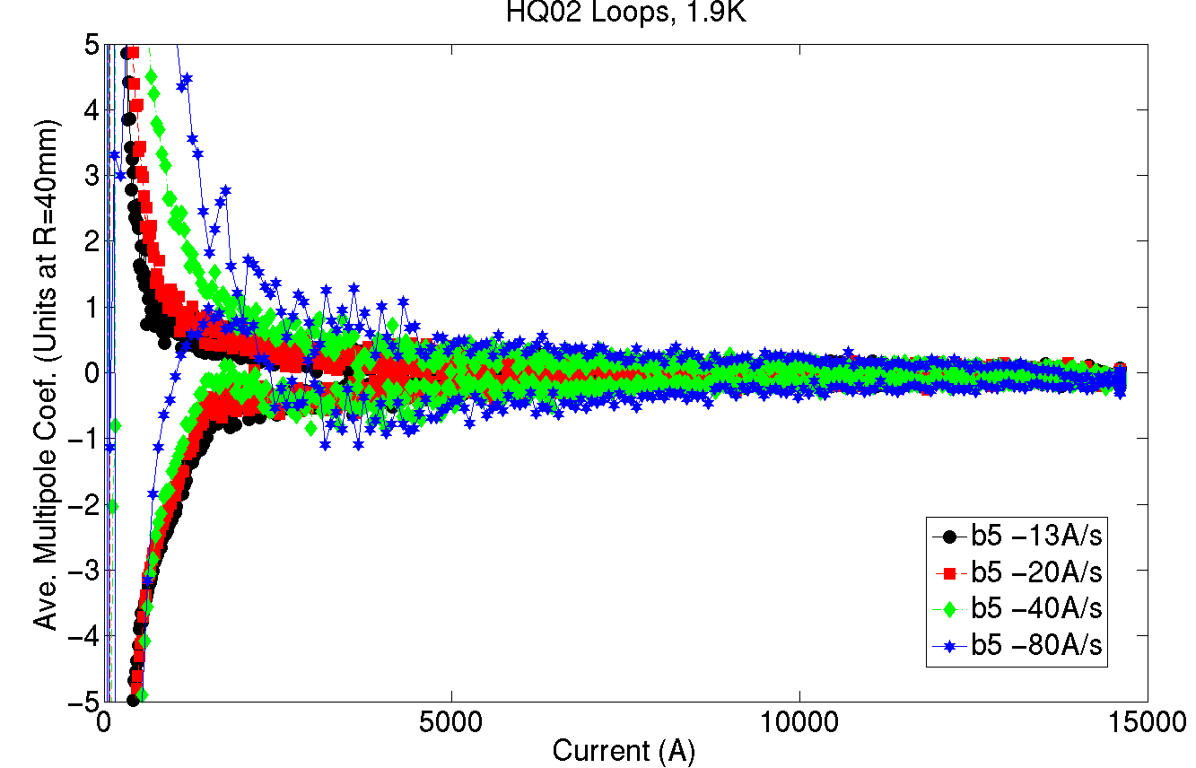
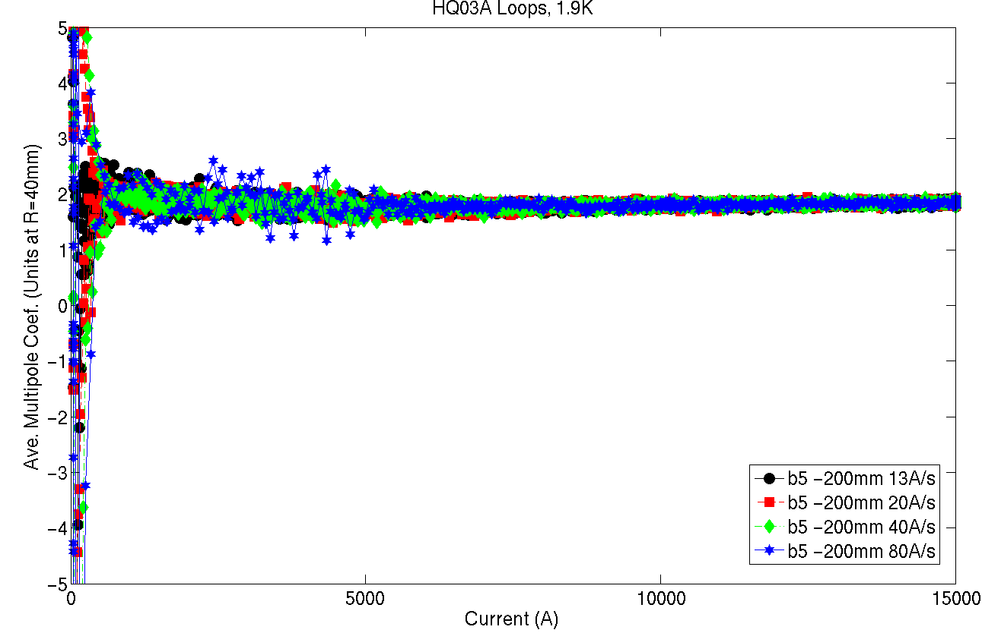
HQ02a
HQ03a
a5
a5
b5
b5

Slide 14
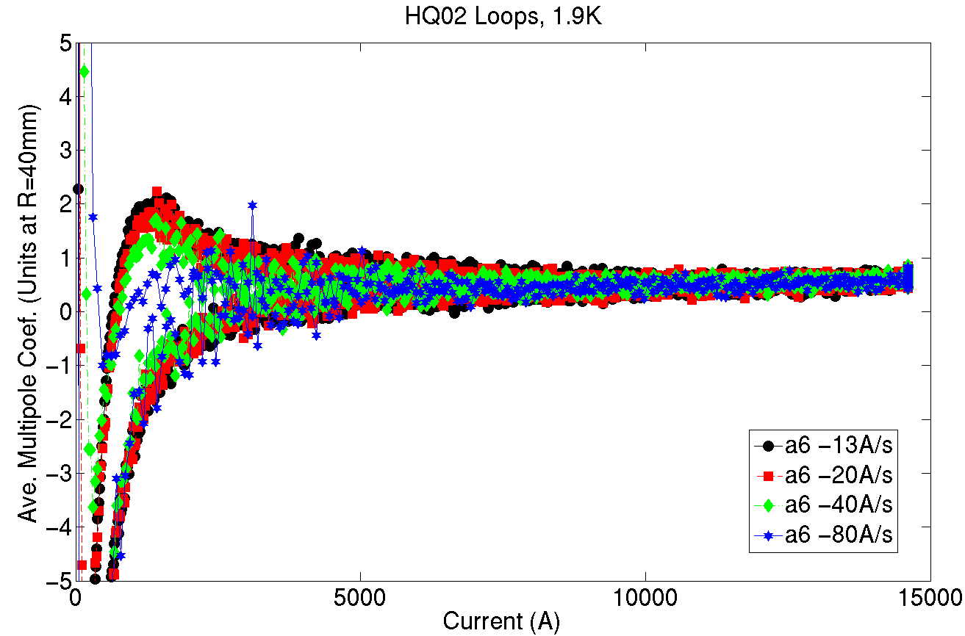
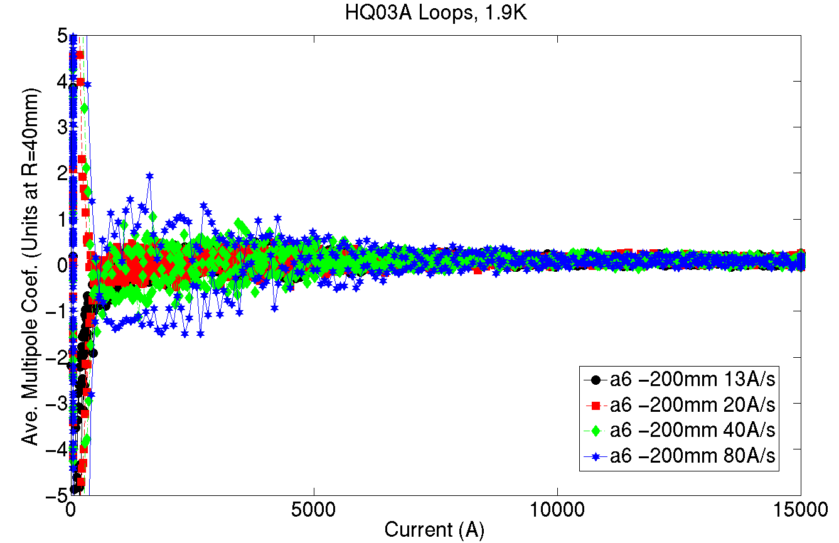
HQ02a
HQ03a
a6
a6
b6
b6

Slide 15
Summary
Geometric field harmonics in the magnet body are generally comparable between HQ02 and HQ03:
b3/a3 are smaller in HQ03 and have smaller axial variation by factor ~2, but still of order few units
a4 fairly large in HQ03 (-4 units)
Some higher order harmonics appear large (b5, a4, a8) – continue to examine these and looking for correlation with conductor placement in magnet cross-section.
Persistent current fields in TF, b6 seem similar in HQ02 and HQ03
Dynamic effects in b3/a3 during ramp smaller in HQ03 than in HQ02 (cable core nominally same). These also have reversed sign in the two magnets.
Tests of magnetic shims are planned to test possibility of correcting some amount of field errors with this technique

Slide 16
Additional slides

Slide 17
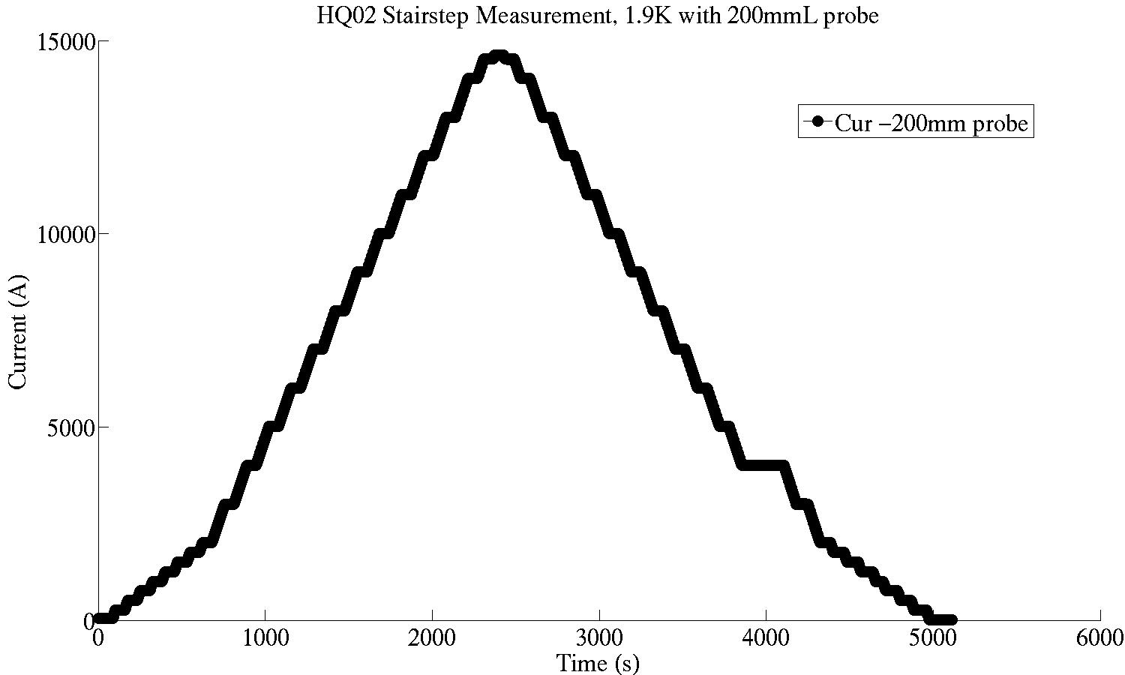
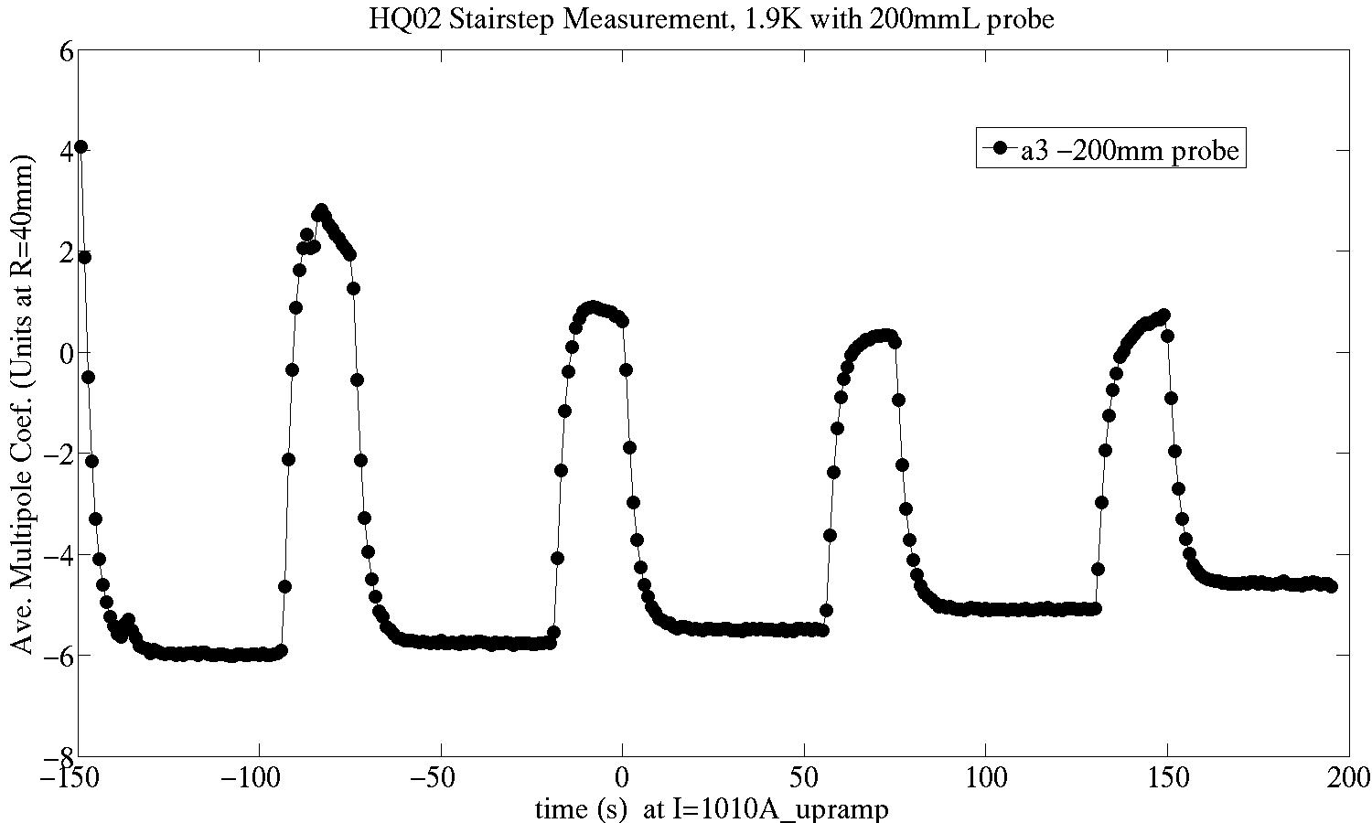
Eddy Current Effects in Un-allowed Harmonics While Ramping
‘Stairstep’ measurement to examine ramping effects
Current vs. Time
60s flattop
Ramping stops
Ramping resumes
Presence of eddy current effects here and in some other un-allowed harmonics
When ramping stops, these effects decay relatively quickly with a time constant of ~3-4s.
a3
Time (s) from 1000A Upramp flattop

Slide 18
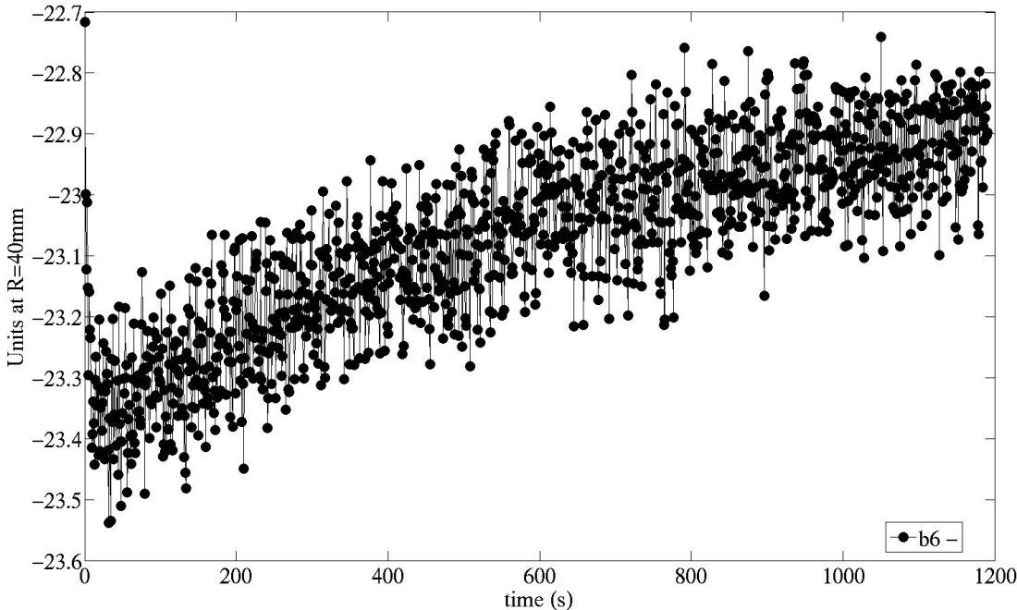
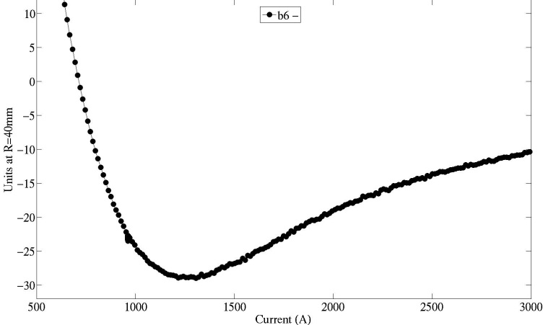
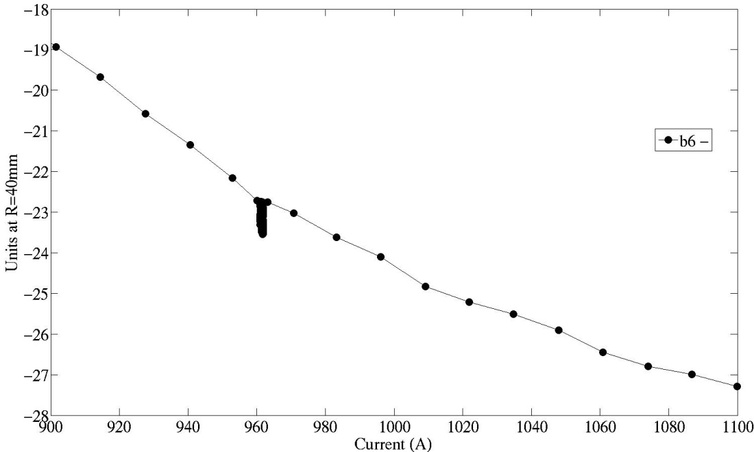
Time dependence of b6 at injection plateau in HQ02
Fast decay when arrive on porch
b6 vs I
b6 vs t
Area of detail
Probe radius 23.5mm (limited by warm bore tube size)
About 0.5 units b6 change over 20 min.
Drift during porch is comparable to dynamic component while ramping
‘Snap-back’ is therefore very small
b6 vs I

Slide 19
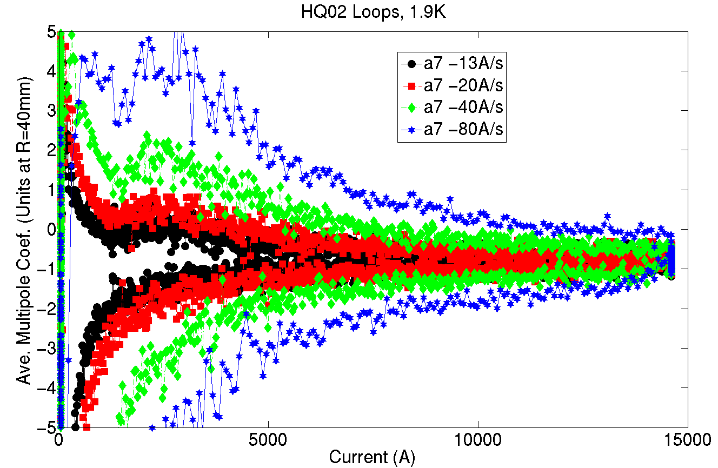
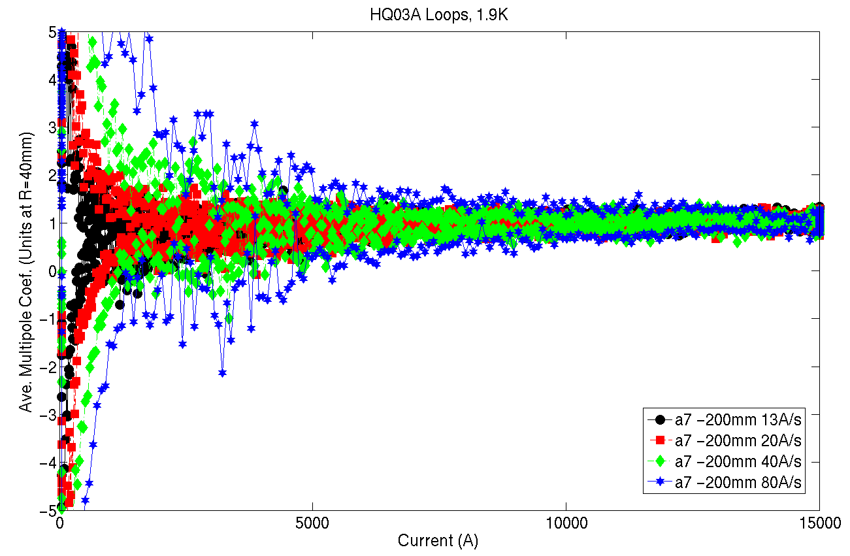
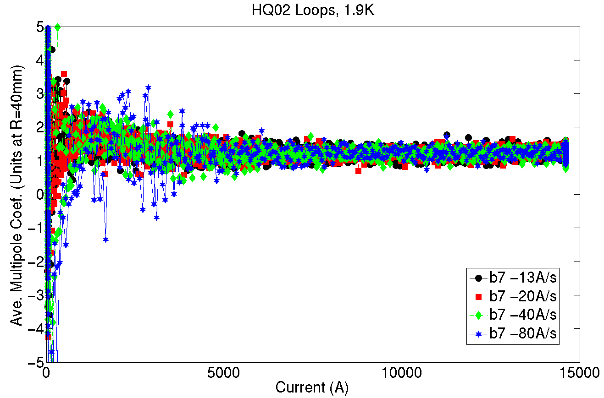
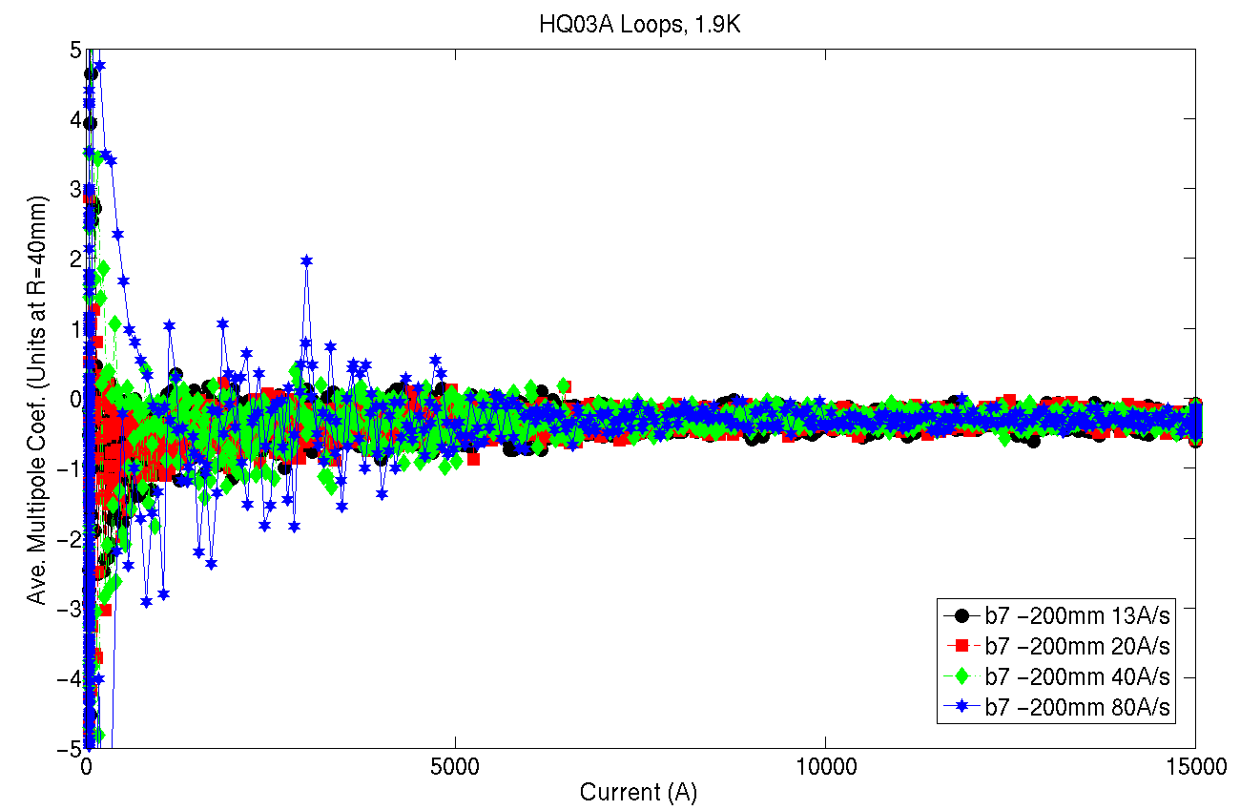
HQ02a
HQ03a
a7
a7
b7
b7

Slide 20
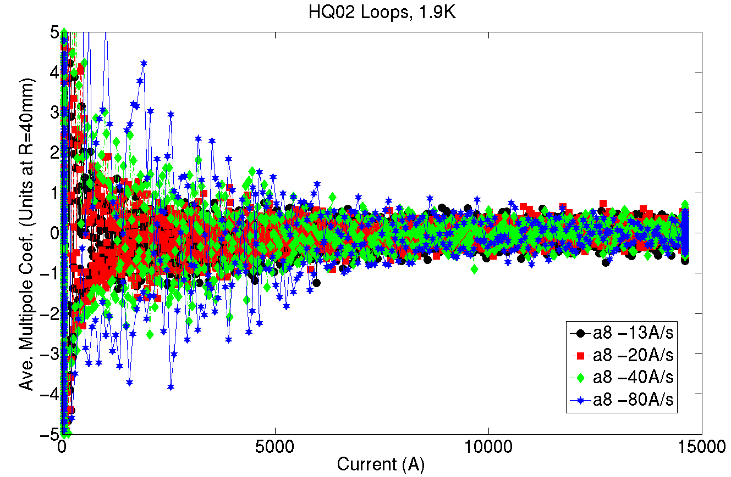
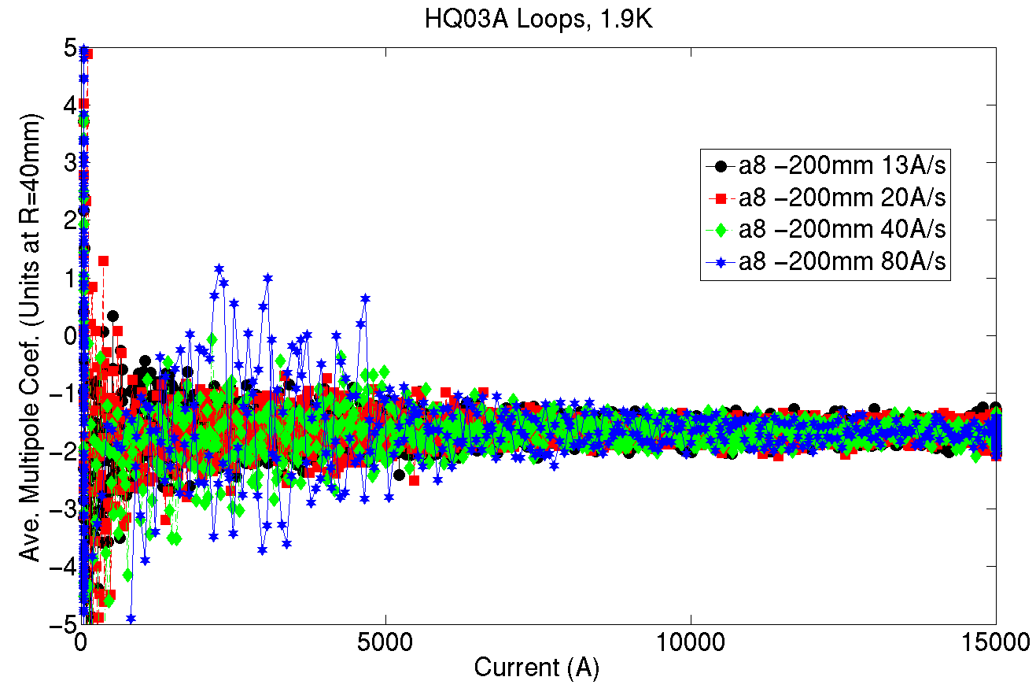
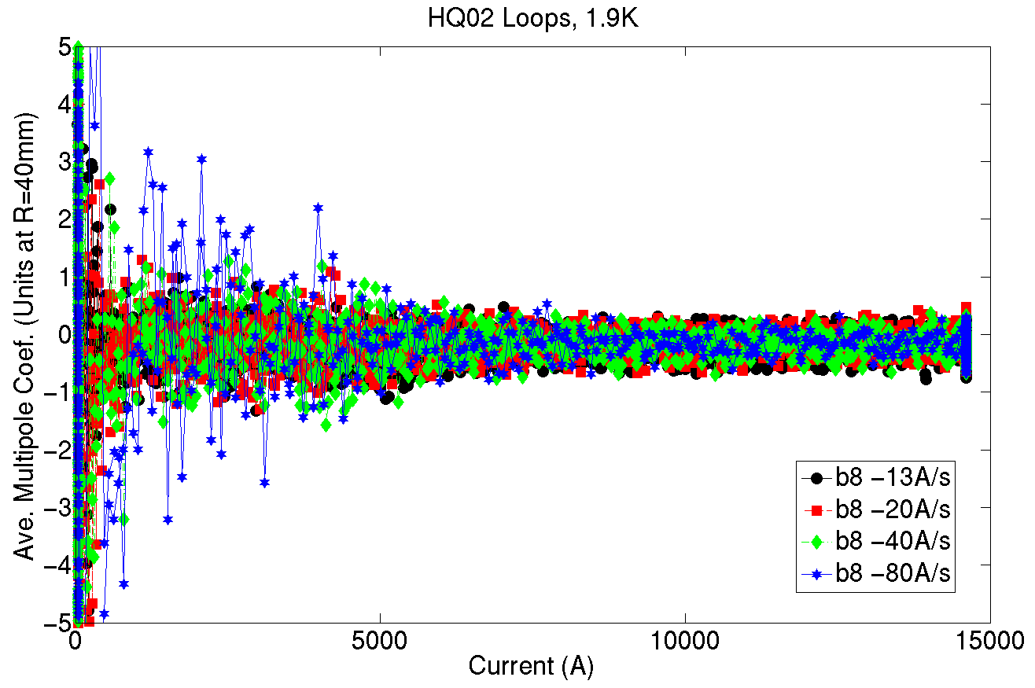
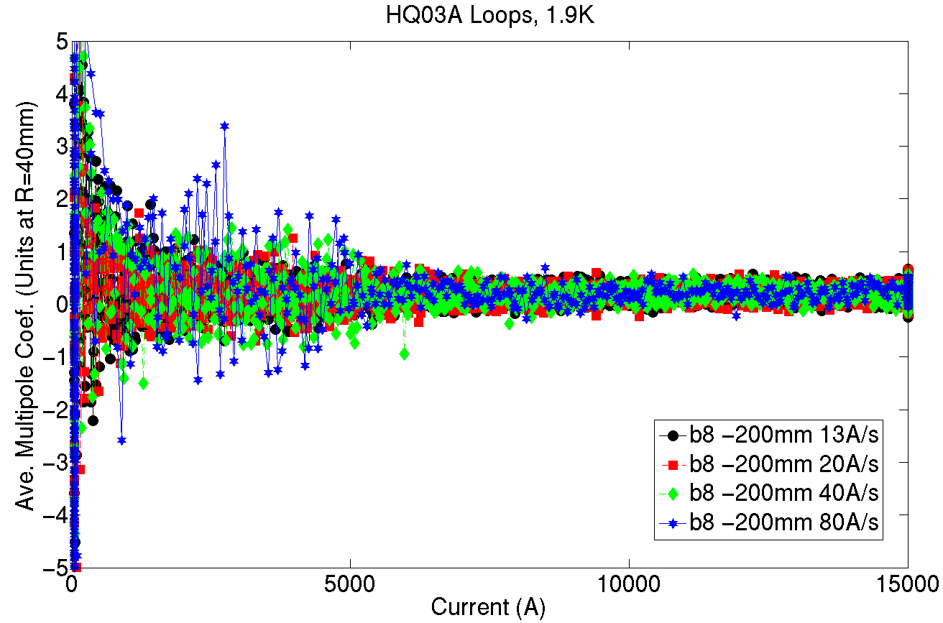
HQ02a
HQ03a
a8
a8
b8
b8

