Slide 1
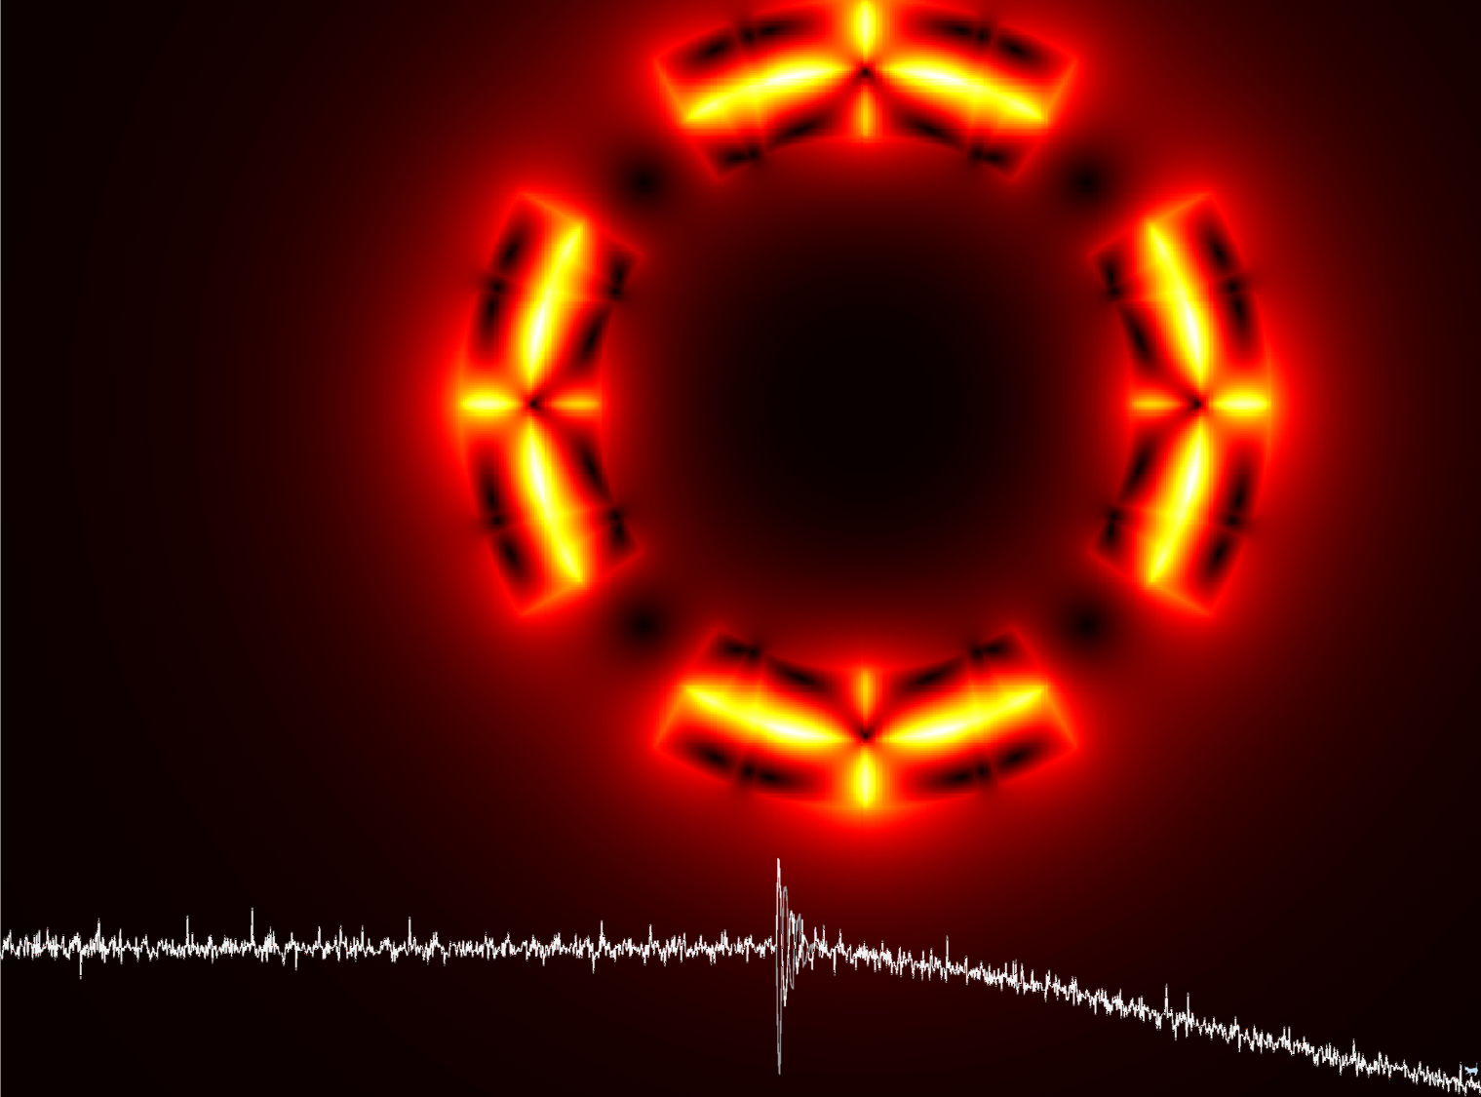
Emmanuele Ravaioli
Toohig fellowship candidate
LARP Collaboration Meeting
11 May 2015
“The reward is that Joy.”
Timothy Toohig

Slide 2
My background
2008, M.Sc. in Energy engineering at the University of Bologna, Italy
Best Italian thesis concerning urban heating
2009-12, Fellow at CERN
Circuit modelling of LHC superconducting circuits
Optimization of the quench detection system (LHC restart 2010-11)
Wave propagation in superconducting circuits
2012-15, PhD at CERN and University of Twente
Title of my dissertation: “CLIQ”
Quench simulation
Magnet testing
Design and optimization of quench protection systems
Emmanuele Ravaioli - Toohig fellowship candidate LARP Collaboration Meeting - 11 May 2015

Slide 3
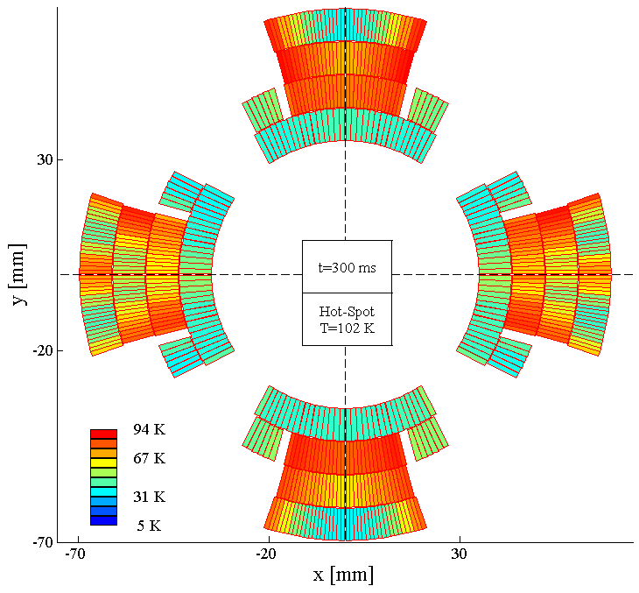
Fellow at CERN – Modelling of LHC superconducting circuits
All most critical circuits modeled
Electro-thermal models
Wave propagation
Analysis of fault cases
QSF
Development of a Quench Simulation Framework
Emmanuele Ravaioli - Toohig fellowship candidate LARP Collaboration Meeting - 11 May 2015

Slide 4
Notable example: LHC main dipole circuit -1
Power converter
switching-off
Voltage transients propagating along the chain
Spurious triggering of the quench detection system
1st energy-extraction
switch opening
2nd energy-extraction
switch opening
Emmanuele Ravaioli - Toohig fellowship candidate LARP Collaboration Meeting - 11 May 2015

Slide 5
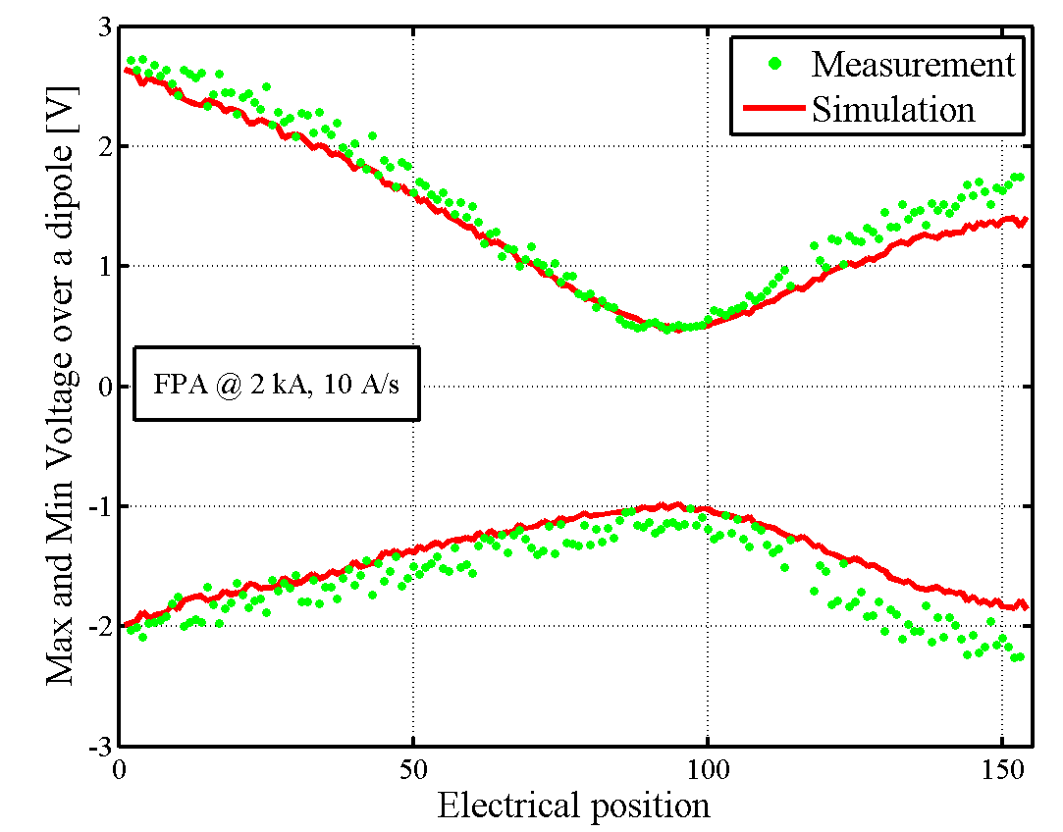
Notable example: LHC main dipole circuit -2
Wave propagation
Reflection and superposition
Emmanuele Ravaioli - Toohig fellowship candidate LARP Collaboration Meeting - 11 May 2015

Slide 6
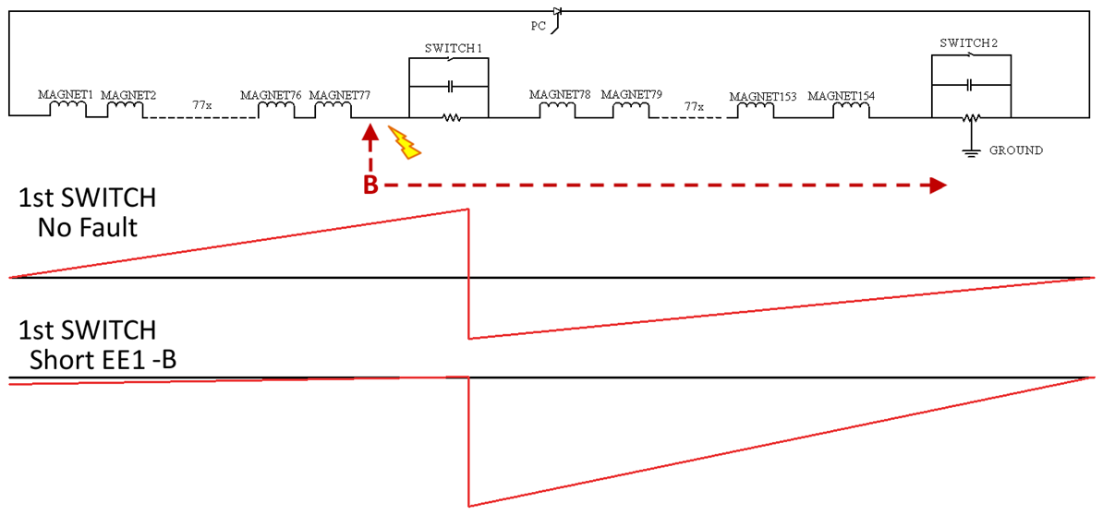
4 years later
LHC main dipole circuit – Analysis of failure cases
Position of the short circuit pinpointed very quickly
Worst-case estimation of the peak voltage to ground reviewed
(900 V → 1300 V)
Emmanuele Ravaioli - Toohig fellowship candidate LARP Collaboration Meeting - 11 May 2015

Slide 7
LHC main dipole circuit – Intermittent short to ground -1
1st switch opening
2nd switch opening
Intermittent short to ground
Emmanuele Ravaioli - Toohig fellowship candidate LARP Collaboration Meeting - 11 May 2015

Slide 8
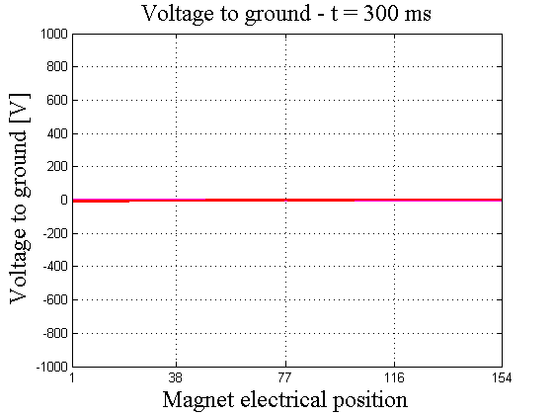
LHC main dipole circuit – Intermittent short to ground -2
t<320 ms
Short present
t=320 ms
1st switch
t=360 ms
Short disappears
t=420 ms
Short reappears
t=450 ms
Short disappears
t=455 ms
Short reappears
t=480 ms
Short disappears
t=580 ms
2nd switch
Emmanuele Ravaioli - Toohig fellowship candidate LARP Collaboration Meeting - 11 May 2015

Slide 9
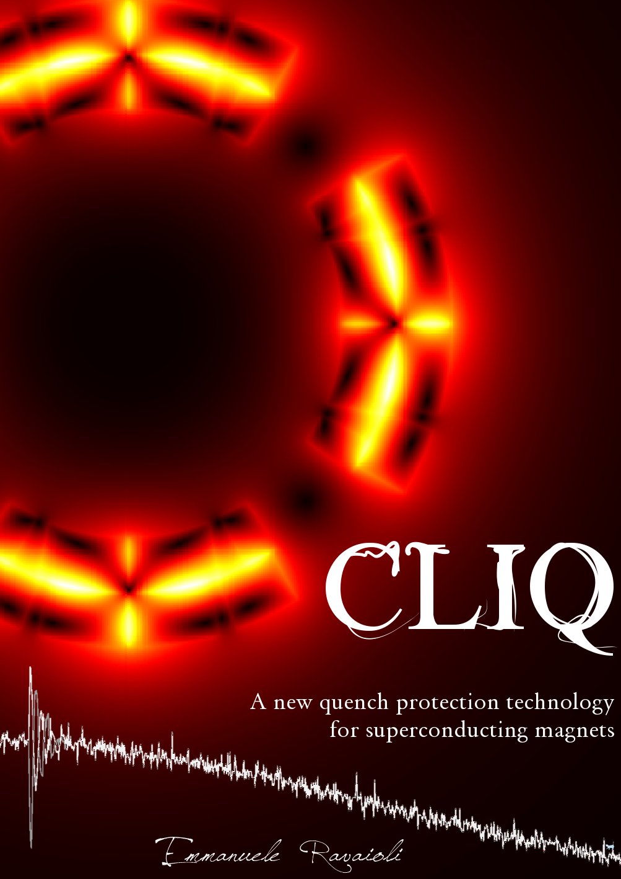
My PhD thesis: “CLIQ” – A new quench protection method
Theory
Develop ment
CLIQ
Modeling
Optimi zation
Testing
Emmanuele Ravaioli - Toohig fellowship candidate LARP Collaboration Meeting - 11 May 2015

Slide 10
Current Change
CLIQ – Coupling-Loss Induced Quench protection system
Magnetic Field Change
Coupling Losses (Heat)
Temperature Rise
QUENCH
Patent EP13174323.9
Emmanuele Ravaioli - Toohig fellowship candidate LARP Collaboration Meeting - 11 May 2015

Slide 11
CLIQ – Typical discharge
Excellent agreement between simulations and measurements
Emmanuele Ravaioli - Toohig fellowship candidate LARP Collaboration Meeting - 11 May 2015

Slide 12
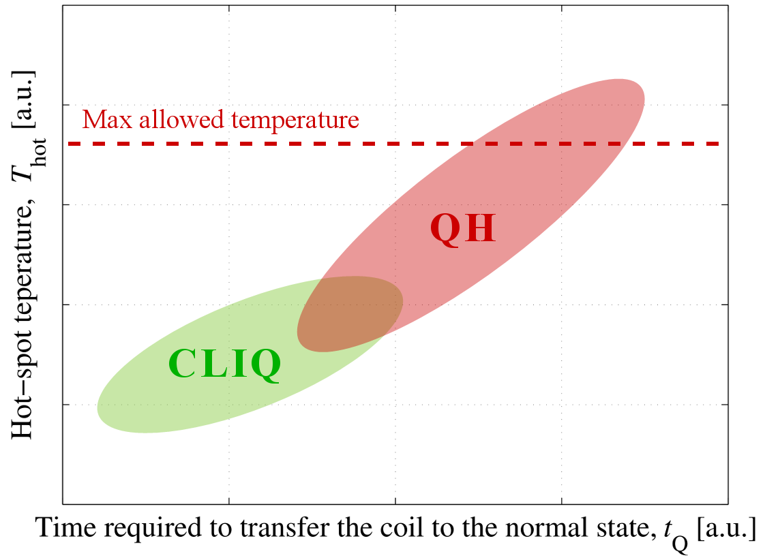
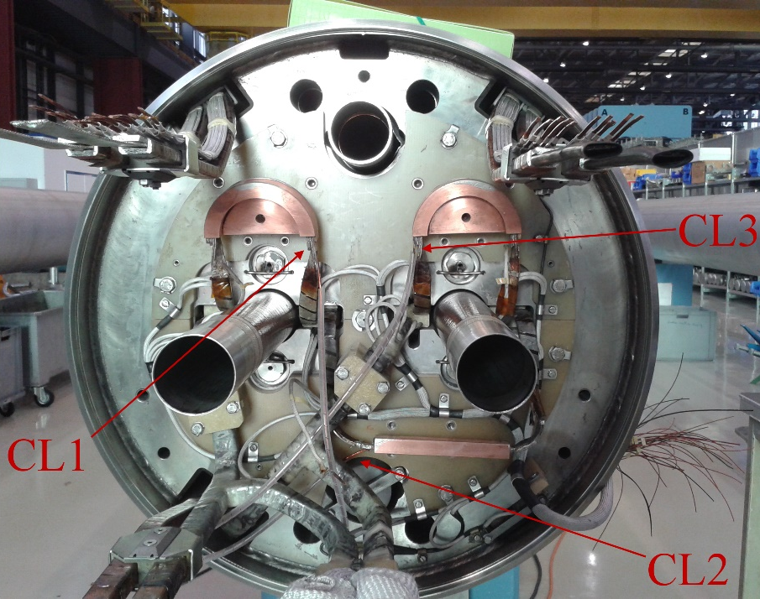
CLIQ – Main advantages
More effective energy deposition
Faster and more homogeneous quench initiation
More robust electrical design
Easier to implement and repair
Lower expected failure rate
External system not interfering with the coil winding technology
Cost- and time-effective back-up solution for protecting magnets with failing quench heaters
15 m long LHC main dipole magnet
Emmanuele Ravaioli - Toohig fellowship candidate LARP Collaboration Meeting - 11 May 2015

Slide 13
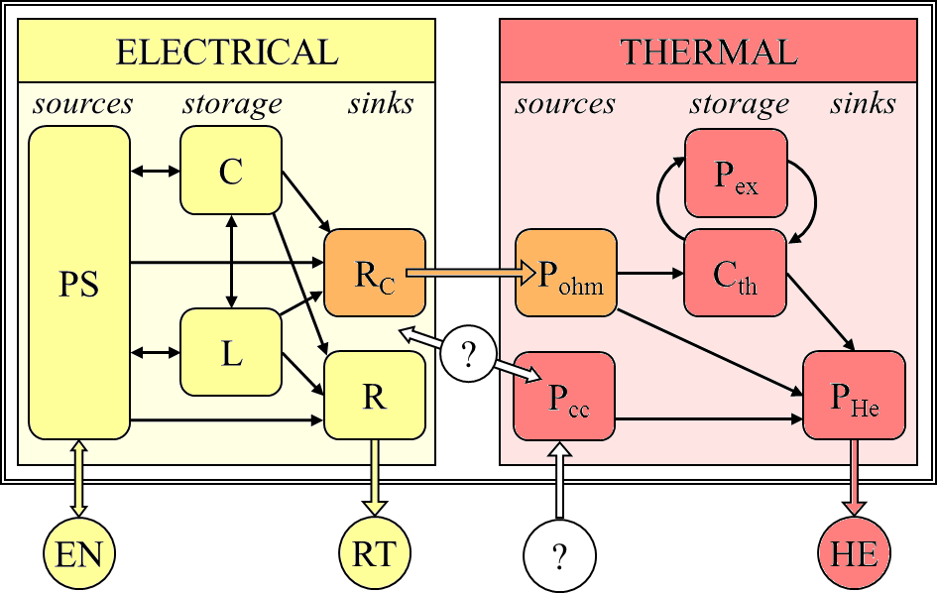
Modeling CLIQ – Challenges
Conventional models
How does the magnet differential inductance change with the current ramp rate?
(Critical for CLIQ)
Coupling losses:
Where is the energy coming from?
New model required!
Emmanuele Ravaioli - Toohig fellowship candidate LARP Collaboration Meeting - 11 May 2015

Slide 14
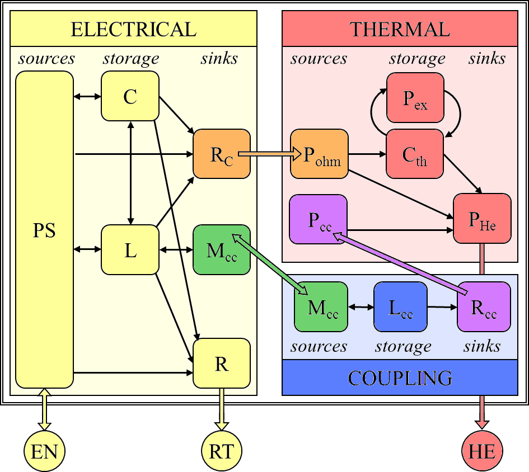
Modelling CLIQ – A novel, elegant modelling technique
LEDET method (Lumped Element Dynamic Electro-Thermal)
Fast, efficient 2D model
Complex dynamic effects represented with equivalent networks of lumped-elements
All energy exchanges coherently accounted for
Emmanuele Ravaioli - Toohig fellowship candidate LARP Collaboration Meeting - 11 May 2015

Slide 15
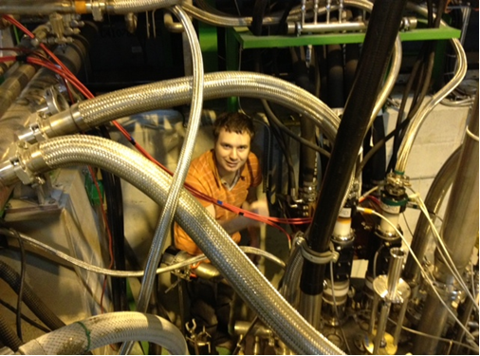
Testing CLIQ
Definition of main objectives
Functional requirements for CLIQ units and test facilities
Test plan
Test coordination
(good planning, and a lot of problem solving..)
7 CLIQ test campaigns
(CERN, LARP collaboration, industry)
Data analysis
(on-air comparison with simulations often possible)
Emmanuele Ravaioli - Toohig fellowship candidate LARP Collaboration Meeting - 11 May 2015

Slide 16
Testing CLIQ – Nb-Ti model magnet for HL-LHC (MQXC2)
First CLIQ tests on an accelerator magnet
Emmanuele Ravaioli - Toohig fellowship candidate LARP Collaboration Meeting - 11 May 2015

Slide 17
Testing CLIQ – Nb₃Sn model magnet for HL-LHC (HQ02b)
First CLIQ tests on a Nb₃Sn magnet
Emmanuele Ravaioli - Toohig fellowship candidate LARP Collaboration Meeting - 11 May 2015

Slide 18
Testing CLIQ – Full-size LHC matching quadrupole (MQY)
EE
First CLIQ tests on a full-size magnet
EE
EE
Emmanuele Ravaioli - Toohig fellowship candidate LARP Collaboration Meeting - 11 May 2015

Slide 19
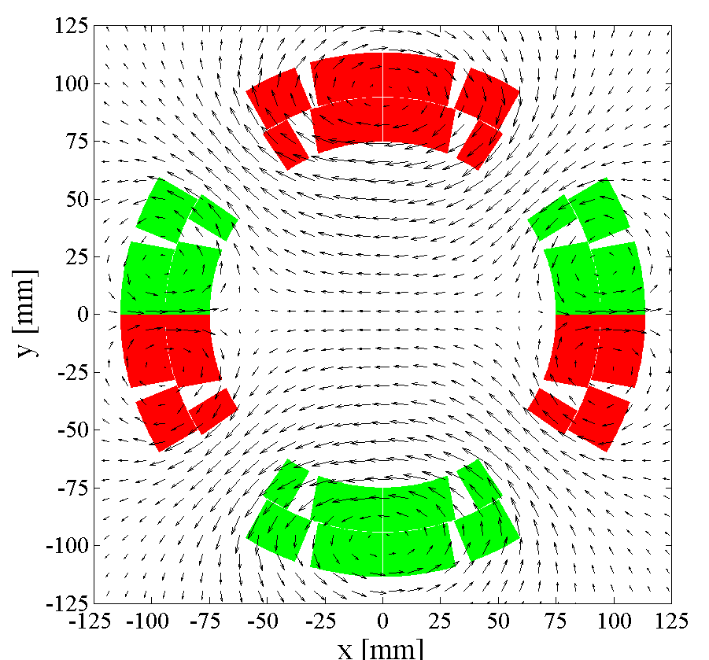
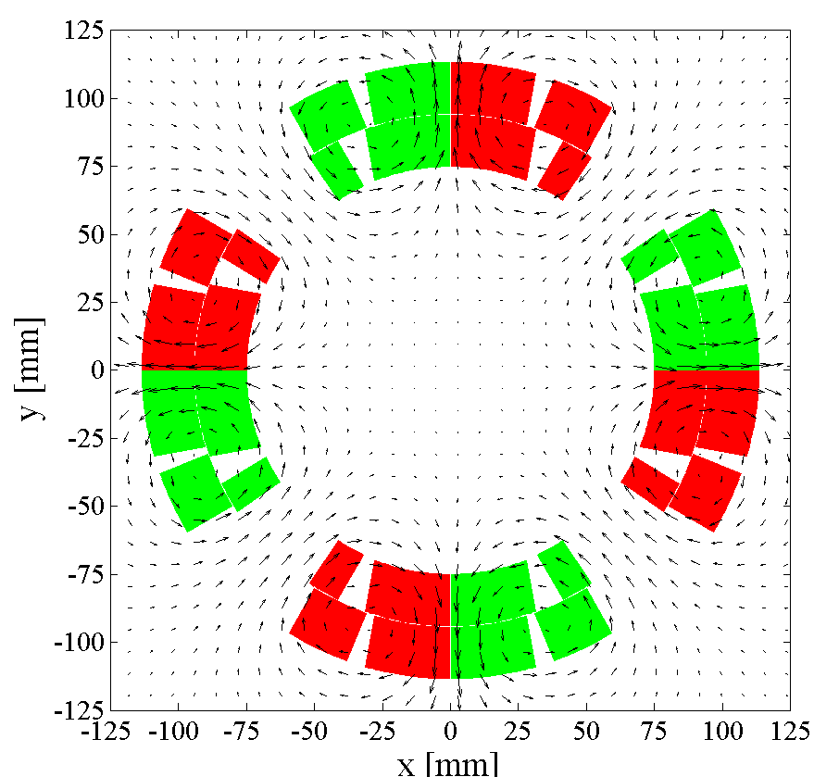
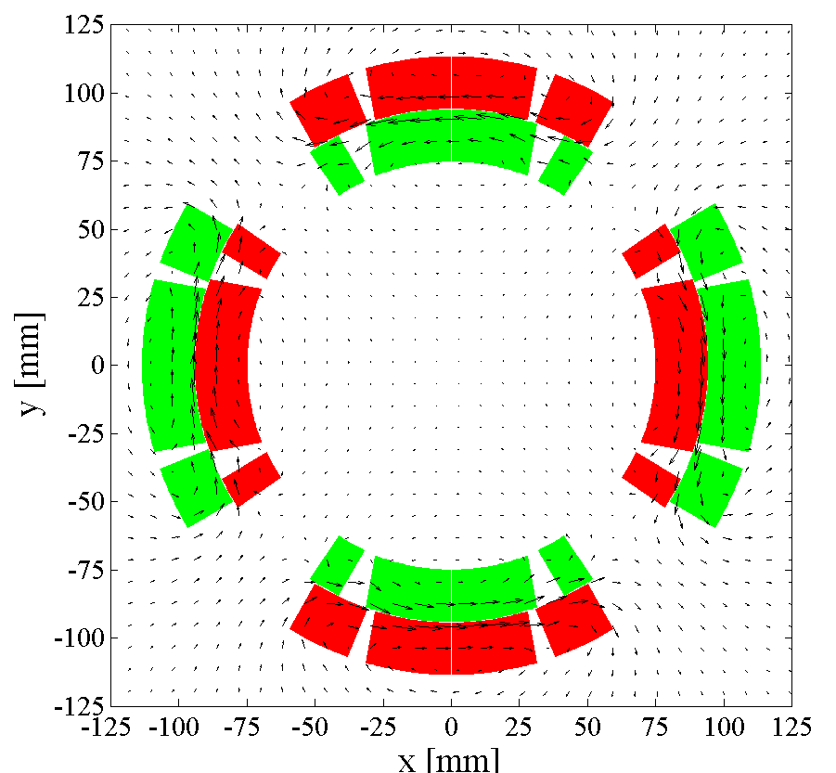
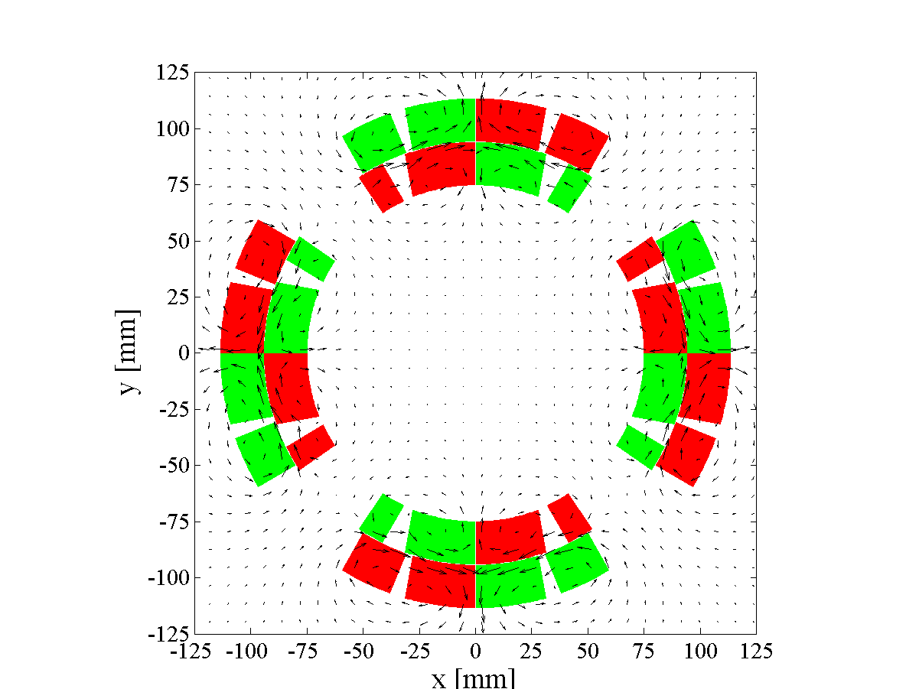
Optimizing CLIQ – Examples of possible configurations
Different configurations can be obtained by varying the electrical order of the poles and the positioning of the CLIQ terminals
Emmanuele Ravaioli - Toohig fellowship candidate LARP Collaboration Meeting - 11 May 2015

Slide 20
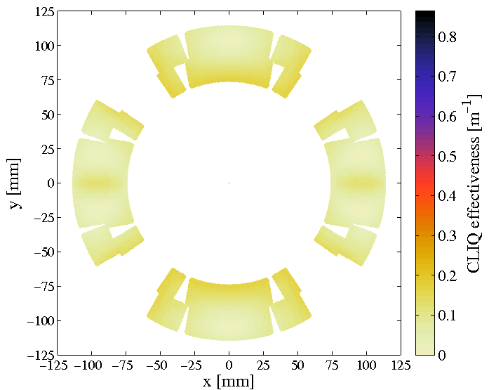
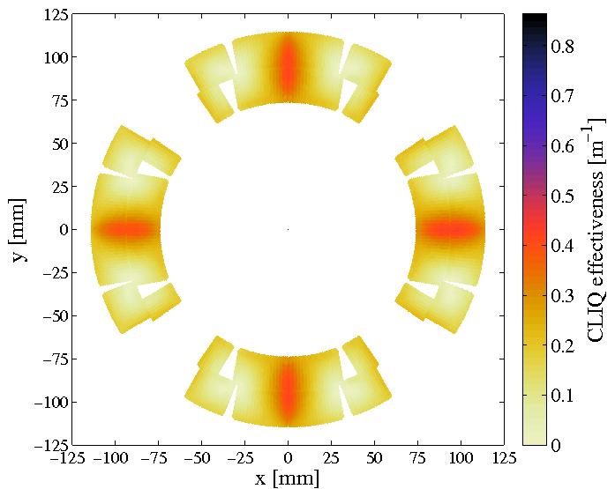
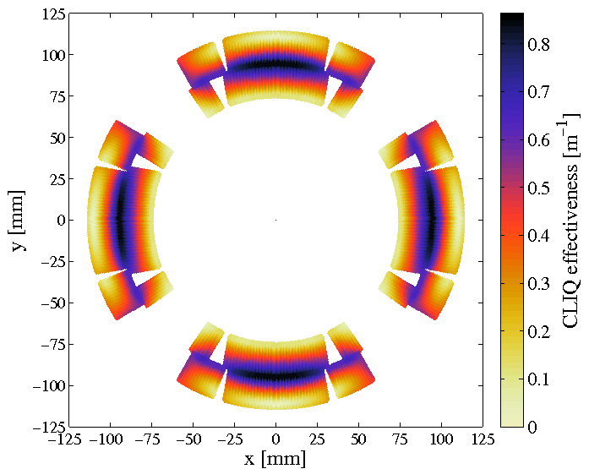
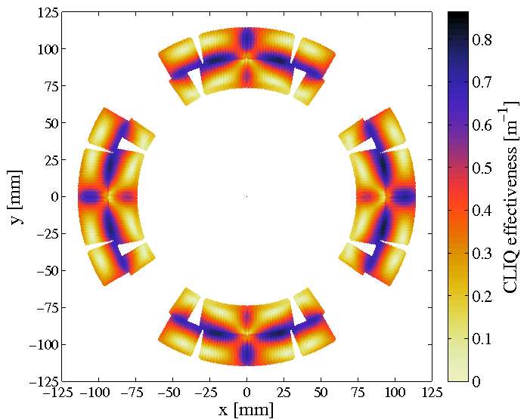
Optimizing CLIQ – CLIQ effectiveness, Ѱ
CLIQ effectiveness, Ѱ
Introduced magnetic-field change, per unit of charging voltage and magnet length
Emmanuele Ravaioli - Toohig fellowship candidate LARP Collaboration Meeting - 11 May 2015

Slide 21
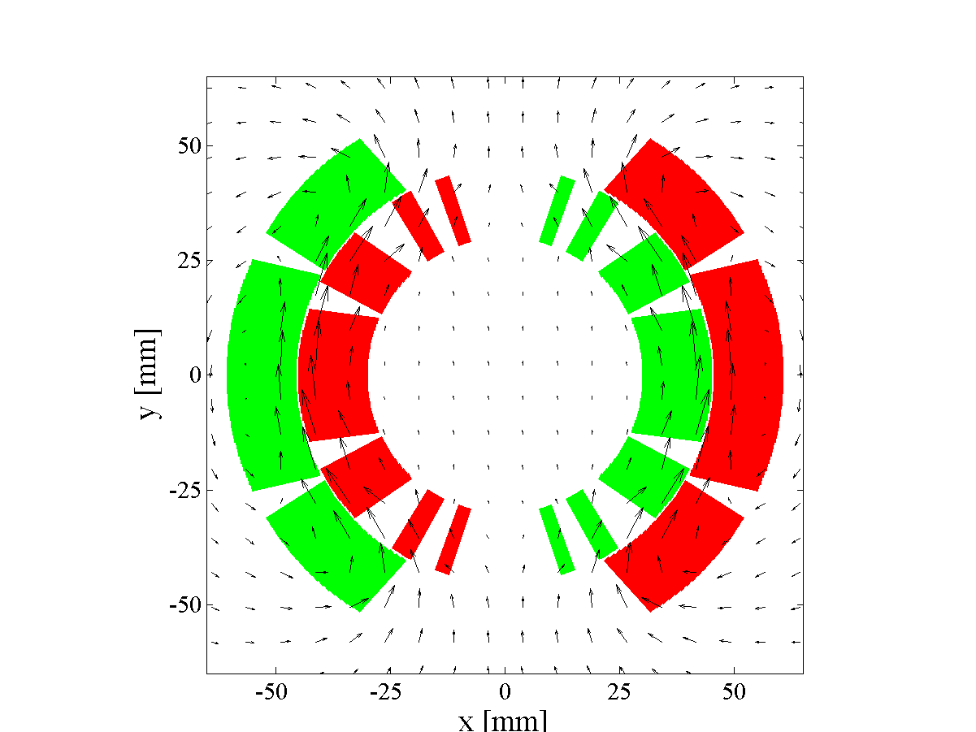
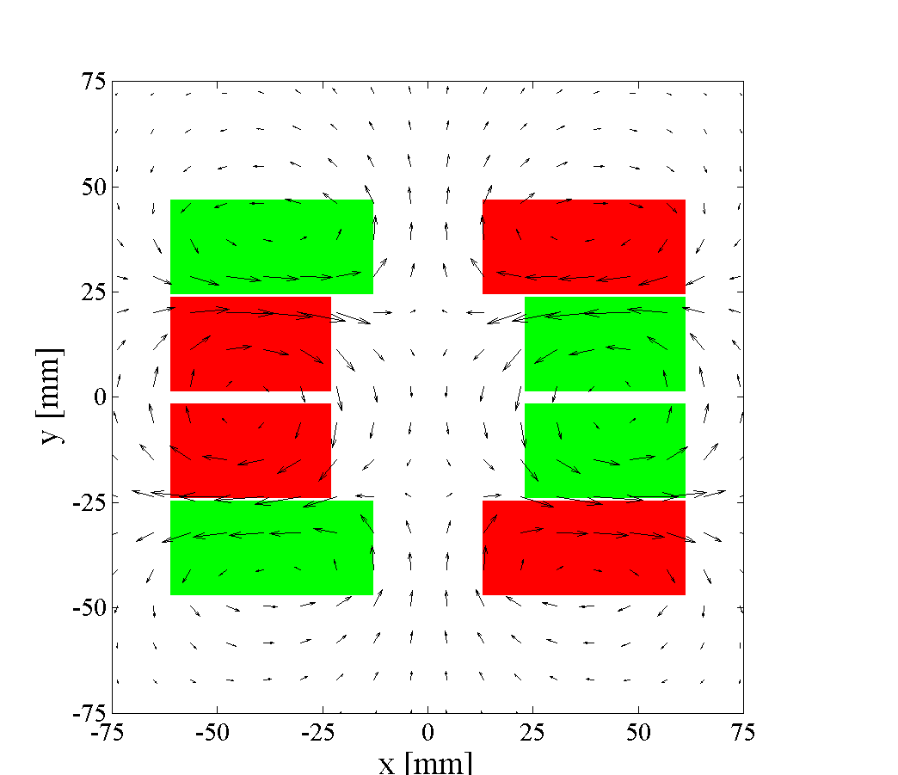
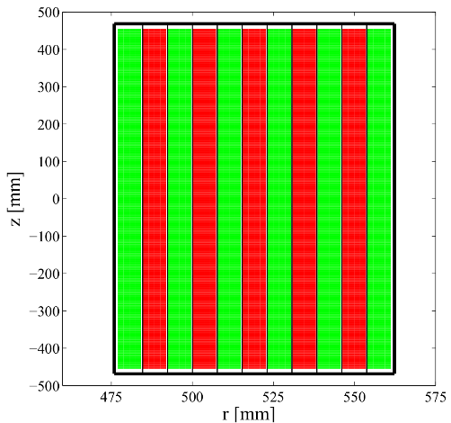
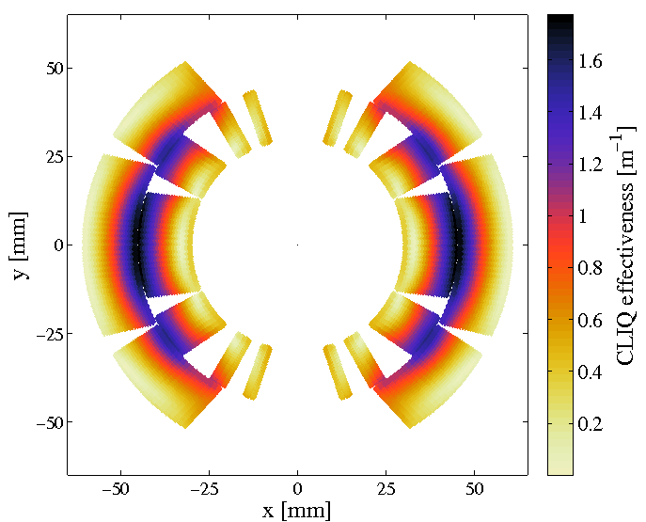
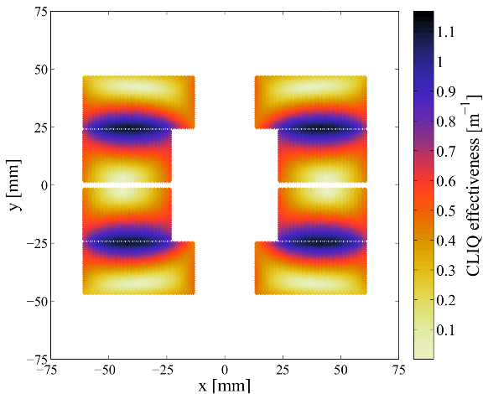
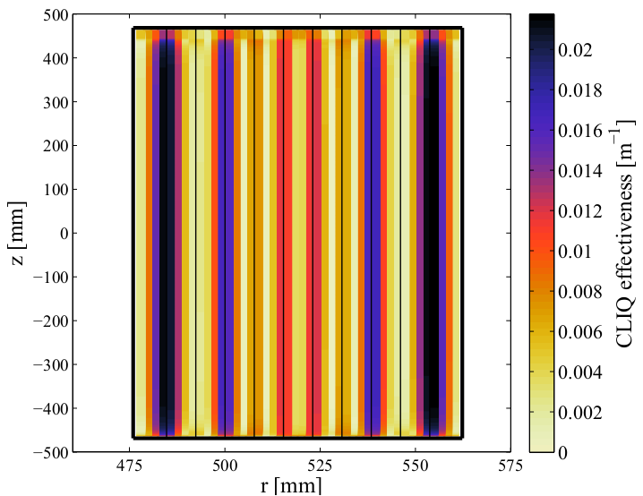
Optimizing CLIQ – Different magnet geometries
Quadrupole
Dipole
Block coil
Solenoid
Golden rules
Subdividing the coil in multiple sections
Introducing opposite current changes in coil sections
that are physically adjacent
Emmanuele Ravaioli - Toohig fellowship candidate LARP Collaboration Meeting - 11 May 2015

Slide 22
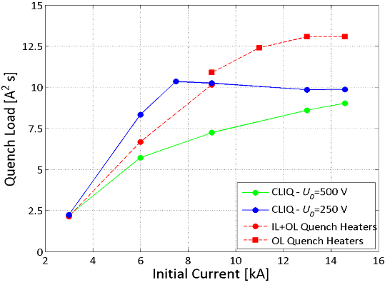
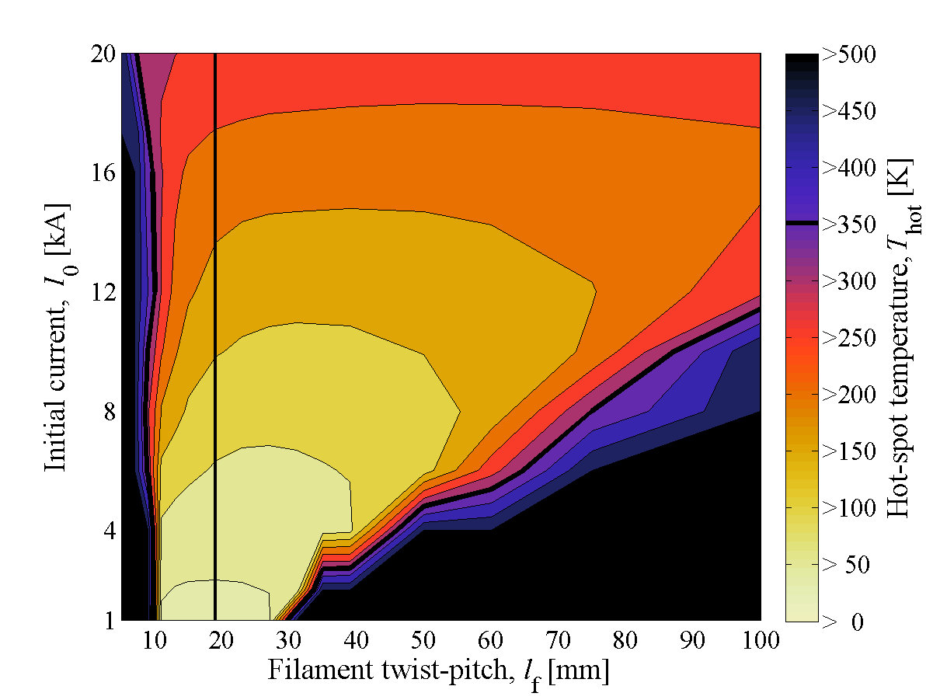
Designing CLIQ – Protection of full-size MQXF magnet
Performance evaluation
Optimum parameters
Integration in the circuit
Redundancy
Double redundancy
CLIQ + Outer quench heaters
Avoiding the installation of the
energy-extraction systems results in savings in the order of a few million $
Emmanuele Ravaioli - Toohig fellowship candidate LARP Collaboration Meeting - 11 May 2015

Slide 23
Designing CLIQ – Simulated CLIQ on a 7 m long MQXF
Temperature
Voltage to ground
t= 10 ms
Emmanuele Ravaioli - Toohig fellowship candidate LARP Collaboration Meeting - 11 May 2015

Slide 24
Designing CLIQ – Simulated CLIQ on a 7 m long MQXF
Temperature
Voltage to ground
t= 20 ms
Emmanuele Ravaioli - Toohig fellowship candidate LARP Collaboration Meeting - 11 May 2015

Slide 25
Designing CLIQ – Simulated CLIQ on a 7 m long MQXF
Temperature
Voltage to ground
t=100 ms
Emmanuele Ravaioli - Toohig fellowship candidate LARP Collaboration Meeting - 11 May 2015

Slide 26
Designing CLIQ – Simulated CLIQ on a 7 m long MQXF
Temperature
Voltage to ground
t=500 ms
Emmanuele Ravaioli - Toohig fellowship candidate LARP Collaboration Meeting - 11 May 2015

Slide 27
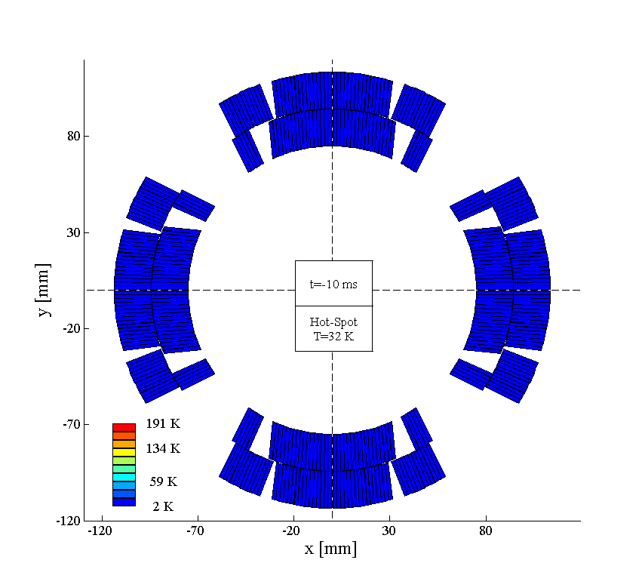
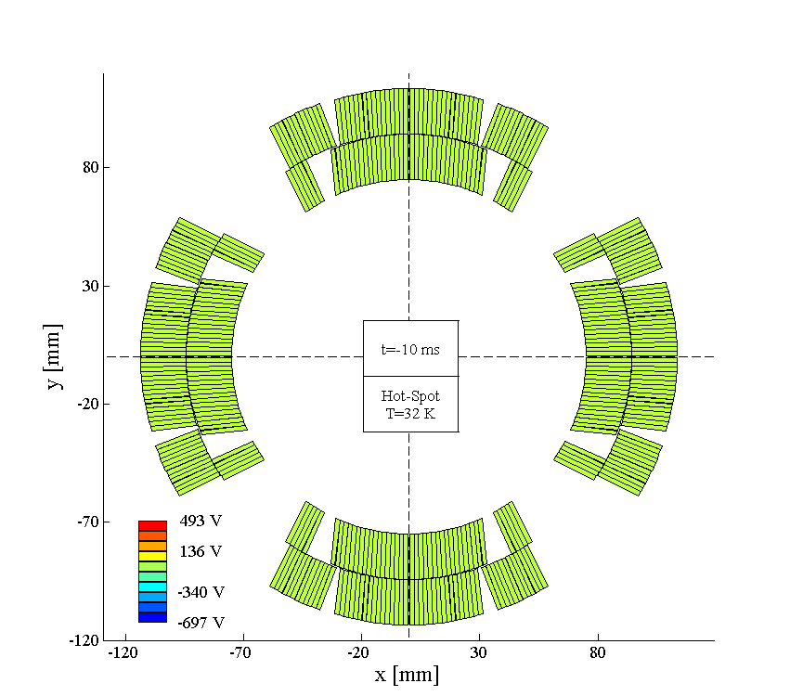
Designing CLIQ – Simulated CLIQ on a 7 m long MQXF
Temperature
Voltage to ground
Emmanuele Ravaioli - Toohig fellowship candidate LARP Collaboration Meeting - 11 May 2015

Slide 28
My profile
My accomplishments
Multi-disciplinary
Experience in circuit design, quench protection, modeling, magnet testing..
Self-starter
CLIQ from scratch, LEDET from scratch
Used to cope with stress
Urgent analyses and simulations of failure events in LHC circuits
Good organizer
Supervised 5 students at CERN
Very active scientific writer
Main author of 15 papers (6 this year) 1 patent (CLIQ)
Award winning
IEEE CSC Graduate Study Fellowship
Best Student Paper at ASC 2014
ESAS prize at EUCAS 2013
Super motivated
Excited at the prospect of working for a period in a US laboratory
Emmanuele Ravaioli - Toohig fellowship candidate LARP Collaboration Meeting - 11 May 2015

Slide 29
My interests in the LARP – How I’d ideally spend my time…
Magnet quench protection
Circuit design and modelling
Quench simulation
Functional requirements of CLIQ units
Magnet testing
Though with limited experience, I’d be interested in magnet design and manufacturing as well
50%
I’m ready to take the challenge of working on new topics if an interesting project is proposed.
50%
Smaller research project of my own initiative
(CLIQ on HTS? New CLIQ variant?)
20%
Emmanuele Ravaioli - Toohig fellowship candidate LARP Collaboration Meeting - 11 May 2015

Slide 30
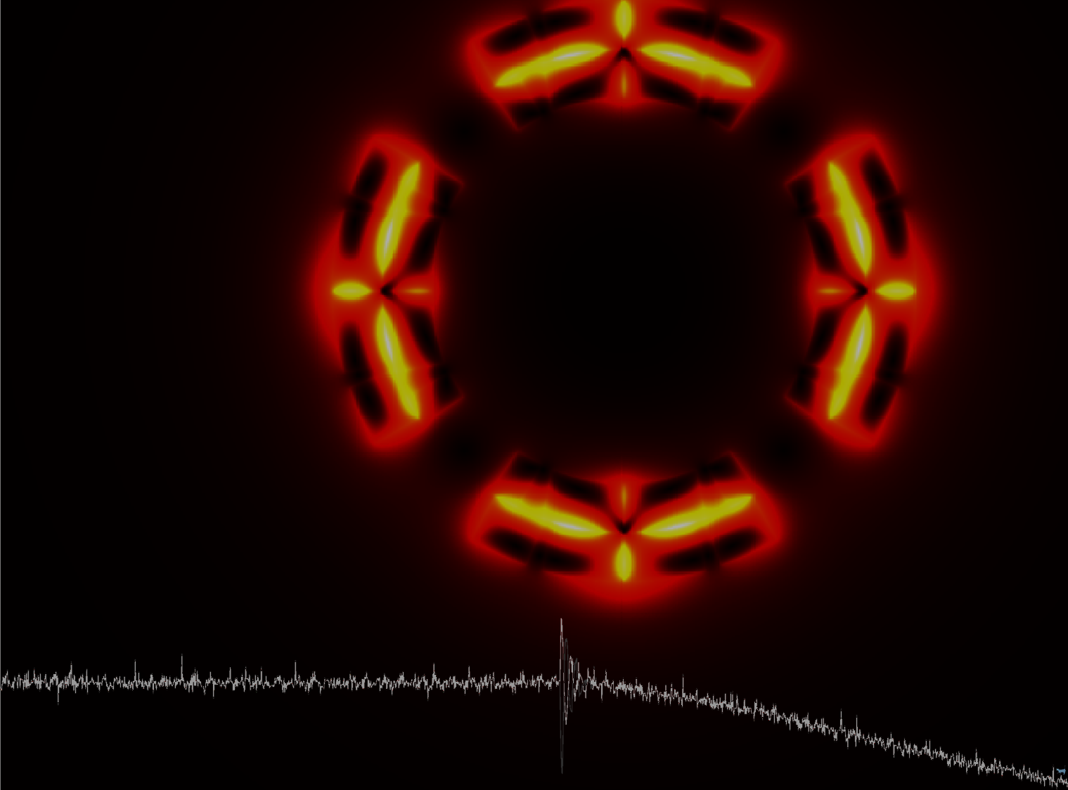
Thanks to
H. ten Kate and A. Verweij,
V. Datskov and G. Kirby,
J. Blomberg Ghini, M. Maciejewski, and K. Sperin,
H. Bajas, K. Dahlerup-Petersen, V. Desbiolles, A. Dudarev,
J. Feuvrier, C. Giloux, T. Mulder, F-O. Pincot, F. Rodriguez-Mateos,
G. Sabbi, A. Siemko, and G. Willering
Emmanuele Ravaioli
Toohig fellowship candidate
LARP Collaboration Meeting
11 May 2015
“The reward is that Joy.”
Timothy Toohig

Slide 31
Annex
Emmanuele Ravaioli - Toohig fellowship candidate LARP Collaboration Meeting - 11 May 2015

Slide 32
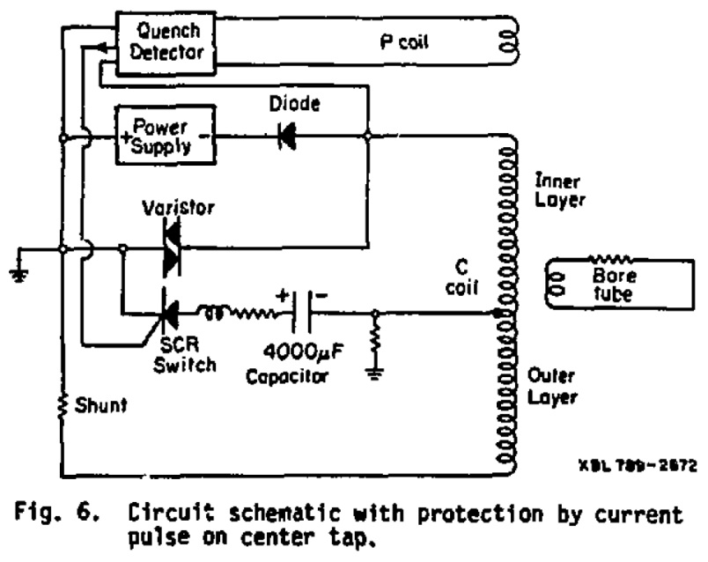
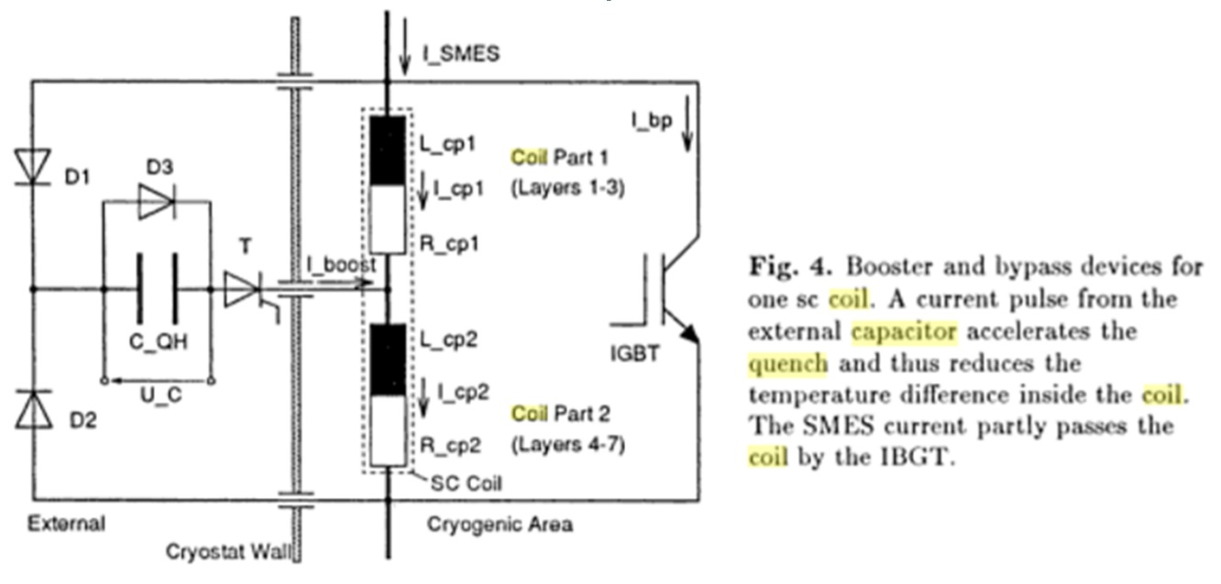
A few months before the end of my fellowship…
Glyn Kirby: “Is it possible to protect a magnet with AC losses?...”
Vladimir Datskov: “I remember a few old papers…”
1978
1996
“Quench Protection for a 2-MJ Magnet”, Taylor et al., Lawrence Berkley National Laboratory
“Temperature and Pressure Rise in Supercritical Helium during the Quench of Indirectly Cooled SC Coils”,
R. M. Schotter and H. W. Lorenzen, Technische Universität München
My idea: Not a pulse but a series of oscillations
Patent EP13174323.9
After 3 year of intense work, it is possible to protect full-size magnets using this new method, CLIQ (Coupling-Loss Induced Quench)
Emmanuele Ravaioli - Toohig fellowship candidate LARP Collaboration Meeting - 11 May 2015

Slide 33
Summary of CLIQ and QH performance on the model magnet
At nominal current quench load reduced by ~30% using CLIQ
However, CLIQ performance strongly depends on the magnet length
Emmanuele Ravaioli - Toohig fellowship candidate LARP Collaboration Meeting - 11 May 2015

Slide 34
Protecting full-scale magnets with CLIQ – The strategy
Power per unit volume deposited by CLIQ depends on inter-filament loss (IFCL)
Charging voltage
(limited for safety reasons)
Number of CLIQ units
(for quadrupoles up to 2 units)
Equivalent inductance
of the discharge circuit
→ Coil geometry
→ Position of CLIQ connections
→ Electrical order of the poles
(always an advantage, typically possible with minor changes)
Magnet length
(defined by design)
Capacitance of CLIQ unit
(no effect on power, but
to discharged energy)
For a given quadrupole magnet
Choose optimum CLIQ configuration
Increase voltage U₀
Increase capacitance of CLIQ unit(s)
2-CLIQ
Emmanuele Ravaioli - Toohig fellowship candidate LARP Collaboration Meeting - 11 May 2015

Slide 35
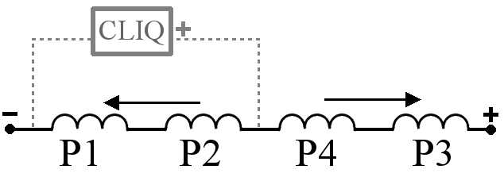
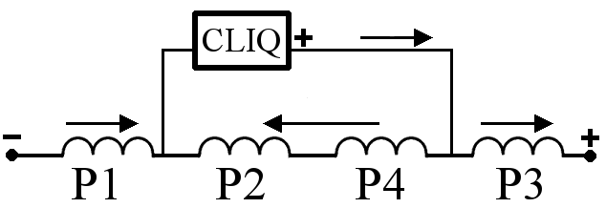
Optimum CLIQ discharge configuration -1
Not Optimized
Optimized
–
–
+
+
+
–
–
+
Significant reduction of L_{eq} (2.5-3 times!)
→ Increase of deposited loss (6-9 times!)
Golden rule for optimizing any CLIQ discharge circuit
Introduce opposite current change in coils which are physically adjacent
Emmanuele Ravaioli - Toohig fellowship candidate LARP Collaboration Meeting - 11 May 2015

Slide 36
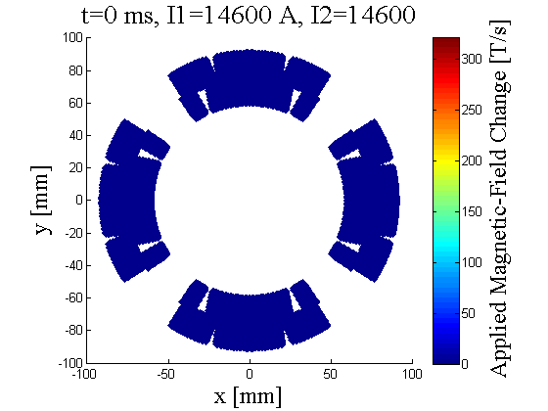
Optimum CLIQ discharge configuration -2
Efficient distribution of magnetic-field change
Not Optimized
Optimized
[a.u.]
[a.u.]
2
1
2
1
3
4
3
4
Golden rule for optimizing any CLIQ discharge circuit
Introduce opposite current change in coils which are physically adjacent
Emmanuele Ravaioli - Toohig fellowship candidate LARP Collaboration Meeting - 11 May 2015

Slide 37
Multi-CLIQ
Further decreasing the impedance of the circuit can be reduced by subdividing the electrical circuit into 2xN_{C} elements, effectively in parallel when CLIQ is triggered.
1-CLIQ
2-CLIQ
Emmanuele Ravaioli - Toohig fellowship candidate LARP Collaboration Meeting - 11 May 2015

Slide 38
Simulation results – I₀ = 17.3 kA (I_{nom})
MQXF
Magnetic Length 6.8 m
Self-inductance 70 mH
Nominal current 17.3 kA
Quadrupole magnet for the LHC high luminosity upgrade
(US-LARP collaboration)
For each studied configuration a minimum capacitance is needed to protect the magnet
As expected performance of
2-CLIQ-500 V
similar to 1-CLIQ-1 kV
Assumptions: no QH; no EE; RRR=140;
10 ms detection time
Emmanuele Ravaioli - Toohig fellowship candidate LARP Collaboration Meeting - 11 May 2015

Slide 39
Simulation results – I₀ = 9 kA (~50% I_{nom})
1-CLIQ-500 V
is not sufficient to protect the full-length magnet
Both 2-CLIQ-500 V
and 1-CLIQ-1 kV are valid protection solutions for C>50 mF
Assumptions: no QH; no EE; RRR=140;
10 ms detection time
Emmanuele Ravaioli - Toohig fellowship candidate LARP Collaboration Meeting - 11 May 2015

Slide 40
CLIQ – Coupling-Loss Induced Quench
Current
Change
Magnetic Field
Change
Coupling-Losses
(Heat)
Temperature
Rise
QUENCH
Principle: When subjected to a magnetic field change, coupling losses occur in superconducting wires and cables. These losses are heat generated directly in the superconductor to quench!
Emmanuele Ravaioli - Toohig fellowship candidate LARP Collaboration Meeting - 11 May 2015

Slide 41
With CLIQ connections at the joint between inner/outer layers
Golden rule for optimizing any CLIQ discharge circuit
Introduce opposite current change in coils which are physically adjacent
2o
1o
2o
1o
Existing magnets
Configurations easy to implement on most existing magnets
2i
1i
2i
1i
3i
4i
3i
4i
3o
4o
3o
4o
Future magnets
With connections between
in/out layers
2o
1o
2o
1o
2i
1i
2i
1i
3i
4i
3i
4i
3o
4o
3o
4o
Emmanuele Ravaioli - Toohig fellowship candidate LARP Collaboration Meeting - 11 May 2015

Slide 42
CLIQ – How is the energy deposited? with Inter-Filament Coupling Loss
The current introduced in the magnet coil generates a change in the local magnetic field.
When a superconductor is subjected to an applied magnetic-field change, an induced magnetic field is generated which opposes to the applied field.
For fast transients, the actual magnetic field does not change much, because the applied and induced magnetic field almost cancel out.
The presence of the induced field generates currents between superconducting filaments and between superconducting strands. These currents flow through the copper matrix of the conductor, thus they generate loss (=heat) inside the cable.
For typical ranges of magnet inductance (5-100 mH) and CLIQ capacitance (5-50 mF), the range of the CLIQ oscillation period is 10-100 ms (frequency range 10-100 Hz)
Inter-Filament Coupling Loss
For typical filament twist-pitch and Cu transverse resistivity, time constant in the order of tens of ms
High energy deposition
with CLIQ discharge
Inter-Strand Coupling Loss
For typical strand twist-pitch and cross-contact resistance, time constant in the order of hundreds of ms / seconds
Limited energy deposition with CLIQ discharge
Magnetization Loss
Very limited change in the local magnetic field, hysteresis loops are small
Limited energy deposition with CLIQ discharge
Emmanuele Ravaioli - Toohig fellowship candidate LARP Collaboration Meeting - 11 May 2015

Slide 43
Multi-CLIQ – 2 CLIQ units, 4 CLIQ units, N_{C} CLIQ units…
L_{eq} can be reduced by further subdividing the electrical circuit into N_{E} elements, effectively in parallel when CLIQ is triggered.
They can be magnets in a chain, poles of a magnet, or inner/outer layers of each pole.
1-CLIQ
2-CLIQ
4-CLIQ
Peak power deposition
proportional to N_{C}²
Parameter | 1 CLIQ | 1 CLIQ 2xU₀ | 2 CLIQ | 4 CLIQ | N_{C} CLIQ
Number of elements, N_{E} | 2 | 2 | 4 | 8 | 2 N_{c}
Equivalent inductance, L_{eq} | L_{eq} | = | ÷4 | ÷16 | ÷N_{C}²
Total capacitance, C_{eq} | C | = | x2 | x4 | xN_{C}
Charging voltage, U₀ | U₀ | x2 | = | = | =
Peak current change, dI/dt | U₀/L_{eq}/N_{E} | x2 | x2 | x4 | xN_{C}
Peak deposited loss | ∞(U₀/L_{eq}/N_{E})^2 | x4 | x4 | x16 | xN_{C}²
Peak AC current, I | ∞U₀*sqrt(C_{eq}/L_{eq})/N_{E} | x2 | x2^{0.5} | x2 | xN_{C}^{0.5}
Frequency, f | 1/2/π/sqrt(L_{eq}*C_{eq}) | = | x2^{0.5} | x2 | xN_{C}^{0.5}
Emmanuele Ravaioli - Toohig fellowship candidate LARP Collaboration Meeting - 11 May 2015

Slide 44
Why do we need to delay the triggering of the extraction-system?
Avoid interference between CLIQ and EE system
Avoid superposition of voltage across CLIQ and across EE resulting in voltage too high
Avoid reducing CLIQ performance
Emmanuele Ravaioli - Toohig fellowship candidate LARP Collaboration Meeting - 11 May 2015

Slide 45
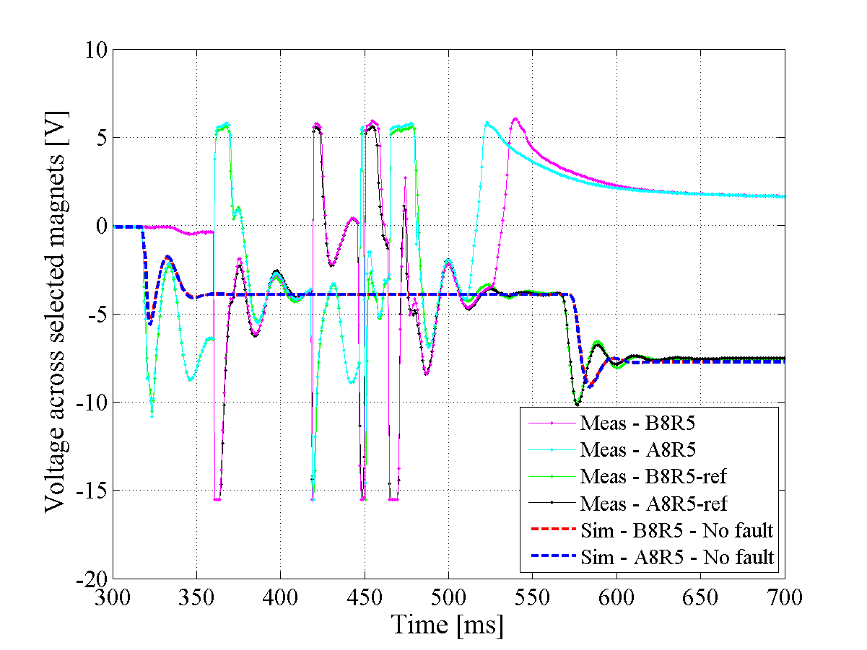
Event in RB56 – Cpr to simulation without faults
Emmanuele Ravaioli - Toohig fellowship candidate LARP Collaboration Meeting - 11 May 2015

Slide 46
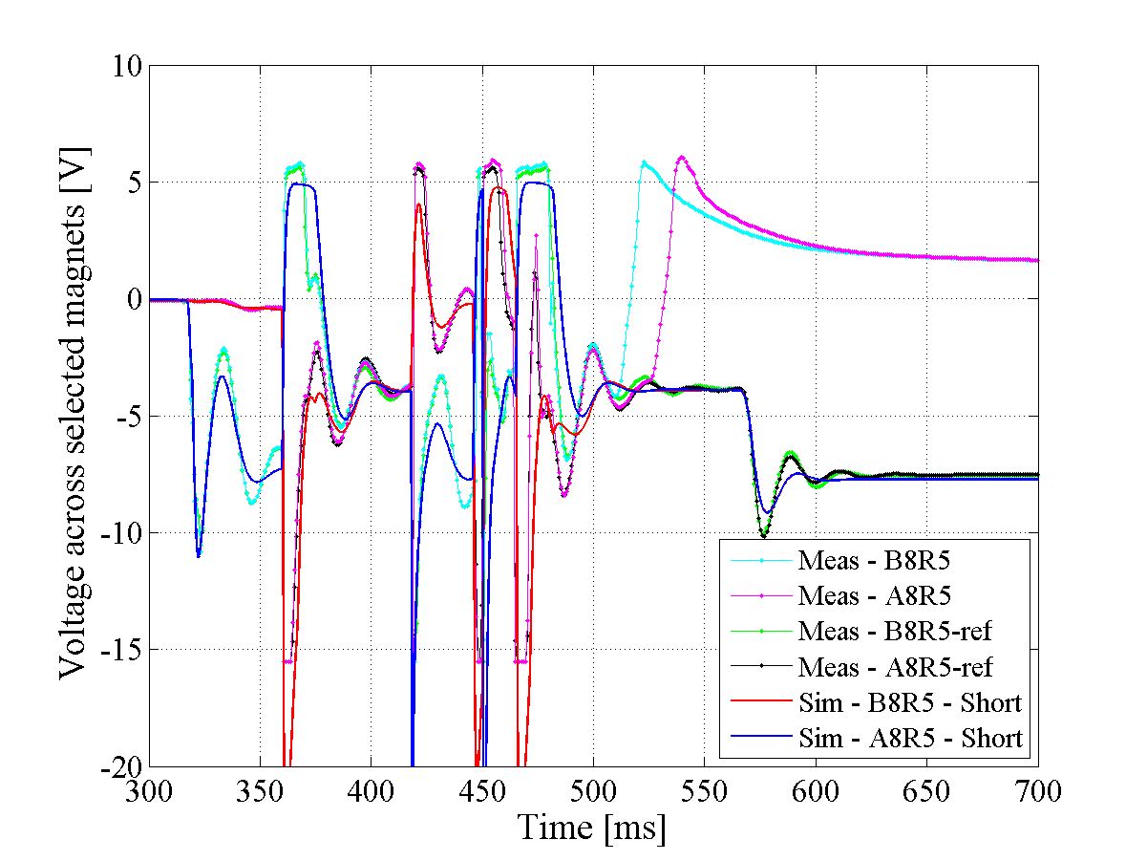
nQPS measurements cpr to Simulation – Intermittent short
EE openings
Short to ground
Emmanuele Ravaioli - Toohig fellowship candidate LARP Collaboration Meeting - 11 May 2015

Slide 47
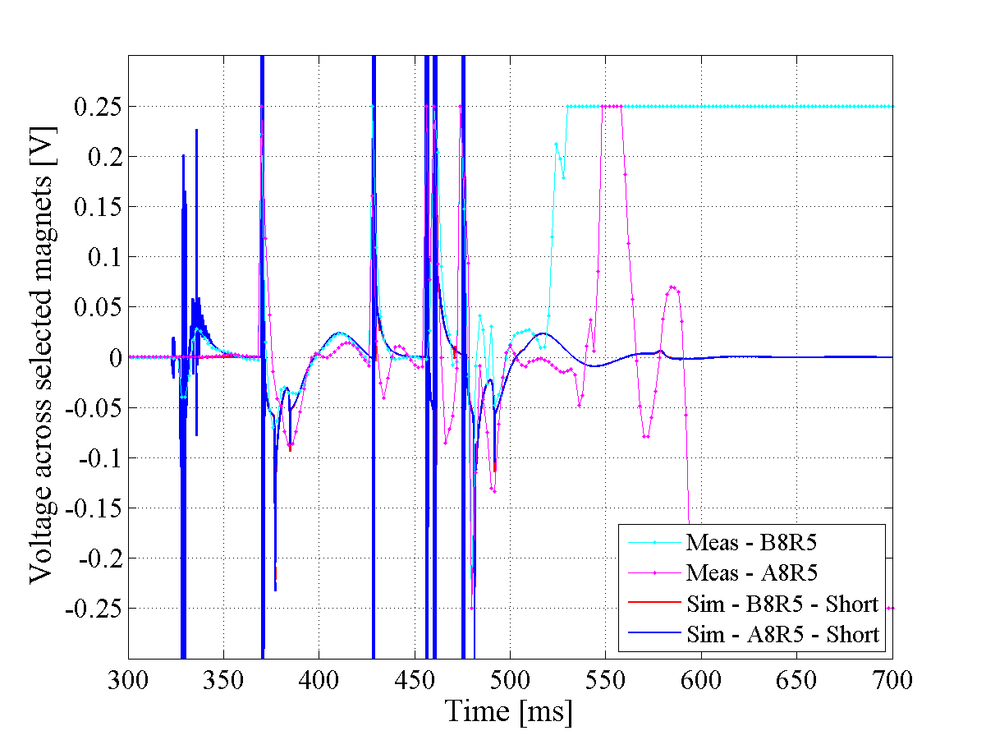
iQPS measurements cpr to Simulation – Intermittent short
EE openings
Short to ground
Emmanuele Ravaioli - Toohig fellowship candidate LARP Collaboration Meeting - 11 May 2015

