Slide 1
US-HiLumi at FNAL: SC Magnets and SRF Cavities Facilities
H. Padamsee
Fermilab Chief Technology Officer and Head Technical Division
24th LARP Collaboration Meeting
11 May 2015

Slide 2
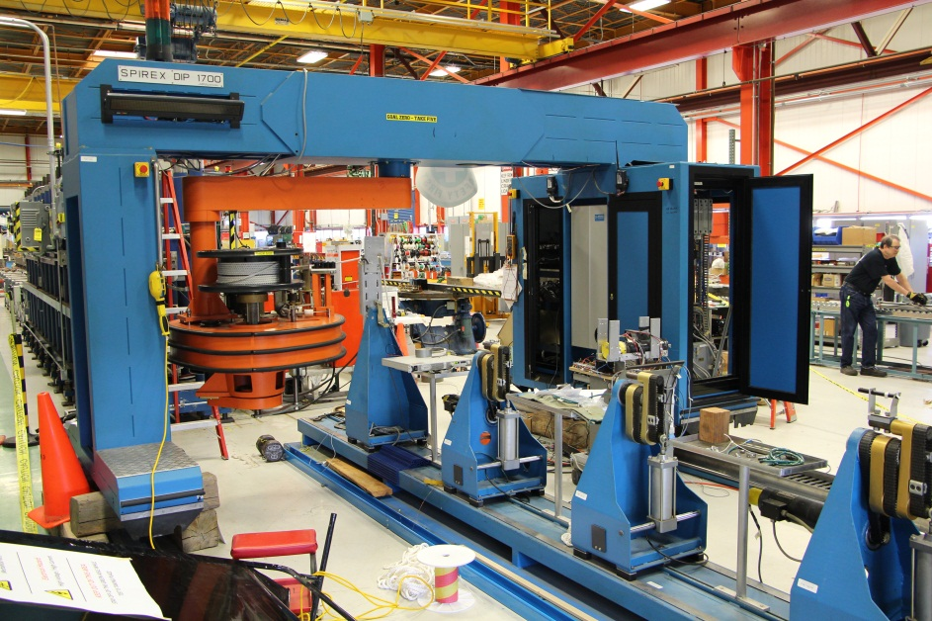
Superconducting Magnet Assembly Facility
Main functions
Coil winding & Curing
Reaction & Impregnation
Instrumentation
Cold Mass Assembly and Cryostating
As for all Test Facilities
Magnet fabrication and other direct work is charged to projects and programs.
FY15-FY17
High Field Magnet Program
LARP, PIP-II
FY18-FY22
US-HiLumi Project might become sole-user of some facilities
long coil winding machine, reaction oven, etc.

Slide 3
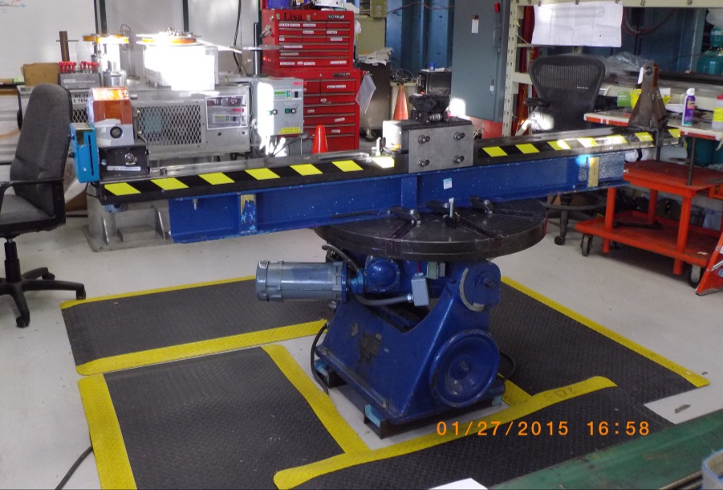
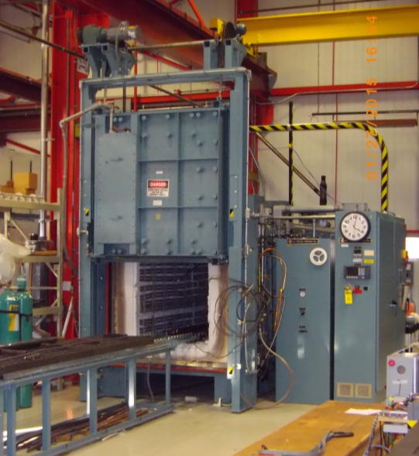
Superconducting Magnet Facility Photos
Cabling Machine:
Available for R&D in FY15-FY22
Short Coils Winding Table:
Available for R&D in FY15-FY22
Long Coils Winding Machine:
US-HiLumi in FY18-FY22
Nb₃Sn Reaction Oven:
Prioritized for US-HiLumi in ~FY18-FY22

Slide 4
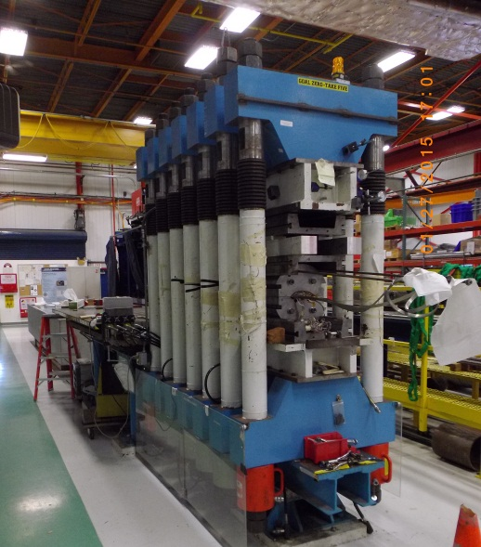
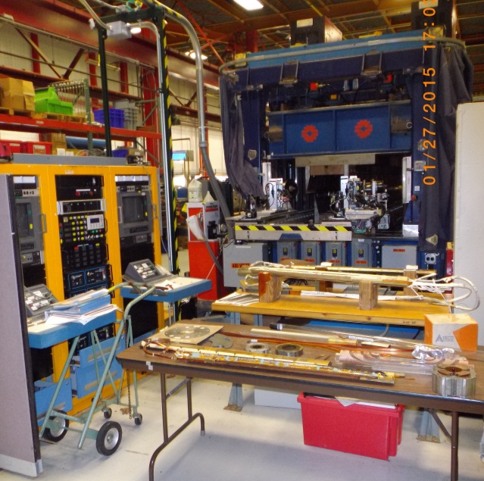
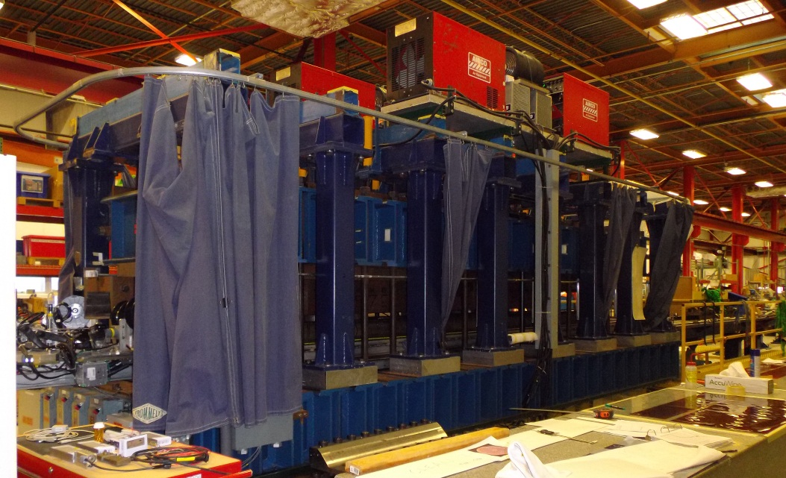
Superconducting Magnet Facility Photos
Curing Press:
Available for R&D in FY15-FY17
Prioritized for US-HiLumi in FY18-FY22
Collaring Press:
Available for R&D in FY15-FY22
Welding Press:
Available for R&D in FY15-FY22

Slide 5
Superconducting Magnet Fabrication Facility Investment
Fermilab is upgrading the Selva coil winding machine used to wind the original IR quad coils
and SSC coils before that
We are replacing old controls with a modern system and improving the safety for both personnel and equipment.
The system can now operate in manual mode, with an operator directing the motion of a spool of cable and the machine maintaining a specified tension.
Work is still needed to allow automation of the winding, speeding the process and ensuring a reproducible cable path onto the mandrel.

Slide 6
Superconducting Magnet Fabrication Facility Investment
Over the last 5 years Fermilab has invested $1.5M of operating funds in the upgrade work.
LARP has also provided funding, especially in FY15 when operating funds were very tight.
Fermilab expects a slight increase in operating funds for this work in FY16, and hopes for a larger increase in FY17.
This would allow us to continue the upgrade program, incorporating the desired automation features.

Slide 7
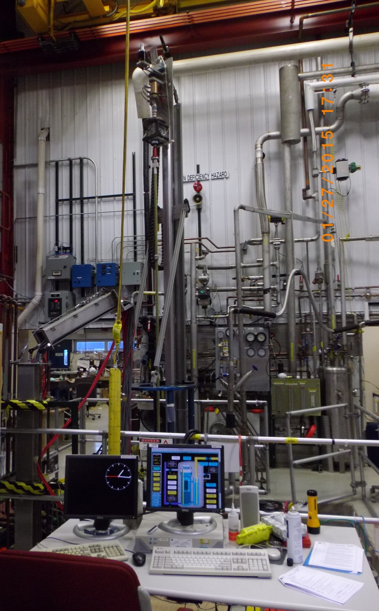
Vertical Magnet Test Facility (VMTF) Scope
Main functions
Test and measure
Superconducting accelerator magnet (coil and support structure)
As for all Test Facilities, Improvements for the benefit of one program are charged to projects and programs.
Magnet testing work is charged to projects and programs
High Field Magnet program
LARP
PIP II

Slide 8
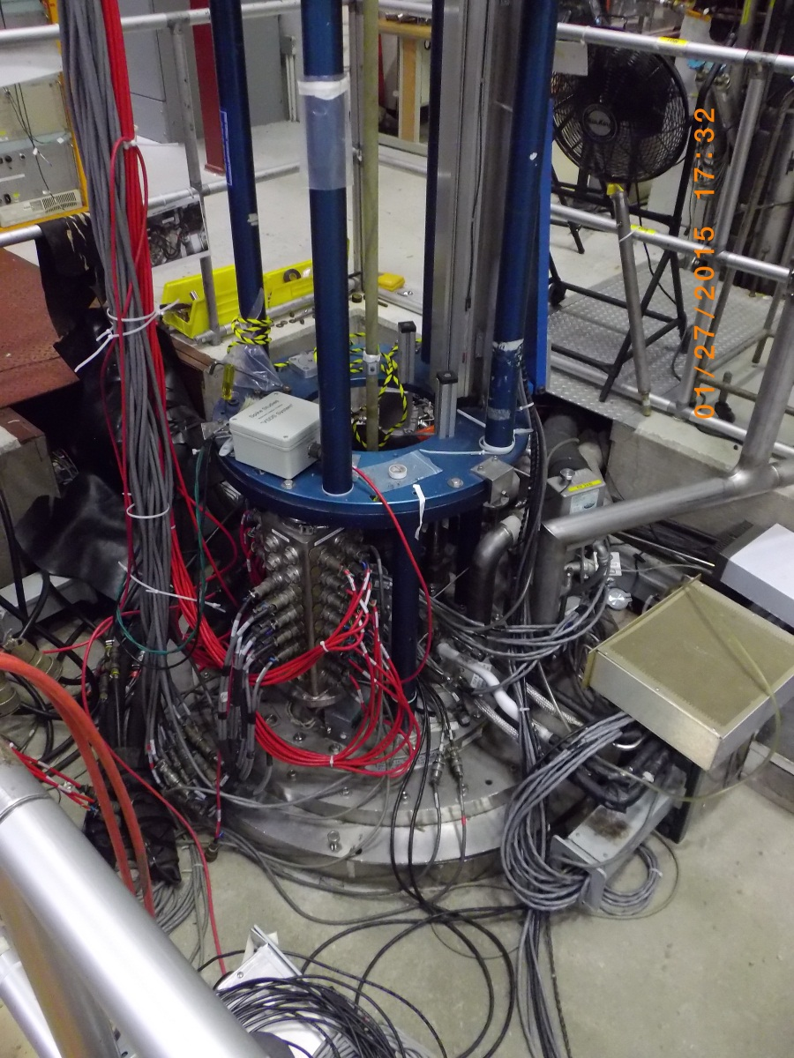
VMTF Measurement Capabilities
One test stand
15 kA, 1.9 K top plate assembly
30 kA, 1.9 K top plate assembly
Maximum capacity: 10 tons, 3.7 meters long
Not enough for US-HiLumi 5 m Long Magnets
FNAL will not invest in increasing the length of the VMTF Facility
Measurements
Quench performance
Warm bore tubes 30, 90, 150 mm diameters
Rotating probes for field strength and harmonic measurements

Slide 9
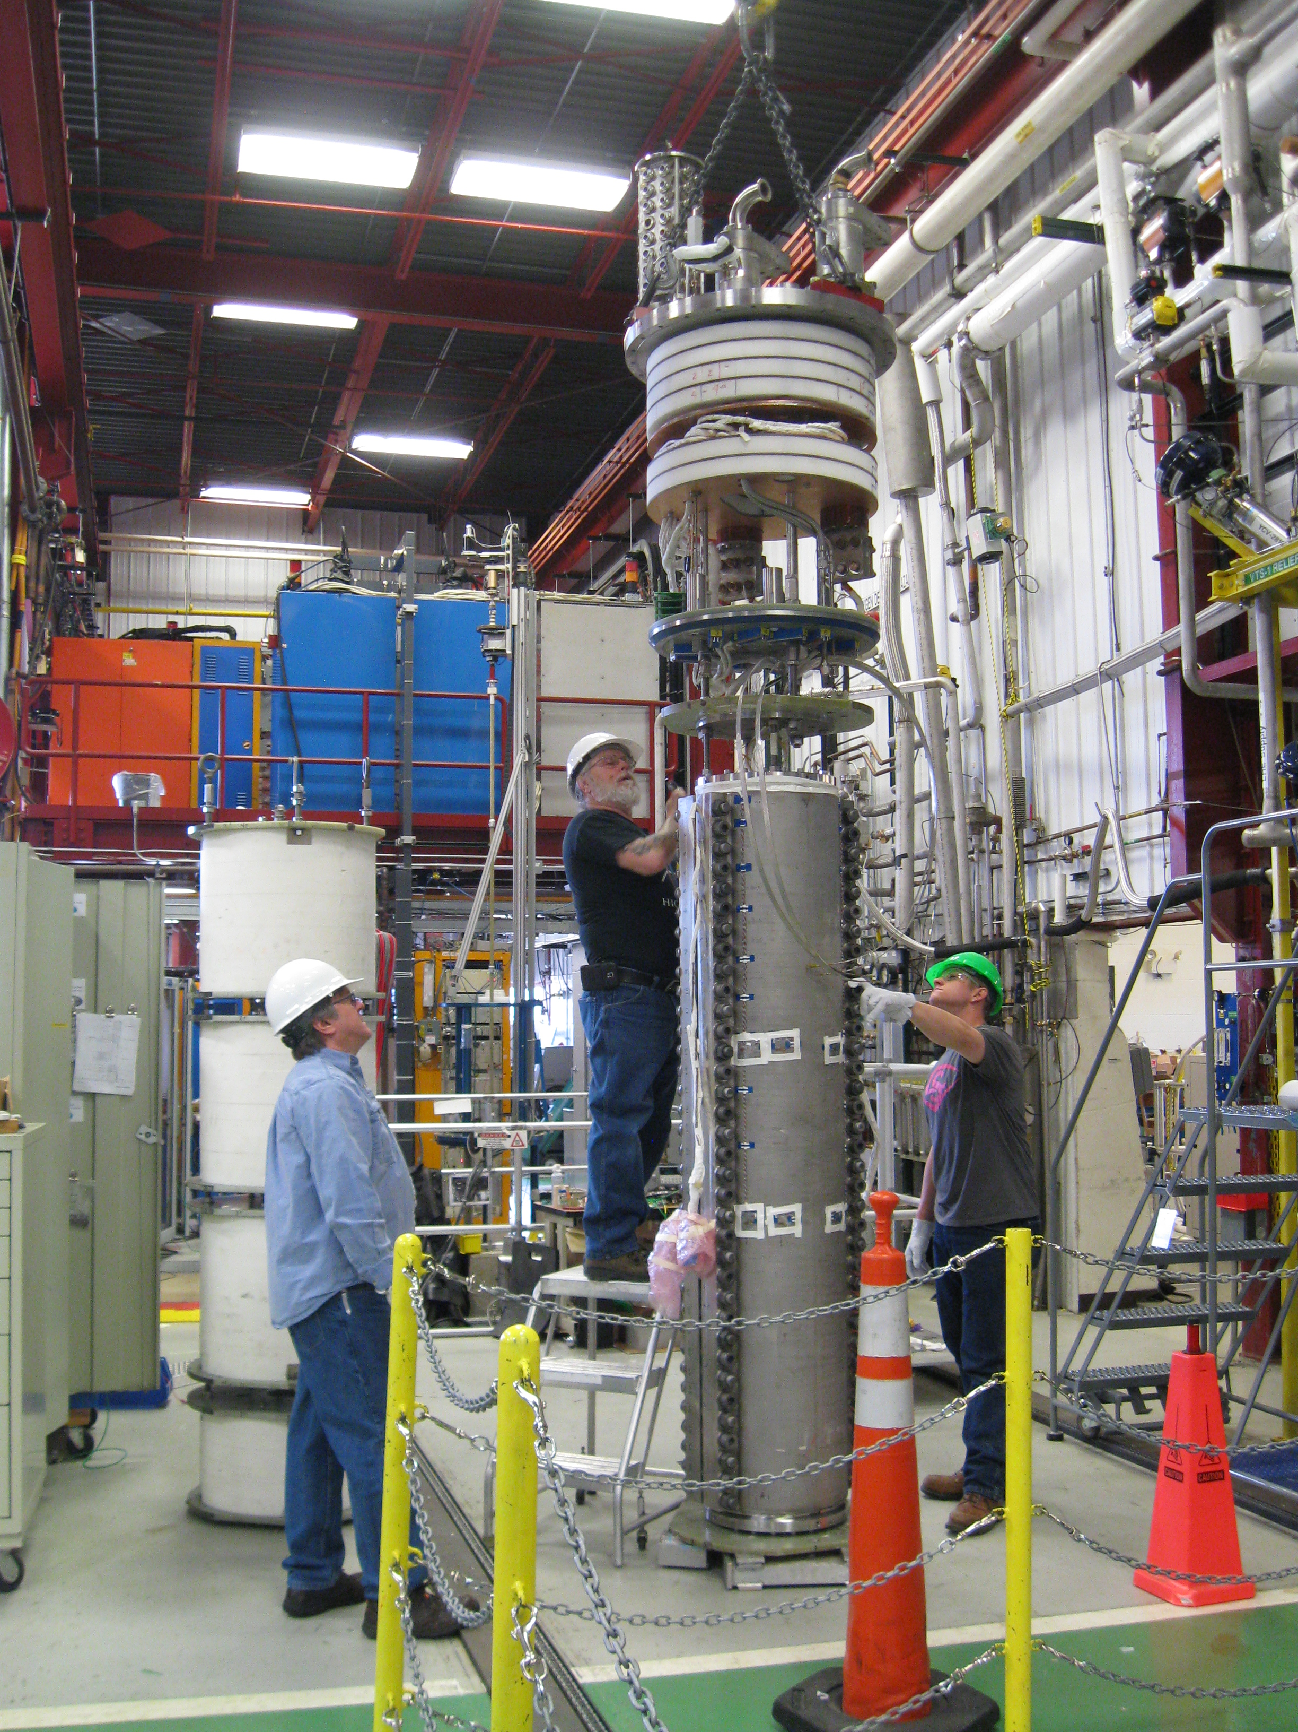
VMTF Upgrades
LARP has funded the construction of a new top plate for VMTF that increases the current capacity to 30kA at 1.9K, with larger aperture and warm bore, as required for LARP.
Over the next several years, Fermilab plans to modernize the controls, monitoring, and measurement systems for the test stand to provide a robust testing environment for LARP, US-HiLumi, and the High field Magnet R&D program.
Much of this work will also be directly applicable to the Horizontal Test facility.
The speed of this upgrade program is dependent on the level of funding for test facility operations that Fermilab receives.

Slide 10
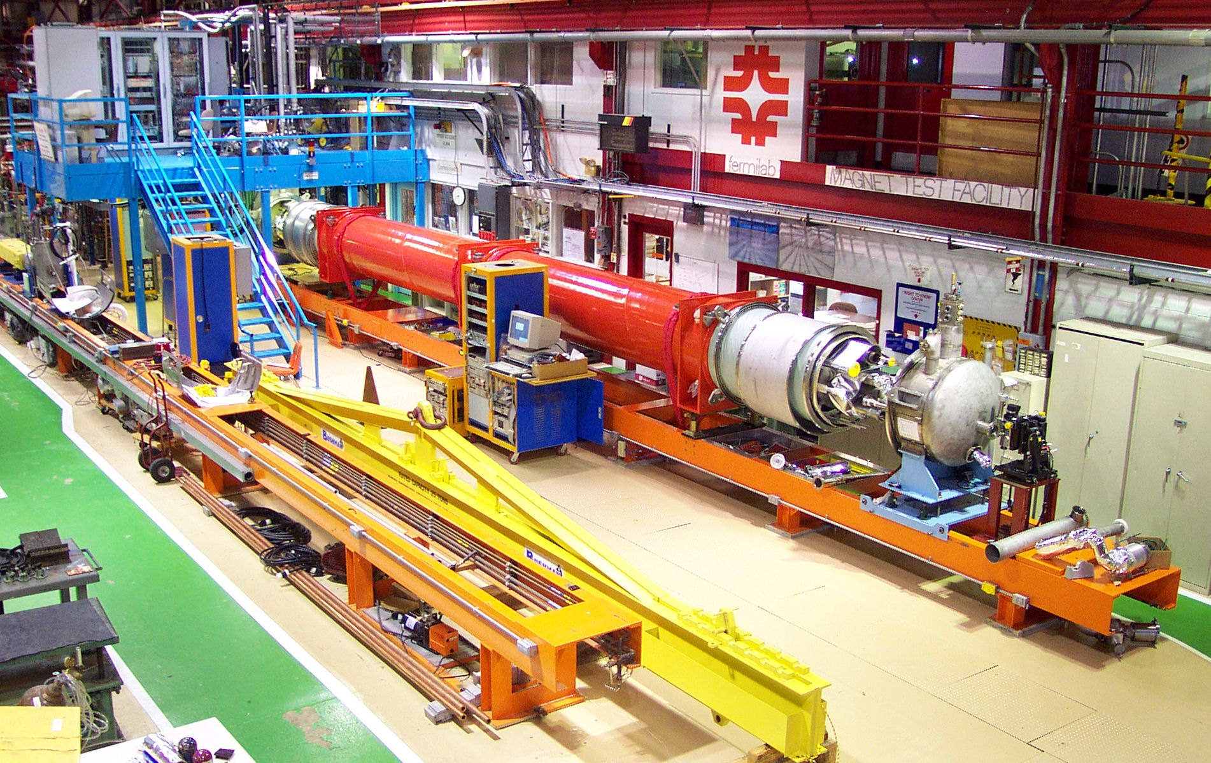
Stand 4 - Horizontal Test Facility
Test and measure
Large SC cryostated magnets
Used for SSC, LHC IR Triplets
Maximum length: ~15 meters
25 ton crane limit
1.9 K minimum temperature
15 kA maximum current
LARP/LHC/FCC plans
20-30 kA Leads Upgrade
Larger bore
Measurements
Quench performance, Rotating coil for field strength and uniformity, Single stretched wire
FNAL considering investment (TD Facilities Operation funding) to support the upgrades of the Horizontal Test Facility
FY16 & 17: ~2 FTEs &~ 0.5 – 1 M$ in Materials (WAG, estimates under prep)

Slide 11
SRF Facilities
Fermilab has been equipped with a vast array of SRF Facilities in preparation for ILC
Cavity Processing Facilities
Cavity Testing Facilities (both Vertical and Horizontal)
Cryomodule Assembly Facilities
Main Users of these facilities in the next decade:
LCLS-II (FY16-FY18)
152 Cavites (1.3 & 3.9 GHz) and 19 Cryomodules (8-Cavities each)
PIP-II (FY19-FY23)
113 Cavities (5 different design at 325 & 650 MHz) and 19 CM
R&D Efforts (High Q0, SRF cost reduction, ILC Upgrade,…)
Fermilab will play the role agreed upon by DOE for Crab cavities
Construction and/or testing

Slide 12
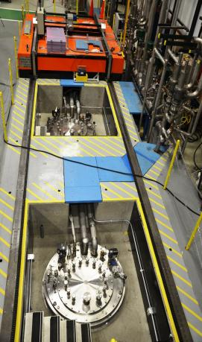
Vertical Test Stands (VTS-1, 2, 3)
Main Functions
Measurements of bare and dressed SRF cavities of various frequencies at temperatures down to 1.4K
Q(E) curves, Q(T)
Full diagnostics instrumentation
Magnetic fields, quench detection, T-map
Fermilab capacity would allow testing of US-HiLumi crab cavities at VTS after some upgrades
e.g. RF upgrades for new frequency.
VTS1, VTS2 and VTS3 pits
VTS1 insert with 1.3 GHz 9-cell

Slide 13
IB1 Test Operations History

Slide 14
Magnet-Cavities Testing Interference
Historical plots show up to ~140 cavities test/year during efficient times. The recent commissioning of two new test stands could increase that rate.
Challenge comes from the increase in magnet testing in concurrence with cavity testing
not present in past when we had no cavities to test, or lately where we only had an handful of HFM and LARP Magnets to test.
Latest studies show that the IB1 Liquefaction rate (~300 l/h) and usage rate might support one cold mass (2 magnets) and 30 cavity test cycles every 14 weeks with proper co-ordination.
A 14-week test cycle and 85% facility availability => 177 weeks (3.4 years) to test all 10 US-HiLumi LHC cold masses.
This is almost 1 year longer than the expected 2.5 years
however 2 out the 10 LHC cold masses are spares providing some flexibility.
No problem expected for cavity testing.

Slide 15
Conclusions and Challenges
FNAL intends to remain a premier player in the field of Superconducting Magnets with the US-HiLumi production and the HFM R&D for Future Circular Colliders.
Fermilab will play the role agreed upon by DOE for Crab cavities construction and/or testing
Challenges include:
Securing support for Facilities Operations to allow much needed upgrades for the automatization of the SELVA winding machine and of the Horizontal Magnet Test Stand-4 Facility
Coordination of cryogenic resources to allow progress on all 3 major future projects on TD plate: LCLS-II, PIP-II and US-HiLumi
Proper Coordination and Prioritization of test cycles during the parallel Testing of US-HiLumi Magnets and PIP-II Cavities (FY19-FY22)

