Slide 1

Recent Magnet Results
& Future Plans
Ambrosio & P. Ferracin
on behalf of the MQXF team
With special contributions by: R. Bossert, G. Chlachidze,
H. Felice, E. Holik, S. Izquierdo Bermudez, M. Juchno,
G.L. Sabbi, J. Schmalzle, M. Yu, …
HiLumi - LARP Collaboration Meeting
May 11-13, 2015
FNAL

Slide 2
Outline
MQXF Design
Short Models (MQXFS)
    Status
    Results
Long Model & Prototypes (MQXFL & MQXFA/B)
    Status
Plans
Risks, Risk Mitigation & Opportunities
    HQ tests & coil analysis
Conclusions

Slide 3
MQXF Design Finalization
Length & Gradient:
  Gradient: 132.6 T/m
  Length: 4.2 m (MQXFA), 7.15 m (MQXFB)
RRP strand specs: 108/127
  with 1.2 Cu/NonCu (632 A @12T, 331 A @ 15T 4.2K)
Cable keystone angle: 0.4 deg
Coil cross-section:
  Small adjustment
More margin
Better Quench Protection
Cost savings
OK for PIT conductor
For 2nd gen. cable
b6 optimization

Slide 4
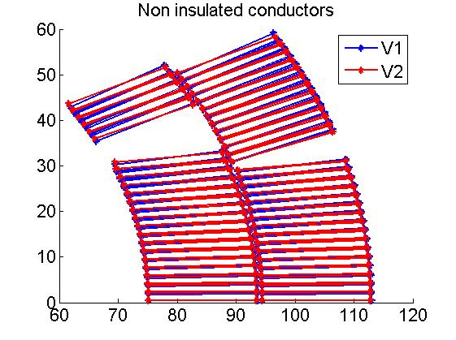
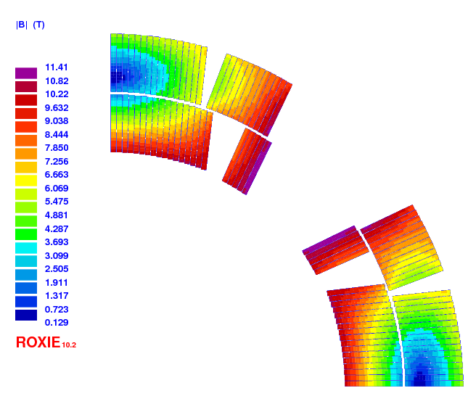
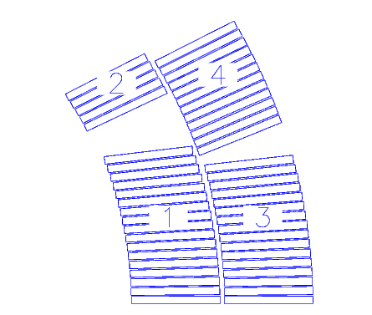
MQXF 2nd Generation Design
 | Unit | Value
Operating temperature | K | 1.9
Operating current | kA | 16.5
Peak field at op. current | T | 11.4
Op. overall current density | A/mm² | 462
Stored energy/length | MJ/m | 1.17
Inductance/length | mH/m | 8.21
Peak field including strand self field
+125 µm Mid plane
-125 µm Pole
Δb₆ = -5, Δb₁₀=-0.5
-125 µm Mid plane
+125 µm Pole
Δb₆ = +5, Δb₁₀=+0.5

Slide 5
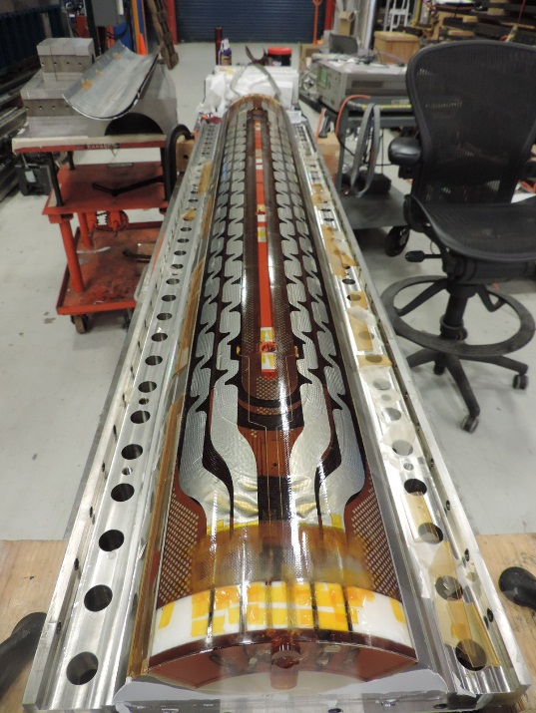
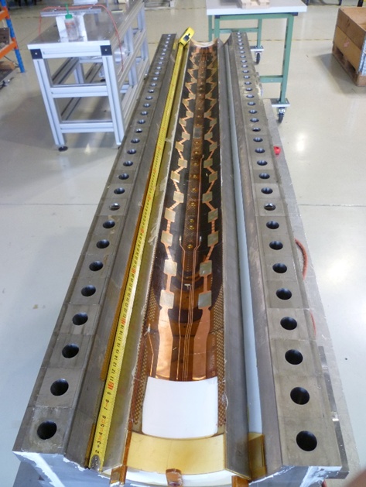
Short Coil Fabrication Status
Mostly good coils,
a few bumps on the road,
more details tomorrow.
WG for MQXFS1 coil selection on Thursday
6 RRP coils by LARP:
  1 practice coil (cut for inspection & analysis)
  1 coil for test in mirror structure
  4 coils for MQXFS1/2 (2 need only instrumentation)
1 Cu, 1 low-grade, 3 RRP, 1 PIT by CERN:
  1 Cu and 1 low-grade Nb₃Sn for practice
  1 RRP coil for possible single-coil test
  2 RRP coils for MQXFS1/2 (almost completed)
  1 PIT coil in progress

Slide 6


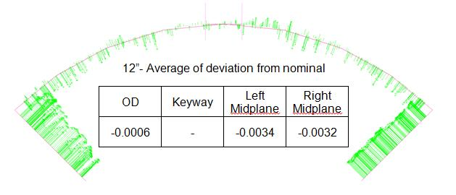
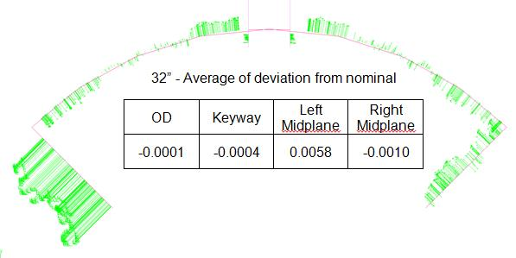
Short Coil Fabrication QC
Electrical tests: Good
Dimensional tests: To be improved
  Some left-right asymmetry

Slide 7
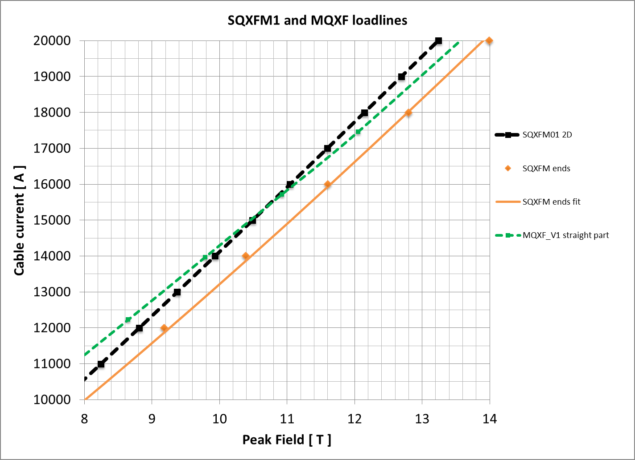
Short Coil QC (MQXFSM)
Mirror structure as coil test facility for QC:
  Load line within a few percent from MQXF load line
  Low prestress to avoid damage
Coil Protective Shell
Yoke (EDM’d blocks)
Bolt on skin
Aluminum Side Clamp
Design by
A. Zlobin & I. Novitski
Coil Midplane shim

Slide 8
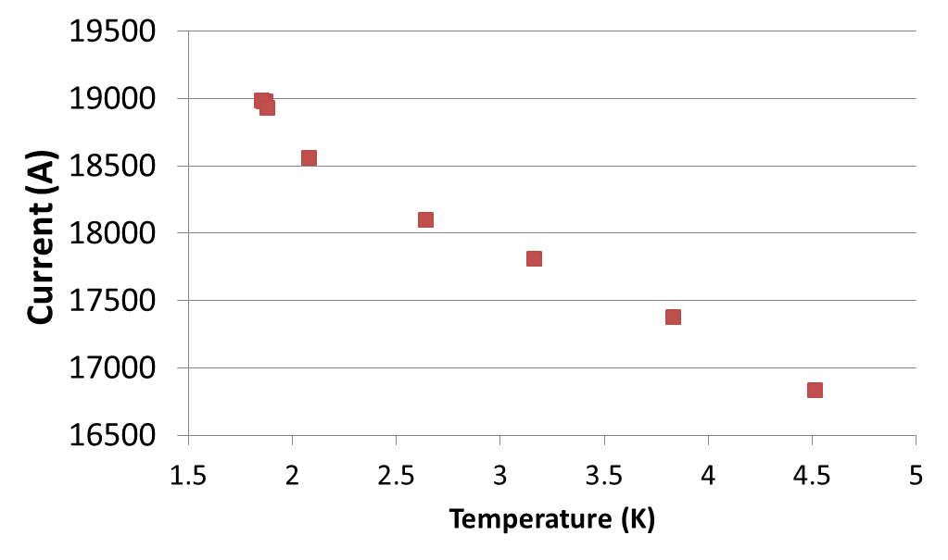
MQXFS1 Test Results - Preliminary
Conductor: RRP 108/127 by OST
19.2 kA = 91% SSL
16.5 kA

Slide 9
MQXFS1 Test Results - Preliminary
The new top-head for VMTF with current up to 30 kA at 1.9 K performed very well!
Ramp rate dependence & holding current tests
No quench in ramp down from 16.5 kA to 0 kA at 300 A/s
Note:
ramp rate dependence is different in mirror and in quadrupole
Holding 16.5 kA at 4.5 K for 2 hours w/o quench
To be repeated for longer time at 1.9 K
More details tomorrow morning in Magnet Session at 10:00 am

Slide 10
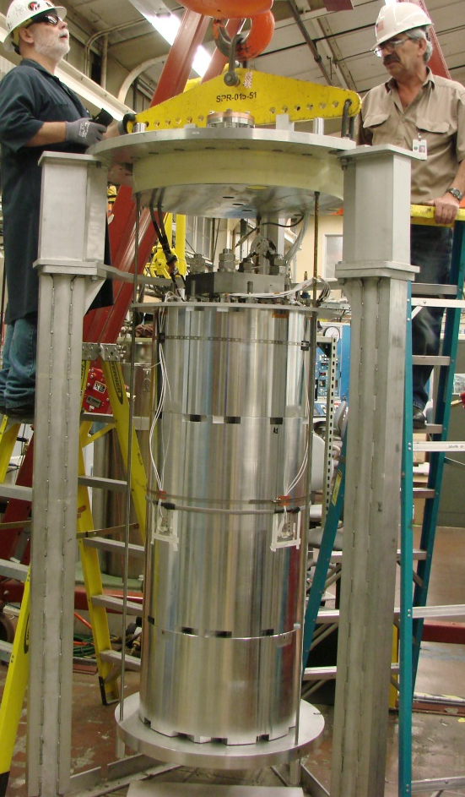
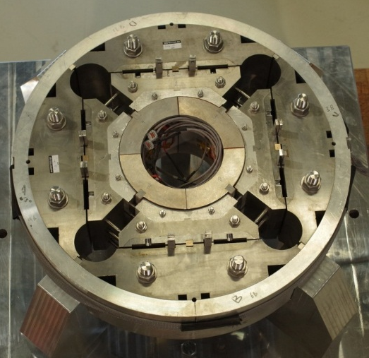
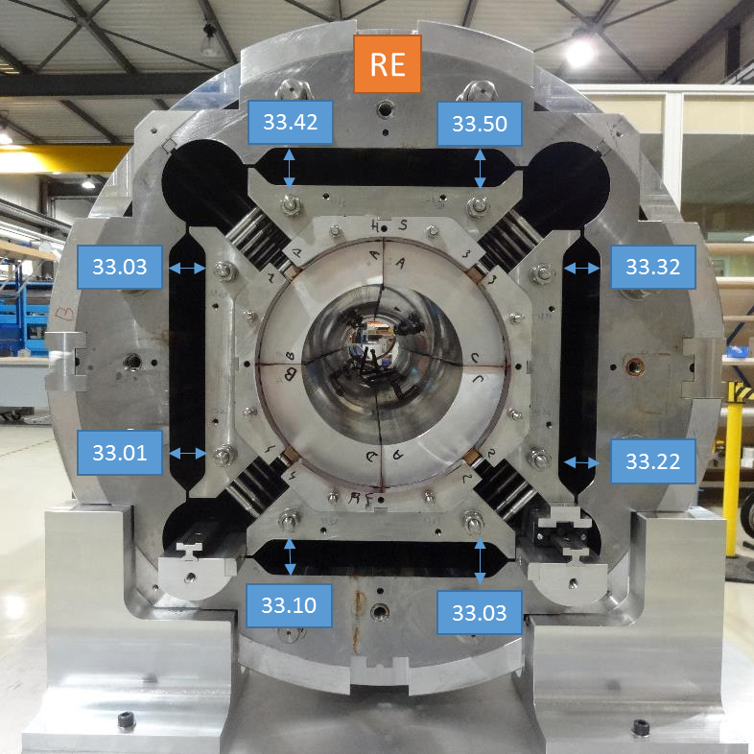
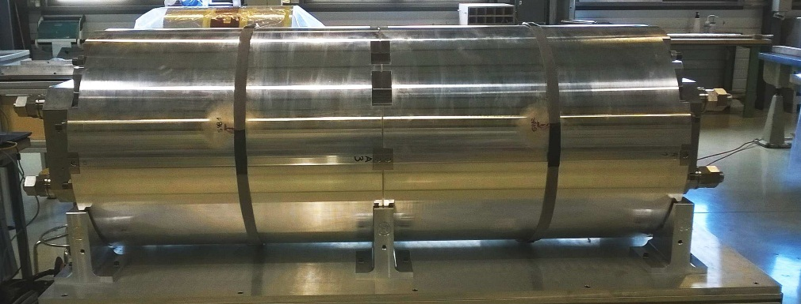
Mech. Model & Short Models
Assembly & LN cooldown:
  1 mechanical model
  (15 cm long)
  2 short model structures with dummy coils
CERN
LARP
CERN

Slide 11
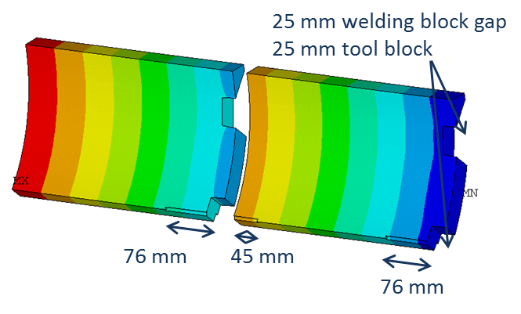
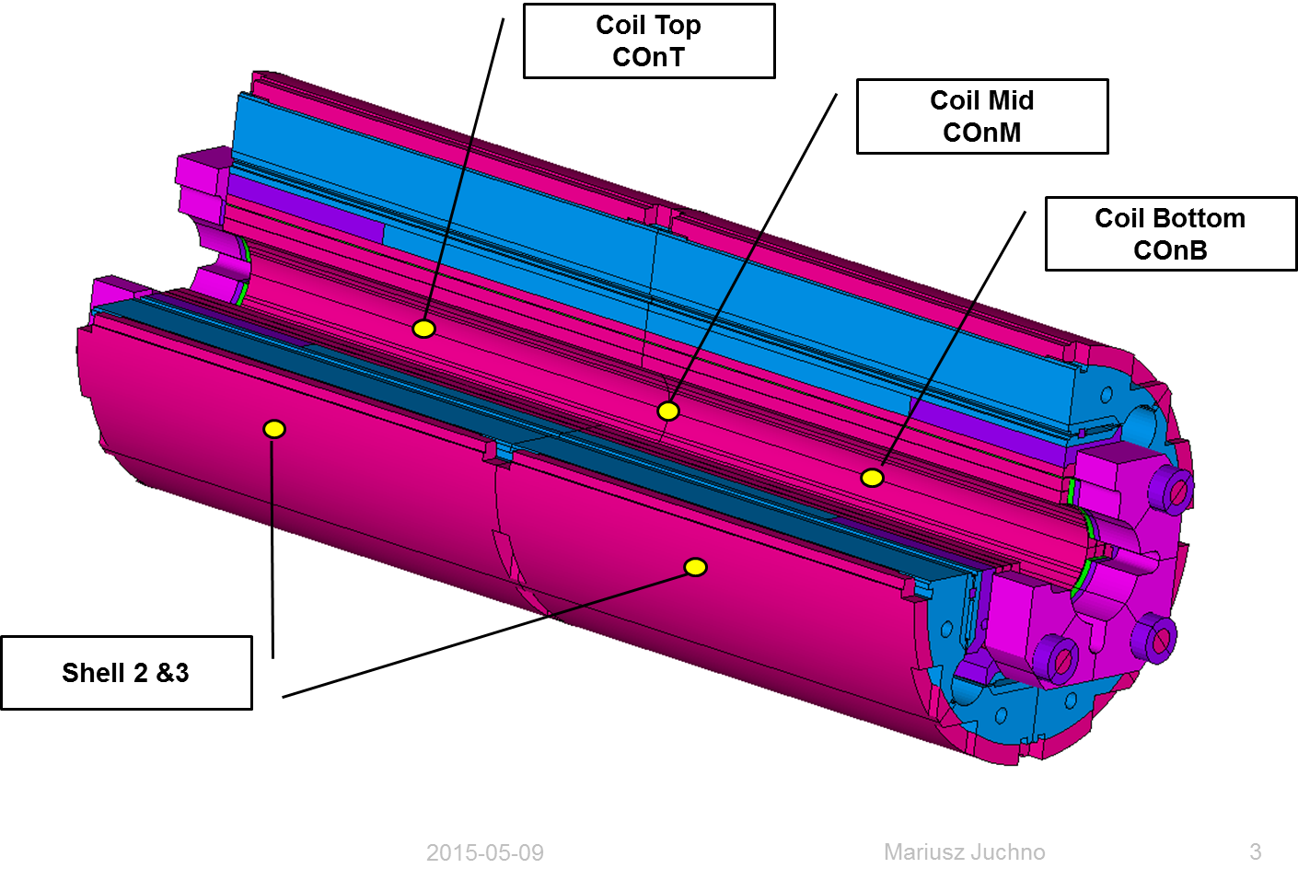
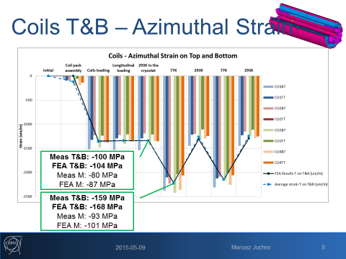
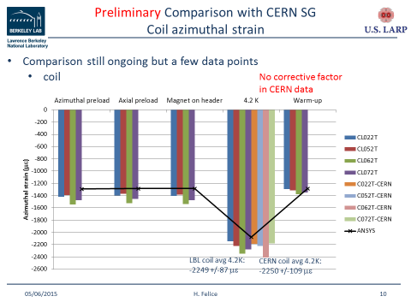
Short Models & Mech Models
Strain gauge results:
consistent with FEM analysis
  Adjusting friction coefficients for fine tuning
More details tomorrow morning in Magnet Session at 10:00 am

Slide 12
Long Models & Prototypes
More details tomorrow afternoon in Magnet Session
LARP Status:
  Equipment:
    Wind&Cure @ FNAL just commissioned
    Wind&Cure @ BNL fabrication in FY16 (budget constrained)
    React&Impr @ FNAL operational
    React&Impr @ BNL operational (oven upgrade in FY16 for 4.2 m)
  Tooling:
    Wind&Cure ready for use
    React&Impr is being procured (one set in)
  4m coil fabrication is starting now; 4.2m coils start in 09/16
  Structure: review in mid July ➔ procurement
  Vertical Test Facility upgrade @ BNL in progress

Slide 13
Prototypes
More details tomorrow afternoon in Magnet Session
CERN Status:
  Equipment
    Modification of winding machine in progress, to be completed by 10/15
    Curing press operational
    Impregnation system to be delivered to CERN by 06/15
    Reaction oven to be delivered to CERN by 04/16
  Tooling
    Winding and curing tooling procurement launched, to be delivered in 11/15
    Reaction/impregnation tooling design in progress
  Coil fabrication to be started in 12/15
  Long support structure design started

Slide 14
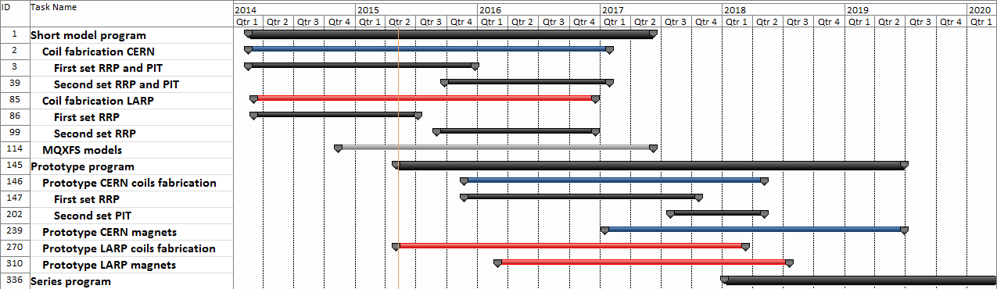

Plans
Short model program: 5 CERN-LARP models, 2014-2017
  Coil fabrication started in 03/2014
  First coil test in 05/2015
  First magnet test (MQXFS1) in 08/2015 (2 LARP coils, 2 CERN coil)
Long prototype program: 2 (CERN) + 3 (LARP) models, 2015-2018
  Coil fabrication starts in 2015: 05 (LARP), 12 (CERN)
  First coil test in 07/2016 (LARP) and 08/2017 (CERN)
  First magnet test in 02/2017 (LARP) and 06/2018 (CERN)
Series production: 10 (CERN) + 10 (LARP) cold masses, 2018-2022
  Coil fabrication starts in 01/2018
  First magnet test in Q1/2020

Slide 15
Risks & Mitigation Strategy
Assembly and pre-load of long coils with alignment features in long segmented structures
  Mitigation: short models have segmented structure
Quench Protection is challenging because of high energy density in the coils
  Mitigation: lower operating current wrt original design
  Mitigation: address QP through HQ tests
Field Quality: tradeoff btw turn compaction (for FQ) and room for expansion during HT (to avoid possible degradation and electrical issues)
  Mitigation: address FQ through HQ tests and coil analysis

Slide 16


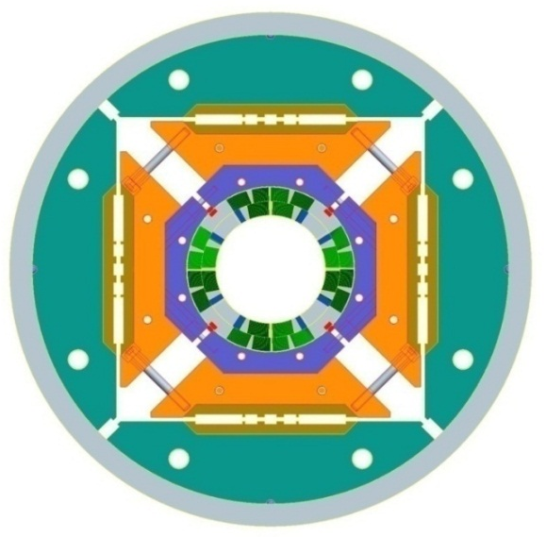
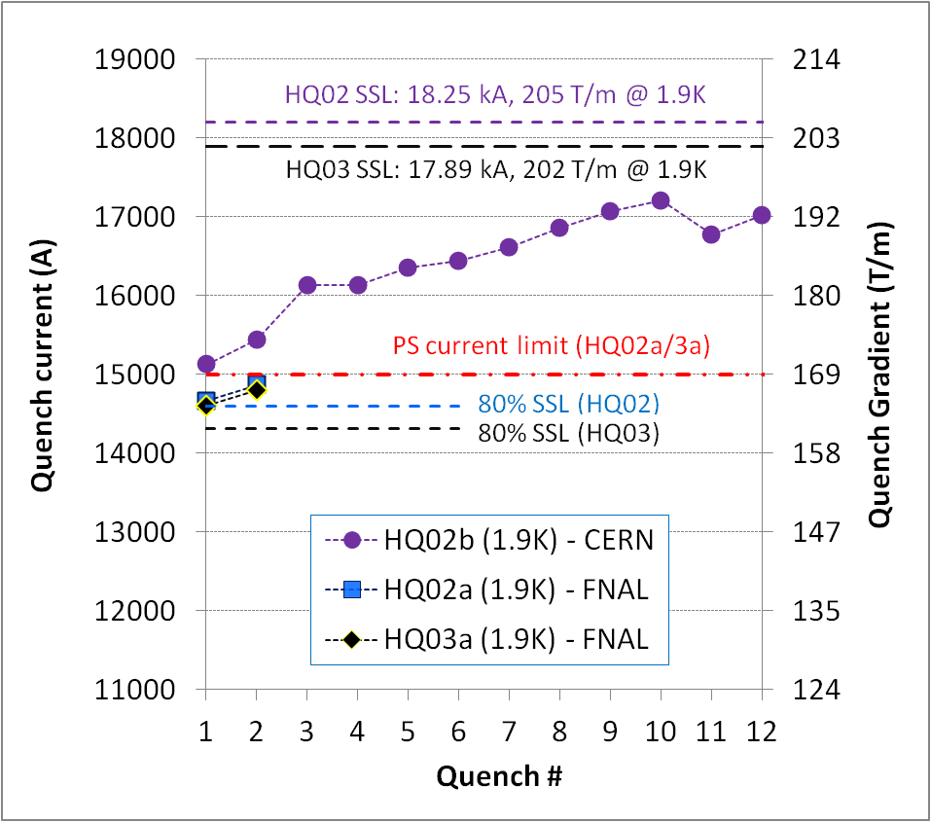
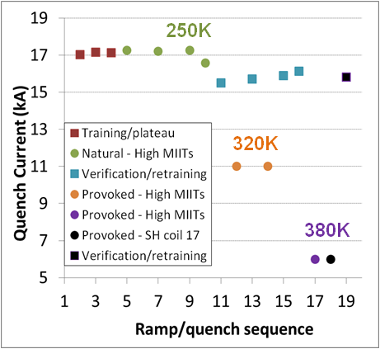
Recent HQ Test Results
HQ02b: fast training to 95% level with 200 MPa pre-load
01/15 HQ03a: first quench above operational level (80%)
Next: full training after removing 15 kA current limit
Small effect of high temperature quenches
G.L. Sabbi

Slide 17
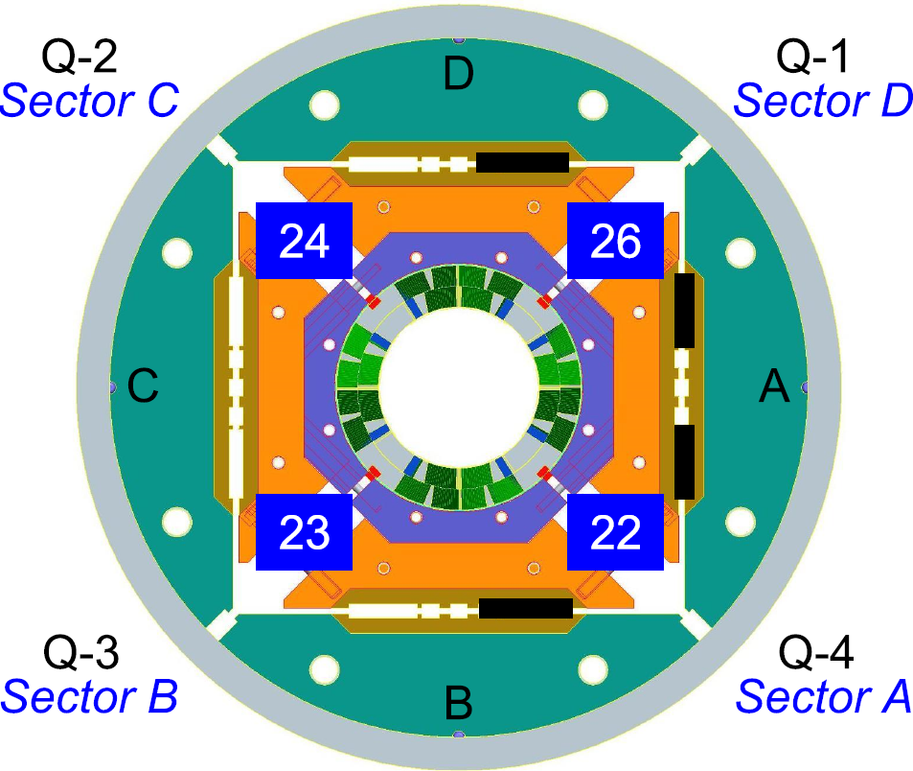
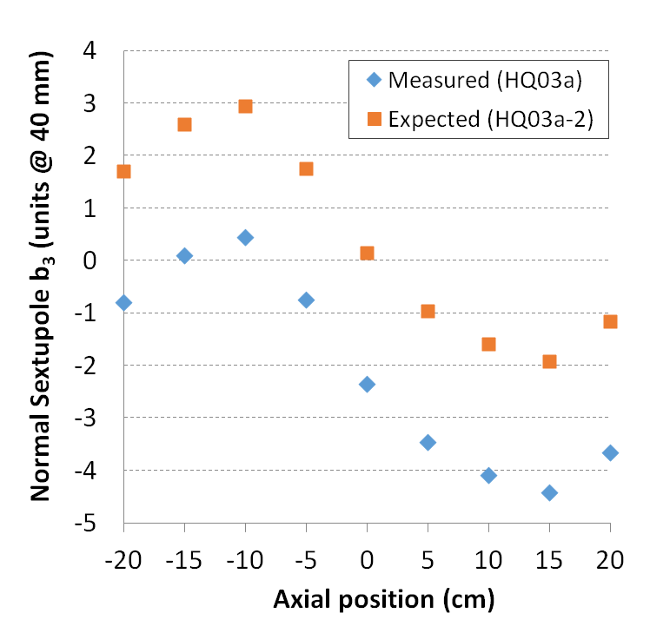
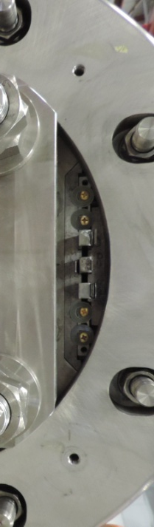
Magnetic Shim Test in HQ03
HQ03 Goal: maximum correction of b₃ (+2.5 units) with no change in other harmonics
Note: shimming range is insufficient for simultaneous correction of b₃, a₃, b₄, a₄ in HQ03
Magnetic shimming plan and installation
Sextupole correction (15 kA)
+2.5
G.L. Sabbi

Slide 18
Last HQ Plans before decommissioning
Next test (HQ03a-2) expected to be performed at Fermilab following the QXF mirror:
Complete training, evaluate performance; “partial” thermal cycle feedback
Include magnetic shims for correction of b₃
Evaluation of new quench antenna and heater designs for application to QXF
Outlook beyond HQ03a-2:
Some indication of insufficient pre-load, to be confirmed in HQ03a-2
  Increase preload (HQ03b) ?
HQ03b goals:
  Check performance after pre-load increase
  CLIQ studies
  Timeline: October-November
  Location: CERN or Fermilab (if CLIQ upgrade is completed by then)
  Additional options: cycling test; quench limits (extend HQ02b); stress limits (HQ03c)
G.L. Sabbi

Slide 19
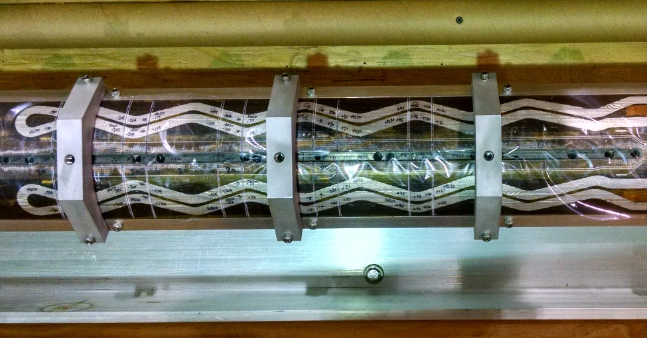
Turn position ➔ Field Quality
Exploring correlation between turn position and field quality
Unallowed a3 and b3 Along Bore of HQ02
Coil Cuts
Cut HQ02 coils at locations corresponding to the magnetic measurements, compute field & compare with measurements
E. Holik
Notes:
We are attempting to measure turn location of all 4 HQ02 coils with enough accuracy to correlate to the measured harmonics.

Slide 20
Opportunities
Possible significant cost savings by using thin laminations
  Strategy: demonstrate it through short models
Possible cost savings by exchanging parts/components btw US-HiLumi & CERN
  Exploiting it in this phase
  Exploring continuation/increase in construction phase

Slide 21
Conclusions
The Short Model program is going ahead at full speed generating good results
The Long Model/Prototype program is starting
We are addressing risks through design & plans
We are exploring how to exploit opportunities
Next big milestone:
MQXFS1 test this summer

