Slide 1

Application to the
Miriam Fitterer
(CERN)

Slide 2
Outline
Research achievements during the PhD (Wolfgang-Gentner Scholarship, CERN and University of Karlsruhe):
  the LHeC project
  the Rapid Cycling Synchrotron at CERN
Post-doctoral research achievements (COFUND fellow at CERN for the HL-LHC project):
  tolerances on stability and current ripple of the inner triplet (IT) power converters for HL-LHC
  LHC vibration limits in view of HL-LHC civil engineering works during RunIII
  development of alternative optics for HL-LHC (optics optimized for crab cavities, optics for PIC/US1 scenarios – RLIUP 2013)
  review and optimization of the crossing scheme and orbit correction in the interaction region for HL-LHC in view of the specification of the IR orbit correctors and BPM precision
Future research interests and possible topics within the LARP activities

Slide 3
Achievements during the PhD
- the LHeC project

Slide 4
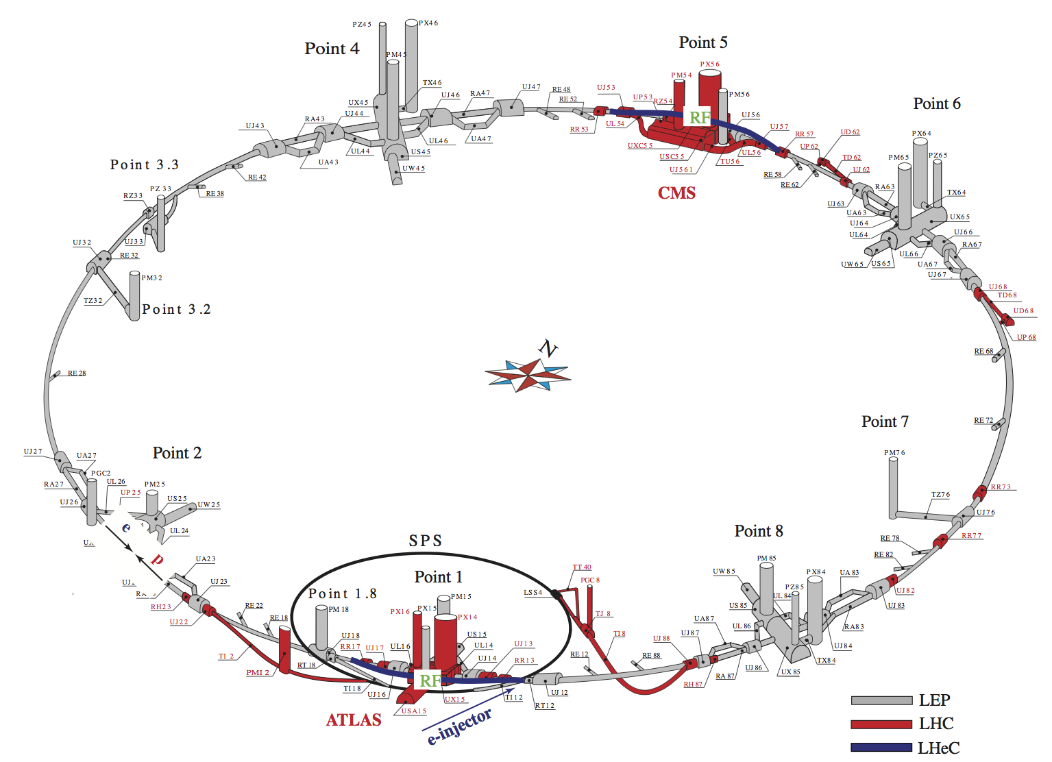
LHeC project
concept of a high luminosity electron-nucleon collider of 1.3 TeV center of mass energy
existing LHC proton beam collides with electron beam of 60 to 140 GeV
two options were considered as e-accelerator:
Linac-Ring option:
new ERL
Ring-Ring option:
installation of e-ring
on top of existing
LHC (PhD thesis)
LHeC Ring-Ring option
Ring-Ring option:
e-p experiment installed in IR2 or IR8
RF in bypasses around IR1/5

Slide 5
LHeC project
Contribution to the LHeC design study:
design of ring layout and geometry (integration of the e-ring into the existing LHC tunnel, design of bypasses, matching of e- and p-ring circumference)
  design of ring optics (arc, dispersion suppressor, bypasses) to achieve design parameters (synchrotron radiation and emittance)
  further beam dynamics studies: chromaticity correction, coupling to achieve emittance ratio, effect of circumference errors
 | p-beam | e-beam
beam energy [GeV] | 7000 | 60
luminosity [10³² cm⁻²s⁻¹] | 9 (HA) to 18 (HL)
hor./vert. emittance [nm] | 0.5/0.5 | 5.0/2.5
synchrotron radiation power | - | <50 MW
LHeC Design Report, J. Phys. G: Nucl. Part. Phys. 39, 2012

Slide 6
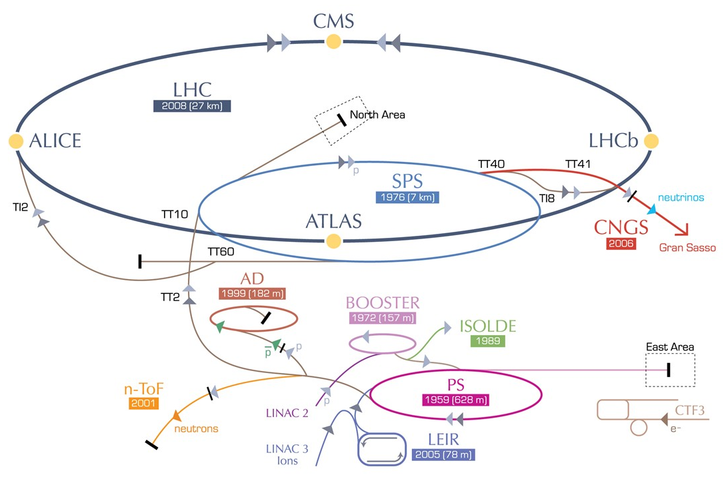
Achievements during the PhD
-
RCS study
RCS

Slide 7
RCS related studies
Feasibility study of a new Rapid Cycling Synchrotron as alternative to the PS Booster 2 GeV energy upgrade in 2011
Contribution to the RCS study:
lattice and optics design
 | PS Booster (upgrade) | RCS
inj./extr. energy [GeV] | 0.16/2.0
circumference [m] | 1/4 C_{PS} = 157.08 | 4/21 C_{PS} = 119.68
repetition rate | 0.8 Hz | 10 Hz
Feasibility Study of a Rapid Cycling Synchrotron to replace the PS Booster, Engineering/Technical Report 2011-08-01
differences between PSB lattice/optics and RCS lattice/optics motivated a general study of the effect of the linear optics in the case of space-charge dominated lattices in view of the design of future high power hadron machines

Slide 8
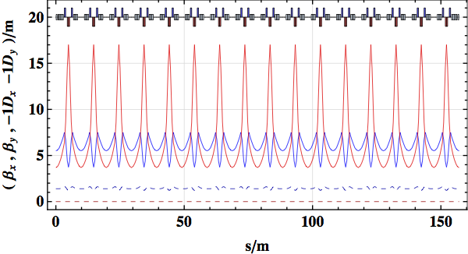
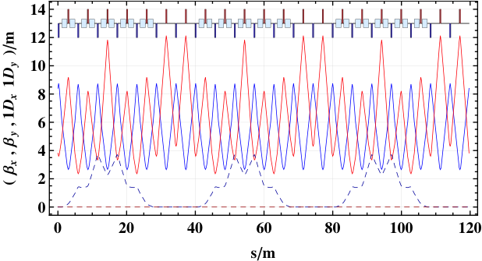
RCS related studies
main differences between PS Booster and proposed RCS lattice:
  variation of the beam size
  symmetry of the lattice and optics
  inserted straight sections (dispersion suppression)
2 cells
5 cells
RCS
21 cell FODO lattice
with 3x2 cells of straight
section
5 cells
PSB
regular
16 cell triplet lattice
2 cells
2 cells
5 cells
smallest emittance growth = best performance for:
small variation of the beam size
high lattice symmetry
small dispersion “beating”

Slide 9
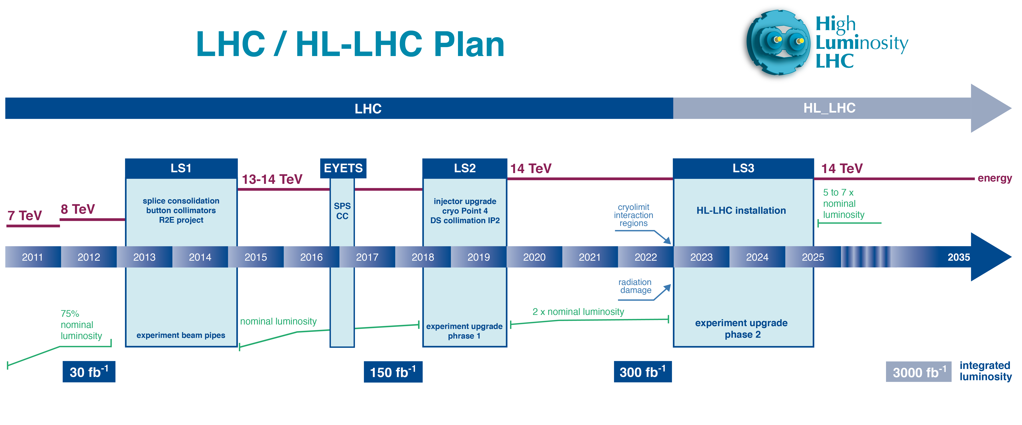
Achievements during the Fellowship
-
HL-LHC optics and beam dynamics studies

Slide 10
IT power converters
Motivation:
at HERA beam losses and emittance growth were observed when the beams were brought into collision due to an interplay of ground motion and power supply ripple [1]. At the SPS the observed slow beam losses could be explained by power supply ripple [2].
for HL-LHC β* values as small as β*=0.15 m are envisaged leading to a large maximum β in the IT of around β_{max,IT}=20 km, in comparison to e.g β_{min}*=0.40 m and β_{max,IT}=6 km for LHC RunII/RunIII. Due to the large β the HL-LHC will be even more sensitive to power supply ripple than the LHC.
Contribution to the specification of IT power supplies:
provide tolerances for IT power converters in respect of beam dynamics
comparison of different powering schemes in respect of beam dynamics
specification of IT power supply tolerances in order to ensure beam stability (losses, emittance growth)
[1] O.S. Brüning, F. Willeke, “Reduction of Proton Losses in HERA by Compensating Tune Ripple due to Power Supplies “, Phys. Rev. Lett. 76, 3719
[2] D. Brandt et al., ”Influence of Power Supply Ripple on the Dynamic Aperture of the SPS in the presence of Strong Nonlinear Fields”, EPAC 1990

Slide 11
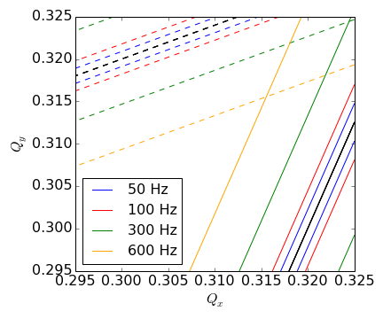
IT power converters
Power converter ripple:
is a modulation of the current and thus magnetic field usually associated with certain frequencies:
  50 Hz, 300 Hz and 20 kHz harmonics
modulation of IT current introduces a quadrupolar error and thus a tune shift
in addition to the tune shift the PC ripple introduces resonance side bands [1]:
DA aperture studies to identify effect of resonance sidebands introduced by PC ripple
[1] O.S. Brüning, F. Willeke, “Reduction of Proton Losses in HERA by Compensating Tune Ripple due to Power Supplies“, Phys. Rev. Lett. 76, 3719

Slide 12
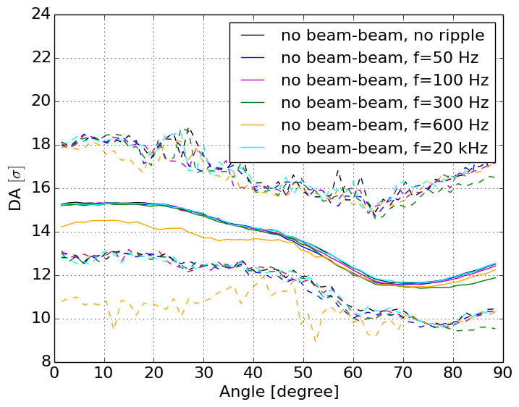
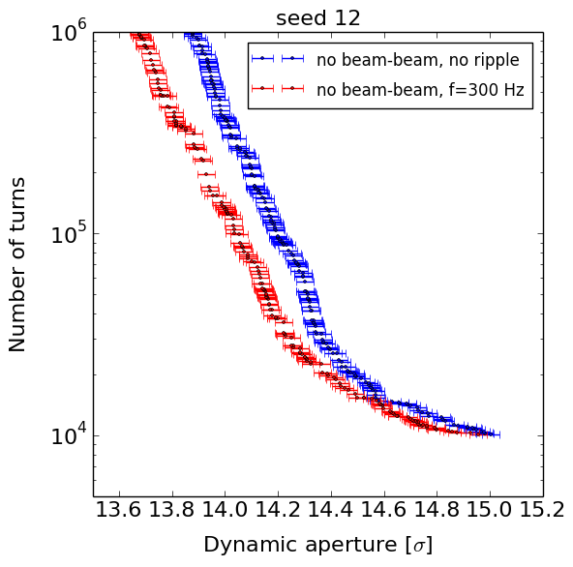
IT power converters
DA simulations with SixTrack for individual frequencies and complete spectrum as well as different beam configurations
Example for simulation results for ΔQ=10⁻⁴:
particle lost criterion
DA vs turns
specification of PC tolerances = determination of tolerances for individual frequencies and complete spectrum

Slide 13
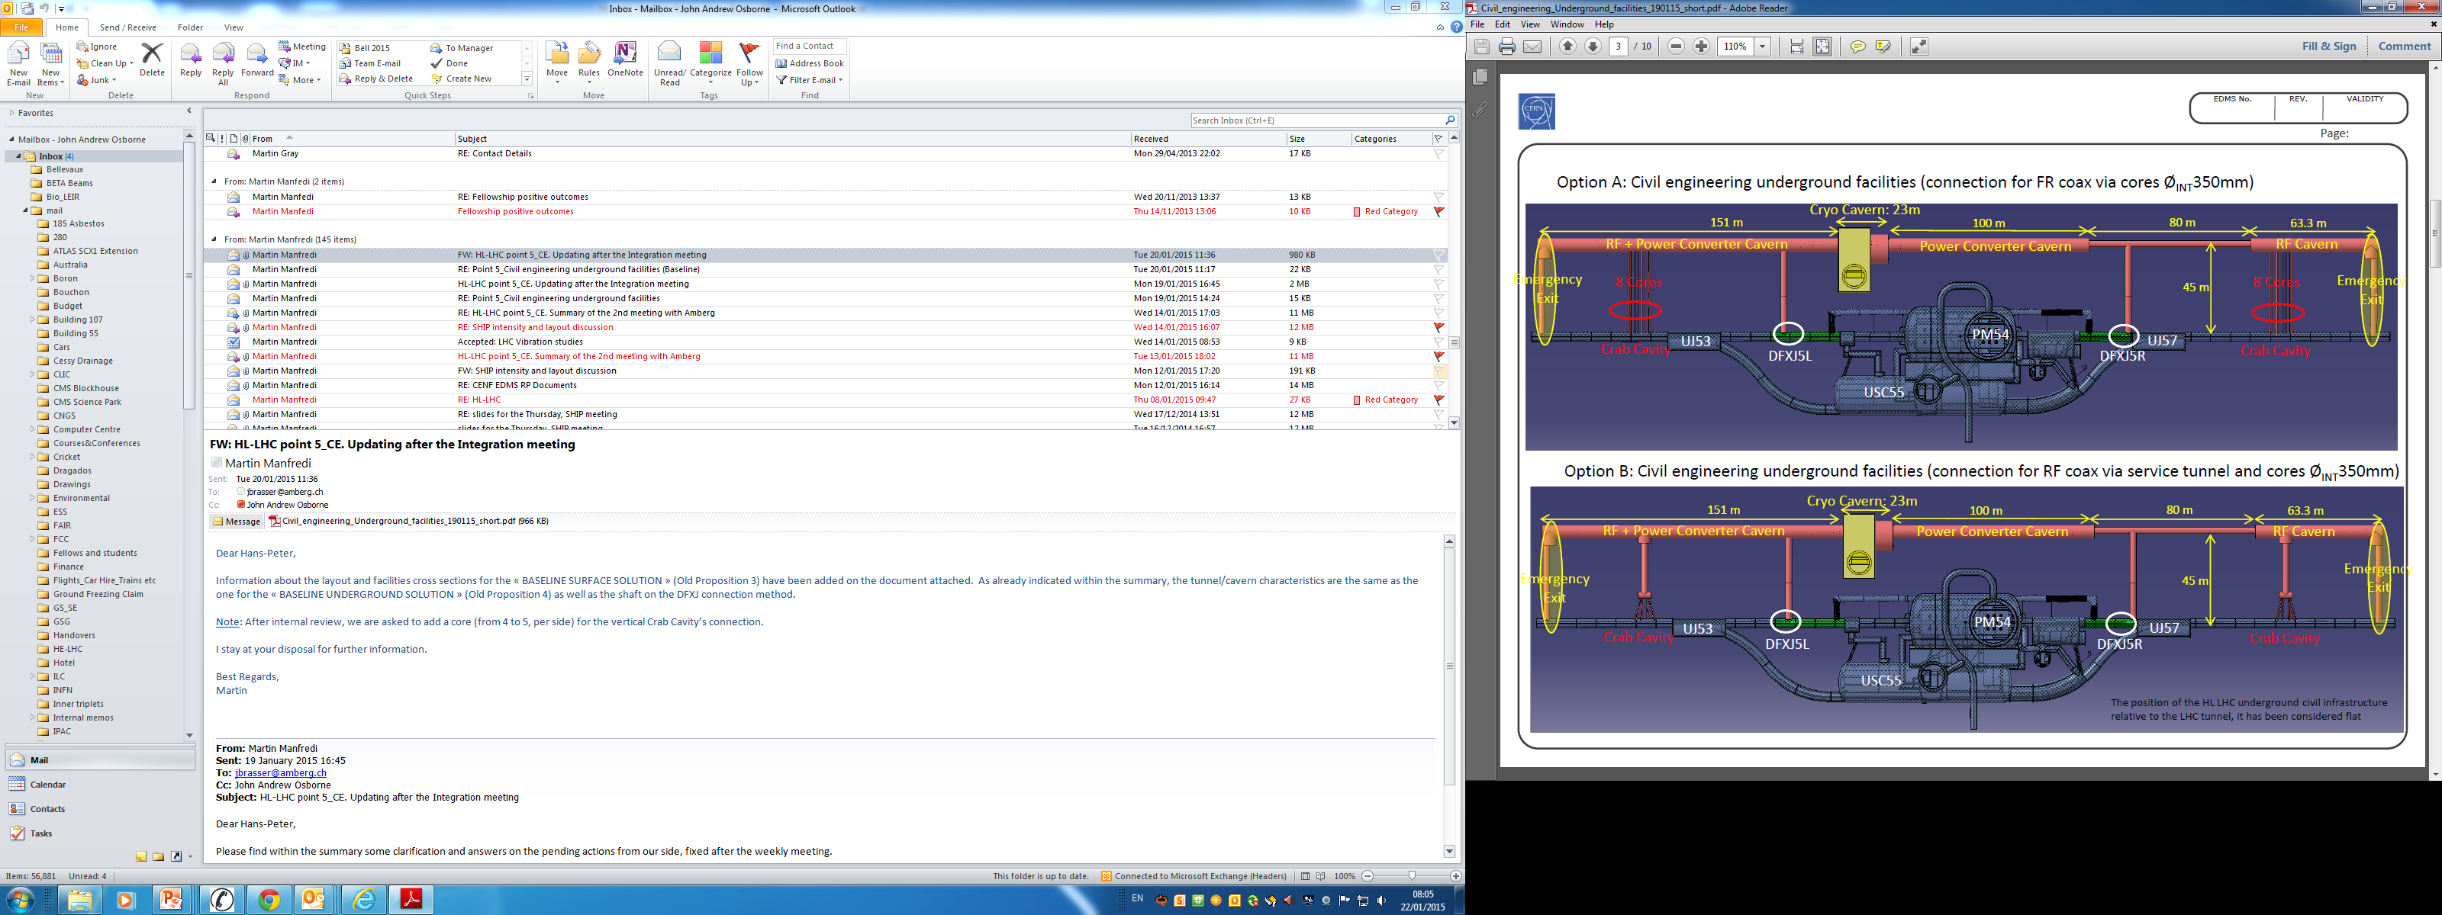
LHC vibration limits
Motivation:
additional tunnel parallel to IR1/5 planned hosting powering and RF (crab cavities)
with the original proposal the civil engineering works would have been started in LS2 and extended up to 1.5 years in RunIII
Contribution to the LHC vibration study:
identify main limitations due to vibrations from CE for RunIII asap
specify tolerances for vibrations caused by CE asap
=> Is an operation of the LHC during CE possible?
P. Fessia, J. Osborne
Is an operation of the LHC during CE possible? –Yes!/No!
work in progress

Slide 14


LHC vibration limits
Effect of vibrations due to CE on the beam:
main effect of CE is expected to be misalignment of quadrupoles in IR1/5 resulting in a closed orbit distortion:
  => main contribution from IT during collision (closest to CE!!!)
  effect of closed orbit distortion depends on:
    wavelength of the vibrations (1 μm displacement IT and RunIII parameters*):
    frequency of the vibrations
    CE spectrum lies in the range of 0-200 Hz => low frequency excitation:
    luminosity loss (softer limit)
    emittance growth (softer limit)
    increased losses at collimators due to orbit deviations + stronger population of tails due to low frequency excitation (hard limit)
no separation of the beams, small residual orbit at collimators (3 μm)
max. separation at IP (14 μm), residual orbit at collimators (19 μm)
no separation of the beams, max residual orbit at collimators (170 μm)
    *RunIII parameters: N_{bunch}=1.25x10¹¹, ε_{N}=2.0 μm, bunch length= 7.55 cm, N_{tot}=2740, β*(IP1/5)=0.4 m (option med RunII), E=6.5 TeV, σ_{IP}=10.7 μm

Slide 15
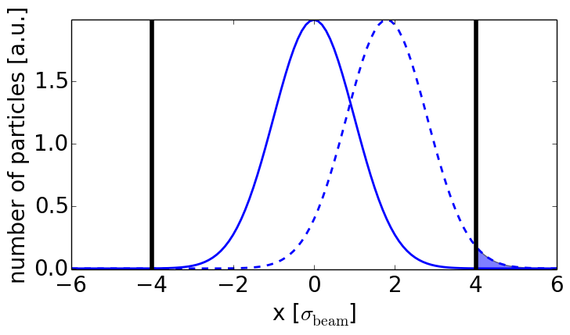
LHC vibration limits
Evaluation of limits from beam losses:
input: measurement of CE vibration spectrum (0-200 Hz) and wavelength (ongoing and needed for further evaluation)
calculation of orbit deviation at the primary collimators
prediction of halo distribution and diffusion rate
    => proposal of experiment at LHC
    to measure diffusion rate/halo population with and without low frequency excitation
δx
collimators
collimators
δx
lost particles
estimate of particle losses at primary collimators => vibration limits

Slide 16
Research interests and possible LARP activities

Slide 17
General research interests
General research interests:
high energy colliders like LHC and HL-LHC
optics and linear/non-linear beam dynamics in theory, simulation and experiment
in general many interesting and challenging topics in the field of optics and beam dynamics like e.g.:
halo diffusion processes/halo population (only partly understood, e.g. effect of a low frequency excitation – vibration studies, overpopulated halo in the LHC …)
effect of noise on the beam
effect of non-linear errors on the beam stability and possible corrections
optics and lattice design of future accelerators like the HL-LHC upgrade
optics measurements and corrections
development of optics and beam dynamics simulation codes
… and many more

Slide 18
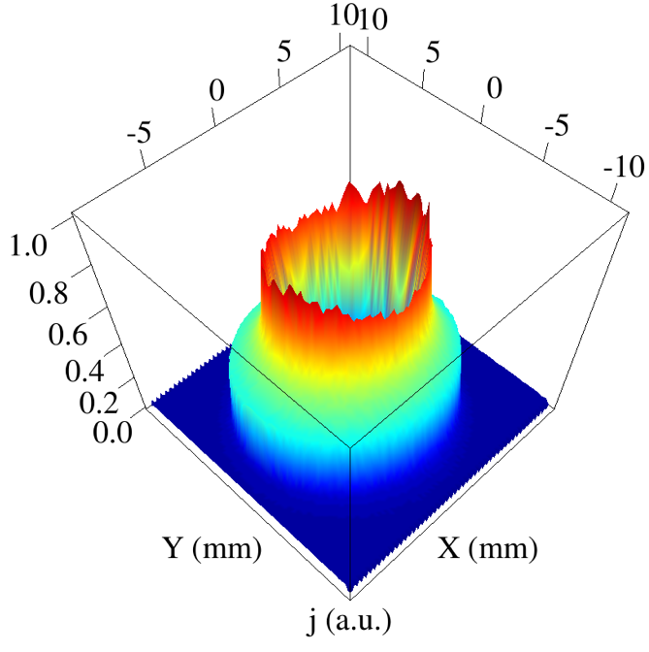
Possible LARP activities
Electron lens
Motivation:
LHC and HL-LHC represent a large increase in the stored energy
halo population e.g. 4σ to 6σ are poorly known. Current measurements indicate 0.1%-5% of total energy, which translates to 0.7 MJ - 35 MJ for HL-LHC
fast losses, e.g. crab cavity failure around 1.5σ, could exceed quench limit the threshold for collimator deformation or even lead to magnet damage
possible halo control methods
  tune modulation
  transverse damper
  electron lens
 | Tevatron | LHC 2012 | LHC nominal | HL-LHC
Stored energy per beam | 2 MJ | 140 MJ | 362 MJ | 692 MJ
essential to understand, monitor and control halo population
act in tune space
G. Stancari

Slide 19
Possible LARP activities
Topics connected to electron lens:
understanding halo population during different conditions in view of collimation and machine protection in experiment and simulation
the effect and performance of hollow electron lens for LHC and HL-LHC with e.g. tracking simulations and experiments
studies of alternative methods for active halo control (tune modulation, transverse damper)
conceptual design of electron lens wire for long-range beam-beam compensation in HL-LHC

Slide 20
Thank you for your attention!

Slide 21
RCS – emittance growth
Example lattice symmetry (FODO lattices):
systematic resonances are crossed for 15, 18 and 21 cells, no systematic resonances for 16 ad 24 cells
Example dispersion suppression:
Considerable reduction of emittance growth achieved with half missing dispersion suppressor scheme

Slide 22
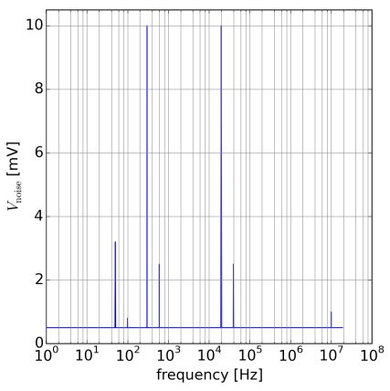
Voltage spectrum IT
current control:
class 1 PC: 1ppm
class 2 PC: 10 ppm
voltage control (class 1 + class 2 PC):
50 Hz harmonics (main grid):
50 Hz: 3.2 mV R.M.S.
100Hz: 0.8 mV R.M.S.
300 Hz harmonics (diode rectifier):
300 Hz: 10.0 mV R.M.S.
600 Hz: 2.5 mV R.M.S.
20 kHz harmonics (ITPT converters):
20 kHz: 10.0 mV R.M.S.
40 kHz: 2.5 mV R.M.S.
10 MHz harmonics:
10 MHz: 1.0 mV R.M.S. (0.5 mV)
all other frequencies:
0.5 mV R.M.S
300 Hz
20 kHz
50 Hz
600 Hz
40 kHz
100 Hz
10 MHz
Notes:
dBmuV = Gain references to 1muV, e.g. 20*log10(3.2 mV/(1muV))=70 and 20*log10(10 mV/(1muV))=80
Nominal LHC (peak to peak): Vpk-pk(PC1 (8kA, 8V)) = 5 mV => Vrms=0.707*Vpk-pk =>V [dBmuV) = 20*log10(0.707 Vpk-pk/(1muV))=70

Slide 23
Model of PC ripple
two regimes:
current control (<0.1 Hz):
voltage control (>0.1 Hz):
with
current ripple (Power converter specifications)
voltage ripple (Power converter specifications)
transfer function of the load (circuit) seen by the power converter
transfer function from the input current of the magnet to the
magnetic field (assumed constant)
transfer function of the cold bore, absorber, beam screen etc.,
T_{Vacuum} ≤1 (not taken into account)

Slide 24
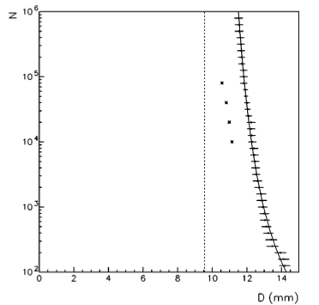
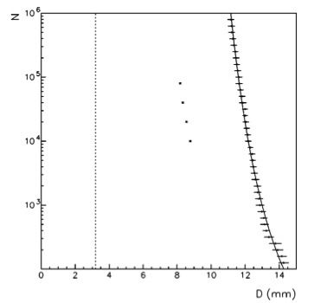
IT power converters
DA can be determined by different criteria:
particle lost criterium: particle is considered unstable if it is lost after the number of turns tracked
Lyapunov exponent: common approach to distinguish regular from chaotic motion, but in general “very sensitive” and underestimates the DA in case of slow particle losses
DA vs turns = DA as a function of the number of turns N:
DA can be determined by different criteria:
particle lost criterium: particle is considered unstable if it is lost after the number of turns tracked
Lyapunov exponent: common approach to distinguish regular from chaotic motion, but in general “very sensitive” and underestimates the DA in case of slow particle losses
DA vs turns = DA as a function of the number of turns N:
no modulation
extrapolation to infinity
prediction through Lyapunov exponent
[8]
with modulation
suited for slow losses
[8]
[8] E. Todesco, M. Giovannozzi,” Dynamic aperture estimates and phase-space distortions in nonlinear betattron motion, Phys. Rev. E 53, No. 4067 (1996)
Notes:
plots are for the Henon map
sigma(N)=1/N*log(A_lambda * N), all particles with\lambda(N)>sigma_lambda(N) particle is considered to be chaotic, otherwise it is considered stable

Slide 25
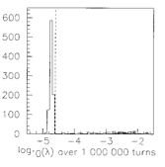
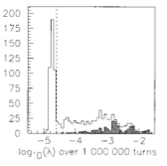
DA criteria
one of the most common approaches to determine the dynamic aperture is the Lyapunov exponent, which distinguishes regular from chaotic motion:
In case of tune modulation the particle losses can be extremely slow and chaotic regions can be stable for a sufficiently long time resulting in an underestimate of the DA with the Lyapunov exponent [7].
no modulation
with modulation
[7] M. Giovannozzi, W. Scandale, E. Todesco, Phys. Rev. E 57, No. 3 (1998)
stable after 10⁷ turns
threshold
lost after 10⁷ turns
Notes:
plots are for the Henon map
sigma(N)=1/N*log(A_lambda * N), all particles with\lambda(N)>sigma_lambda(N) particle is considered to be chaotic, otherwise it is considered stable

Slide 26
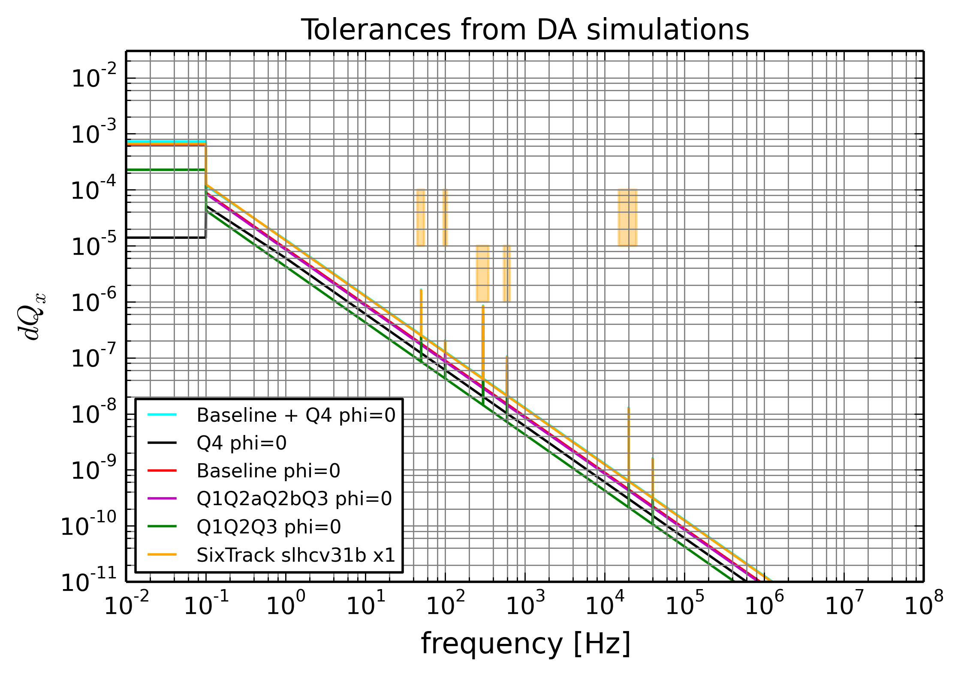
Tolerances for IT PC
tolerances provided from DA simulations
Notes:
plots are for the Henon map
sigma(N)=1/N*log(A_lambda * N), all particles with\lambda(N)>sigma_lambda(N) particle is considered to be chaotic, otherwise it is considered stable

Slide 27
IT movement <-> orbit
  same displacement for all IT magnets in IR (parallel):
  -> no separation of the beams
  -> small residual orbit outside of IR
  -> small residual orbit at collimators
  alternated displacement of IT magnets in IR (alternate):
  -> maximum separation at IP
  -> residual orbit outside of IR
  -> residual orbit at collimators
  “side-alternated” displacement of IT magnets in IR (side alternate):
  -> no separation of the beams
  -> maximum residual orbit outside of IR
  -> maximum residual orbit at collimators
Notes:
all max values at TCP.D6L7.B1 -> x(TCP, b1) stands for x(TCP.D6L7.B1,b1)

Slide 28
IT movement <-> orbit
orange = maximum separation IP
red = maximum orbit collimators
 | misalignment reference value IT: +/-1 μm in z=x,y | max(|z(b1)-z(b2)|) [μm] |  | max(|z|) [μm]
 |  | IP1 | IP5 | TCP.[BCD]
only IR1 | parallel | 0.00 | (0.28) | 3.16
 | alternate | 14.48 | (0.47) | 18.78
 | side alternate | 0.00 | (15.44) | 172.54
only IR5 | parallel | (0.28) | 0.00 | 3.09
 | alternate | (0.77) | 14.48 | 18.80
 | side alternate | (15.45) | 0.00 | 170.51
IR1+IR5 | parallel IR1 + IR5 | 0.28 | 0.28 | 6.25
 | alternate IR1 + side alternate IR5 | 29.93 | 0.47 | 151.74
 | side alternate IR1 + alternate IR5 | 0.77 | 29.94 | 191.45
 | side alternate IR1 + side alternate IR5 | 15.46 | 15.44 | 342.95
Notes:
all max values at TCP.D6L7.B1 -> x(TCP, b1) stands for x(TCP.D6L7.B1,b1)

Slide 29
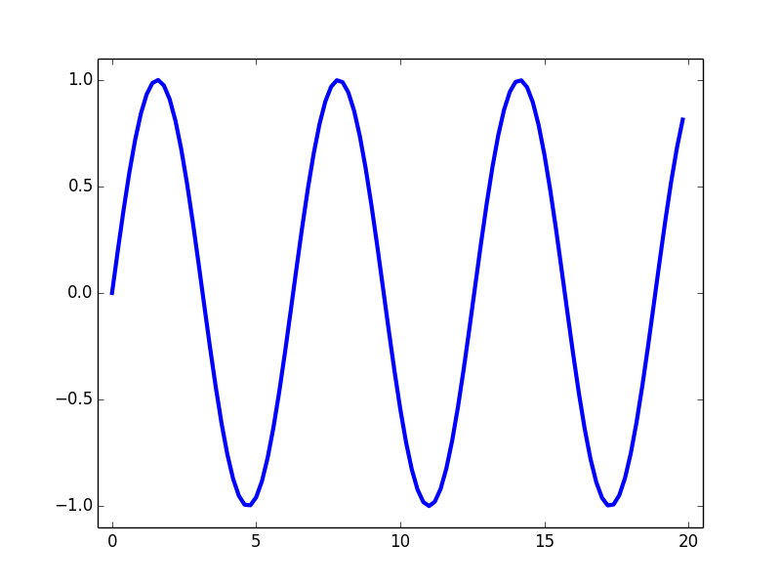
MD proposal vibrations
  MD request to study the effect of a low frequency excitation:
  create low frequency dipole noise with ADT or AC dipole:
  real frequency spectrum: more challenging to implement
  single or multiple sinusoidal excitation(s): easier and already available with ADT
  study effect on:
  tail population: collimator scans, wire scanners, diamond monitors (2ns acquisition time)
  emittance growth: BSRT, wire scanner and luminosity monitors
  => ideally flat top, squeezed, colliding and full intensity to obtain max. tune spread and non-linearities from beam-beam
bunch train
Beam 1
turn-number
1
2
3
windowing function to adjust amplitude
single bunch
excitation
Beam 2
turn-number
1
2
3

